Slide 1

Notes:
Britney

Slide 2
1
Problem
2
Solution Intro
3
Design Evolution
4
Solution Details
5
Conclusion
Notes:
Britney
Talk outline: what you are going to tell us in the rest of the talk – tell a story

Slide 3
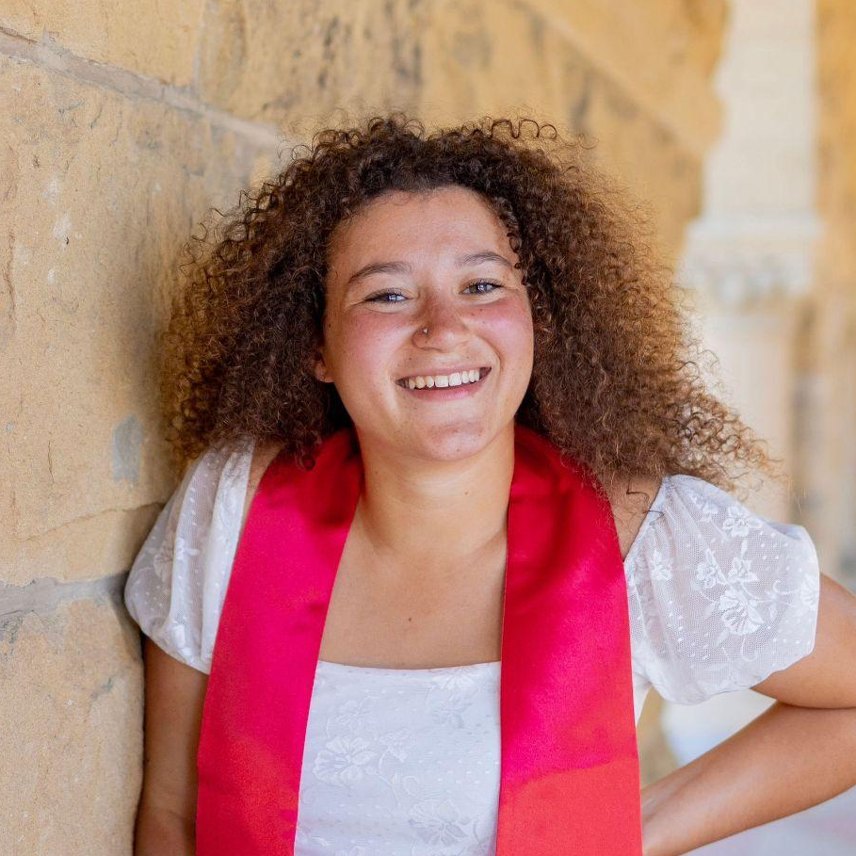
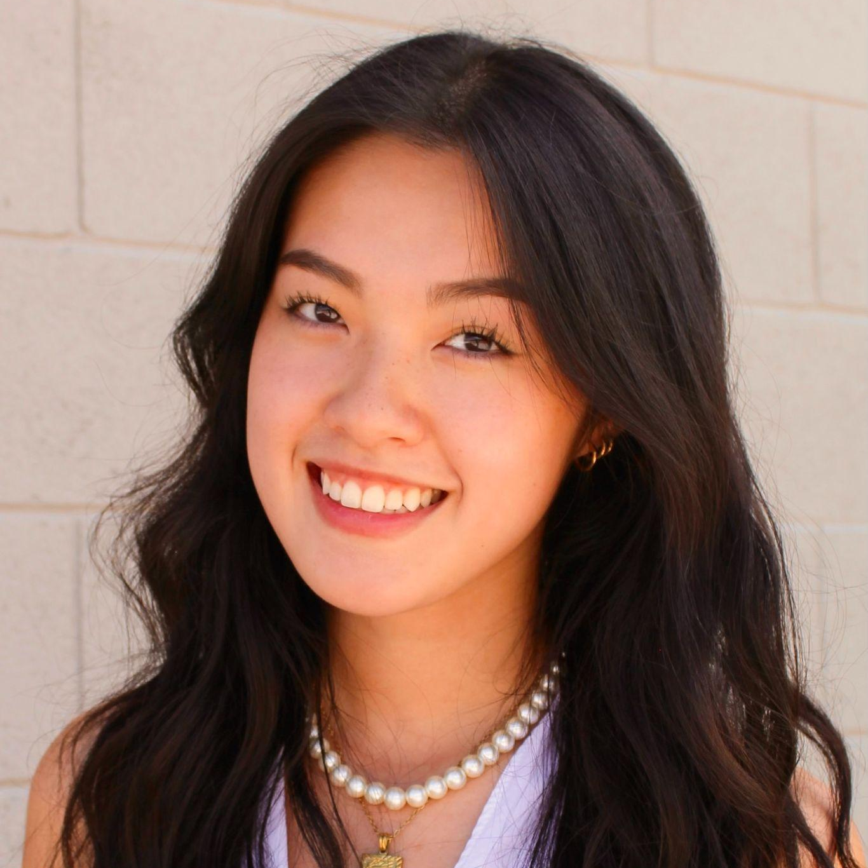

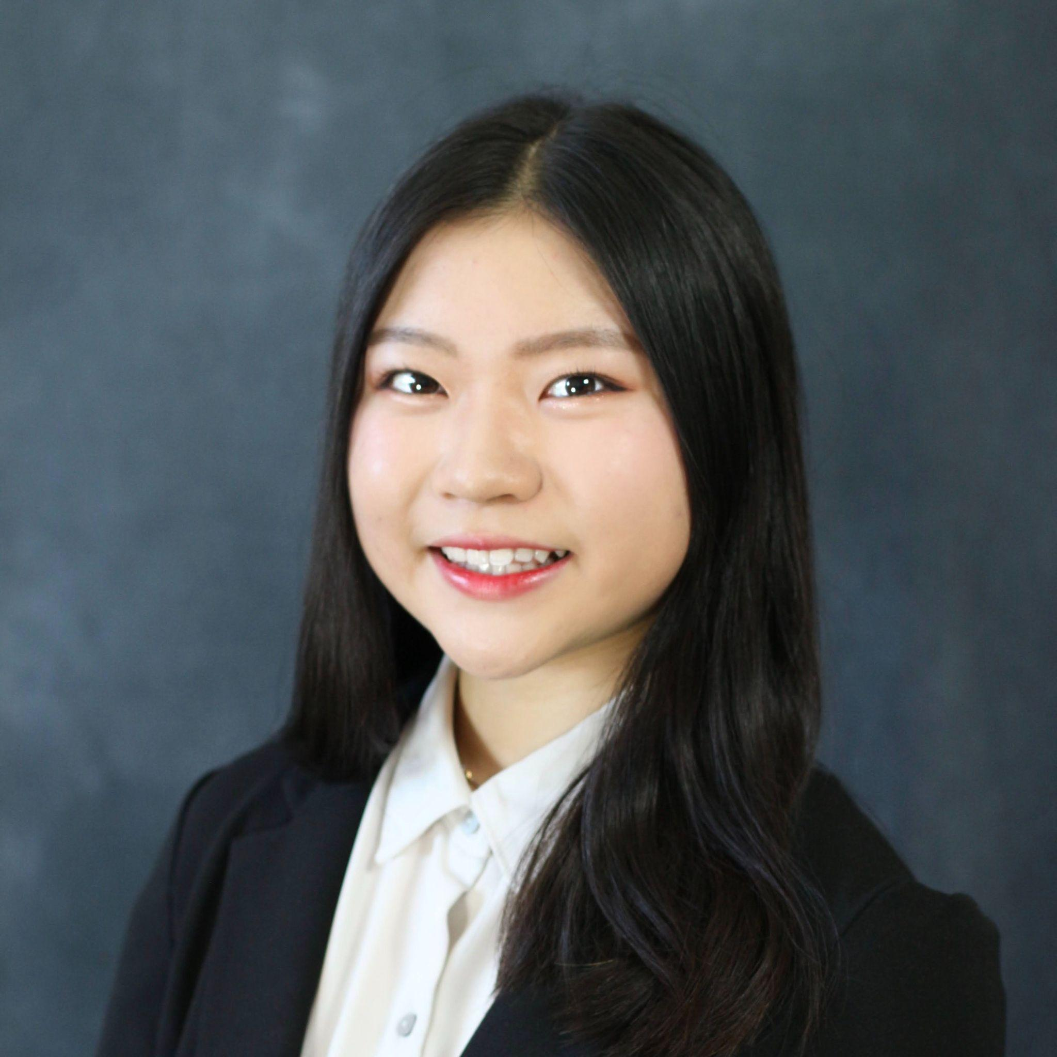
Meet The Team
Alissa Vuillier
Britney Tran
Kayla Patterson
Anna Chang
DESIGNER/DEVELOPER
DESIGNER/DEVELOPER
DESIGNER/DEVELOPER
DESIGNER/DEVELOPER
Notes:
Britney

Slide 4
What organizations are the most in need?
Notes:
Britney
One thing that every single one of us has in common is that we have things we care about. Chances are, there are so many communities and organizations out there who care about the same things and are dedicated to supporting these causes. You really want to contribute in a meaningful way, but don’t know where to start looking.

Slide 5
What organizations are the most in need?
How do I best support an organization?
Notes:
Britney
One thing that every single one of us has in common is that we have things we care about. Chances are, there are so many communities and organizations out there who care about the same things and are dedicated to supporting these causes. You really want to contribute in a meaningful way, but don’t know where to start looking.

Slide 6
What organizations are the most in need?
How do I best support an organization?
How do I budget to donate?
Notes:
Britney
One thing that every single one of us has in common is that we have things we care about. Chances are, there are so many communities and organizations out there who care about the same things and are dedicated to supporting these causes. You really want to contribute in a meaningful way, but don’t know where to start looking.

Slide 7
What organizations are the most in need?
How do I best support an organization?
How do I budget to donate?
Notes:
Britney
One thing that every single one of us has in common is that we have things we care about. Chances are, there are so many communities and organizations out there who care about the same things and are dedicated to supporting these causes. You really want to contribute in a meaningful way, but don’t know where to start looking.

Slide 8
From finding where to donate, to which charities are most in need, giving is filled with pitfalls for the average donor.
Problem
Notes:
Britney

Slide 9

Notes:
Britney
Platforms that focus on researching organizations, but do not support managing donations, such as Charity Navigator
These platforms also do not address the problem for organizations to get recurring payments

Slide 10

Notes:
Britney
Competitors such as gofundme help users find groups seeking short-term donations
Falls short on doing the research of finding an organization

Slide 11

Notes:
Britney
Search engines are a natural tool for donors to attempt at researching organizations
Sponsored organizations – aka organizations with money that may be overfunded, are filtered to the top
Searching can be overwhelming

Slide 12
Solution
Notes:
Kayla
Next we will be talking about the solution we have came up with

Slide 13
Our mission is to help donors donate easily and effectively to the causes they care about and track their donations over time.
Mission Statement
Notes:
Kayla
Read from slide

Slide 14
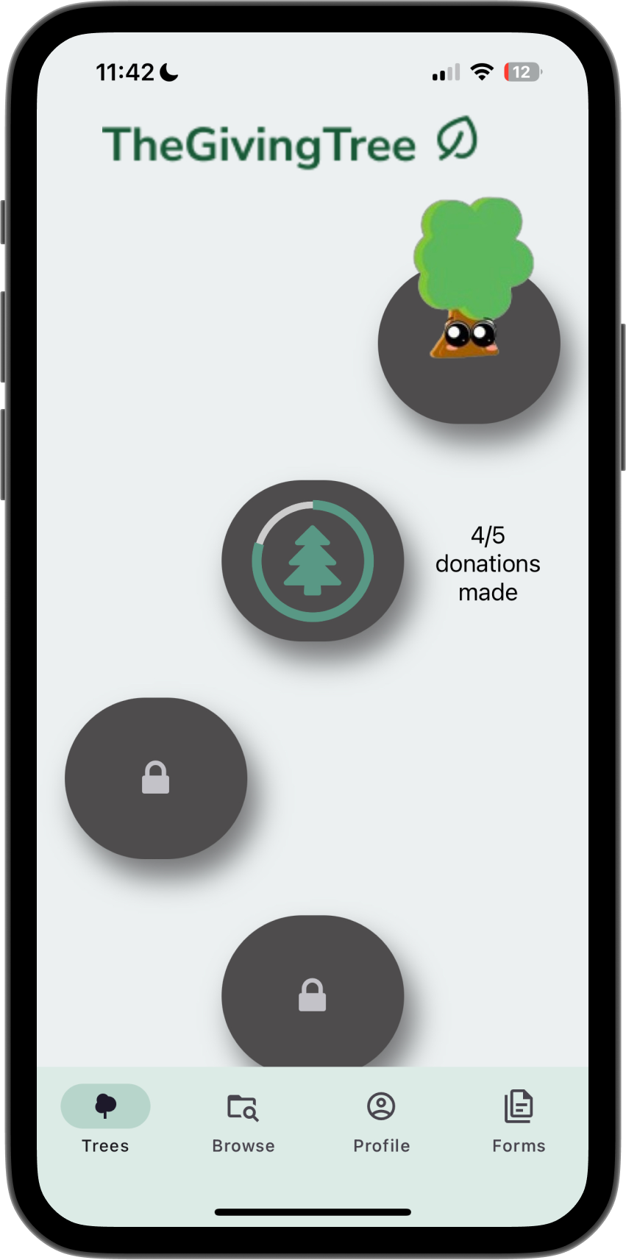
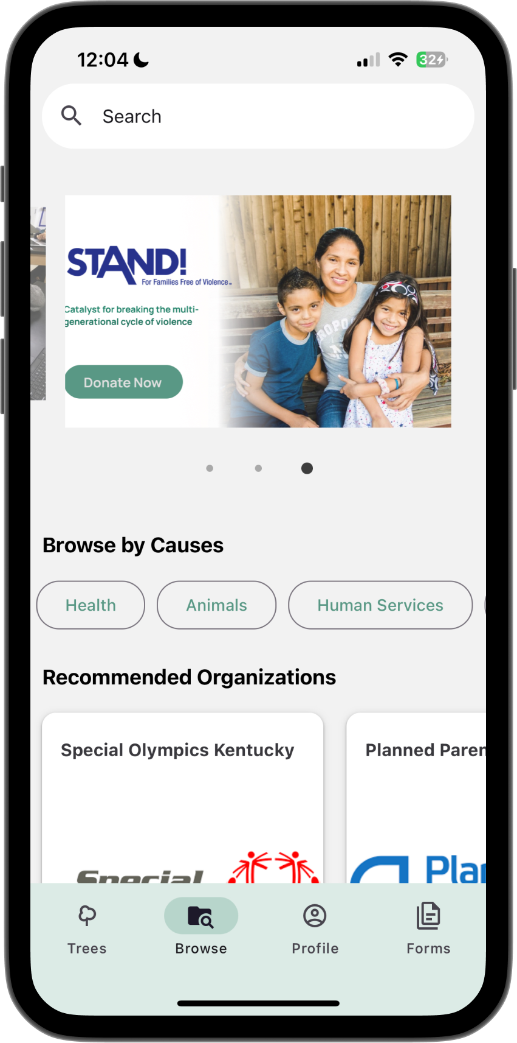
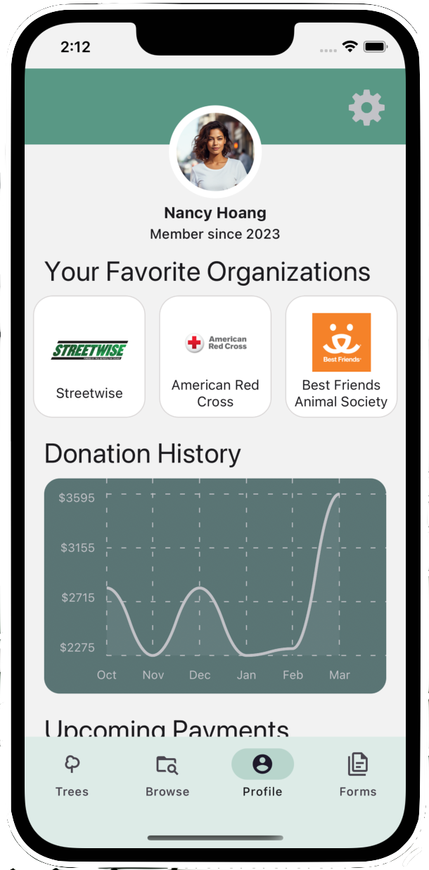
Our Solution
Notes:
Kayla
High-level solution description, with image(s) of design
Our platform takes the guesswork out of donating by automatically identifying high-impact nonprofits, helping donors set up recurring donations, and tracking donations long-term

Slide 15

Video
Notes:
Kayla
Video: use your final video to introduce context and solution
Next we will be showing our conceptual video

Slide 16
03
Design Evolution
Notes:
Kayla
Now onto our design evolution

Slide 17
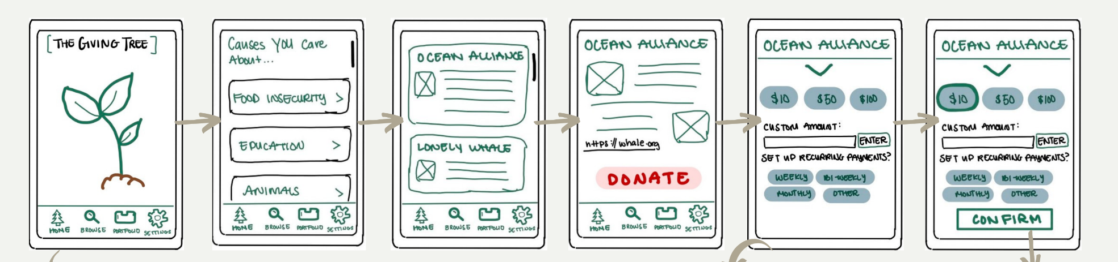
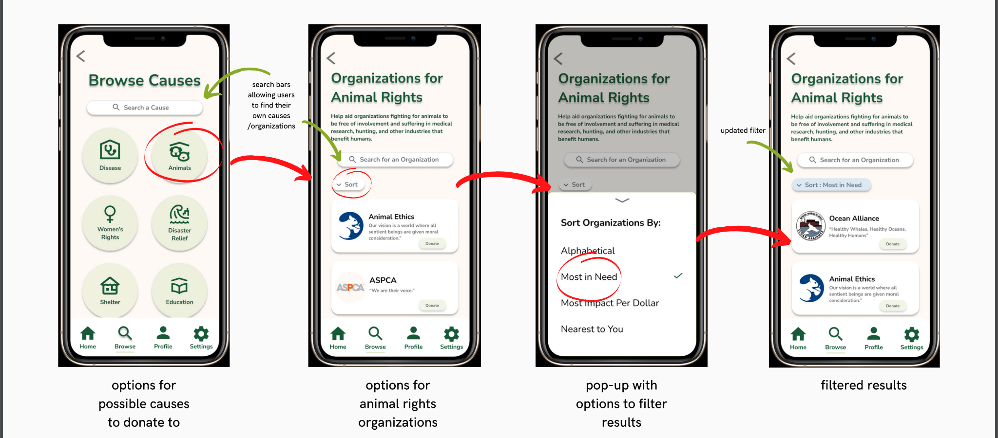
Low-fi & Med-fi Prototype
Hi-fi Prototype
CS147
Hi-fi Prototype
CS194H V1
Hi-fi Prototype
CS194H V2
Notes:
Kayla
Explain reasoning, evidence, and implications behind design changes

Slide 18
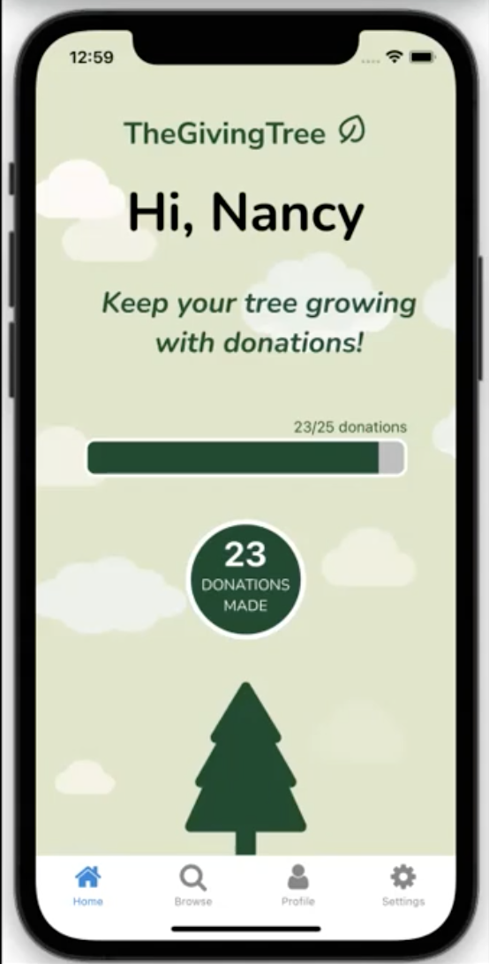
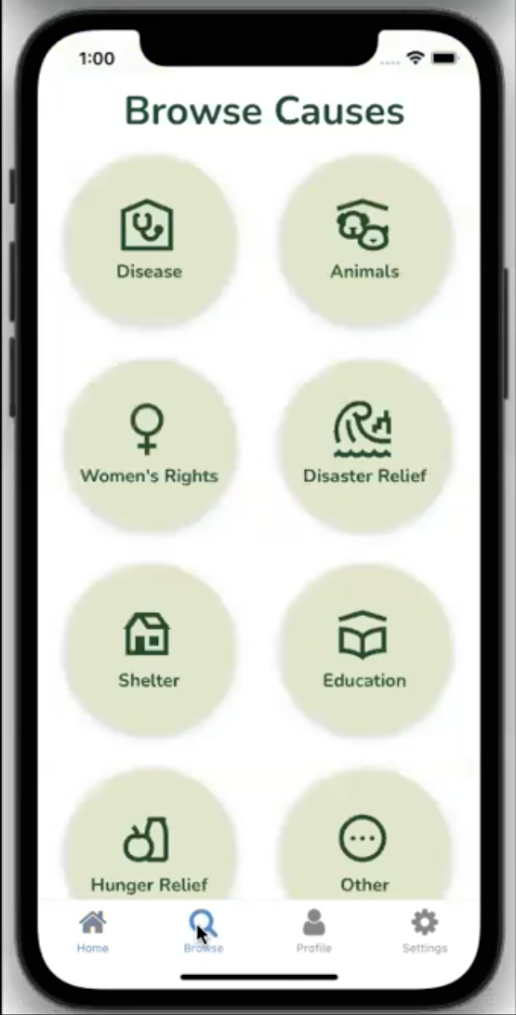
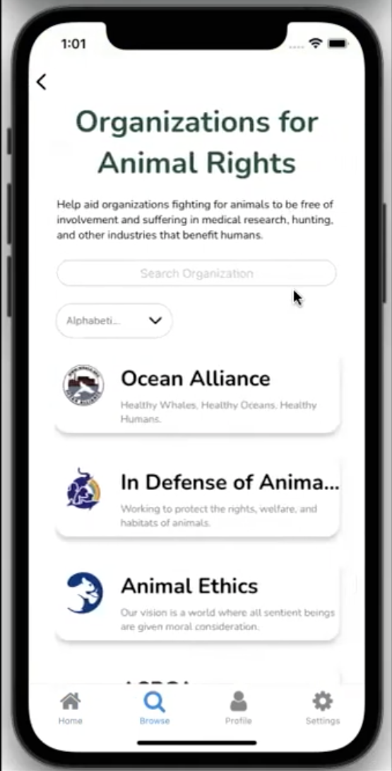
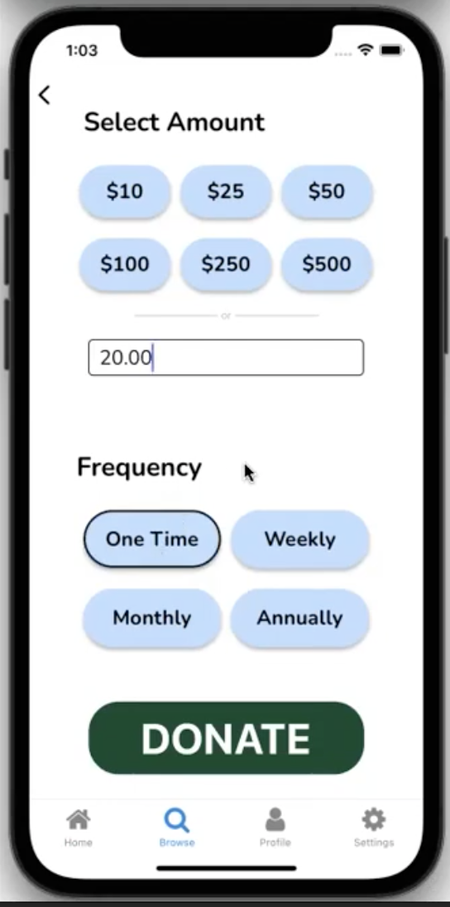
Low-fi Prototype
Hi-fi Prototype
CS147
Hi-fi Prototype
CS194H V1
Hi-fi Prototype
CS194H V2
Notes:
Kayla
Explain reasoning, evidence, and implications behind design changes

Slide 19
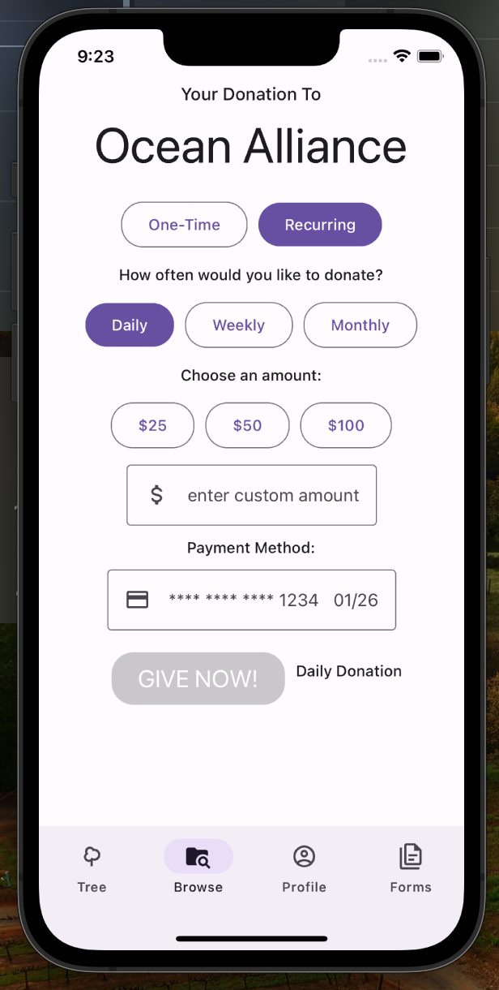
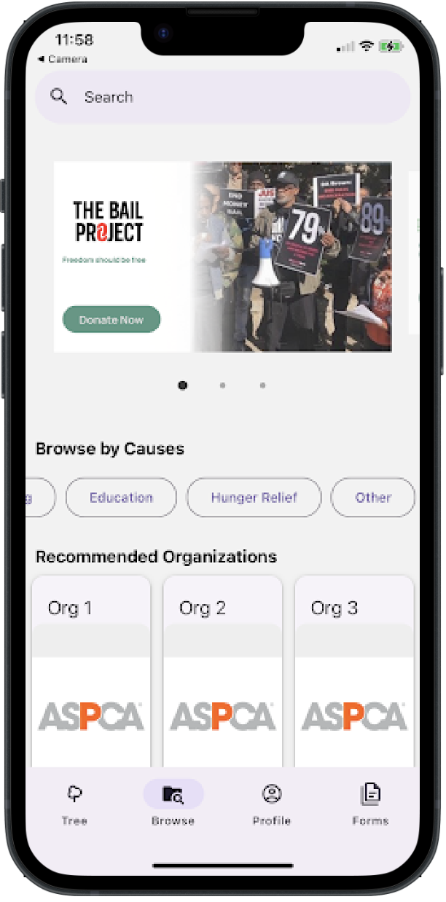
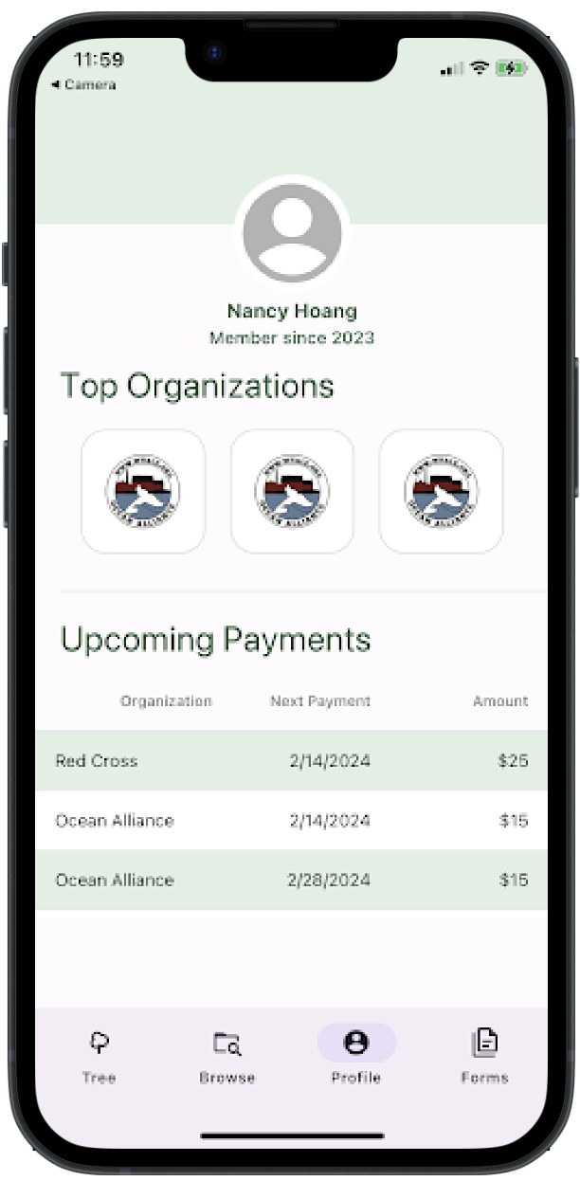

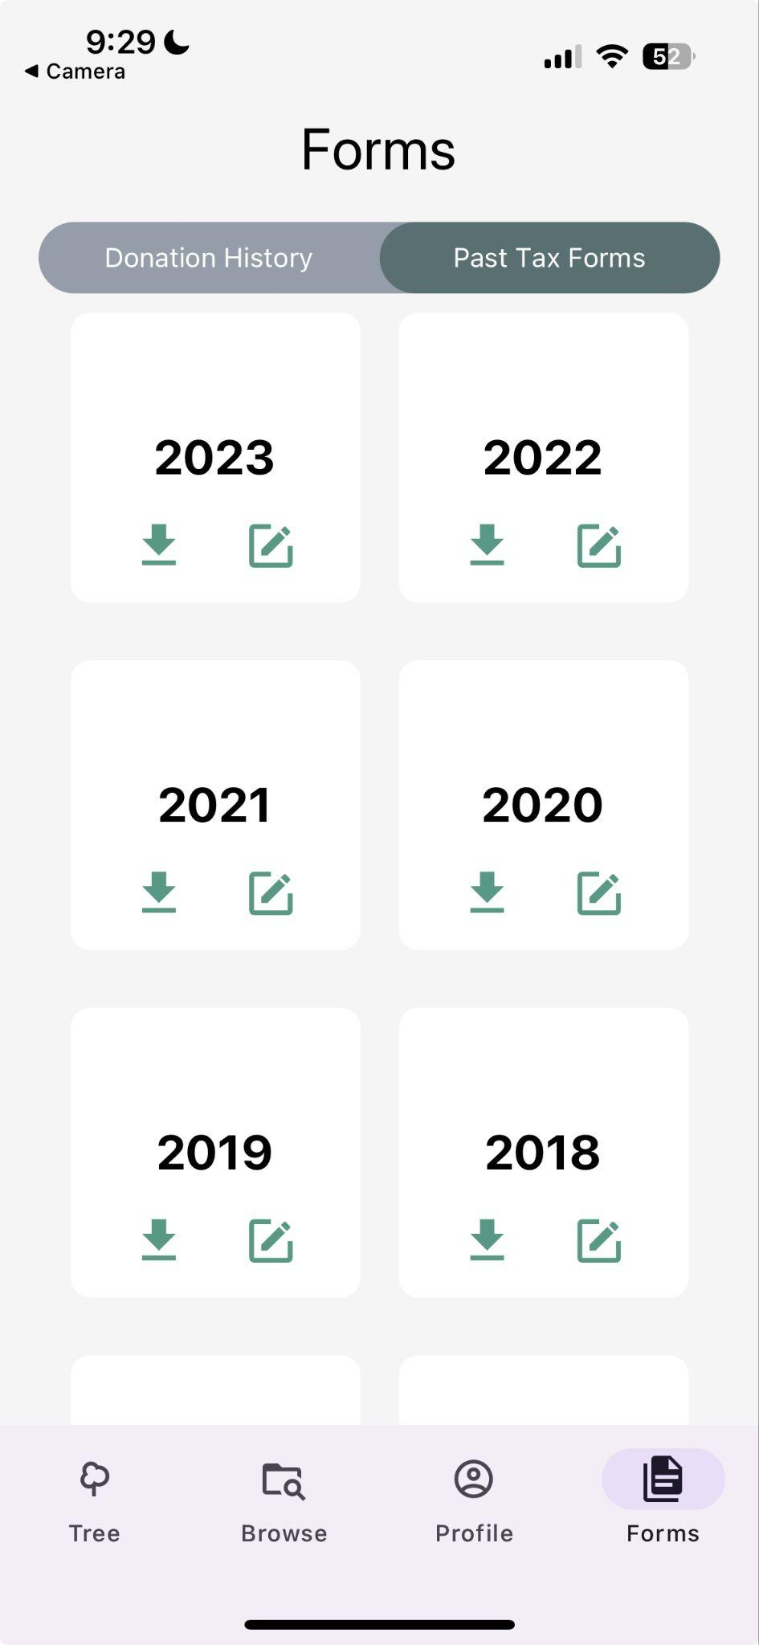
Low-fi Prototype
Hi-fi Prototype
CS147
Hi-fi Prototype
CS194H V1
Hi-fi Prototype
CS194H V2
Notes:
Kayla
We started completely over

Slide 20
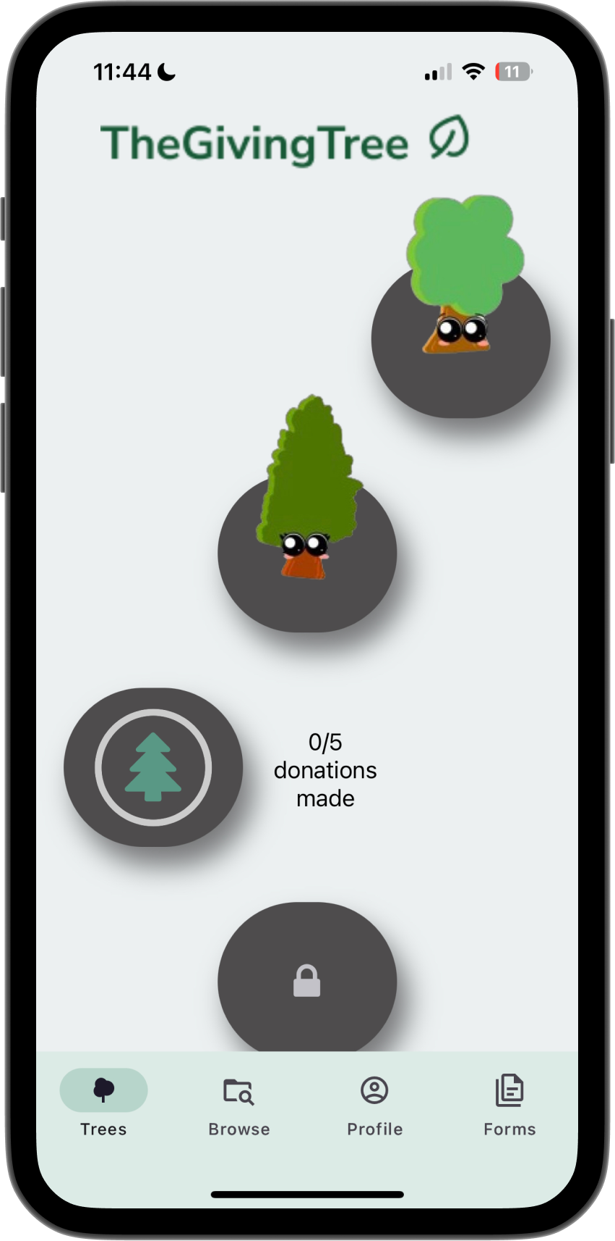
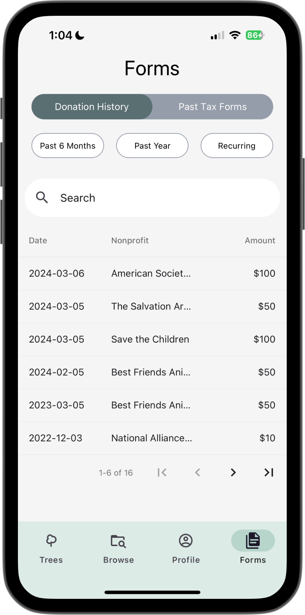
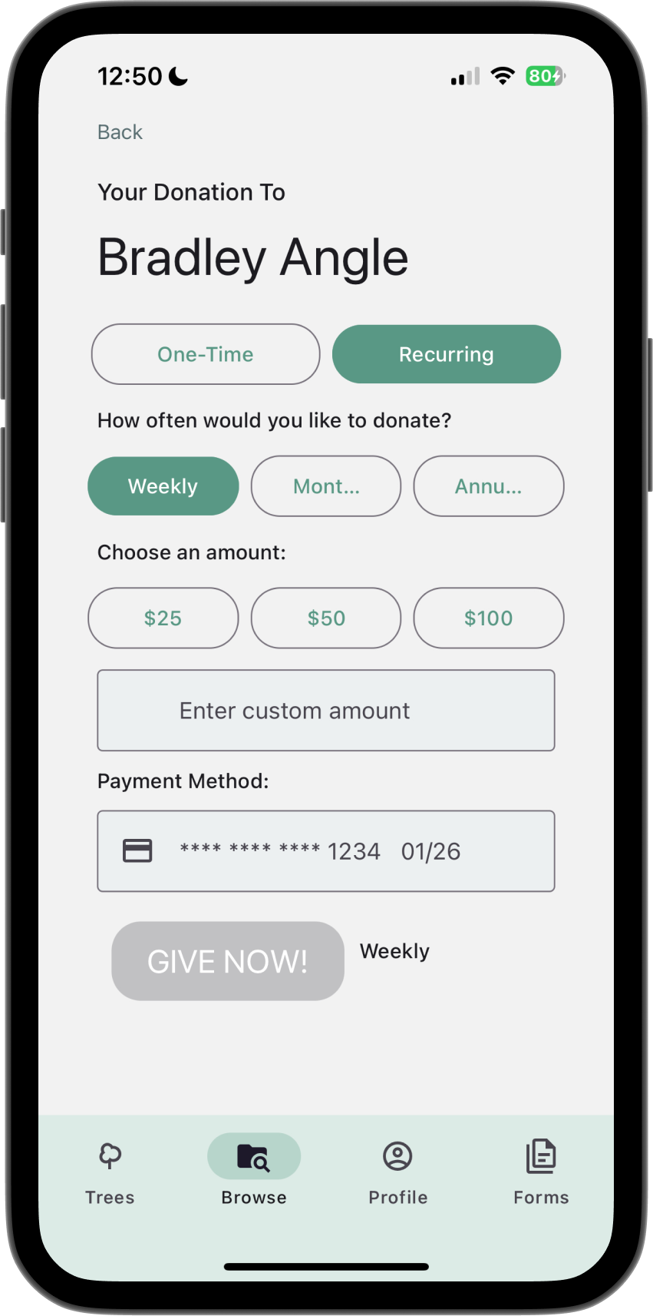
Low-fi Prototype
Hi-fi Prototype
CS147
Hi-fi Prototype
CS194H V1
Hi-fi Prototype
CS194H V2
Notes:
Kayla
Explain reasoning, evidence, and implications behind design changes

Slide 21
04
Solution Details
Notes:
Alissa

Slide 22
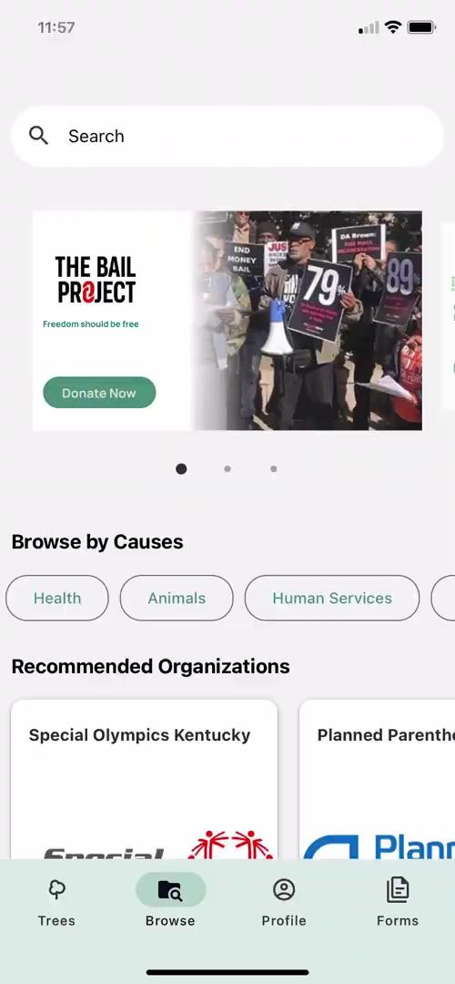
Browse Causes
Simple Task
Notes:
Alissa
Tasks & interface description (deep on 1 task, briefly on others)
Reasoning behind choice of each of the tasks
Walkthrough of each task: short video/gif demo

Slide 23
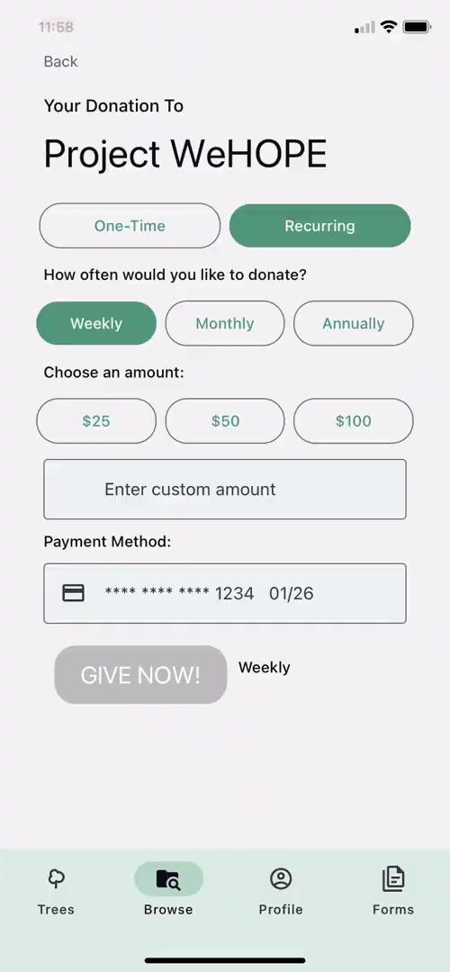
Donate
Moderate Task
Notes:
Alissa
Tasks & interface description (deep on 1 task, briefly on others)
Reasoning behind choice of each of the tasks
Walkthrough of each task: short video/gif demo

Slide 24
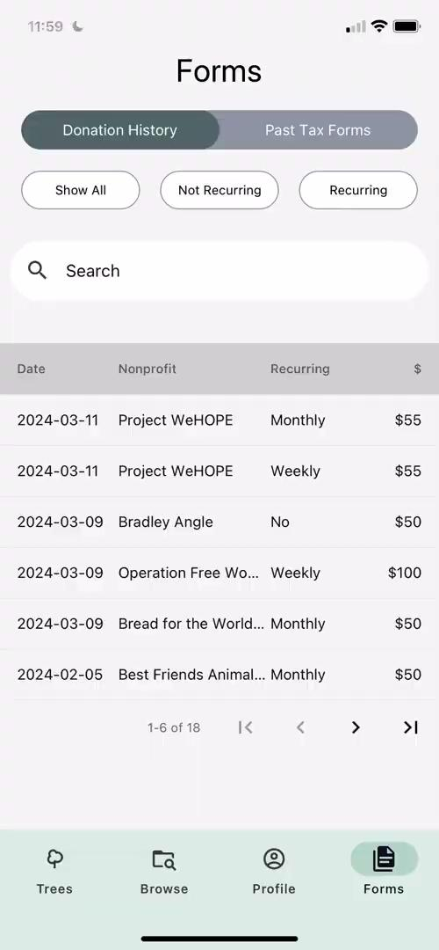
Tax Forms
Complex Task
Notes:
Alissa
Tasks & interface description (deep on 1 task, briefly on others)
Reasoning behind choice of each of the tasks
Walkthrough of each task: short video/gif demo

Slide 25
05
Implementation
Notes:
Alissa

Slide 26



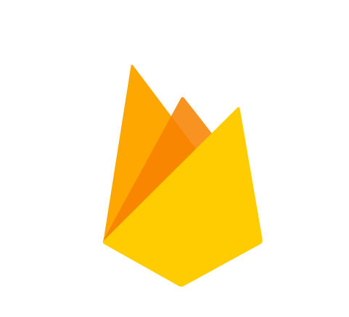

Tools
React Native Paper
Expo Go Mobile App
Figma
Realtime Database and Firebase Analytics
React Native
Notes:
Alissa
Describe the equipment / software you used and where tests were run
Indoor locations consisted of dorms, apartments, and community centers

Slide 27
Future Implementation
Missing
Editable tax form PDF
Future Additions
PayPal Implementation
Organizations as users
Notes:
Alissa
What is missing & what might you add in the future?

Slide 28
End-to-end
Donor Experience
Notes:
Alissa
Conclusion: What is your key innovation? What will your key impact on the world be?
Key Innovation is End-to-end donor experience
Which correlates to our key impacts which are education, recurring payments and financial stability

Slide 29

End-to-end
Donor Experience
Education
Notes:
Alissa
Conclusion: What is your key innovation? What will your key impact on the world be?
Key Innovation is End-to-end donor experience
Which correlates to our key impacts which are education, recurring payments and financial stability

Slide 30

End-to-end
Donor Experience
Education
Recurring Payments
Notes:
Alissa
Conclusion: What is your key innovation? What will your key impact on the world be?
Key Innovation is End-to-end donor experience
Which correlates to our key impacts which are education, recurring payments and financial stability

Slide 31

End-to-end
Donor Experience
Education
Recurring Payments
Financial Stability
Notes:
Alissa
Conclusion: What is your key innovation? What will your key impact on the world be?
Key Innovation is End-to-end donor experience
Which correlates to our key impacts which are education, recurring payments and financial stability

Slide 32
Make your donations go further
https://web.stanford.edu/class/cs194h/projects/TheGivingTree /
Notes:
Alissa
Project title: the project name

