Slide 1
TheGivingTree
HIGH-FI PROTOTYPE V3

Slide 2



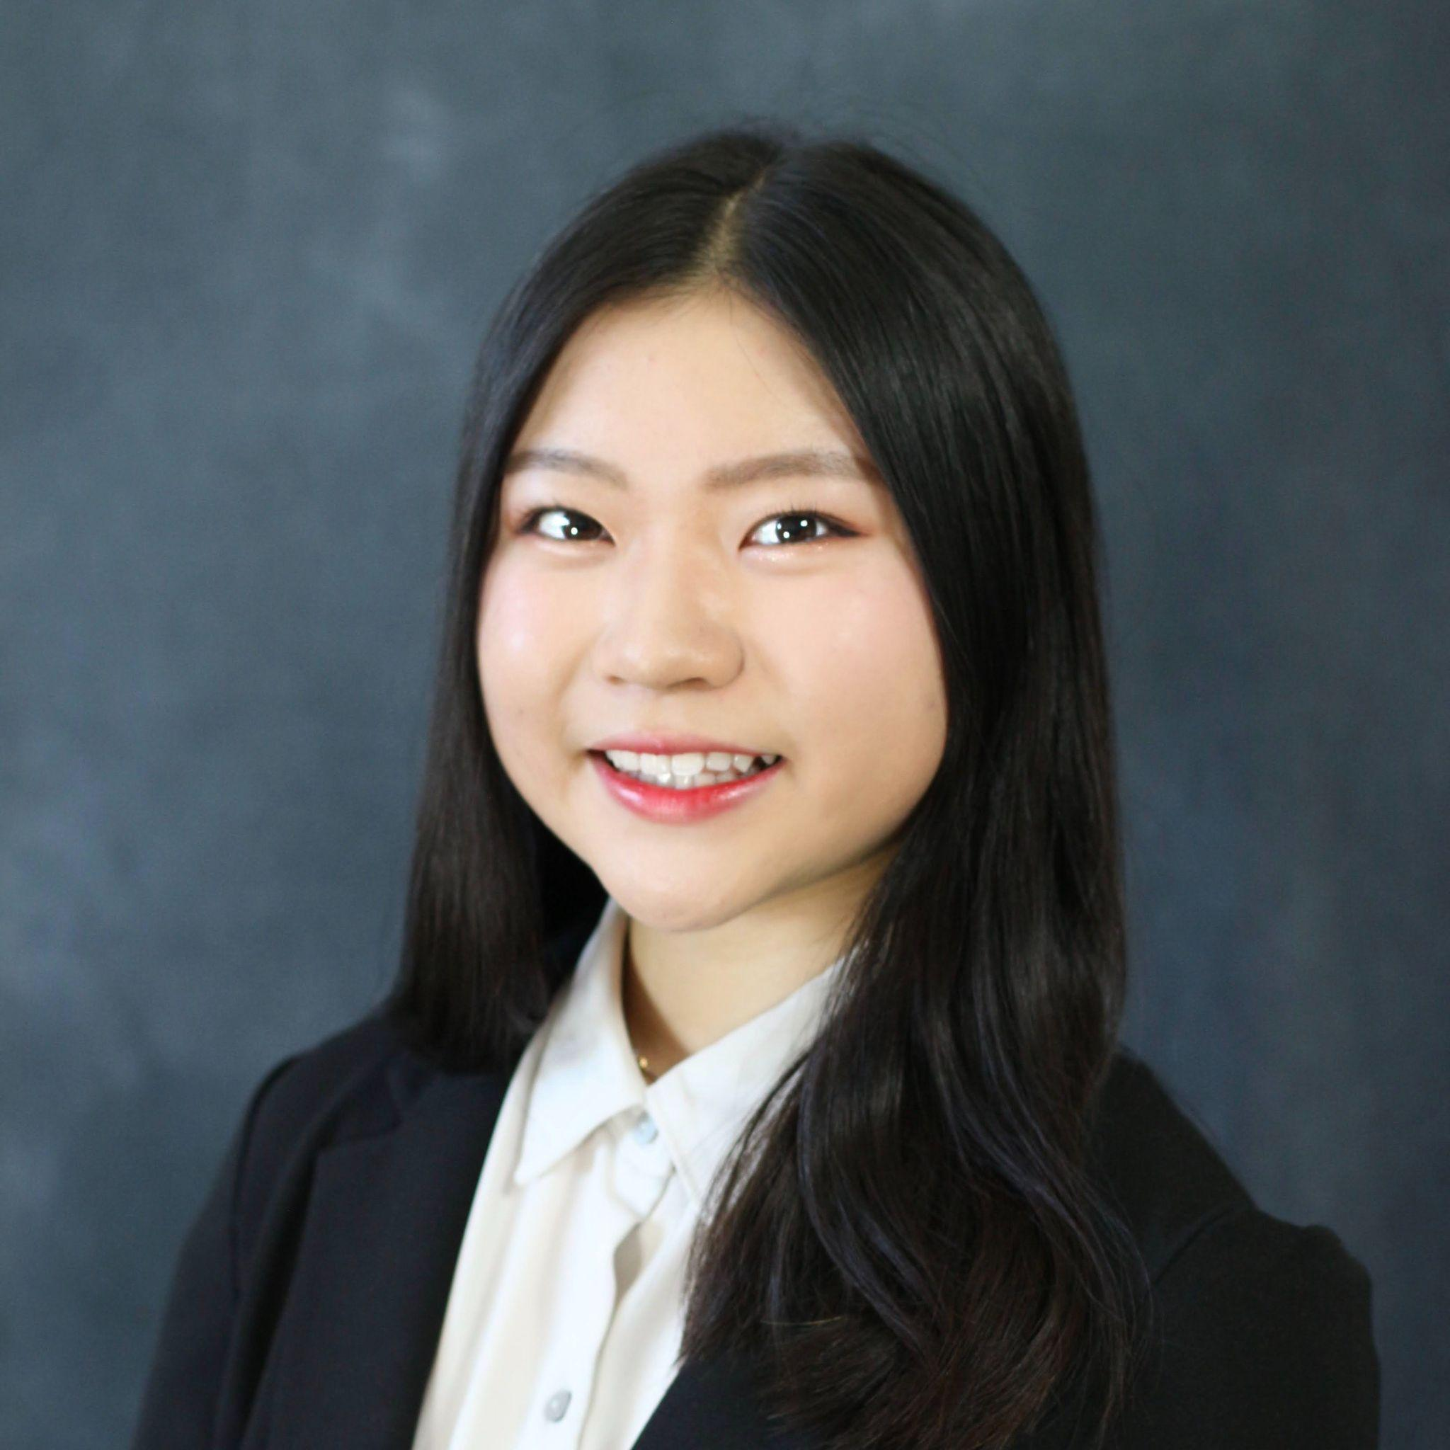
OUR TEAM MEMBERS
Alissa Vuillier
Designer/Developer
Britney Tran
Designer/Developer
Kayla Patterson
Designer/Developer
Anna Chang
Designer/Developer

Slide 3
PROBLEM
From finding where to donate, to which charities are most in need, giving is filled with pitfalls for the average donor.
SOLUTION
Our mission is to help donors donate easily and effectively to the causes they care about and track their donations over time.
VALUE PROP
Our platform takes the guesswork out of donating by automatically identifying high-impact nonprofits, helping donors set up recurring donations, and tracking donations long-term.

Slide 4
INTERFACE
CHANGES

Slide 5
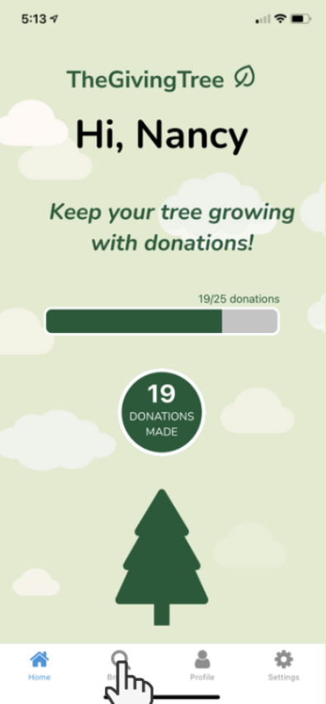
BEFORE CHANGE #1: Tree Page
One tree that grew
Status bar that also showing how many donations a user donated

Slide 6
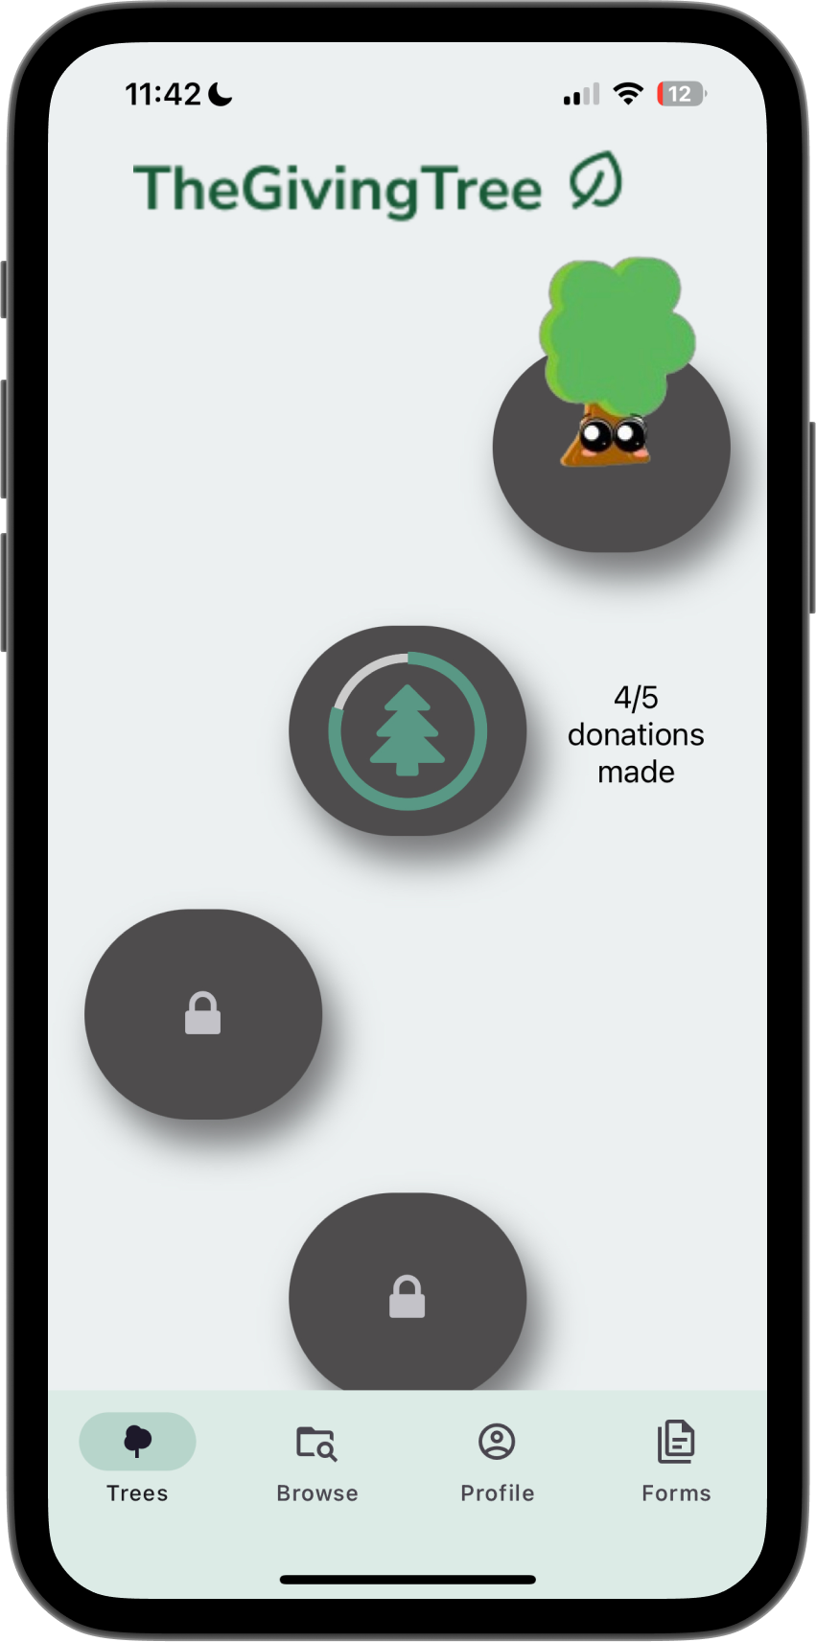
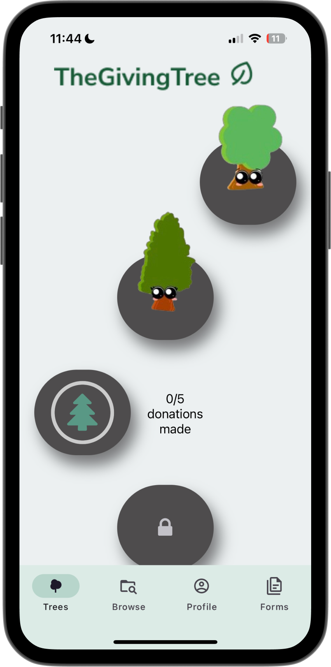
CHANGE #1: Tree Page
New trees earned collected based on the number of donations
Follows Duolingo-like path to incentivize users to keep donating through the app

Slide 7
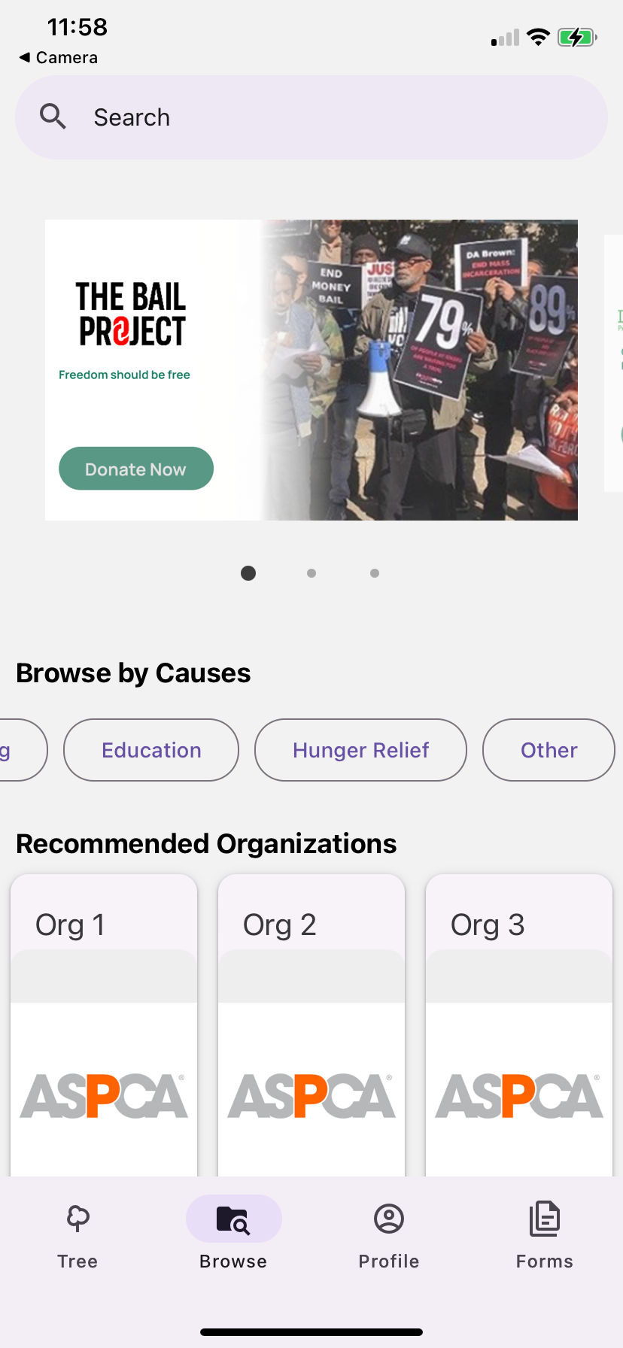
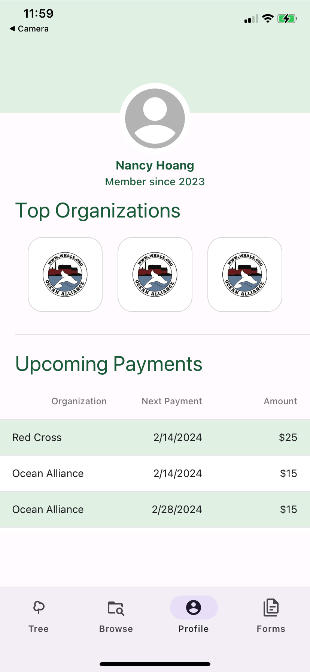
BEFORE CHANGE #2: Database
Everything was wizard of oz
No data was stored within the Firebase database
  Frontend stored all of the data

Slide 8
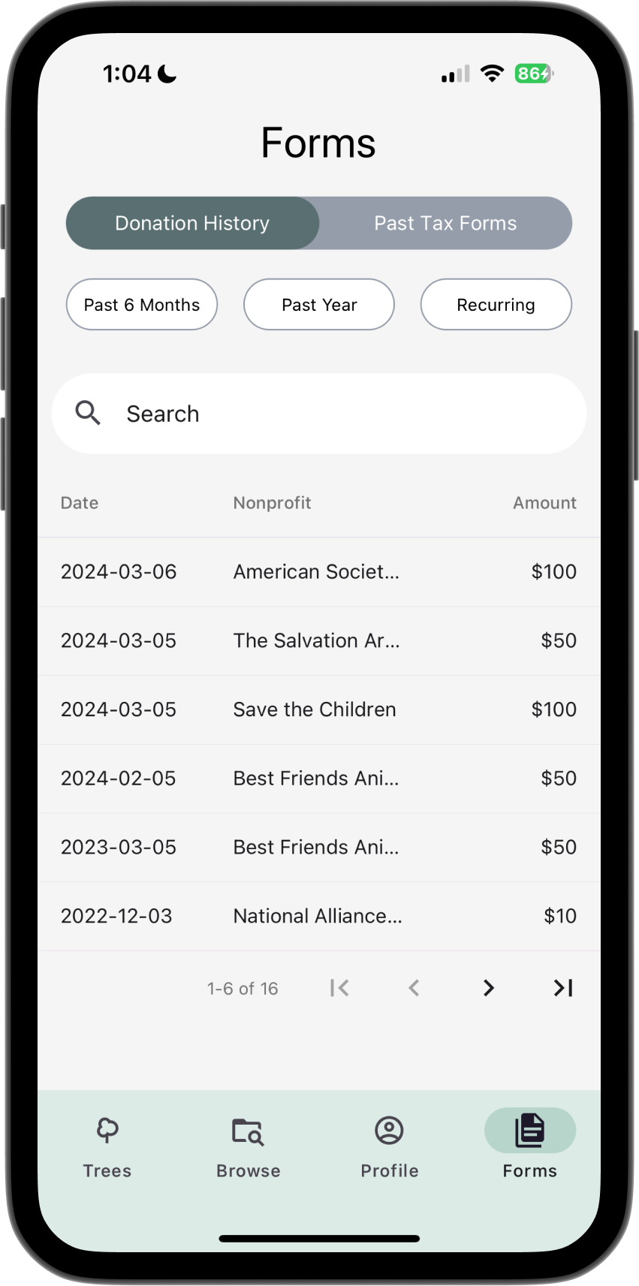
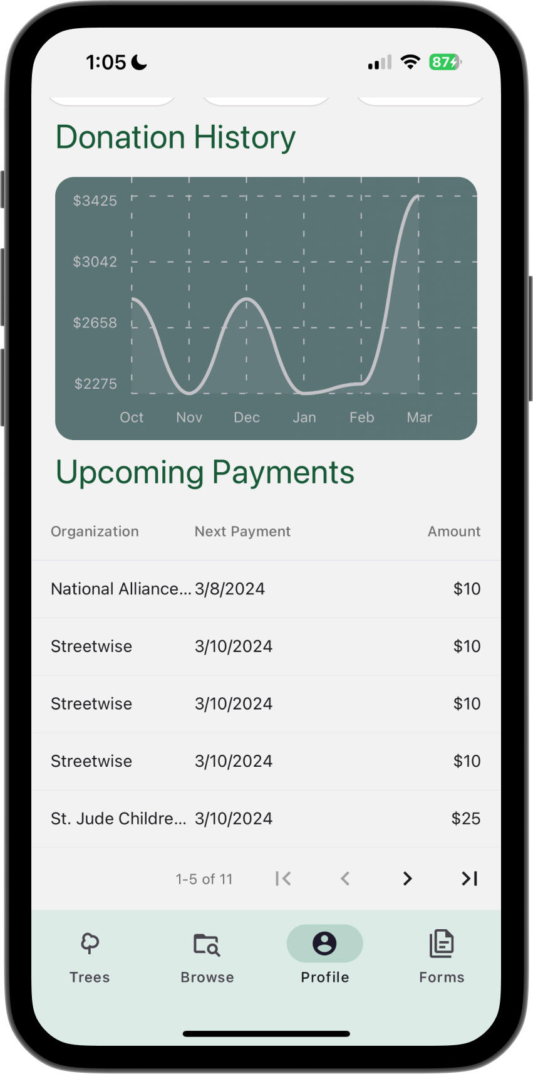
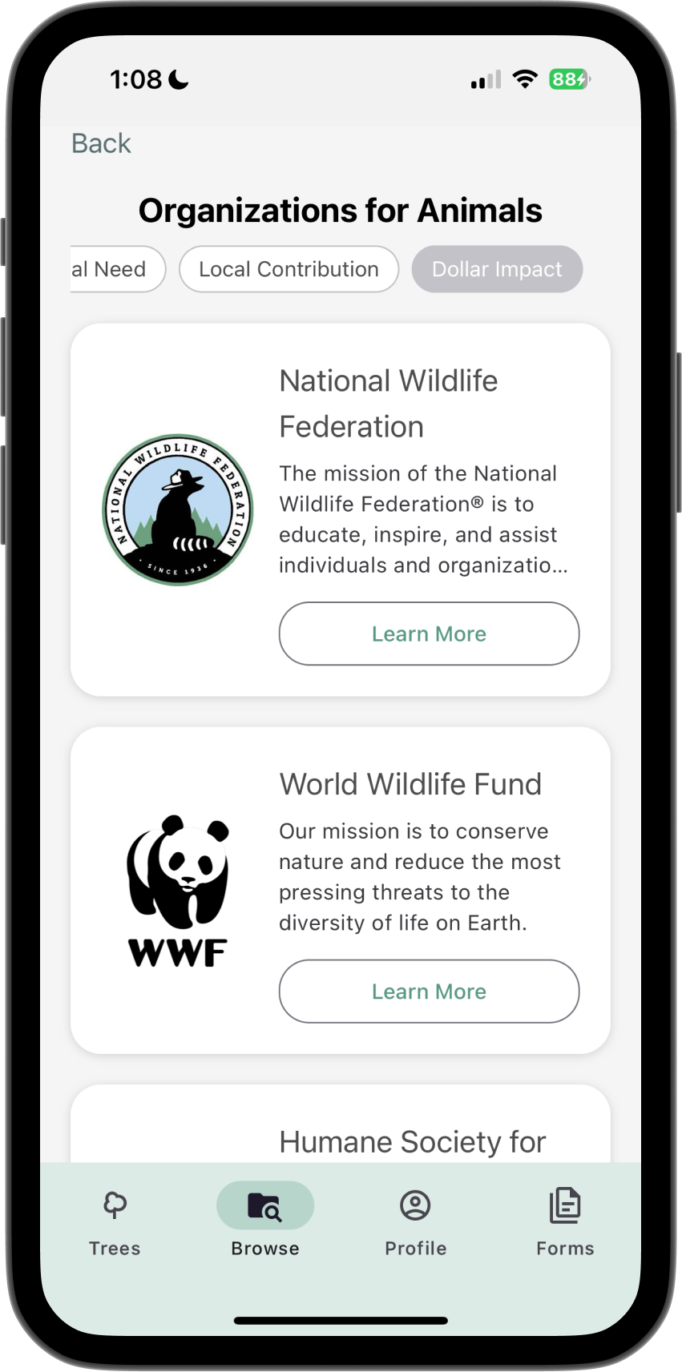
CHANGE #2: Database
Data stored in Firebase and storage system
Organizations
Donation history
Organizations images
Graph

Slide 9
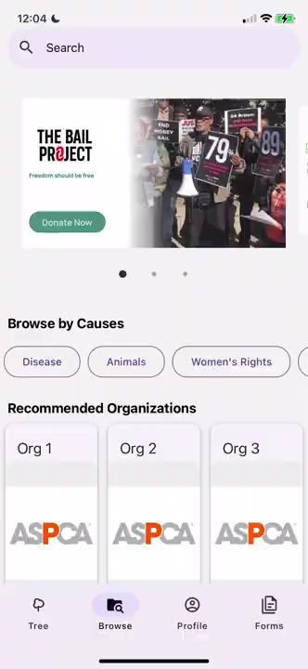
BEFORE CHANGE #3: Researched Orgs
There were placeholder for the organizations
Nothing was stored in the Firebase database

Slide 10
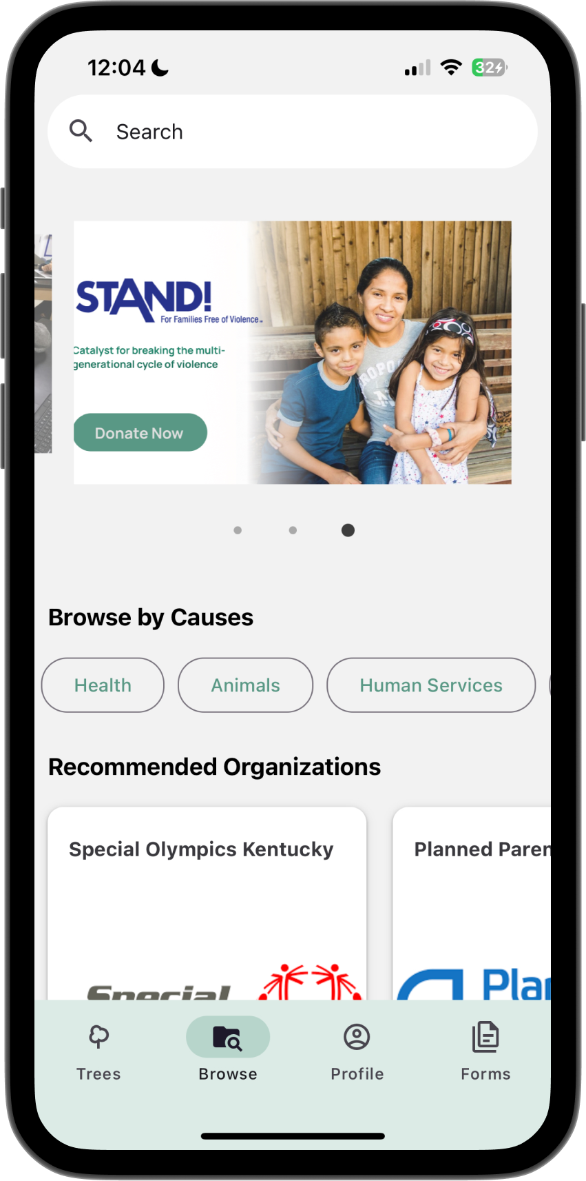
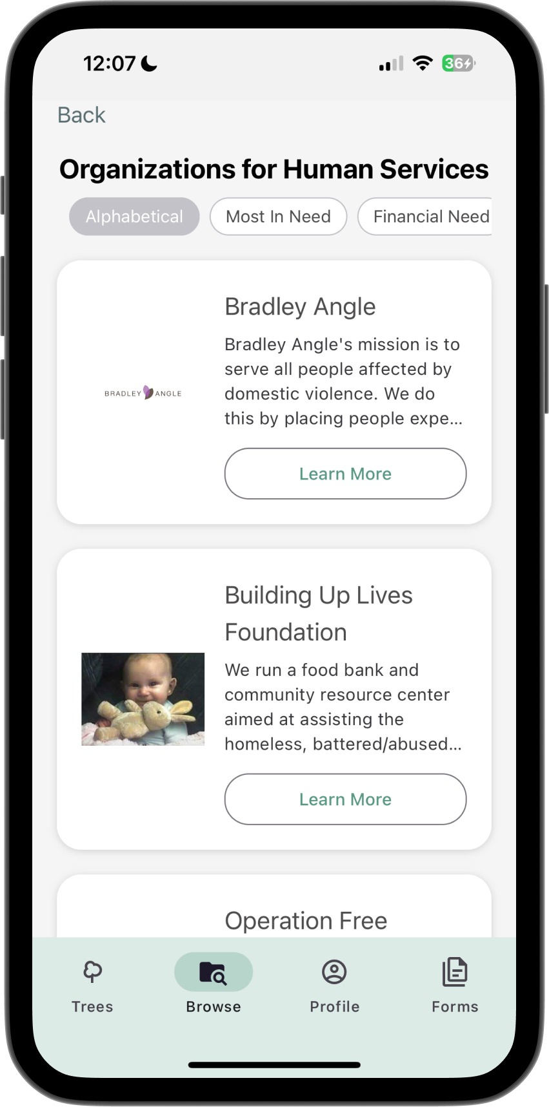
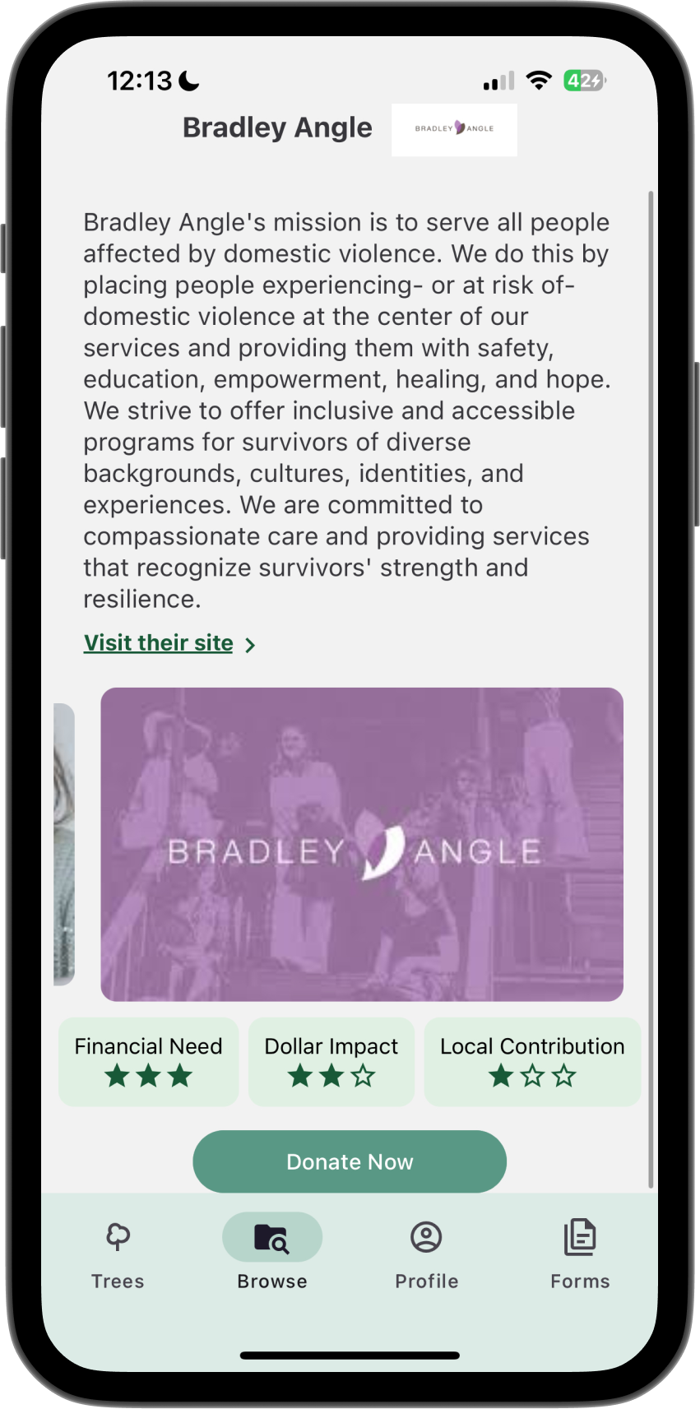
CHANGE #3: Researched Orgs
Organizations populated for browsing
Filter Tabs let users prioritize organizations
Stars display show different needs
Carousel to show images from orgs

Slide 11
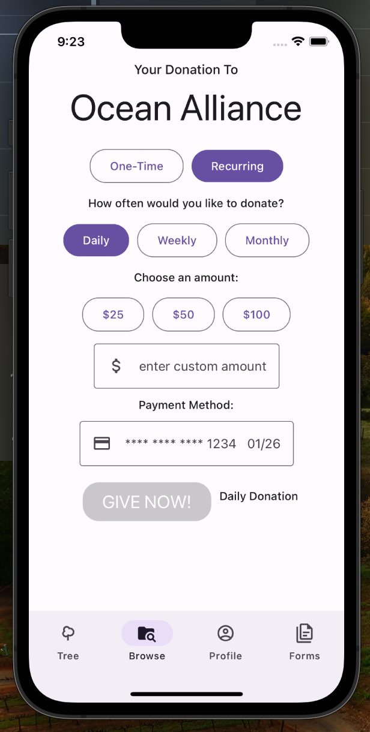
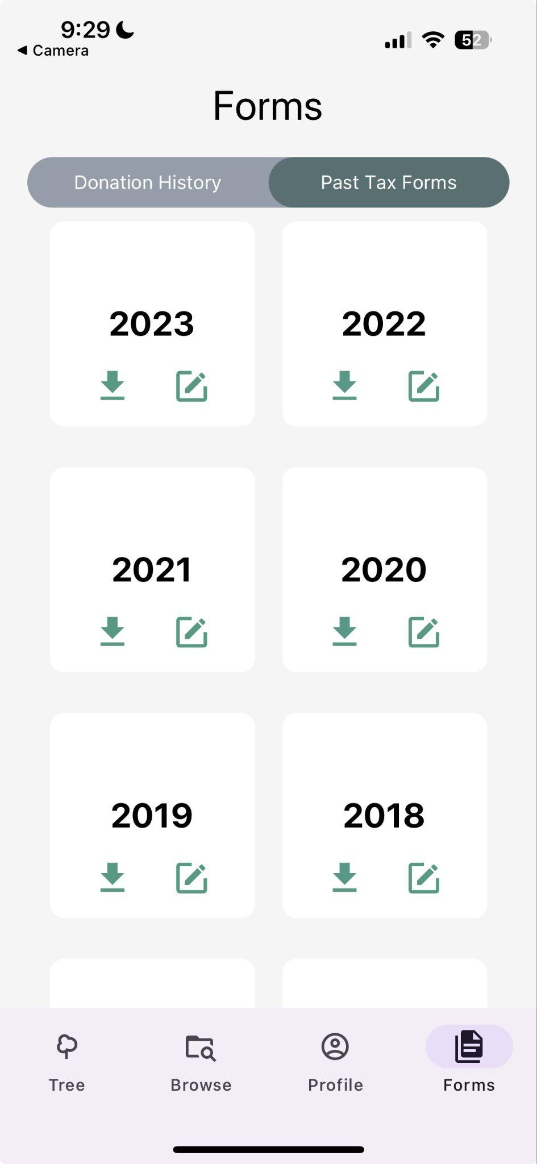
BEFORE CHANGE #4: Styling
We had a purple default color on some screens
Styles were not consistent throughout different screens
Notes:
We have made the style of our screens consistent with using this light green and dark green throughout the screens

Slide 12
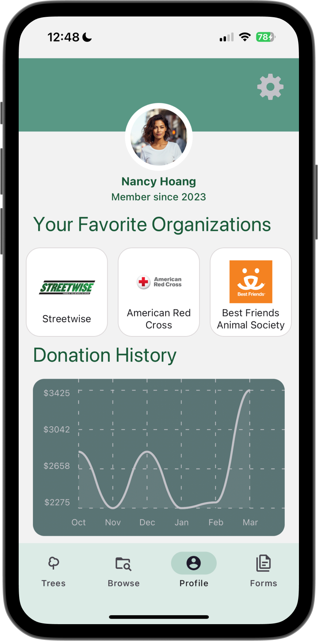
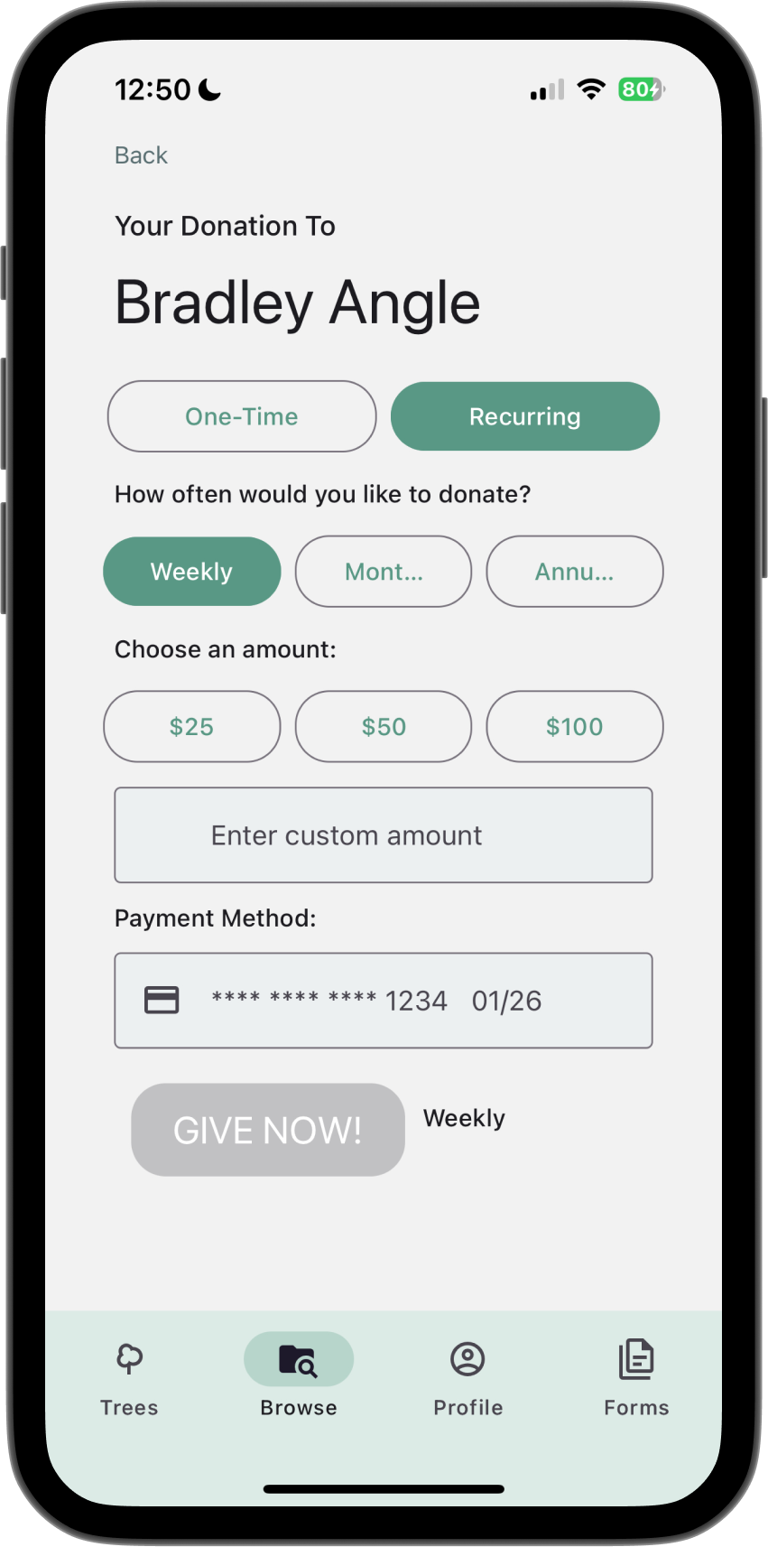
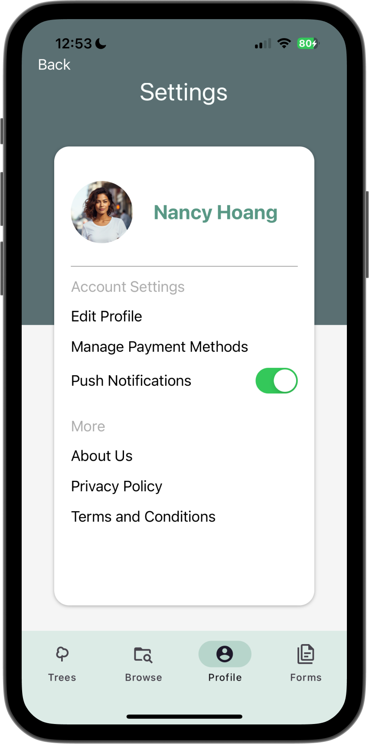
CHANGE #4: Styling
Standardized colors to make it consistent throughout the app and with our theme in response to feedback
Themes file to standardize buttons and other components
Notes:
We have made the style of our screens consistent with using this light green and dark green throughout the screens

Slide 13
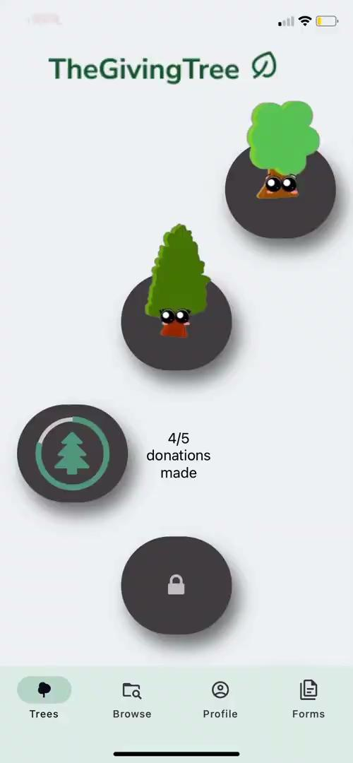
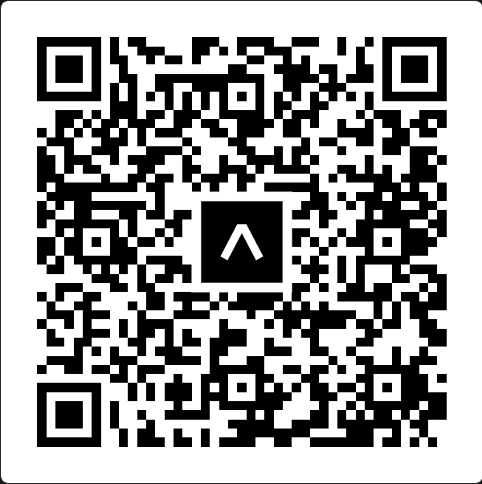
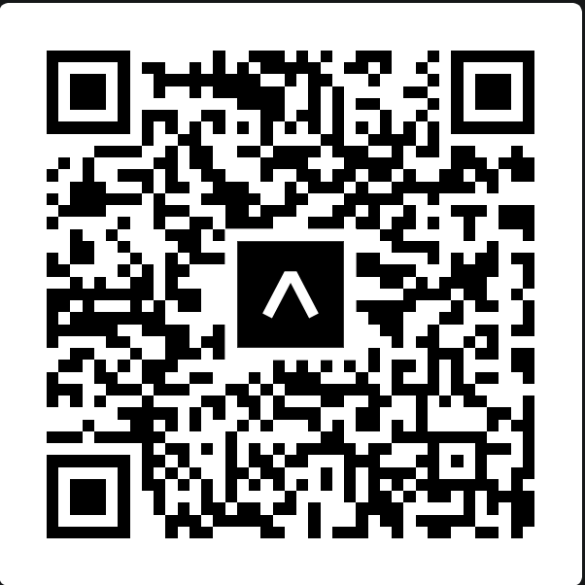
LIVE DEMO AND VIDEO
ios version
android version

Slide 14
FUTURE
WORK

Slide 15
LEFT UNIMPLEMENTED
Search bar and autofill
Making payments to the organizations’ Paypals using the Paypal API integration
Editable tax forms

Slide 16
NEXT STEPS FOR IMPLEMENTATIONS
Implement search bar allowing users to find individual organizations
Store credit card information in Firebase
  Security is implemented within Firebase
Utilize PDF library in React to be able to write on the pdf and display amounts from database

Slide 17
THANK YOU
Any questions?

