Slide 1
TheGivingTree
Make your donations go further.

Slide 2
Our Team
1
Let’s start with the first set of slides

Slide 3

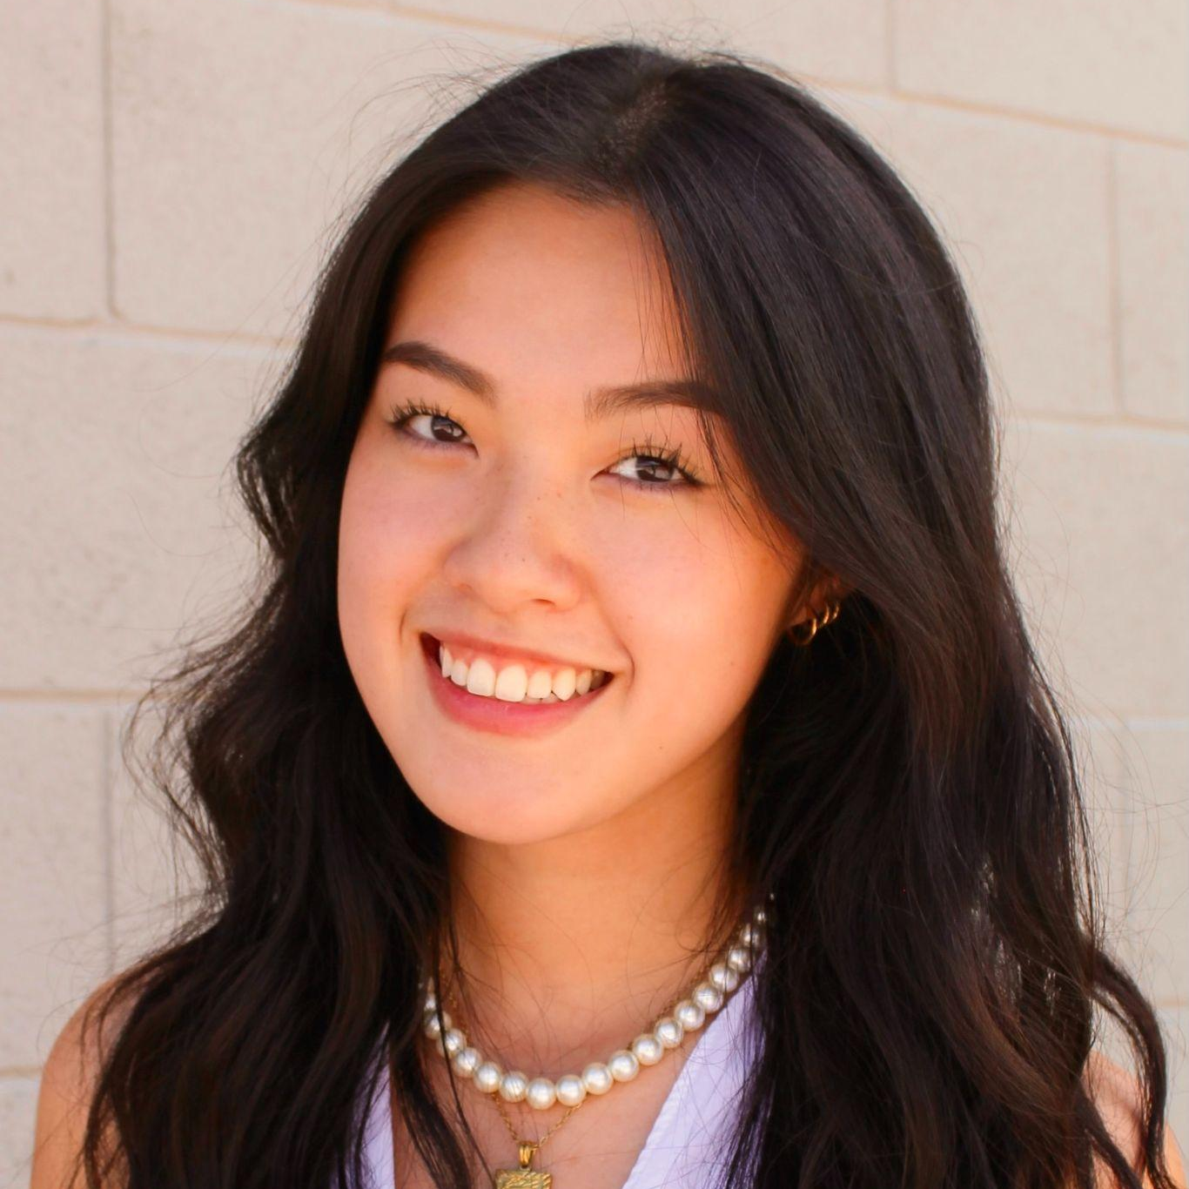

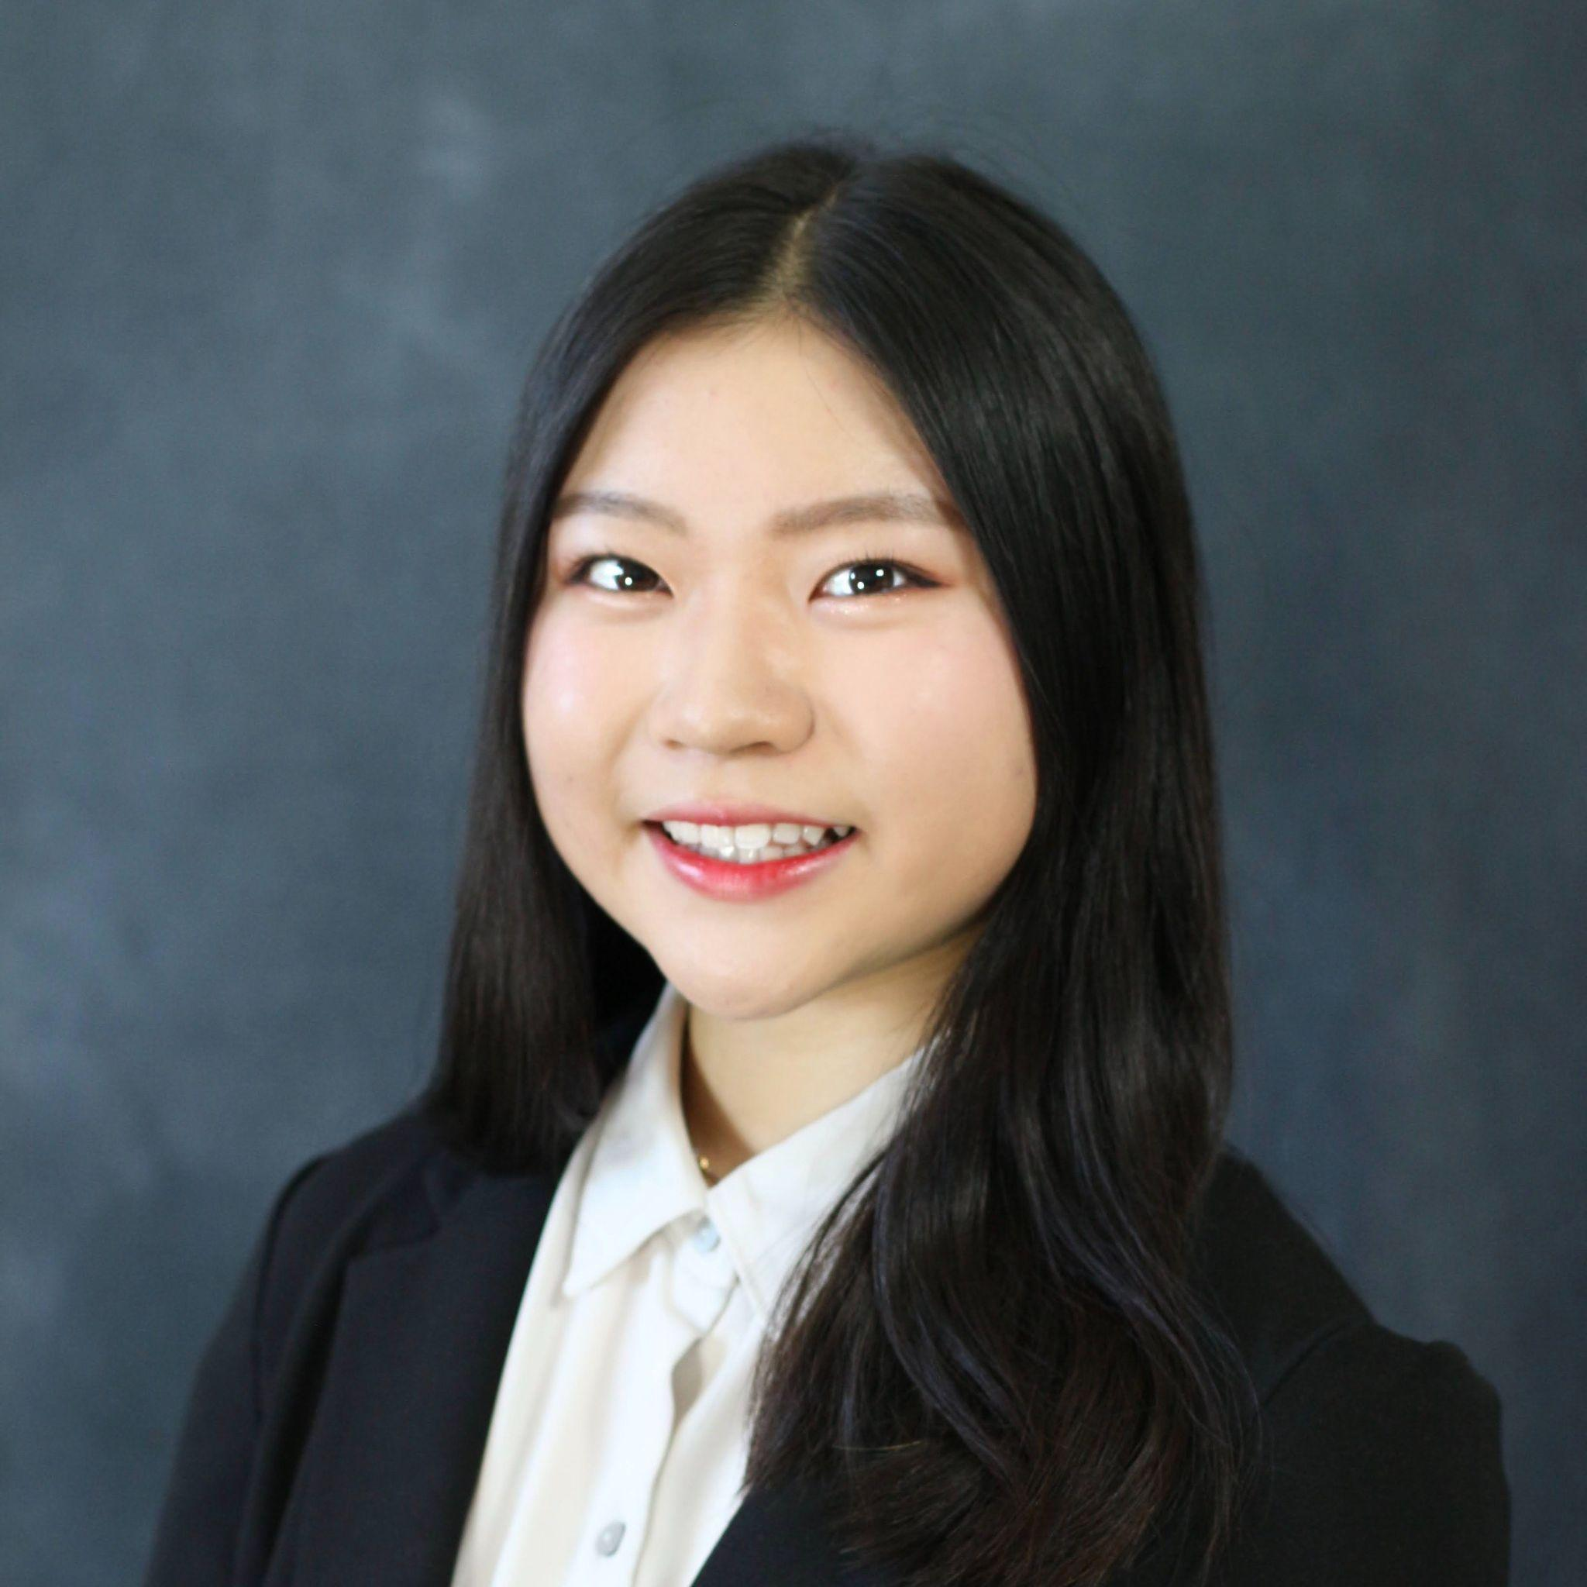
Alissa Vuillier
DESIGNER/DEVELOPER
Britney Tran
DESIGNER/DEVELOPER
Kayla Patterson
DEVELOPER
Anna Chang
DESIGNER

Slide 4
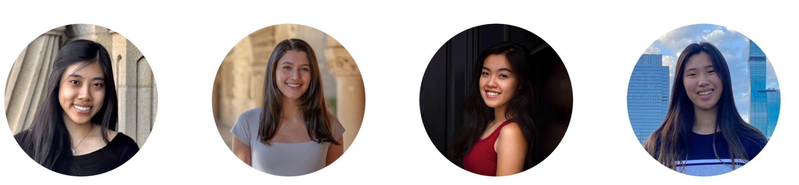
FORMER MEMBERS
Nancy Hoang
PROJECT MANAGER/DESIGNER
Fernanda Kramer
DESIGNER/DEVELOPER
Britney Tran
DESIGNER/DEVELOPER
Lainey Wang
DESIGNER/DEVELOPER

Slide 5
Overview
2
Let’s start with the first set of slides

Slide 6
Problem
From finding where to donate, to which charities are most in need, giving is filled with pitfalls for the average donor.
Notes:
(add animation to show solution after problem)
Can show your concept video/parts of it if helpful

Slide 7
Problem
From finding where to donate, to which charities are most in need, giving is filled with pitfalls for the average donor.
Solution
Our mission is to help donors donate easily and effectively to the causes they care about and track their donations over time.
We want to create a platform that takes the guesswork out of donating by automatically identifying high-impact nonprofits that users can donate to, letting them set up recurring donations, and managing donations long-term.
Notes:
(add animation to show solution after problem)
Can show your concept video/parts of it if helpful

Slide 8
Values
Equity: financial equity, wealth redistribution, sharing knowledge
Efficiency: minimizing complexity of donating and help charities that are effectively using donations or are in need of money
Education: Learning about which organizations are legitimate, and financial benefits of donating

Slide 9
Outline
Needfinding
Prototypes
Demo
Ideation
Current UI
Future Enhancements
Notes:
Outline of talk

Slide 10
Needfinding
3
Let’s start with the first set of slides
Notes:
Needfinding, sketches, low-fi, medium-fi, high-fi
Explain rationale/evidence behind key design decisions

Slide 11
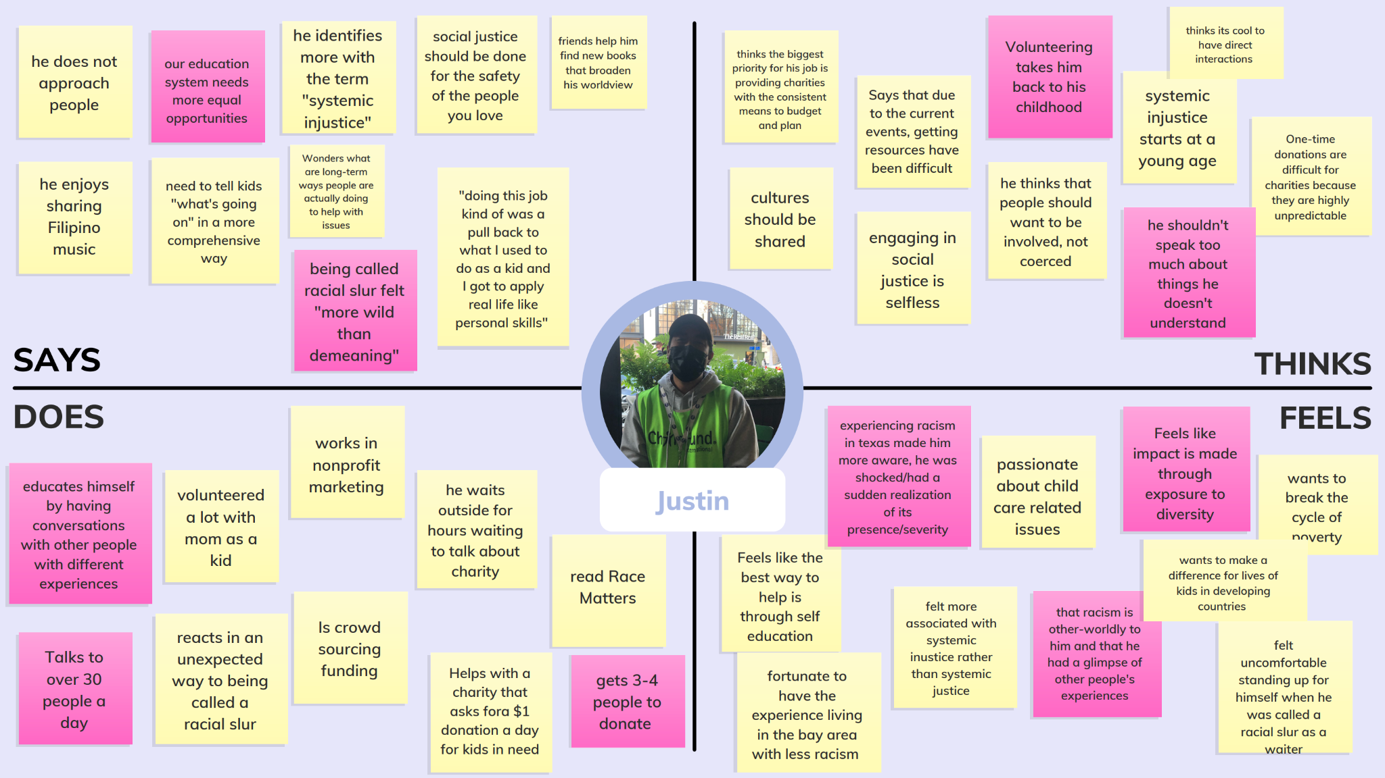
Needfinding
Direct marketer for nonprofit in Bay Area
Explained challenge: donor consistency
Many donors give in lump sums
Involvement in youth organizations → stressed importance of consistent food, shelter, education

Slide 12
Needfinding
Donors know causes they want to donate towards, struggled towards finding organization
  Overfunding
  Improper use of donations
  Finding legitimacy of organization

Slide 13
Ideation
4
Let’s start with the first set of slides
Notes:
Needfinding, sketches, low-fi, medium-fi, high-fi
Explain rationale/evidence behind key design decisions

Slide 14
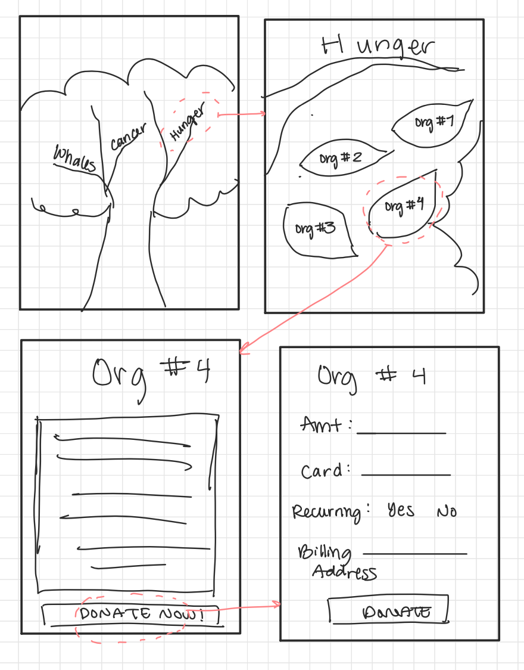
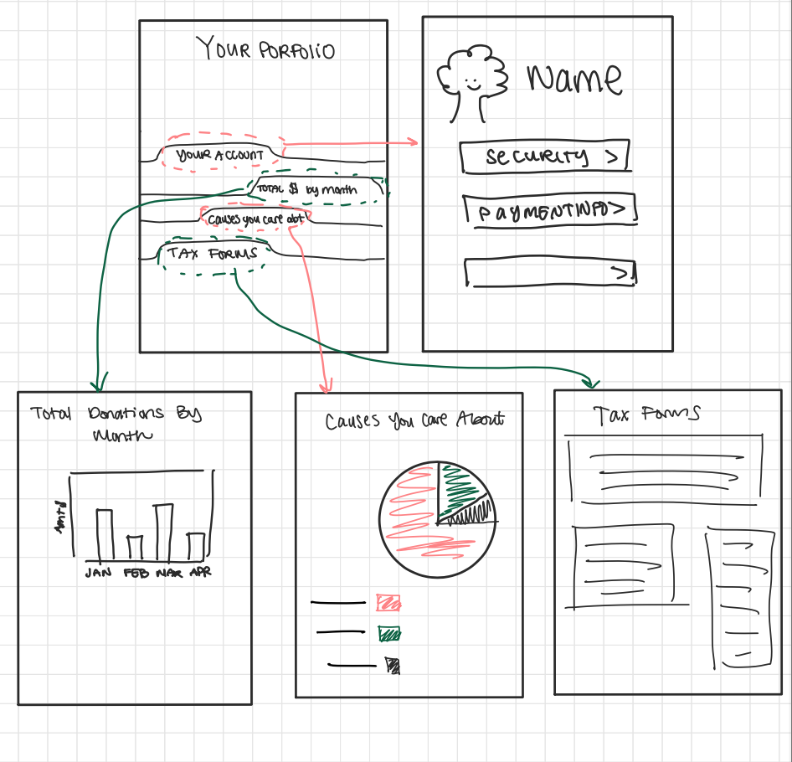
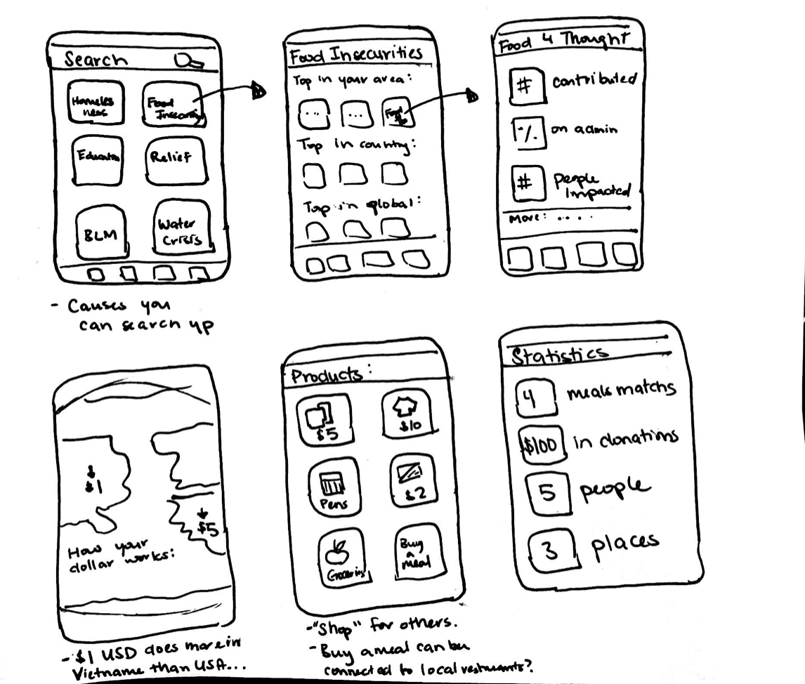
Sketches

Slide 15
Key Tasks
Browse Causes
Recurring Donations
Tax Forms
simple
medium
complex
Notes:
Representative tasks – show what can be accomplished
Why are these tasks important to the user?

Slide 16
Low-Fi Prototype
5
Let’s start with the first set of slides
Notes:
Needfinding, sketches, low-fi, medium-fi, high-fi
Explain rationale/evidence behind key design decisions

Slide 17
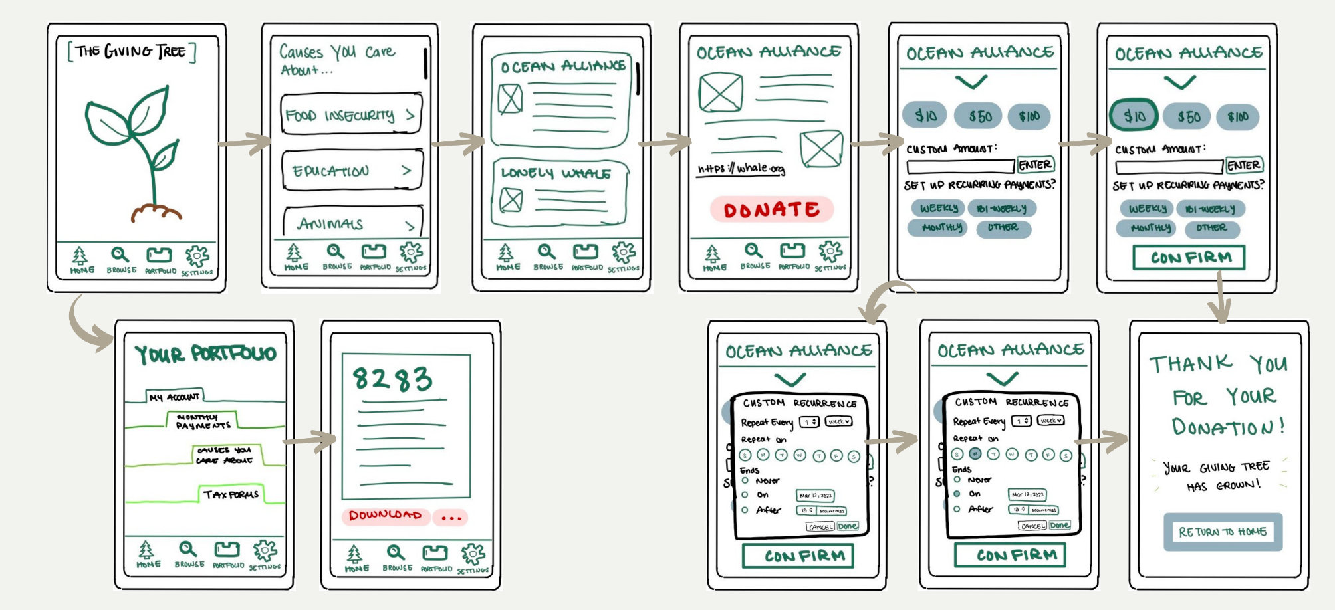
Low-Fi

Slide 18
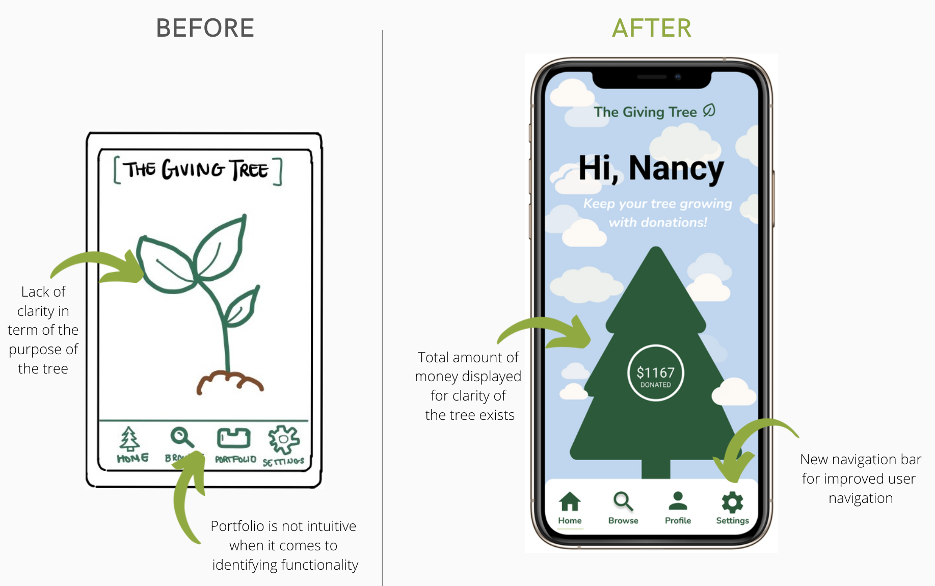
Changes Made: Home Page
Donations that stimulate tree’s growth
Navigation bar’s “Profile” icon instead of “Portfolio” icon

Slide 19
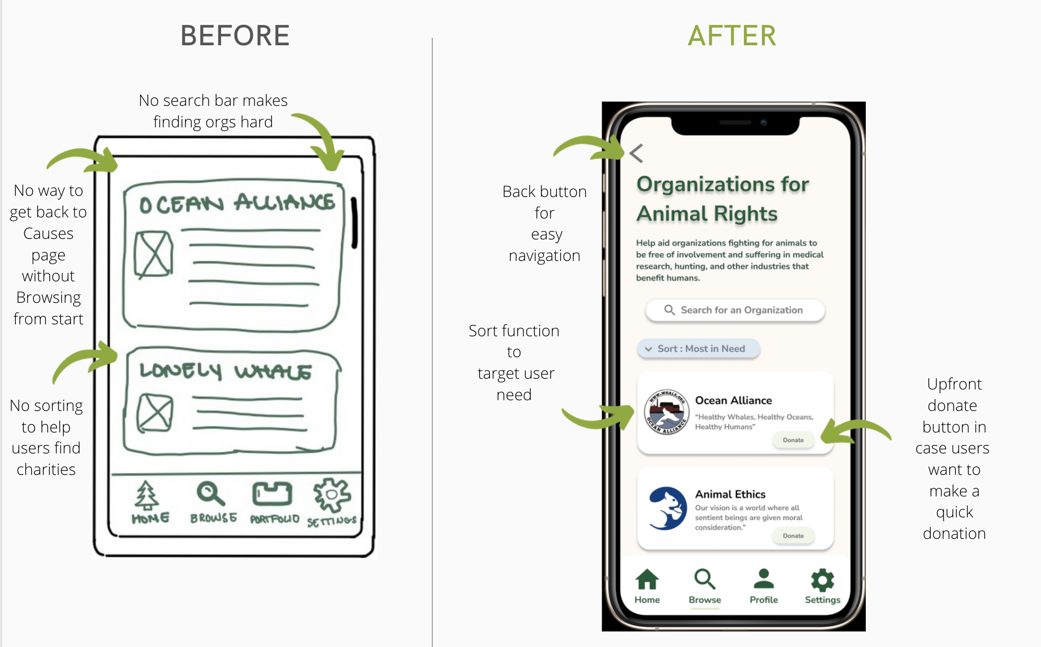
Changes Made: Organizations Page
Back button
Sort function for ‘Education and Efficiency’
Upfront donate button

Slide 20
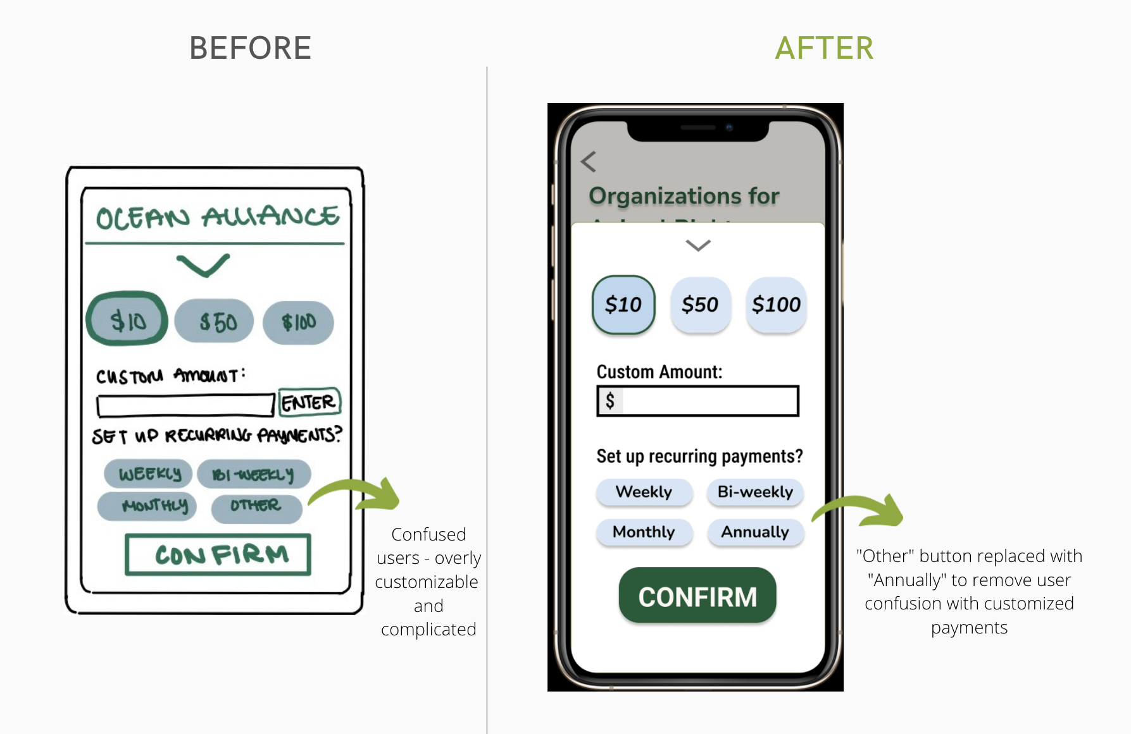
Changes Made: Donations Page
Prioritized simplicity over customization

Slide 21
Medium-Fi Prototype
6
Let’s start with the first set of slides
Notes:
Needfinding, sketches, low-fi, medium-fi, high-fi
Explain rationale/evidence behind key design decisions

Slide 22
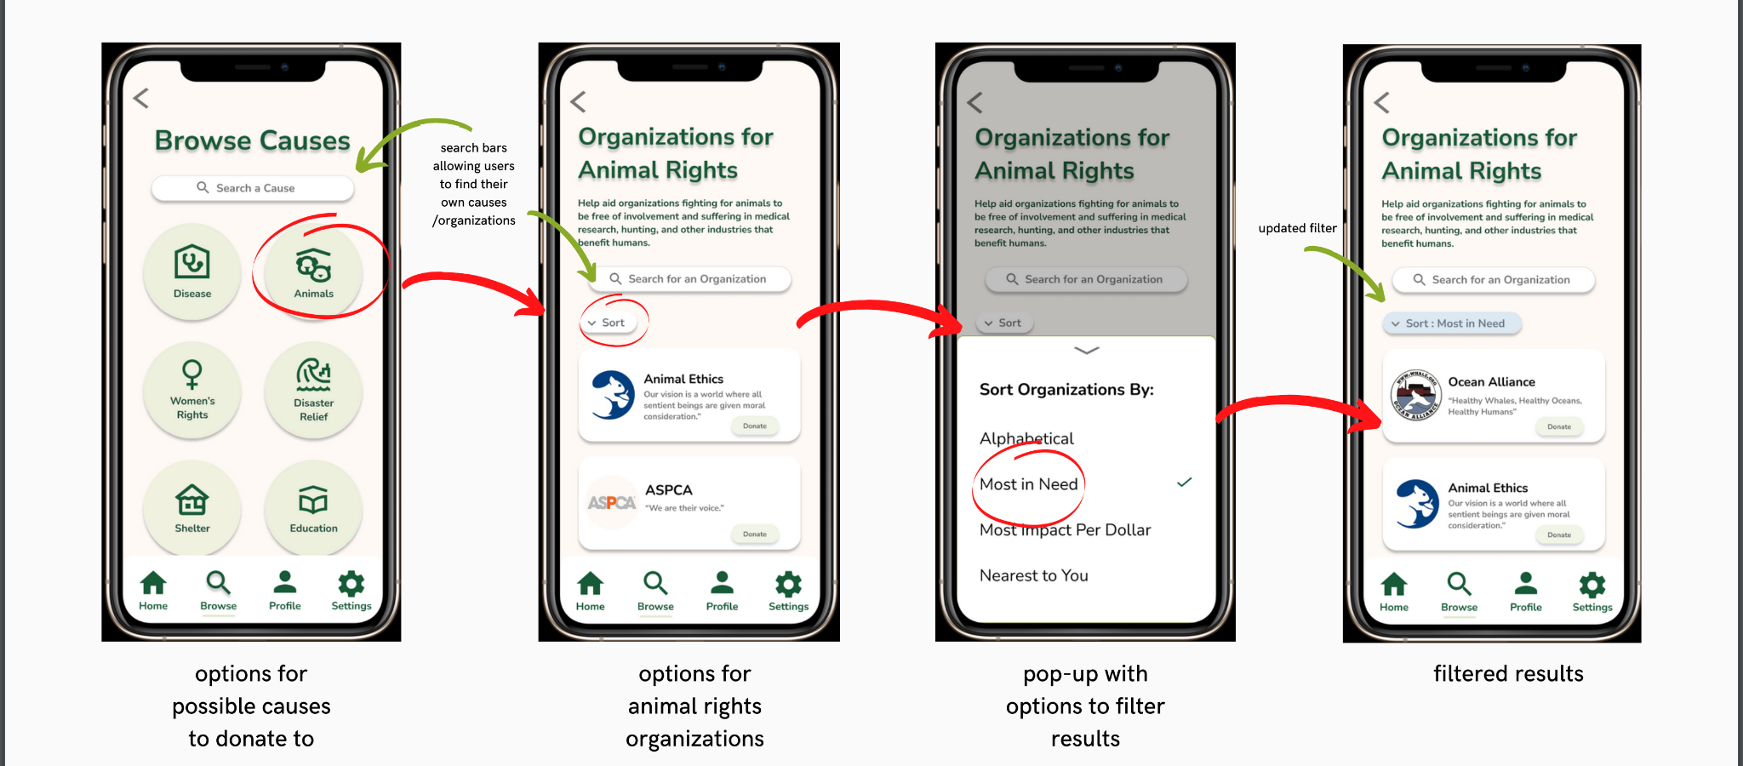
Simple Task: Browse Causes

Slide 23
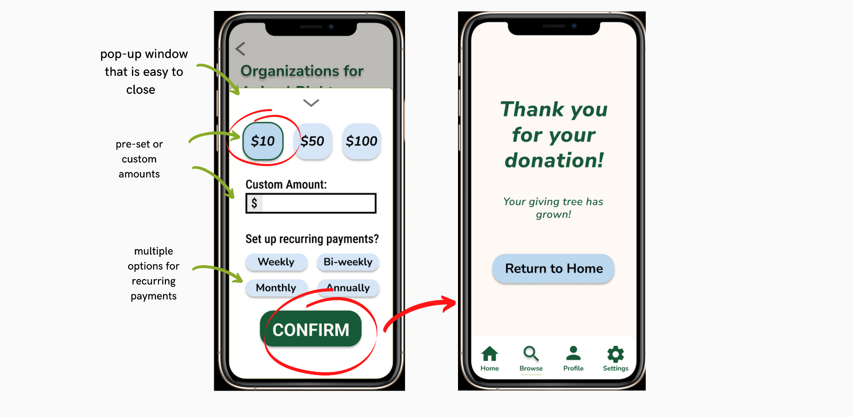
Medium Task: Donate

Slide 24
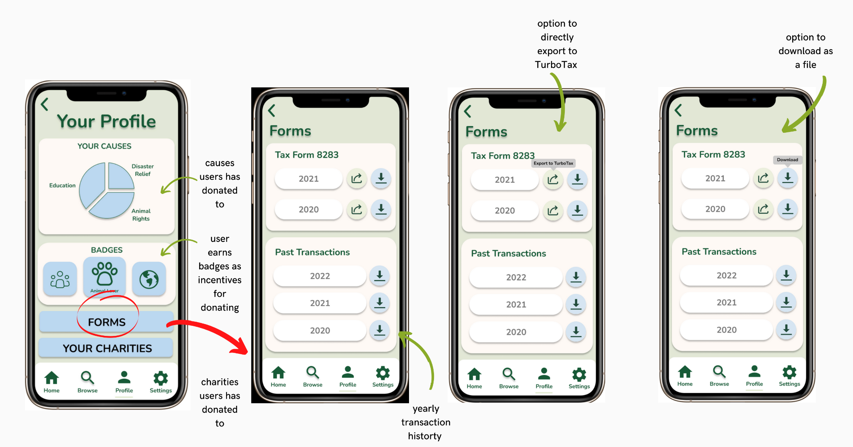
Complex Task: Generate Tax Forms

Slide 25
High-Fi Prototype
7
Let’s start with the first set of slides
Notes:
Needfinding, sketches, low-fi, medium-fi, high-fi
Explain rationale/evidence behind key design decisions

Slide 26
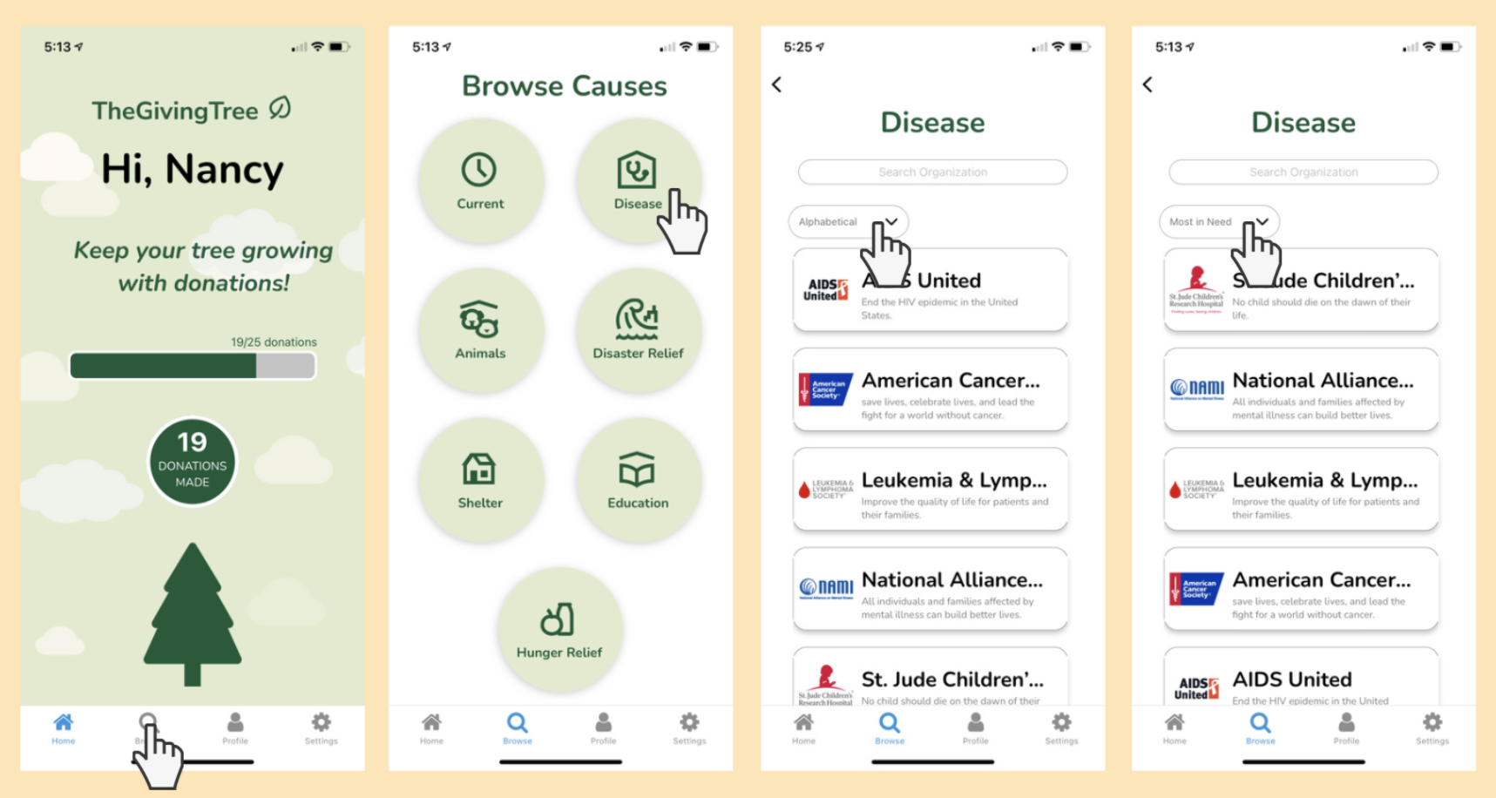
Simple Task: Browse Causes

Slide 27
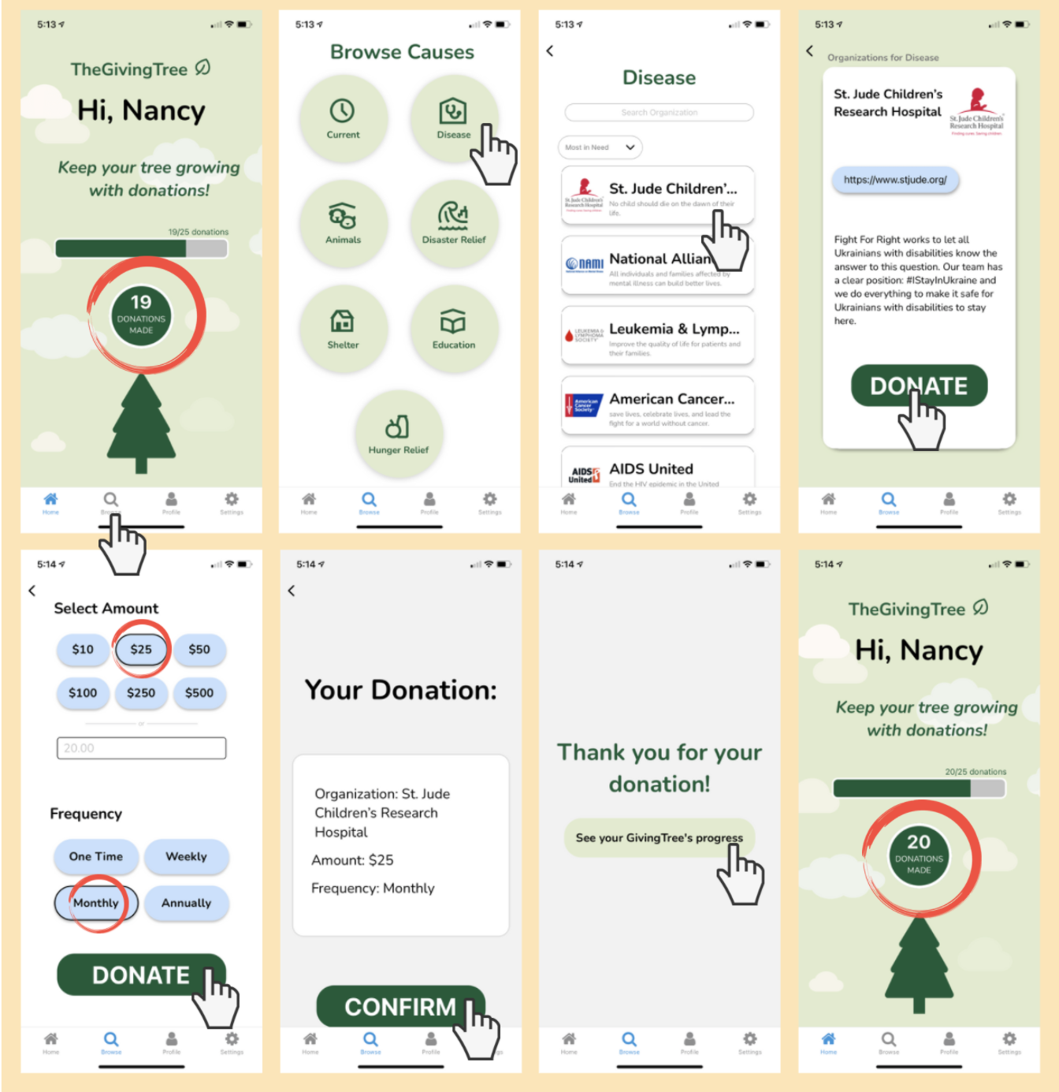
Medium Task: Donate

Slide 28
Medium Task: Donate

Slide 29
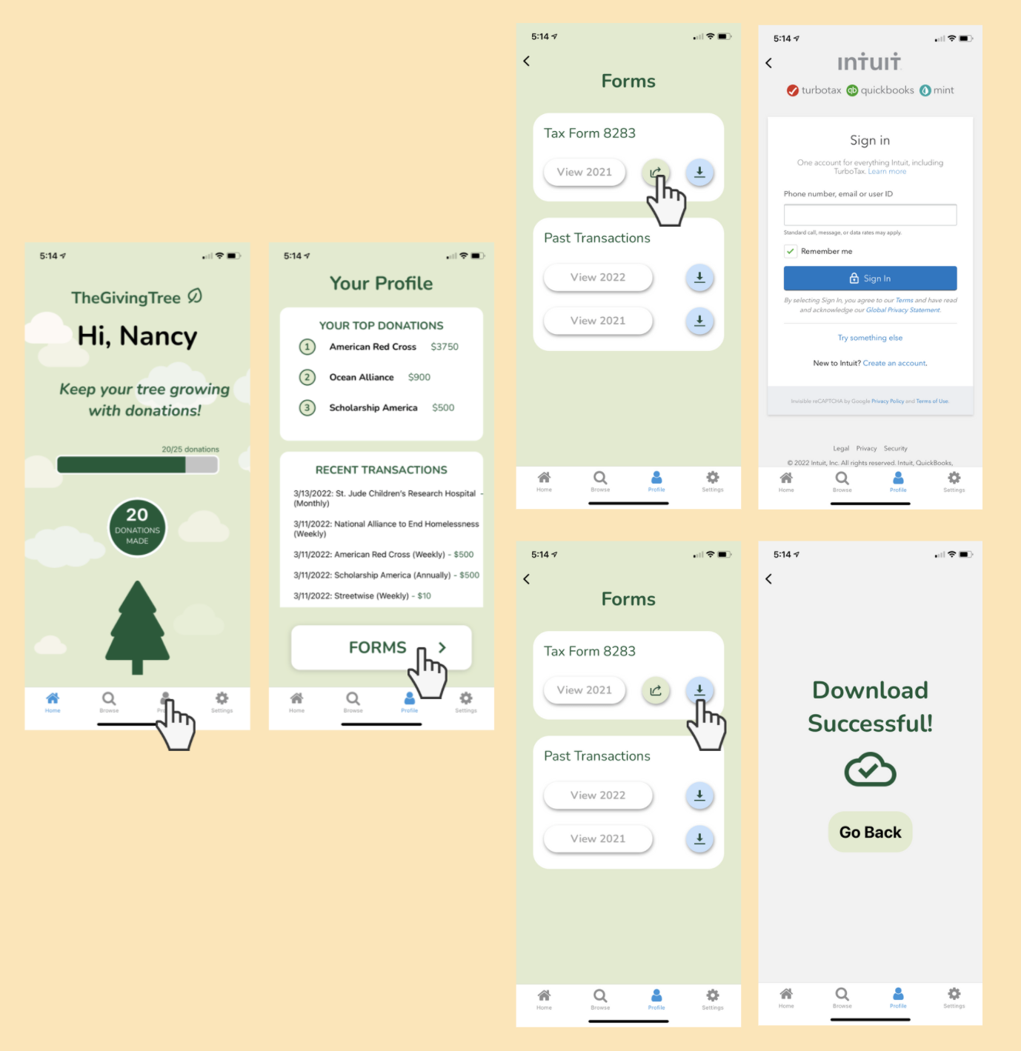
Complex Task: Generate Tax Forms

Slide 30
Current UI
4
Let’s start with the first set of slides

Slide 31
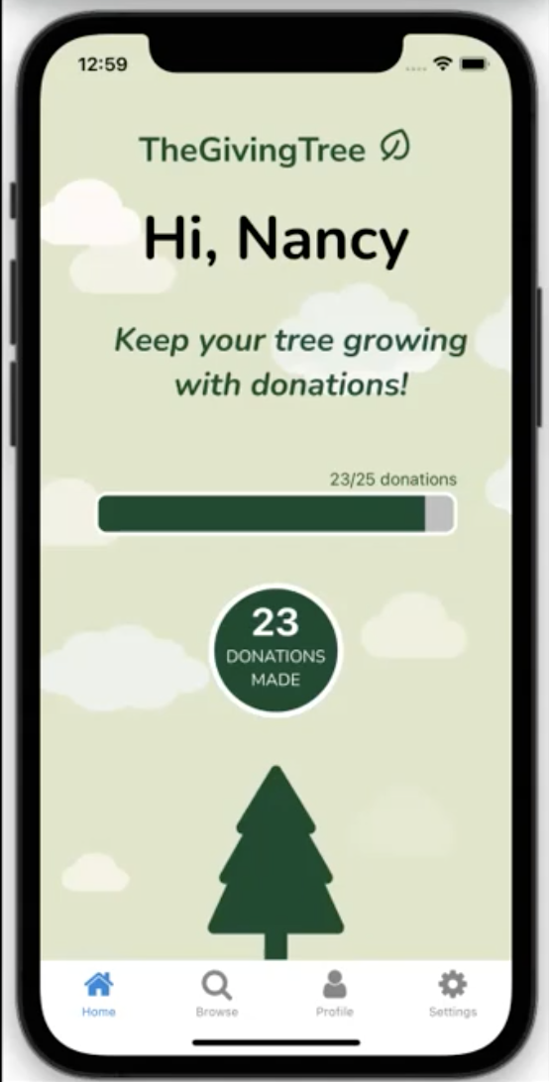
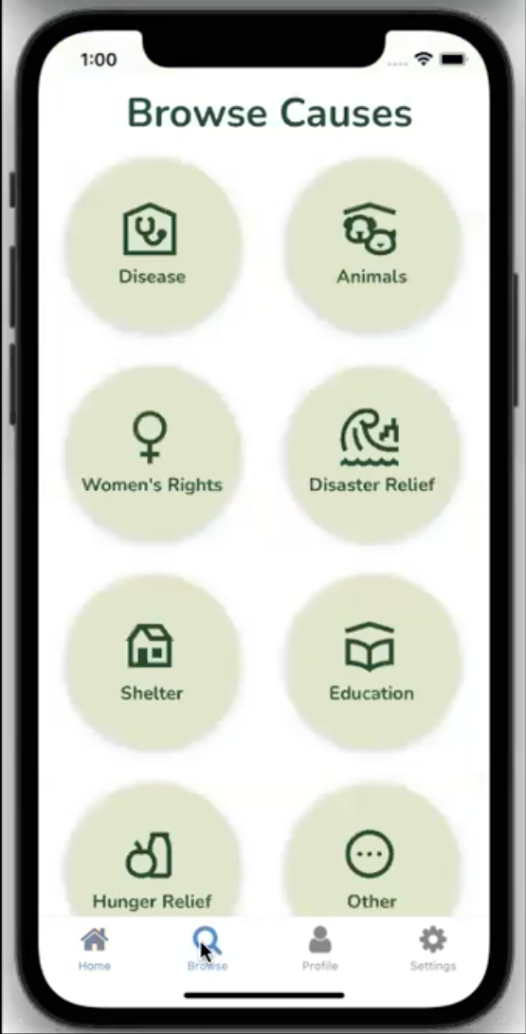
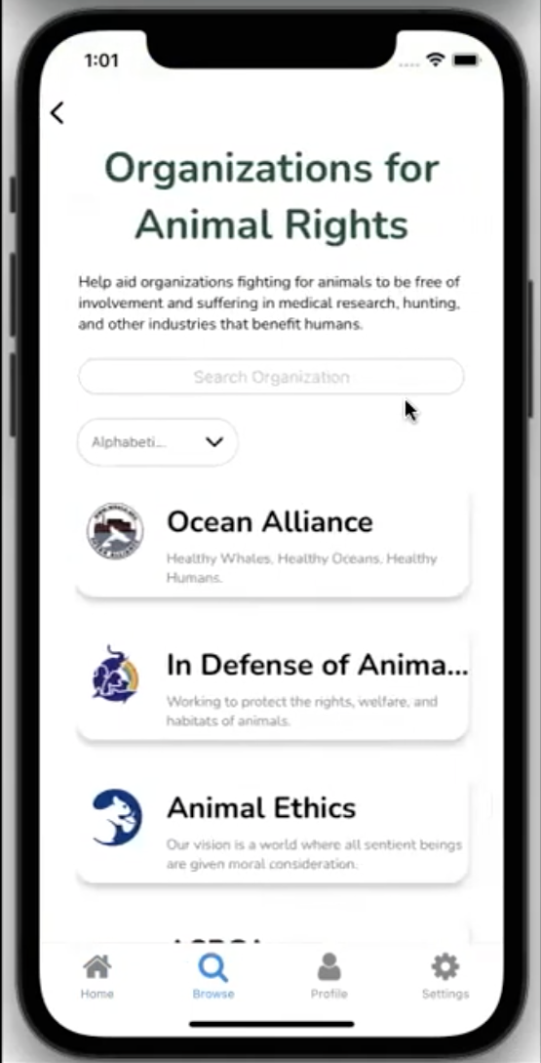
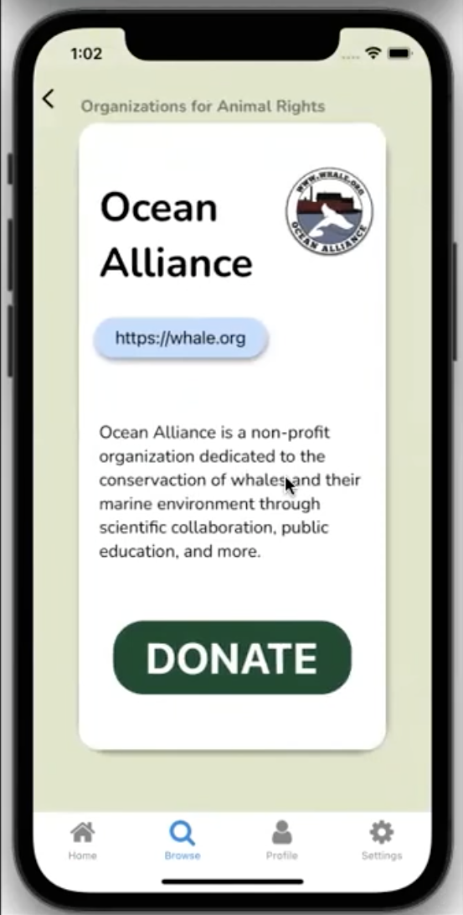
Simple Task: Browse Causes
Notes:
Demos can be either live or pre-recorded

Slide 32
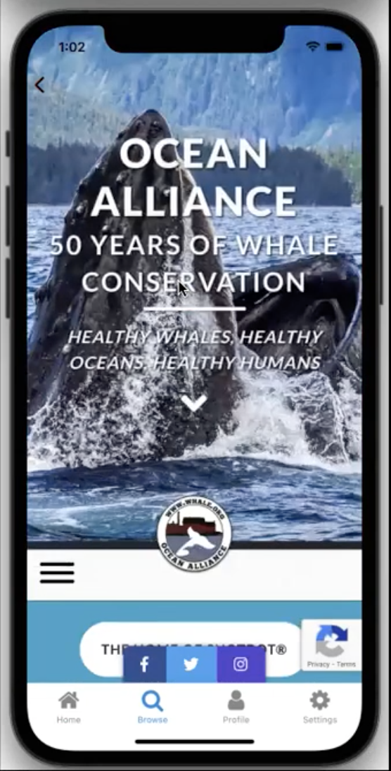
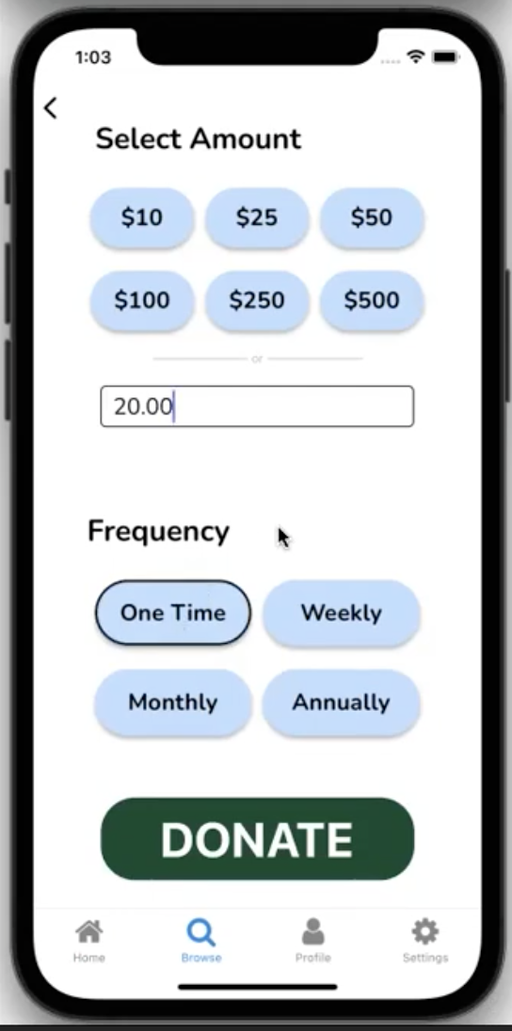
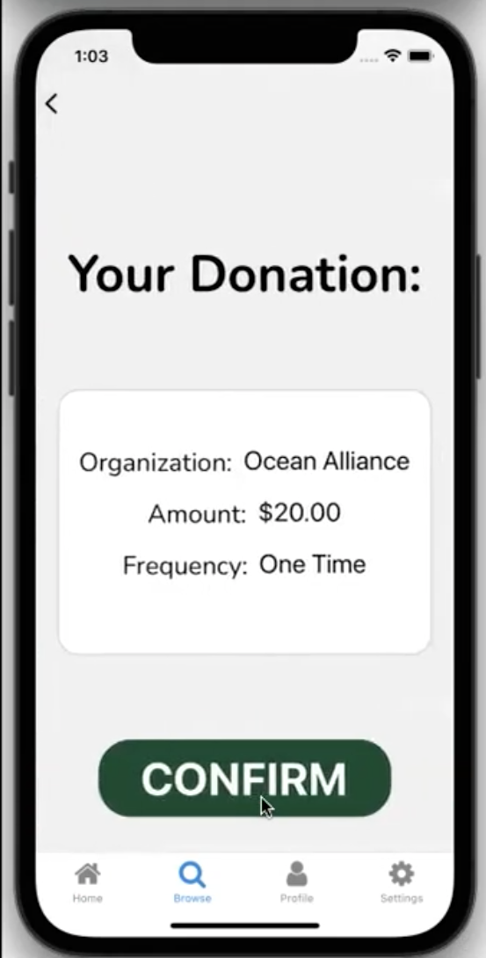
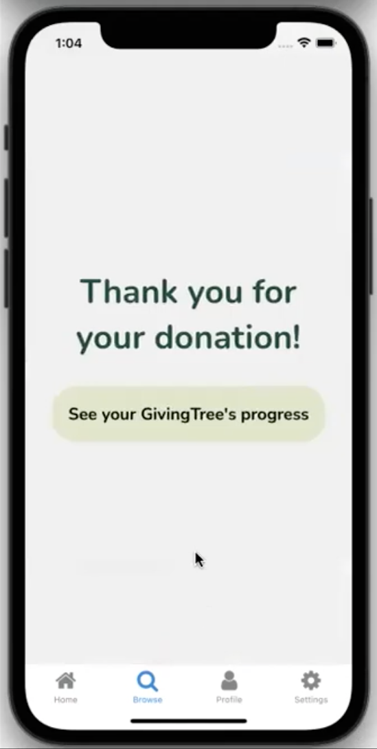
Medium Task: Donate
Notes:
Demos can be either live or pre-recorded

Slide 33
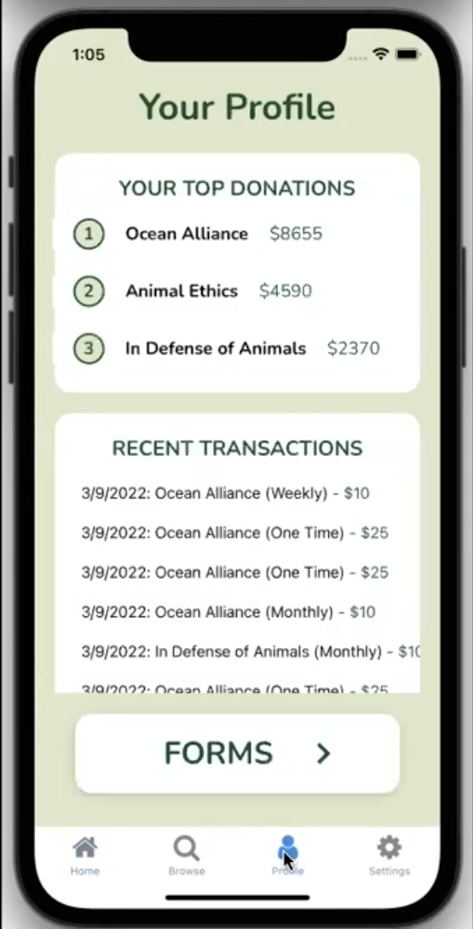
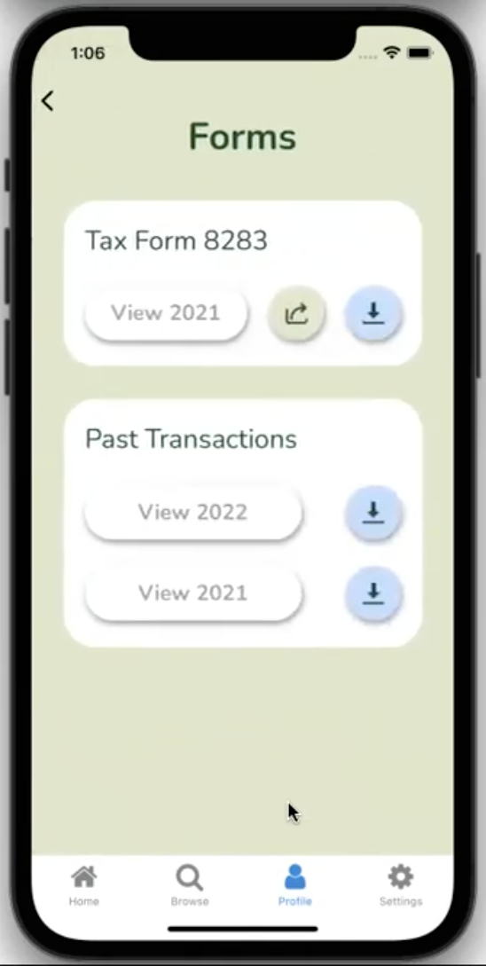
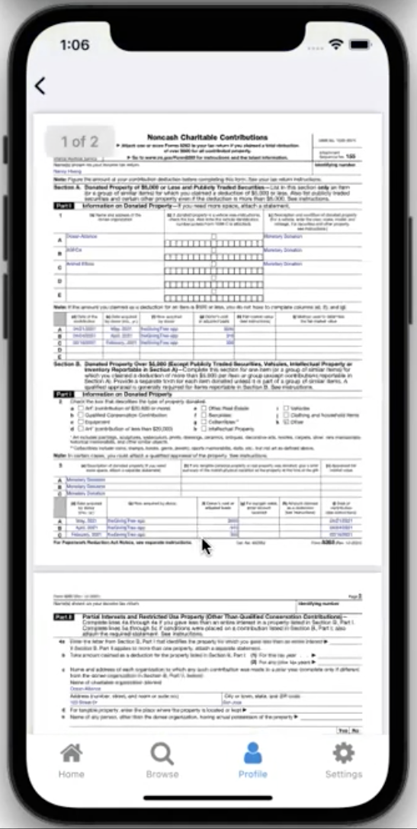
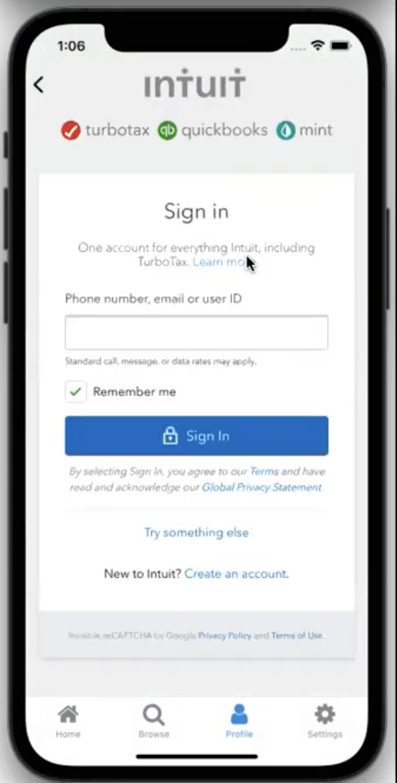
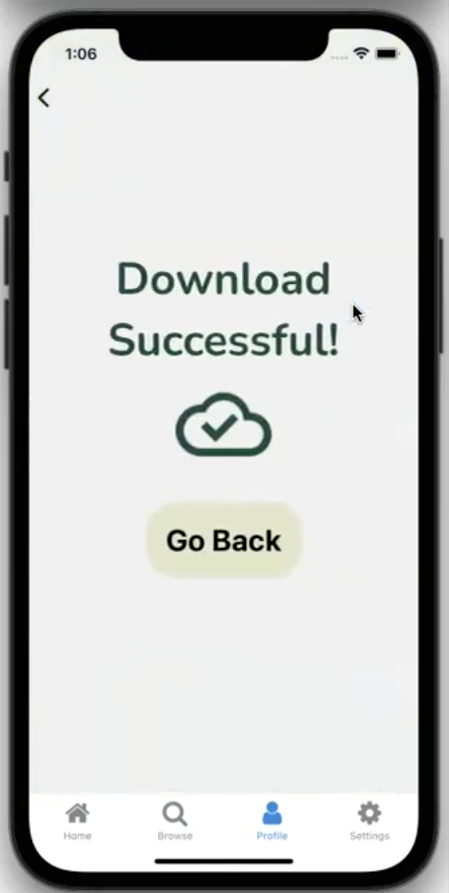
Complex Task: Generate Tax Forms
Notes:
Demos can be either live or pre-recorded

Slide 34
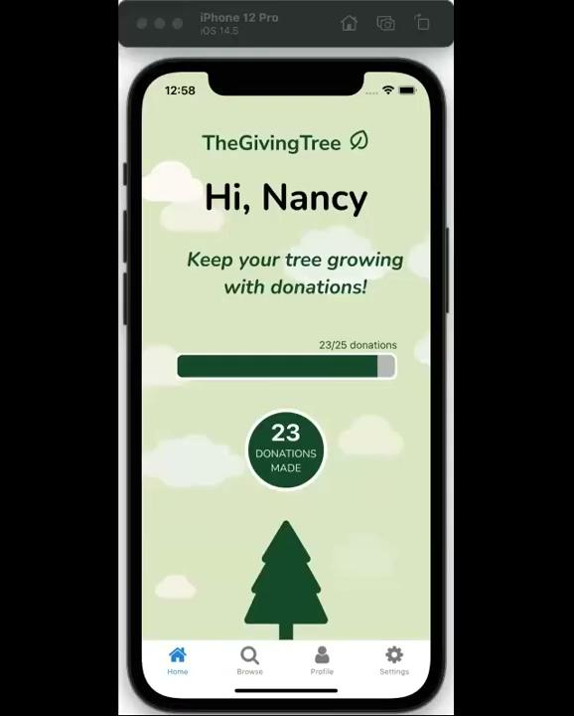
Notes:
Demos can be either live or pre-recorded

Slide 35
Future Enhancements
6
Let’s start with the first set of slides

Slide 36
What is missing?
Wizard of Oz: recommended organizations, sorting feature, growth of tree
Hardcoded: Organization titles/descriptions/logos
Hardcoded: Tax forms
User login
Inputting payment information → transaction pipeline
Reward system has fixed limit
Notes:
What is missing & how did you fake it?

Slide 37
What will we add?
Tutorial
Notification System
Notes:
What additions would make it even better? Why?

Slide 38
Thanks!
Any questions ?

