Slide 1
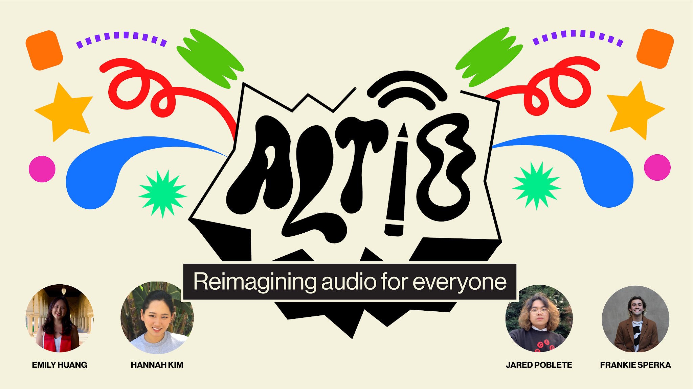

Slide 2

Outline
Introduction
Needfinding
Brainstorming & Testing
Low-Fi
Medium-Fi
High-Fi & Demo
Future Enhancements

Slide 3

PROBLEM
Deaf and hard of hearing people are often left out of key nuanced information that is conveyed through audio in digital spaces
SOLUTION
ALTiO is a social media platform that encourages and provides drawings as visual supplements for interpreting audio–providing alternative options for everyone to experience content

Slide 4
Design Evolution

Slide 5
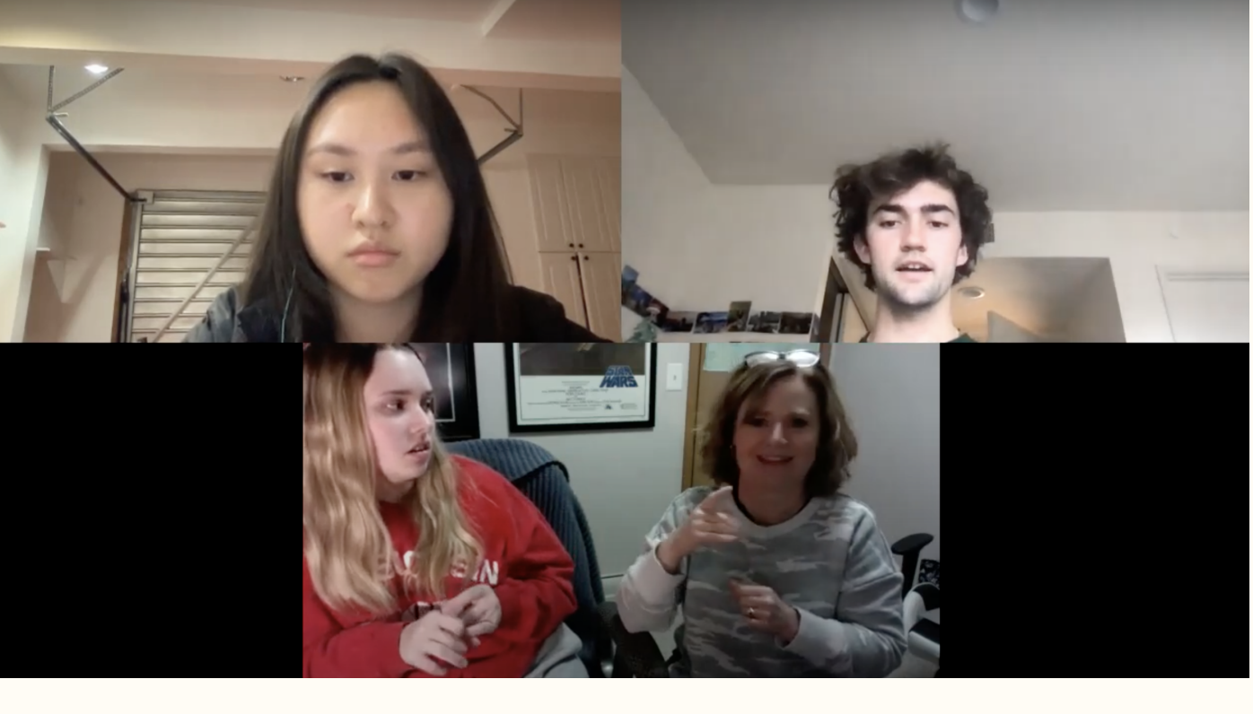
Needfinding
Initially, we hoped to find ways to design to improve accessibility for the Deaf and hard of hearing community. To begin this process we connected with individuals who are members of or adjacent to the Deaf and Hard of Hearing communities.
Focus areas: General Inclusion, Entertainment, Mobile apps, Pandemic

Slide 6
Needfinding Results
“Our art has no noise or music” but the participant enjoys attending her children’s choir concerts
“If there’s a video without captions, I’ll just skip it. Sometimes I’ll try to go to the comments and piece things together but it’s usually not worth it.”
Participants mentioned they were very frustrated when there is lag between captions and TV
America is very biased towards listening to things
“Hearing is something that is difficult for me, visual is something that is easy.”
Independence, inclusion, and representation emerged as throughlines

Slide 7
Three Solutions
How might we
Enable connection between the Deaf and Hard of Hearing community and individuals outside of it?
Prioritize feeling connected through shared experiences for Deaf / HoH people?
Convey nuanced descriptions in a non-auditory way to include the Deaf / HoH community in pop culture?

Slide 8
Three Solutions
How might we
Solutions
Enable connection between the Deaf and Hard of Hearing community and individuals outside of it?
Prioritize feeling connected through shared experiences for Deaf / HoH people?
Convey nuanced descriptions in a non-auditory way to include the Deaf / HoH community in pop culture?
Virtual group environment (similar to Clubhouse) centering people in the Deaf / HoH community that supports their preferred method of communication.
Haptic feedback phone extension/ feature that varies in intensity based on audio input.
Audio interpretation provided by hearing people of different media that have audio, can be how it makes you feel, details that are important to the overall meaning

Slide 9
EXPERIENCE PROTOTYPE 1
HMW convey nuanced descriptions in a non-auditory way to include the Deaf/HoH community in pop culture?
ASSUMPTION
A unique audio interpretation can be effective for conveying the nuance of information and meaning in content
DESCRIPTION
Two interviewees take turns between: interviewee A listening to a song and drawing how it ‘feels,’and interviewee B interpreting said drawing. After the exercise, both interviewees listen to the audio together and compare their experience and expectations.
We chose songs that ranged between instrumentals, non-English, and English and observed the difference in drawings.

Slide 10
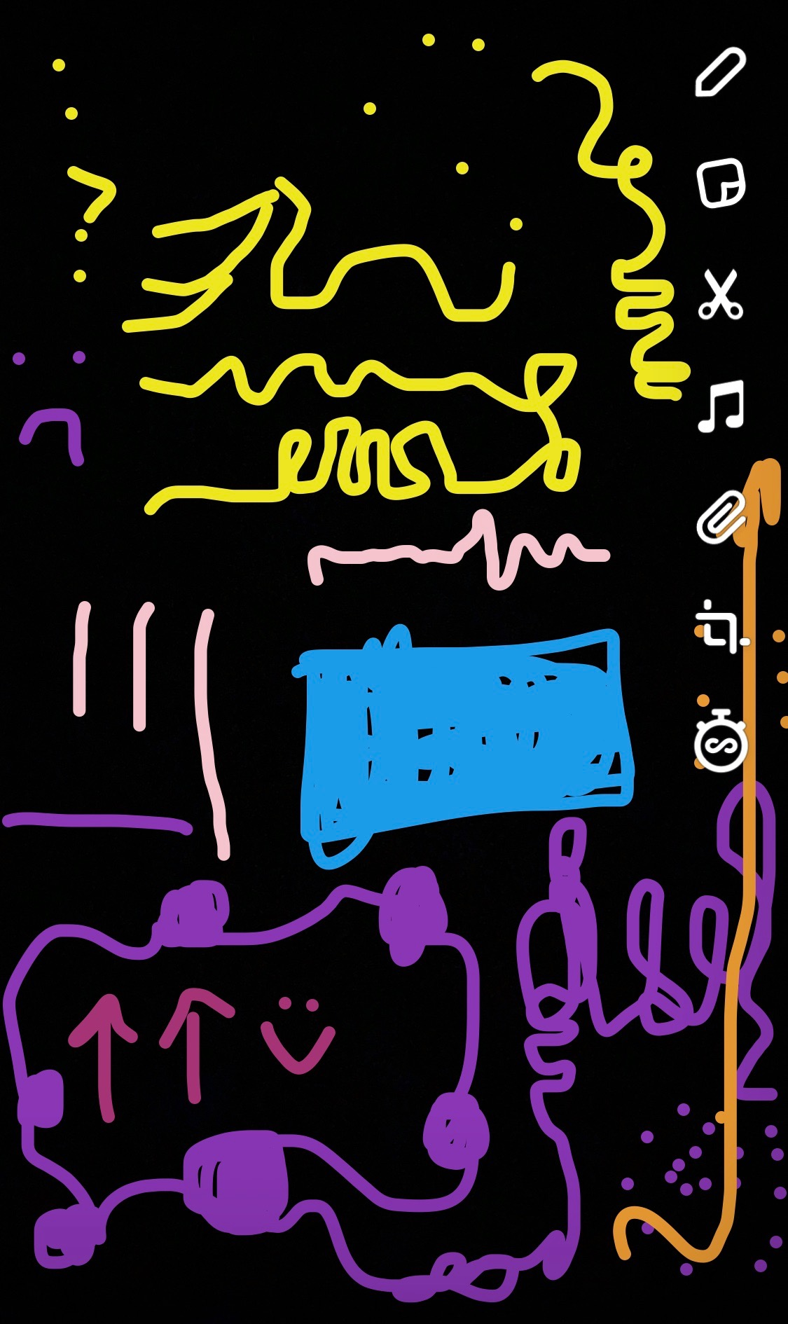
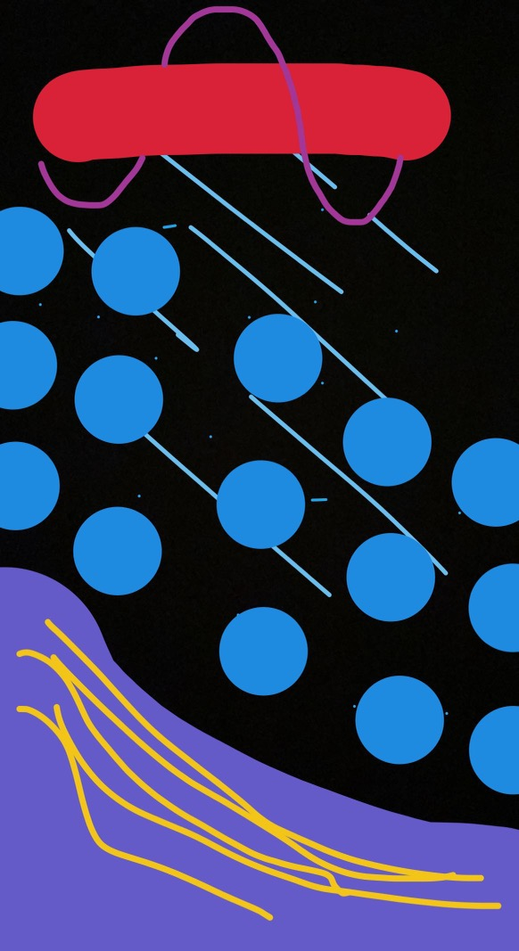
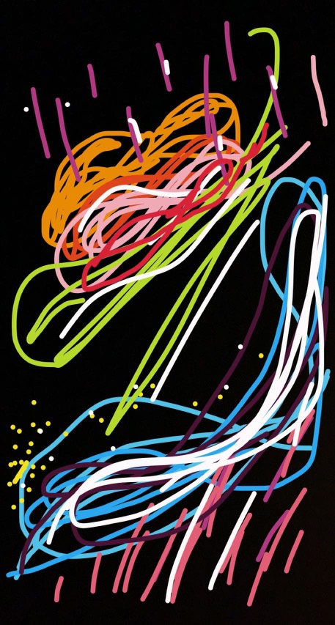
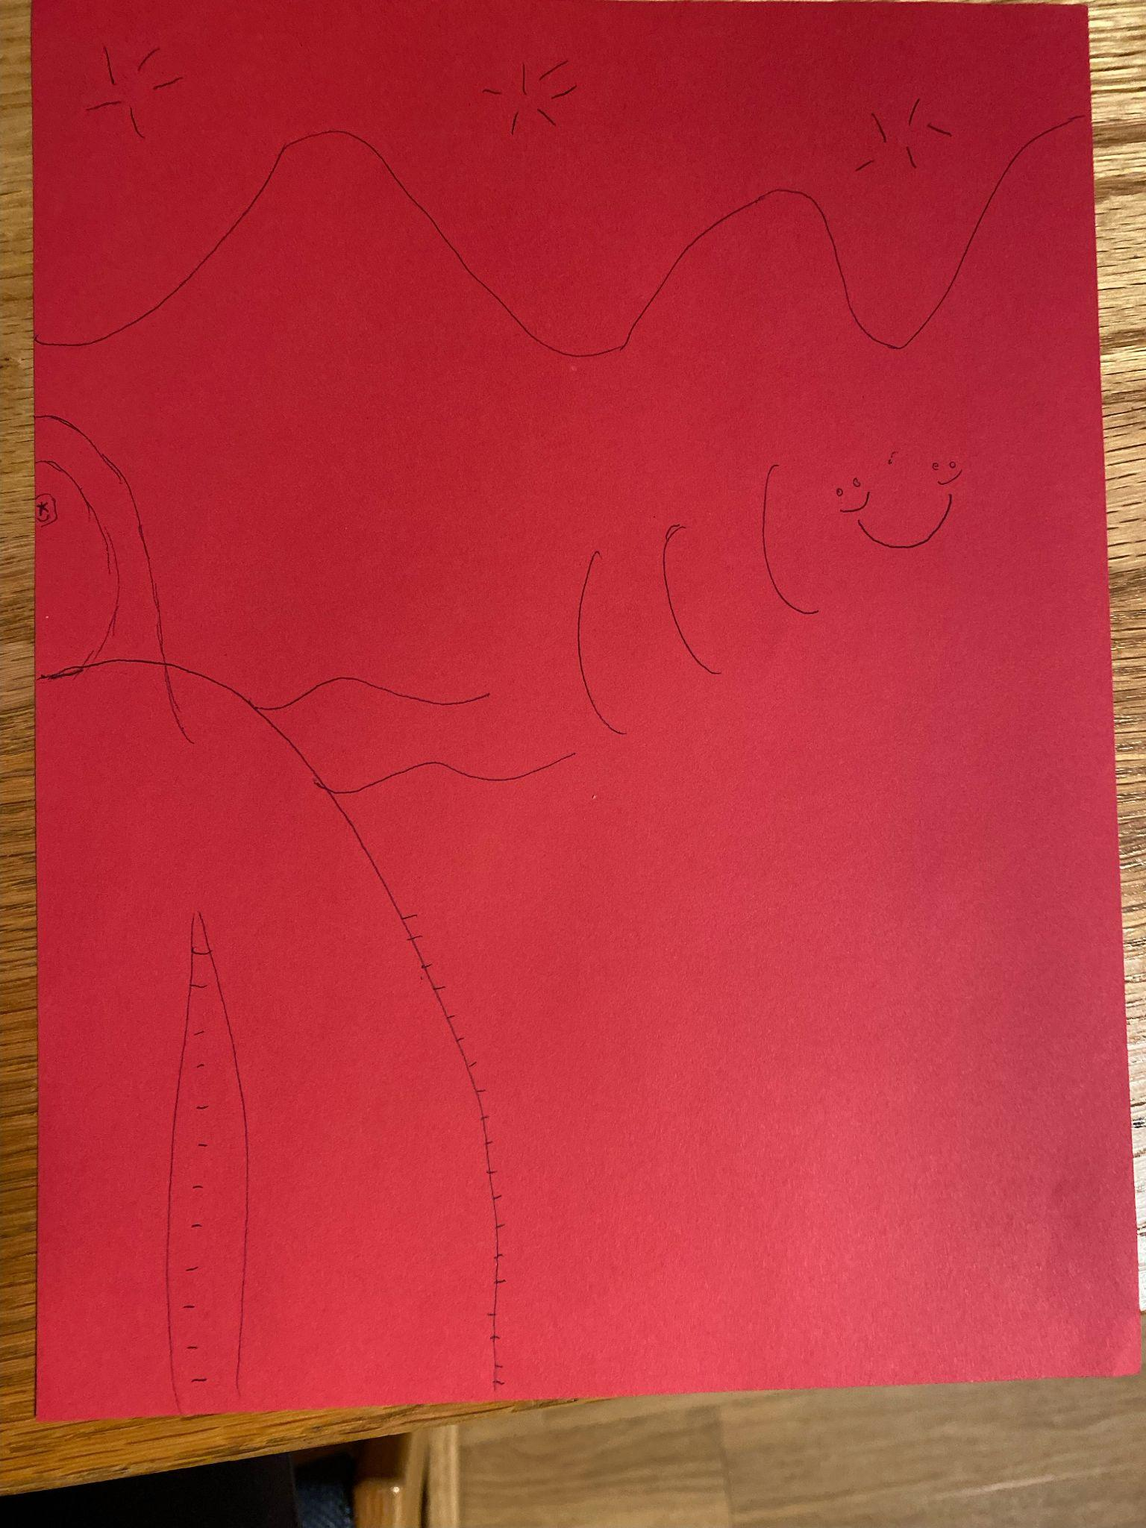
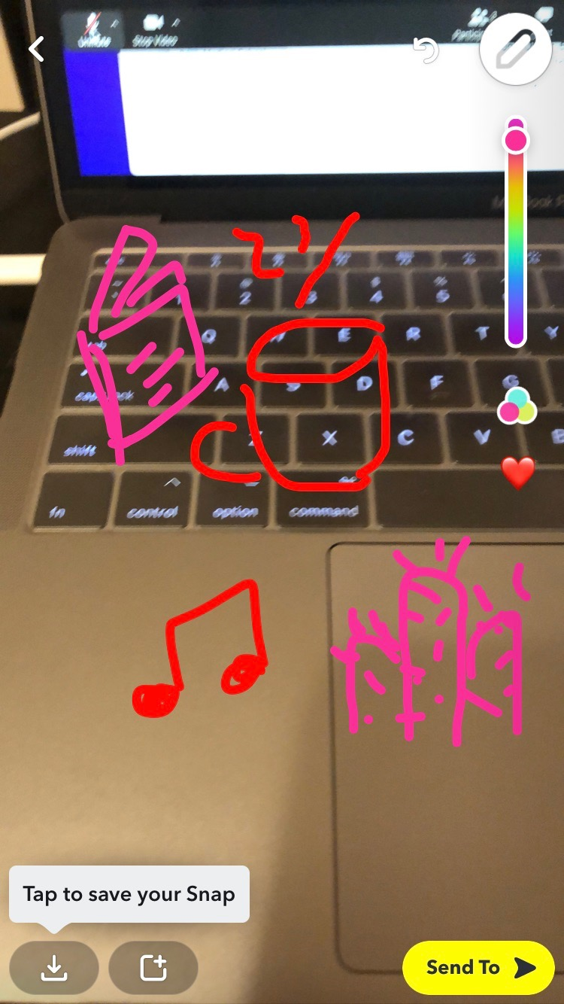
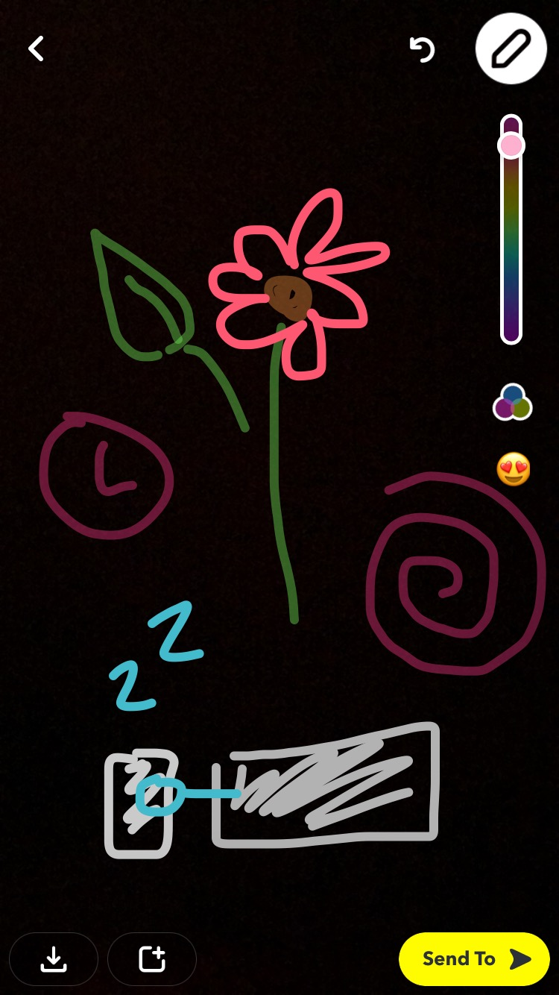
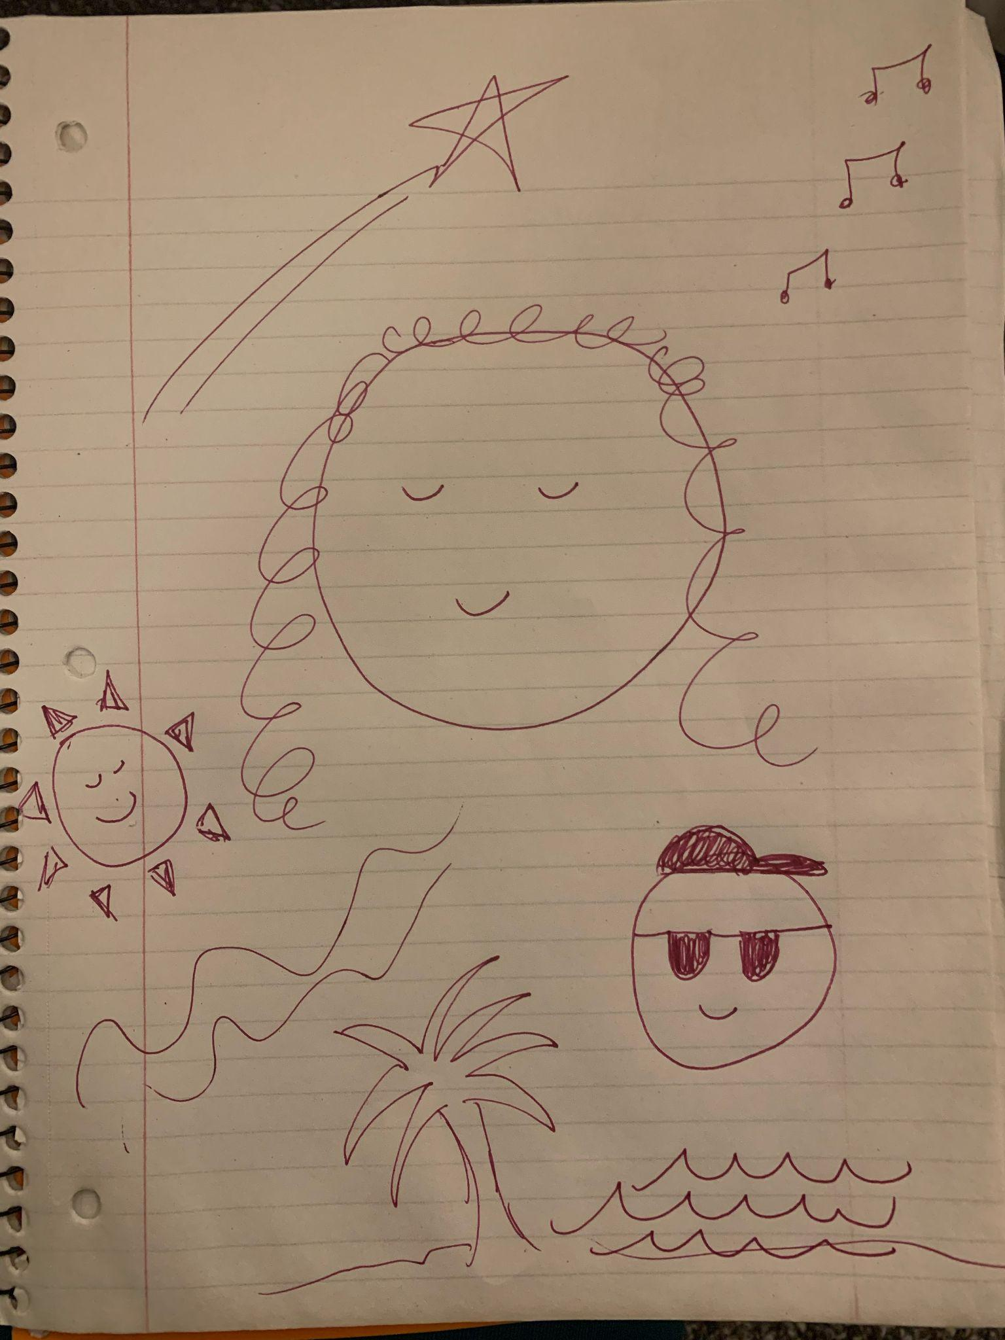
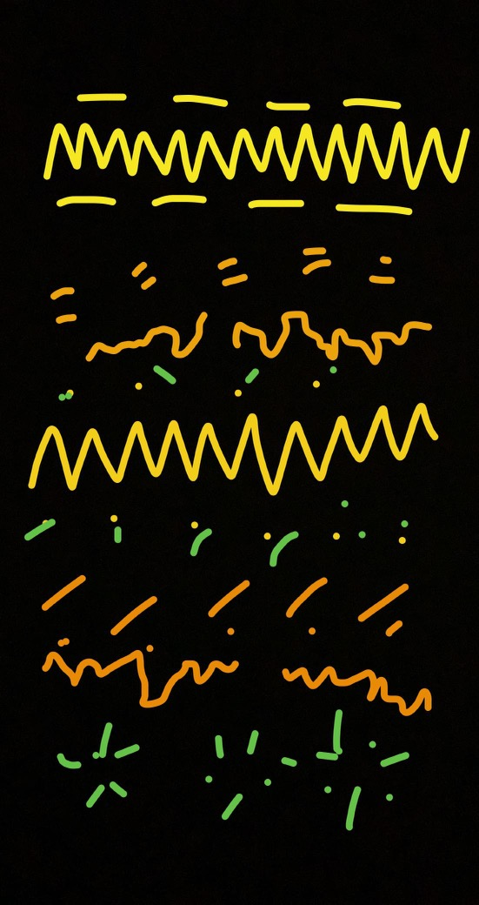
EXPERIENCE PROTOTYPE RESULTS
Andy Brown Trio at the Whiskey Lounge
idontwannabeyouanymore - Billie Eilish
Instagram - DEAN
Corpus Christi - PRETTYMUCH

Slide 11
EXPERIENCE PROTOTYPE RESULTS
We interviewed four groups of varying amounts of people. All participants were hearing.
Things that worked
Things that didn’t work
Interviewees enjoyed the activity
Interviewees relayed their feelings through drawing
Interviewees could accurately extrapolate some kind of feeling from the drawings
Interpretation without info. was daunting
Doing the exercises sequentially could potentially influence the second drawer
Surprises
New learnings
non-English songs had an effect on the approach to drawing
abstract vs. symbolic
The constraint of using Snapchat was enjoyable
Guidance and encouragement would help reduce doubt
People are excited about using this prototype
Drawing in real time might be interesting to explore

Slide 12
EXPERIENCE PROTOTYPE VALIDITY
VALID
To a certain extent, each participant was able to infer some kind of meaning from each drawing, despite the diverse and unique approaches each interviewee had to translating the audio.
“She got more out of it than I even realized was there” - Participant 015

Slide 13
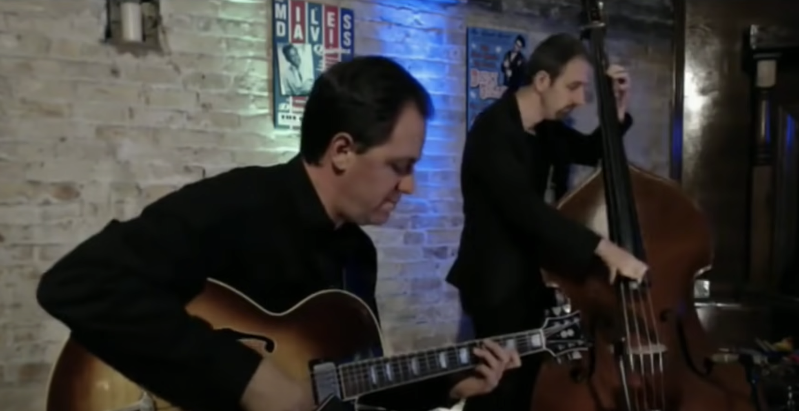
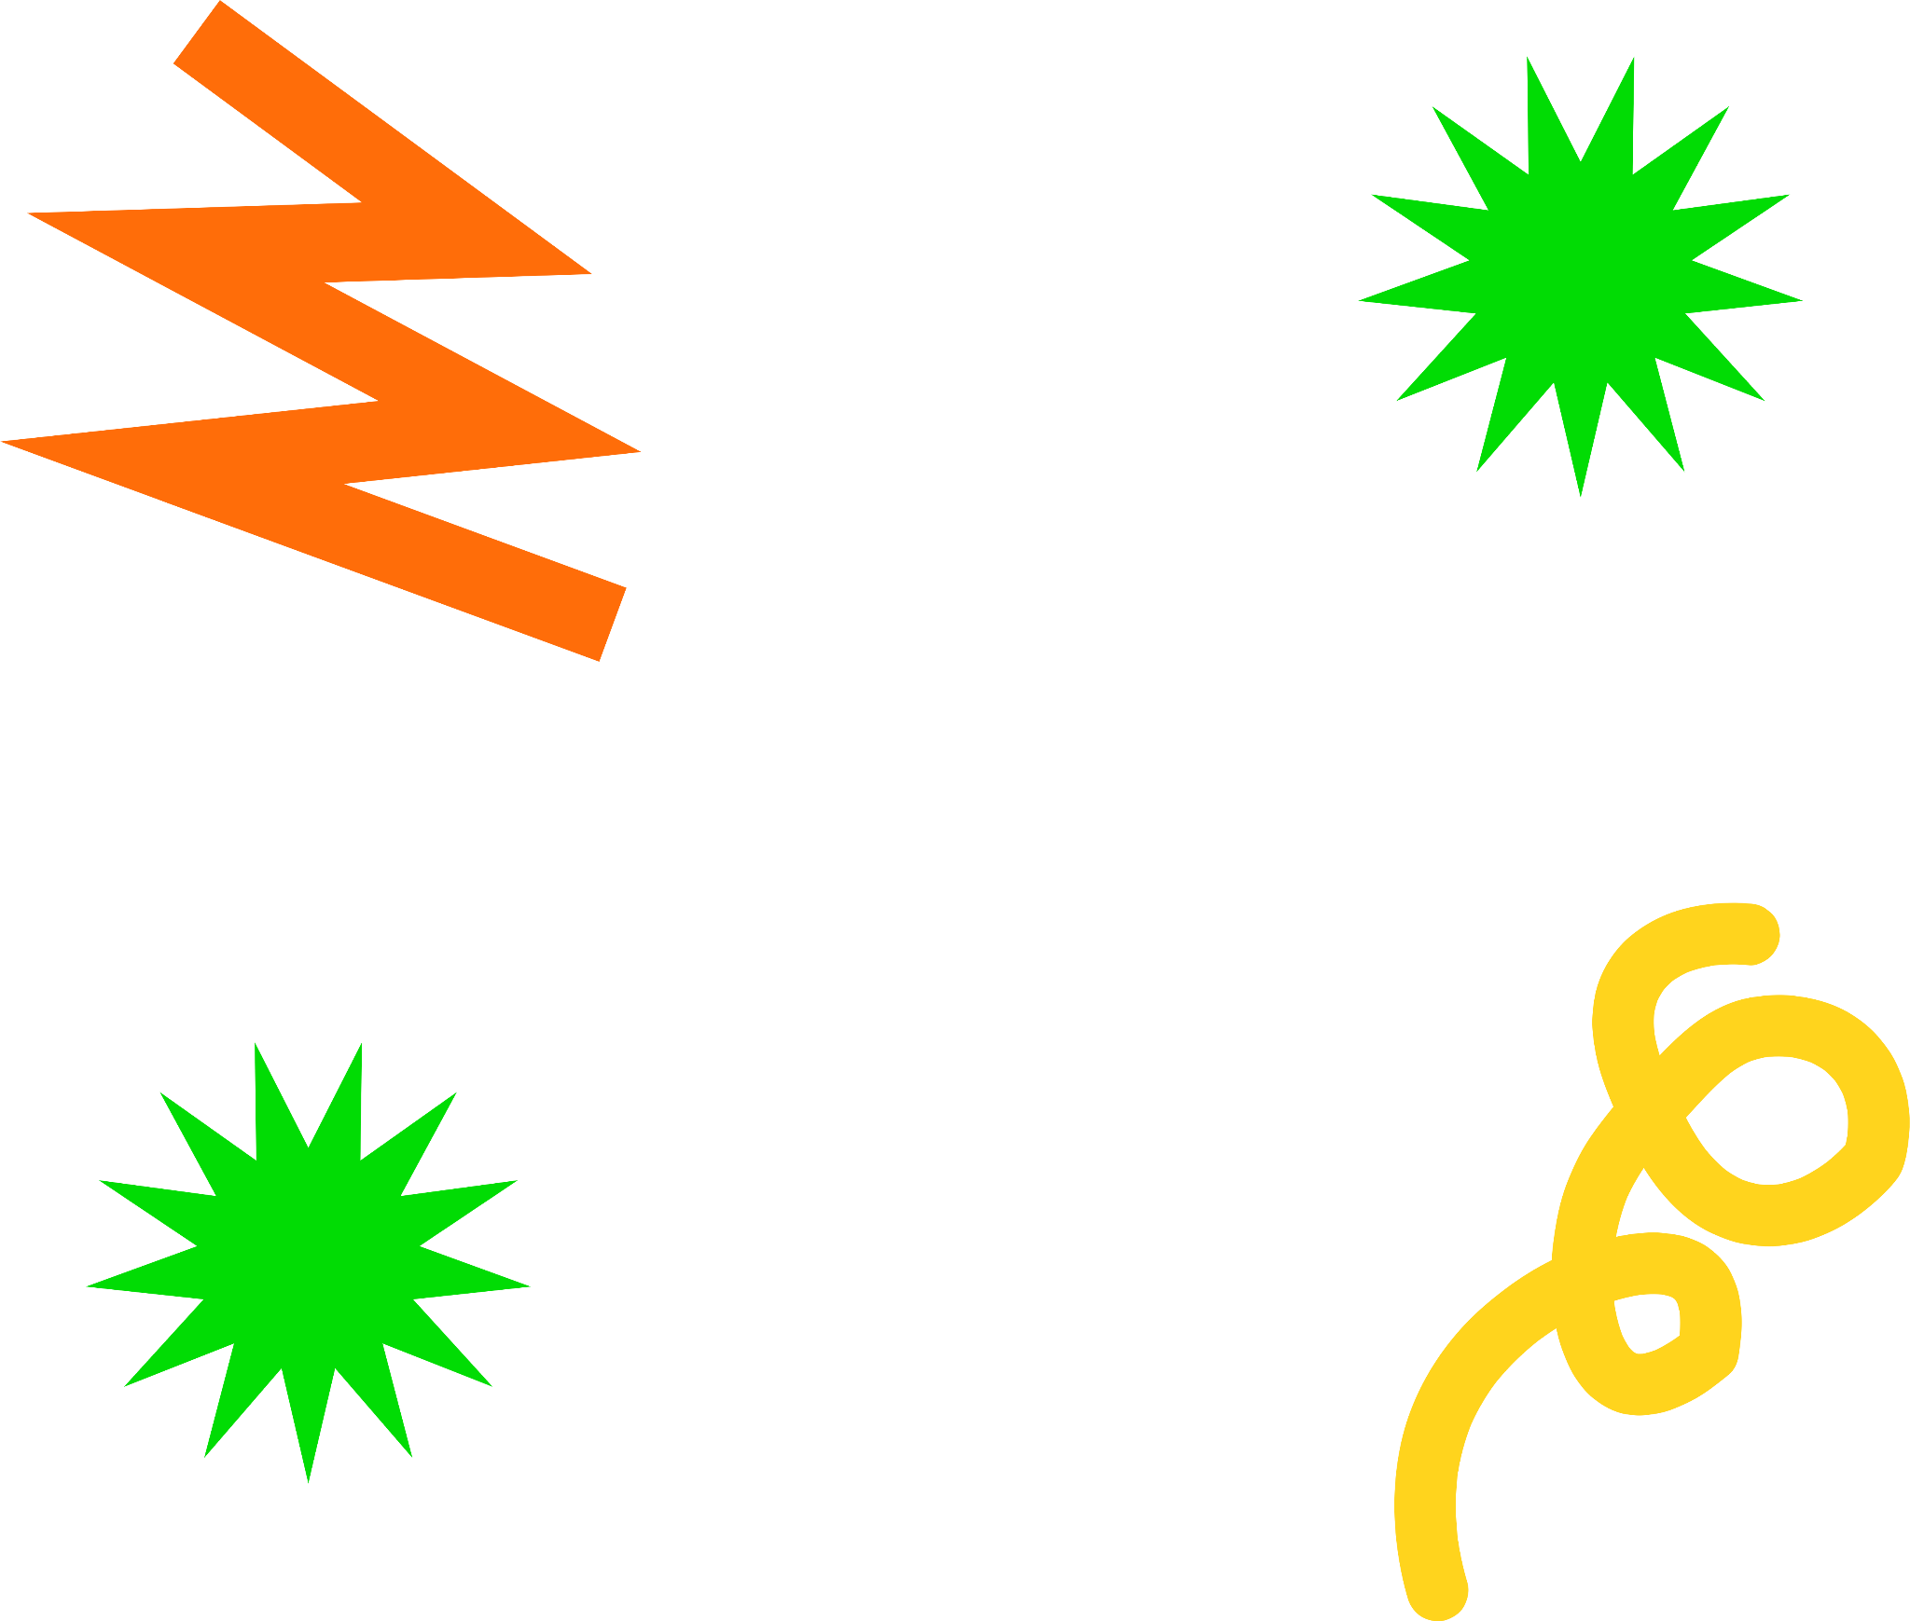
“ALTiO”
NOUN
a combination of alternative and audio that denotes a visual interpretation of audio which can convey a more emotional or descriptive meaning
than captioning

Slide 14
Low-Fi Prototyping

Slide 15
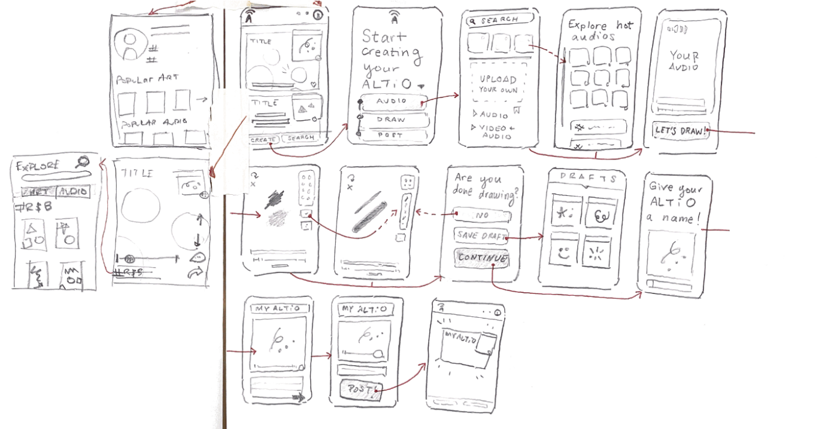
Low-fidelity: Original ALTiO Idea #1
an independent social media platform with drawing interpretations on each post

Slide 16
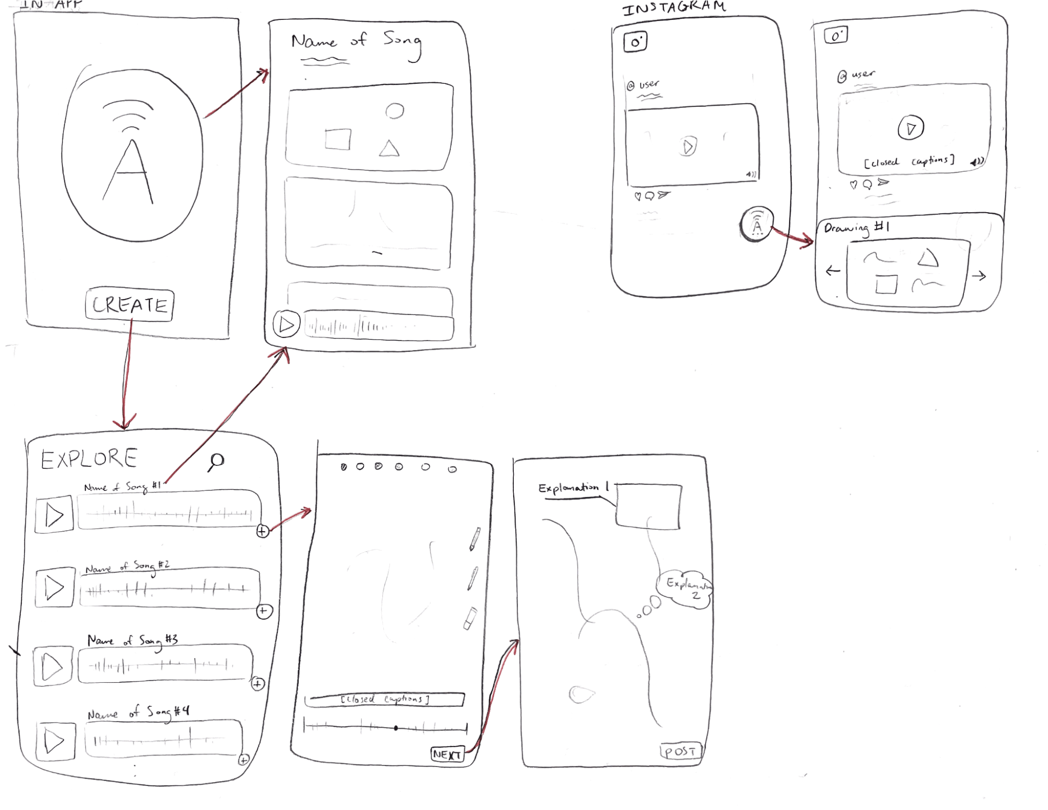
Low-fidelity: Original ALTiO Idea #2
an audio recognition app/plug-in

Slide 17
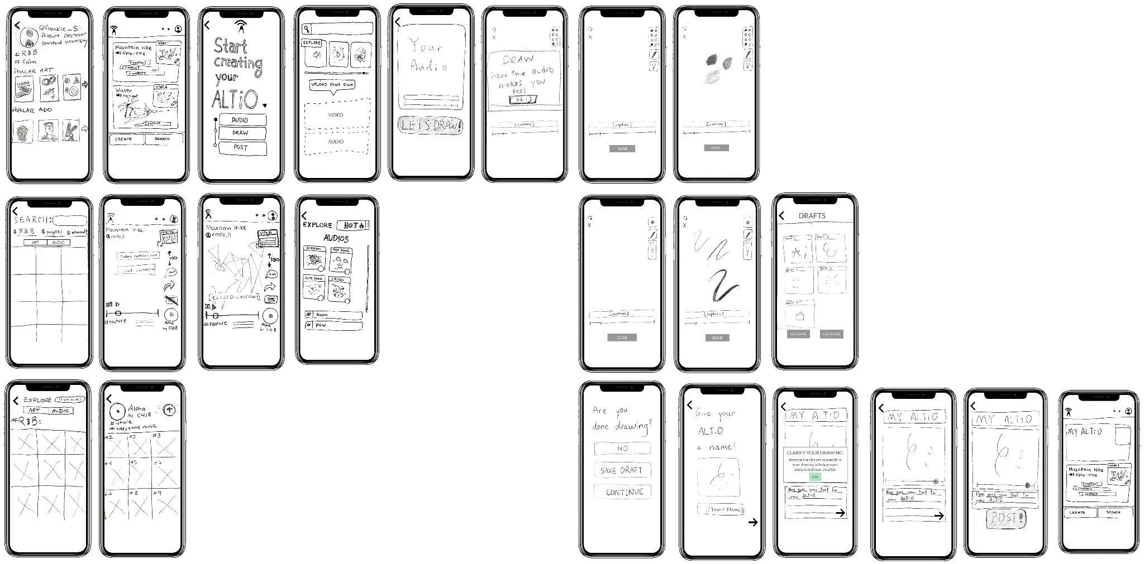
Low-fidelity:
We chose to implement the independent social media platform because it requires every post to have a drawn interpretation

Slide 18
Medium-Fi Prototyping

Slide 19
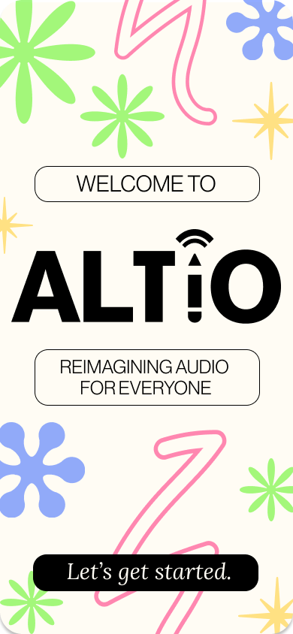
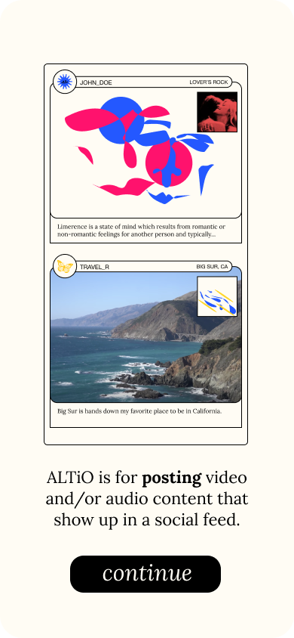
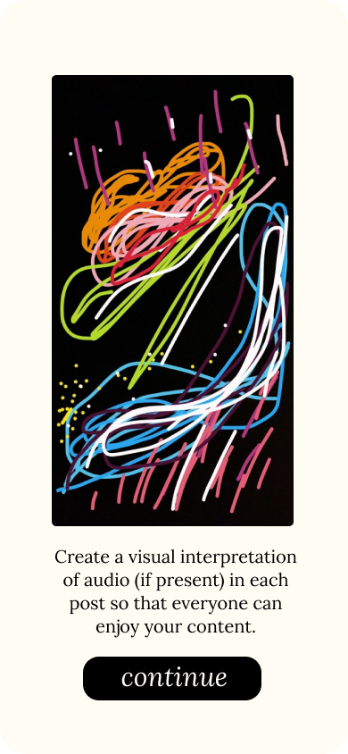
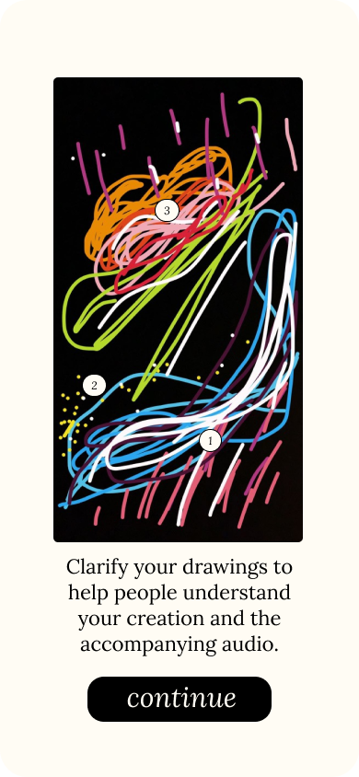
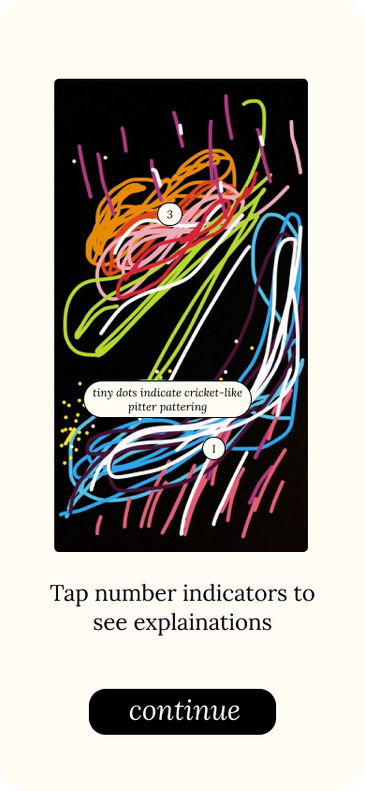
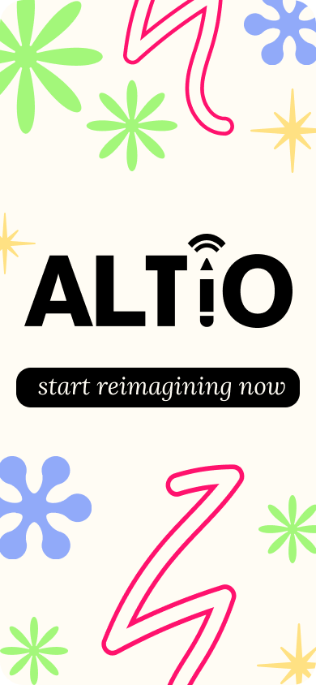
Revised Interface Design
MAJOR DESIGN CHANGE 1 - Onboarding Flow
From low-fidelity prototyping, it took one of our users around 15 minutes to understand the purpose of our app.
med-fi:
low-fi:
[NONEXISTENT]
SOLUTION: Create an onboarding flow to inform users of the purpose and ease user into unique features.
Notes:
No “before,” considering that it was newly added. We needed to add this clarification because many users who had no experience with the app took a long time to figure out what exactly the purpose of the app was.

Slide 20
Revised Interface Design
MAJOR DESIGN CHANGE 1 - Onboarding Flow
Explain the concept of an ALTiO (alternative audio)
Explain ability to click to expand explanations on drawing
Explain the main function of the app (social media)
Show the process of adding clarification for drawings
Notes:
Onboarding screen is colorful and sketch-like to emphasize creativity.

Slide 21
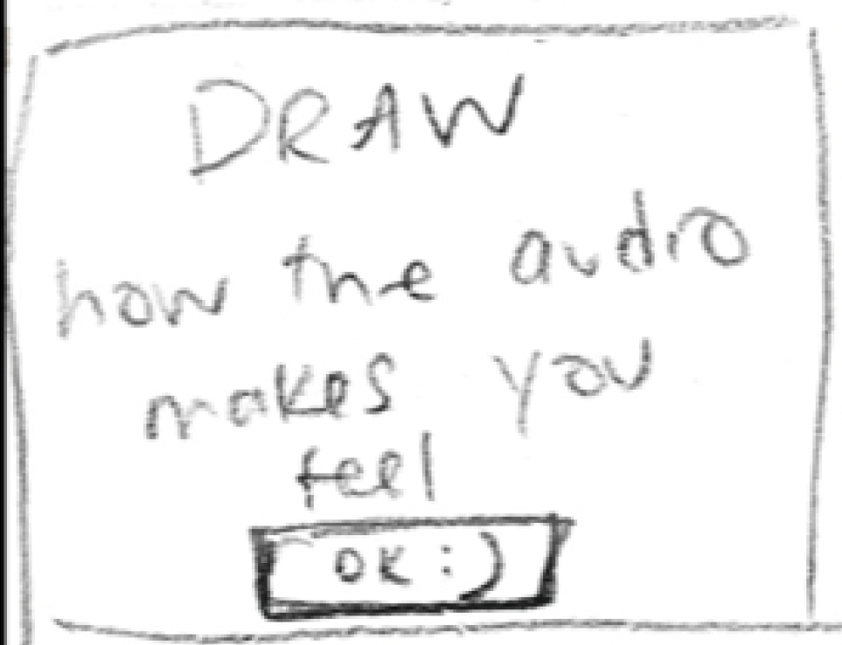
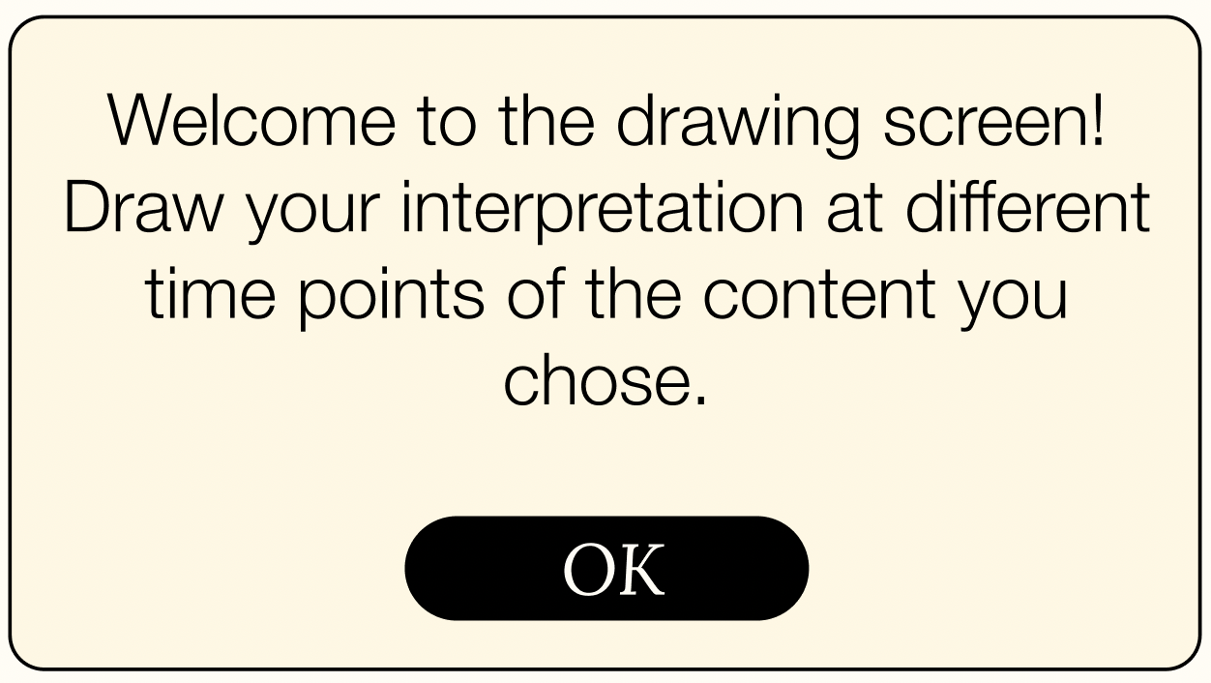
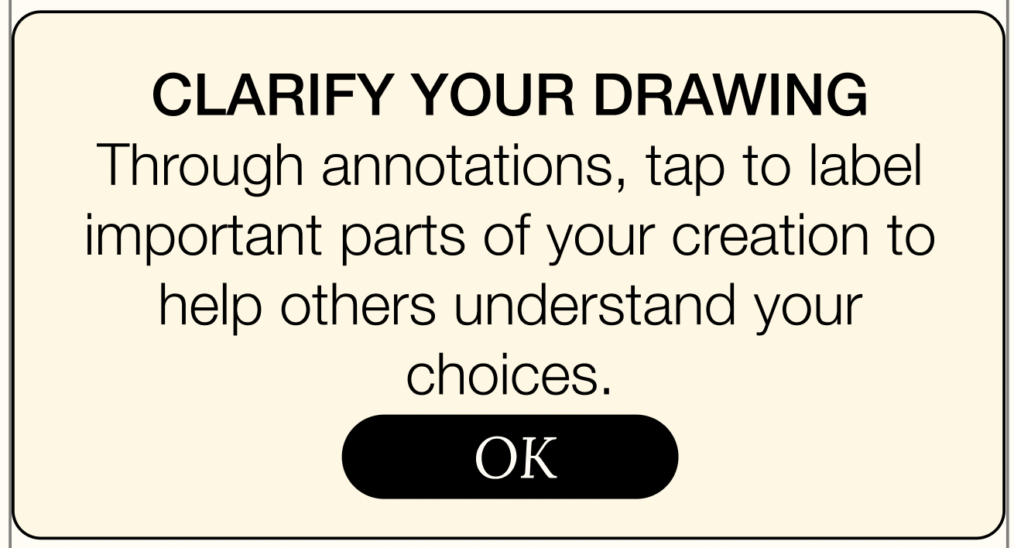
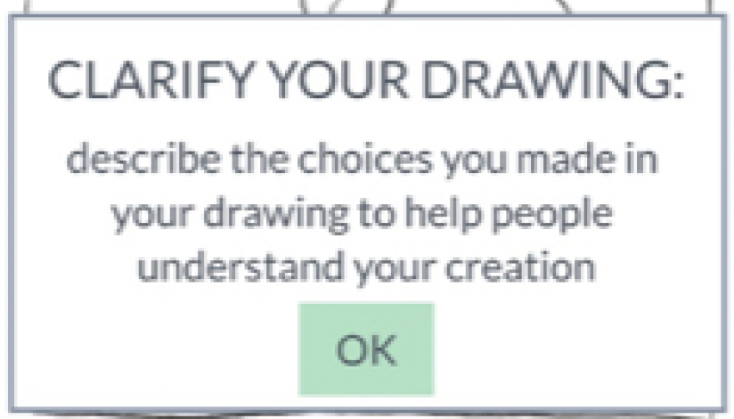
Revised Interface Design
MAJOR DESIGN CHANGE 2 - Revised Clarifications
For some participants, directions were not fully clear around the purpose of the drawings or explanations.
We wanted to emphasize that users can draw interpretations at different time points.
This instruction was vague for many participants - the lack of guidance may make people confused about how to draw their interpretation.
This pop-up failed to explain how users might annotate to clarify their drawings.
This pop-up clarifies how users might label their drawings and what information to include.

Slide 22
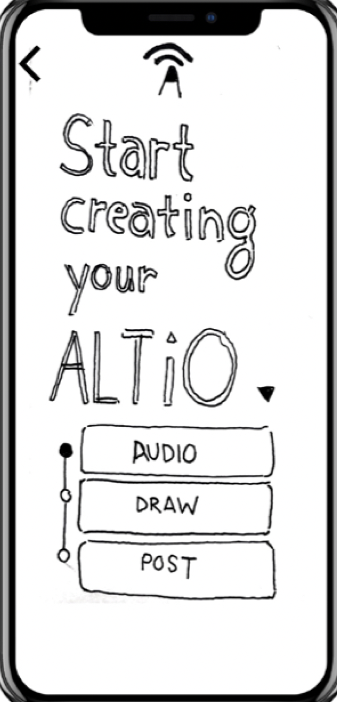
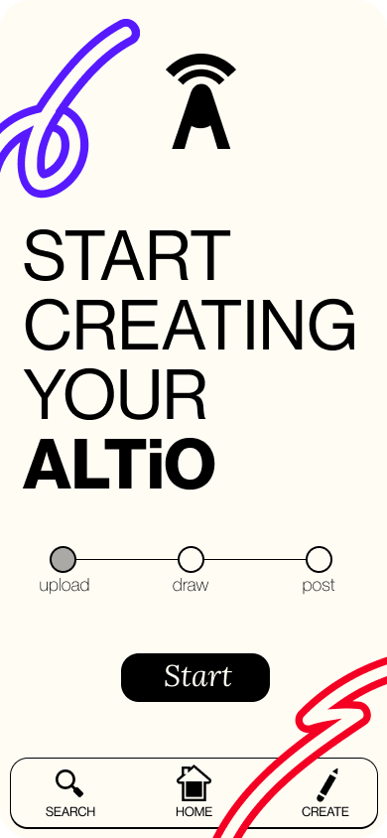
Revised Interface Design
MAJOR DESIGN CHANGE 3 - Starting Creation Screen
For our Deaf participant in particular, in starting the posting process, she was concerned about clicking on the word “audio”. Other users were confused about which buttons were clickable.
We changed the starting screen to look more like a progress bar, which is present on other screens in the posting process
Our Deaf participant was concerned about choosing “audio”.
Participants were frequently confused by the design on this page - “audio” is the starting point, and the only one users can click on, however “draw” and “post” both look like clickable buttons.
“Audio” is replaced with “Upload” so that content is not limited to audio, and for ease of mind for participants.
Notes:
SOLUTION: Change content uploading flow - make the start screen more intuitive by changing buttons, allow for different types of content to be uploaded to allow all to participate.
This progress bar looks like a bar now and not a set of buttons. We changed it to be horizontal to clarify the process of creation, make sure that users were not frustrated with the new type of posting ALTiO offers, and to indicate where exactly in the process they were.

Slide 23
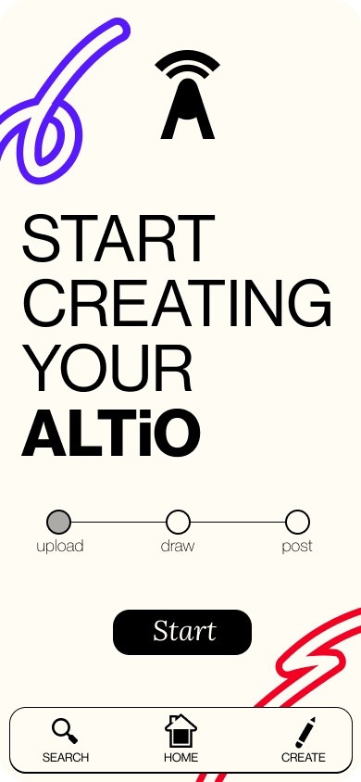
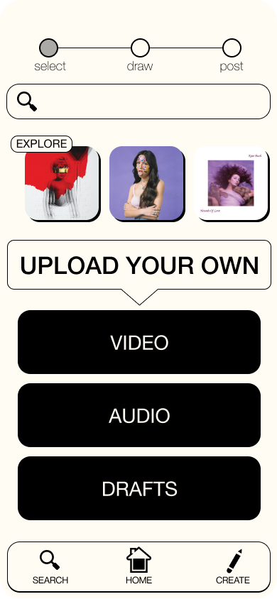
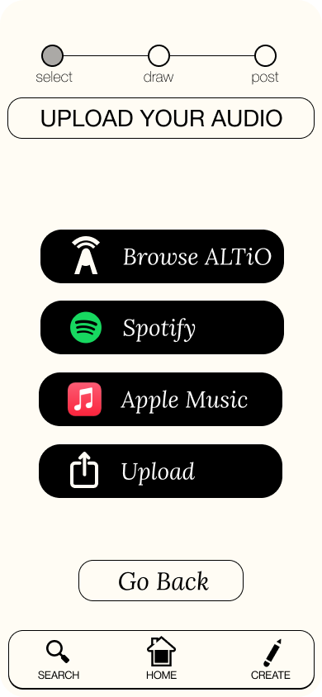
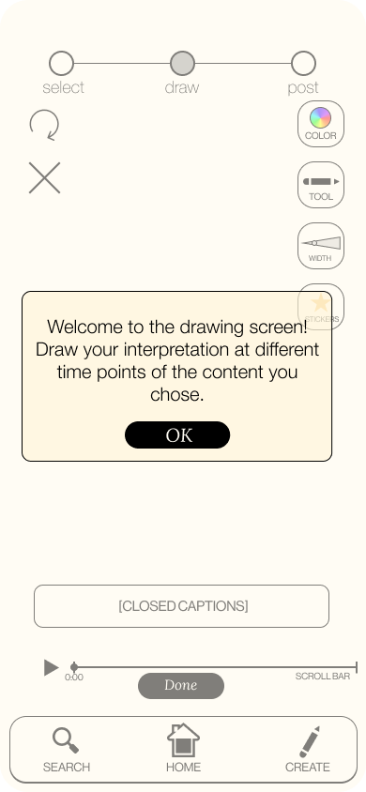
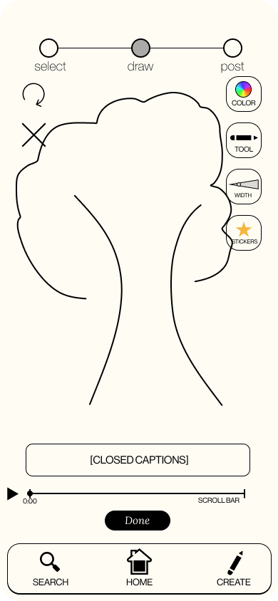
Revised Task Flows
Drawing screen to draw interpretation, different pickers to change color, tool, thickness, or to include stickers.
Audio can be uploaded from different sources, or chosen from the existing audios in ALTiO.
SIMPLE TASK: Interpret audio
Drag scroll-bar to move to different timestamp to create new drawing at different timestamps.
Some screens are missing for space concerns, but this is the overall flow.
Video and or audio can be uploaded, or continue posting from a draft saved.

Slide 24
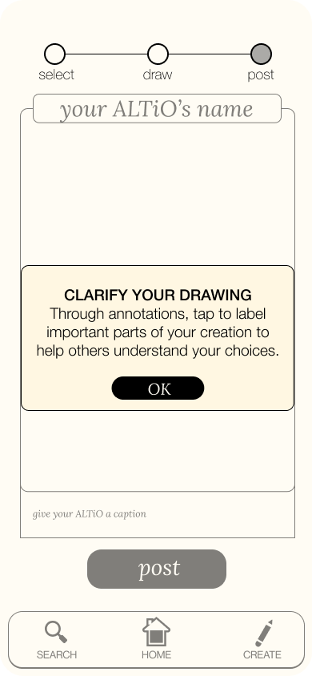
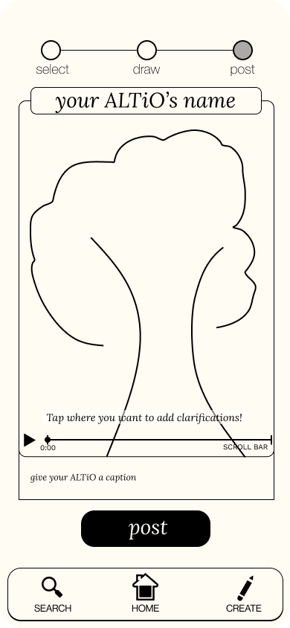
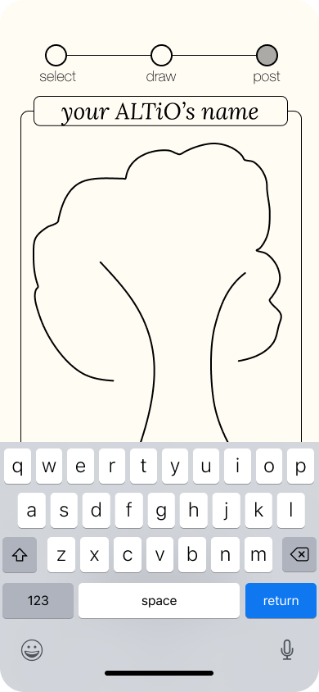
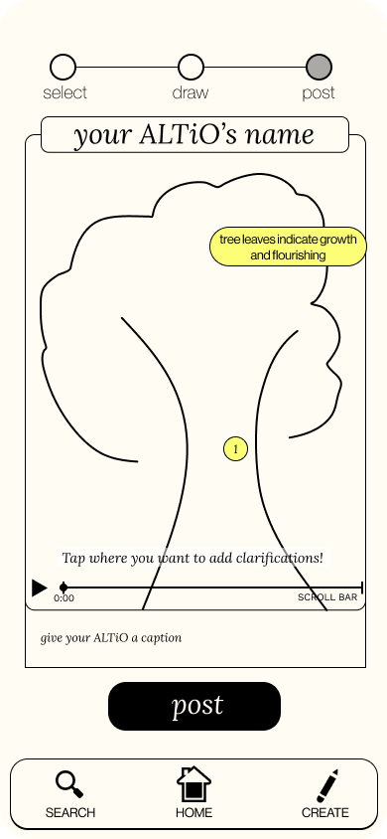
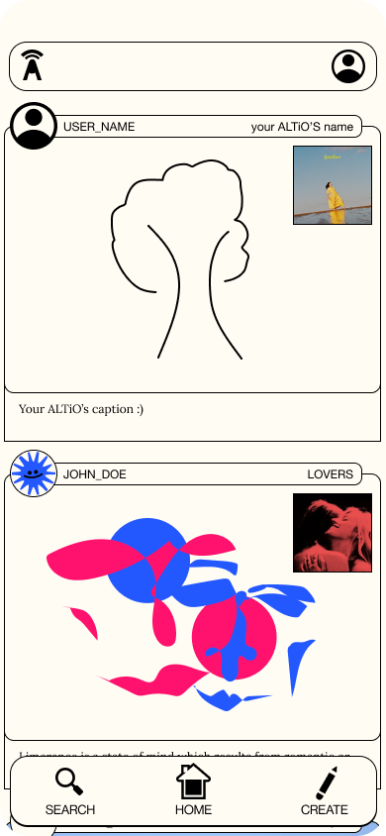
Revised Task Flows
MODERATE TASK: Explain and clarify interpretation
Illustrating the UI of how clarifications showed up was key in this prototype and is important to the clarity and usefulness of the interpretations.
The posted ALTiO is now in the social feed.
Users can add the ALTiO’s name, clarifications, or caption by tapping.
The scroll bar allows for clarifications to be written for different time points.
Clarifications show up after tapping the screen and typing them (click to open and close)

Slide 25
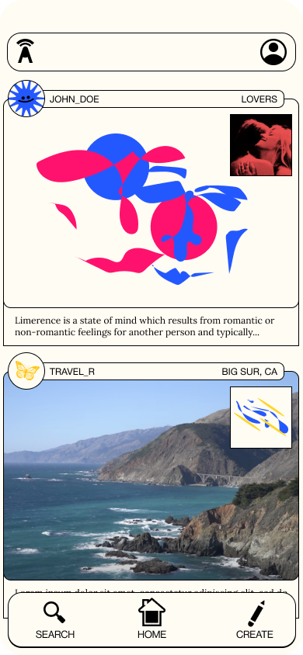
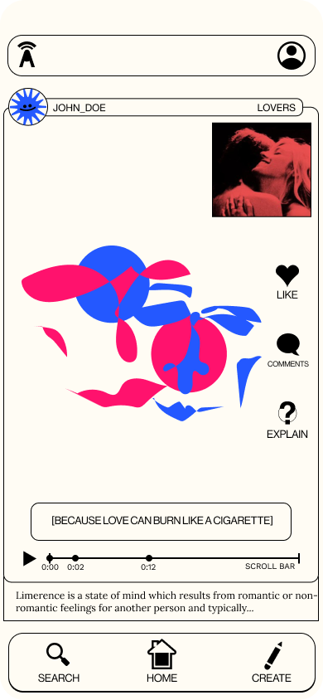
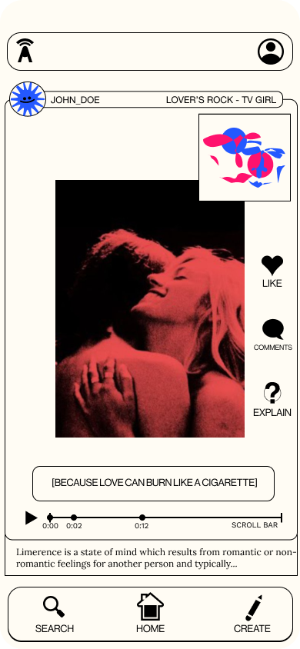
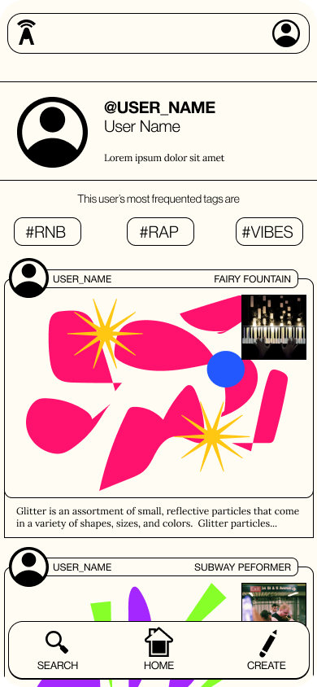
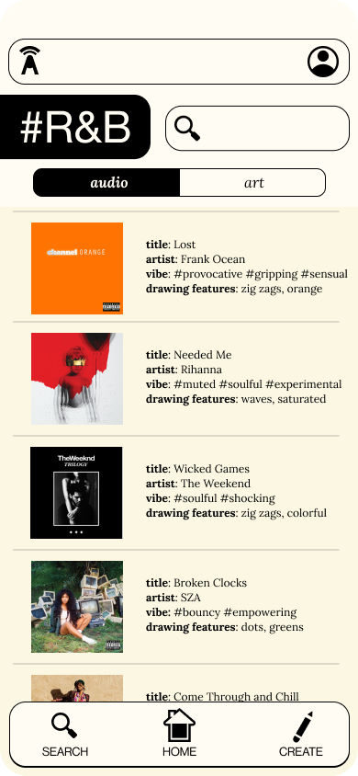
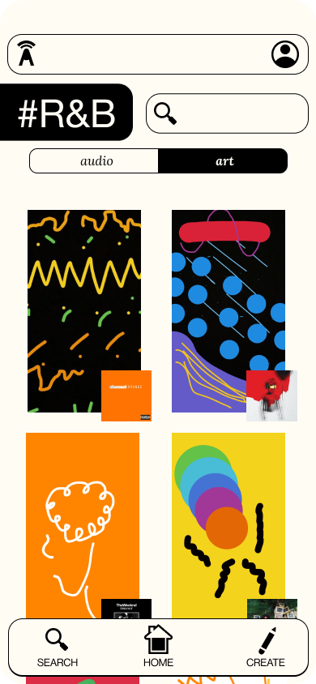
Revised Task Flows
COMPLEX TASK: Interact with various interpretations and artists on the platform
Tap to switch between video and drawing
Switch between audio and art at the explore page
Tap to toggle explanations
Users can navigate to explore pages either by searching or by tapping hashtags.

Slide 26
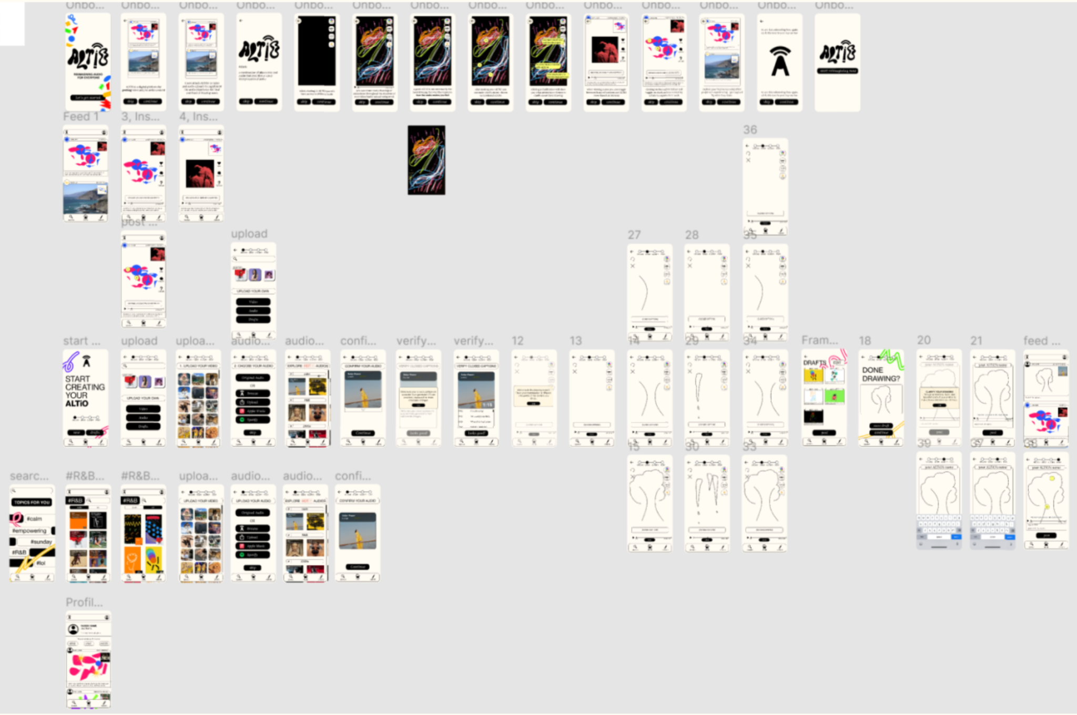
Full Med-Fi Prototype

Slide 27
Current Design & Video Demo

Slide 28
TASK 1: View an altio
TASK 2: Create an altio
TASK 3: Explore app
High-Fi Tasks
Interact with an altio by viewing the art, captioning, and clarifications
core of our app: including Deaf and Hard of Hearing individuals more fully in social media experiences
Choose audio, approve and edit captioning, draw your interpretation, and add annotations to explain your art
translating your auditory experience into a visual one
Users can interact with other profiles and search through tags
building community and awareness through inclusion

Slide 29
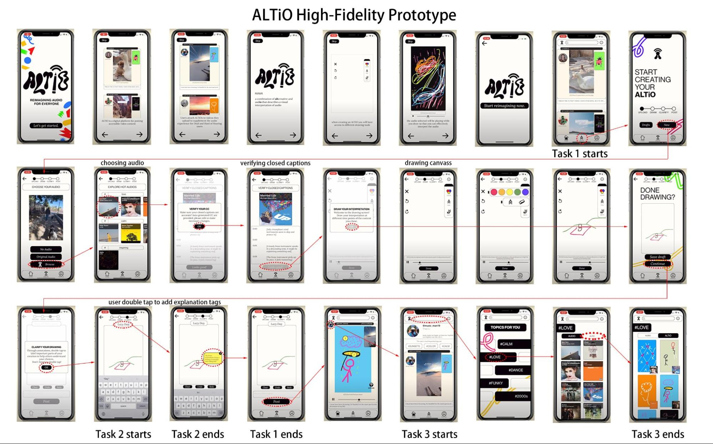
Notes:
Mention was done in react native/expo b/c cs47

Slide 30
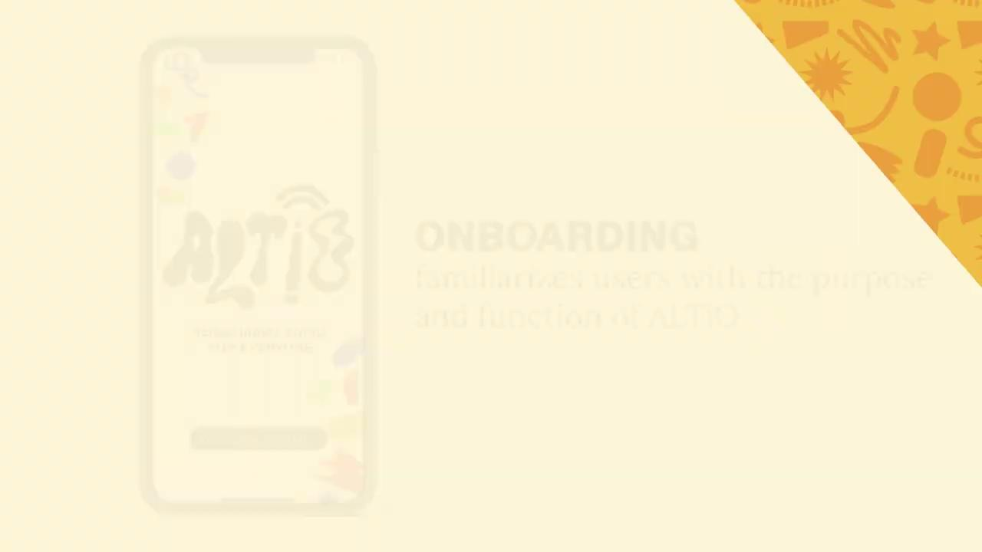

Slide 31
Future Enhancements

Slide 32
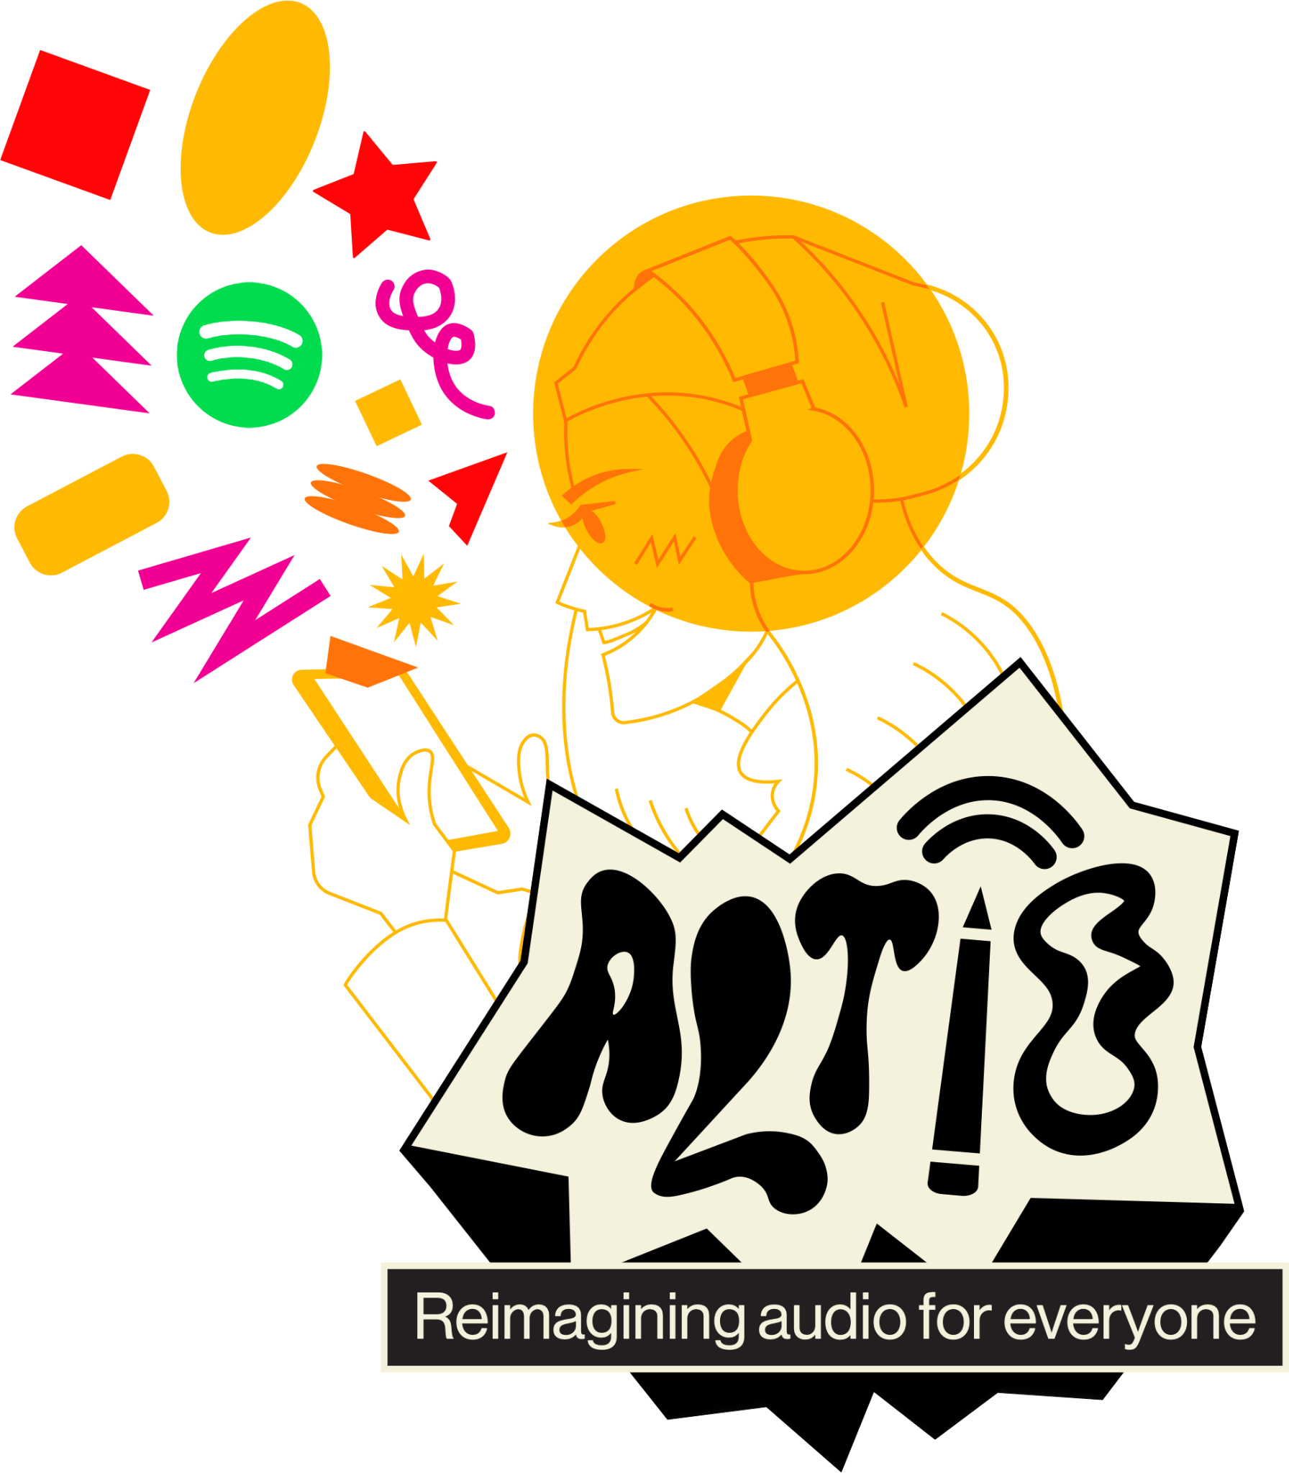
Integrate with Spotify/Musixmatch APIs to get larger audio database and lyrics
Explore written captions as a way for users to interpret audio (especially instrumental audio)
Adjust flows to potentially be less overwhelming
Allow for user authentication, rework content viewing screens
Migrate to pure React Native to allow for more functionality
Test with Deaf/HOH users

