Slide 1
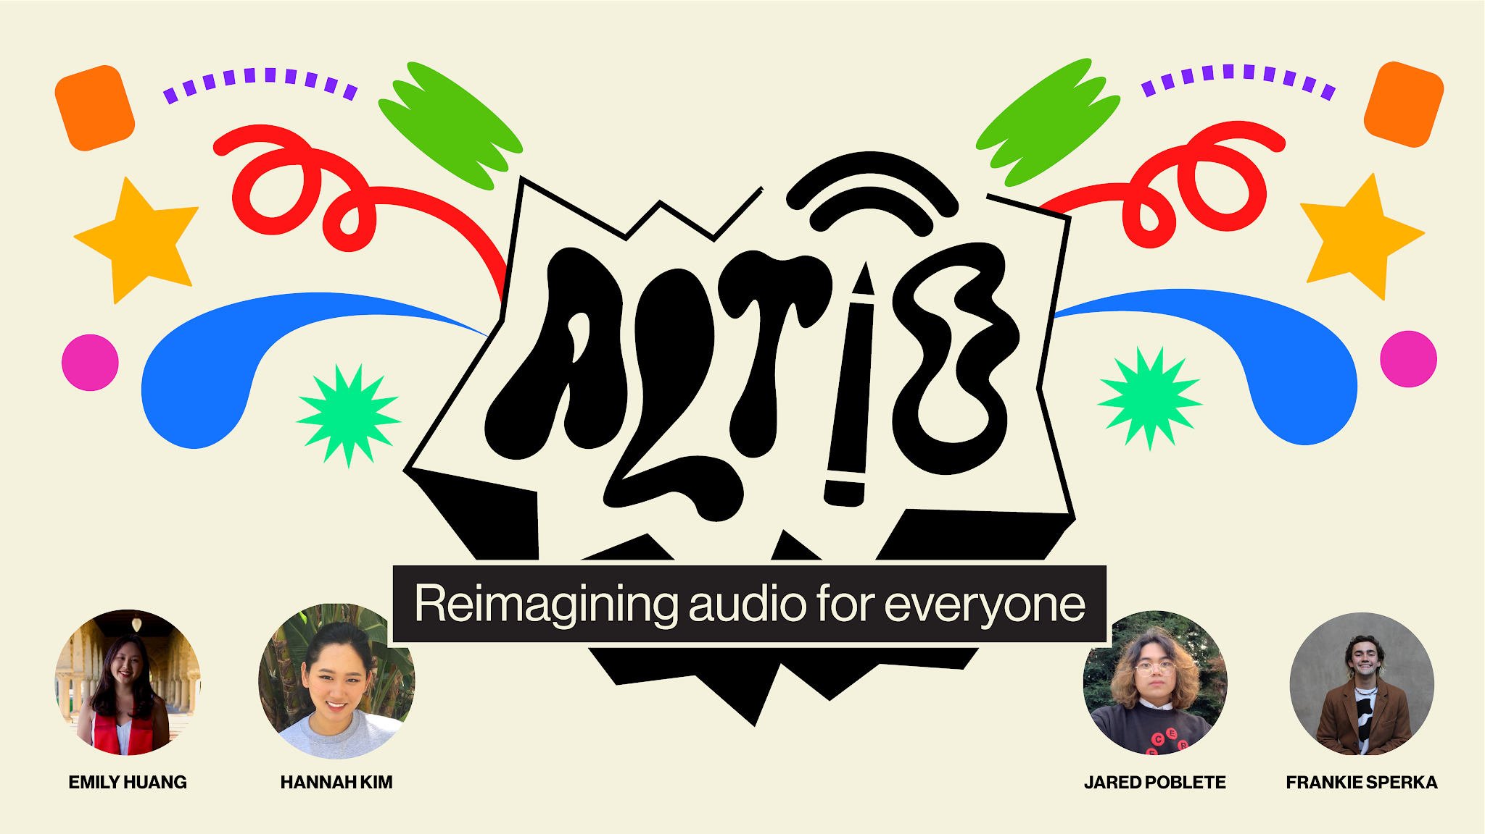

Slide 2

Outline
What We Do
Major Interface Changes
3 Task Flows
Future Work

Slide 3

PROBLEM
Deaf and hard of hearing people are often left out of key nuanced information that is conveyed through audio in digital spaces
SOLUTION
ALTiO is a social media platform that encourages and provides visual interpretations of audio–providing alternative options for everyone to experience content
ALTiO is a social media platform that encourages and provides drawings as visual supplements for interpreting audio–providing alternative options for everyone to experience content

Slide 4
Interface Changes

Slide 5
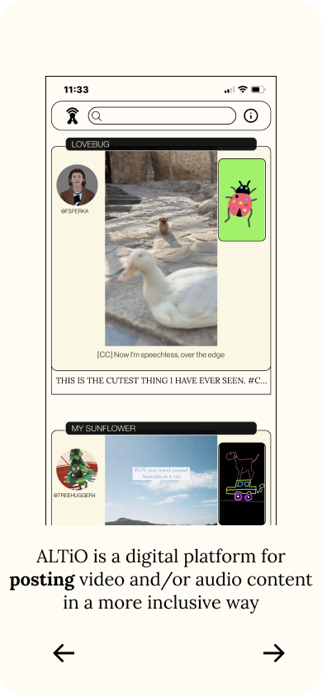
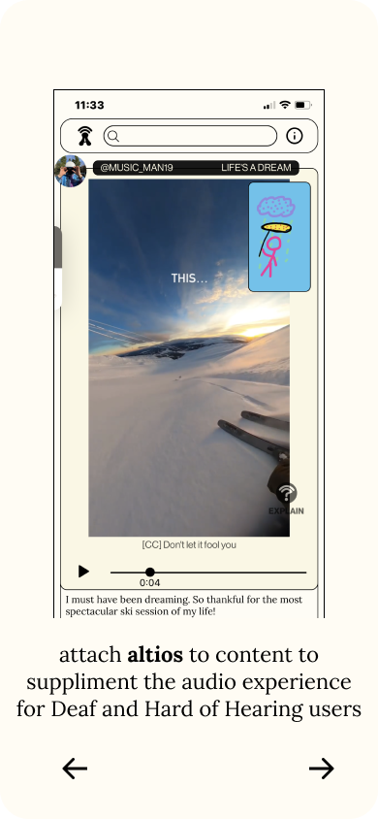
Interface Changes
MAJOR CHANGE 1 -
Onboarding
Old design:
PROBLEM: Through testing we found that information in the onboarding was not introduced intuitively. Users were often confused and had to scroll back and forth.
Notes:
First major change: inherent structure of interpretations of audio
Previously: linear process to create altio
Drawing is main interpretation to toggle between

Slide 6
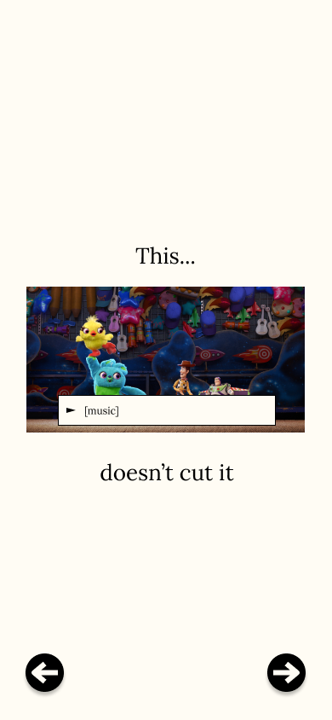
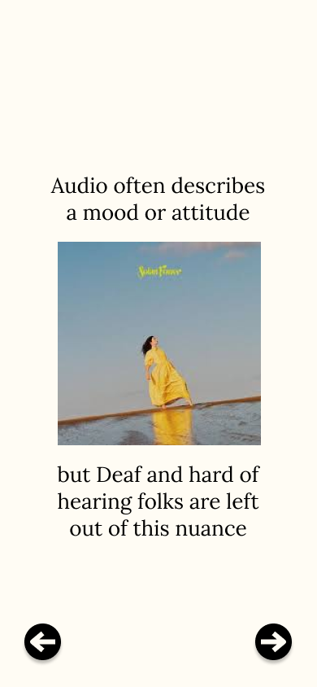
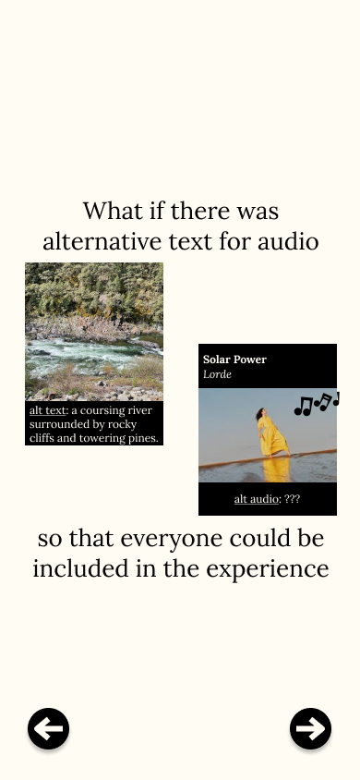
Interface Changes
MAJOR CHANGE 1 -
Onboarding
New design:
SOLUTION: Our new onboarding flow introduces the problem we are aiming to solve and uses more fun and friendly language–with lots of pictures along the way. This hopefully captures a more engaging narrative for users to follow while learning about altio.
Notes:
First major change: inherent structure of interpretations of audio
Previously: linear process to create altio
Drawing is main interpretation to toggle between

Slide 7
Interface Changes
MAJOR CHANGE 2 -
Account Creation
Old design:
non-existent
PROBLEM: Our app originally had no way of creating an account to begin engaging with content.
Notes:
First major change: inherent structure of interpretations of audio
Previously: linear process to create altio
Drawing is main interpretation to toggle between

Slide 8
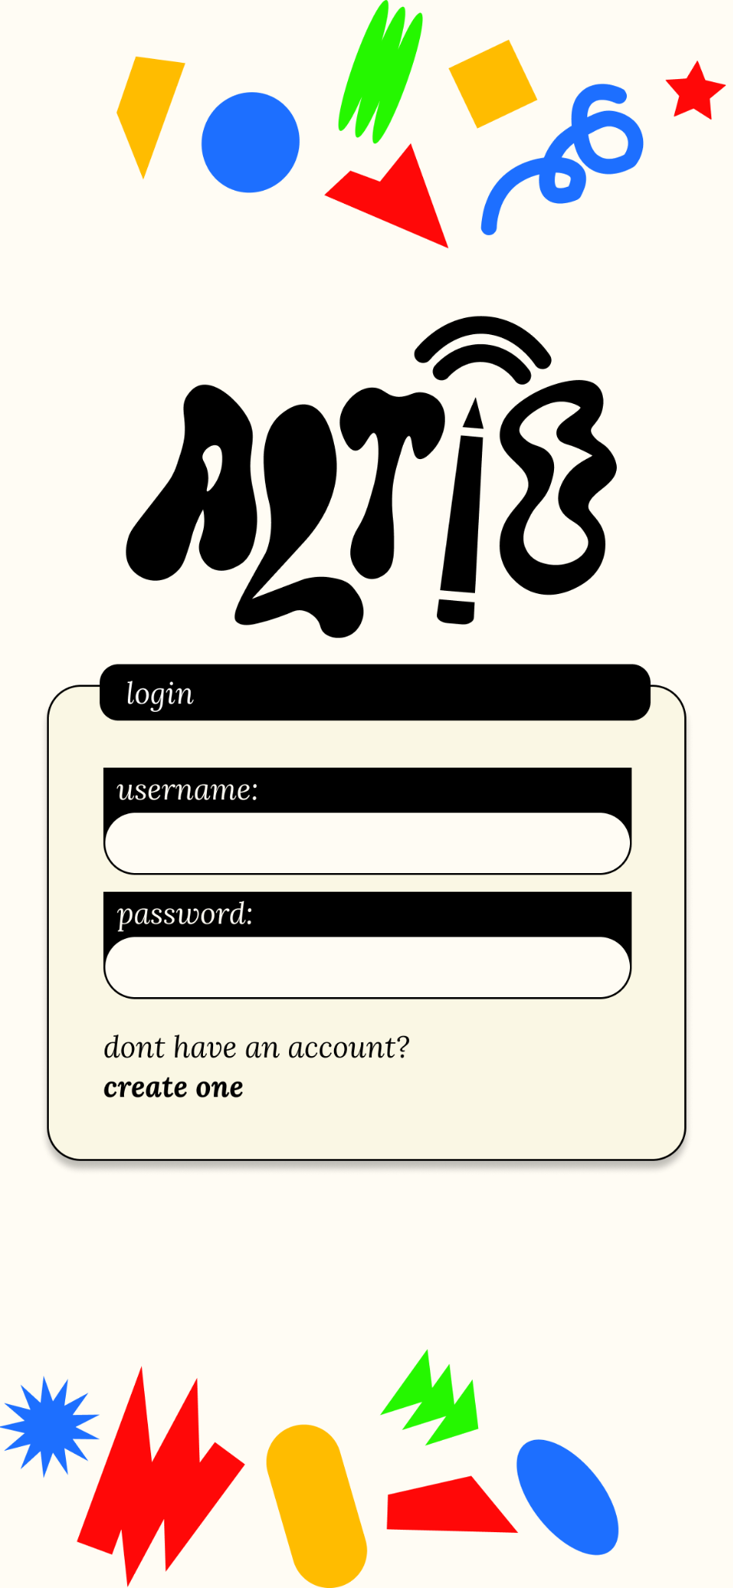
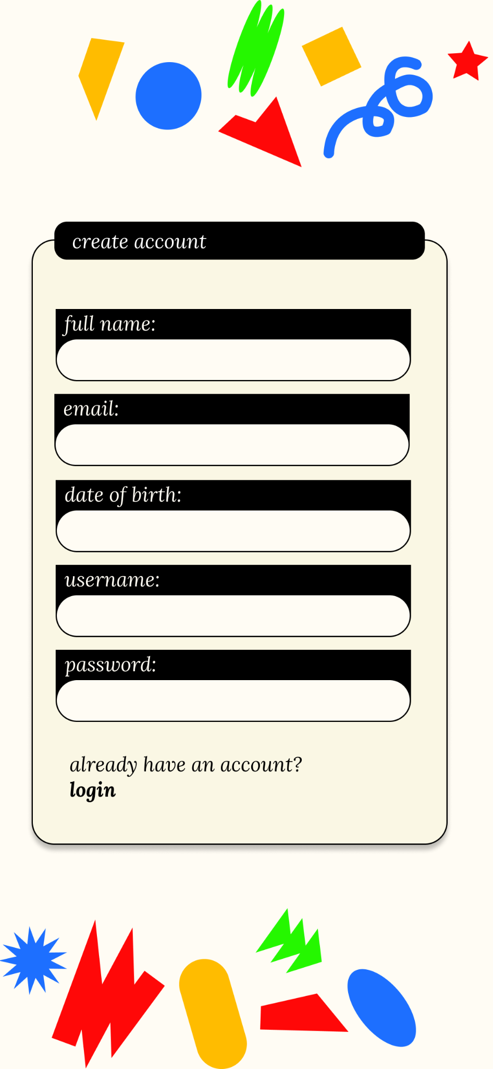
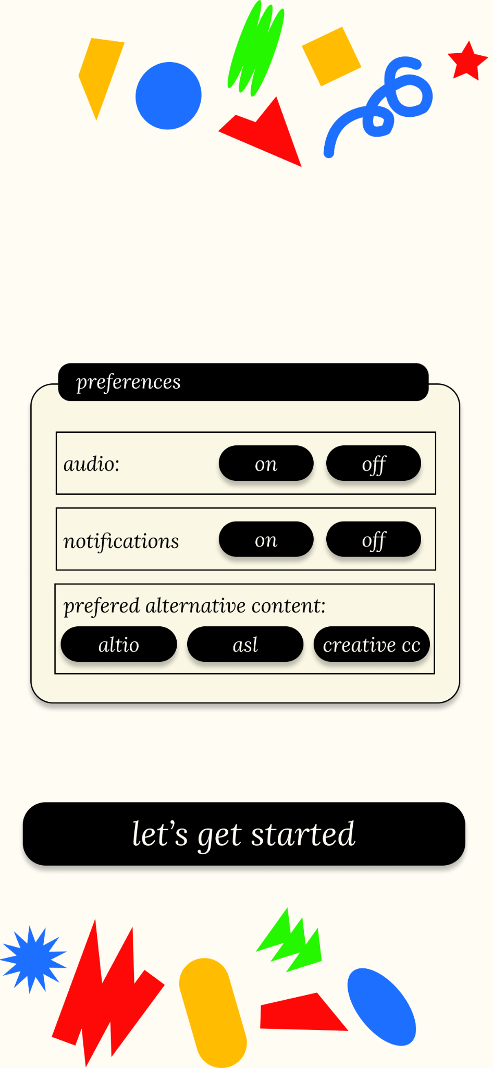
Interface Changes
MAJOR CHANGE 2 -
Account Creation
New design:
SOLUTION: Introduce an account creation / login page, as well as a preferences section where users can choose their preferred audio and interpretation preferences. This was done to allow users to actually engage with content.
Notes:
First major change: inherent structure of interpretations of audio
Previously: linear process to create altio
Drawing is main interpretation to toggle between

Slide 9
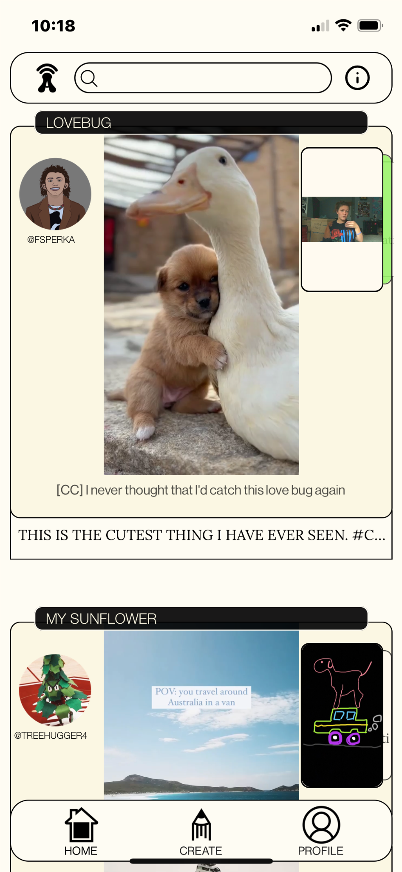
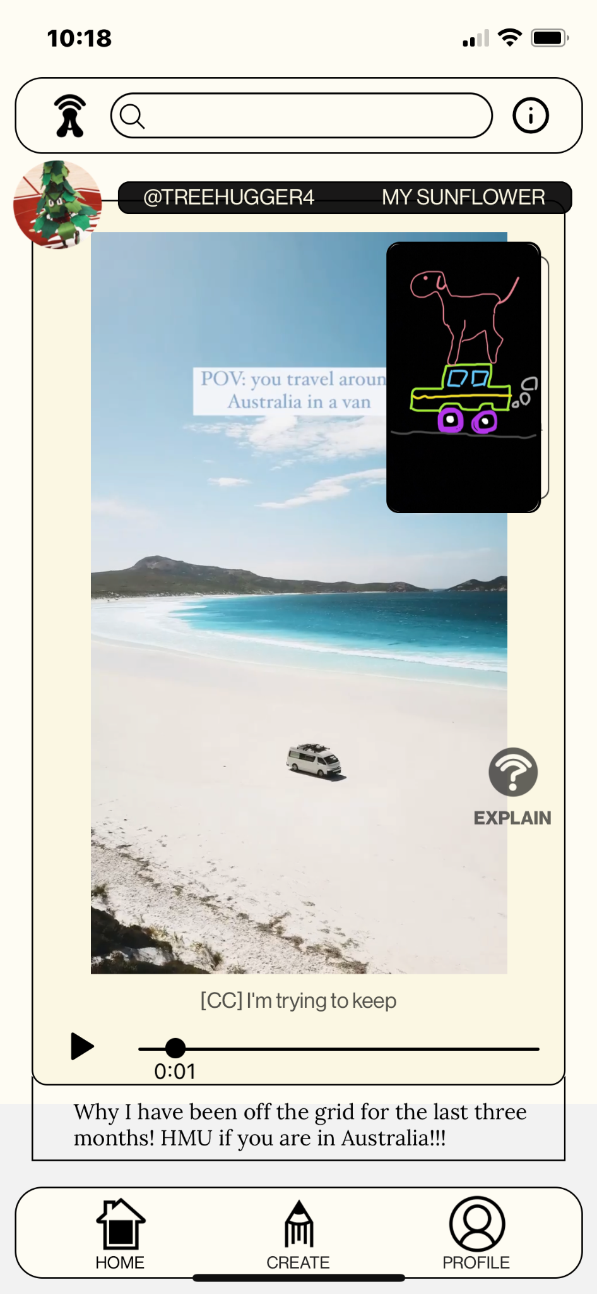
Interface Changes
MAJOR CHANGE 3 -
Home Screen
Old design:
PROBLEM: Toggling between altio and content requires users to sacrifice the experience of viewing one piece of content for another. It is also unintuitive to switch back to the smaller post view for scrolling
Notes:
First major change: inherent structure of interpretations of audio
Previously: linear process to create altio
Drawing is main interpretation to toggle between

Slide 10
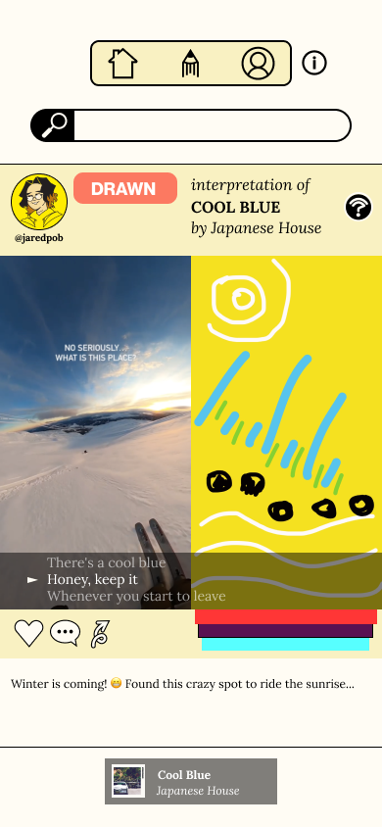
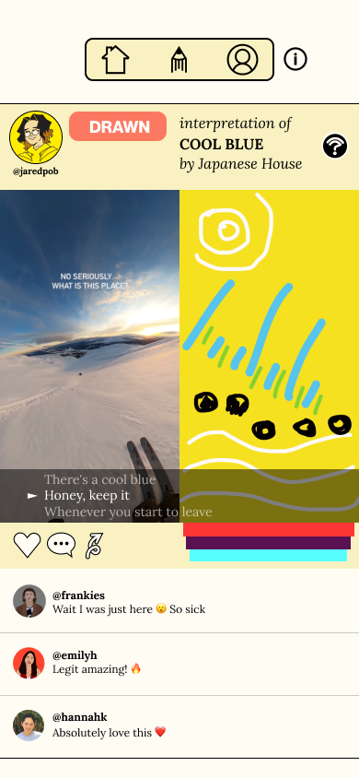
Interface Changes
MAJOR CHANGE 3 -
Home Screen
New design:
SOLUTION: Removing the “switch” feature between altio and standardizing the post to just the expanded view to allow both to be seen simultaneously with a larger view.
Notes:
First major change: inherent structure of interpretations of audio
Previously: linear process to create altio
Drawing is main interpretation to toggle between

Slide 11
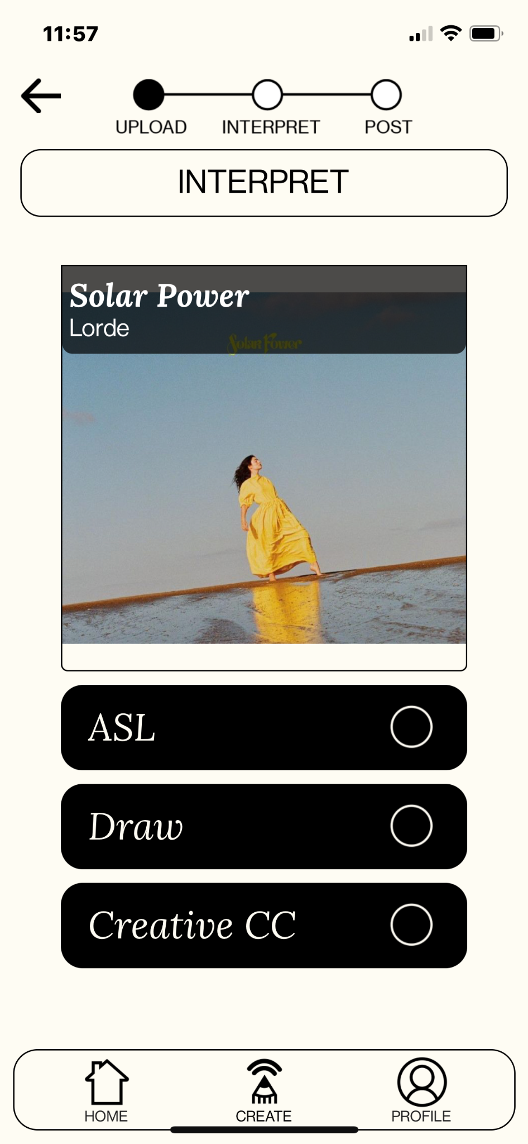
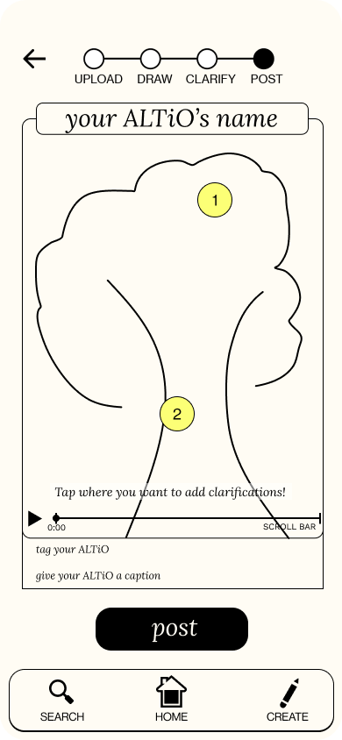
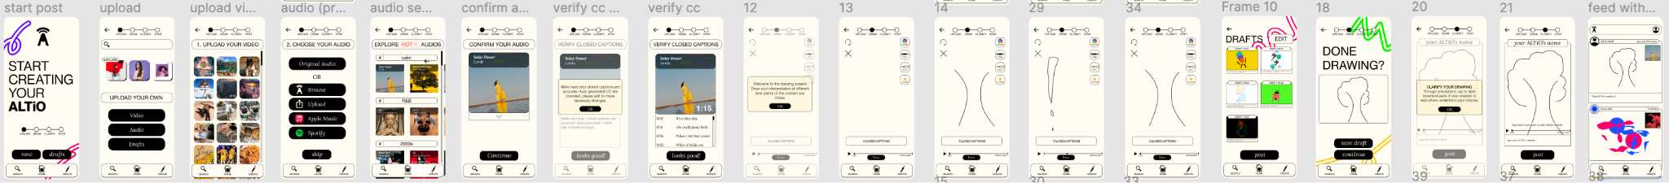
Interface Changes
MAJOR CHANGE 4 -
“Create” Flow
Old design:
PROBLEM: Creation process was lengthy and linear, featuring screens that weren’t always necessary to users

Slide 12
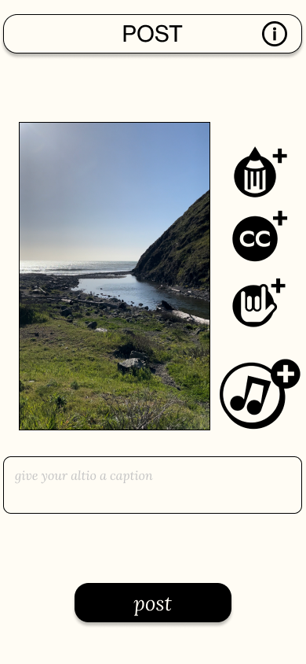
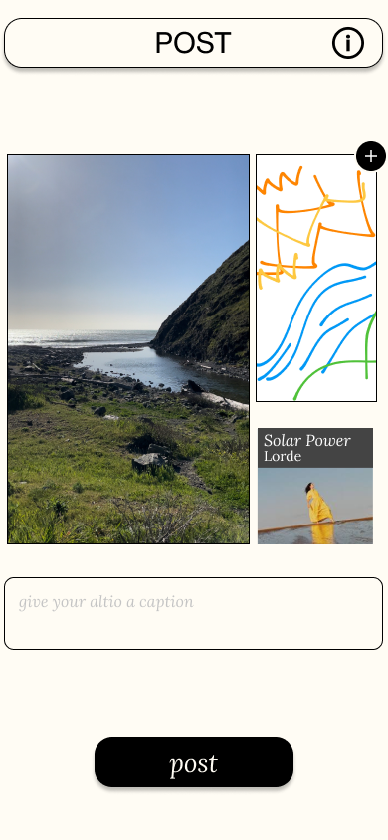
Interface Changes
MAJOR CHANGE 4 -
“Create” Flow
New design:
SOLUTION: Adding new options for other alternative interpretations in a way that is less linear with more options. This helps users have more freedom with their interpretations and makes the flow seem less time intensive, as users have options along the way.

Slide 13
Task Flows

Slide 14
Task 1
Getting Situated

Slide 15
Task 2
Viewing Content

Slide 16
Task 3
Creating Content

Slide 17
Task 4
Community Engagement

Slide 18
Wizard of Oz

Slide 19
Hard Coded
STOCK ALTIOS-
We still need to include some content to populate the app when users first start using our app – until we have a strong user base, we plan to keep these in the app.
MUSIC OPTIONS-
Due to some significant UI changes in the last round of prototyping, we were unable to integrate Spotify and Apple Music compatibility. This will be done soon.
RECOMMENDATIONS-
Content that is recommended to users is currently hard-coded as we are focussed on improving other more pressing issues of the app.
LIKES, COMMENT, SHARE-
Interacting with posts is not reliant on any backend code.

Slide 20
Future Works

Slide 21
Frontend
SEARCH -
We may need to flesh out our beautiful - yet technically challenging - search screen to allow for more backend functionality before we test with users.
SPOTIFY / APPLE MUSIC INTEGRATION -
Adding music application functionality using APIs will require a new UI for users to interact with stock playlists as well as their own music.
CREATIVE CC -
Making a clean and user friendly UI for creating your own captions has proven to be challenging, working with backend in mind, we may need to change this going forward.
DEBUGGING -
Making sure that our information icons, pop-ups, and app is working as intended.

Slide 22
Backend
FIREBASE x POSTS -
Before testing, we will integrate firebase with our post storing process to allow posts to be seen and shared across users.
CLICKSTREAM LOGGING -
Before testing, we will also need to include clickstream logging to allow for more accurate and useful user data when testing.
DEBUGGING -
Working with our content player, etc.

Slide 23
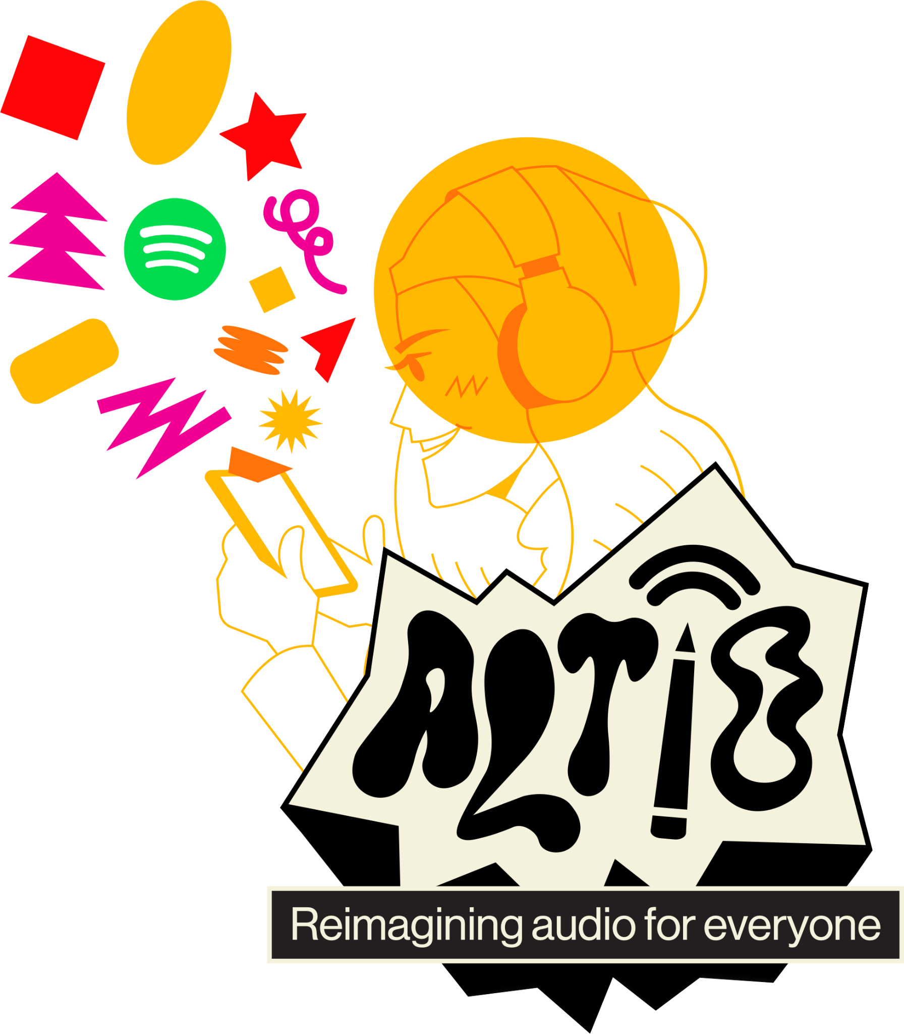
thanks :)

