Slide 1
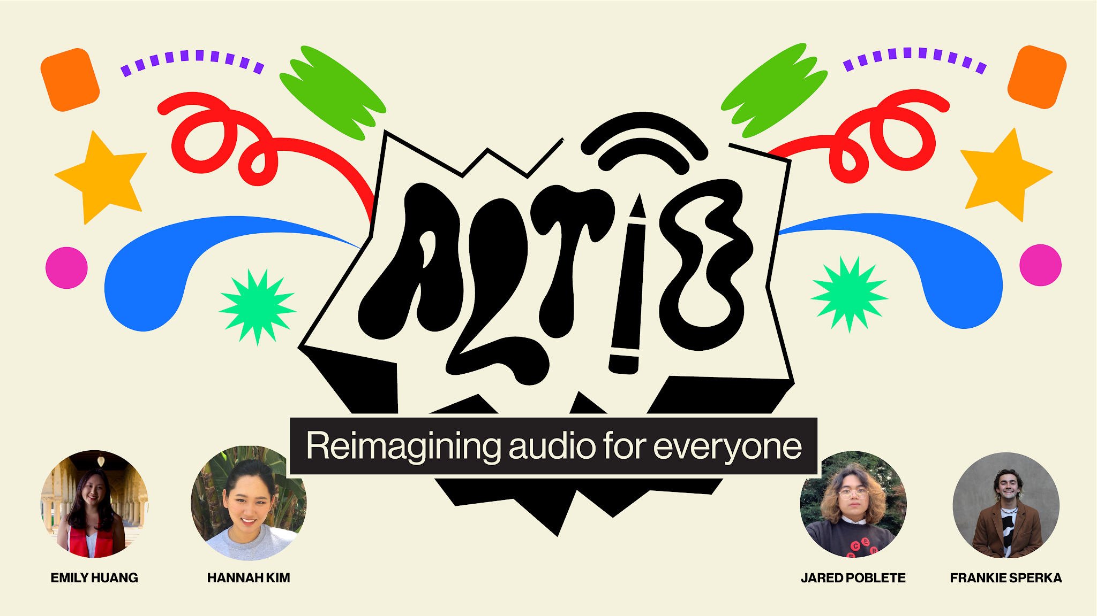

Slide 2

PROBLEM
Deaf and hard of hearing people are often left out of key nuanced information that is conveyed through audio in digital spaces
SOLUTION
ALTiO is a social media platform that encourages and provides visual interpretations of audio–providing alternative options for everyone to experience content
ALTiO is a social media platform that encourages and provides drawings as visual supplements for interpreting audio–providing alternative options for everyone to experience content

Slide 3

Outline
Interface Changes
Testing Methodology
Results
Discussion

Slide 4
Prototype Changes

Slide 5
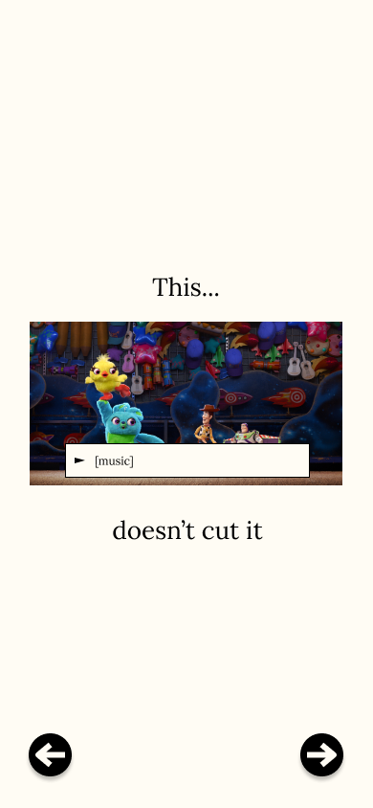
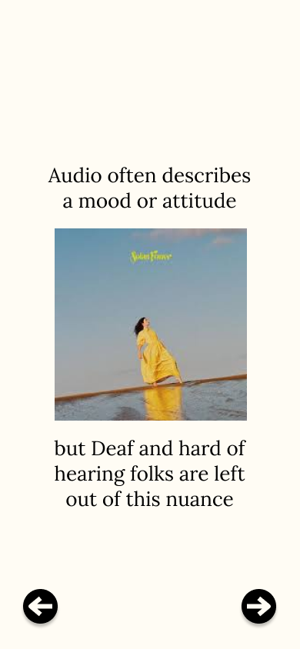
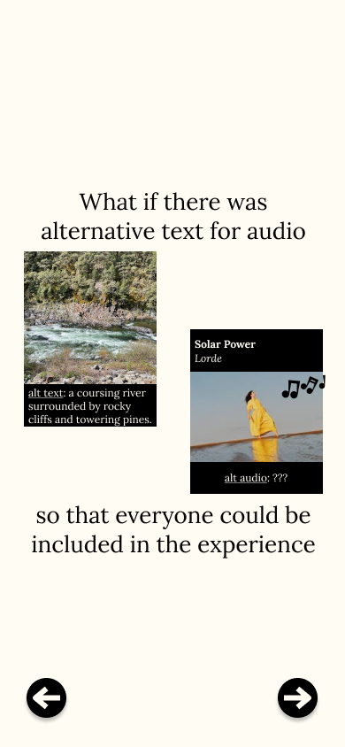
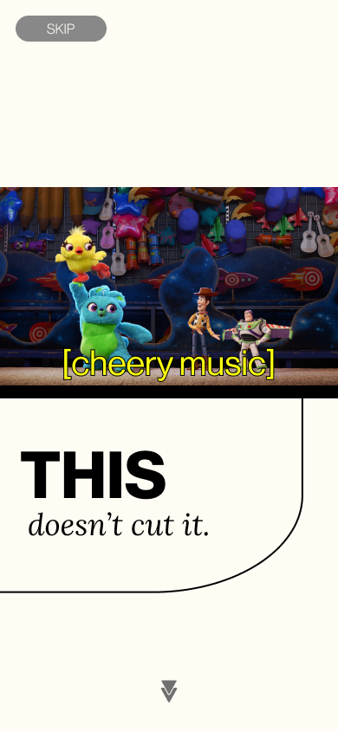
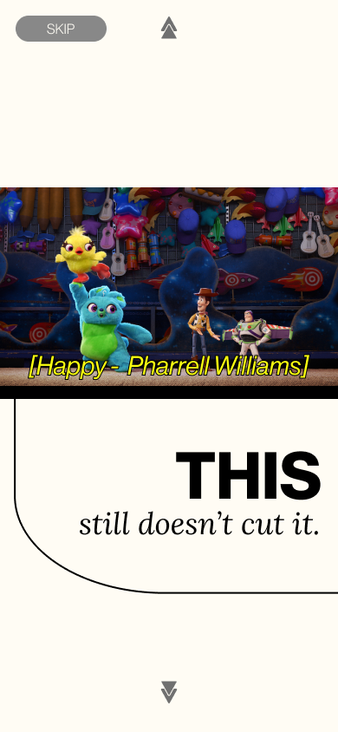
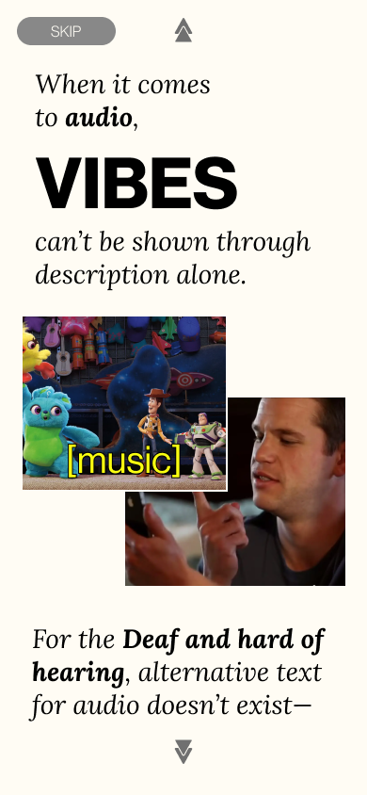
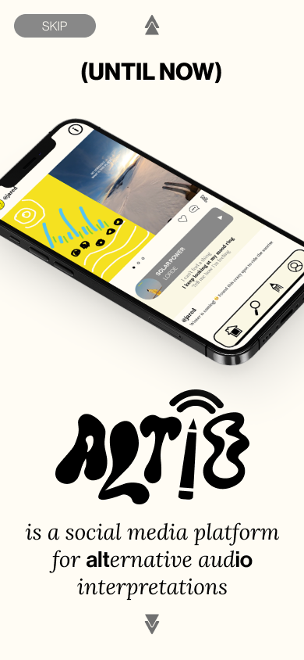
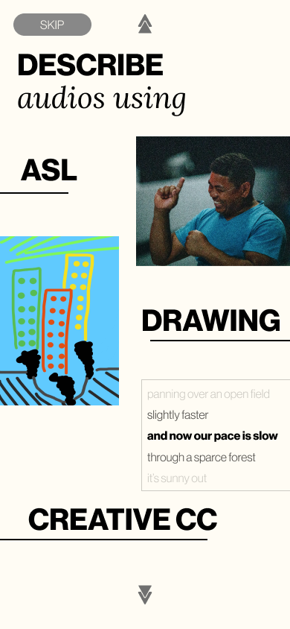

Interface Changes
MAJOR CHANGE 1 -
Onboarding
Old design:
New design:
Notes:
First major change: inherent structure of interpretations of audio
Previously: linear process to create altio
Drawing is main interpretation to toggle between

Slide 6
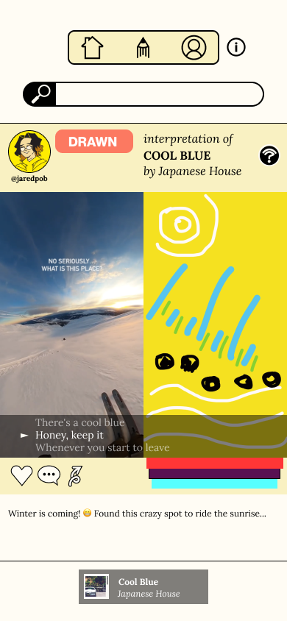
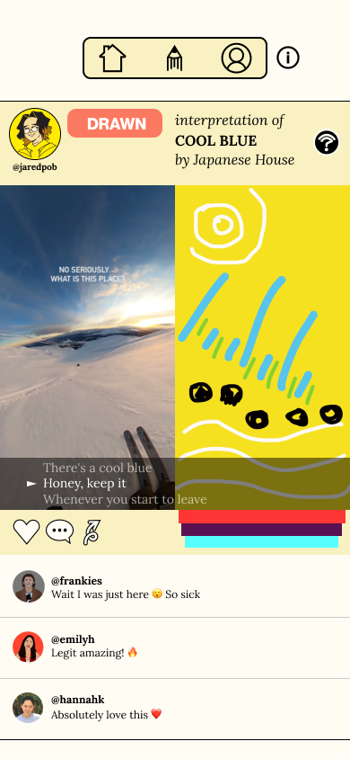
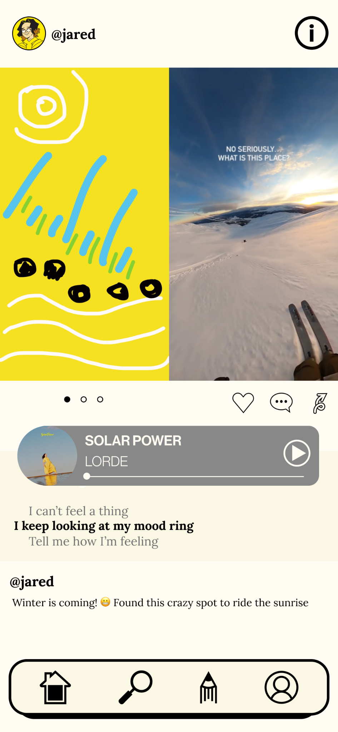
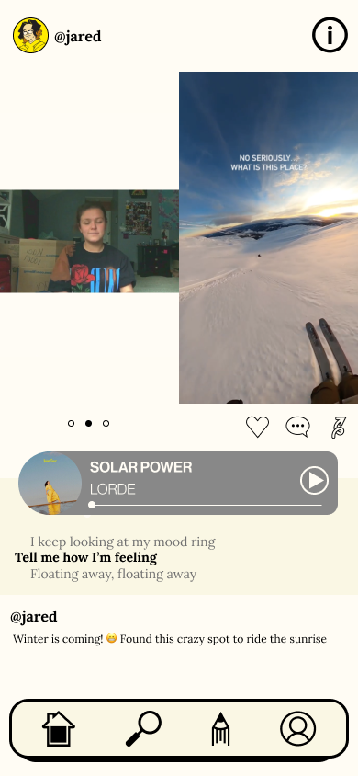
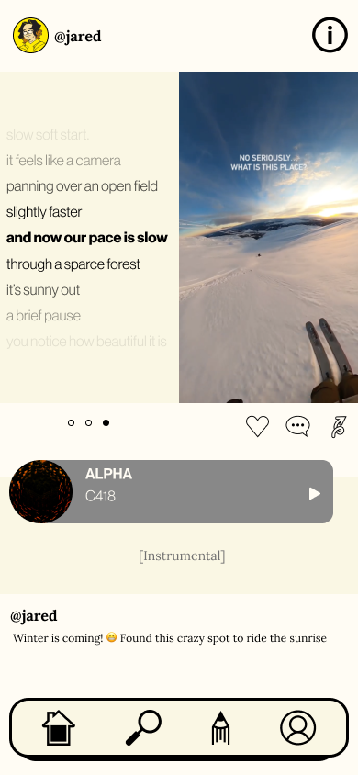
Interface Changes
MAJOR CHANGE 2 -
Home Screen
Old design:
New design:
Notes:
First major change: inherent structure of interpretations of audio
Previously: linear process to create altio
Drawing is main interpretation to toggle between

Slide 7
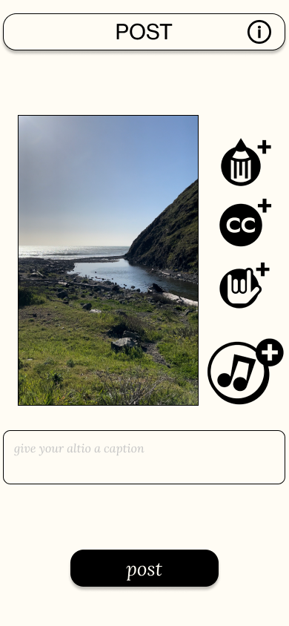
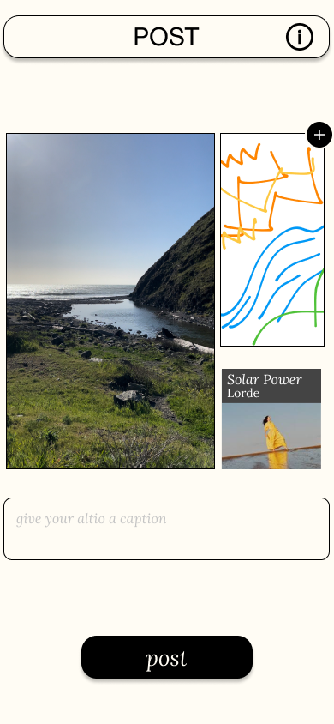
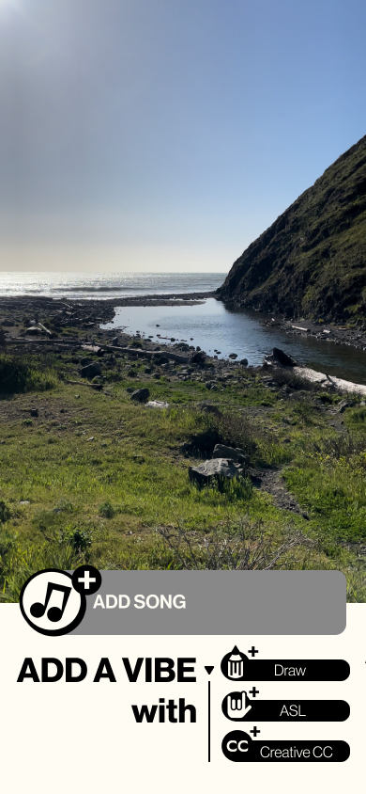
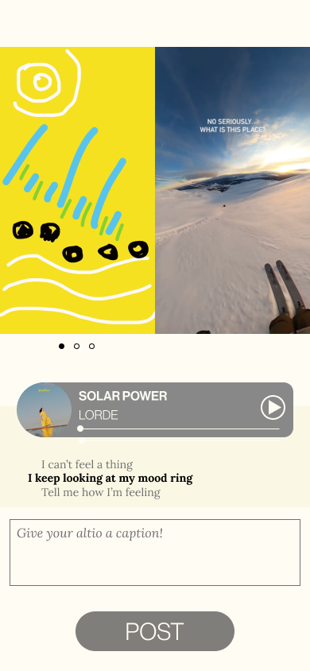
Interface Changes
MAJOR CHANGE 3 -
“Create” Flow
Old design:
New design:

Slide 8
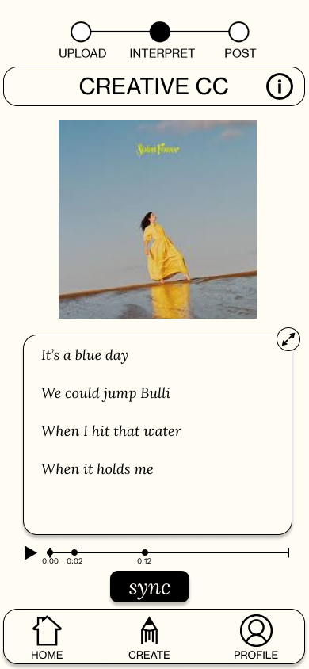
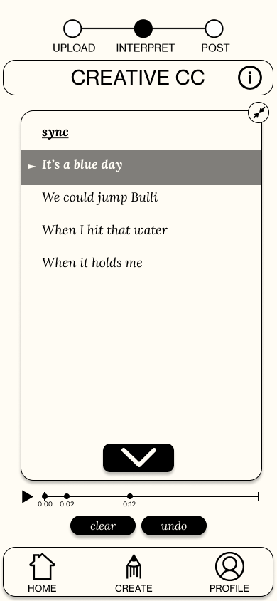
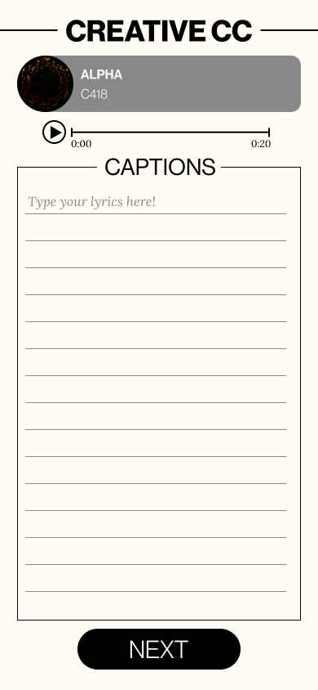
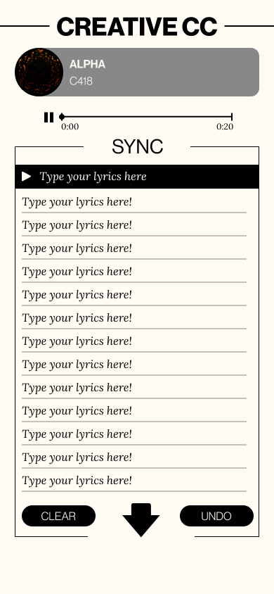
Interface Changes
MAJOR CHANGE 4 -
Creative CC Flow
Old design:
New design:

Slide 9
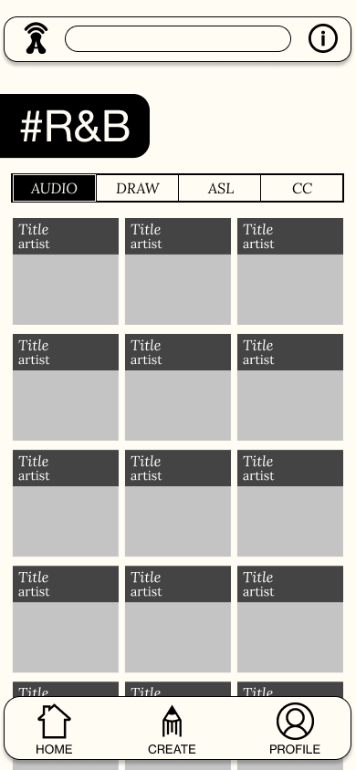
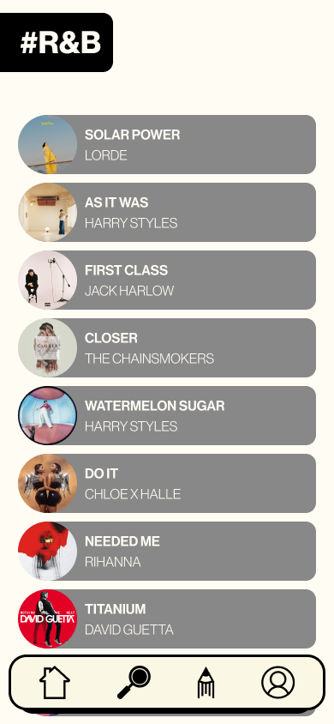
Interface Changes
MAJOR CHANGE 5 -
Search View
Old design:
New design:

Slide 10
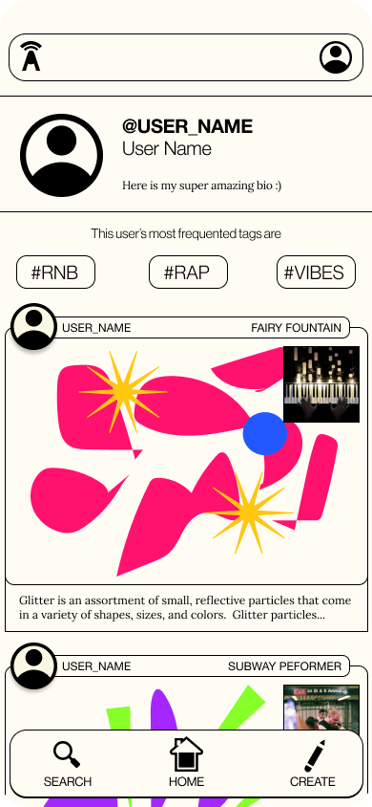
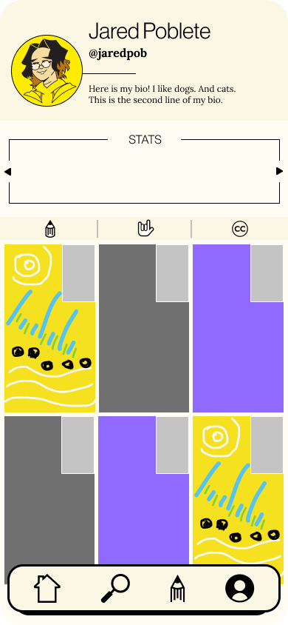
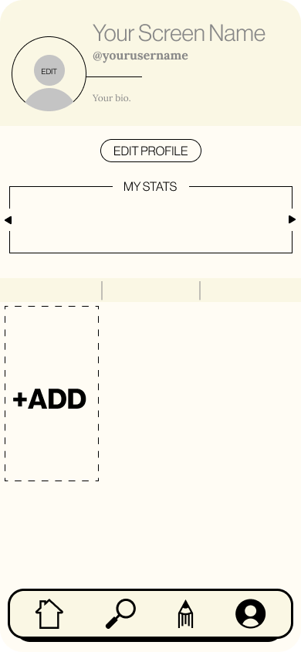
Interface Changes
MAJOR CHANGE 6 -
Profile View
Old design:
New design:

Slide 11
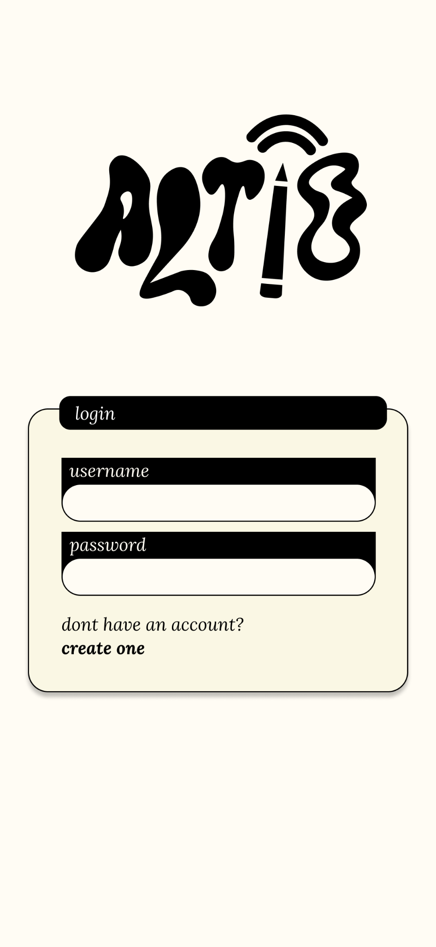
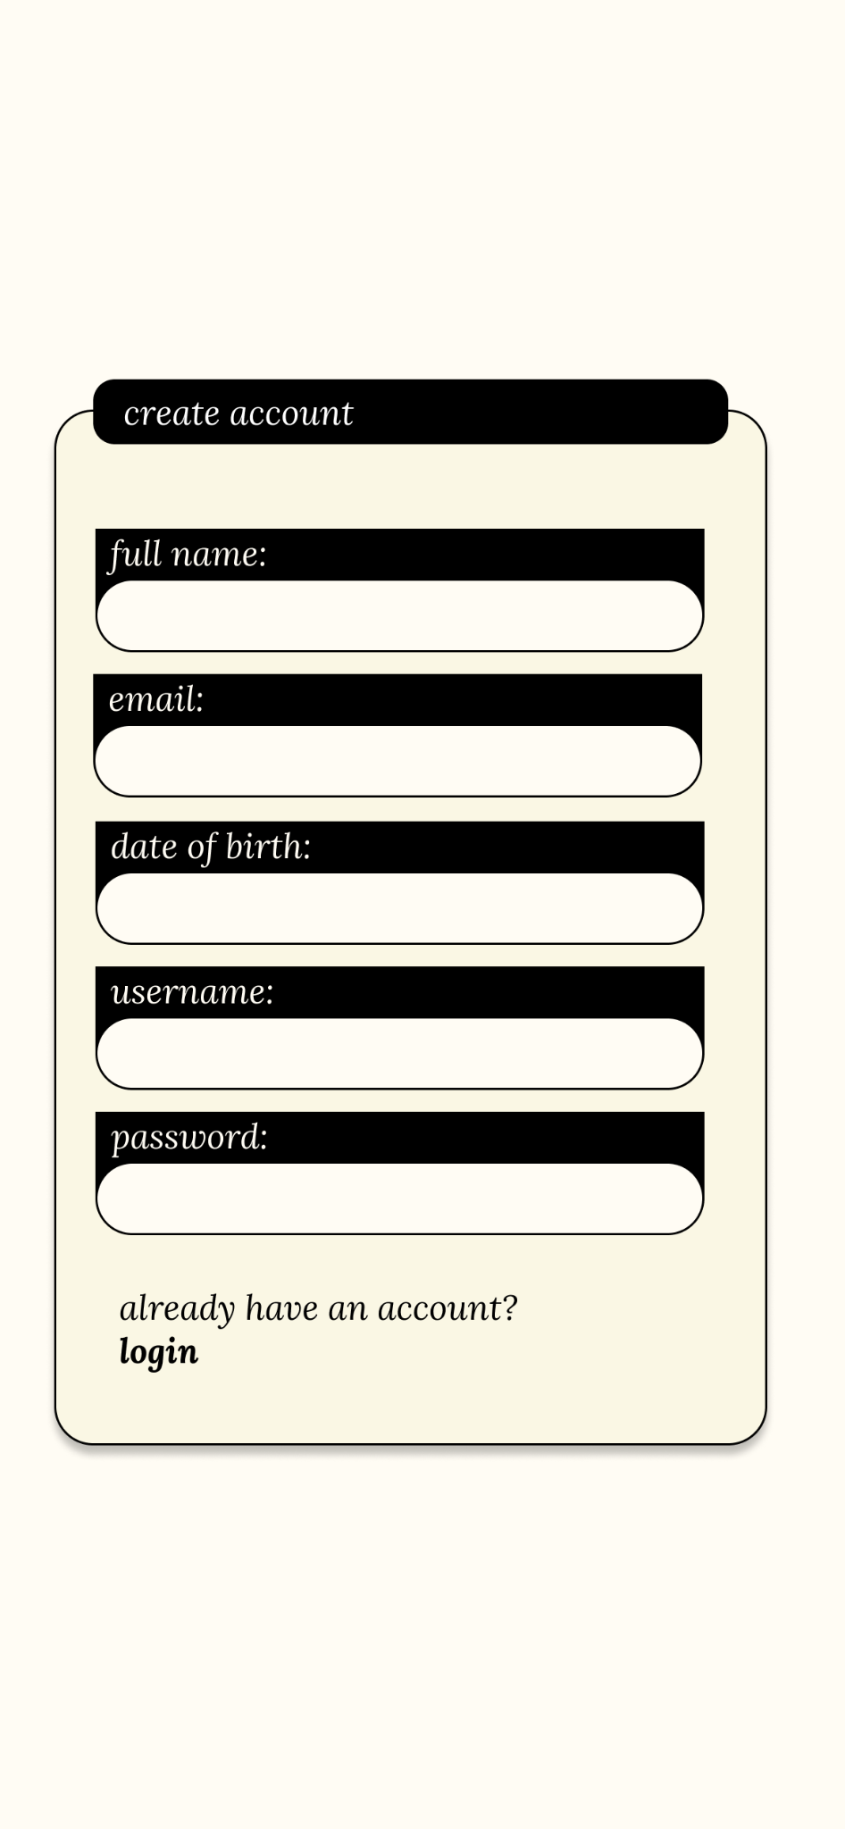
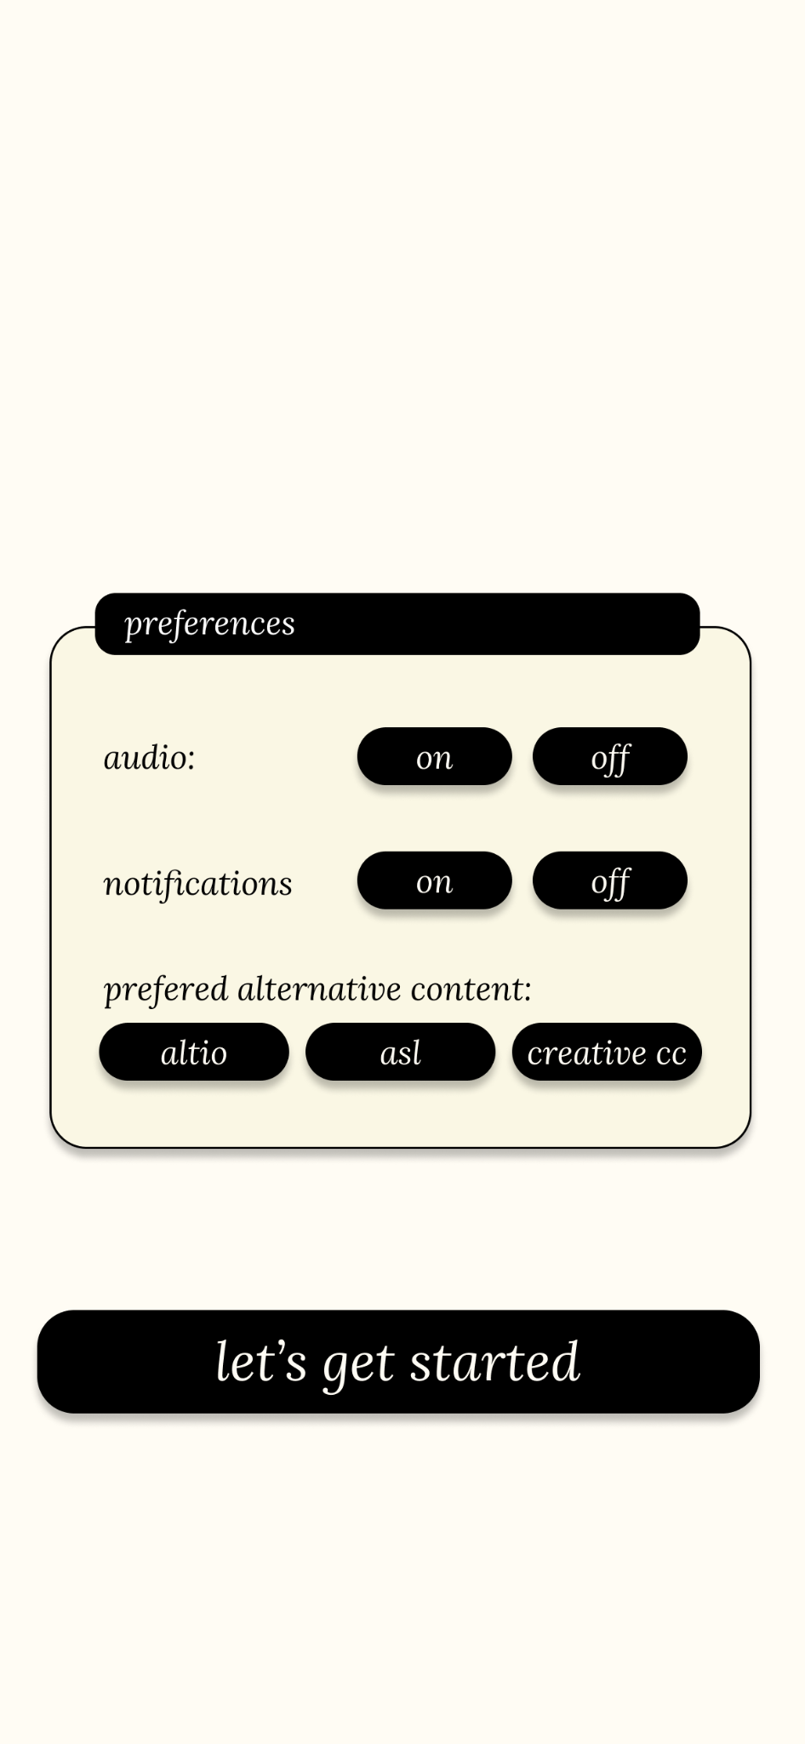
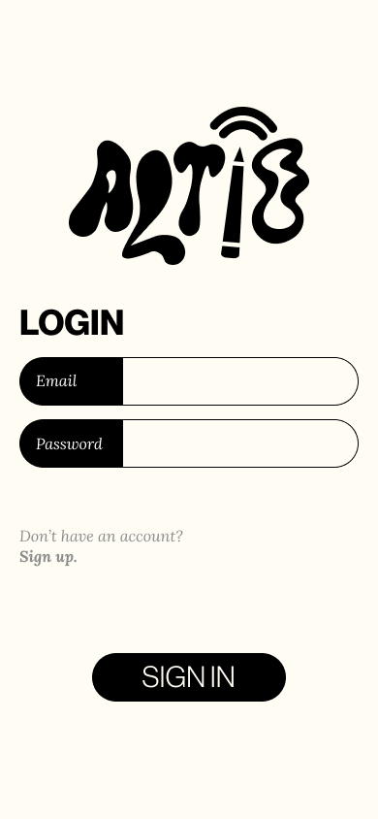
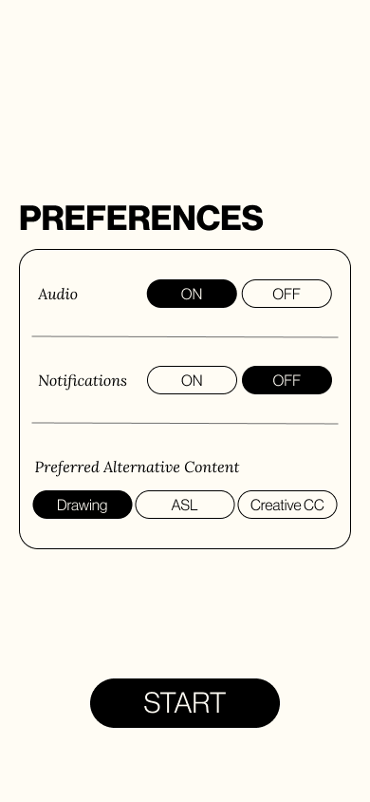
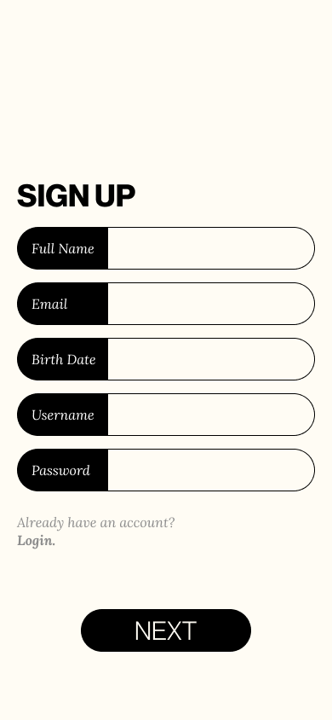
Interface Changes
MAJOR CHANGE 7 -
Create Account
Old design:
New design:

Slide 12
Testing Methodology

Slide 13
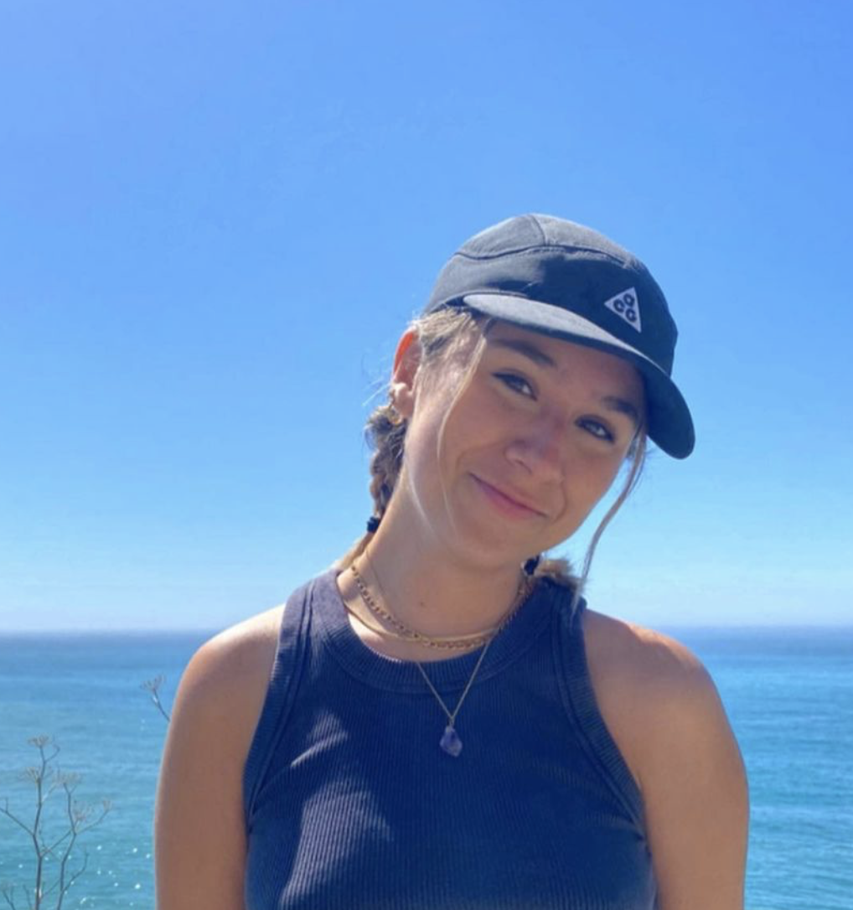


Participants
PARTICIPANT 006
PARTICIPANT 007
PARTICIPANT 008
Current Stanford Junior
Hearing
Product Design
Working woman in her 50s
Deaf
Current Stanford Junior
Hearing
Science and Technology in Society
Notes:
Three participants total
Since weren’t able to test hi fi prototype wanted to get better sense of features w community members

Slide 14
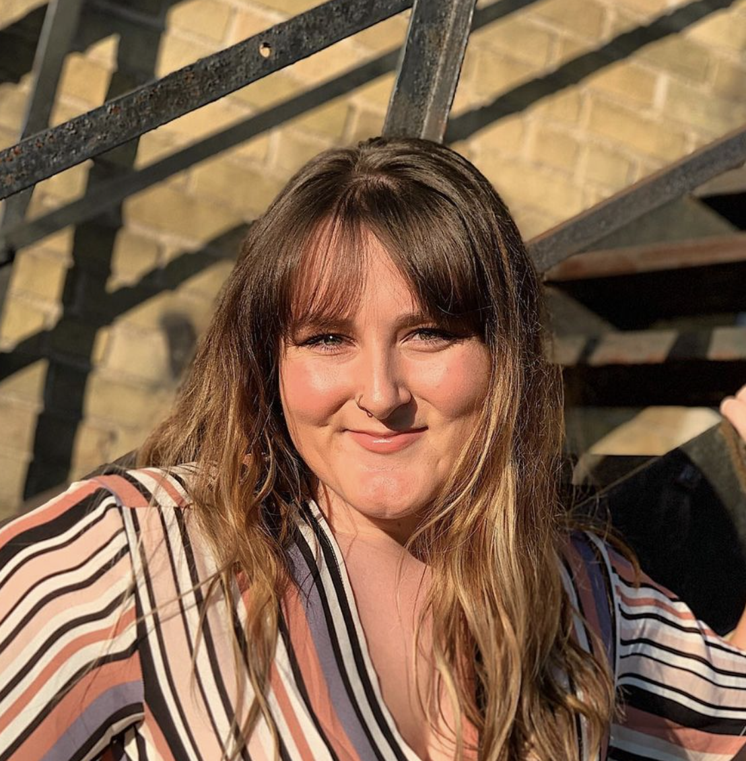

Participants Cont.
PARTICIPANT 009
PARTICIPANT 010
Recent College Graduate
Hearing
Medical Lab Sciences
Current Stanford Freshman
Hearing
Symbolic Systems
Notes:
Three participants total
Since weren’t able to test hi fi prototype wanted to get better sense of features w community members

Slide 15




Apparatus
INTERVIEWS CONDUCTED
APP
ACCESS
SCREEN
RECORDINGS
Notes:
Testing technology

Slide 16
Procedure
We instructed participants to download Expo Go on their device, then log in with provided credentials to access our app by scanning a QR code.
We briefly introduced our app and purpose, as well as how the testing procedure would look. At this point we began recording if possible.
We asked users to complete the first task that we introduced. After completion, we asked a few questions about their personal experience throughout the process.
We repeated this with each task, and finally concluded the interview.

Slide 17
Test Measures
ONBOARDING QUIZ SCORE
  Does the user understand the basic goals and functions of the app from the onboarding screens?
NOTABLE CHALLENGES
  Can the user achieve the app’s goals with minimal frustration?
NOVELTY & FUN
  Do they enjoy using the app?
Notes:
For Onboarding:
number of “correct” answers to questions asked, to ensure clarity of onboarding flow.
For View Content:
success in finding annotations, to make sure it is clear where to find annotations
number of misclicks, to understand what elements may be confusing for users
length to completion, to observe how difficult this process is
instances of visible enjoyment, to observe how much users enjoy this process
For Interpret ALTiO:
Success in interpreting and posting
Instances of visible enjoyment
Number of interpretation methods interacted with
Length of time to add annotations
Length to completion
For Engage with Community:
Number of misclicks
Number of clicks of different elements on pages (discoverability/curiosity)
Length to finding correct screen

Slide 18
Tasks
TASK 1 - Onboarding
We had the user click through and read through the onboarding flow.
GOAL: For users to be able to understand the purpose of the app and what an “ALTiO” is.

Slide 19
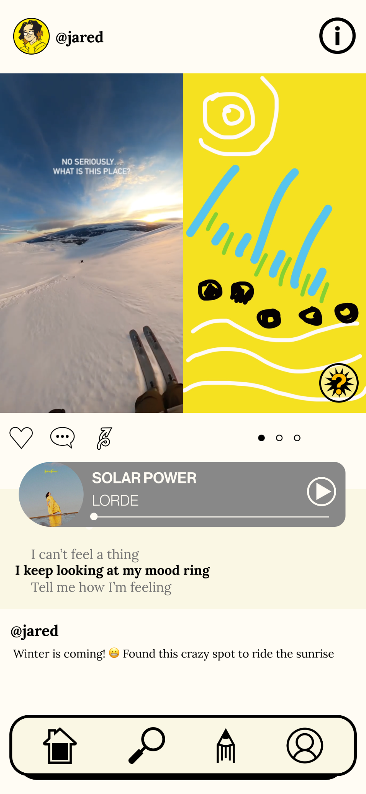
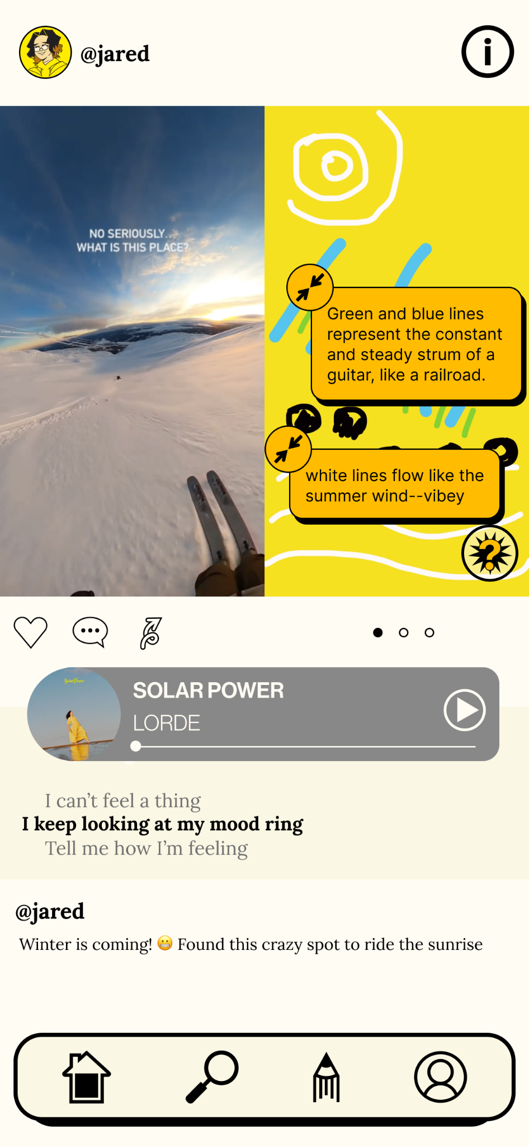
Tasks
TASK 2 - View Content
We had the user navigate to an “ALTiO” interpretation for a post and view its annotations.
GOAL: A user can successfully navigate to an interpretation relatively easily, and that it is an enjoyable process.

Slide 20
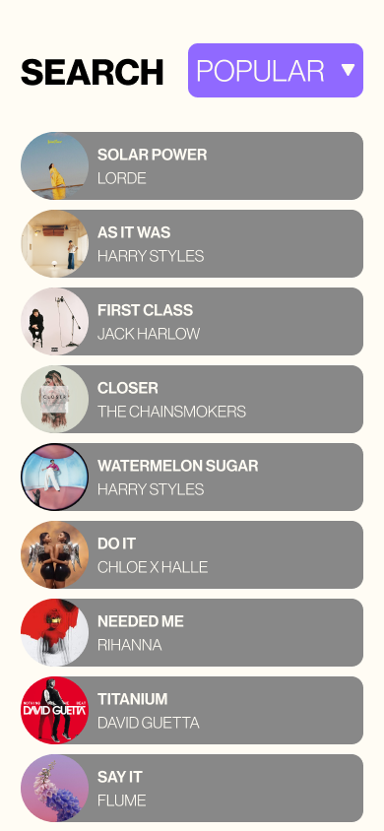
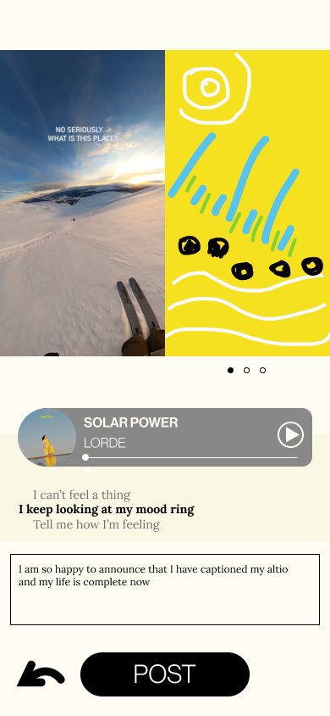
Tasks
TASK 3 - Post ALTiO
We had the user create a post with an ALTiO interpretation.
GOAL: A user can successfully create a post with ease and enjoyment.

Slide 21
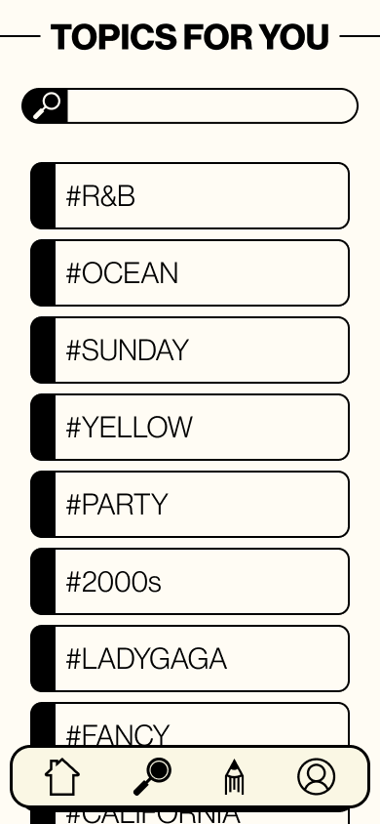
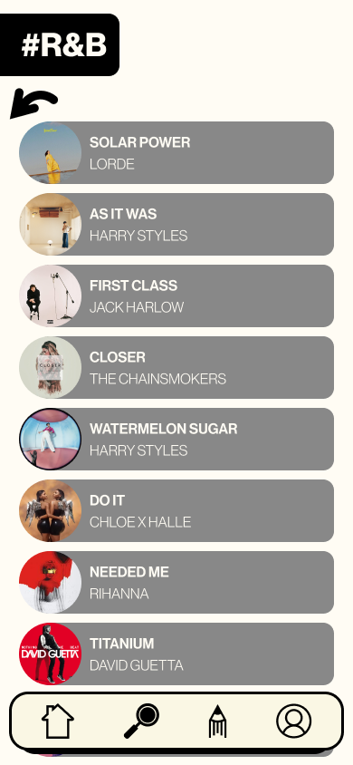
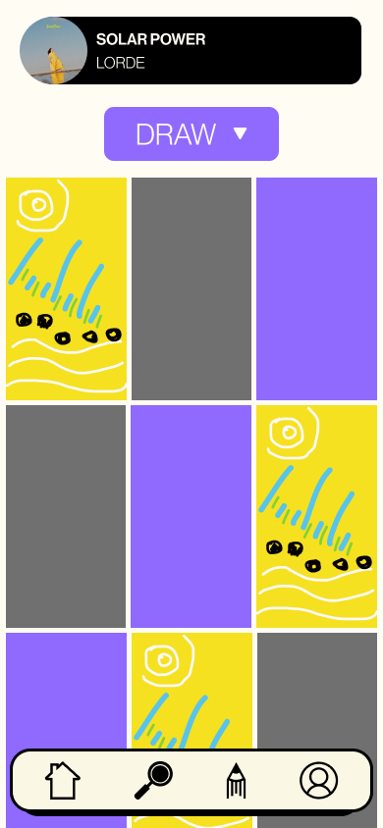
Tasks
TASK 4 - Engage with Community
We had the user navigate to find more interpretations of Funky audio.
GOAL: A user can find other interpretations of audio with ease, and the user is curious about other areas of the app.

Slide 22
Results

Slide 23
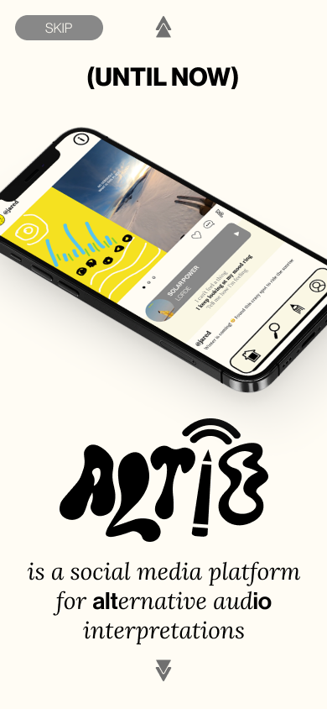
Onboarding Quiz Score
Based on what you saw in the onboarding, what can you do in this app?
What is the purpose of this app?
What is an altio?
PARTICIPANT 006
2/3
Every incorrectly answered question was for number 3. In our new onboarding, we don’t have an explicit screen that defines altio, but we do it more subtly seen here:
PARTICIPANT 007
2/3
PARTICIPANT 008
3/3
PARTICIPANT 009
3/3
PARTICIPANT 010
2/3
Notes:
Three questions asked each participant at end of onboarding flow
On avg ⅔ right
Participant with 3 right had to reread, and spent significantly more time on this section
Each had some confusion about purpose of app after first read

Slide 24
Notable Challenges
PARTICIPANT 006
8
Noting incidents where users explicitly stated
confusion, dissatisfaction, or questions regarding
the apps high level functionality (not a simple
coding bug)
PARTICIPANT 007
8
Examples:
“Creative CC is not user friendly to change what I want.”
“If I’m using it in class and the song reloads for each I would be concerned”
“I really don’t understand the app, I don’t know what it’s doing. I don’t understand the two pictures next to each other, no signing or anything”
“I clicked on explanations and saw them, but don’t understand what they have to do with hamster or rabbit (don’t see how they are related)”
PARTICIPANT 008
4
PARTICIPANT 009
5
PARTICIPANT 010
4
Notes:
Three questions asked each participant at end of onboarding flow
On avg ⅔ right
Participant with 3 right had to reread, and spent significantly more time on this section
Each had some confusion about purpose of app after first read

Slide 25
Instances of Visible Enjoyment
PARTICIPANT 006
PARTICIPANT 007
PARTICIPANT 008
“I like [the topics for you] aesthetic”
“It’s like a super artsy tiktok”
“[The process is] challenging, but [the interpretation] is cool and allows me to explain what i just posted. I do like that, it’s nice”
“You could do this with teaching sign”
Overall really excited about the capabilities of this app
Notes that she gets scared when she draws, so the info. pop-up was helpful for confidence

Slide 26
Instances of Visible Enjoyment Cont.
PARTICIPANT 009
PARTICIPANT 010
“I like the color because it’s not out and popping out at you, not white. Font is really nice too”
“This is actually a very important thing, especially since I know ASL and it’s hard communicating This is so cool, I like it.”
“Cool because it’s not something you usually experience in a song, but this gives you an idea of it”
“Oh, no uploads for Solar Power. I’ll add an upload for it.”

Slide 27
Critical Incidents
Scale from 0-4, 0 being least severe
PARTICIPANT 006
PARTICIPANT 007
PARTICIPANT 008
Believed play button on audio card is for pausing and beginning song | 3
Couldn’t determine if hashtags were clickable or not | 2
Profile unavailable | 3
Was confused about posting videos due to lack of context from onboarding | 4
Couldn’t toggle between interpretations on home screen | 4
Still was unsure on what creative CC was | 4
Misinterpreted features of app after onboarding | 4
Incorrect “altio” definition | 2
“I don’t know who is talking and what it’s related to | 4
Initially didn’t understand the interpretations next to content on home feed | 4
Assumed lyrics were attached to a song but didn’t understand their connection to interpretation | 3
Was distracted during drawing by bugged audio | 4
Pressed ‘x’ instead of return during annotating | 3
Couldn’t view post behind keyboard | 3
Couldn’t access info button during task 2 | 3
Annotations on home feed not implemented | 4
Didn’t know where the top of the home feed posts was | 2
Notes:
Play button on audio card eventually implemented

Slide 28
Critical Incidents
Scale from 0-4, 0 being least severe
PARTICIPANT 009
PARTICIPANT 010
TOTAL
Tapped annotation on side and it ran off | 2
Audio bugged and not playing on home feed | 4
Thought “Done” meant post was over | 1
Wasn’t able to exit to Home without posting | 4
Video and Drawing in Search were not clickable | 4
Type ran below keyboard | 3
Did not double tap the right button for annotations | 3
Didn’t have volume on during ASL interpreting | 4
Tried to drag annotations to move | 2
Made it to onboarding without choosing a interpretation preference | 3
“Coming from instagram [there’s] a lot of extra steps, but then again if I’m using this app I would be using it to make accessible content” | 4
Severity | Number of Incidents
0
1 | 1
2 | 5
3 | 7
4 | 13

Slide 29
Discussion

Slide 30
What we learned
NEED MORE CLARIFICATION FROM THE BEGINNING
Potential solutions:
Have preview screens of what creating a post will look like so people learn
Clarify interpreting videos vs. audio; It's important that users know what kinds of content they can post on this app
Despite being more concise, onboarding didn’t prepare users for the app’s content

Slide 31
What we learned
The home screen was overwhelming to most users in terms of clickable objects
MAKE ONBOARDING
MORE DIRECTED
Potential solution:
Create interactive tasks for tutorial content

Slide 32
What we learned
EXPLAIN INTERPRETING BY REORDERING SETTINGS
Have the onboarding sequence explain the types of interpretation before choosing preferences
Short description of each kind of interpretation method
Most users didn’t understand the concept of “preferred alternative content” in sign-up

Slide 33
What we learned
POP-UPS
Only show pop-ups to first-time users
Make info buttons more concise (UX writing!) and standardized throughout the app
Users were put off by the pop-ups that explain app features

Slide 34
What we learned
GIVE USERS OPTIONS FOR CHANGING THEIR POSTS
Once you have uploaded Draw, ASL, or Creative CC you should be able to change it
Cancel a post
Add back or redo buttons
Users wanted to edit their interpretation uploads

Slide 35
Looking forward
THE ALTIO LEARNING CURVE
Learning our way toward the most concise and didactic onboarding sequence. We want people to know as much as possible before they even reach the home screen, but how can we do that naturally?
HOW DO WE LOWER THE BAR FOR WHAT IT MEANS TO BE CREATIVE?
008: ““I get self-conscious about my drawing…”
009: “I’m not really a good artist so I’ll see what I can do…”
Is this something we want to cater to, or lean into a demographic?
EXPLORE EXPANDING DRAW FEATURES
Fill, stickers, color wheel, scrolling indication
Drawing upload?

Slide 36
Directives
INTERACTIVE ONBOARDING
MAKING HOME FEED AS APPROACHABLE AS POSSIBLE
INCLUDE “VIDEO UPLOADS” IN ONBOARDING
ADDING FLEXIBILITY IN CREATE FLOW (CANCEL, EDIT, BACK)
IMPROVING KEYBOARD FUNCTIONALITY
INTEGRATE SPOTIFY
MATCHING HIGH-FI AND FIGMA SCREENS
UPDATED ASSETS (EXPLAIN BUBBLES, TEXT STYLES, PLAY BUTTONS)
CLEAN STYLING

Slide 37

Thank you!

