Slide 1
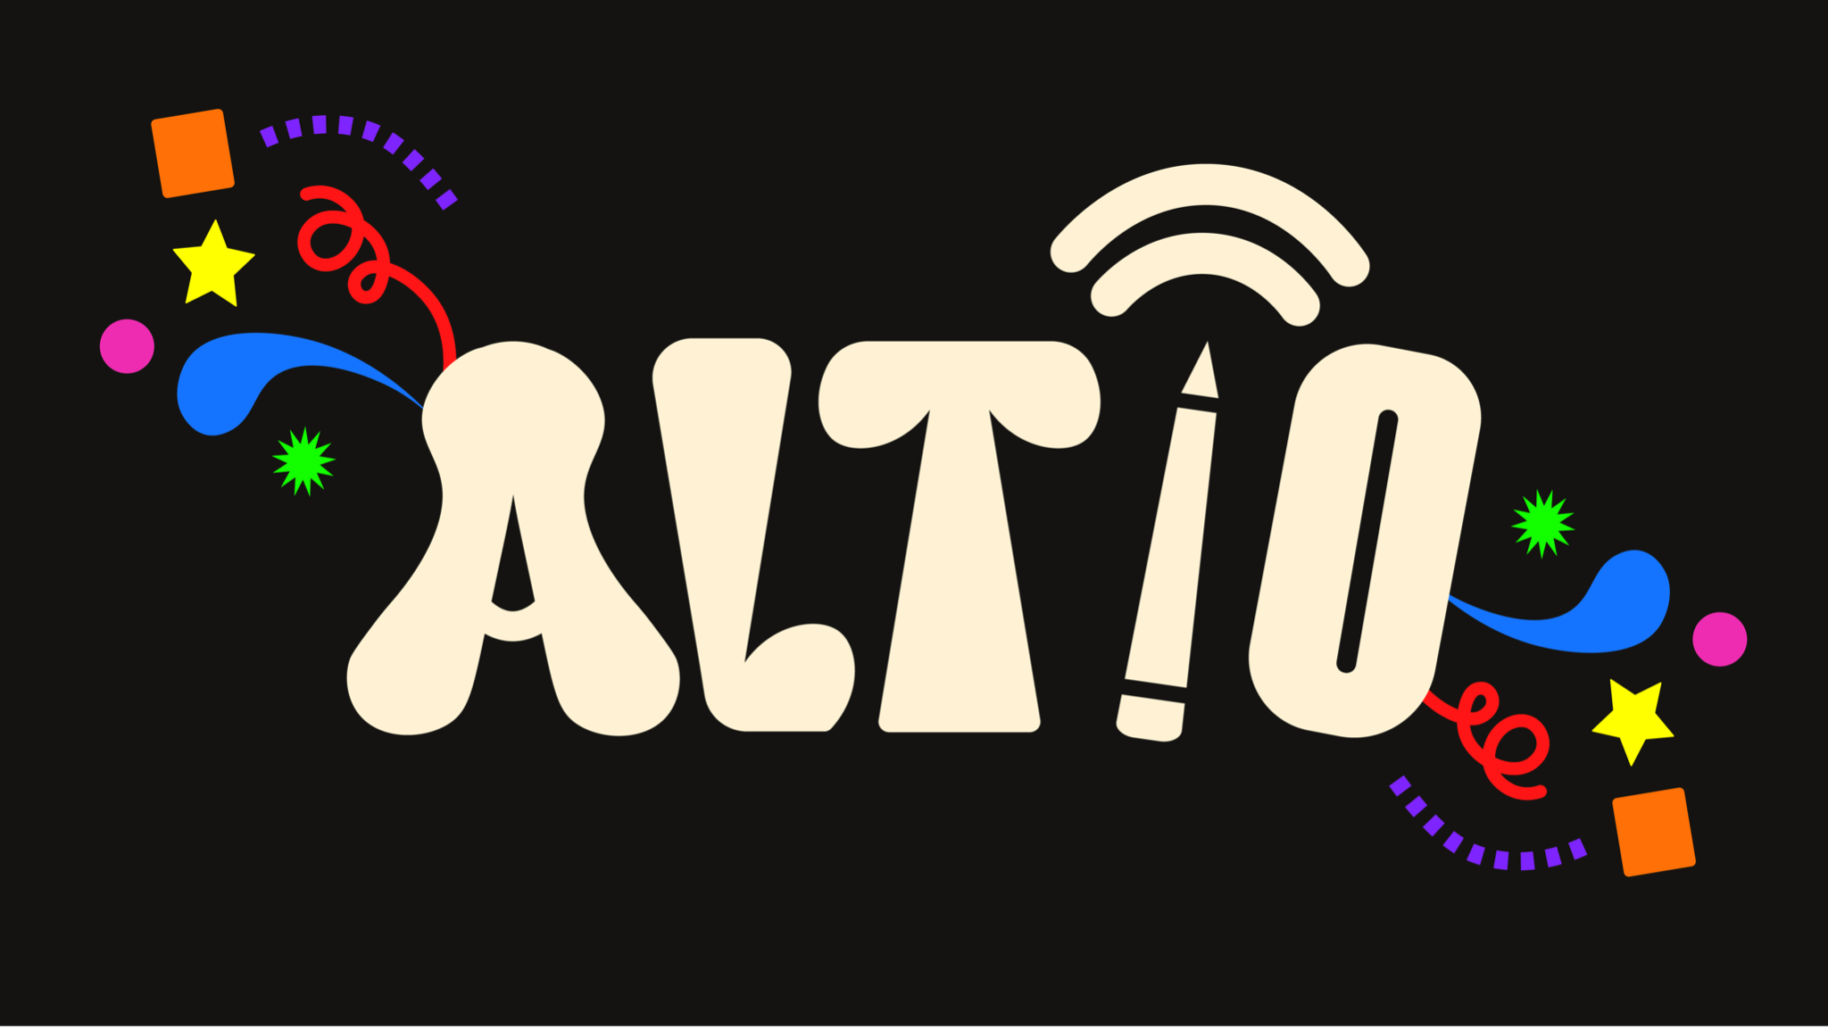

Slide 2
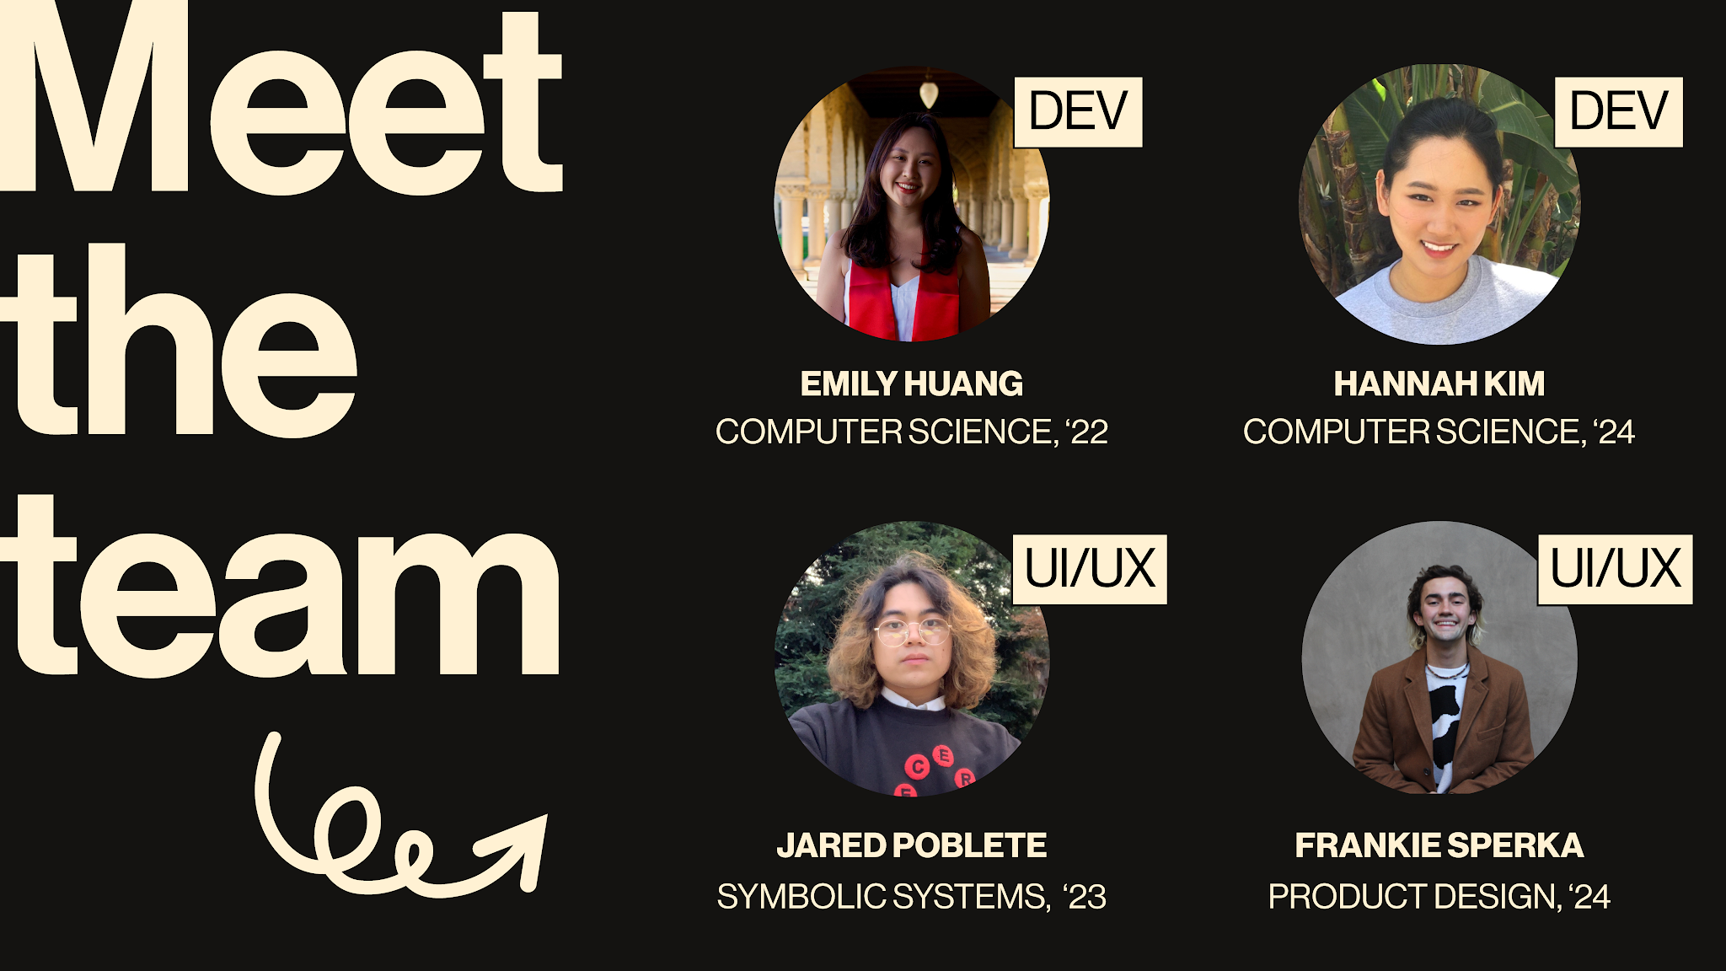

Slide 3
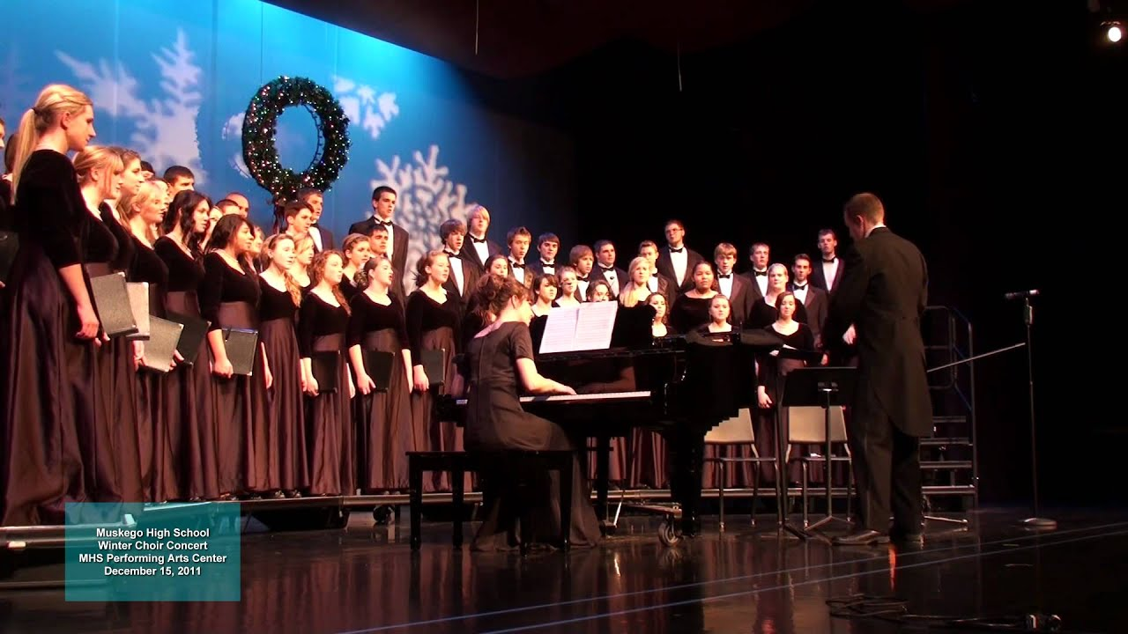

Slide 4
Why isn’t this the norm?

Slide 5
Why isn’t this the norm?
We want to bridge that gap

Slide 6
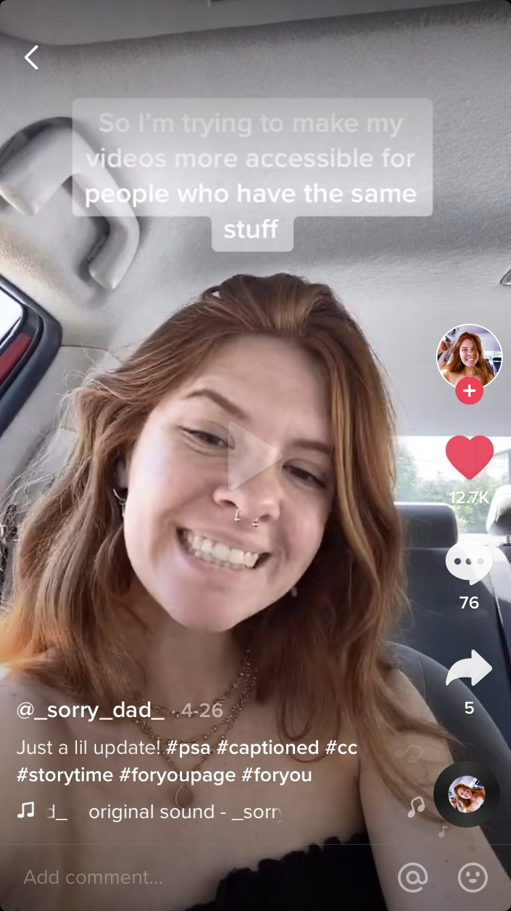
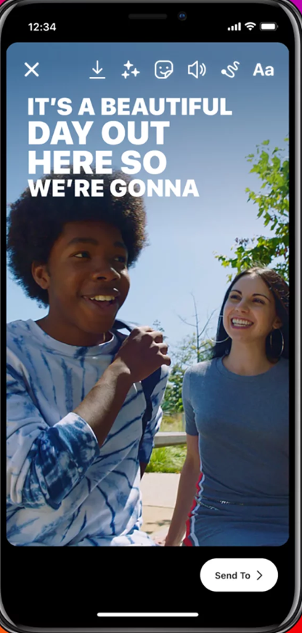
What’s out there

Slide 7
(There isn’t much else.)

Slide 8
Outline
Who are we?
Where have we been?
Where are we now?
What comes next?

Slide 9

(WHO ARE WE?)

Slide 10

PROBLEM
Deaf and hard of hearing people are often left out of key nuanced information that is conveyed through audio in digital spaces
SOLUTION
ALTiO is a social media platform that encourages and provides visual interpretations of audio–providing alternative options for everyone to experience content
ALTiO is a social media platform that encourages and provides drawings as visual supplements for interpreting audio–providing alternative options for everyone to experience content

Slide 11
PROBLEM
Deaf and hard of hearing people are often left out of key nuanced information that is conveyed through audio in digital spaces
SOLUTION
ALTiO is a social media platform that encourages and provides drawings as visual supplements for interpreting audio–providing alternative options for everyone to experience content

Slide 12
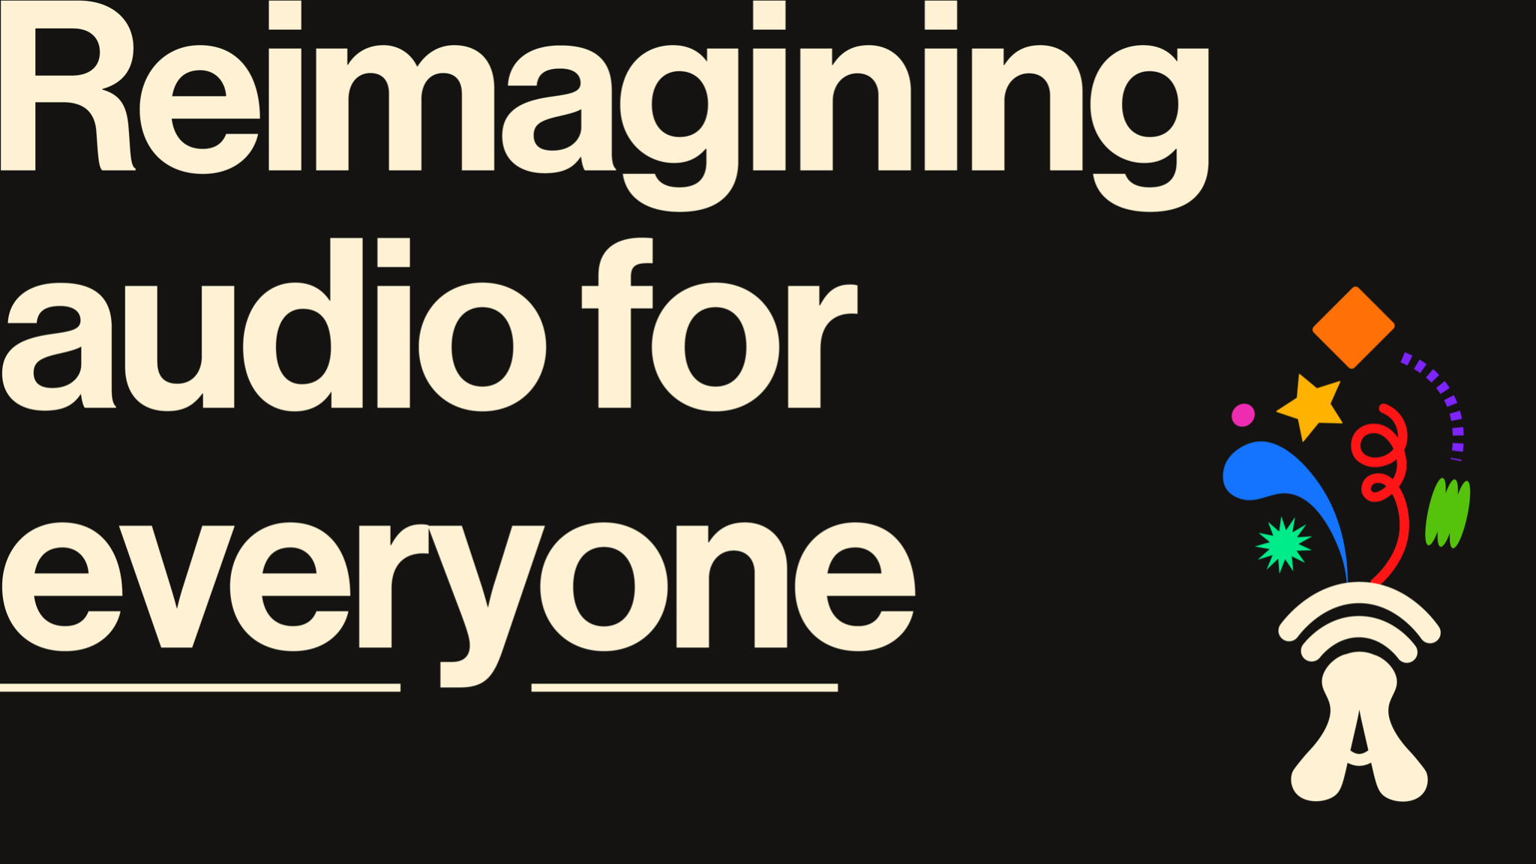

Slide 13

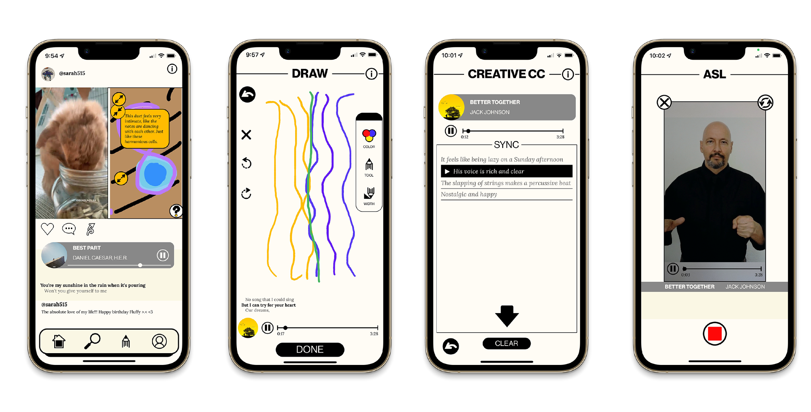

Slide 14
A social media app dedicated to creating and viewing alternative audio interpretations

Slide 15


Slide 16
(WHERE HAVE
WE BEEN?)

Slide 17
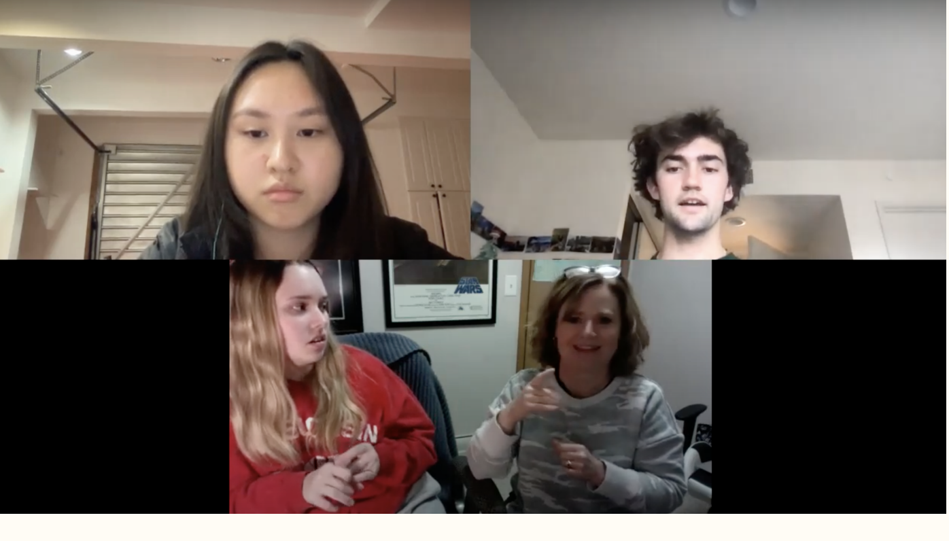
Needfinding
The participant enjoys attending her children’s choir concerts
…convey nuanced descriptions in a non-auditory way to include the Deaf / HoH community in pop culture?
HOW MIGHT WE?
“Hearing is something that is difficult for me, visual is something that is easy.”

Slide 18
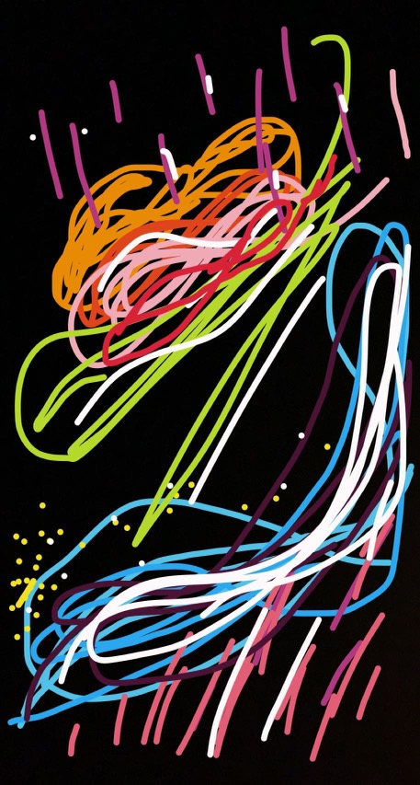
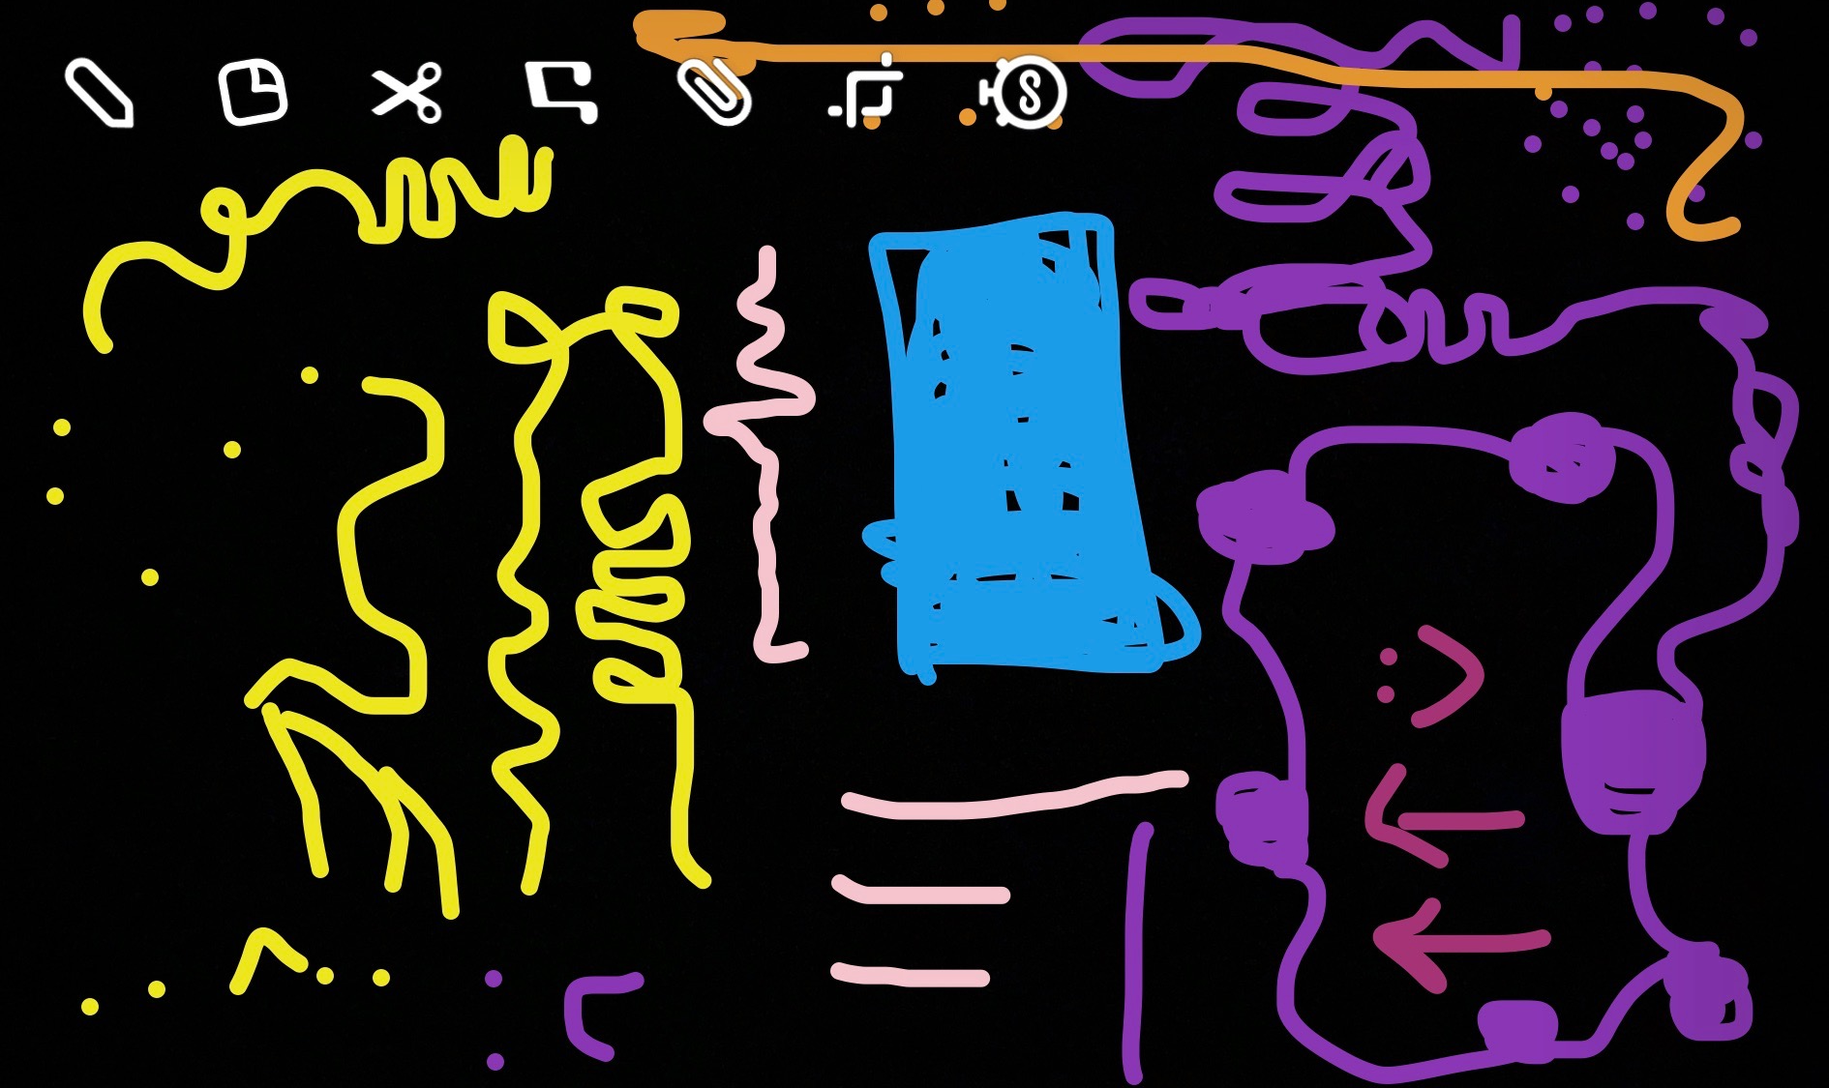
Early Testing
A unique audio interpretation can be effective for conveying the nuance of information and meaning in content
VALID
Experience prototype results of drawing “Idontwannabeyouanymore” by Billie Eilish
“She got more out of it than I even realized was there” - Participant 015

Slide 19
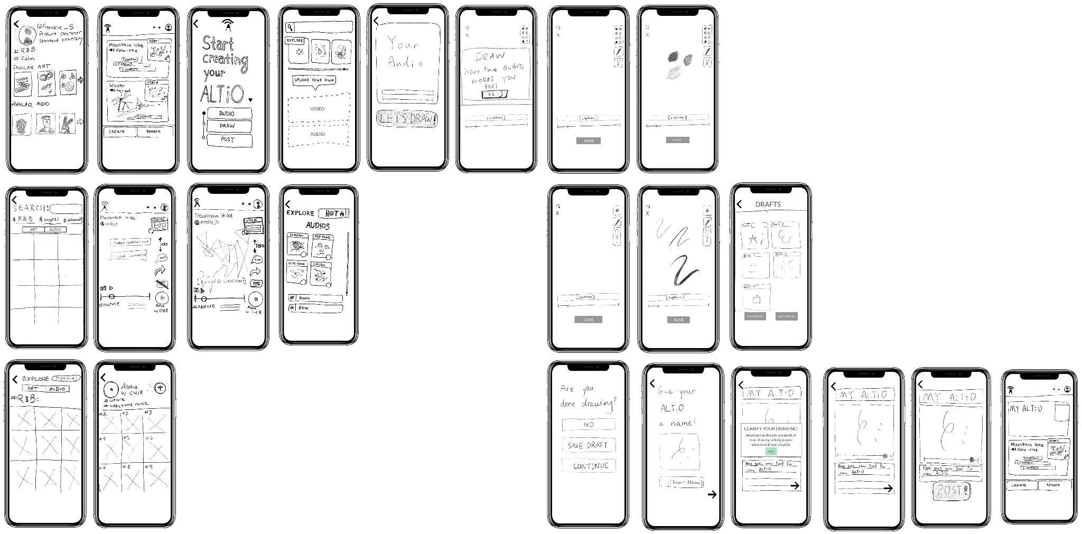
Low-Fi Prototype

Slide 20



Implementation
EXPO, REACT-NATIVE
FIGMA
FIREBASE
Notes:
Testing technology

Slide 21
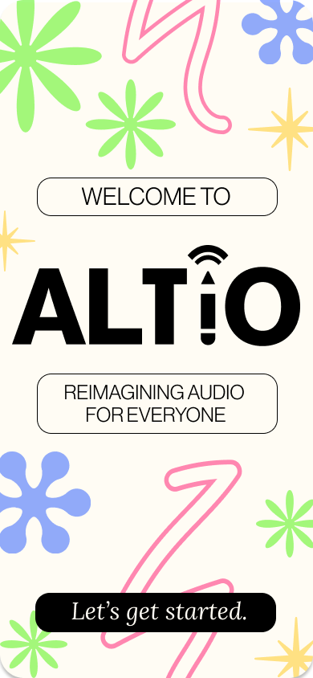
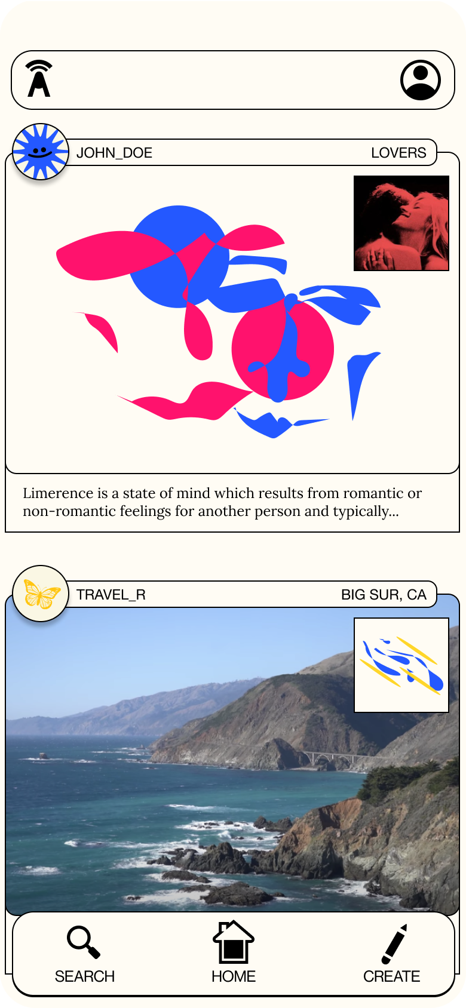
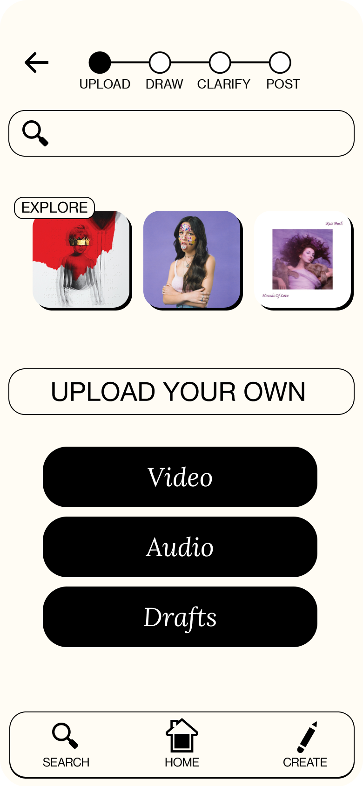
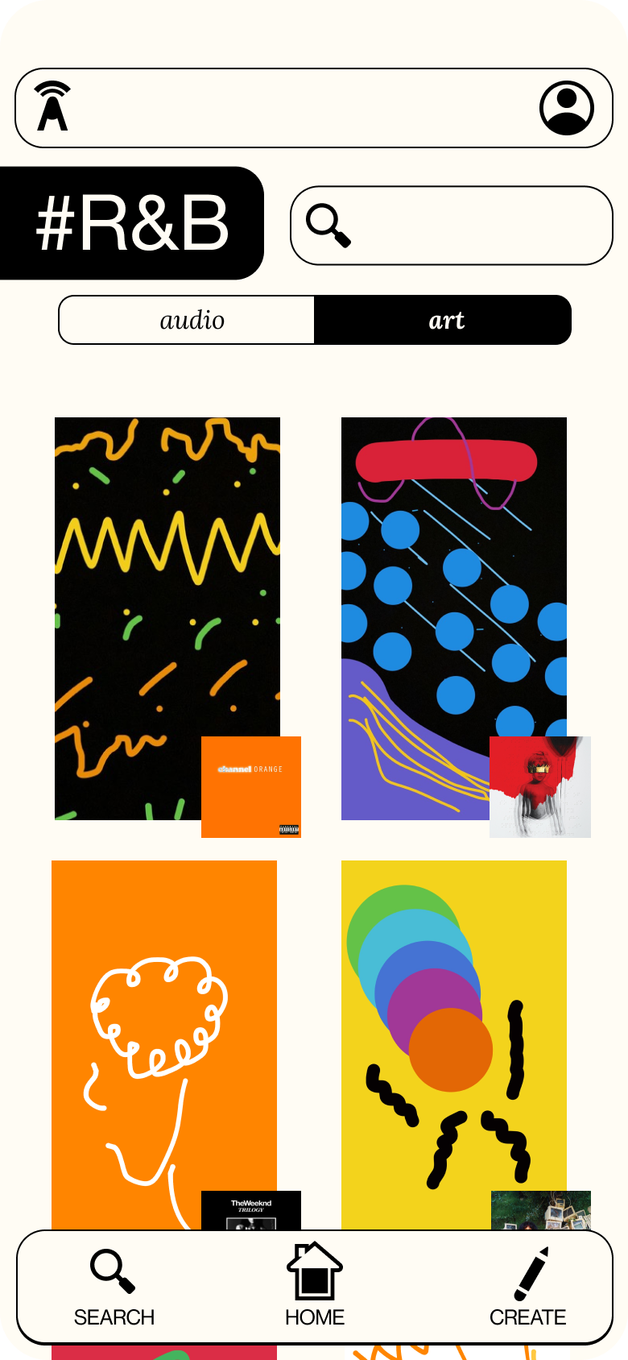
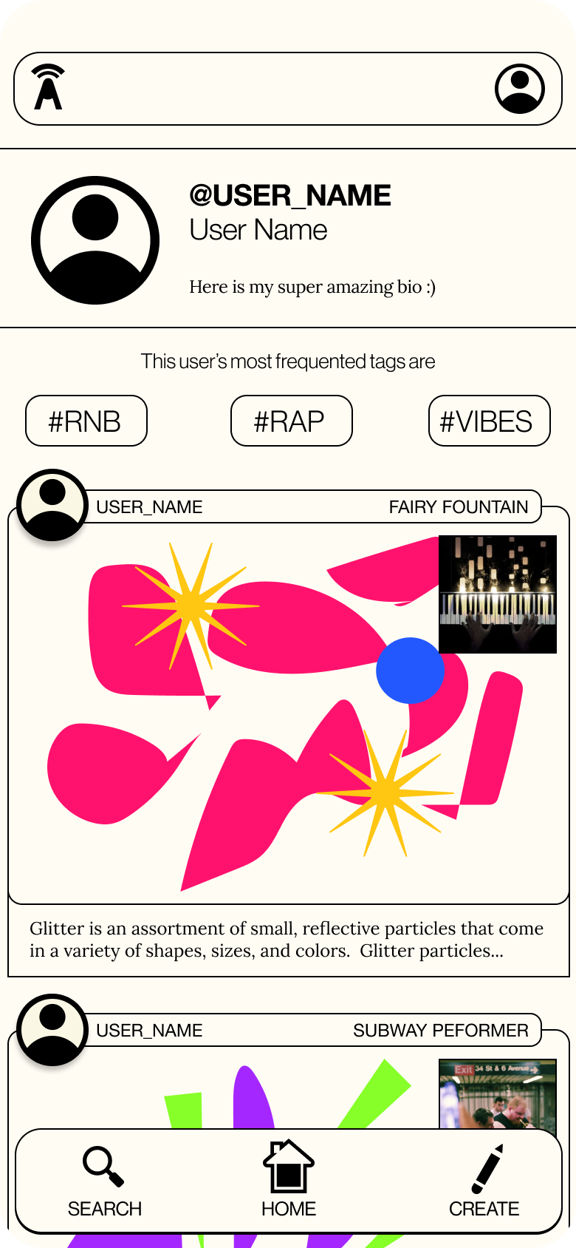
Hi-Fi Prototype V1

Slide 22
Usability Study
ONBOARDING NEEDS IMPROVEMENT
“It doesn’t tell me what my audience can expect to see”
Confused on first read, but after rereading participant understood
ACCOUNT CREATION / USER PREFERENCES
Avoid feelings of exclusion for Deaf and HoH users by asking for preferences of content type and audio preferences early on
INTRODUCED ASL / CREATIVE CC SUPPORT
FLEXIBILITY IN POST PROCESS

Slide 23
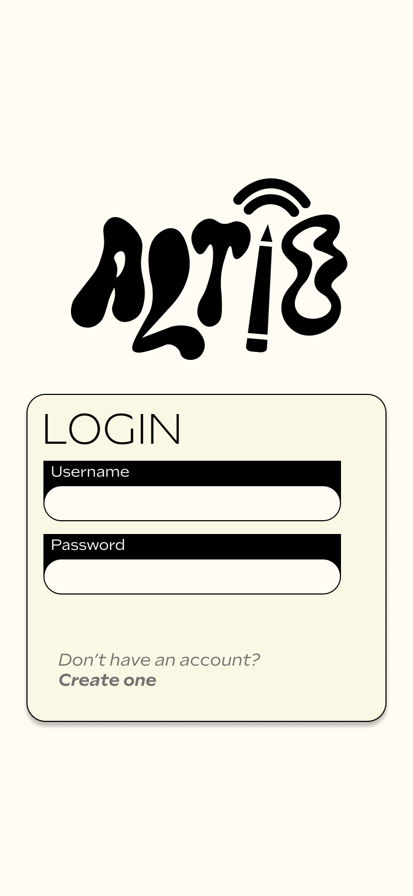
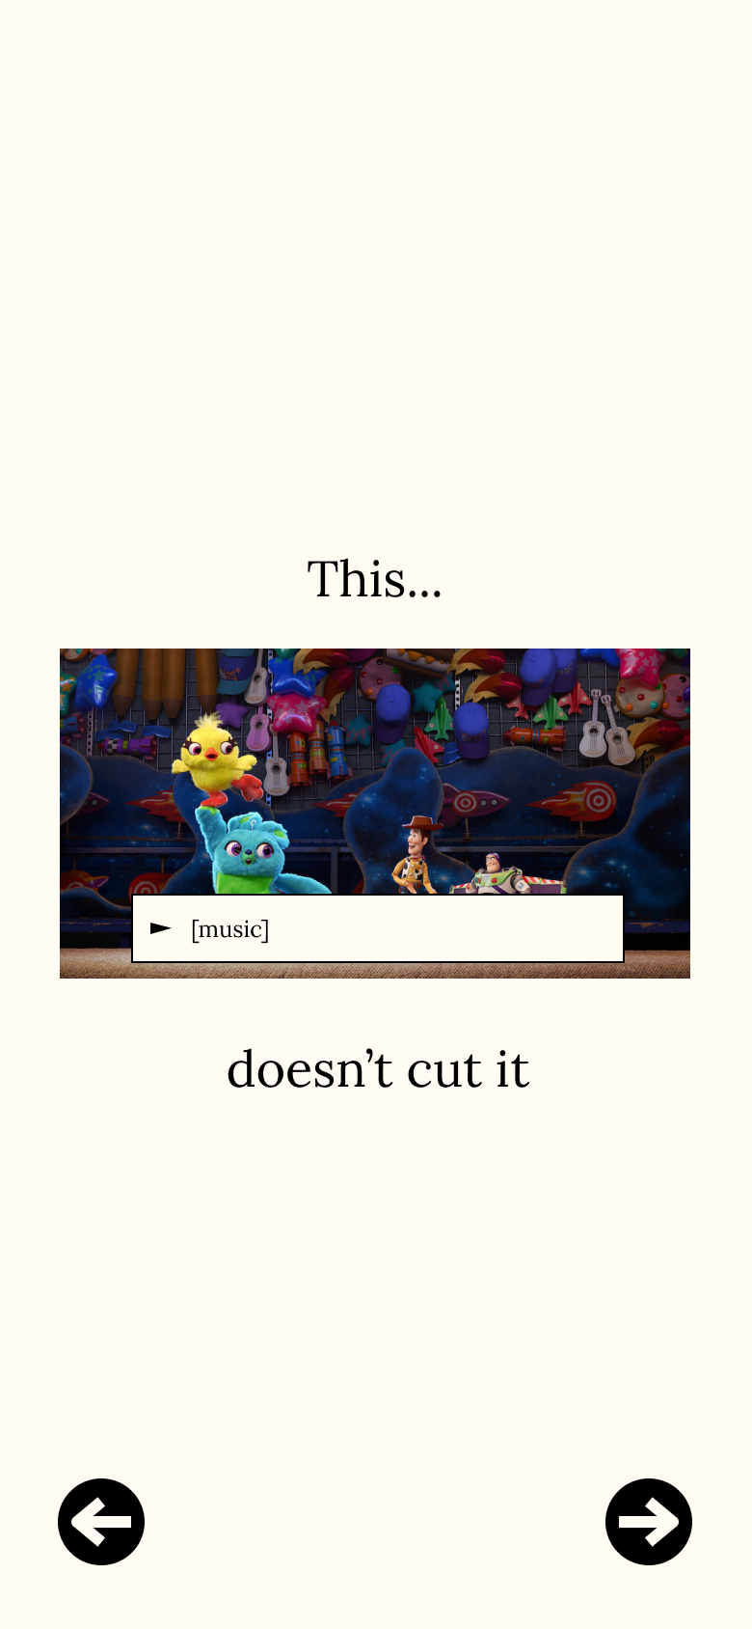
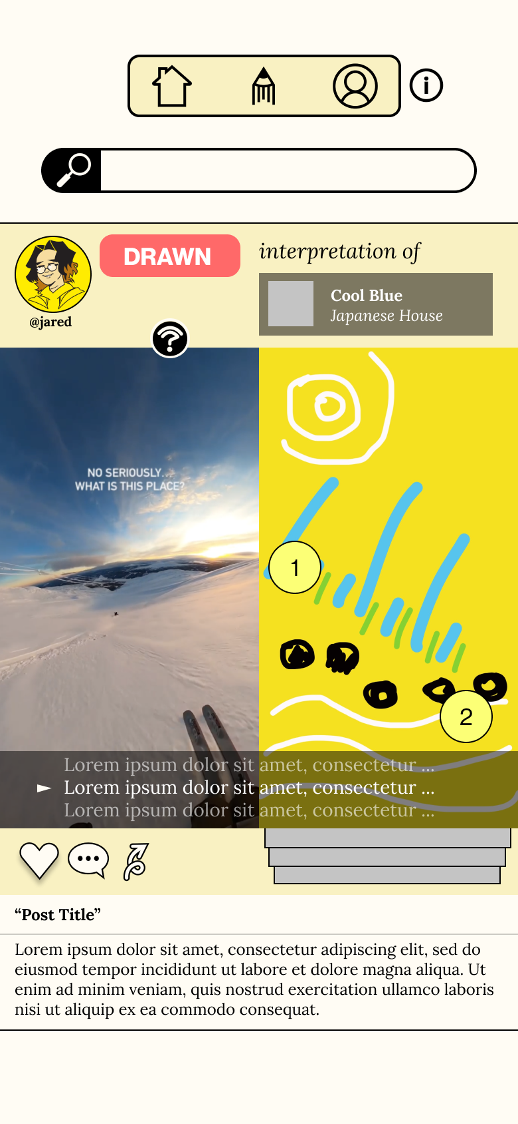
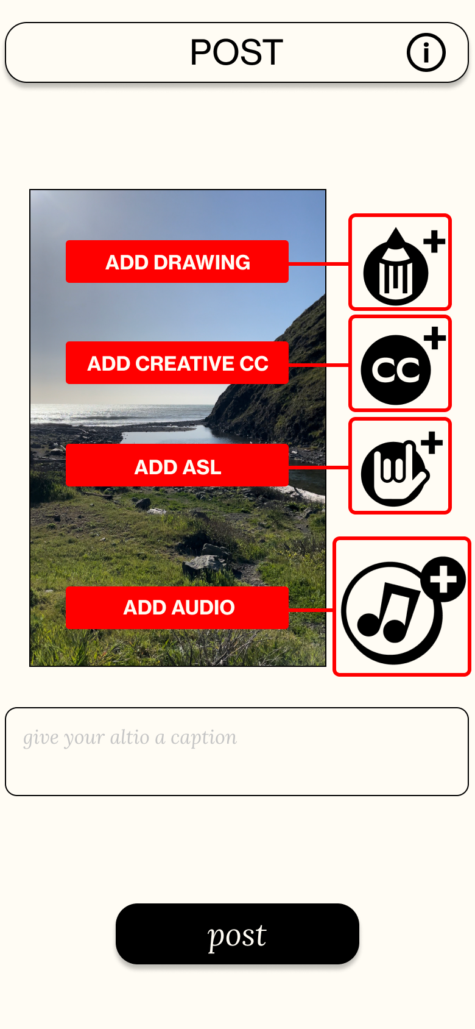
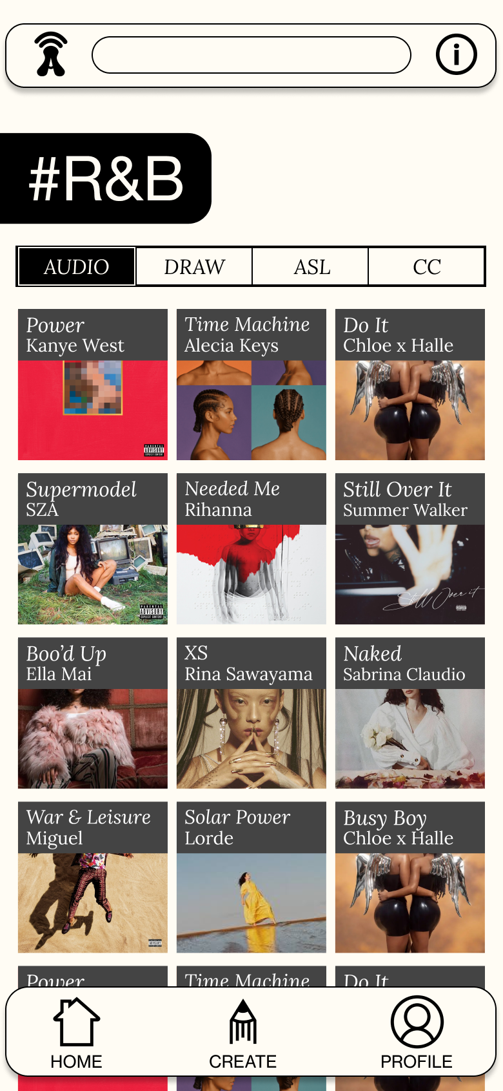
Hi-Fi Prototype V2

Slide 24
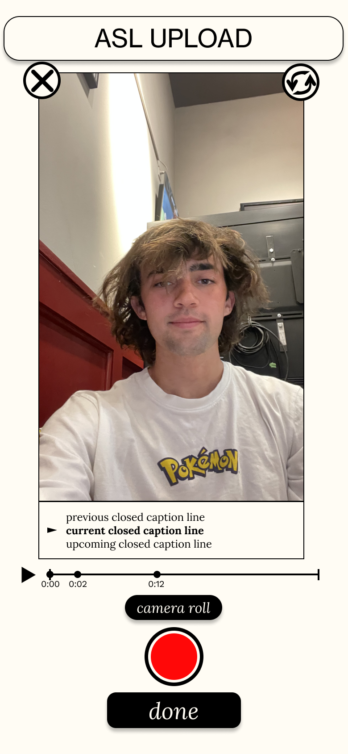
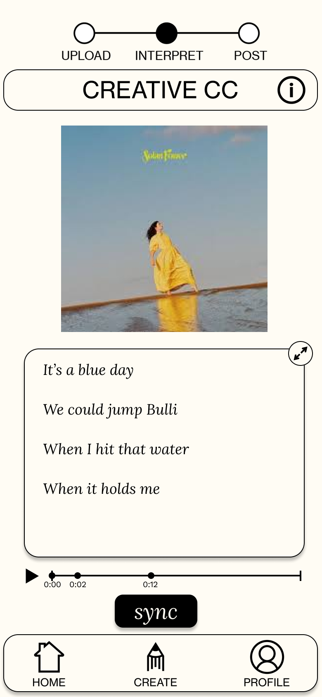
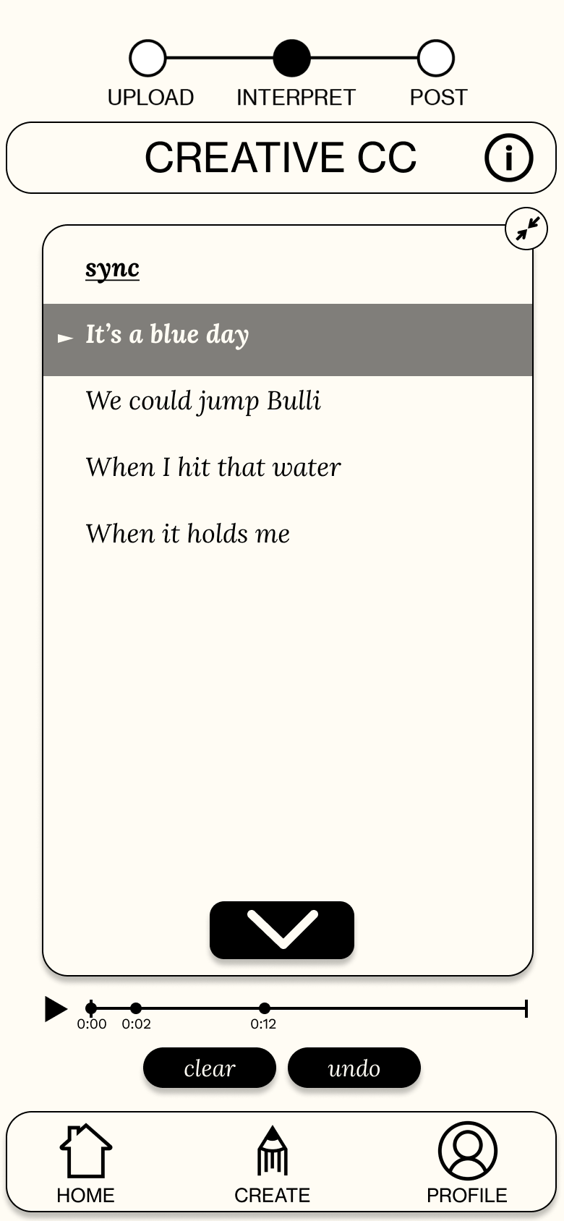
Hi-Fi Prototype V2

Slide 25
Field Testing
THE ALTIO LEARNING CURVE
Learning our way toward the most concise and didactic onboarding sequence.
ADDING FLEXIBILITY IN CREATE FLOW (CANCEL, EDIT, BACK)
IMPROVED SEARCH USABILITY AND BACKEND IMPLEMENTATION
IMPROVED ASL / CREATIVE CC SUPPORT
CLARITY IN POST PROCESS

Slide 26
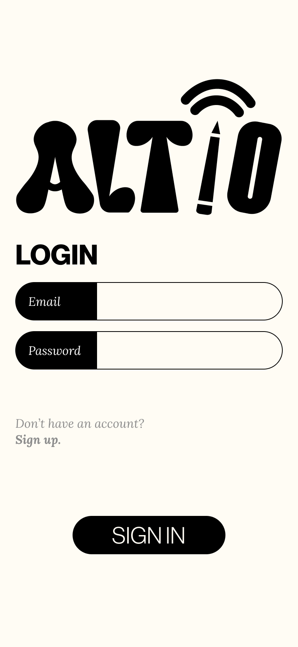
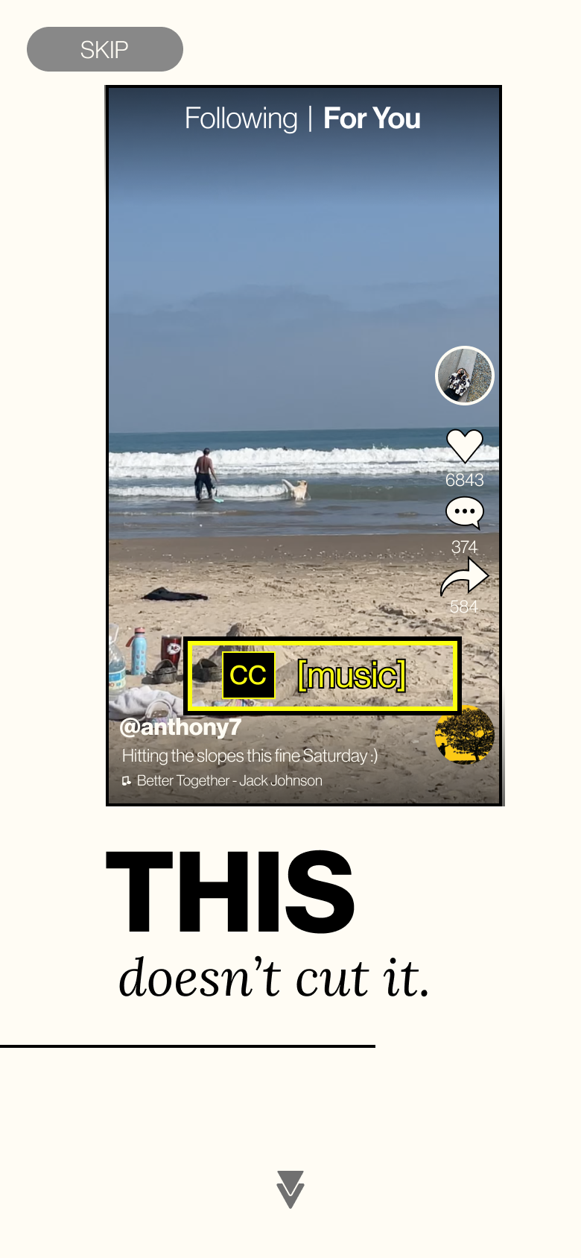
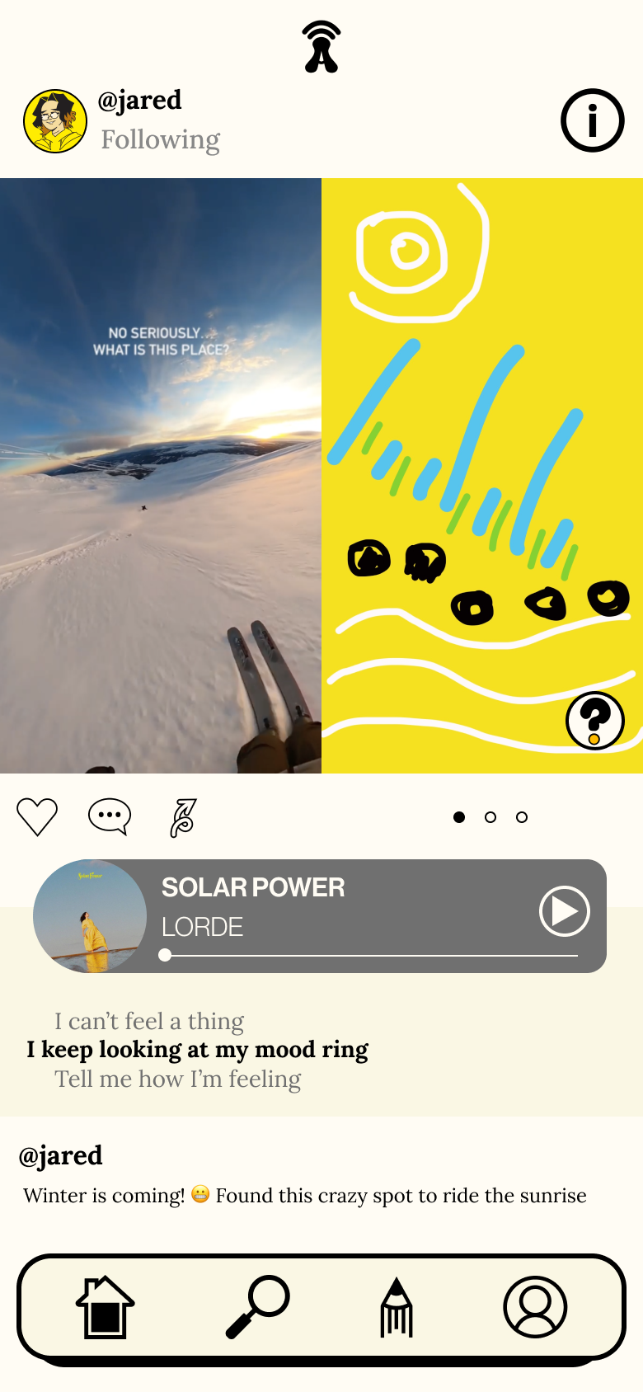
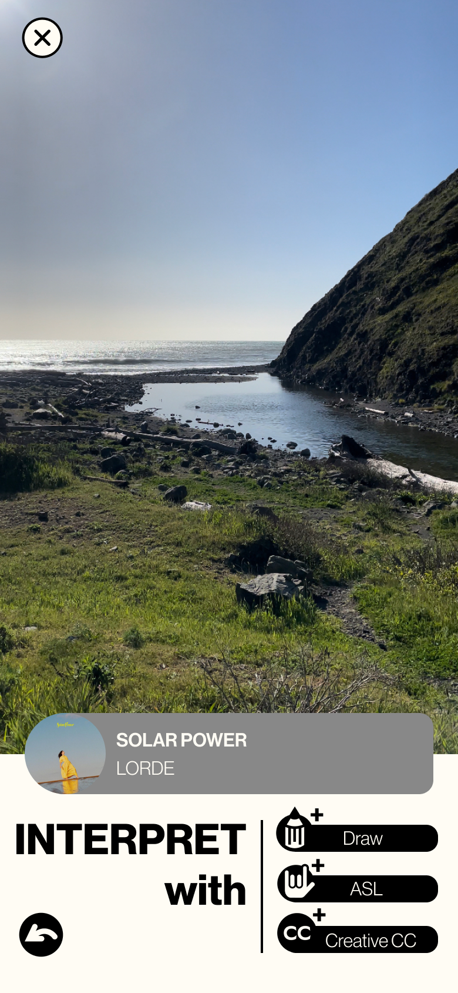
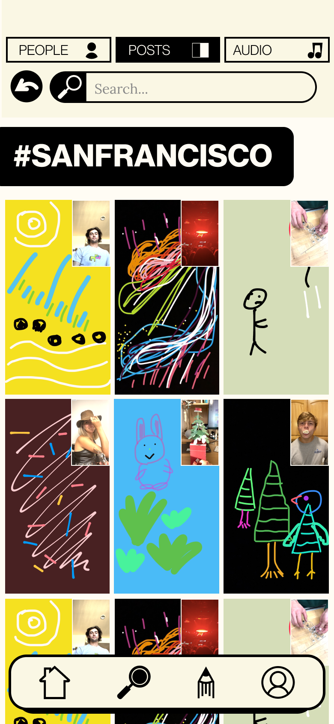
Hi-Fi Prototype V3

Slide 27
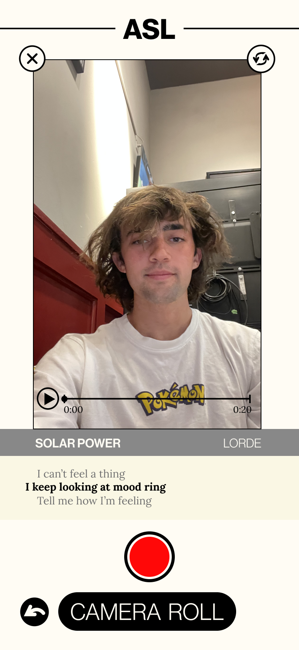
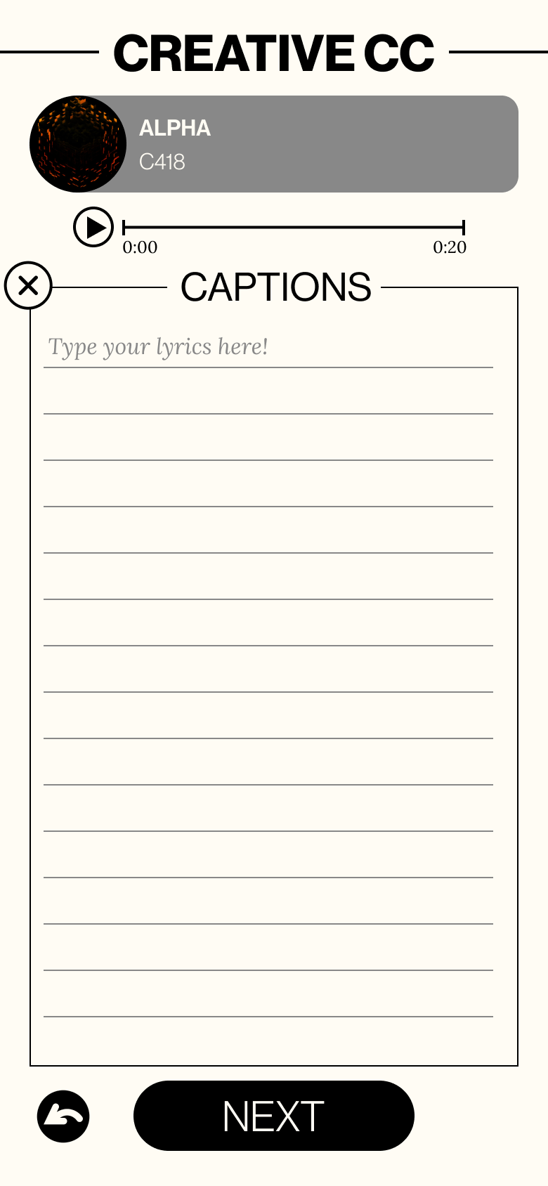
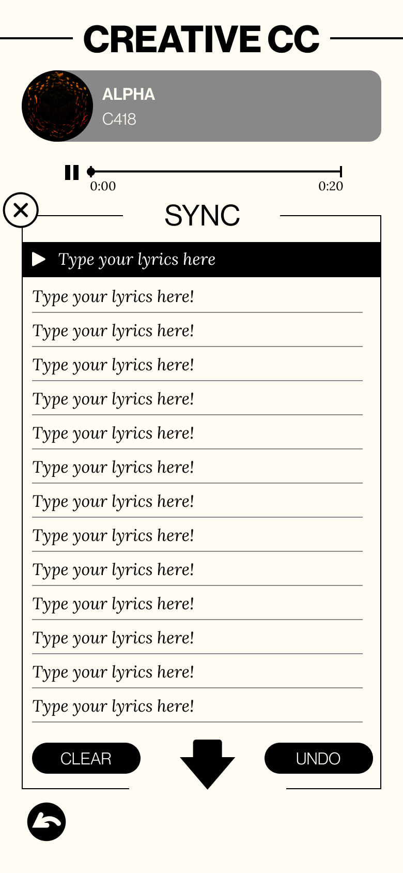
Hi-Fi Prototype V3

Slide 28
(WHERE ARE
WE NOW?)

Slide 29
Task 1 - GETTING STARTED
CREATE your individual profile
EXPLORE and learn about the app

Slide 30
Task 2 - SEE ALTIO
SCROLL through a robust home feed populated by users you’re following and suggested content
VIEW alternative interpretations from users including drawings, creative closed captioning,
and ASL
UNDERSTAND users by revealing their creative clarifications

Slide 31
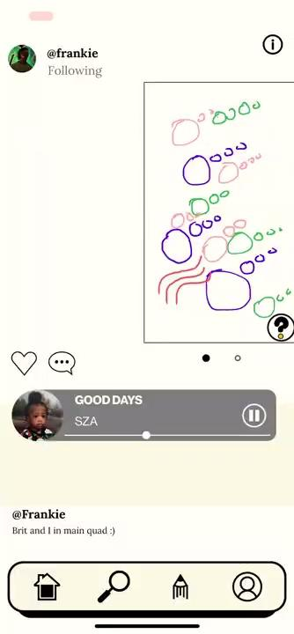
Task 3 - CREATE ALTIO
CREATE alternative interpretations based on your listening experience
DRAW what you hear
TRANSLATE audio into ASL
WRITE creative closed captioning like poetry
CLARIFY your post with annotations for other people to see

Slide 32
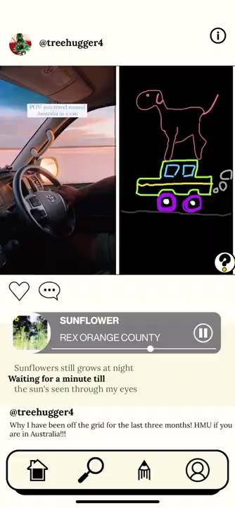
Task 4 - EXPLORE ALTIO
VIEW other users posts and scroll through interpretations
SEARCH for users, tags, music, and posts
TOGGLE between alternative interpretations
INTERACT with other users’ profiles

Slide 33
(WHAT COMES NEXT?)

Slide 34
[
Unimplemented
ALTERNATE ONBOARDING SEQUENCE
Considering asking about how users identify to create a more curated experience for a deaf or HoH user
This was a late add and new realization
Participant 007: “Confusing, there was a lot of verbiage, initially didn’t know it was for accessibility for me”
SPOTIFY x MUSIXMATCH
Having users own music in our app
We are in contact with musixmatch to get captions for music but they have been unresponsive and we do not want to include audio that does not have captions

Slide 35
