Slide 1
Extending Toddler
-1xx
LOADX xx
Loads the value from address xx into XR
-2xx
STOREX xx
Stores the value from XR into address xx
-3xx
LOAD xx(XR)
Loads AC with the contents of xx + XR
-4xx
STORE xx(XR)
Stores AC into address xx + XR
-500
RETURN
Returns from a function
-5xx
CALL xx
Call the function at address xx
-6xx
PUSH xx
Push the contents of xx on the stack
-7xx
POP xx
Pops the top element on the stack into xx
-8xx
INCHAR xx
Reads a character code into address xx
-9xx
OUTCHAR xx
Prints the character code in address xx
Chris Gregg, based on slides by Eric Roberts
CS 208E
October 15, 2021

Slide 2



The Concept of a Stack
A stack is a data structure in which the elements are accessible only in a last-in/first-out order. The operations on a stack are push, which adds a value to the top of the stack, and pop, which removes and returns the top value.
One of the most common metaphors for the stack concept is a spring-loaded storage tray for dishes. Adding a new dish to the stack pushes any previous dishes downward. Taking the top dish away allows the dishes to pop back up.
Stacks are important in von Neumann machines because function calls obey a last-in/first-out discipline.

Slide 3
The Toddler System Stack
Like all modern hardware, the Toddler machine implements a stack in hardware to simplify dividing programs up into independent functions.
The Toddler stack lives at the highest addresses in memory, so the bottom of a stack is at address 99, and the stack grows toward lower memory addresses.
The address of the element at the top of the stack is stored in the register SP. If the SP is 00, that means the stack is empty.
Pushing a value on the stack corresponds to subtracting one from the SP and then storing a value in the resulting address.
Popping the top value from the stack reverses the process by taking the current contents of the word addressed by SP and then adding one to SP.

Slide 4
Functions and Stacks
The CALL instruction pushes the current value of the PC (which has already been incremented to refer to the next instruction) on the stack. This value is called the return address.
The RETURN instruction pops the top value on the stack into the PC, which has the effect of returning to the point just after the CALL instruction.

Slide 5
The Extended Instruction Set
-1xx
LOADX xx
Loads the value from address xx into XR
-2xx
STOREX xx
Stores the value from XR into address xx
-3xx
LOAD xx(XR)
Loads AC with the contents of xx + XR
-4xx
STORE xx(XR)
Stores AC into address xx + XR
-500
RETURN
Returns from a function
-5xx
CALL xx
Call the function at address xx
-6xx
PUSH xx
Push the contents of xx on the stack
-7xx
POP xx
Pops the top element on the stack into xx
-8xx
INCHAR xx
Reads a character code into address xx
-9xx
OUTCHAR xx
Prints the character code in address xx

Slide 6
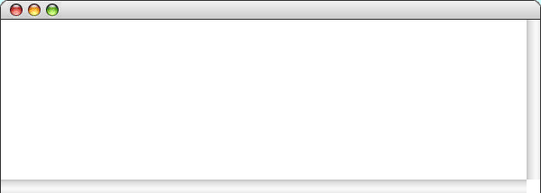
Exercise: Multiply as a Function
Rewrite the Multiply.td program so that it defines a function called mult that takes values in the variables n1 and n2 and returns its answer in a variable called result.
Use that function to write a program called Factorial.td that computes the factorial of an integer. The largest factorial that fits in three digits is 6!, so a sample run might look like this:
Console
?
6
720

Slide 7
The Extended Instruction Set
-1xx
LOADX xx
Loads the value from address xx into XR
-2xx
STOREX xx
Stores the value from XR into address xx
-3xx
LOAD xx(XR)
Loads AC with the contents of xx + XR
-4xx
STORE xx(XR)
Stores AC into address xx + XR
-500
RETURN
Returns from a function
-5xx
CALL xx
Call the function at address xx
-6xx
PUSH xx
Push the contents of xx on the stack
-7xx
POP xx
Pops the top element on the stack into xx
-8xx
INCHAR xx
Reads a character code into address xx
-9xx
OUTCHAR xx
Prints the character code in address xx

Slide 8
Class Example: Hello, World
The INCHAR and OUTCHAR instructions are similar to INPUT and OUTPUT except that they read and write the numeric representation of a single character.
The rest of this lecture develops three implementations of a program that prints the string “hello, world” on the console.
Console
hello, world

Slide 9
Hello World: The Brute Force Version
/*
* File: HelloWorld1.td
* --------------------
* Writes out "hello, world" character by character.
*/
start: OUTCHAR #104 /* The code for the character 'h' */
OUTCHAR #101 /* 'e' */
OUTCHAR #108 /* 'l' */
OUTCHAR #108 /* 'l' */
OUTCHAR #111 /* 'o' */
OUTCHAR #44 /* ',' */
OUTCHAR #32 /* ' ' */
OUTCHAR #119 /* 'w' */
OUTCHAR #111 /* 'o' */
OUTCHAR #114 /* 'r' */
OUTCHAR #108 /* 'l' */
OUTCHAR #100 /* 'd' */
OUTCHAR #10 /* The newline character ('\n') */
HALT

Slide 10
Self-Modifying Code
One of the defining features of the von Neumann architecture is that instructions and data are stored in the same memory. That fact makes it possible for programs to modify their own instructions by treating them just like any other numeric data.
The HelloWorld2.td program uses this technique to create an instruction that prints a character from the address that is the start of the string "hello, world" plus the value of the index i. It then stores that instruction in the program and executes it.
Programs that change their own instructions are said to be self-modifying. In early machines, this strategy was often the only way to accomplish certain operations. Today, it is generally seen as a dangerous programming practice.

Slide 11
Hello World: Self-Modifying Code
/*
* File: HelloWorld2.td
* --------------------
* Writes out "hello, world" using self-modifying code.
*/
start: LOAD #msg /* Load the address of the string */
CALL strout /* Call the function to output a string */
HALT /* And halt */
strout: STORE addr /* Store current address */
LOAD ldins /* Load a word with a LOAD 0 instruction */
ADD addr /* Add the address offset */
STORE patch /* Store the LOAD in the next word */
patch: 0 /* This will get filled in */
JUMPZ ret /* A zero character marks the end */
STORE ch /* Store the character */
OUTCHAR ch /* Write it out */
LOAD addr /* Get the current address */
ADD #1 /* Move to the next one */
JUMP strout /* And go back for more */
ret: RETURN /* Return from the strout function */
msg: "hello, world"
ldins: LOAD 0
addr: 0
ch: 0

Slide 12
The Ugliest Program I Ever Wrote
Guy Steele

Slide 13
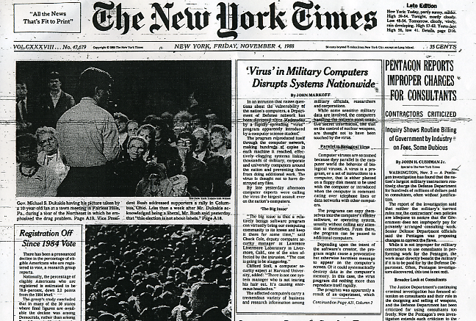
The Internet Worm

Slide 14

Robert Morris Jr.

Slide 15
How the Morris Worm Worked
One of Morris’s techniques was to exploit a bug in a system utility called fingerd, which was responsible for giving information about the users of a system. The fingerd code was susceptible to a buffer overflow attack, in which the hacker writes data past the end of an array. Failing to test the array bounds makes it possible to insert the worm’s own code on the system stack.
Storage for local variables in Unix is provided by a stack, which grows toward low memory addresses as functions are called.
If the user, however, enters a name string that overflows the buffer, the bytes in that name will overwrite the data on the stack.
e
t
r
h
o
i
b
s
e
-
r
i
t
s
s
-
\0
-
a
-
-
The fingerd code allocates a stack buffer to hold the user name, which might be declared like this:
char buffer[20];
l
o
n
g
Now when the function returns, it will jump into the code written as part of the name, thereby executing the worm’s instructions.
n
a
m
e
return address
return address
new return address
new code
What’s supposed to happen is that the name is read into the buffer and is then processed by some function, which eventually returns.
stack frames
from earlier calls
stack

Slide 16
The Extended Instruction Set
-1xx
LOADX xx
Loads the value from address xx into XR
-2xx
STOREX xx
Stores the value from XR into address xx
-3xx
LOAD xx(XR)
Loads AC with the contents of xx + XR
-4xx
STORE xx(XR)
Stores AC into address xx + XR
-500
RETURN
Returns from a function
-5xx
CALL xx
Call the function at address xx
-6xx
PUSH xx
Push the contents of xx on the stack
-7xx
POP xx
Pops the top element on the stack into xx
-8xx
INCHAR xx
Reads a character code into address xx
-9xx
OUTCHAR xx
Prints the character code in address xx

Slide 17
Index Registers
The HelloWorld3.td program avoids the self-modifying strategy by using the Toddler machine’s index register (XR), which automatically adds the contents of the index register to the address given in a LOAD or STORE instruction.
The LOADX and STOREX instructions load and store the contents of the XR itself. Supplying the (XR) suffix on a LOAD or STORE instruction changes what memory address is referenced.

Slide 18
Hello World: Using the Index Register
/*
* File: HelloWorld3.td
* --------------------
* Writes out "hello, world" using the index register.
*/
start: LOAD #msg /* Load the address of the string */
CALL strout /* Call the function to output a string */
HALT /* And halt */
strout: STORE addr /* Store current address */
LOADX addr /* Load that address into the XR */
LOADX 0(XR) /* Load the value at that address */
JUMPZ ret /* A zero character marks the end */
STORE ch /* Store the character */
OUTCHAR ch /* Write it out */
LOAD addr /* Get the current address */
ADD #1 /* Move to the next one */
JUMP strout /* And go back for more */
ret: RETURN /* Return from the strout function */
msg: "hello, world"
addr: 0
ch: 0

Slide 19
The End

