Slide 1
The P = NP Question
NP
P and NP
P
or
Chris Gregg, based on slides by Eric Roberts
CS 208E
October 24 , 2021

Slide 2
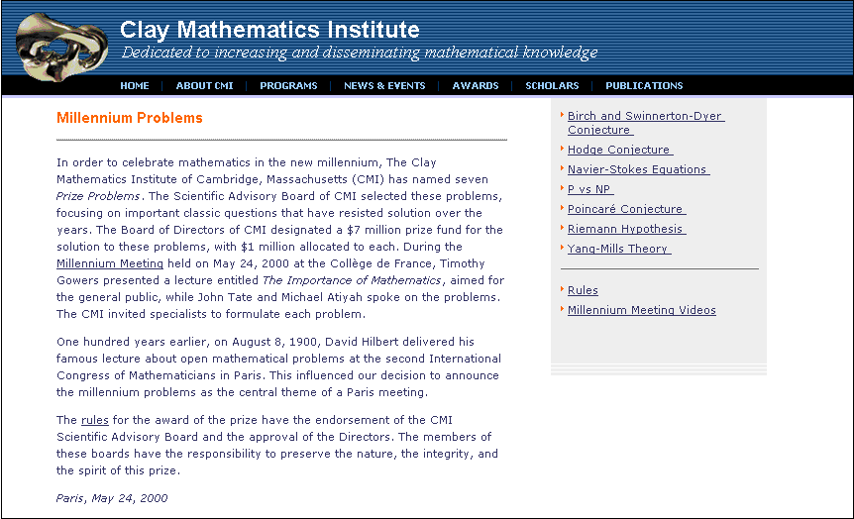
The P = NP Question

Slide 3
Definitions
The class P consists of all decision problems that can be solved in polynomial time by a deterministic Turing machine.
The class NP consists of all decision problems that can be solved in polynomial time by a nondeterministic Turing machine.
  A decision problem is one that has only a yes-or-no answer.
  Polynomial time is a measure of computational complexity that is bounded by a polynomial.
  A deterministic Turing machine follows only one execution path at a time.
  A nondeterministic Turing machine can follow multiple paths in parallel.
The P = NP question is whether these two classes are the same.

Slide 4
Preview: Computational Complexity
https://www.youtube.com/watch?v=MyeV2_tGqvw

Slide 5

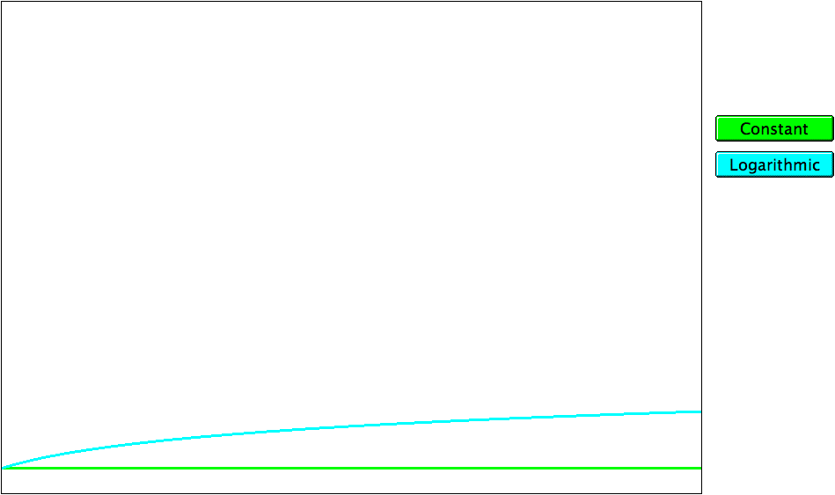
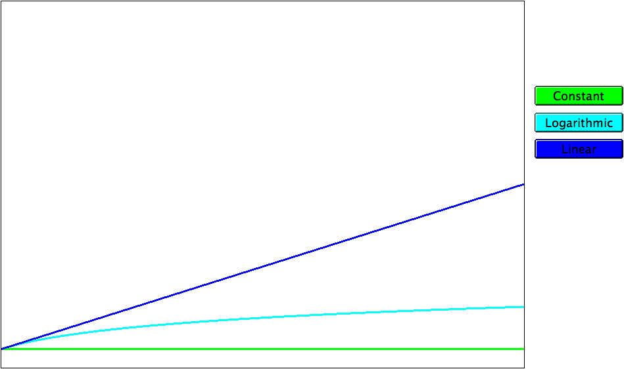
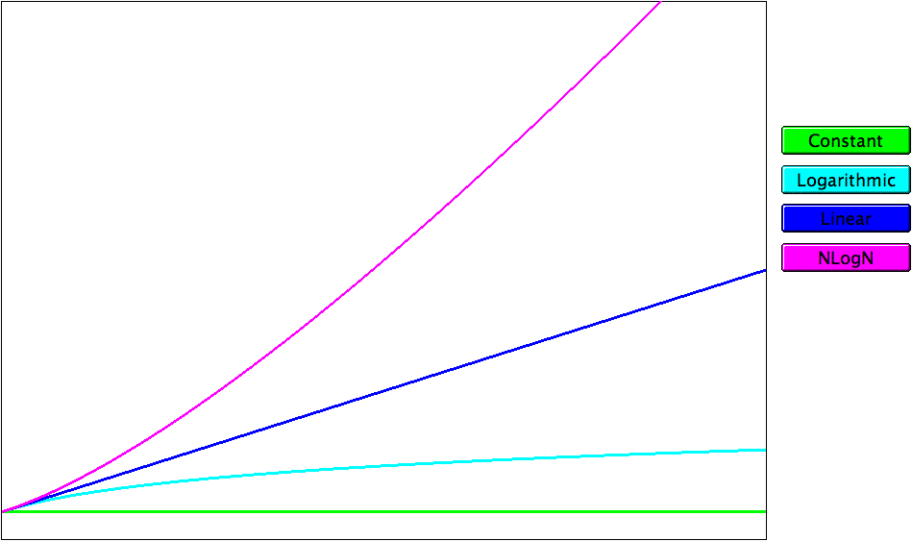
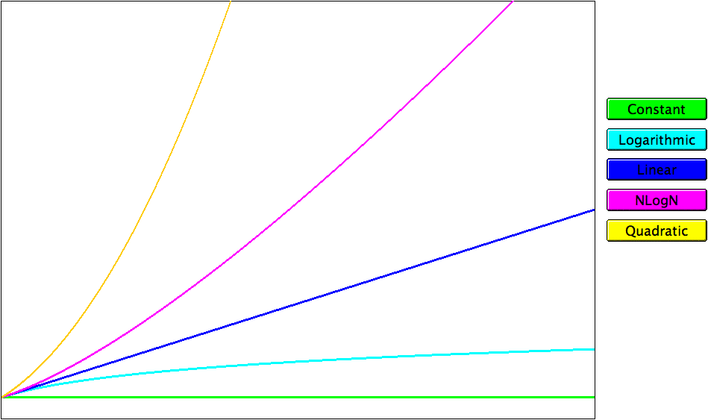
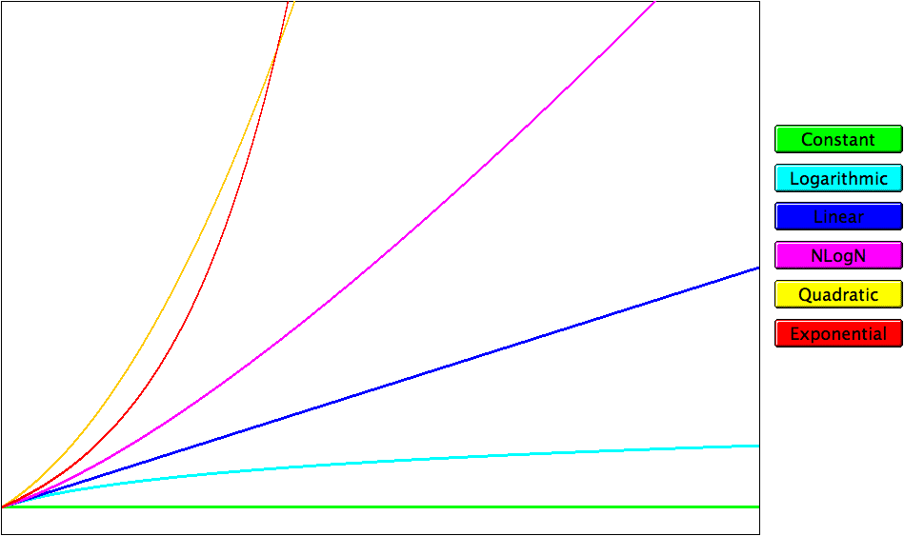
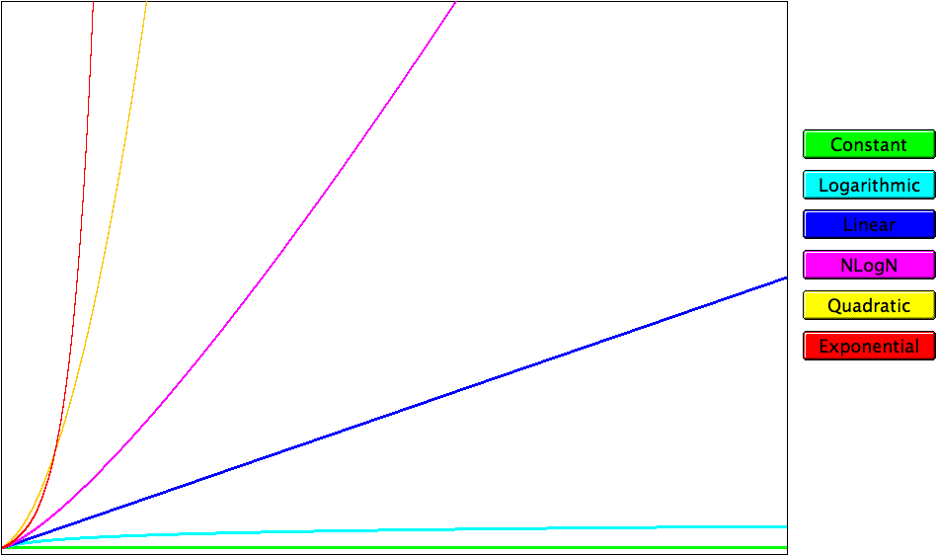
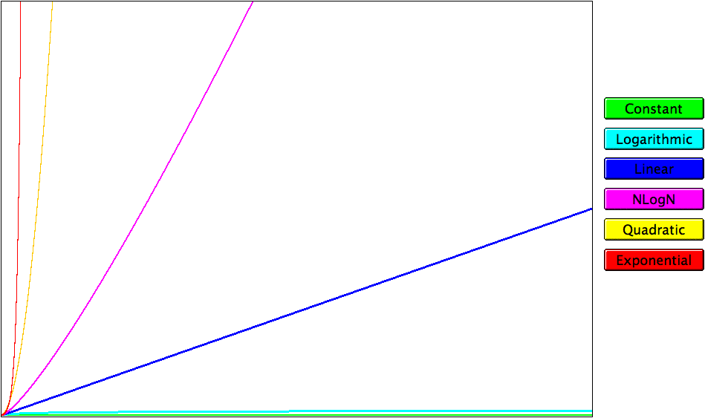
Graphs of the Complexity Classes
running time
problem size

Slide 6
Recursion
One of the most important great ideas in computer science is the concept of recursion, which is the process of solving a problem by dividing it into smaller subproblems of the same form. The italicized phrase is the essential characteristic of recursion; without it, all you have is a description of stepwise refinement of the sort we teach in courses like CS 106A.
The fact that recursive decomposition generates subproblems that have the same form as the original problem means that recursive programs will use the same function or method to solve subproblems at different levels of the solution. In terms of the structure of the code, the defining characteristic of recursion is having functions that call themselves, directly or indirectly, as the decomposition process proceeds.

Slide 7
A Simple Illustration of Recursion
Suppose that you are the national fundraising director for a charitable organization and need to raise $1,000,000.
One possible approach is to find a wealthy donor and ask for a single $1,000,000 contribution. The problem with that strategy is that individuals with the necessary combination of means and generosity are difficult to find. Donors are much more likely to make contributions in the $100 range.
Another strategy would be to ask 10,000 friends for $100 each. Unfortunately, most of us don’t have 10,000 friends.
Recursion offers a more promising strategy. All you need to do is find ten regional coordinators and ask each one to raise $100,000. Those regional coordinators in turn delegate the task to ten local coordinators, each with a goal of $10,000, and so on until the donations can be raised individually.

Slide 8
A Simple Illustration of Recursion
The following diagram illustrates the recursive strategy for raising $1,000,000 described on the previous slide:
Goal:
$1,000,000
Goal:
$100,000
Goal:
$100,000
Goal:
$100,000
Goal:
$100,000
Goal:
$100,000
Goal:
$100,000
Goal:
$100,000
Goal:
$100,000
Goal:
$100,000
Goal:
$100,000
Goal:
$10,000
Goal:
$10,000
Goal:
$10,000
Goal:
$10,000
Goal:
$10,000
Goal:
$10,000
Goal:
$10,000
Goal:
$10,000
Goal:
$10,000
Goal:
$10,000
Goal:
$1000
Goal:
$1000
Goal:
$1000
Goal:
$1000
Goal:
$1000
Goal:
$1000
Goal:
$1000
Goal:
$1000
Goal:
$1000
Goal:
$1000
Goal:
$100
Goal:
$100
Goal:
$100
Goal:
$100
Goal:
$100
Goal:
$100
Goal:
$100
Goal:
$100
Goal:
$100
Goal:
$100

Slide 9
A Pseudocode Fundraising Strategy
If you were to implement the fundraising strategy in the form of a JavaScript function, it would look something like this:
function collectContributions(n) {
if (n <= 100) {
Collect the money from a single donor.
} else {
Find 10 volunteers.
Get each volunteer to collect n/10 dollars.
Combine the money raised by the volunteers.
}
}
What makes this strategy recursive is that the line
Get each volunteer to collect n/10 dollars.
will be implemented using the following recursive call:
collectContributions(n / 10);

Slide 10
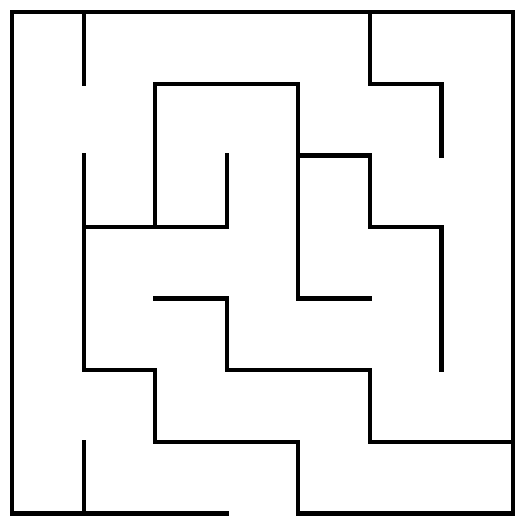
A Recursive View of Mazes
Solving a maze algorithmically is simplest if you use recursion, but coding that solution requires you to find the right recursive insight.
Consider the maze shown at the right. How can Theseus transform the problem into one of solving a simpler maze?
The insight you need is that a maze is solvable only if it is possible to solve one of the simpler mazes that results from shifting the starting location to an adjacent square and taking the current square out of the maze completely.
Θ

Slide 11
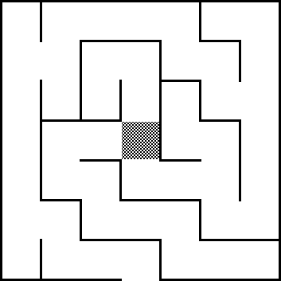
A Recursive View of Mazes
Thus, the original maze is solvable only if one of the three mazes at the bottom of this slide is solvable.
Each of these mazes is “simpler” because it contains fewer squares.
The simple cases are:
  Theseus is outside the maze
  There are no directions left to try
Θ
Θ
Θ
Θ

Slide 12
Recursion and Backtracking
The complete recursive solution operates as follows:
+
+
+
+
+
+
+
+
+
+
+
+
+
+
+
+
+
+
+
+
+
+
+
+
+
+
+
+
+
+
+
+
+
+
+
+
+
+
+

Slide 13
Exponential Backtracking
The time required for the standard backtracking algorithm grows exponentially if there are large open areas in the maze:
+
+
+
+
+
+
+
+
+
+
+
+
+
+
+
+
+
+
This exponential behavior is not fundamental to the maze algorithm. If the program doesn’t unmark the squares as it backtracks, the program can find the exit in linear time.

Slide 14
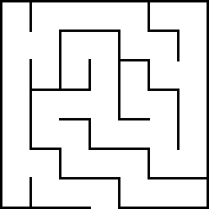
Exploiting Nondeterminism
Another approach to solving a maze is to explore all paths concurrently as you proceed. This strategy is analogous to cloning yourself at each intersection and sending one clone down each path.
6
5
5
5
5
4
4
6
5
1
1
5
5
4
7
5
1
1
2
5
4
7
3
3
1
2
2
4
Θ
7
3
3
2
2
2
4
7
7
3
3
3
4
4
8
7
7
7
3
3
3
7
Is this parallel strategy more efficient in the general case?

Slide 15
Nondeterministic Turing Machines
As with the nondeterministic maze solver, a nondeterministic Turing machine can explore more than one solution strategy at once.
In its most common formulation, a nondeterministic Turing machine is defined by allowing each instruction to transition to several new states. In effect, these multiple transitions clone the machine, with each of the clones continuing in a different state.
It is conventional to define two new states: accept and reject. A nondeterministic Turing Machine accepts its input if any of its cloned copies ever reaches the accept state.

Slide 16
Relationship between P and NP
All decision problems
NP
P

Slide 17
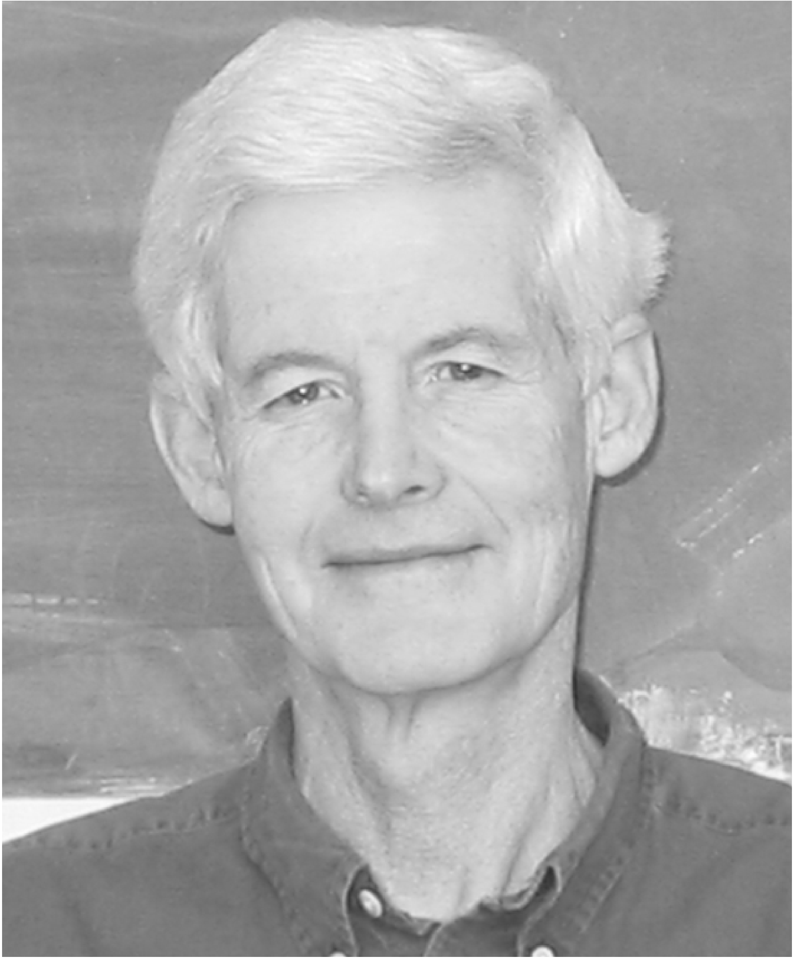
NP-Complete Problems
The search for an answer to the P=NP question depends on the notion of NP-complete problems, which was introduced by Stephen Cook in 1971. In an informal sense, a problem is NP-complete if it is provably as difficult to solve as any other problem in NP.
The immediate implication of this definition is that if some NP-complete problem can be solved in polynomial time, then all problems in NP can be solved in polynomial time.
Stephen Cook (1939–)
In practice, one establishes that a problem is NP-complete by showing that the computation of any nondeterministic Turing machine can be expressed in that domain.
https://www.youtube.com/watch?v=OY41QYPI8cw

Slide 18
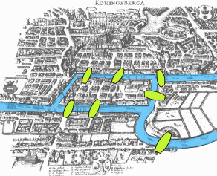
The Seven Bridges of Konigsberg
Source:
Bogdan Giuşcă - Public domain, based on the image, CC BY-SA 3.0,
https://commons.wikimedia.org/w/index.php?curid=112920

Slide 19
Euler’s Representation of the Bridges
Leonhard Euler (1707–1783) represented the Konigsberg bridge problem using a mutigraph, which allows vertices to be connected by multiple edges:
B
A
D
C
An Eulerian cycle is a path that traverses every edge of the graph exactly once and returns to its starting point.

Slide 20
Euler’s Theorem
A connected multigraph has an Eulerian cycle if and only if the degree of each vertex is even.
Euler’s graph of the bridges of Konigsberg therefore has no Eulerian cycle because the degree of every vertex is odd:
3
B
5
3
A
D
3
C
Euler’s theorem provides a necessary and sufficient condition.

Slide 21
Hamiltonian Cycles
A Hamiltonian cycle is one that passes through every vertex of the graph exactly once.
Suppose that G is the following graph:
2
2
3
1
3
1
4
4
5
5
6
6
Can you find a cycle that contains all the vertices in G?

Slide 22
The Petersen Graph
The Danish mathematician Julius Petersen (1839–1910) proved in 1898 that the following graph is not Hamiltonian:
8
2
1
7
9
3
5
4
6
10

Slide 23
Ore’s Theorem
Norwegian mathematician Øystein Ore (1899–1968) proved that a graph G is Hamiltonian if for all non-adjacent pairs of vertices x and y, their degree sum is at least the order of G.
The English physicist Paul Dirac (1902–1984) used Ore’s theorem to prove that a graph G is Hamiltonian if the degree of each of the N vertices is at least N / 2.
Each of these theorem’s provides a sufficient condition for a Hamiltonian graph, but not a necessary one. Any simple cycle is a Hamiltonian graph even though it fails these tests:

Slide 24
Recognizing Hamiltonian Graphs Is Hard
As far as we know, there is no simple test to determine whether a graph is Hamiltonian.
In fact, all known algorithms for determining whether a graph is Hamiltonian take exponential time.
The Hamiltonian graph problem is an NP-complete problem. If the Hamiltonian graph problem has a polynomial time solution, then every problem in NP has a polynomial time solution.

Slide 25
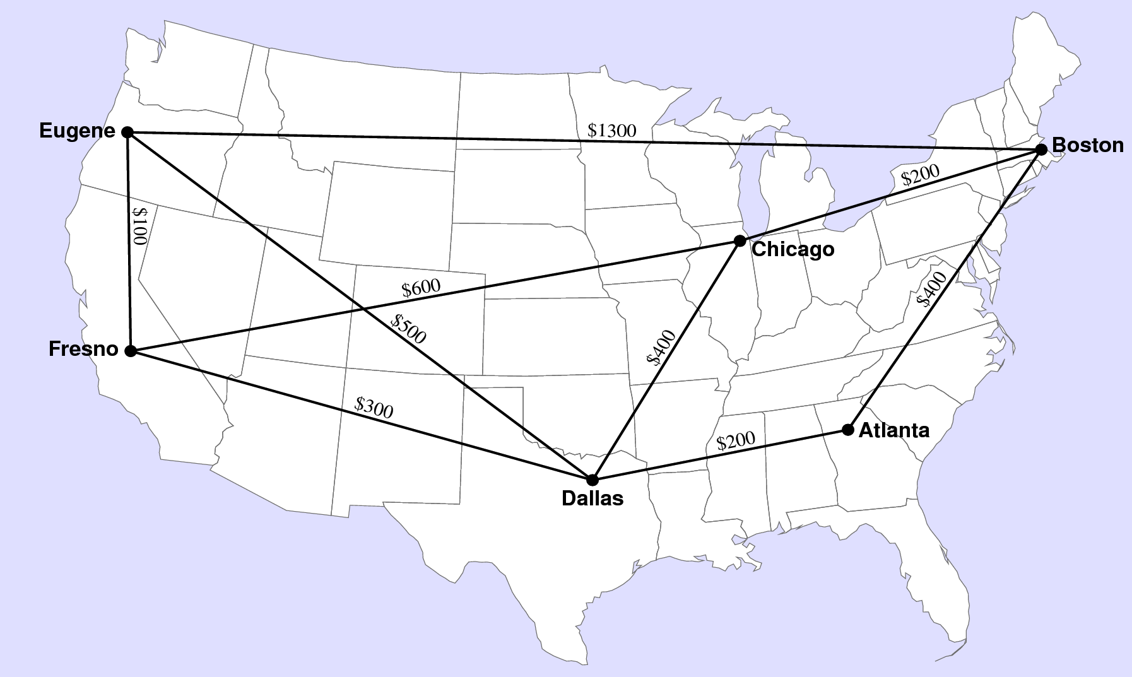
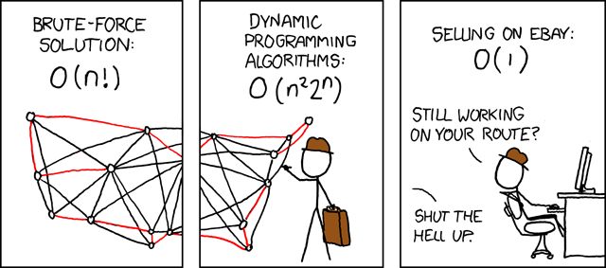
Traveling Salesman Problem
One of the classic NP-complete problems, which is closely related to the Hamiltonian cycle problem, is the Traveling Salesman Problem (often designated as TSP for short), which asks, Given a list of cities and the distances between each pair of cities, what is the shortest possible route that visits each city and returns to the origin city?
—Randall Munroe, XKCD

Slide 26
The Subset-Sum Problem
Suppose that you have a set of integers called S. The subset-sum problem asks whether there is a subset of the elements of S that add up to a particular target value t.
For example, if S is the set { –3, 5, 7, 10 }, the subset-sum problem when t is 12 returns the answer true because the elements in the subset { –3, 5, 10 } add up to 12. By contrast, if t were 11, the answer is false because it is impossible to choose a subset of S whose values adds up to 11.
In his early study of NP-complete problems in 1972, Richard Karp proved that the subset-sum problem is NP-complete, although his original papers refer to the problem by a different name.
As you will see next week, the subset-sum problem plays a role in the development of public-key cryptography.

Slide 27
The Knapsack Problem
The knapsack problem, which dates back to 1897, asks the following question: Given a set of items, each with a weight and a value, determine the number of each item to include in a collection so that you keep the total weight under given limit and maximize the total value.
Although the knapsack problem is NP-complete, there are efficient strategies that often provide good answers. Such strategies are called heuristics and cannot guarantee the best possible result.

Slide 28
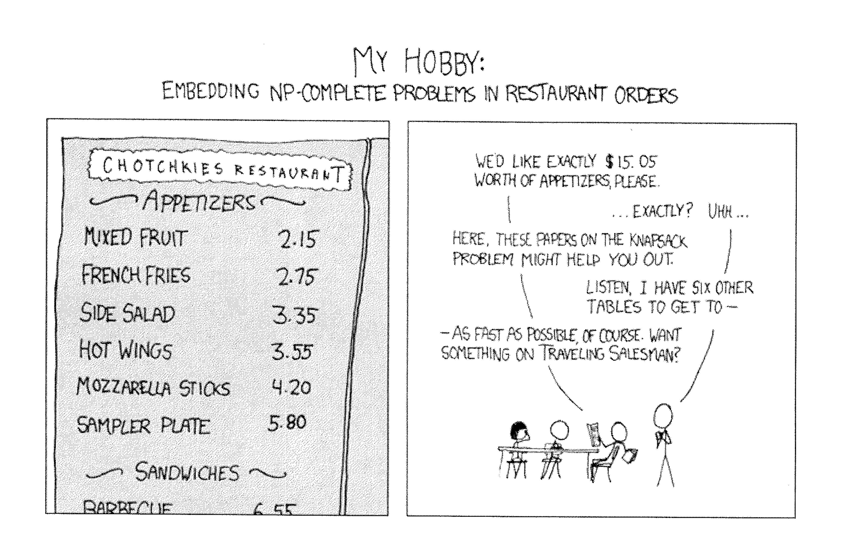
NP-Complete Problems
—Randall Munroe, XKCD

Slide 29
Graph Coloring
Suppose that you have a graph consisting of a set of vertices connected by a set of edges, such as the one shown on the right.
The vertices of this graph can be colored using three colors so that no adjacent vertices share a color. You could, for example, color 1 and 3 white, 2 and 4 red, and 5 blue.
In the second graph, every node is adjacent to all the others, so that each must have a different color.
Deciding whether a graph can be colored with k colors is NP-complete.
1
2
5
3
4
1
4
2
3

Slide 30
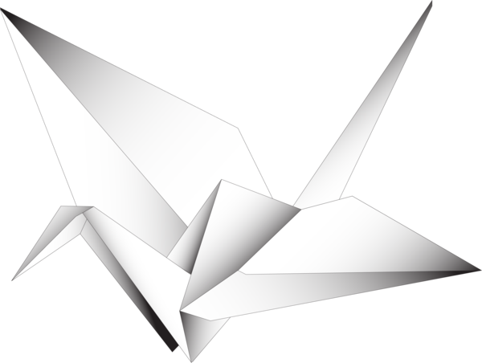
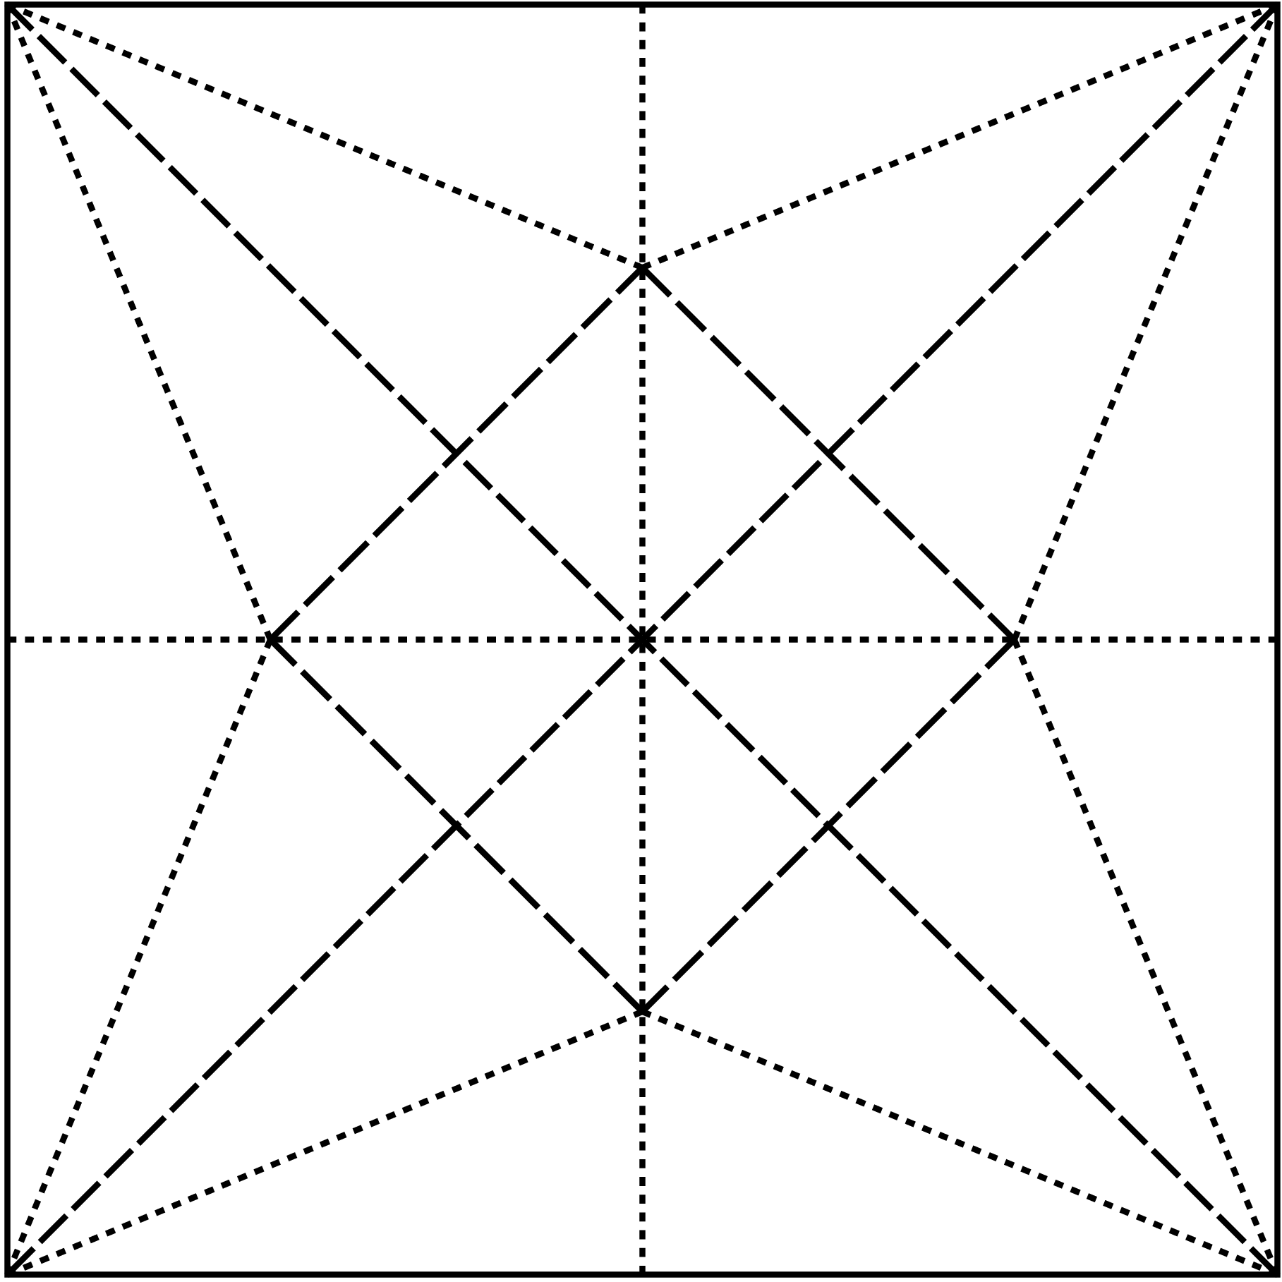
Origami Folding
The diagram at the right shows the first eight folds on the way to the creation of a classic origami crane.
In some of these folds, the crease rises toward you from the paper. These are called mountain folds and appear as dashed lines. In other folds, the crease moves away from you. These are called valley folds and appear as dotted lines.
In 1996, Marshall Bern and Barry Hayes proved that deciding whether a particular pattern of mountain and valley folds will produce a flat origami figure is NP-complete.

Slide 31
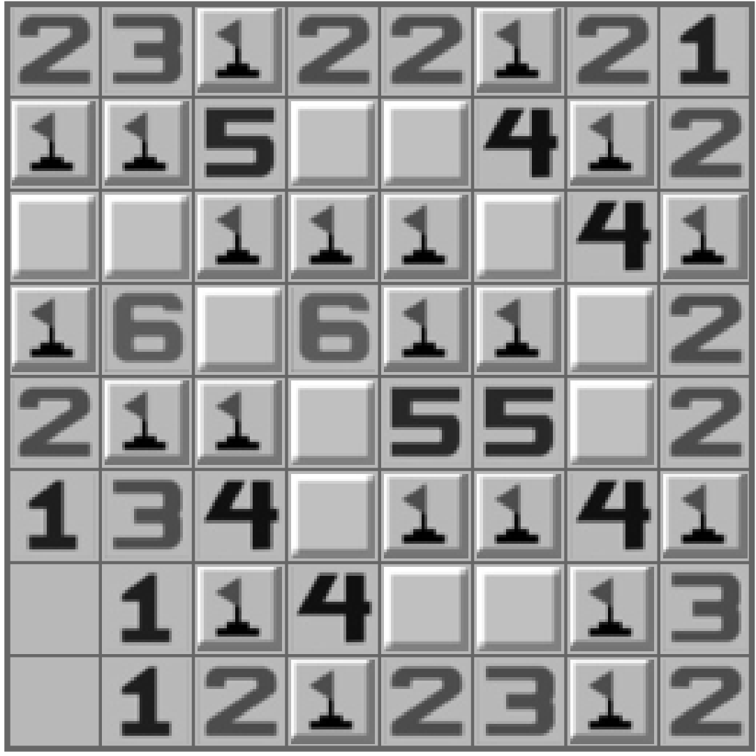
Minesweeper
One of the most widely publicized NP-complete problems is that of determining whether a particular pattern of warning counts in the popular Microsoft Minesweeper game is consistent.
In 2000, Richard Kaye published a paper proving that solving the minesweeper consistency problem is NP-complete.
Because of the popularity of the game, Kaye’s result was reported in newspapers throughout the world.

Slide 32
Satisfiability
The problem that Steven Cook used in his proof is the Satisfiability Problem (commonly abbreviated as SAT), which asks whether any assignment of values to the variables of an expression in predicate logic makes that expression true.
Expressions in predicate logic consist of individual terms, each of which can take on the value true or false, connected by operators, which include ∧ (and), ∨ (or), and ¬ (not). Terms appear as lowercase italic letters, such as p, q, r, and s.
The SAT problem requires that the logical expression be in conjunctive normal form, in which the expression consists of individual terms, possibly preceded by ¬ (and usually written using an overbar instead of the ¬ symbol), and then combined first by the ∨ operator, and finally by the ∧ operator. It is always possible to use the rules of logic to rewrite any expression in conjunctive normal form.
https://www.youtube.com/watch?v=-wlUDJZb6-Q

Slide 33
Proving Satisfiability is NP-Complete
The goal is to show that SAT is NP-complete, which means that a polynomial time solution to SAT implies a polynomial time solution to an arbitrary problem in NP.
If X is an arbitrary problem in NP, that means that there must be a Turing machine M_{X} that solves X in time bounded by a polynomial p_{X}.
The fact that the running time of M_{X} is bounded by p_{X} not only limits the number of steps M_{X} can execute but also puts an upper bound on how many tape squares it can reach because the tape head can move only one square per step.
If SAT can be solved in polynomial time, it is then possible to solve X in polynomial time by taking its Turing machine M_{X}, transforming it into an equivalent SAT problem, and then using the polynomial-time solution of SAT to find the answer.

Slide 34
Constructing the SAT Expression
Step 1:
Start with a Turing machine M_{X} and its polynomial p_{X}.
Step 2:
Create a set of logical variables to describe the computation:
s_{k,t}
indicates that the machine is in state k at time t.
p_{k,t}
indicates that the tape head is in position k at time t.
c_{k,t}
indicates that the tape square k contains a 1 at time t.
Step 3:
Encode the Turing machine operation as logical rules that
Encode the initial configuration
Ensure the machine is in exactly one state.
Ensure the tape head is in one position.
Restrict changes to the tape head.
Encode all transitions of the machine.
Guarantee that the machine ends in the accept state.

Slide 35
The End

