Slide 1
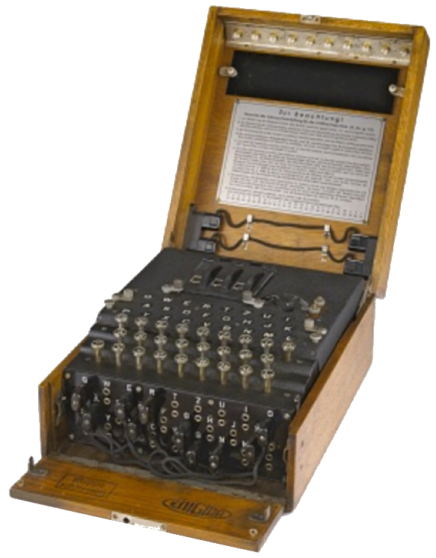
Cryptography
Chris Gregg, based on slides by Eric Roberts
CS 208E
October 29, 2021

Slide 2
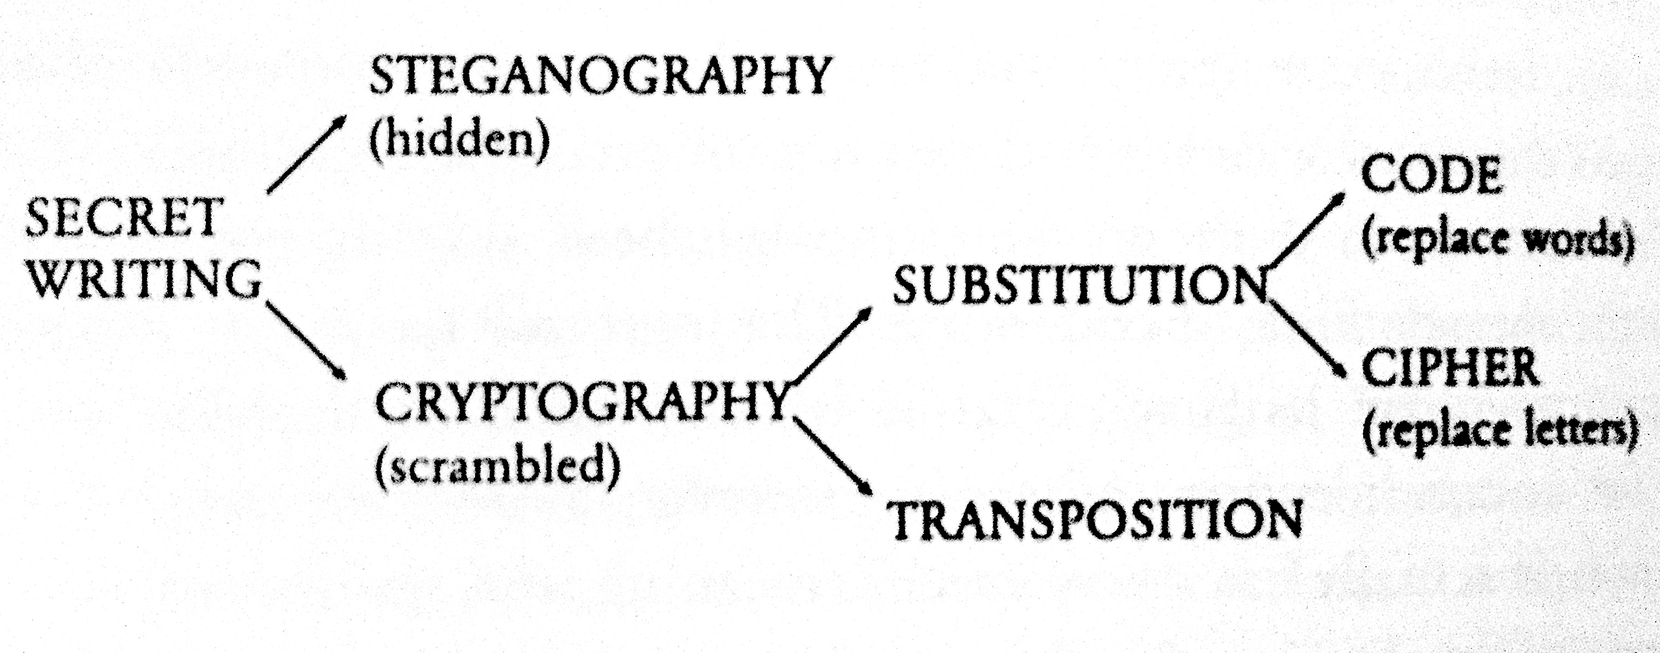
Taxonomy of Secret Writing
(Simon Singh, 1999 )

Slide 3
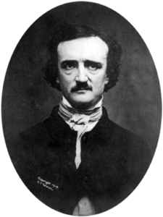
Cryptograms
A cryptogram is a puzzle in which a message is encoded by replacing each letter in the original text with some other letter. The substitution pattern remains the same throughout the message. Your job in solving a cryptogram is to figure out this correspondence.
One of the most famous cryptograms was written by Edgar Allan Poe in his short story “The Gold Bug.”
In this story, Poe describes the technique of assuming that the most common letters in the coded message correspond to the most common letters in English, which are E, T, A, O, I, N, S, H, R, D, L, and U.
Edgar Allan Poe (1809-1849)

Slide 4
Poe’s Cryptogram Puzzle
5
3
‡
‡
†
3
0
5
)
)
6
*
;
4
8
2
6
)
4
‡
•
)
4
‡
)
;
8
0
6
*
;
4
8
†
8
¶
8
33
6
0
)
)
8
5
;
1
‡
(
;
:
‡
*
8
†
8
3
(
8
8
)
5
*
†
;
4
6
(
;
8
8
*
9
6
*
;
26
?
;
8
)
*
‡
(
;
4
8
5
)
;
5
*
†
2
:
*
‡
(
;
4
9
5
6
*
2
(
5
*
–
4
)
8
¶
4
19
8
*
;
4
0
6
9
2
8
5
)
;
)
6
†
8
)
4
‡
‡
;
1
(
‡
9
;
4
8
0
8
1
;
8
:
8
‡
‡
16
1
;
4
8
†
8
5
;
4
)
4
8
5
†
5
2
8
8
0
6
*
8
1
(
‡
9
;
4
8
;
(
8
8
;
4
(
)
16
*
13
‡
?
3
4
;
4
8
)
4
‡
;
1
6
1
;
:
1
8
8
;
‡
?
;
5
12
6
11
(
10
†
8
1
8
0
6
9
5
5
2
5
5
5
A
3
3
3
G
‡
‡
‡
O
‡
‡
‡
O
†
†
†
D
3
3
3
G
0
0
0
L
5
5
5
A
)
)
)
S
)
)
)
S
6
6
6
I
*
*
*
N
;
;
T
T
4
4
H
H
8
E
E
E
2
2
2
B
6
6
6
I
)
)
)
S
4
4
H
H
‡
‡
‡
O
•
•
•
P
)
)
)
S
4
4
H
H
‡
‡
‡
O
)
)
)
S
;
;
T
T
8
E
E
E
0
0
0
L
6
6
6
I
*
*
*
N
;
;
T
T
4
4
H
H
8
E
E
E
†
†
†
D
8
E
E
E
¶
¶
¶
V
6
:
4
6
6
I
0
0
0
L
)
)
)
S
)
)
)
S
8
E
E
E
5
5
5
A
;
;
T
T
1
1
1
F
‡
‡
‡
O
(
(
(
R
;
;
T
T
:
:
:
Y
‡
‡
‡
O
*
*
*
N
8
E
E
E
†
†
†
D
8
E
E
E
3
3
3
G
(
(
(
R
8
E
E
E
8
E
E
E
)
)
)
S
5
5
5
A
*
*
*
N
†
†
†
D
;
;
T
T
4
4
H
H
6
6
6
I
(
(
(
R
;
;
T
T
8
E
E
E
8
E
E
E
*
*
*
N
9
9
9
M
6
6
6
I
*
*
*
N
?
3
4
?
?
U
;
;
T
T
8
E
E
E
)
)
)
S
*
*
*
N
‡
‡
‡
O
(
(
(
R
;
;
T
T
4
4
H
H
8
E
E
E
5
5
5
A
)
)
)
S
;
;
T
T
5
5
5
A
*
*
*
N
†
†
†
D
2
2
2
B
:
:
:
Y
*
*
*
N
‡
‡
‡
O
(
(
(
R
;
;
T
T
4
4
H
H
9
9
9
M
5
5
5
A
6
6
6
I
*
*
*
N
2
2
2
B
(
(
(
R
5
5
5
A
*
*
*
N
–
–
–
C
4
4
H
H
)
)
)
S
8
E
E
E
¶
¶
¶
V
?
3
8
E
E
E
*
*
*
N
;
;
T
T
4
4
H
H
0
0
0
L
6
6
6
I
9
9
9
M
2
2
2
B
8
E
E
E
5
5
5
A
)
)
)
S
;
;
T
T
)
)
)
S
6
6
6
I
†
†
†
D
8
E
E
E
)
)
)
S
4
4
H
H
‡
‡
‡
O
‡
‡
‡
O
;
;
T
T
1
1
1
F
(
(
(
R
‡
‡
‡
O
9
9
9
M
;
;
T
T
4
4
H
H
8
E
E
E
0
0
0
L
8
E
E
E
1
1
1
F
;
;
T
T
8
E
E
E
:
:
:
Y
8
E
E
E
‡
‡
‡
O
¶
2
1
1
1
F
;
;
T
T
4
4
H
H
8
E
E
E
†
†
†
D
8
E
E
E
5
5
5
A
;
;
T
T
4
4
H
H
)
)
)
S
4
4
H
H
8
E
E
E
5
5
5
A
†
†
†
D
5
5
5
A
2
2
2
B
8
E
E
E
8
E
E
E
0
0
0
L
6
6
6
I
*
*
*
N
8
E
E
E
1
1
1
F
(
(
(
R
‡
‡
‡
O
9
9
9
M
;
;
T
T
4
4
H
H
8
E
E
E
;
;
T
T
(
(
(
R
8
E
E
E
8
E
E
E
;
;
T
T
4
4
H
H
(
(
(
R
–
1
‡
•
1
‡
‡
O
?
?
?
U
3
3
3
G
4
4
H
H
;
;
T
T
4
4
H
H
8
E
E
E
)
)
)
S
4
4
H
H
‡
‡
‡
O
;
;
T
T
1
1
1
F
6
6
6
I
1
1
1
F
;
;
T
T
:
:
:
Y
1
1
1
F
8
E
E
E
8
E
E
E
;
;
T
T
‡
‡
‡
O
?
?
?
U
;
;
T
T
Notes:
4

Slide 5
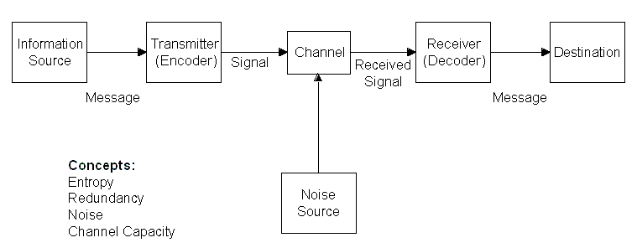
Shannon and Weaver’s
“Mathematical Model of Communication”

Slide 6
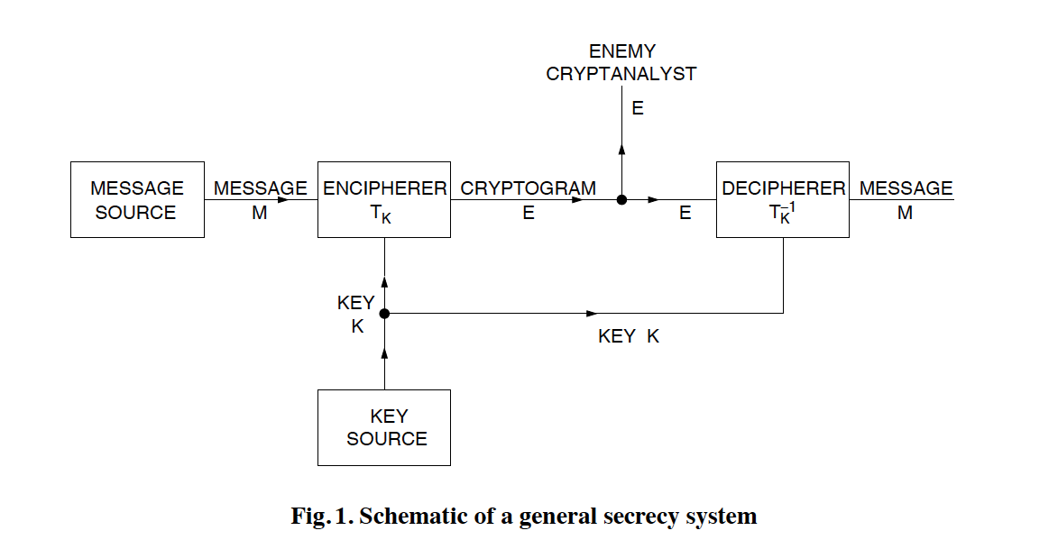
Shannon’s Model of Cryptography

Slide 7

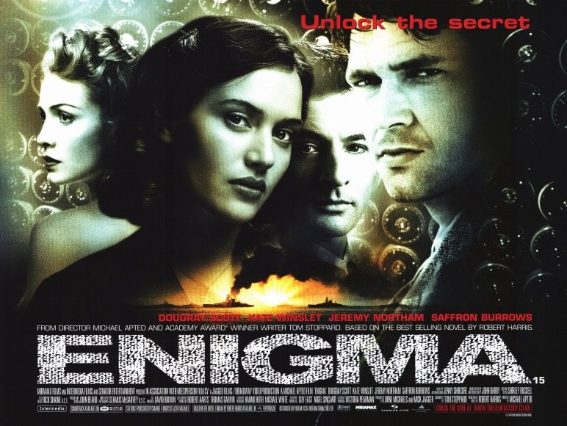
Enigma Trailer

Slide 8
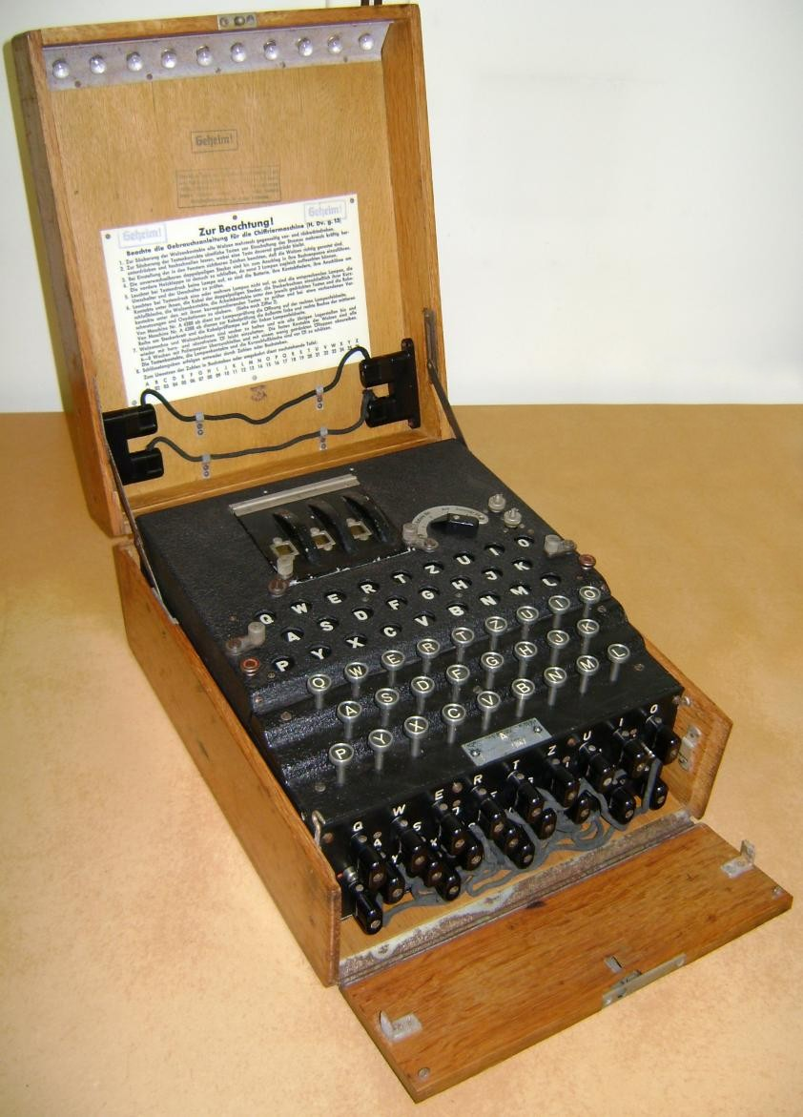
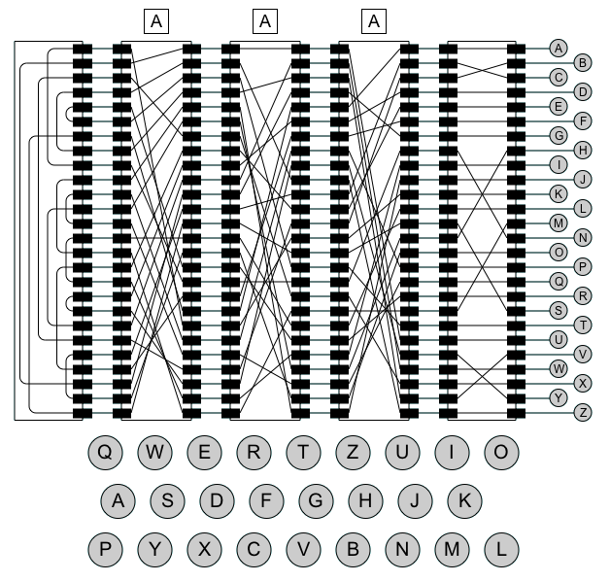
The Enigma Machine
Notes:
8

Slide 9
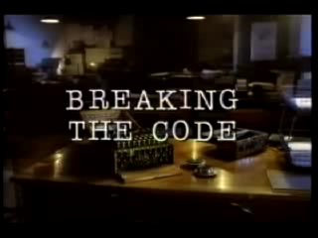
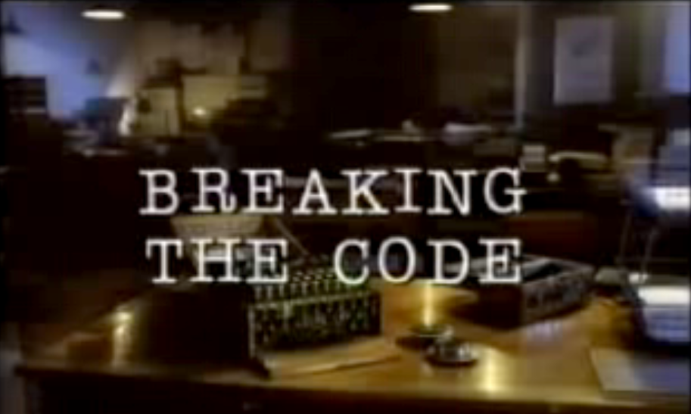
Breaking the Code
https://www.youtube.com/watch?v=Av6EUqf10vM&t=2076s
37:01 – 39:25

Slide 10
Important Properties of the Enigma Code
The decryption team at Bletchley was able to exploit the following facts about the Enigma machine:
  The encoding is symmetrical.
  The Enigma machine can never map a character into itself.
  The steckerboard does not affect the transformation pattern of the rotors, but only the characters to which the outputs of that rotor are assigned.
The codebreakers were also helped by the fact that the Germans were often both careless and overconfident. In believing they had an unbreakable encoding machine, they failed to take adequate measures to safeguard the integrity of their communications.

Slide 11
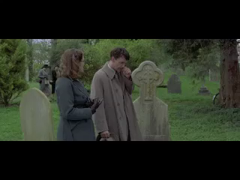
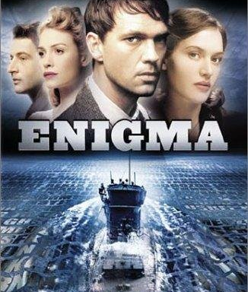
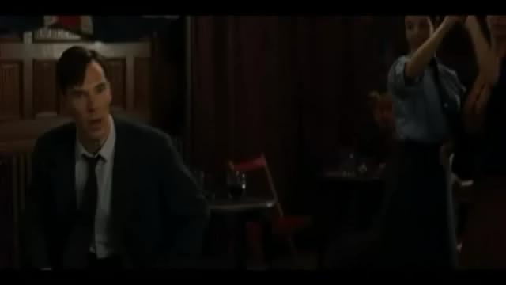

Breaking the Enigma Code
The most common technique used at Bletchley Park was the known-plaintext attack, in which the codebreakers guess that a particular sequence of characters exists somewhere in the decoded message. A sequence of characters that you guess is part of the plaintext is called a crib.

Slide 12
Breaking the Enigma Code
The most common technique used at Bletchley Park was the known-plaintext attack, in which the codebreakers guess that a particular sequence of characters exists somewhere in the decoded message. A sequence of characters that you guess is part of the plaintext is called a crib.
Breaking an Enigma message required the following steps:
  Align the crib with the ciphertext to eliminate crashes in which a letter appears to map to itself.
  Create a menu recording the links between letter pairs in the crib and ciphertext.
  Identify loops in the menu at which a chain of letter pairs cycles back to the original letter.
  Use the loops in the menu to create a wiring pattern for an electromechanical device called a Bombe that searches for settings of the Enigma rotors that produce the observed pattern.

Slide 13
Step 1: Align the Crib and Ciphertext
U
A
E
N
F
V
R
L
B
Z
P
W
M
E
P
M
I
H
F
S
R
J
X
F
M
J
K
W
R
A
X
Q
E
Z
K
E
K
I
E
K
N
I
E
K
E
N
I
E
K
B
E
N
I
E
K
E
B
E
N
I
E
S
E
B
E
N
I
O
S
E
B
E
N
N
O
S
E
B
E
D
N
O
S
E
B
E
D
N
O
S
E
R
E
D
N
O
S
E
R
E
D
N
O
N
E
R
E
D
N
E
N
E
R
E
D
R
E
N
E
R
E
E
R
E
N
E
R
I
E
R
E
N
E
G
I
E
R
E
N
N
G
I
E
R
E
I
N
G
I
E
R
S
I
N
G
I
E
S
S
I
N
G
I
E
S
S
I
N
G
E
S
S
I
N
E
S
S
I
E
S
S
E
S
E
No crashes exist in this alignment, so it is a feasible solution.

Slide 14
Step 2: Construct the Menu
V
V
R
R
L
L
B
B
Z
Z
P
P
W
W
M
M
E
E
P
P
M
M
I
I
H
H
F
F
S
S
R
R
J
J
X
X
F
F
M
M
J
J
K
K
W
W
R
R
A
A
K
K
E
E
I
I
N
N
E
E
B
B
E
E
S
S
O
O
N
N
D
D
E
E
R
R
E
E
N
N
E
E
R
R
E
E
I
I
G
G
N
N
I
I
S
S
S
S
E
E
0
0
1
1
2
2
3
3
4
4
5
5
6
6
7
7
8
8
9
9
10
10
11
11
12
12
13
13
14
14
15
15
16
16
17
17
18
18
19
19
20
20
21
21
22
22
23
23
24
24
L
K
0
V
2
21
O
F
18
I
H
P
5
B
8
13
11
12
9
3
1, 15
Z
4
E
1
R
16
J
20
N
G
24
17
6
23
14
19
A
X
W
22
S
7
M
10
D

Slide 15
Step 3: Find the Loops
V
R
L
B
Z
P
W
M
E
P
M
I
H
F
S
R
J
X
F
M
J
K
W
R
A
K
E
I
N
E
B
E
S
O
N
D
E
R
E
N
E
R
E
I
G
N
I
S
S
E
0
1
2
3
4
5
6
7
8
9
10
11
12
13
14
15
16
17
18
19
20
21
22
23
24
L
K
0
V
2
21
O
F
18
I
H
P
5
B
8
13
11
12
9
3
Z
4
E
1, 15
R
16
J
20
N
G
24
17
6
23
14
19
A
X
W
22
S
7
M
10
D

Slide 16
Exercise: Enigma Decryption
On D-Day (June 6, 1944), the first Enigma decrypt used the following crib:
W
E
T
T
E
R
V
O
R
H
E
R
S
A
G
E
B
I
S
K
A
Y
A
You believe that this crib exists somewhere in the following ciphertext:
Q
F
Z
W
R
W
I
V
T
Y
R
E
S
X
B
F
O
G
K
U
H
Q
B
A
I
S
E
Z
Create the menu that Alan Turing and his Bletchley Park colleagues would use to program the Bombe.

Slide 17
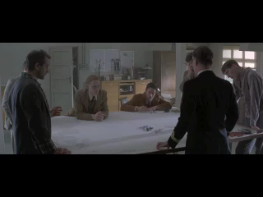
Enigma Decryption

Slide 18

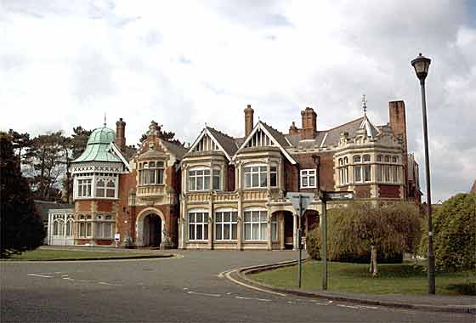
Cryptography—Bletchley Park
Bletchley
Oxford
If you have the chance to visit Bletchley Park—the home of the Government Code and Cipher School (GCCS), where the Enigma code was broken—do it. It is a fun museum and a great tour of WWII history.

Slide 19
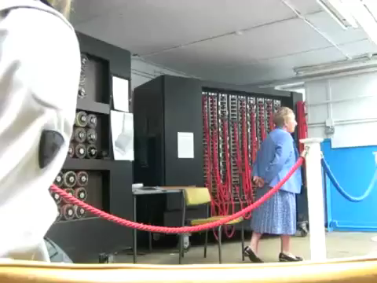
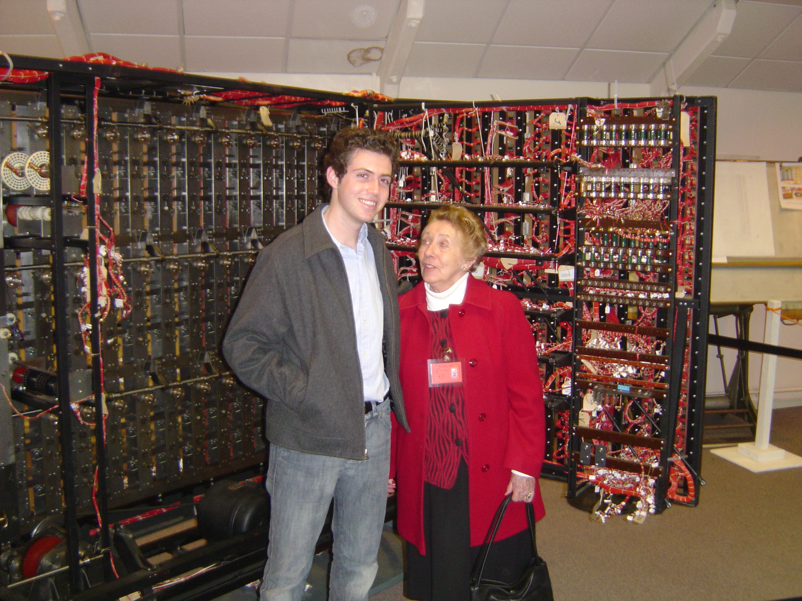
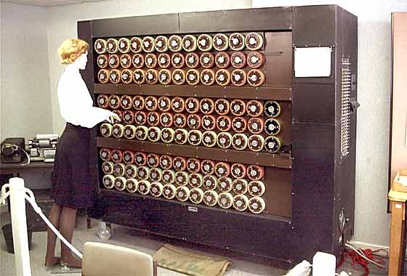
Cryptography—Bletchley Park
One Bletchley Park tour guide is Jean Valentine, who worked with the Bombe decryption machine shown in these pictures.

Slide 20
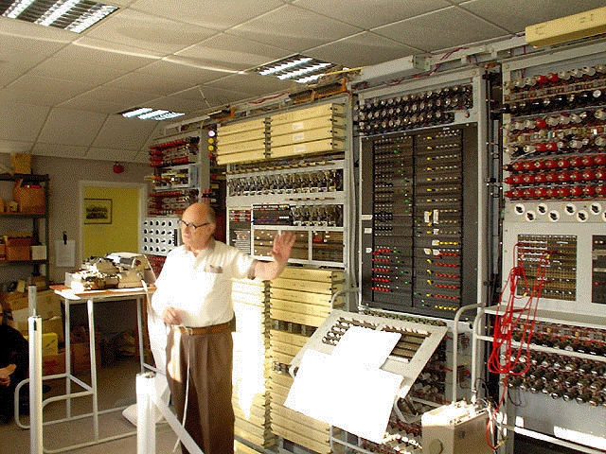
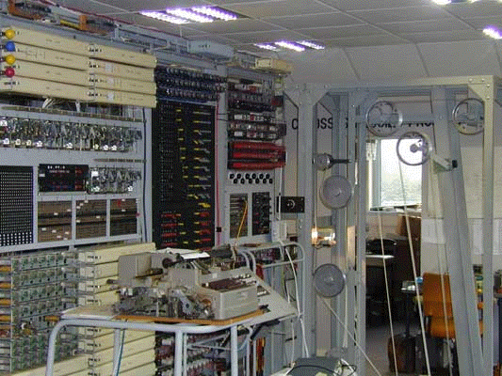
The Colossus Machine
The museum also holds Tony Sale’s reconstruction of Colossus, which broke the German diplomatic code. The Colossus machine was phenomenally fast for its day, reading 300 characters per second.

Slide 21
The End

