Slide 1
CS248 Lecture 6
Simple Animations In Unity
January 26th, 2017

Slide 2
Overview
  Course Logistics
  Short-Form Assignment Feedback
  Practical Uses of Simple Animation
  Animation in Maya
  Animation in Unity
  In-Class Demo

Slide 3

Course Logistics

Slide 4
Piazza
  Please be on it.
  Please use it.
  Last reminder if you joined late.

Slide 5
Grades
  A way to check your grades is on the way (website similar to the one used for CS148 this past quarter).
    Will be announced on Piazza when it is ready.

Slide 6
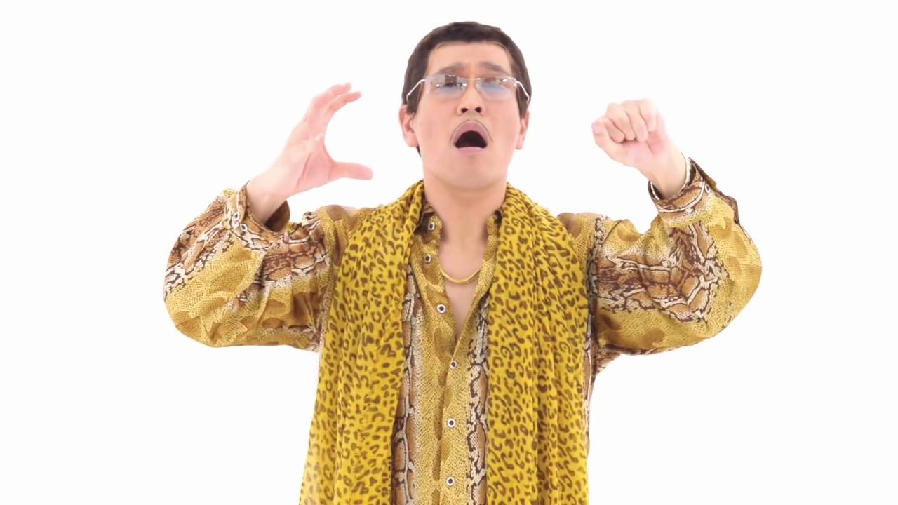
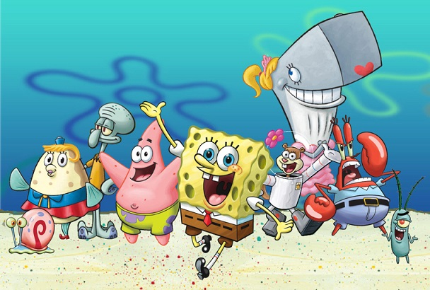
Short-Form Assignments
  Write your name (or at least your SUNetID).
    Lecture 4 had one without a name.
    If you have any doubts, please email me (mikebao@stanford.edu) to double check to see if we have recorded your attendance.
  Write legibly.
  Answers should be RELEVANT.
    Future answers with horribly irrelevant answers will have points deducted.
    Don’t get points deducted from your attendance when you actually attended.
    Example: Rigid Bodies.

Slide 7
Short Form Assignments Feedback
Yes, I read them (Kind Of).

Slide 8
Rigid Bodies
  A general approximation for certain objects in the world.
  The ENTIRE object can only translate/rotate/scale.
    Each vertex gets transformed the same way.

Slide 9
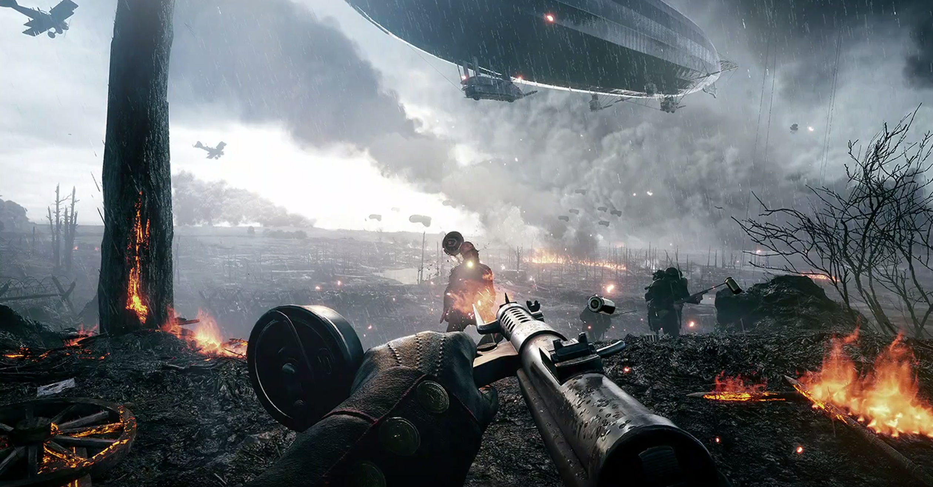
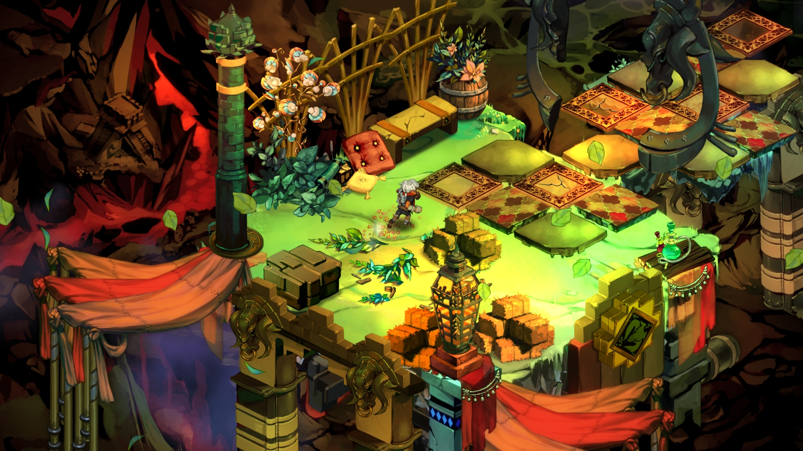
Graphics
Technically Impressive
Aesthetically Pleasing
  Both are good!
  A good game should be aesthetically pleasing/coherent.
    A good game is not necessarily technically impressive.
  “Gameplay over Graphics”
  Do NOT spend significant time implementing rendering techniques not packaged with Unity (e.g. real-time ray-tracing).

Slide 10
General Good Advice
  Start small.
  Design your game around a singular mechanic.
    Super Mario = Jumping.
    Flappy Birds = Tapping.
    Etc.
  Sound/music is an often overlooked part of video games but they contribute a lot.
    Generally harder to find/create though so don’t worry about it that much.
  What is fun?
    Fun is different for different people.
    Casual vs Hardcore.
    PC vs Console vs Mobile.
    RPG vs RTS etc.

Slide 11
Practical Uses of Animation
In Video Games!
Notes:
Everything can be animated – not just rigid transformation.

Slide 12
How to Make Animations
  Pre-Made
    Maya
    Unity
  Scripted
    Tweening Package
    Change based off some velocity/acceleration value and/or user input.

Slide 13
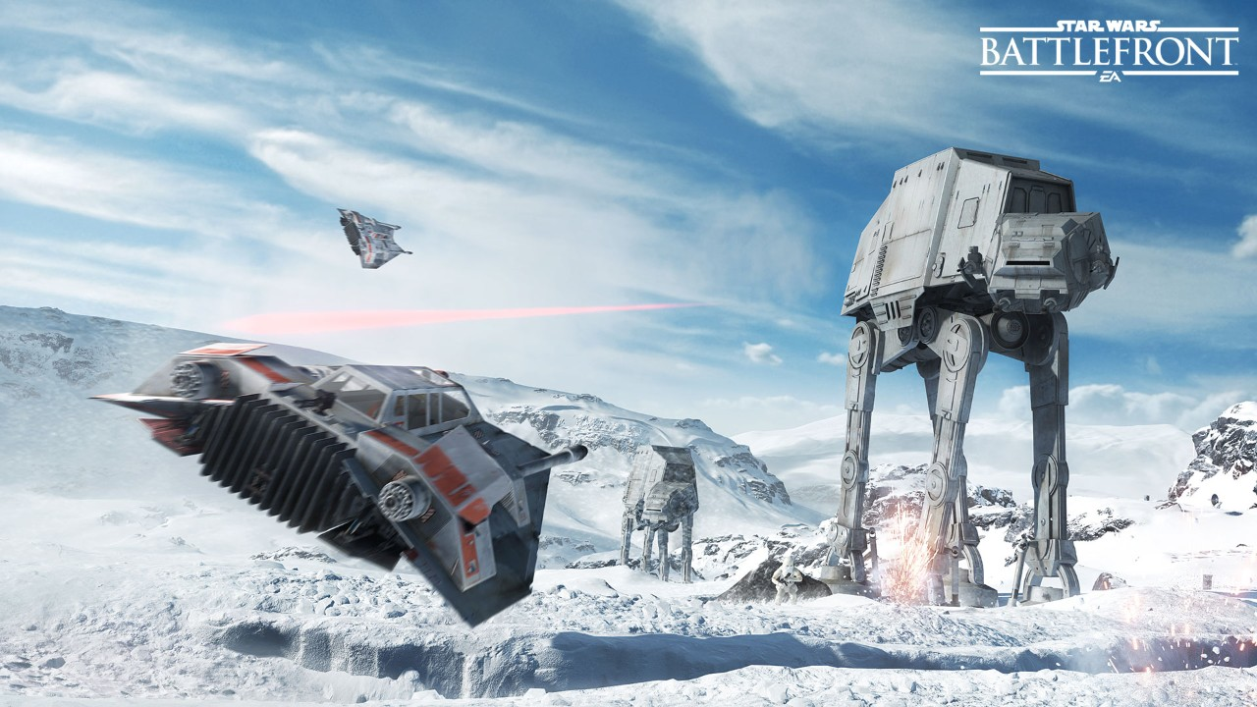
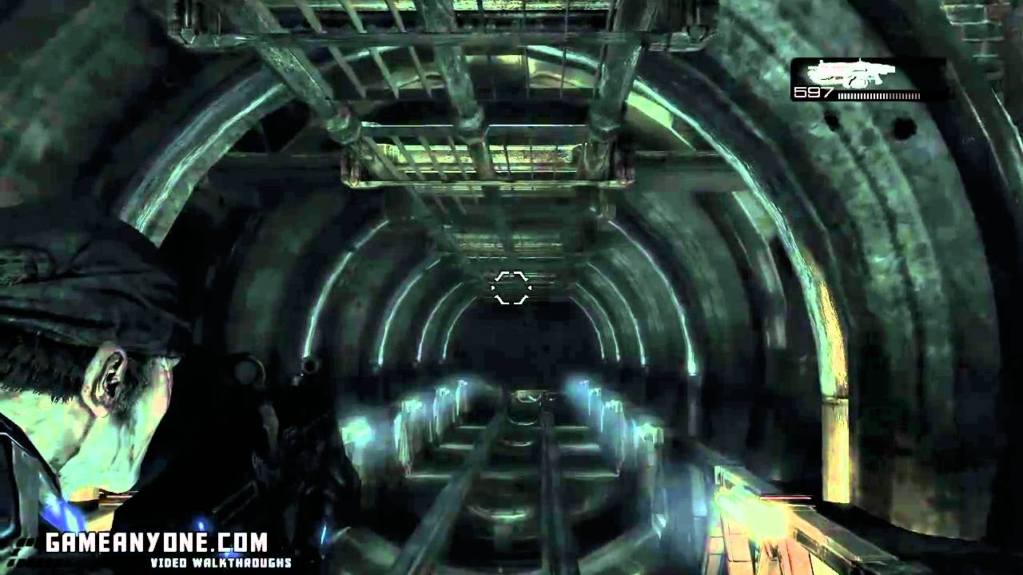
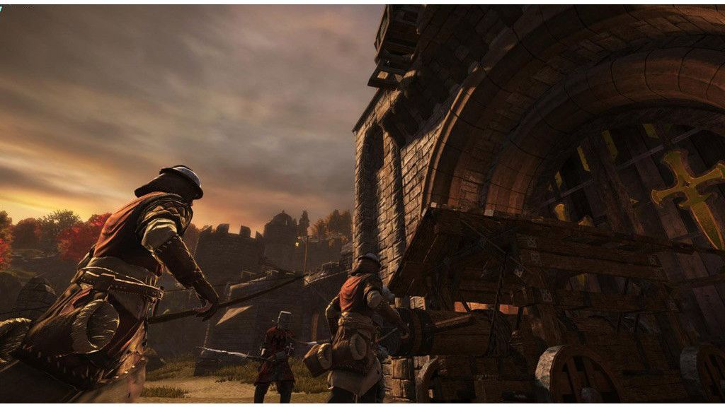
On-Rails Movement
Star Wars Battlefront
Gears of War
Chivalry: Medieval Warfare

Slide 14
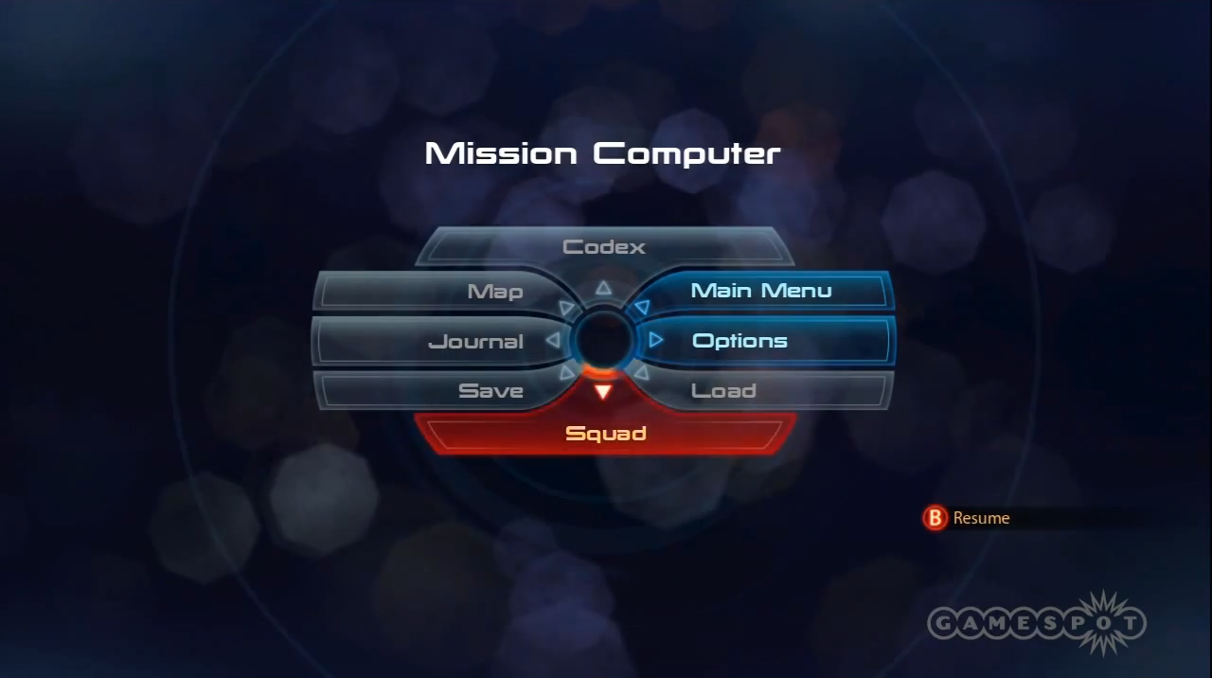
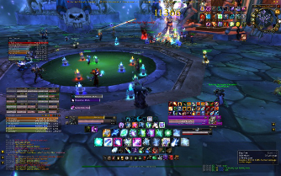
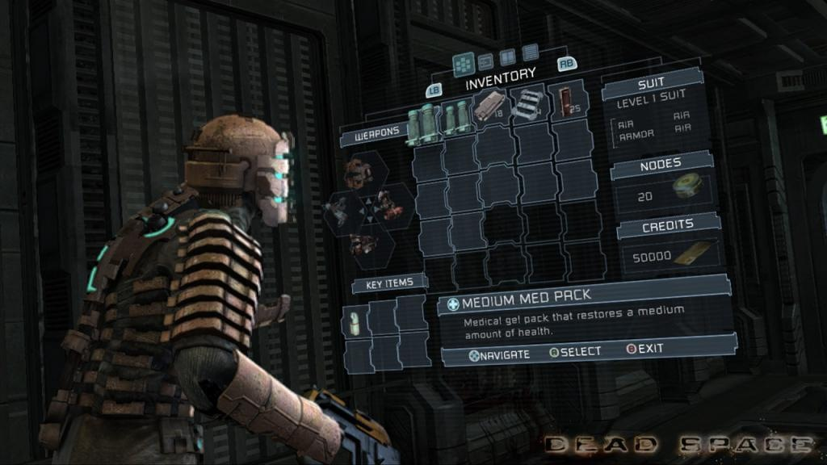
User Interface
Mass Effect
World of Warcraft
Dead Space

Slide 15
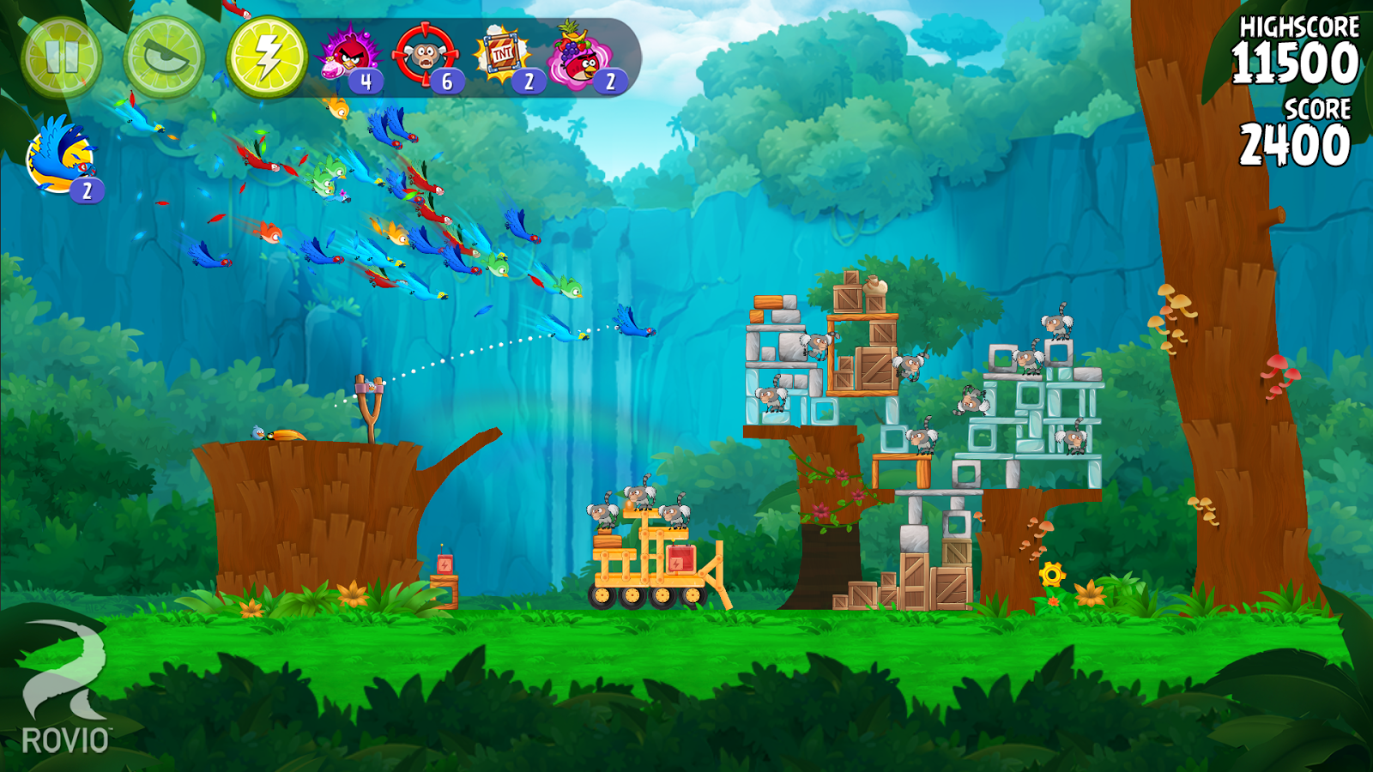
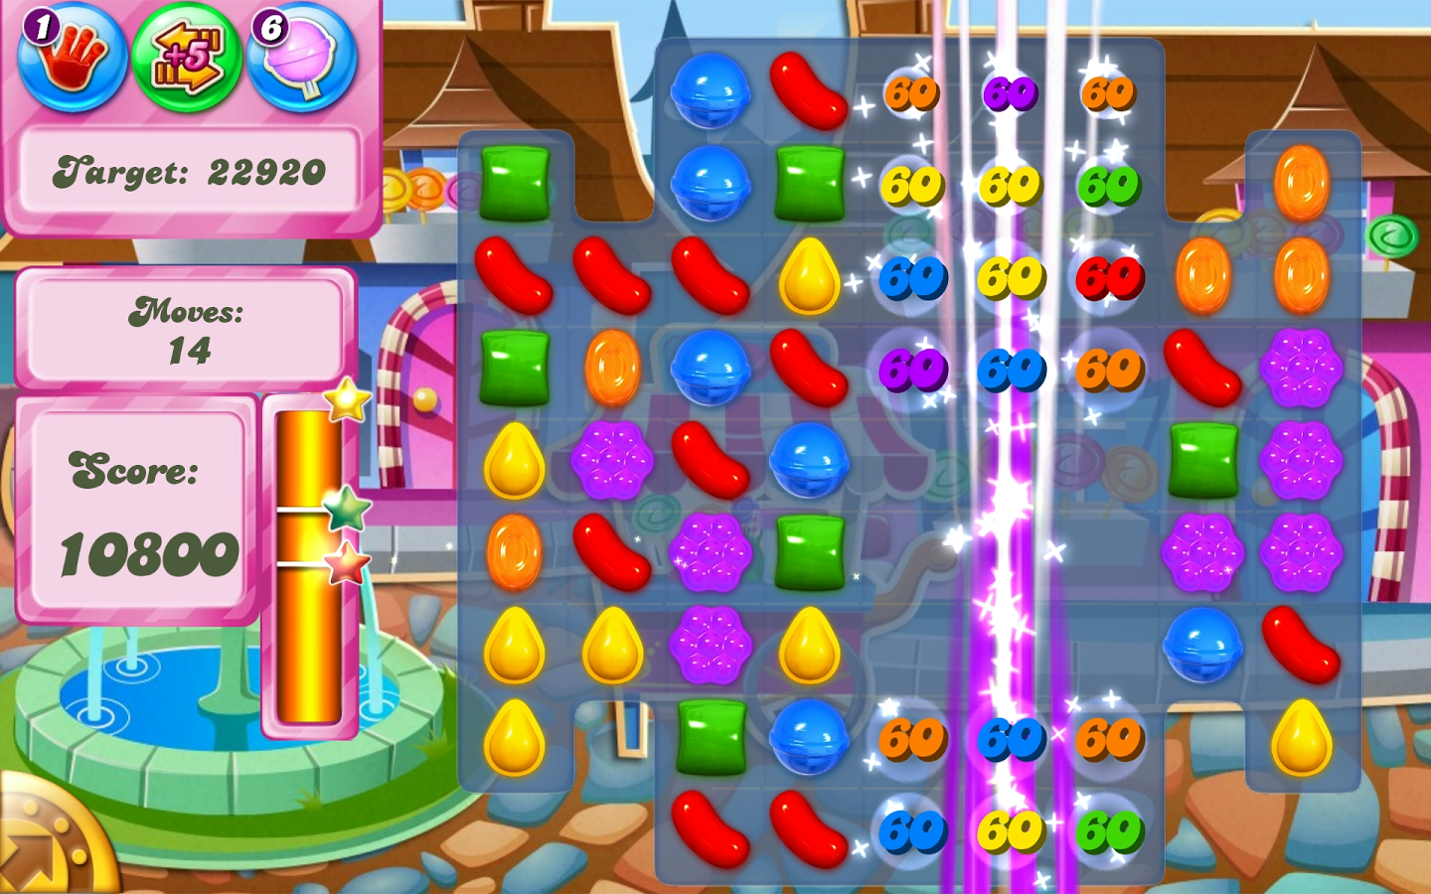
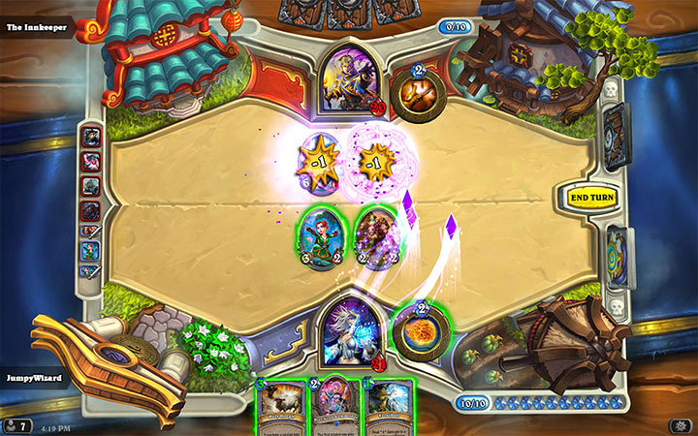
And More…
Angry Birds
Candy Crush
Hearthstone

Slide 16
Animation in Maya
Or Blender or 3ds Max.

Slide 17
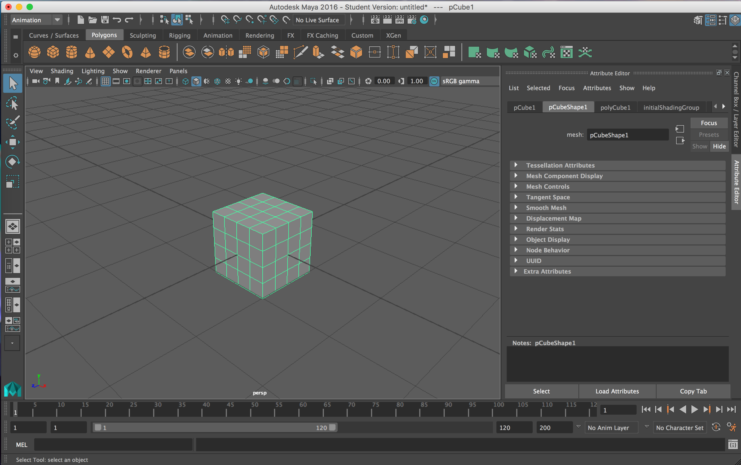
Maya UI
Timeline

Slide 18
Maya UI
First Frame of Entire Animation

Slide 19
Maya UI
Last Frame of Entire Animation

Slide 20
Maya UI
Visible Animation Range

Slide 21
Maya UI
First Frame of Visible Range

Slide 22
Maya UI
Last Frame of Visible Range

Slide 23
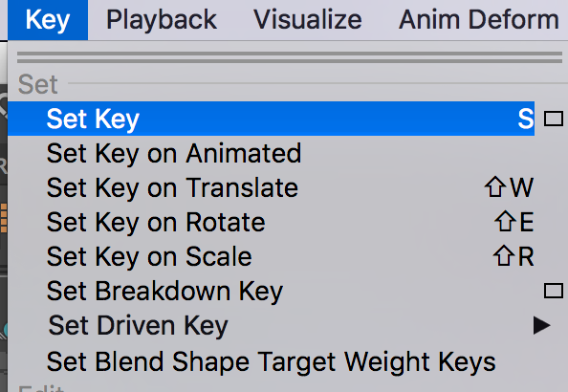
Maya UI - Keyframes

Slide 24
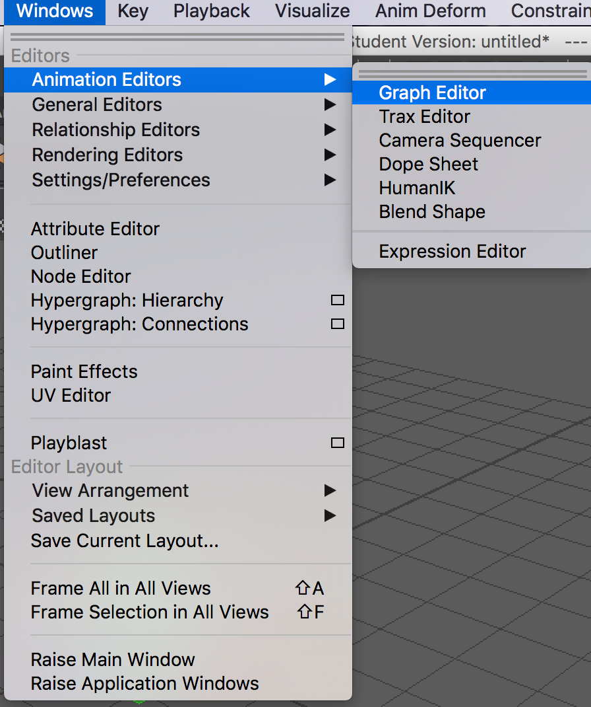
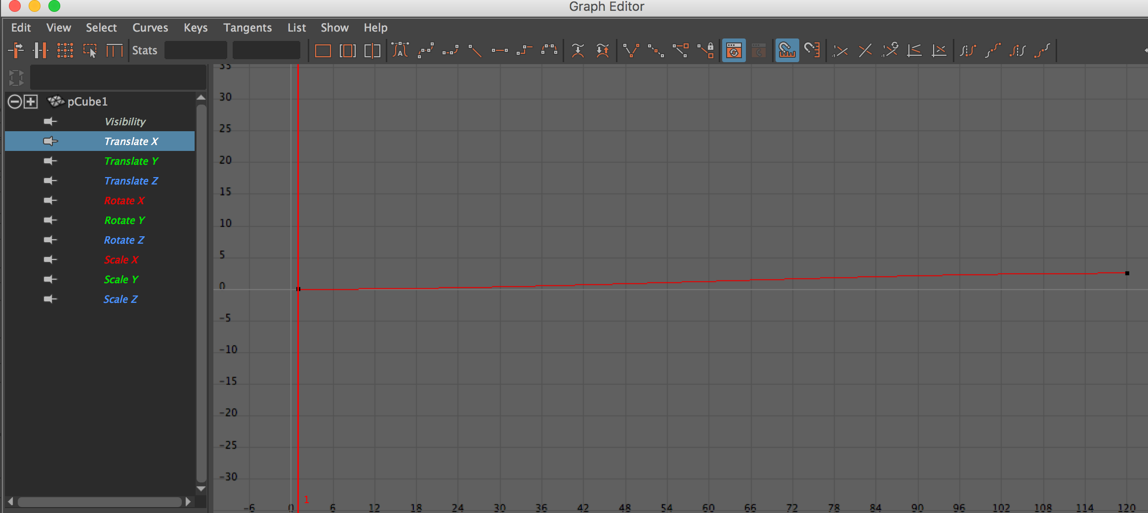
Maya UI – Animation Curve Editor

Slide 25
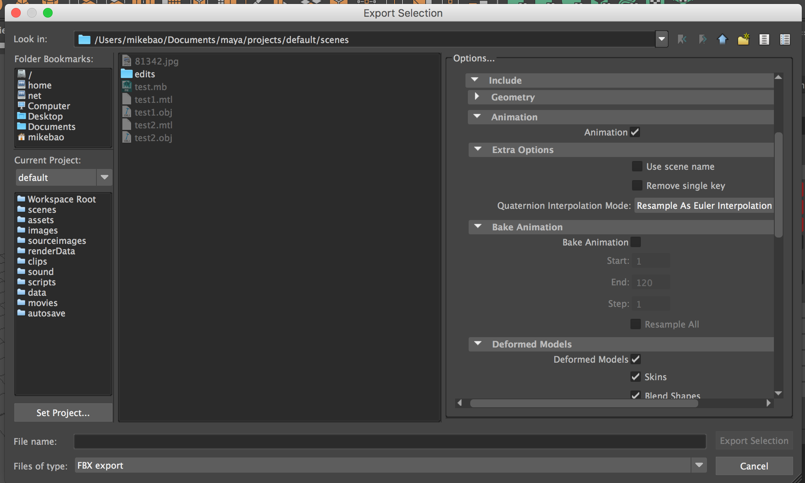
Maya UI – Export Animation

Slide 26
Animation in Unity
Native and Imported Animations.

Slide 27
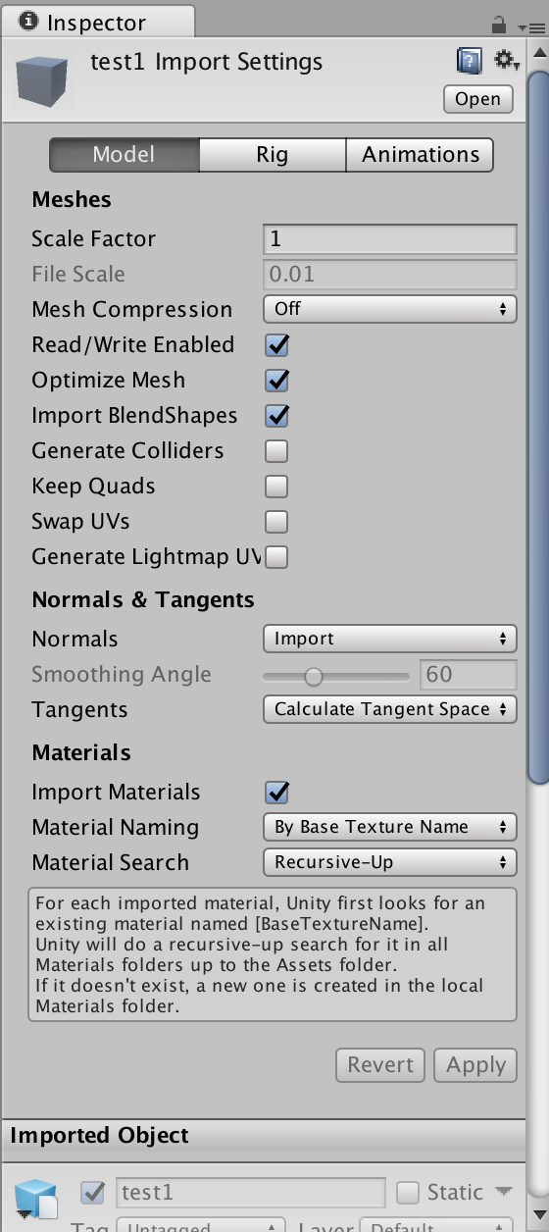
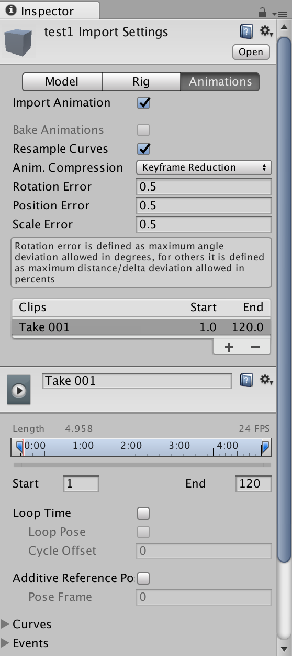
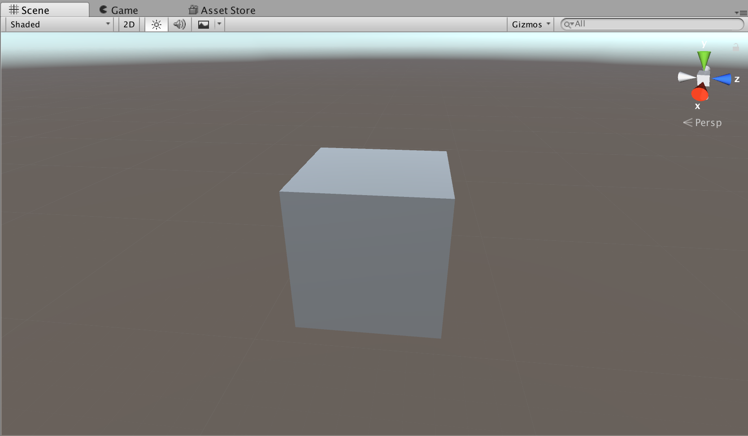
Import Animations From Maya
  Make sure the *.FBX is in your “Assets” folder.
    Unity will automatically import it.
  Drag and drop into your scene!

Slide 28
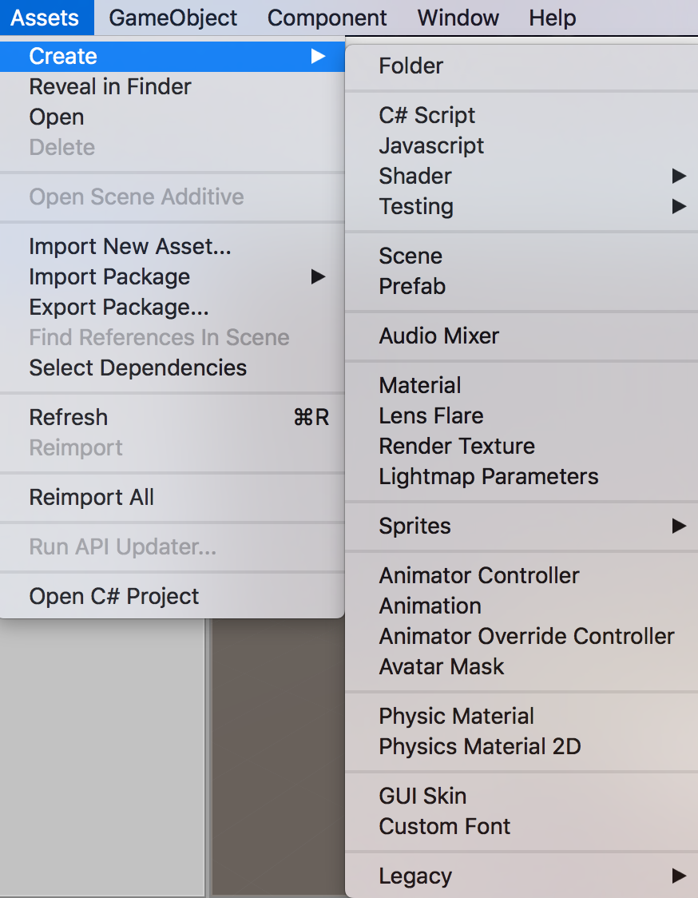
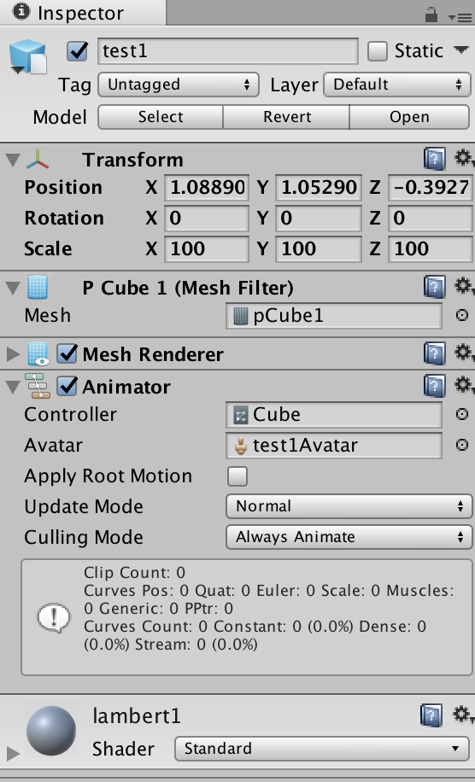
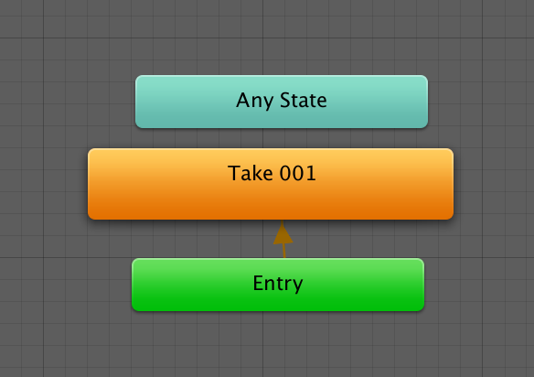
Unity Animation Controller
  Animated objects need an “Animator Controller” to actually play animations.

Slide 29
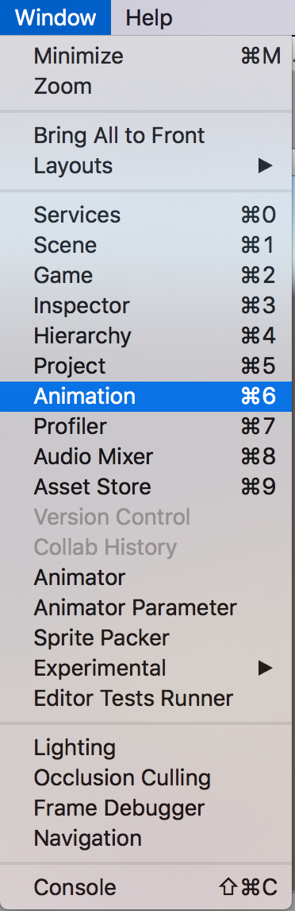
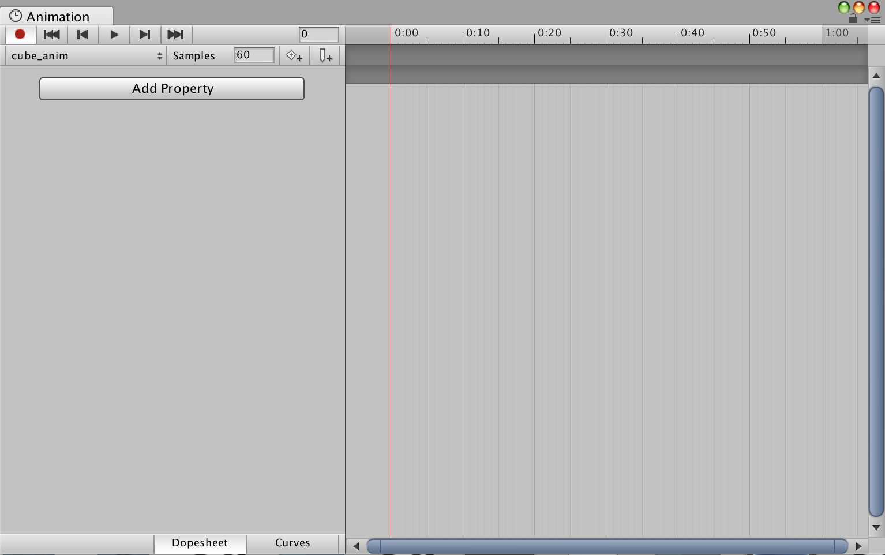
Native Unity Animation
Notes:
This process creates a) an Animation Controller and b) an animation sequence for you.

Slide 30
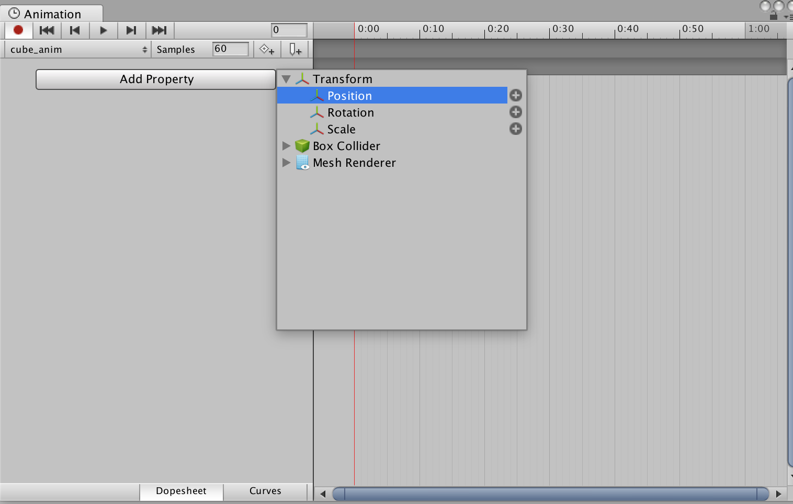
Native Unity Animation

Slide 31
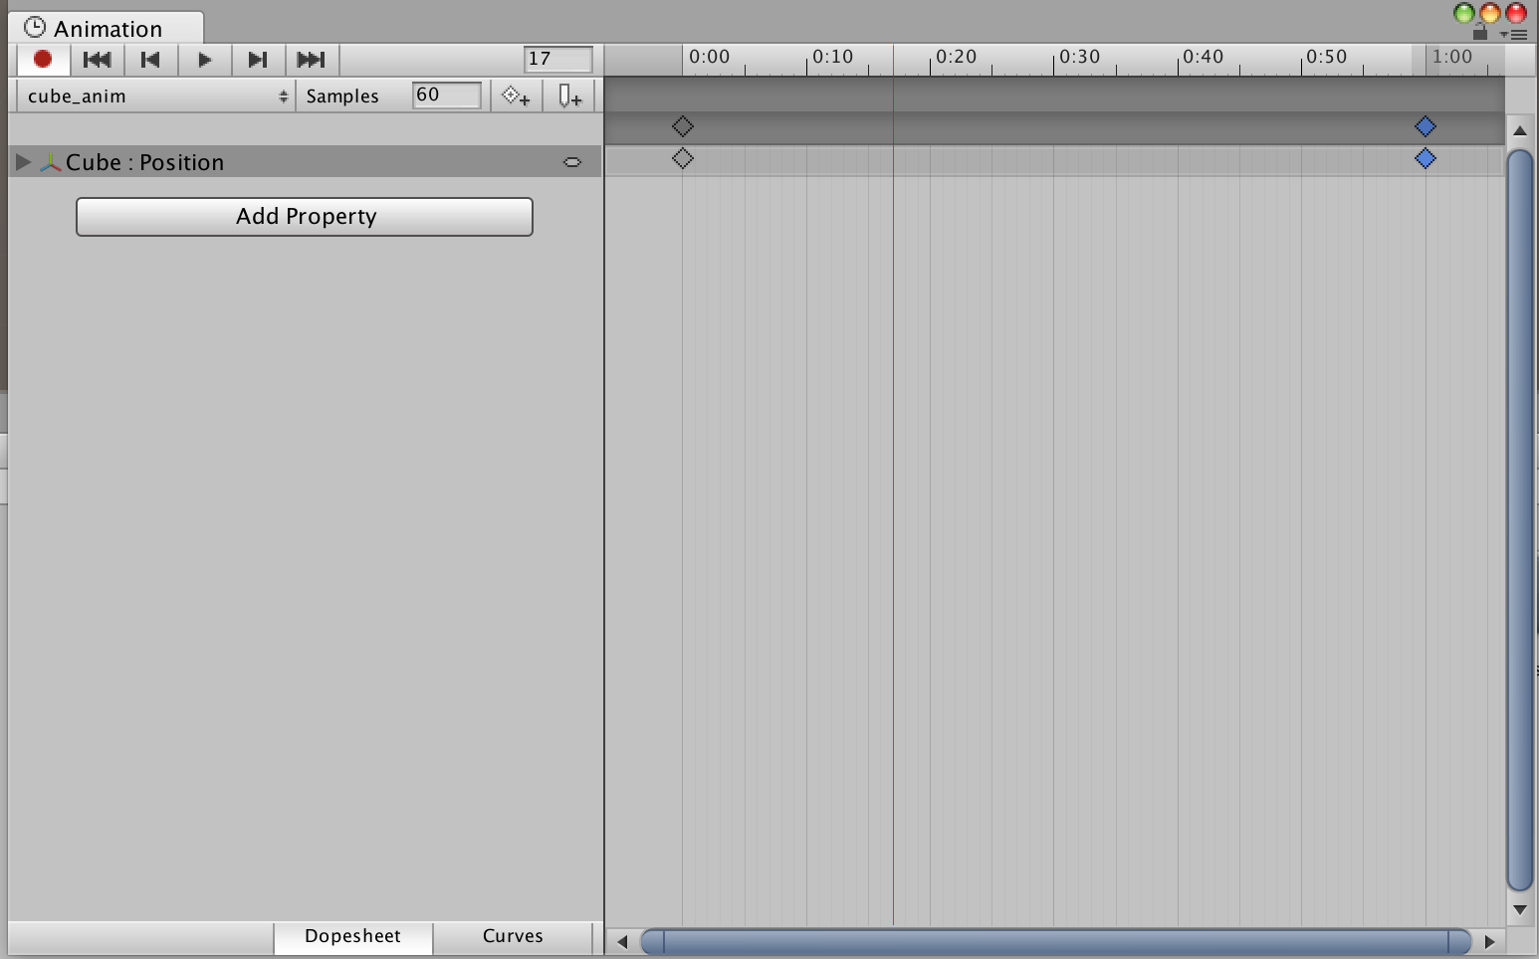
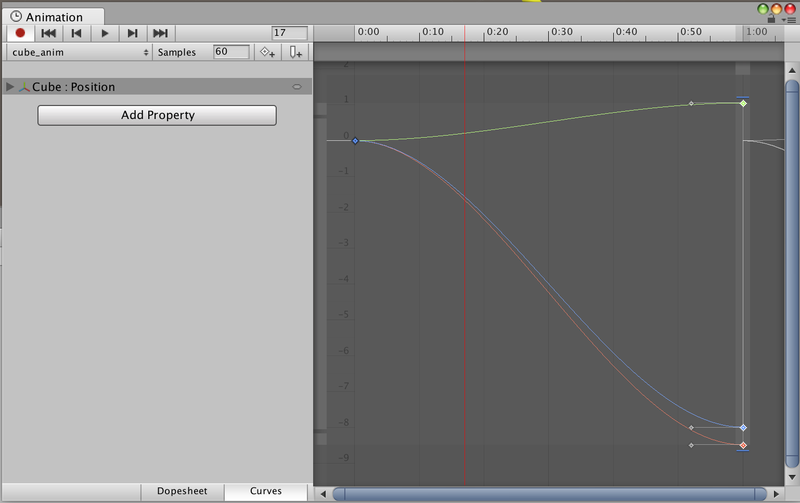
Native Unity Animation

Slide 32
Scripted Animation (Tweening)
  Lots of Tweening packages
    iTween
    DOTween
    Etc.
  Useful for simpler animations (e.g. user interface).
  DOTeen Documentation: http://dotween.demigiant.com/documentation.php
  iTween Documentation: http://www.pixelplacement.com/itween/documentation.php

Slide 33
In-Class Demo
Finally.

