Slide 1

Cancer Sequencing
Credits for slides: Dan Newburger

Slide 2
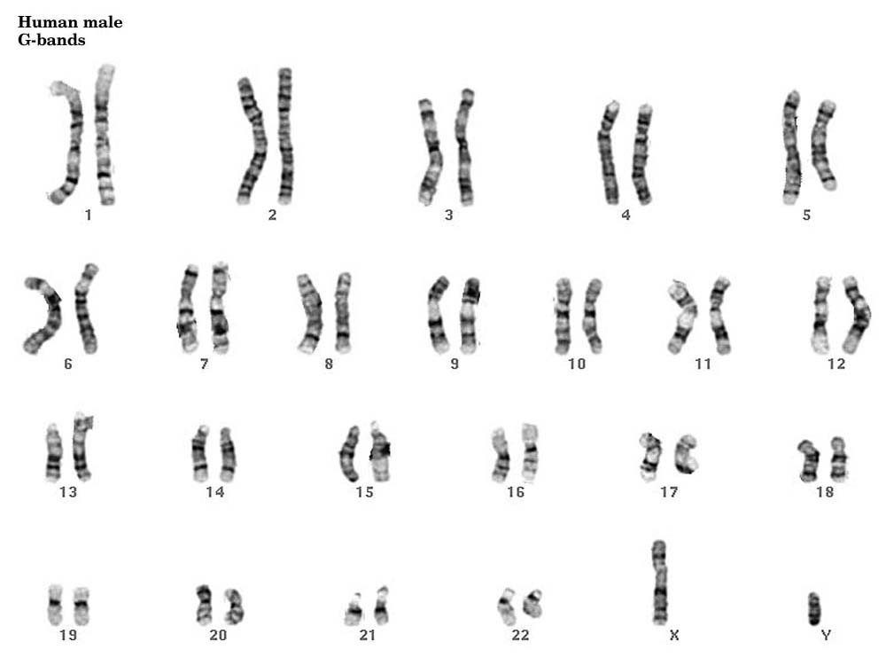
What is Cancer?
Definitions
A class of diseases characterized by malignant growth of a group of cells
  Growth is uncontrolled
  Invasive and Damaging
  Often able to metastasize
An instance of such a disease (a malignant tumor)
A disease of the genome
http://en.wikipedia.org/wiki/Cancer
http://faculty.ksu.edu.sa/tatiah/Pictures%20Library/normal%20male%20karyotyping.jpg
Notes:
What is a tumor? - I like wikipedia’s def. → a class of disease
Also refers to an instance of the disease
Finally, since early days of karyotyping (image chromosomes with dyes, clear that it is a disease of the genome. Image of “Representative G-banded karyotype from a metastatic melanoma”
There are more than 100 cancer types. Some only appear in specific organs, some have very distinctive phenotype when you look at the tissue level. But essential thing to know about cancer is that there are several fundamental pathways which govern transformation of normal tissue into a cancerous tissue

Slide 3
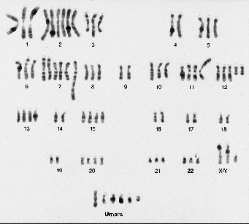
What is Cancer?
Definitions
A class of diseases characterized by malignant growth of a group of cells
  Growth is uncontrolled
  Invasive and Damaging
  Often able to metastasize
An instance of such a disease (a malignant tumor)
A disease of the genome
http://en.wikipedia.org/wiki/Cancer
http://www.moffitt.org/CCJRoot/v2n5/artcl2img4.gif
Notes:
What is a tumor? - I like wikipedia’s def. → a class of disease
Also refers to an instance of the disease
Finally, since early days of karyotyping (image chromosomes with dyes, clear that it is a disease of the genome. Image of “Representative G-banded karyotype from a metastatic melanoma”
There are more than 100 cancer types. Some only appear in specific organs, some have very distinctive phenotype when you look at the tissue level. But essential thing to know about cancer is that there are several fundamental pathways which govern transformation of normal tissue into a cancerous tissue
Make sure to say that because it is a disease of the genome, must understand that it is an evolutionary process. Critical to this lecture. May have heard that disease like HIV famous for being hard to treat because changes so rapidly. Just so in cancer – you are combatting an invasive organism.
Beautifully Summarized by one of the seminal papers in cancer research called “Hallmarks of Cancer”, written by Douglas Hanahan and Robert Weinberg. Ref in corner
Review paper, but marks an important transition in the field where began to think of Cancer in terms of a set of fundamental changes to cellular and extracellular behavior, and to think of cancer in evolutionary terms

Slide 4
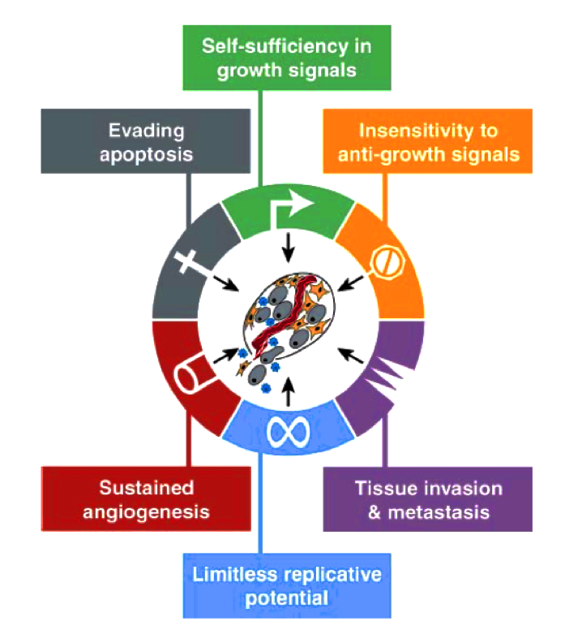
Fundamental Changes in Cancer Cell Physiology
Exploitation of natural pathways for cellular growth
Growth Signals (e.g. TGF family)
Angiogenesis
Tissue Invasion & Metastasis
Evasion of anti-cancer control mechanisms
Apoptosis (e.g. p53)
Antigrowth signals (e.g. pRb)
Cell Senescence
Acceleration of Cellular Evolution Via Genome Instability
DNA Repair
DNA Polymerase
Hanahan and Weinberg. 2000. The hallmarks of cancer. Cell 100: 57-70.
Notes:
Beautifully Summarized by one of the seminal papers in cancer research called “Hallmarks of Cancer”, written by Douglas Hanahan and Robert Weinberg. Ref in corner
Review paper, but marks an important transition in the field where began to think of Cancer in terms of a set of fundamental changes to cellular and extracellular behavior, and to think of cancer in evolutionary terms
Most and possibly all cancer must overcome fundamental anti-cancer and homeostatic mechanisms.
Discuss a couple pathways:
- Growth signals. Exogenous signals, intermembrane signalling proteins, intracellular pathways. Example, cell can become able to produce and export their own grow signals, causing a feedback loop. Also, one of most famous cases is that certain kinases (tyrosine kinase) that recognize growth factors outside the cell propogate the signal inside the cell, become constitutively active
Perhaps most famous if Apoptosis → why cell integrity is sufficiently disrupted, triggers pathway that destroys the cell. Sensors: Frequently occurs do to sufficient disorganization of DNA structure, and effectors. If you turn this pathway off, it means that you can have a cell continue to thrive dispite extremely abnormal behavior. P53 tumor supressor protein
- Anti-growth signals are similar → unless both internal and exogenous signals are in the correct state, prevents cell cycle from continuing and can even prompt cell to enter a quiescent state such that it can never divide again. This must be circumvented in order to become a cancer
Cell senescence → telomerase adds hexamers to ends
- Metastasis – cell cell adhesion molecules (CAMs). Also, change integrins so that surface molecules look different. Also need extracellular proteases

Slide 5
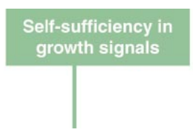
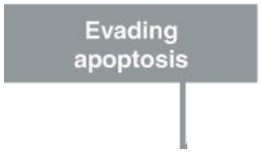
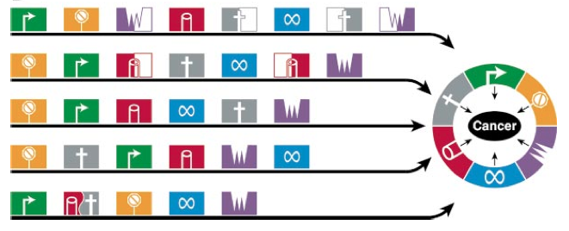
Many Paths Lead to Cancer Self-Sufficiency
Hanahan, Douglas, and Ra Weinberg. 2000. The hallmarks of cancer. Cell 100: 57-70.
Notes:
- Stages can happen in different order
- There are multiple regulatory pathways responsible each physiological change – in some cases need multiple genes to be mutated to achieve change
At each stage, individual cells can die (apoptosis, quiescence, immune response) – strong selective pressure in evolutionary context
This explains why most cancer do not occur until larger in life: requires a certain amount of time before sufficient mutations, in the right pathways, can accumulate to cause cancer. When you do the math, also shows why it is nearly inevitable that you will get cancer if you live long enough.
Also important to think about this in terms of genetic predisposition to cancer. If an essential pathway, likeTP53, is already ineffective at birth, then you’ve seeded your entire body with a potential first step towards cancer. That’s why genetic tests for genes like BRCA are so important – if you have the mutation, it drastically alters your risk of a certain cancer type.

Slide 6
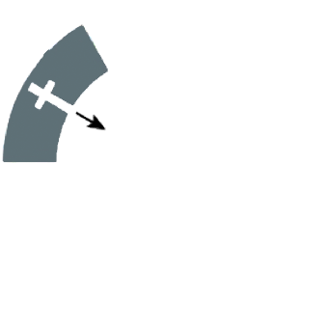
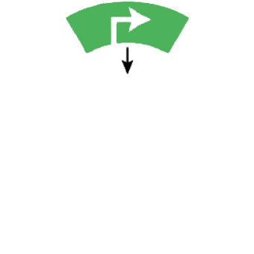
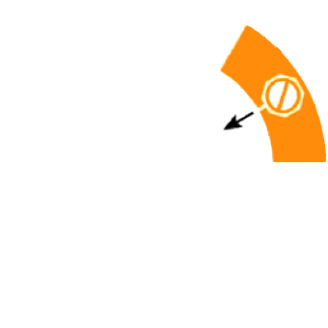

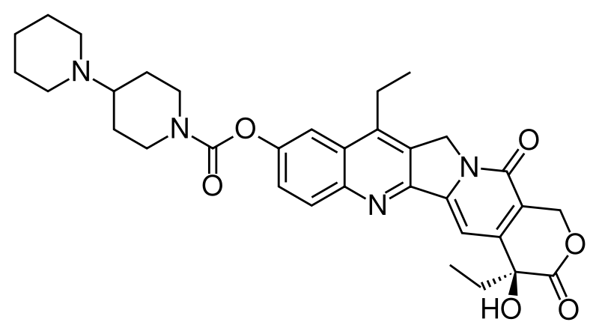
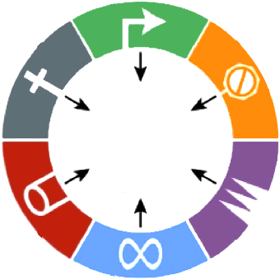
Cancer Heterogeneity
Chemotherapeutic
Notes:
Start out with a small group of cells that have started to transform into benign tumor. Differentiates into several differ paths, one of which is a cancer. Explosive growth of cells, but leads to many different sub populations.
Important: Up until now, you’ve been considering sequencing an animal or an individual with a diploid genome. Suddenly that is not so simple – many different “individuals” in a cancer genome, part of the challenge.
Also, important from clinicla perspective – when get chemo or target drug therapy, some cells die but some won’t. If the cancer recurs, those surviving cells will make up the next round of cancer cells

Slide 7
Cancer Heterogeneity
Chemotherapeutic
Notes:
Start out with a small group of cells that have started to transform into benign tumor. Differentiates into several differ paths, one of which is a cancer. Explosive growth of cells, but leads to many different sub populations.
Important: Up until now, you’ve been considering sequencing an animal or an individual with a diploid genome. Suddenly that is not so simple – many different “individuals” in a cancer genome, part of the challenge.
Also, important from clinicla perspective – when get chemo or target drug therapy, some cells die but some won’t. If the cancer recurs, those surviving cells will make up the next round of cancer cells

Slide 8
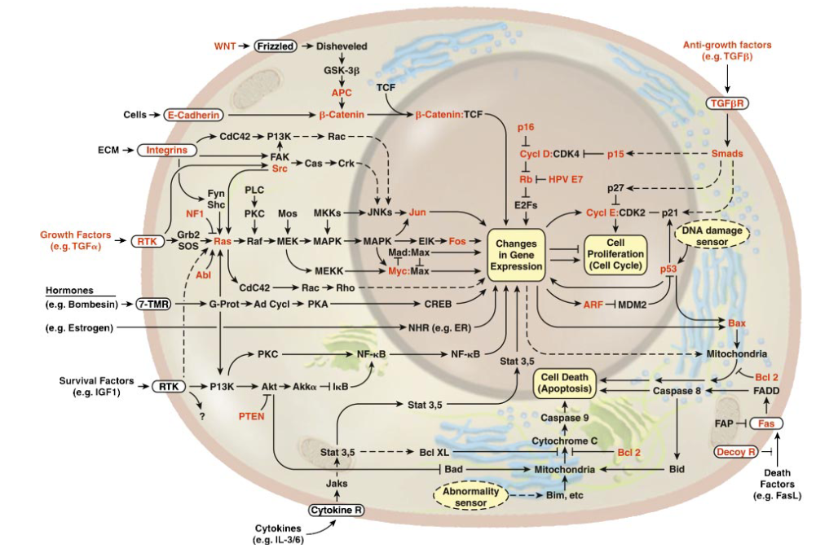
Why Sequence Cancer Genomes?
Better understand cancer biology
  Pathway information
  Types of mutations found in
  different cancers
Notes:
STOP FOR QUESTIONS HERE

Slide 9
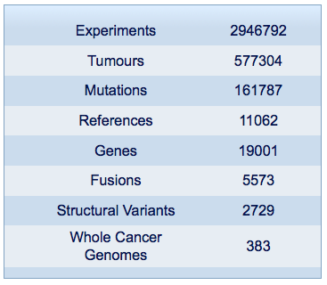
Why Sequence Cancer Genomes?
Better understand cancer biology
  Pathway information
  Types of mutations found in
  different cancers
Cancer Diagnosis
  Genetic signatures of cancer types will inform diagnosis
  Non-invasive means of detecting or confirming presence of cancer
Improve cancer therapies
  Targeted treatment of cancer subtypes
4577043
639580
186431
12441
19885
7062
2753
465
http://www.sanger.ac.uk/genetics/CGP/cosmic/
Forbes et al. 2010. COSMIC: mining complete cancer genomes in the Catalogue of Somatic Mutations in Cancer. Nucleic Acids Research 39, no. Database (October): D945-D950
Notes:
EGRF example for lung cancer – inhibitors very effective for mut. In EGRF for lung, no effect if wild type

Slide 10
Human Genome Variation
TGCTGAGA
TGCCGAGA
TGCTCGGAGA
TGC - - - GAGA
SNP
Novel Sequence
Mobile Element or
Pseudogene Insertion
Inversion
Translocation
Tandem Duplication
TGC - - AGA
TGCCGAGA
Microdeletion
Transposition
Novel Sequence
at Breakpoint
Large Deletion
TGC

Slide 11
Variant Types
Variant Types
Single Nucleotide Variants(SNVs)
Small Insertion / Deletion (indels)
Copy Number Variants (CNVs)
Structural Variants (SVs)
Novel Sequence

Slide 12
SNVs
Variant Types
Single Nucleotide Variants(SNVs)
Small Insertion / Deletion (indels)
Copy Number Variants (CNVs)
Structural Variants (SVs)
Novel Sequence
ATCTATCCGAGTCTATCGATAGATGATGTCTAGGATAGATGAT
ATCTATCCGAGTCTATCGATAGATGATGTCTAGGATAGATGAT
Ref:
ATCTATCCGAGTCGATCGATAGATGATGTCTAGGATAGATGAT
Notes:
SNV vs. SNP (SNV is refering to any location where one or more genomes of interest differ from the reference. SNP is usually designed as a single base difference from the reference that recurs in the population with a frequency of greater than 1%. Rare variant is <1%, but still recurring in population. Mutation means it is very uncommon.

Slide 13
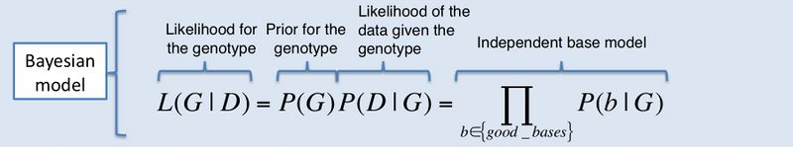
SNV Calling Approaches
Variant Types
Single Nucleotide Variants(SNVs)
Small Insertion / Deletion (indels)
Copy Number Variants (CNVs)
Structural Variants (SVs)
Novel Sequence
A Bayesian Approach is the most general and common method of calling SNVs
  MAQ, SOAPsnp, Genome Analyis ToolKit (GATK), SAMtools
But we would rather use a cancer specific method!
http://www.broadinstitute.org/gsa/wiki/index.php/Unified_genotyper

Slide 14
Considerations for Cancer Sequencing
Factors that effect mutation signal
  Limited genetic material (lower depth)
  Mixture of tumor and normal tissue
  Cancer Heterogeneity
Factors that introduce noise
  Formalin-fixed and Paraffin-embedded samples
  Increased number of mutations and unusual genomic rearrangements
General Consideration
  Each individual has many unique mutations that could be confused with cancer causing mutations
Notes:
So ideally, you would want a model that was geared towards overcoming these challenges, and that took into account that fact that you’re trying to distinguish a given individuals health genome from the cancer genome.

Slide 15
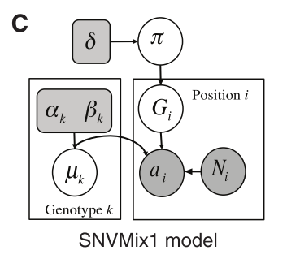

SNV Calling Approaches
Variant Types
Single Nucleotide Variants(SNVs)
Small Insertion / Deletion (indels)
Copy Number Variants (CNVs)
Structural Variants (SVs)
Novel Sequence
SNVMix: example of using a graphical model for SNV calling
Goya et al. 2010. SNVMix: predicting single nucleotide variants from next-generation sequencing of tumors. Bioinformatics (Oxford, England) 26, no. 6 (March)

Slide 16
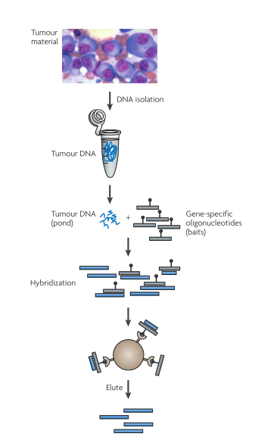
Targeted Sequencing
Exome
Library
Shotgun
Library
Exon 1
Exon 2
Genomic DNA
Capture Methods vs. Shotgun
Targeted sequencing allows for much higher coverage at less cost
Most methods can only capture known sites
These methods also introduce significant captures bias, include failure to capture sites that differ significantly from the reference genome.
Modified from Meyerson et al. . 2010. Advances in understanding cancer genomes through second-generation sequencing. Nature Reviews Genetics 11, no. 10 (October): 685-696
Notes:
Problem is that need a large amount of sequence in order to have accurate SNV calls regardless of the model
Targeted sequencing refers to methods that enrich for a certain portion of the genome prior to the actual sequencing procedure
Use oligos with baits (biotinylated) attached to beads (streptavidin)

Slide 17
Indel Calling
Variant Types
Single Nucleotide Variants(SNVs)
Small Insertion / Deletion (indels)
Copy Number Variants (CNVs)
Structural Variants (SVs)
Novel Sequence
ATCTATCCGAGATAGATGATGTCTAAGTTGGATAGATGAT
AGTT
^
ATCTATCCGA-------GATAGATGATGTCTAGGATAGATGAT
Ref:
ATCTATCCGAGTCGATCGATAGATGATGTCTAGGATAGATGAT
Notes:
For very small deletion, can use similar bayesian method as shown previous, but adding the option of a deletion in either the ref or the genome of interest. However, as get larger (>10bp, depending on read size), hard to map reads correctly to these locations, so need a new option.

Slide 18
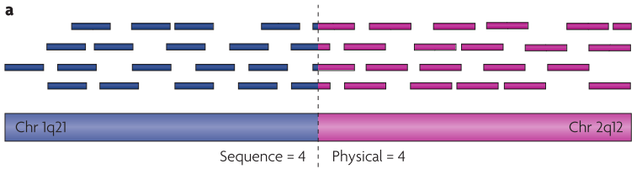
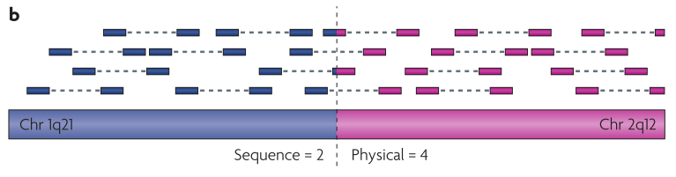
A Brief and Pertinent Digression
Paired-End Read Mapping
Modified from Meyerson et al. . 2010. Advances in understanding cancer genomes through second-generation sequencing. Nature Reviews Genetics 11, no. 10 (October): 685-696

Slide 19
Indel Calling – Discordant Paired Reads
Variant Types
Single Nucleotide Variants(SNVs)
Small Insertion / Deletion (indels)
Copy Number Variants (CNVs)
Structural Variants (SVs)
Novel Sequence
I) Insertion
l
i
m₁
m₁’
G
m₁
m₁’
R
l - i
II) Deletion
l
m₂
m₂’
G
m₂
m₂’
R
d
l + d
Notes:
For very small deletion, can use similar bayesian method as shown previous, but adding the option of a deletion in either the ref or the genome of interest. However, as get larger (>10bp, depending on read size), hard to map reads correctly to these locations, so need a new option.

Slide 20
Copy Number Variants
Variant Types
Single Nucleotide Variants(SNVs)
Small Insertion / Deletion (indels)
Copy Number Variants (CNVs)
Structural Variants (SVs)
Novel Sequence
A B C D C E F
G H C I K
A B C D C E F
G H C I K
Ref:
A B C D E F
G H I K
Notes:
CNV is tricky because mapping is not disrupted.
A category that includes duplications

Slide 21
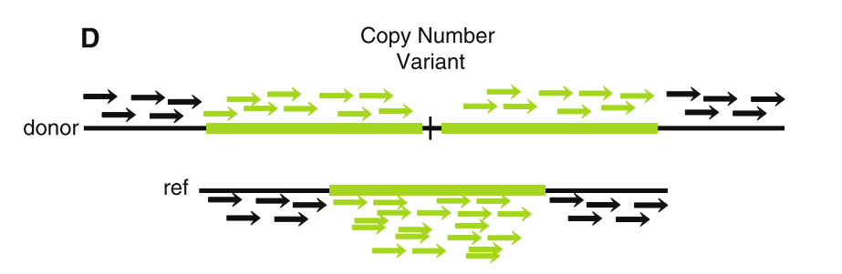


Copy Number Variants
Variant Types
Single Nucleotide Variants(SNVs)
Small Insertion / Deletion (indels)
Copy Number Variants (CNVs)
Structural Variants (SVs)
Novel Sequence
C
C
C
Depth of Coverage
C
Modified from Dalca and Brudno. 2010. Genome variation discovery with high-throughput sequencing data. Briefings in bioinformatics 11, no. 1: 3-14
A B C D C E F
G H C I K
Ref:
A B C D E F
G H I K
Notes:
Coverage variable → need long CNVs for this to work
Coverage bias → can model, but only to a degree
Can’t locate CNVs

Slide 22
Copy Number Variants
Variant Types
Single Nucleotide Variants(SNVs)
Small Insertion / Deletion (indels)
Copy Number Variants (CNVs)
Structural Variants (SVs)
Novel Sequence
C
C
C
Depth of Coverage
C
Problems with DOC
  Very sensitive to stochastic variance in coverage
  Sensitive to bias coverage (e.g. GC content).
  Impossible to determine non-reference locations of CNVs
Graph methods using paired-end reads help overcome some of these problems
A B C D C E F
G H C I K
Ref:
A B C D E F
G H I K
Notes:
Coverage variable → need long CNVs for this to work
Coverage bias → can model, but only to a degree
Can’t locate CNVs

Slide 23
Variant Types
Variant Types
Single Nucleotide Variants(SNVs)
Small Insertion / Deletion (indels)
Copy Number Variants (CNVs)
Structural Variants (SVs)
Novel Sequence
1 2 3
4 G I K
Structural Rearrangement
1 2 4 3
5 6 7 8
Translocation
3 2 1
5 6 7 8
Inversion
1 3
5 9 6 7 8
Large Insertion / Deletion
^
2
1 2 3
4 5 6 7 8
Ref:
A B C D E F
G H I K
Notes:
Inlude large deletions and insertions.
Account for the majority of the difference between any given individuals genomes

Slide 24
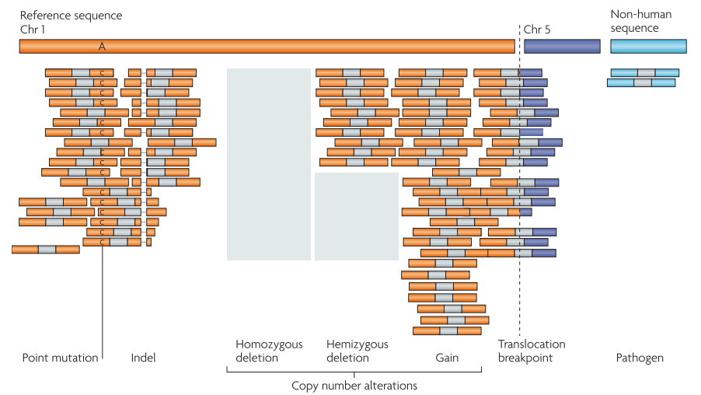
Summary of Variant Types
Meyerson et al. . 2010. Advances in understanding cancer genomes through second-generation sequencing. Nature Reviews Genetics 11, no. 10 (October): 685-696
Notes:
How do we tell what is significant??? Even if we have the cancer patient’s normal genome and have a low false positive rate for calls, there are a large number of mutations that have no effect and are simply propagating alongside functional mutations (have some effect on the cell)

Slide 25
Passenger Mutations and Driver Mutations
Sequencing
Normal
Cancer
X
X
Driver or
Passenger?
X
X
X
X

Slide 26
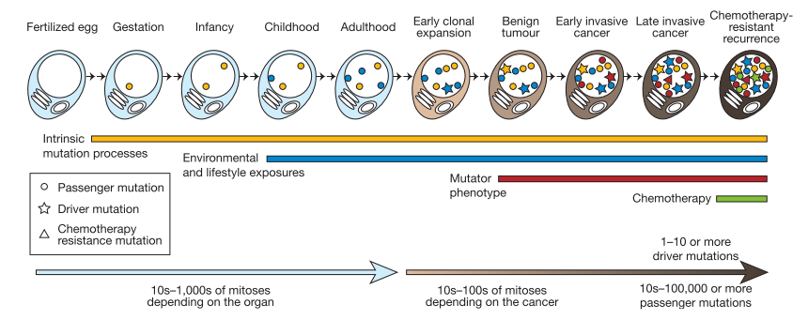
Passenger Mutations and Driver Mutations
Stratton, Michael R, Peter J Campbell, and P Andrew Futreal. 2009. The cancer genome. Nature 458, no. 7239 (April): 719-24. doi:10.1038/nature07943
Notes:
Bad news that many fold more passenger than driver mutations

Slide 27
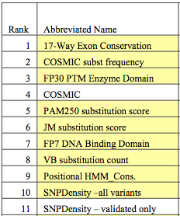

Passenger Mutations and Driver Mutations
Distinguishing Features
Train Classifier using Machine Learning Approaches
Presence in many tumors
Predicted to have functional impact on the cell
  Conserved
  Not seen in healthy adults (rare)
  Predicted to affect protein structure
In pathways known to be involved in cancer
Carter et al. 2009. Cancer-specific high-throughput annotation of somatic mutations: computational prediction of driver missense mutations. Cancer research, no. 16: 6660-6667
Notes:
CHASM – train a Random Forest classifier on a set of over 2000 known missense mutations involved in cancer, with negative control set
Other methods – SVMs (KinaseSVM), etc.
Important to remember that, in the end, must have biological validation in order to impress the cancer community.

Slide 28
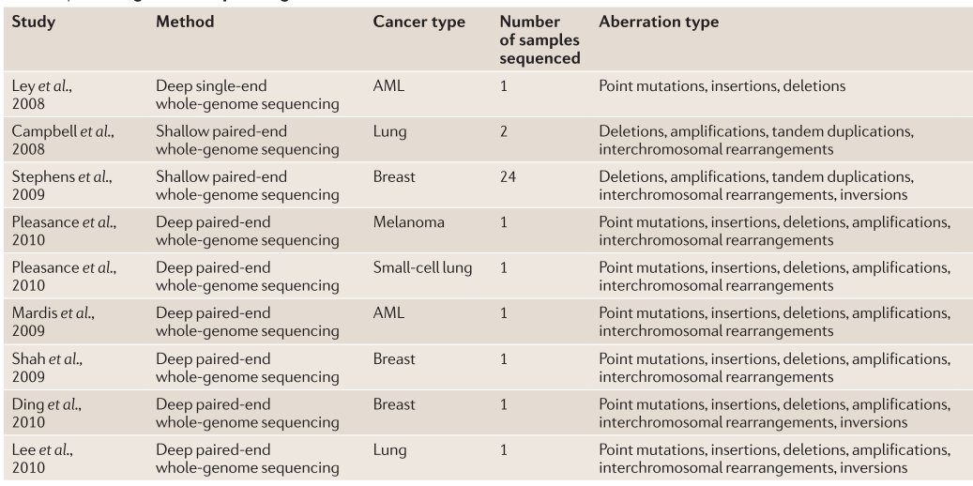
So, What Have We Learned about Cancer?
Meyerson et al. . 2010. Advances in understanding cancer genomes through second-generation sequencing. Nature Reviews Genetics 11, no. 10 (October): 685-696
Notes:
Handful of the first whole cancer genome papers to come out using high throughput sequencing. Expect many, many more coming out this year, on the order of hundreds.

Slide 29
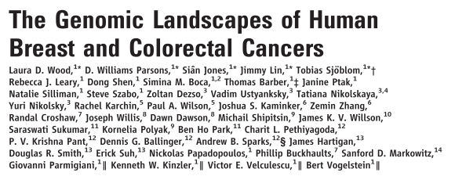
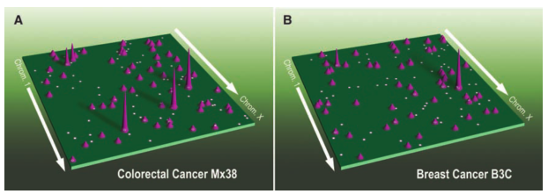
So, What Have We Learned about Cancer?
Human cancer is caused by the accumulation of mutations in oncogenes and tumor suppressor genes. To catalog the genetic changes that occur during tumorigenesis, we isolated DNA from 11 breast and 11 colorectal tumors and determined the sequences of the genes in the Reference Sequence database in these samples. Based on analysis of exons representing 20,857 transcripts from 18,191 genes, we conclude that the genomic landscapes of breast and colorectal cancers are composed of a handful of commonly mutated gene “mountains” and a much larger number of gene “hills” that are mutated at low frequency. We describe statistical and bioinformatic tools that may help identify mutations with a role in tumorigenesis. These results have implications for understanding the nature and heterogeneity of human cancers and for using personal genomics for tumor diagnosis and therapy.
Notes:
11 breast and 11 colorectal cancers sequenced, mutations of interested searched for in 24 additional tumors and some genes were investigated in 96 additional colorectal cancers
A model of Mountains and hills, where there are some mutations in certain cancer types that occur very commonly, but the majority of mutations are mutations that occur infrequently.
Distinct differences in mutation patterns between cancer types – breast vs. colorectal

Slide 30
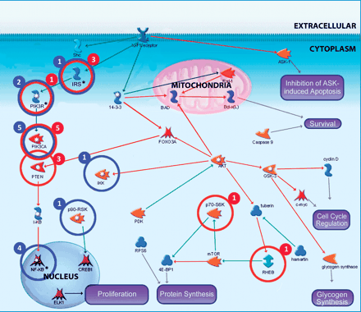
So, What Have We Learned about Cancer?
Notes:
PI3K pathway mutations in breast and colorectal cancers. The identities and relationships of genes that function in PI3K signaling are indicated. Circled genes have somatic mutations in colorectal (red) and breast (blue) cancers. The number of tumors with somatic mutations in each mutated protein is indicated by the number adjacent to the circle. Asterisks indicate proteins with mutated isoforms that may play similar roles in the cell. These include insulin receptor substrates IRS2 and IRS4; phosphatidylinositol 3-kinase regulatory subunits PIK3R1, PIK3R4, and PIK3R5; and NF-κB regulators NFKB1, NFKBIA, and NFKBIE.

Slide 31
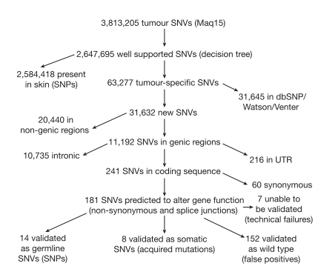
So, What Have We Learned about Cancer?
Removing false positive calls is very hard

Slide 32
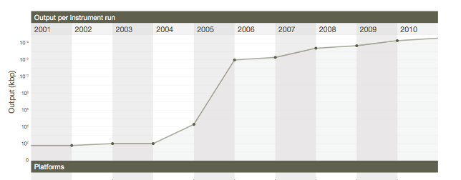
So, What Have We Learned about Cancer?
But improvements in sequencing technology are rapidly overcoming these problems

Slide 33
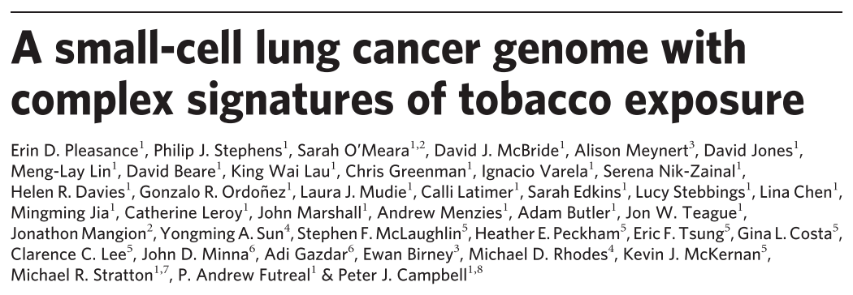
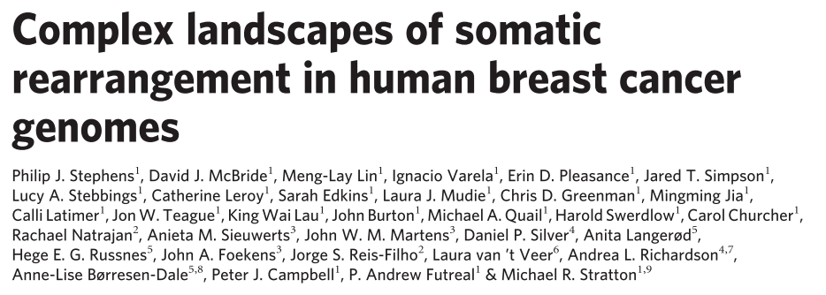
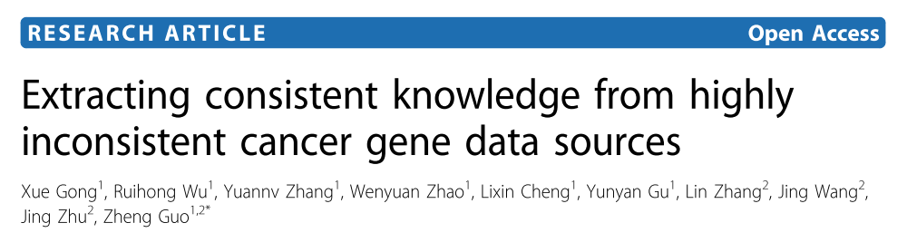
So, What Have We Learned about Cancer?
Notes:
Tobacco → certain patterns of mutation much more common in cancers due to tobacco exposure (excess of C>T transversion, especially at CpG islands), supporting known information that carcinogens in tobacco preferentially bind methyl-CpG islands. Also evidence of upregulation of specific DNA repair mechanisms
Looking at simple genomic features, like the prevalence of tandem repeats, can allow for classification of different Breast cancers. Breast cancers with many tandem duplications areusually oestrogen- and progesterone-receptor negative and classified by expression profile as basal-like. In contrast, cancers with few re- arrangements or with rearrangements within amplicons (other than those involving ERBB2) are usually oestrogen-receptor positive and classified as luminal A and luminal B types, respectively.
Sobering, though, to see that this knowledge is being generated more quickly than it can be effectively organized, documented, and reconciled with older datasets.

Slide 34
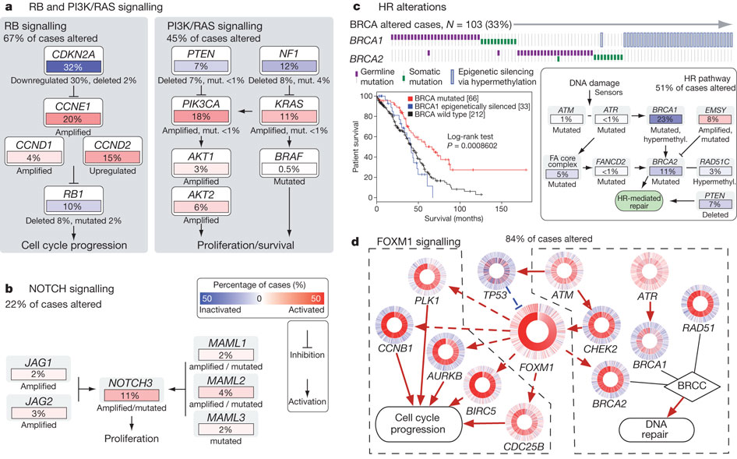
So, What Have We Learned about Cancer?
Integrated genomic analyses of ovarian carcinoma
The Cancer Genome Atlas Research Network
A catalogue of molecular aberrations that cause ovarian cancer is critical for developing and deploying therapies that will improve patients’ lives. The Cancer Genome Atlas project has analysed messenger RNA expression, microRNA expression, promoter methylation and DNA copy number in 489 high-grade serous ovarian adenocarcinomas and the DNA sequences of exons from coding genes in 316 of these tumours. Here we report that high-grade serous ovarian cancer is characterized by TP53 mutations in almost all tumours (96%); low prevalence but statistically recurrent somatic mutations in nine further genes including NF1, BRCA1, BRCA2, RB1 and CDK12; 113 significant focal DNA copy number aberrations; and promoter methylation events involving 168 genes. Analyses delineated four ovarian cancer transcriptional subtypes, three microRNA subtypes, four promoter methylation subtypes and a transcriptional signature associated with survival duration, and shed new light on the impact that tumours with BRCA1/2 (BRCA1 or BRCA2) and CCNE1aberrations have on survival. Pathway analyses suggested that homologous recombination is defective in about half of the tumours analysed, and that NOTCH and FOXM1 signalling are involved in serous ovarian cancer pathophysiology.
Notes:
Tobacco → certain patterns of mutation much more common in cancers due to tobacco exposure (excess of C>T transversion, especially at CpG islands), supporting known information that carcinogens in tobacco preferentially bind methyl-CpG islands. Also evidence of upregulation of specific DNA repair mechanisms
Looking at simple genomic features, like the prevalence of tandem repeats, can allow for classification of different Breast cancers. Breast cancers with many tandem duplications areusually oestrogen- and progesterone-receptor negative and classified by expression profile as basal-like. In contrast, cancers with few re- arrangements or with rearrangements within amplicons (other than those involving ERBB2) are usually oestrogen-receptor positive and classified as luminal A and luminal B types, respectively.
Sobering, though, to see that this knowledge is being generated more quickly than it can be effectively organized, documented, and reconciled with older datasets.

Slide 35
The Future of Cancer Sequencing
Notes:
Back to this picture again because the future of cancer sequencing appears to be in the interpretation of the huge lists of variants and mutation patterns observed
What is important, what is junk
How to integrate sequence data with other sources of information, such as tissue phenotype, to help make diagnoses
Clinical diagnosis and finding targets for new therapeutics
Very exciting time, as several of the first papers have recently been published describing clinical cancer diagnoses using high-throughput sequencing

Slide 36
Further Readings for the Curious
Fantastic Cancer Review
  Hanahan and Weinberg. 2000. The hallmarks of cancer. Cell 100: 57-70.
Modern Reviews of Cancer Genomics
  Meyerson, Matthew, Stacey Gabriel, and Gad Getz. 2010. Advances in understanding cancer genomes through second-generation sequencing. Nature Reviews Genetics 11, no. 10 (October): 685-696. doi:10.1038/nrg2841. http://www.nature.com/doifinder/10.1038/nrg2841.
  Stratton, Michael R, Peter J Campbell, and P Andrew Futreal. 2009. The cancer genome. Nature 458, no. 7239 (April): 719-24. doi:10.1038/nature07943. http://www.ncbi.nlm.nih.gov/pubmed/19360079.
Variant Calling
  Dalca, Adrian V, and Michael Brudno. 2010. Genome variation discovery with high-throughput sequencing data. Briefings in bioinformatics 11, no. 1 (January): http://www.ncbi.nlm.nih.gov/pubmed/20053733.
  Medvedev, Paul, Monica Stanciu, and Michael Brudno. 2009. Computational methods for discovering structural variation with next-generation sequencing. nature methods 6, no. 11 http://www.nature.com/nmeth/journal/v6/n11s/full/nmeth.1374.html.

