Slide 1

ACGTTTGACTGAGGAGTTTACGGGAGCAAAGCGGCGTCATTGCTATTCGTATCTGTTTAG
010101100010010100001010101010011011100110001100101000100101
Human Population Genomics

Slide 2
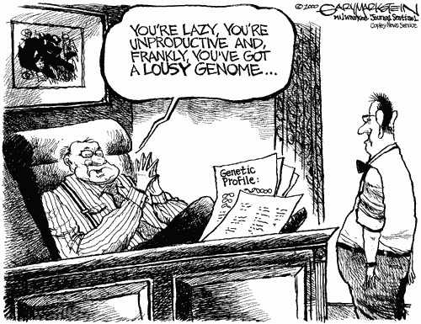
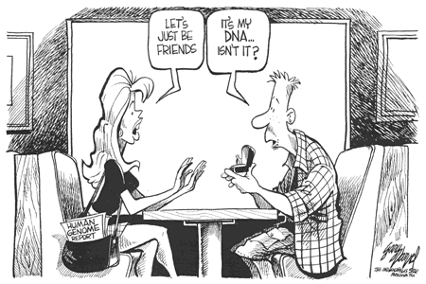

How soon will we all be sequenced?
Cost
Killer apps
Roadblocks?
Applications
Cost
Time
2015?
2020?

Slide 3
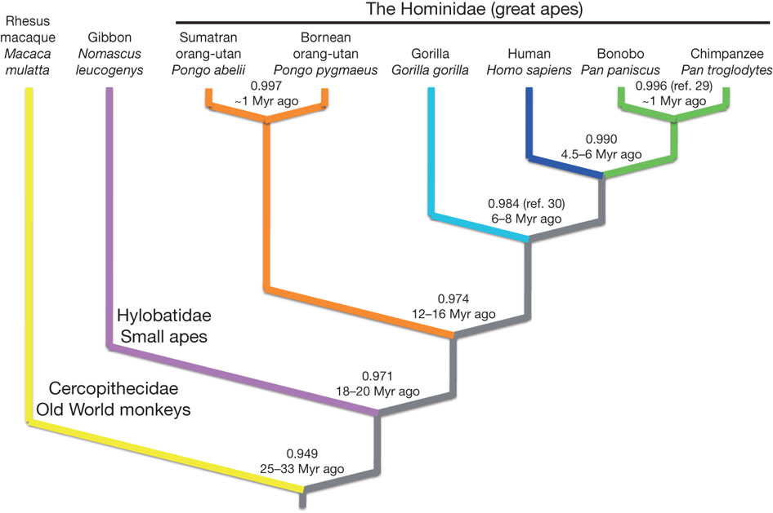
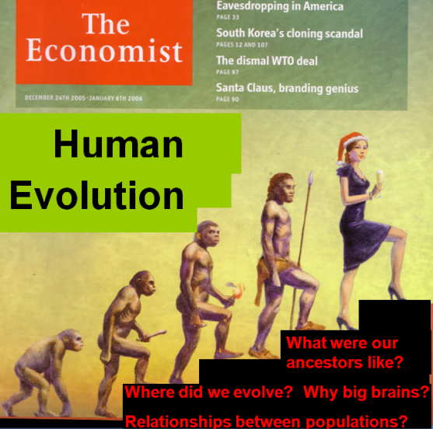
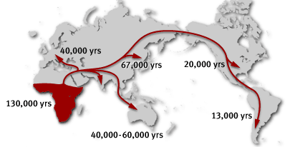
The Hominid Lineage

Slide 4
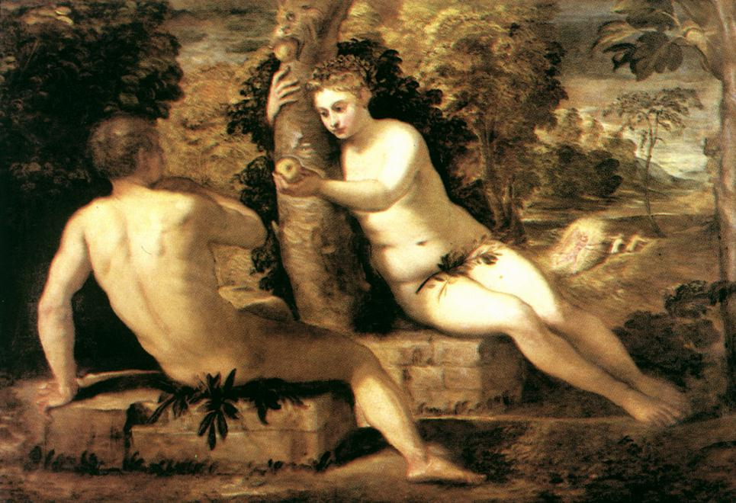
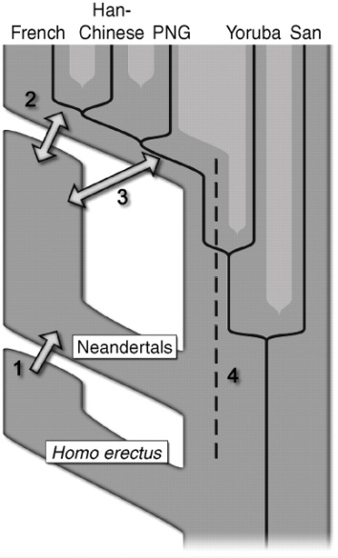
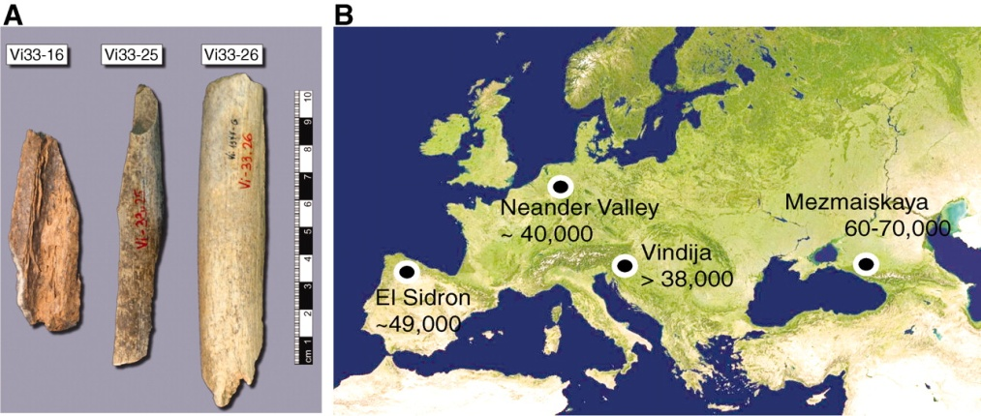
Human population migrations
Out of Africa, Replacement
  Single mother of all humans (Eve) ~190,000yr
  Single father of all humans (Adam) ~340,000yr
  Humans out of Africa ~50000 years ago replaced others (e.g., Neandertals)
Multiregional Evolution
  Generally debunked, however,
  ~5% of human genome in Europeans, Asians is Neanderthal, Denisova

Slide 5
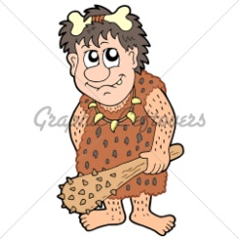








Coalescence
Y-chromosome coalescence

Slide 6
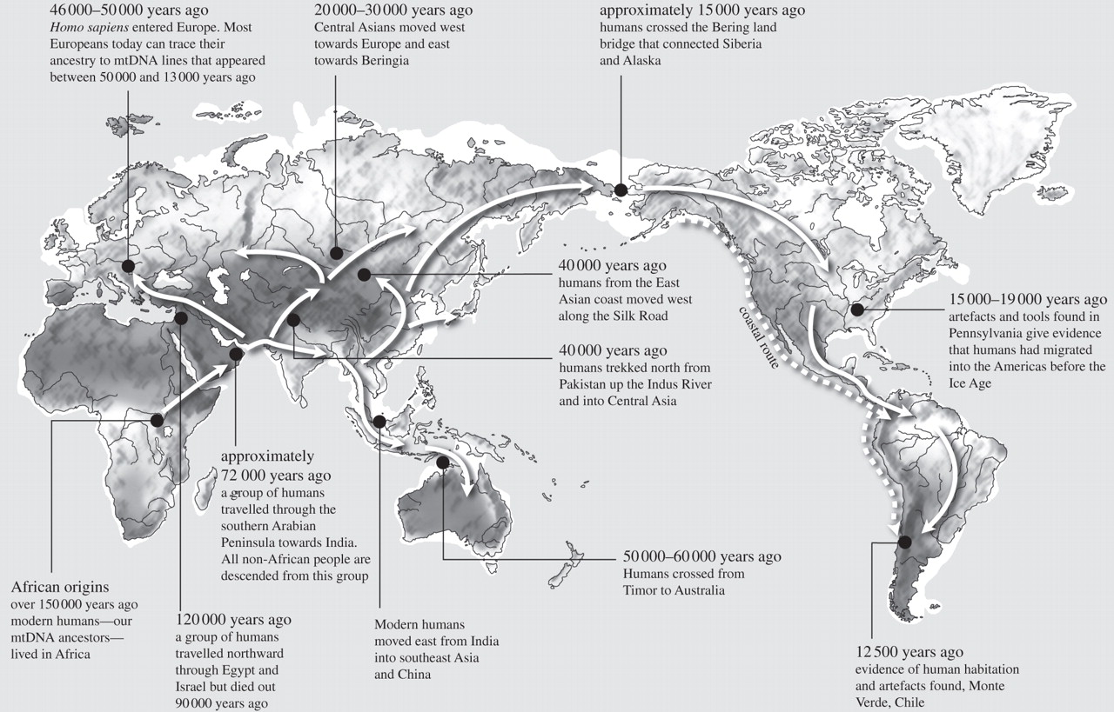
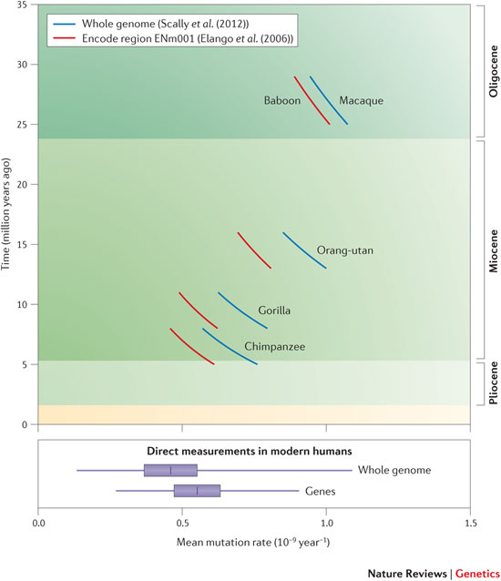
Why humans are so similar
Out of Africa
Oppenheimer S Phil. Trans. R. Soc. B 2012;367:770-784

Slide 7
Some Key Definitions
Mary: AGCCCGTACG
John: AGCCCGTACG
Josh: AGCCCGTACG
Kate: AGCCCGTACG
Pete: AGCCCGTACG
Anne: AGCCCGTACG
Mimi: AGCCCGTACG
Mike: AGCCCTTACG
Olga: AGCCCTTACG
Tony: AGCCCTTACG
G/G
G/G
G/T
G/G
G/G
G/G
G/G
T/T
T/G
T/G
Mom
Dad
Heterozygosity:
Prob[2 alleles picked at random with replacement are different]
    2*.75*.25 = .375
H = 4Nu/(1+4Nu)
Recombinations:
At least 1/chromosome
On average ~1/100 Mb
Alleles: G, T
Major Allele: G
Minor Allele: T
Linkage Disequilibrium:
The degree of correlation between two SNP locations

Slide 8
Human Genome Variation
TGCTGAGA
TGCCGAGA
TGCTCGGAGA
TGC - - - GAGA
SNP
Novel Sequence
Mobile Element or
Pseudogene Insertion
Inversion
Translocation
Tandem Duplication
TGC - - AGA
TGCCGAGA
Microdeletion
Transposition
Novel Sequence
at Breakpoint
Large Deletion
TGC

Slide 9
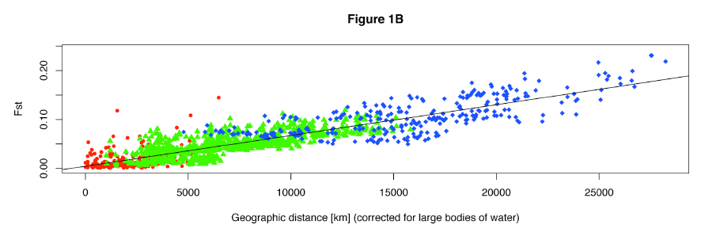
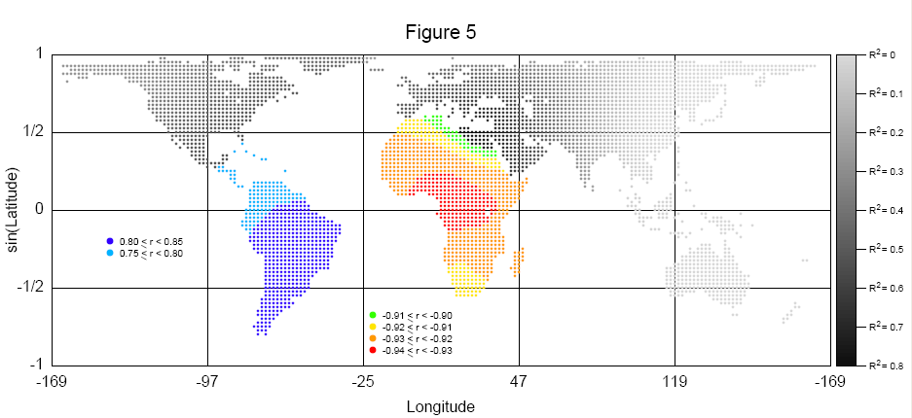
The Fall in Heterozygosity
H – H_{POP}
F_{ST} = -------------
H

Slide 10
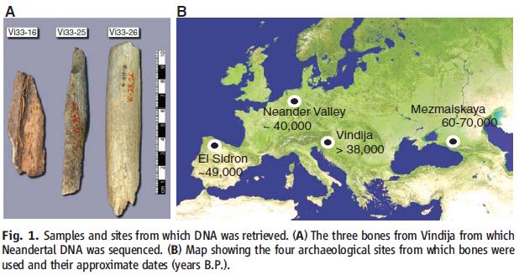
The Neanderthal Genome
From bones, compared genomes of three different Neanderthals with five genomes from modern humans from different areas of the world
Figure 1- R. E. Green et al., Science 328, 710-722 (2010)
Notes:
Photo: Research Articles- A Draft Sequence of the Neandertal Genome, Science. Green et al.
Sample and sites from which DNA was found
more shallow sequencing to find SNPs from these Neanderthal from these different places

Slide 11
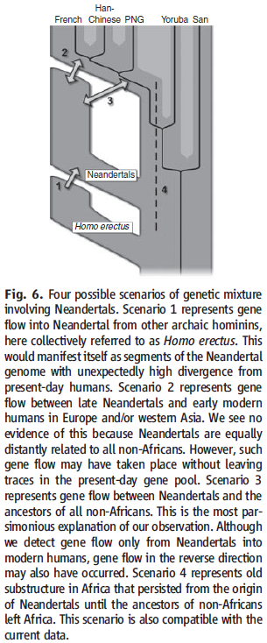
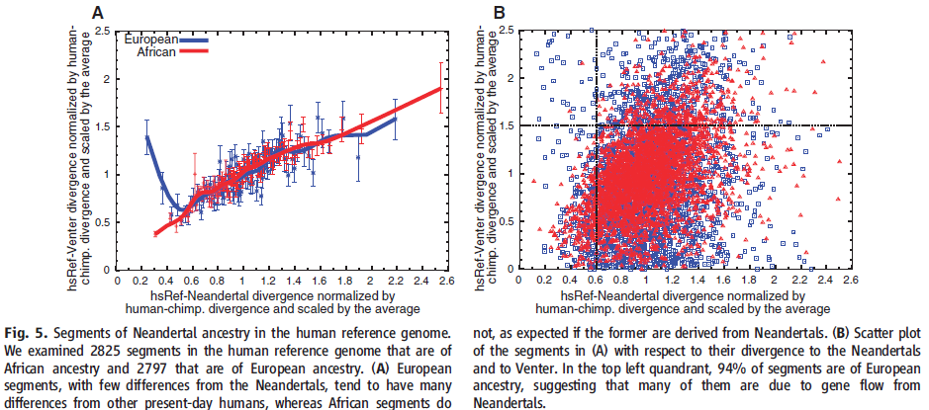
Neanderthal Genome

Slide 12
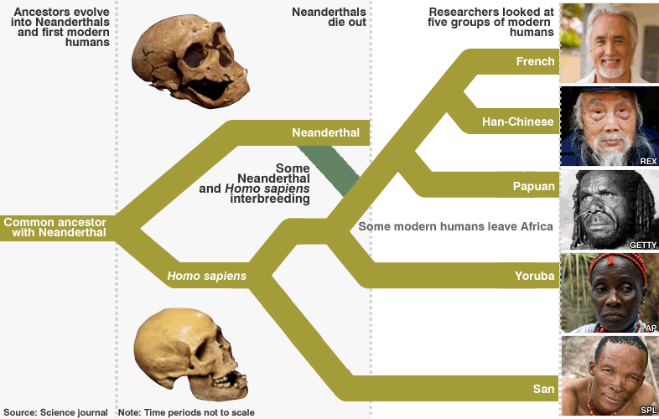
Neanderthal Genome

Slide 13
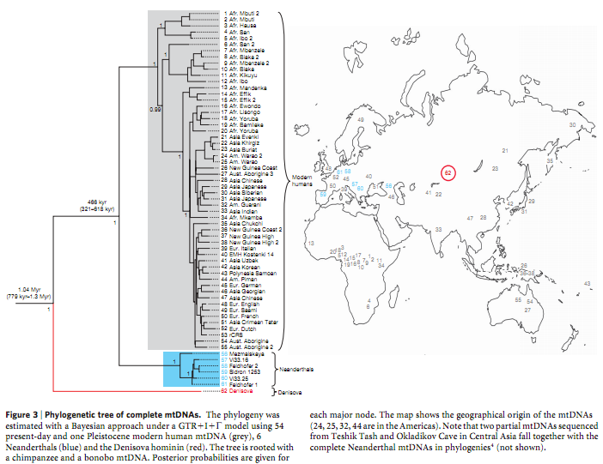
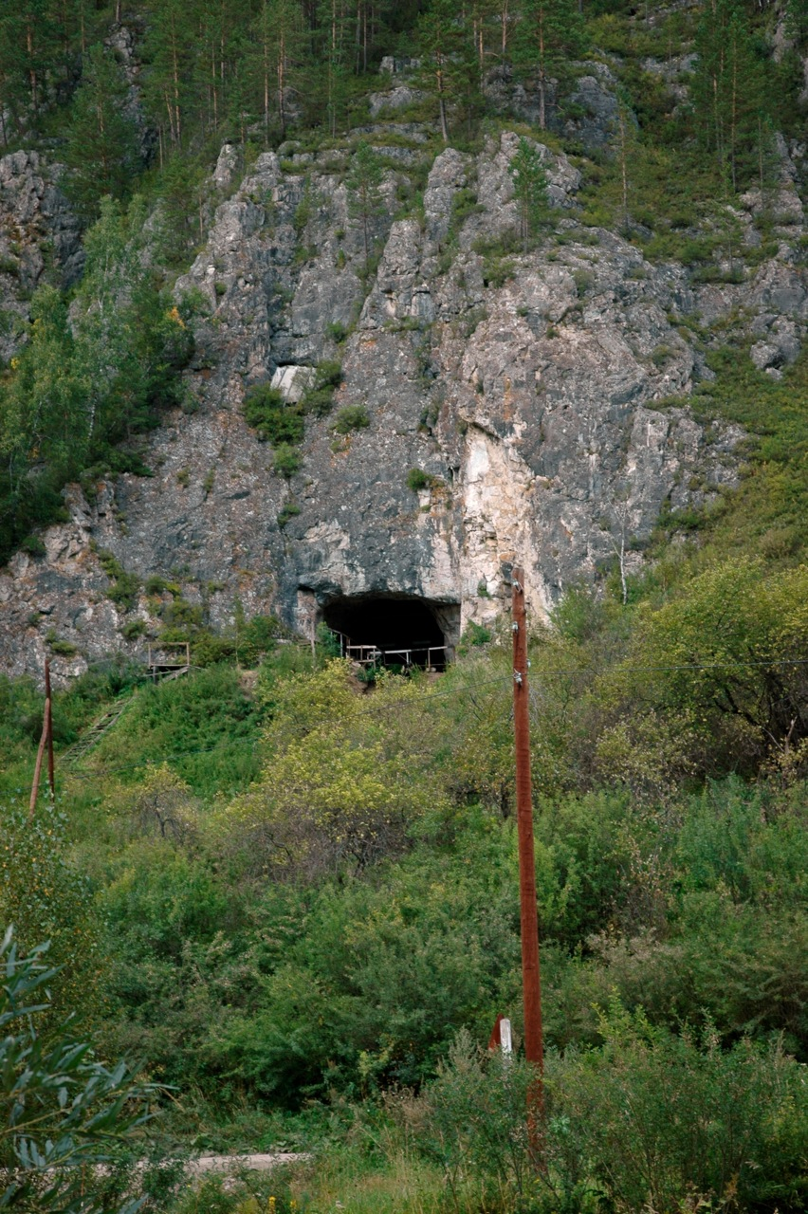
Denisovan – Another human relative
Notes:
Desinova Cave where bone was found suggests that this hominin lived in close space and time with the Neanderthals and humans

Slide 14
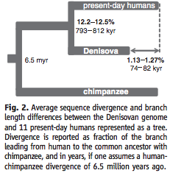

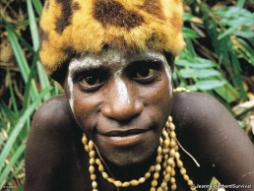
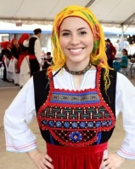
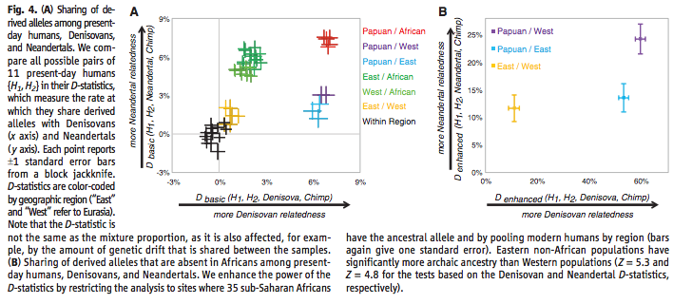
Denisovan/Human Comparison
GCATCGGGCTACTAGTATTTACTAT
GTAACGGGCTACTCGTAGTTCCTAG
GTAACGGTCTACTAGTAGTTCCCAG

Slide 15
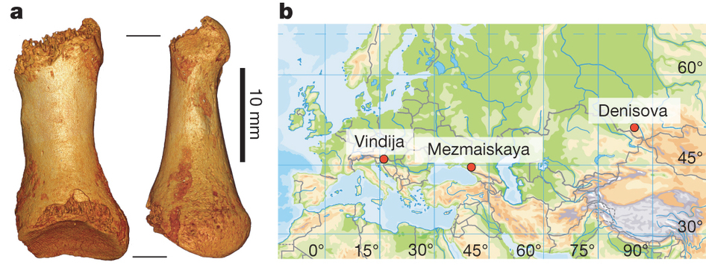
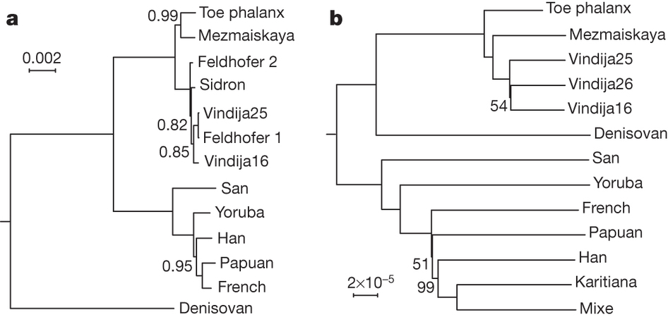
The Neanderthal Whole Genome

Slide 16
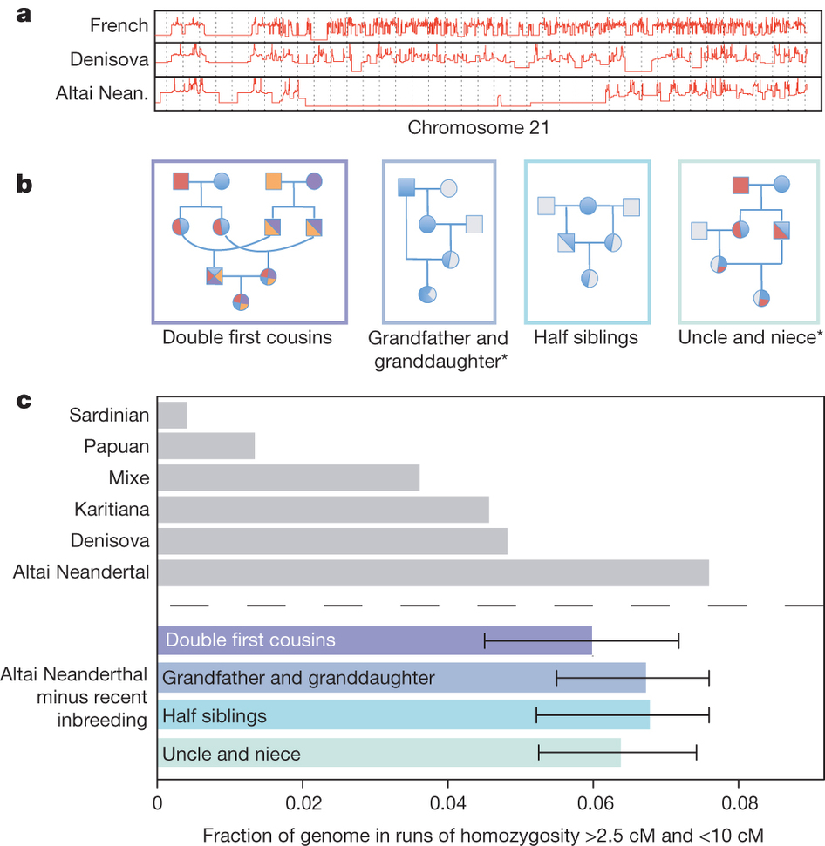
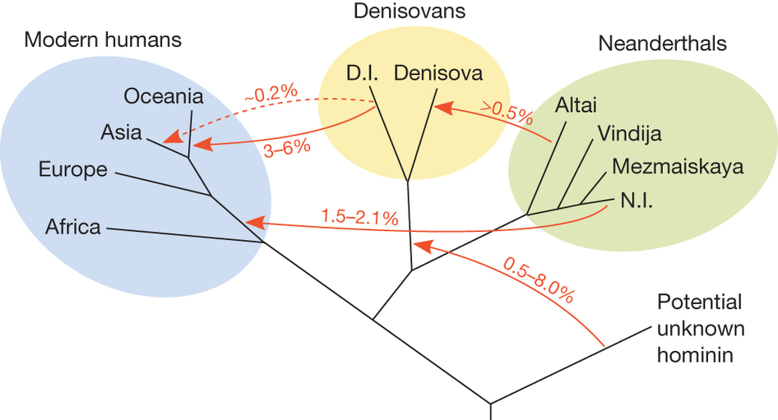
The Neanderthal Whole Genome

Slide 17
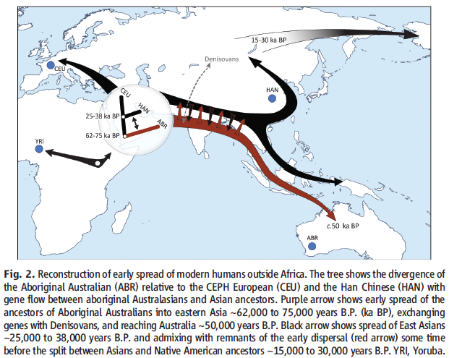
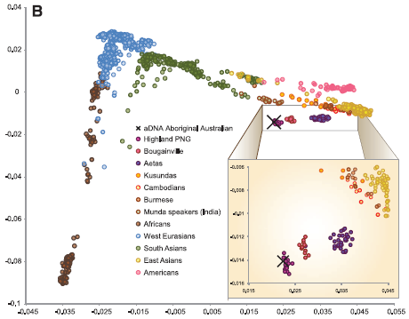
Aboriginal Australian

Slide 18
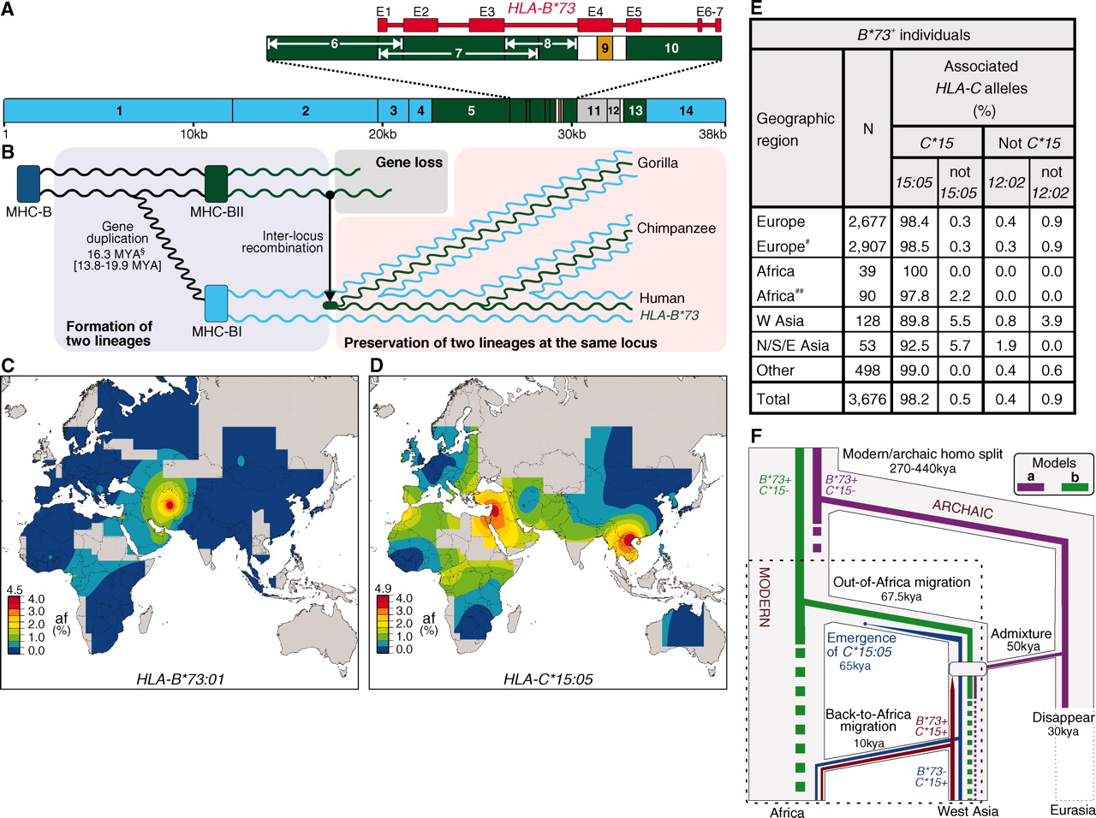
Benefits of Admixture

Slide 19
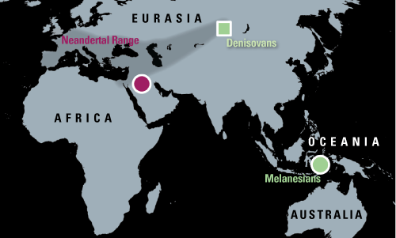
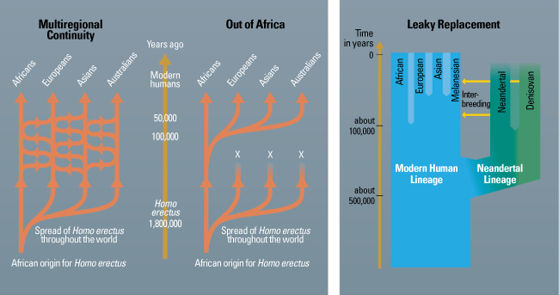
Out of Africa Revisited
“Human uniqueness?”
Ann Gibbons Science 28 January 2011:

Slide 20
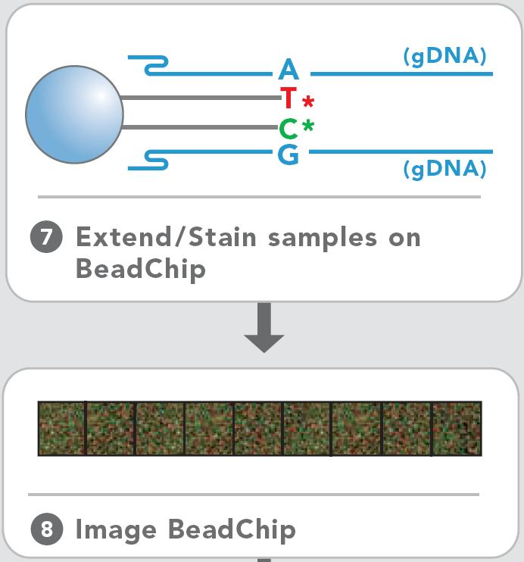
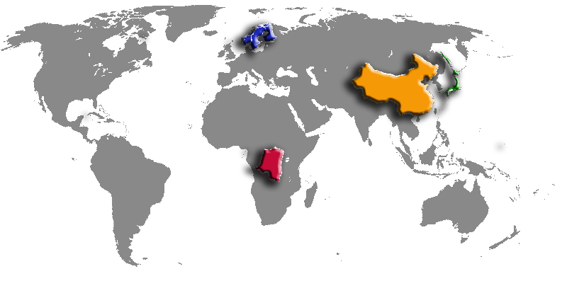
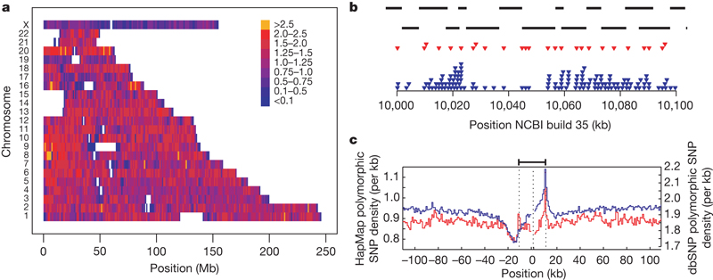
The HapMap Project
ASW African ancestry in Southwest USA 90
CEU Northern and Western Europeans (Utah) 180
CHB Han Chinese in Beijing, China 90
CHD Chinese in Metropolitan Denver 100
GIH Gujarati Indians in Houston, Texas 100
JPT Japanese in Tokyo, Japan 91
LWK Luhya in Webuye, Kenya 100
MXL Mexican ancestry in Los Angeles 90
MKK Maasai in Kinyawa, Kenya 180
TSI Toscani in Italia 100
YRI Yoruba in Ibadan, Nigeria 100
Genotyping:
Probe a limited number (~1M) of known highly variable positions of the human genome

Slide 21
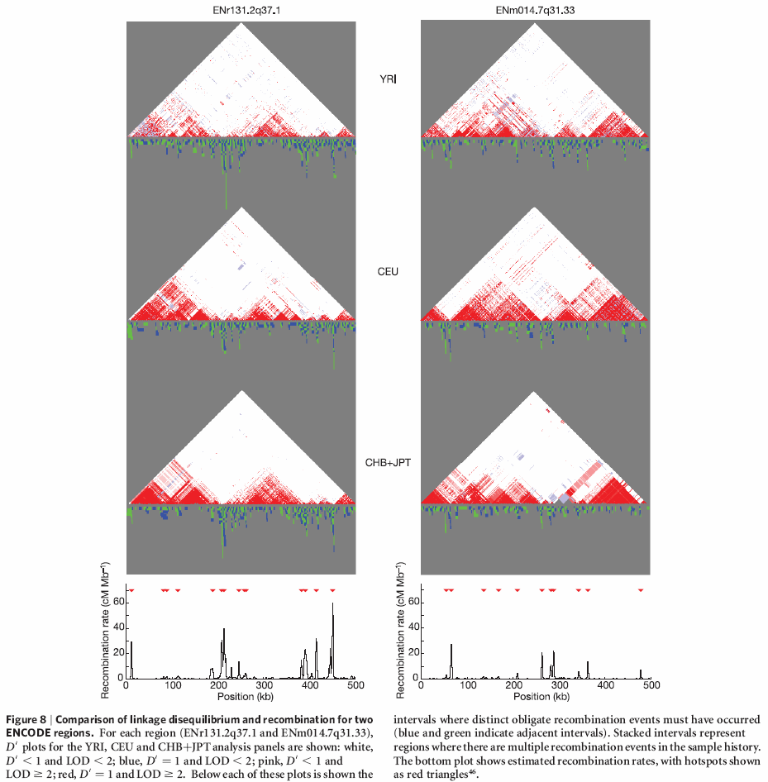
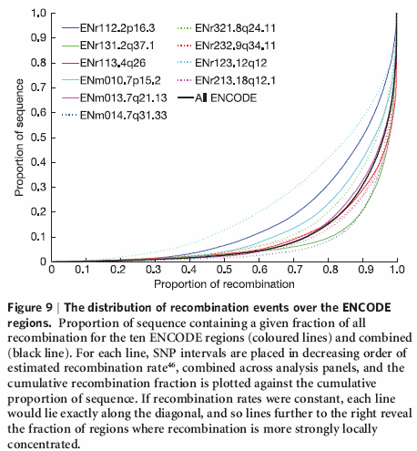
Linkage Disequilibrium & Haplotype Blocks
Minor allele: A G
p_{A}
p_{G}
Linkage Disequilibrium (LD):
D = P(A and G) - p_{A}p_{G}

Slide 22


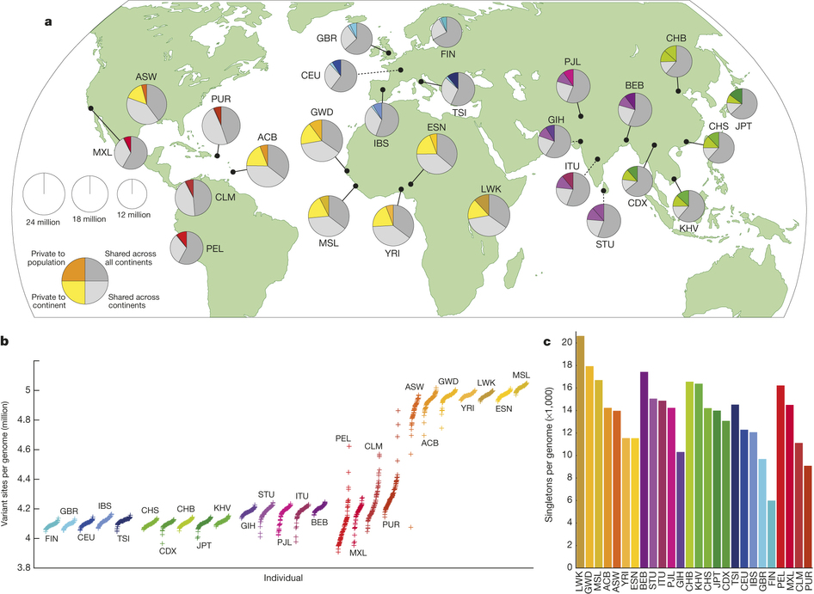
Population Sequencing –
1000 Genomes Project
Notes:
a, Summary of inferred haplotypes across a 100-kb region of chromosome 2 spanning the genes ALMS1 and NAT8, variation in which has been associated with kidney disease⁴⁵. Each row represents an estimated haplotype, with the population of origin indicated on the right. Reference alleles are indicated by the light blue background. Variants (non-reference alleles) above 0.5% frequency are indicated by pink (typed on the high-density SNP array), white (previously known) and dark blue (not previously known). Low frequency variants (<0.5%) are indicated by blue crosses. Indels are indicated by green triangles and novel variants by dashes below. A large, low-frequency deletion (black line) spanning NAT8 is present in some populations. Multiple structural haplotypes mediated by segmental duplications are present at this locus, including copy number gains, which were not genotyped for this study. Within each population, haplotypes are ordered by total variant count across the region. Population abbreviations: ASW, people with African ancestry in Southwest United States; CEU, Utah residents with ancestry from Northern and Western Europe; CHB, Han Chinese in Beijing, China; CHS, Han Chinese South, China; CLM, Colombians in Medellin, Colombia; FIN, Finnish in Finland; GBR, British from England and Scotland, UK; IBS, Iberian populations in Spain; LWK, Luhya in Webuye, Kenya; JPT, Japanese in Tokyo, Japan; MXL, people with Mexican ancestry in Los Angeles, California; PUR, Puerto Ricans in Puerto Rico; TSI, Toscani in Italia; YRI, Yoruba in Ibadan, Nigeria. Ancestry-based groups: AFR, African; AMR, Americas; EAS, East Asian; EUR, European. b, The fraction of variants identified across the project that are found in only one population (white line), are restricted to a single ancestry-based group (defined as in a, solid colour), are found in all groups (solid black line) and all populations (dotted black line). c, The density of the expected number of variants per kilobase carried by a genome drawn from each population, as a function of variant frequency (see Supplementary Information). Colours as in a. Under a model of constant population size, the expected density is constant across the frequency spectrum.

Slide 23
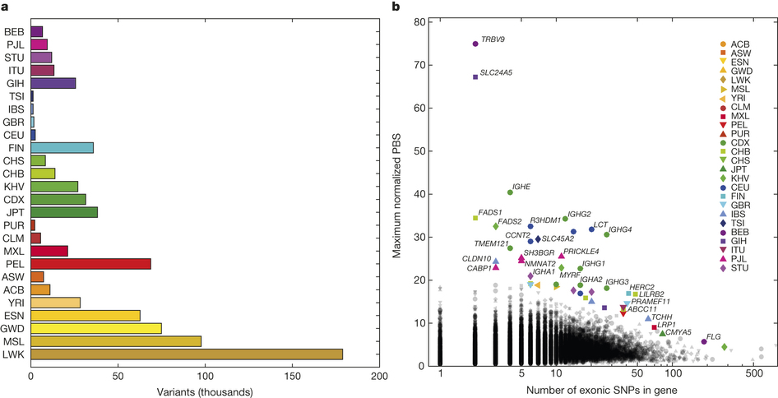
Population Sequencing –
1000 Genomes Project

Slide 24
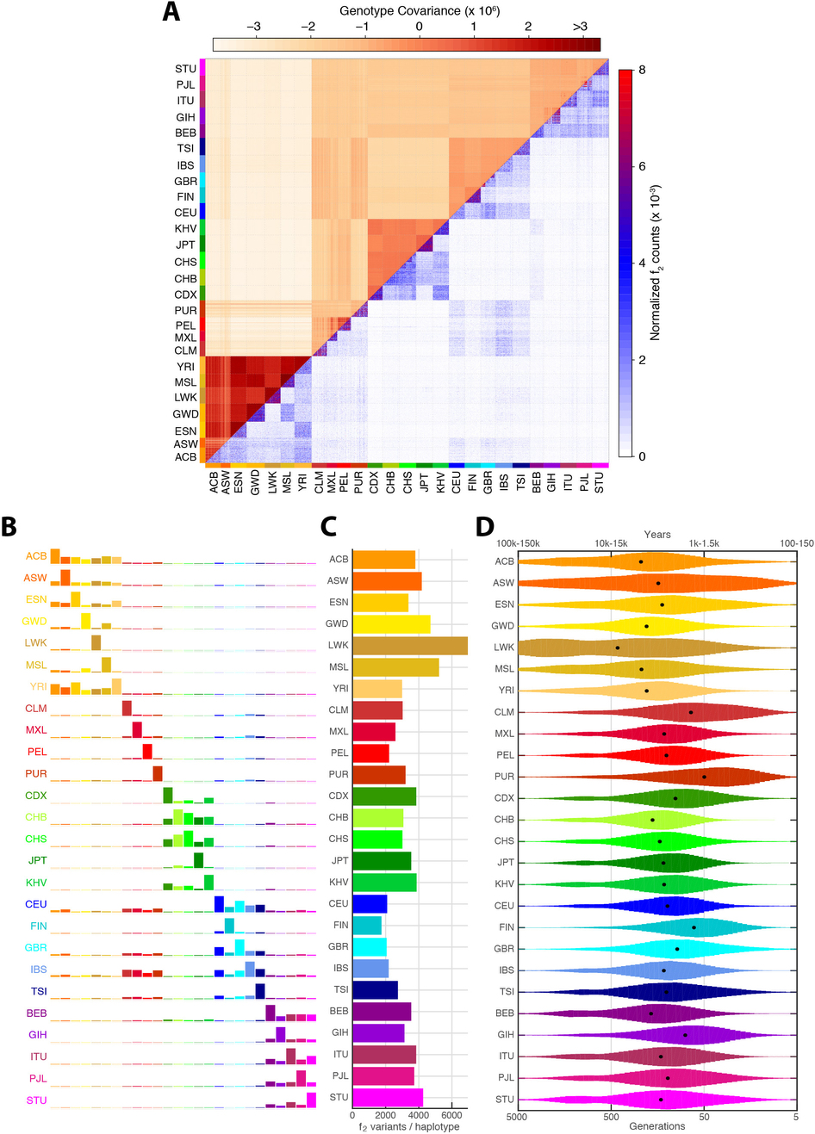
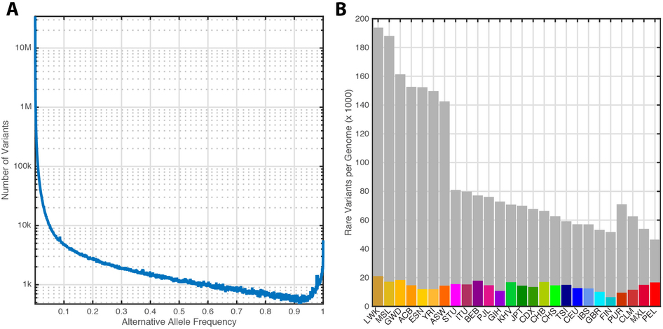
Population Sequencing –
1000 Genomes Project
Notes:
Rare variants <0.5% frequency across all populations

Slide 25
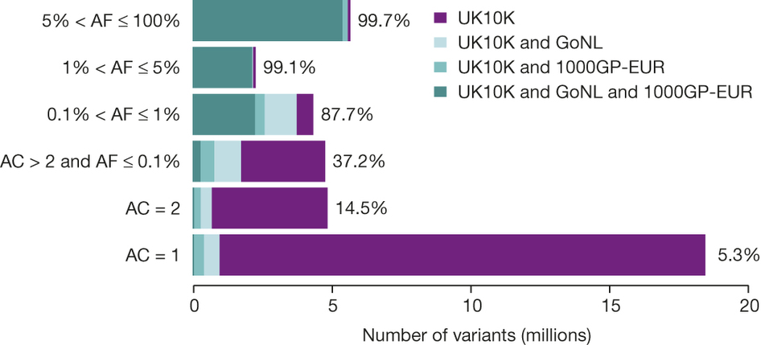
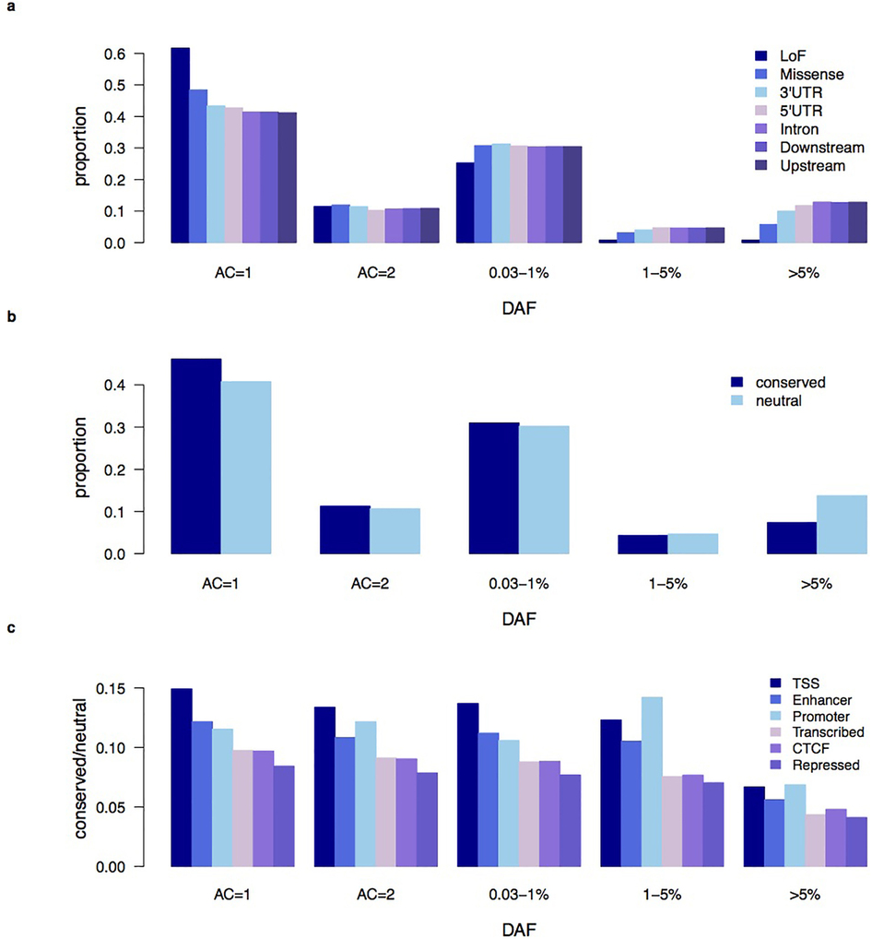
Population Sequencing – UK10K
Notes:
Rare variants <0.5% frequency across all populations

Slide 26
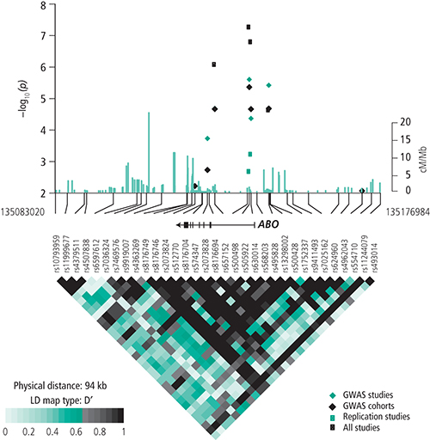




Association Studies
Control
A/G
A/G
G/G
G/G
A/G
G/G
G/G
Disease
A/A
A/G
A/A
A/G
A/G
A/A
A/A
AA | 0 | 4
AG | 3 | 3
GG | 4 | 0
p-value

Slide 27
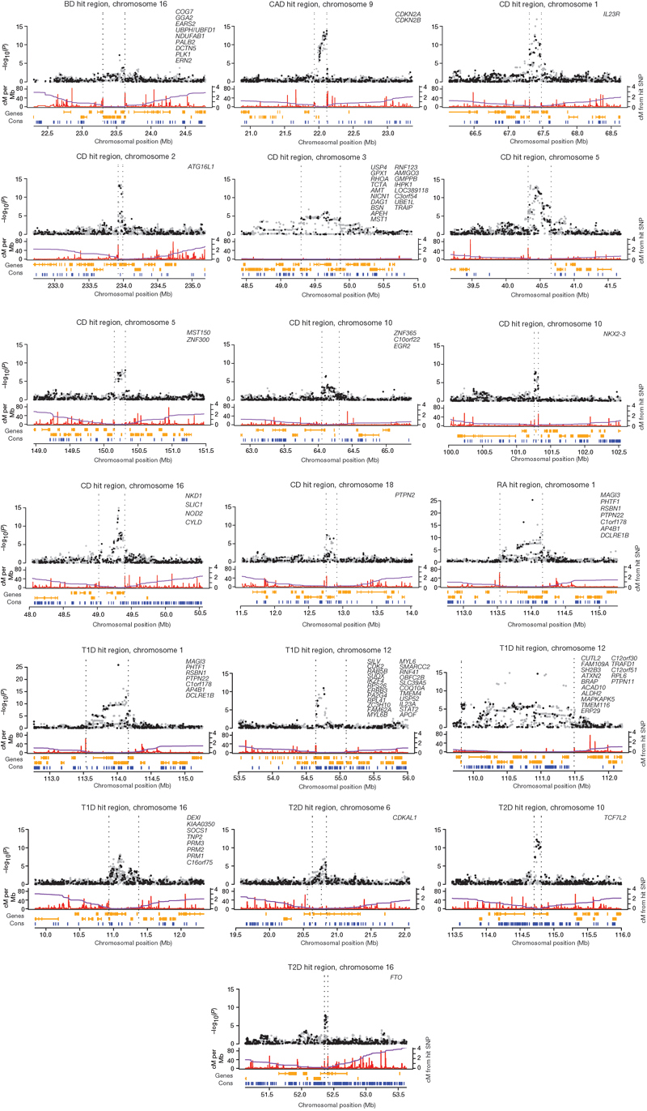
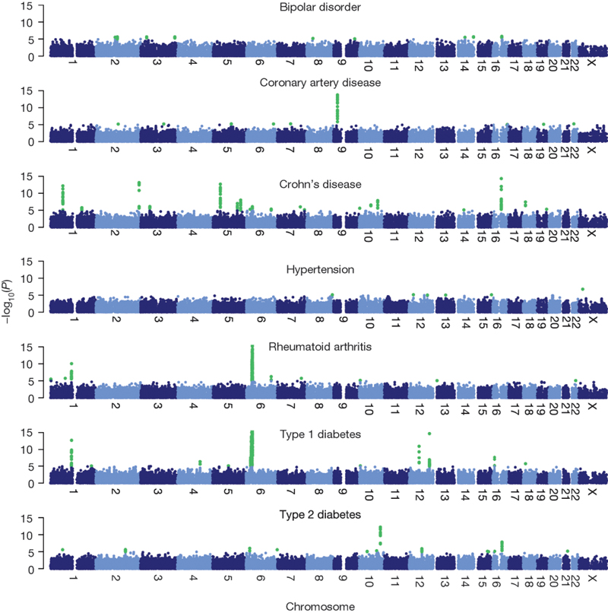
Wellcome Trust Case Control
Many associations of small effect sizes (<1.5)
Nature 447, 661-678(7 June 2007)
Nature 464, 713-720(1 April 2010)

Slide 28
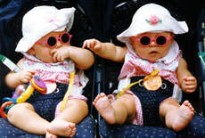
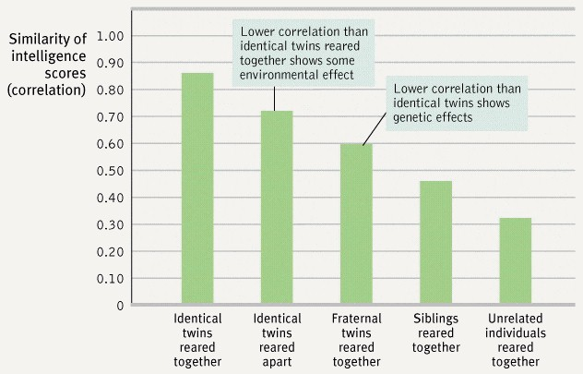
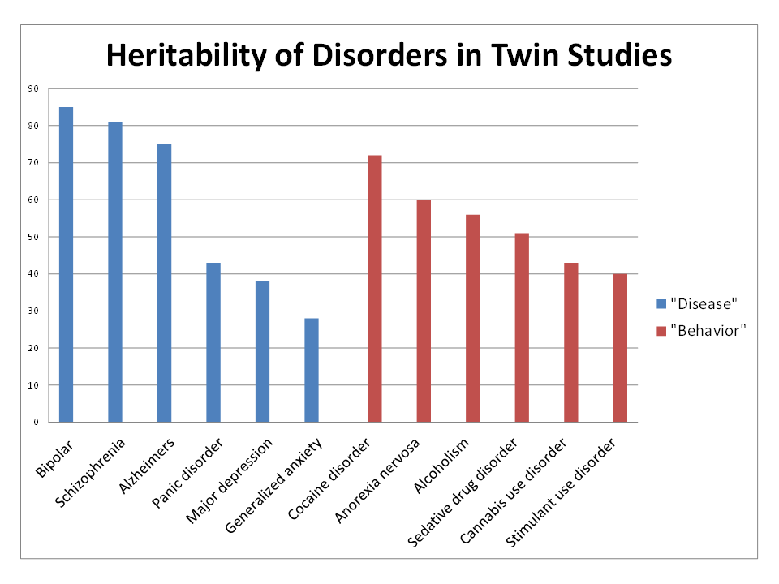
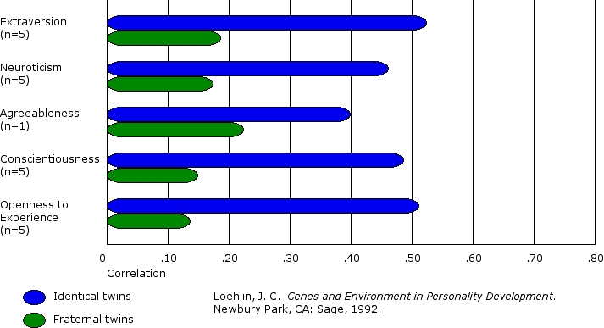
Heritability & Environment
Bienvenu OJ, Davydow DS, & Kendler KS (2011). Psychological medicine, 41 (1), 33-40 PMID:

Slide 29

Disease Clustering
RA vs. ATD
RA vs. MS
  No recorded co-occurrence of RA and MS
SNP - Allele | Gene Symbol | Genetic Variation Score (GVS)
 |  | RA (NARAC) | RA | AS | T1D | ATD | MS (IMSGC) | MS
rs11752919 - C | ZSCAN23 | -3.48 | -3.21 | -9.39 | 1.10 | 0.70 | 3.25 | 2.99
rs3130981 - A | CDSN | -0.46 | -1.00 | -9.47 | -4.94 | 0.33 | 10.00 | 13.41
rs151719 - G | HLA-DMB | -6.71 | -4.77 | -1.08 | -13.63 | 0.34 | 8.58 | 17.76
rs10484565 - T | TAP2 | 25.52 | 8.37 | 1.34 | 15.74 | -1.36 | -0.56 | -0.30
rs1264303 - G | VARS2 | 11.51 | 7.36 | 18.76 | 0.89 | -1.76 | -1.85 | -1.75
rs1265048 - C | CDSN | 6.59 | 2.97 | 50.13 | 6.34 | -0.85 | -2.39 | -4.16
rs2071286 - A | NOTCH4 | 5.30 | 0.78 | 6.42 | 4.04 | -0.03 | -1.89 | -2.45
rs2076530 - G | BTNL2 | 67.49 | 56.46 | 14.06 | 13.58 | -6.41 | -9.50 | -18.52
rs757262 - T | TRIM40 | 14.58 | 9.11 | 6.27 | 1.56 | -0.79 | -2.05 | -7.34

Slide 30



Global Ancestry Inference
Nature. 2008 November 6; 456(7218): 98–101.

Slide 31

Ancestry Painting
Danish
?
French
Spanish
Mexican
Notes:
For example, if we look at the genome of a well known actress, who is a mix of a number of different populations, can we tell which parts of her chromosome derive from which population?

Slide 32


Modeling population haplotypes – VLMC
Browning, 2006
Notes:
Figure 2. A, Tree graph constructed using the haplotype data in table 1. Circles represent nodes, and the values in them represent level and node identifier within level; for example, “3.2” denotes node 2 at level 3. A solid edge between nodes at levels i and i+1 represents allele 1 at SNP marker i; a dashed edge represents allele 2. Numbers above edges represent haplotype counts. Thus, 137 over the edge between 3.3 and 4.4 represents 137 haplotypes that have allele 2 at the first SNP, 1 at the second SNP, and 1 at the third SNP. Although directional arrows are not shown, a left-to-right direction is implied. B, The graph from figure 2A after merging. Nodes 3.1 and 3.3 in figure 2A have been merged, as have all nodes at level 5. Notation is as described for panel A. Edges to be tested are marked with “T.”

Slide 33



Phasing
Browning & Browning, 2007

Slide 34
Identity By Descent
.
.
.
.
.
.
{
{

Slide 35

IBD detection
IBD = F
H₁
H₂
H₃
H₄
IBD = T
H₁
H_{sh}
H₂
FastIBD: sample haplotypes for each individual, check for IBD
Browning & Browining 2011
Parente
Rodriguez et al. 2013

Slide 36
Fixation, Positive & Negative Selection
How can we detect negative selection?
How can we detect positive selection?
Negative Selection
Neutral Drift
Positive Selection

Slide 37


How can we detect positive selection?
Ka/Ks ratio:
Ratio of nonsynonymous to
synonymous substitutions
Very old, persistent, strong positive selection for a protein that keeps adapting
Examples: immune response, spermatogenesis

Slide 38




How can we detect positive selection?

Slide 39


Positive Selection in Human Lineage

Slide 40

Positive Selection in Human Lineage

Slide 41

Mutations and LD
X
X
X
Slide Credits:
Marc Schaub

Slide 42


Long Haplotypes –EHS, iHS tests
Less time:
Fewer mutations
Fewer recombinations

Slide 43

Application: Malaria
Study of genes known to be implicated in the resistance to malaria.
Infectious disease caused by protozoan parasites of the genus Plasmodium
Frequent in tropical and subtropical regions
Transmitted by the Anopheles mosquito
Slide Credits:
Marc Schaub
Image source: wikipedia.org

Slide 44

Application: Malaria
Slide Credits:
Marc Schaub
Image source: NIH - http://history.nih.gov/exhibits/bowman/images/malariacycleBig.jpg

Slide 45

Application: Malaria
Image source: CDC - http://www.dpd.cdc.gov/dpdx/images/ParasiteImages/M-R/Malaria/malaria_risk_2003.gif
Slide Credits:
Marc Schaub

Slide 46

Results: G6PD
Slide Credits:
Marc Schaub
Source: Sabeti et al. Nature 2002.
Notes:
Glucose-6-phosphate dehydrogenase deficiency(G6PD) is an X-linked recessive hereditary disease characterized by abnormally low levels of glucose-6-phosphate dehydrogenase, a metabolic enzyme involved in the pentose phosphate pathway, especially important in red blood cell metabolism. G6PD deficiency is the most common human enzyme defect.^{[1]} Individuals with the disease may exhibit nonimmune hemolytic anemia in response to a number of causes, most commonly infection or exposure to certain medications or fava beans. G6PD deficiency is closely linked to favism, a disorder characterized by a hemolytic reaction to consumption of fava or broad beans, with a name derived from the Italian name of the broad bean (fava). The name favism is sometimes used to refer to the enzyme deficiency as a whole, although this is misleading as not all people with G6PD deficiency or Favism will manifest physically observable symptoms to the consumption of broad beans.
The two variants (G6PD A− and G6PD Mediterranean) are the most commonly inherited variants. G6PD A− has an occurrence of 10% of American blacks while G6PD Mediterranean is prevalent in the Middle East. The known distribution of the disease is largely limited to people of Mediterranean origins (Spaniards, Italians, Greeks, Armenians, and Jews).^{[8]} These variants are believed to stem from a protective effect against Plasmodium falciparumand Plasmodium vivax malaria.^{[9]}

Slide 47


Results: TNFSF5
Slide Credits:
Marc Schaub
Source: Sabeti et al. Nature 2002.
Notes:
“TNFSF5, so called because it is a member of the TNF superfamily, encodes a glycoprotein that is expressed on T cells, known as CD40 ligand. By engaging CD40 on the B-cell surface, it regulates B-cell function, particularly immunoglobulin class switching, and rare coding mutations in CD40L can lead to life-threatening immunodeficiency. In a Gambian case-control study, a significant reduction in risk for severe malaria was associated with males hemizygous for the TNFSF5-726C allele, and this was confirmed by transmission disequilibrium test analysis in affected families. A similar but nonsignificant trend was found in females. Long range haplotype analysis of this allele suggests that it has recently undergone positive evolutionary selection.

Slide 48


Malaria and Sickle-cell Anemia
Allison (1954): Sickle-cell anemia is limited to the region in Africa in which malaria is endemic.
Distribution of malaria
Distribution of sickle-cell anemia
Slide Credits:
Marc Schaub
Image source: wikipedia.org

Slide 49

Malaria and Sickle-cell Anemia
Single point mutation in the coding region of the Hemoglobin-B gene (glu → val).
Heterozygote advantage:
    Resistance to malaria
    Slight anemia.
Slide Credits:
Marc Schaub
Image source: wikipedia.org

Slide 50

Lactose Intolerance
Slide Credits:
Marc Schaub
Source: Ingram and Swallow. Population Genetics of Encyclopedia of Life Sciences. 2007.

Slide 51


Lactose Intolerance
LCT, 5’
LCT, 3’
Slide Credits:
Marc Schaub
Source: Bersaglieri et al. Am. J. Hum. Genet. 2004.

Slide 52



13910*T distribution
Lactase persistence (litterature)
Predicted lactase persistence
Source: Ingram et al. Lactose digestion and the evolutionary genetics of lactase persistence. Hum Genet. 2009 Jan;124(6):579-91.
Slide Credits:
Marc Schaub

Slide 53


Positive Selection in Human Lineage
Notes:
Figure 5. Characterization of Candidate Regions and Variants
(A and B) All candidate regions in the genome are shown in gray. (A) Candidate functional elements in localized regions, including regions with genes (blue), eQTLs (orange), long noncoding RNAs (green), and nonsynonymous variants (red). (B) Regions with genes relating to potential selective pressures, such as metabolism (red circle), infectious disease (purple), brain development (red), hearing (green), and hair and sweat (orange
(Sabeti, 2013)

Slide 54
Orthology and Paralogy
Yeast
Orthologs:
Derived by speciation
Paralogs:
Everything else
HA1 Human
HA2 Human
WA Worm
HB Human
WB Worm

Slide 55


Orthology, Paralogy, Inparalogs, Outparalogs

