Slide 1
CS448f: Image Processing For Photography and Vision
Sharpening

Slide 2
Sharpening
Boost detail in an image without introducing noise or artifacts
Undo blur
  due to lens aberrations
  slight misfocus

Slide 3
Recall Denoising
Input
=
Signal + Noise

Slide 4

Recall Denoising
Input
=
Signal + Noise

Slide 5
Sharpening
Input
=
Coarse + Fine

Slide 6
Sharpening
Output
=
Coarse + Fine

Slide 7
Sharpening
Any Filter which removes fine details can be used to sharpen
  1) Coarse = Remove Fine Details from Input
  2) Fine = Input - Coarse
  3) Output = Input + Fine x 0.5
Which filters should be use to create the coarse base layer?
What about noise?

Slide 8
Linear Sharpening Filters
Let G be a Gaussian Kernel
  1) Coarse = G * Input
  2) Fine = Input - Coarse
  3) Output = Input + Fine x 0.5

Slide 9
Convolution is Linear
  G*(a+b) = G*a + G*b
  Output = Input + 0.5 Fine
  Output = Input + 0.5 (Input - G*Input)
  Output = 1.5 Input - 0.5 G*Input
  Output = (1.5 I - 0.5 G) * Input
Or in Fourier Space
  Output’ = (1.5 I’ - 0.5 G’) x Input’
I

Slide 10
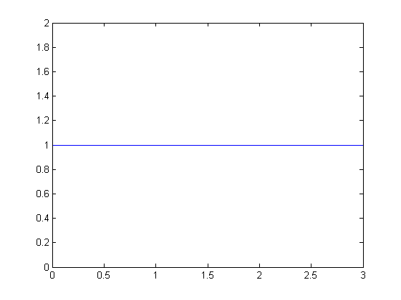
Linear Sharpening Filters
  I is the filter that does nothing when you convolve by it, so I’ is the filter that does nothing when you multiply by it => I’ = 1

Slide 11
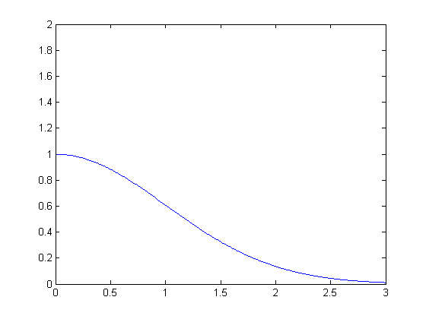
Linear Sharpening Filters
  The Fourier Transform of a Gaussian is a Gaussian
  G’:

Slide 12
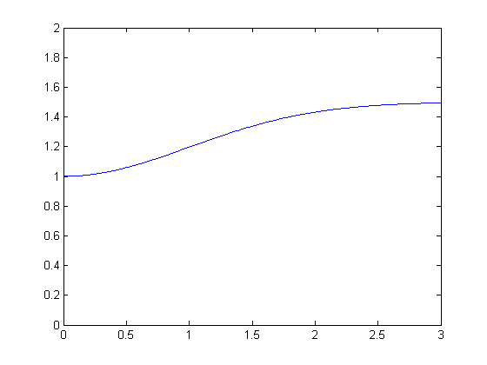
The result in Fourier space:
(1.5 I’ - 0.5 G’) = amplify high frequencies

Slide 13
Demo
ImageStack -load dog.jpg -dup -dup -dup -gaussianblur 4 -pull 1 -subtract -scale 2 -add -adjoin t -resample 10 width height -display

Slide 14
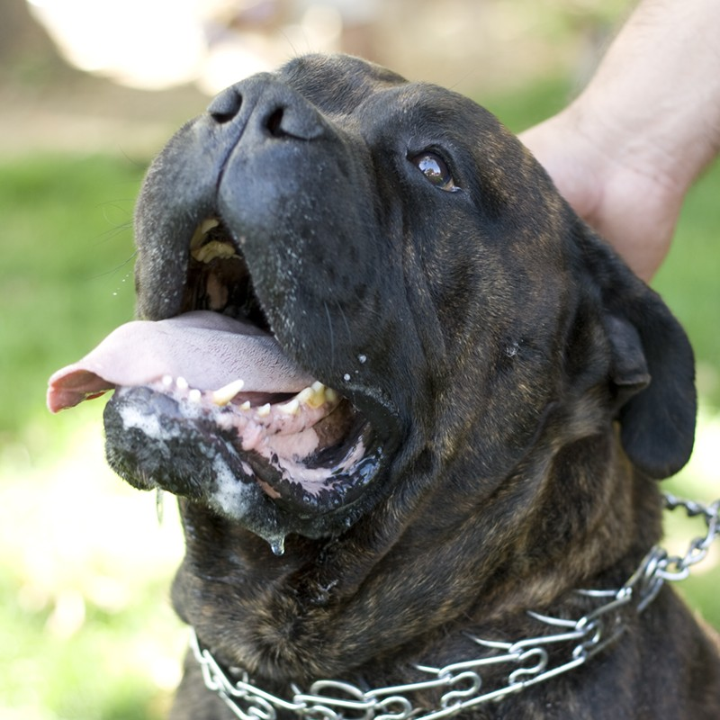
Input

Slide 15

Coarse

Slide 16
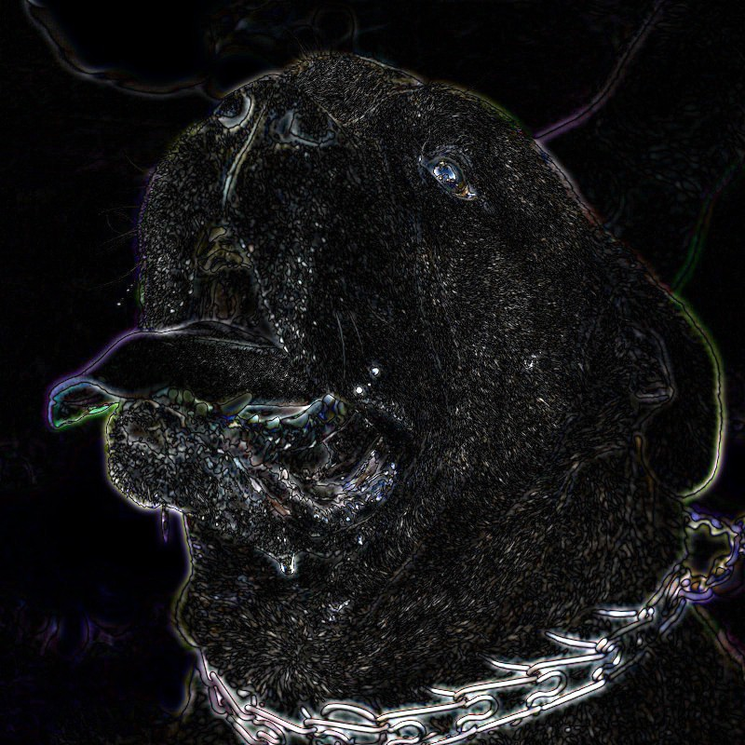
Fine x 3

Slide 17
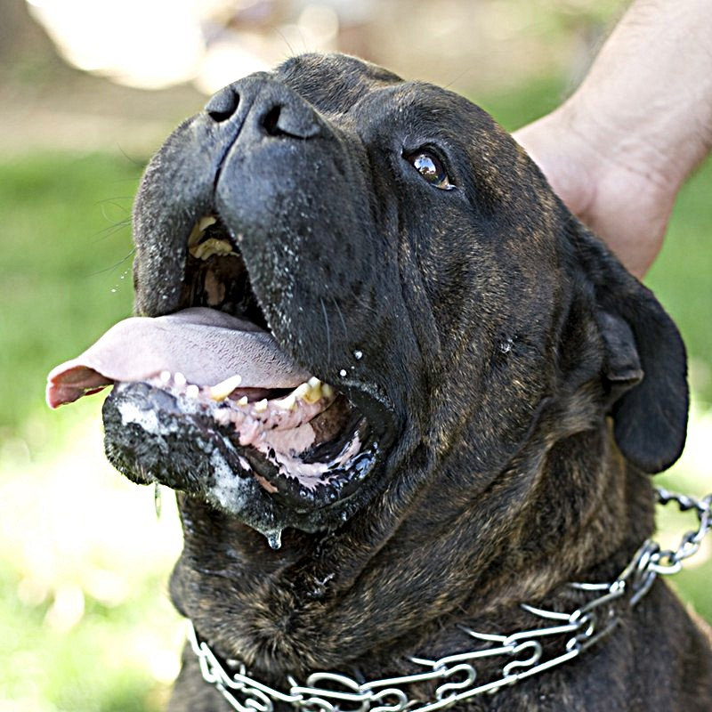
Input +
Fine

Slide 18
Input

Slide 19
Halos:

Slide 20
Halos

Slide 21
Let’s see what Photoshop Does
Unsharp Masking...

Slide 22
Let’s see what Photoshop Does
Unsharp Masking creates halos
With the threshold set, fine details are not boosted, only strong edges

Slide 23
Suggestions?
What removes fine detail without blurring edges?

Slide 24
Median Sharpen
The “Fine” image is the same as the “Method Noise” images in the previous lecture.
It should only contain fine detail, not strong edges
Let’s make the base layer with a median filter!

Slide 25
Input

Slide 26

Median
Coarse

Slide 27
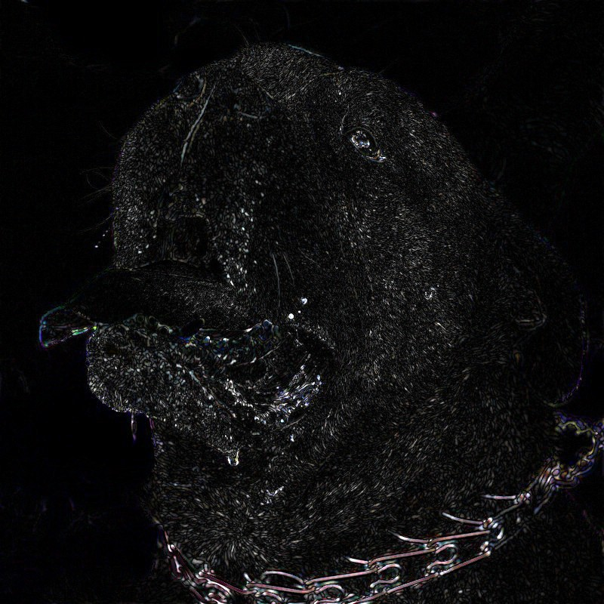
Median
Fine x 3

Slide 28

Median
Result

Slide 29
Linear
Result

Slide 30
Bilateral Sharpen
Let’s make the base layer with a bilateral filter!

Slide 31
Input

Slide 32

Bilateral
Coarse

Slide 33
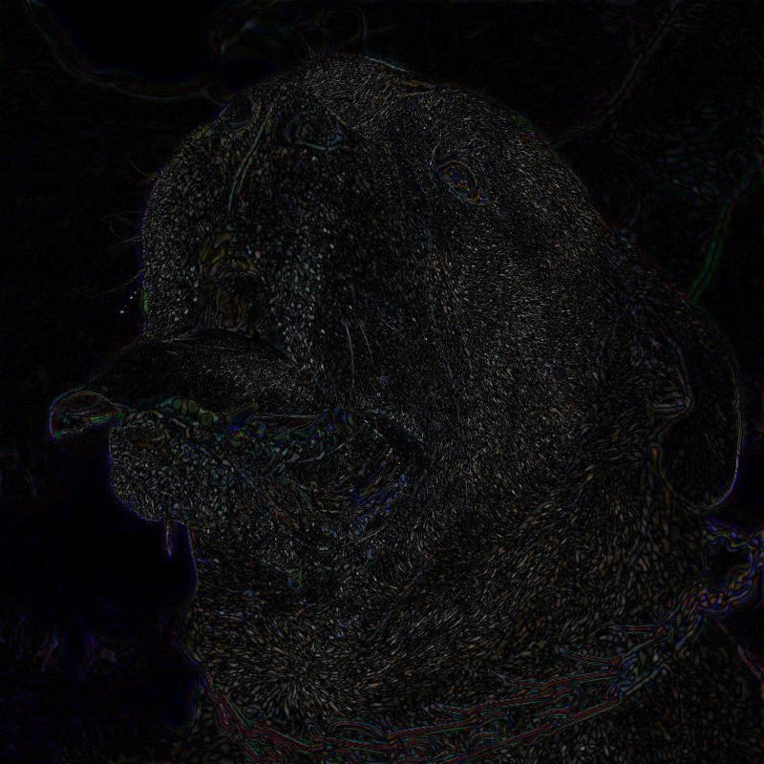
Bilateral
Fine x 3

Slide 34

Bilateral
Result

Slide 35
Median
Result

Slide 36
Linear
Result

Slide 37
Non-Local Means Sharpen?
Non-Local Means looks for similar patches and averages my value with theirs
  Conformity with peer group
Non-Local Means sharpening figures out what makes me different from other similar things in the image, and exaggerates that
  Rebellion against peer group

Slide 38
Input

Slide 39

NLMeans
Coarse

Slide 40
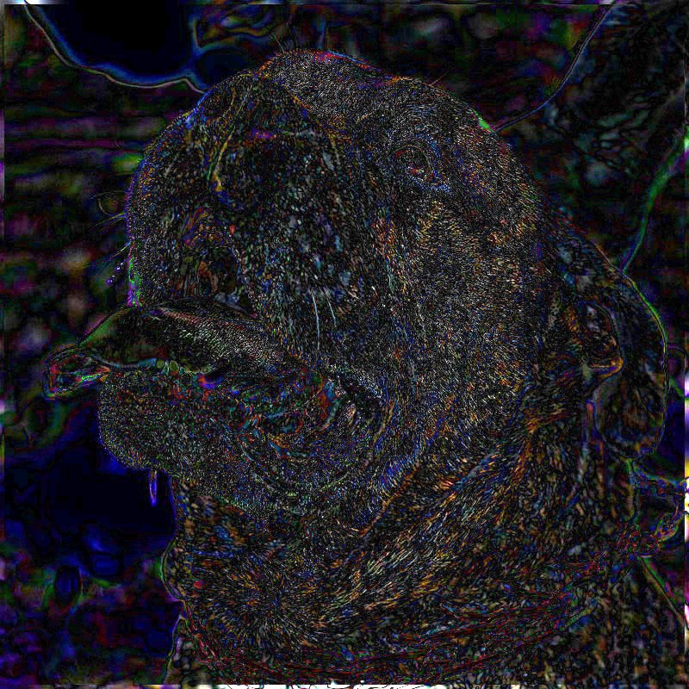
NLMeans
Fine x 8

Slide 41
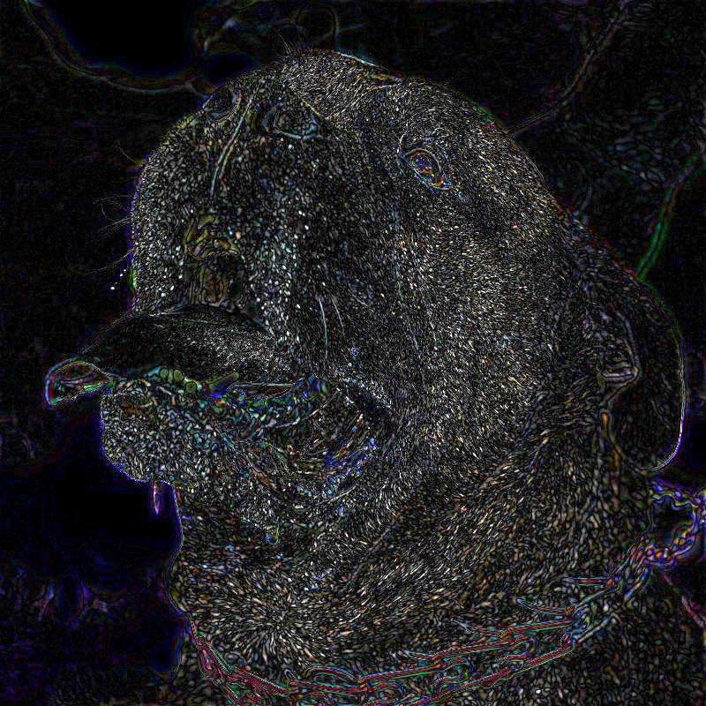
Bilateral
Fine x 8

Slide 42

NLMeans
Result

Slide 43
Bilateral
Result

Slide 44
Input

Slide 45
Remember...
None of this is useful if we can’t make it go fast

Slide 46
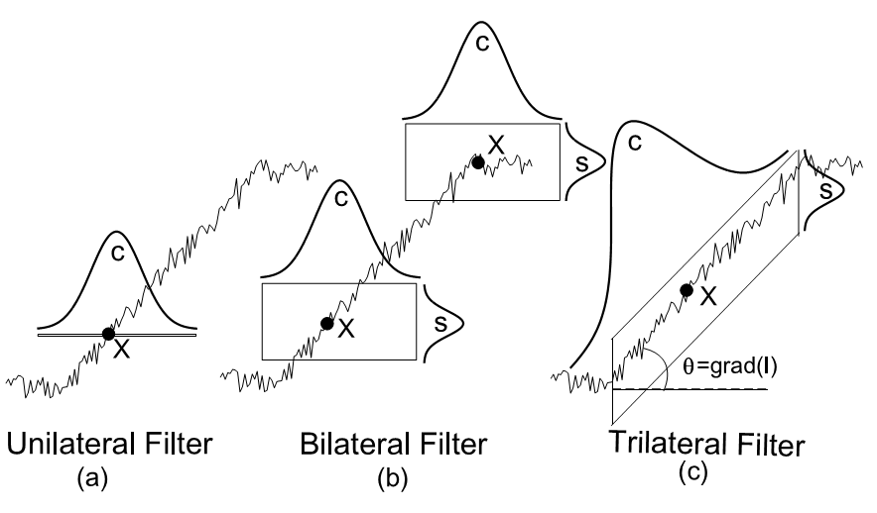
Other Techniques
Everyone wants to best the bilateral filter
Two notable papers to look at:
  The Trilateral filter (Tumblin et al, EGSR 2003)

Slide 47
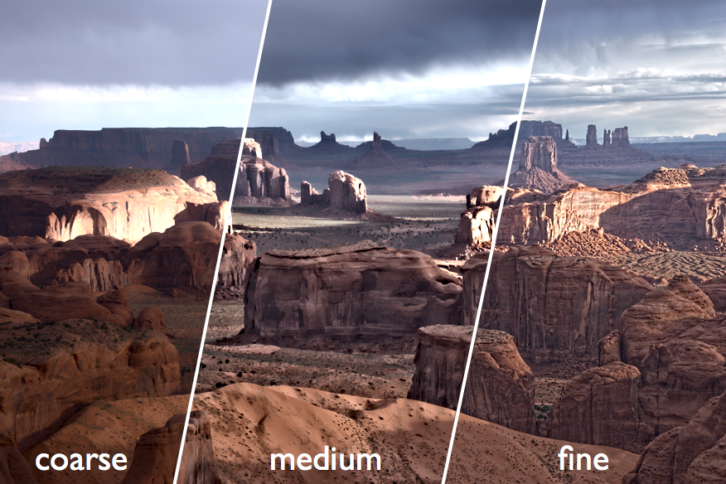
Other Techniques
Edge Preserving Decompositions for Multi-Scale Tone and Detail Manipulation:
  Farbman et al, SIGGRAPH 2008

