Slide 1
CS448f: Image Processing For Photography and Vision
Graph Cuts

Slide 2
Seam Carving
Video
Make images smaller by removing “seams”
Seam = connected path of pixels
  from top to bottom
  or left edge to right edge
Don’t want to remove important stuff
  importance = gradient magnitude

Slide 3
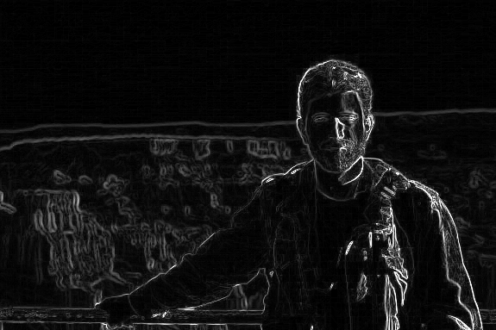
Finding a Good Seam
How do we find a path from the top of an image to the bottom of an image that crosses the fewest gradients?

Slide 4
Finding a Good Seam
Recursive Formulation:
Cost to bottom at pixel x =
    gradient magnitude at pixel x +
    min(cost to bottom at pixel below x,
    cost to bottom at pixel below and right of x,
    cost to bottom at pixel below and left of x)

Slide 5
Dynamic Programming
Start at the bottom scanline and work up, computing cheapest cost to bottom
  Then, just walk greedily down the image
for (int y = im.height-2; y >= 0; y--) {
for (int x = 0; x < im.width; x++) {
im(x, y)[0] += min3(im(x, y+1)[0],
im(x+1,y+1)[0],
im(x-1, y+1)[0]);
}
}

Slide 6
Instead of Finding Shortest Path Here:

Slide 7
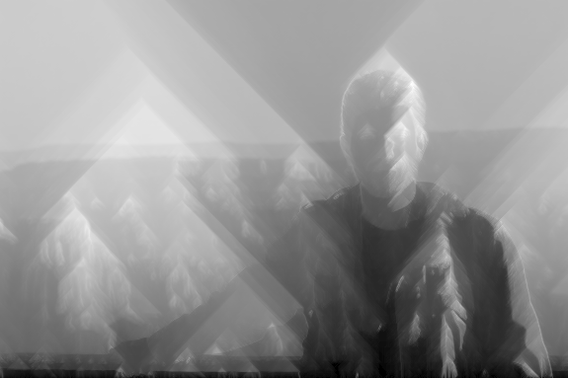
We greedily walk down this:

Slide 8
We greedily walk down this:

Slide 9
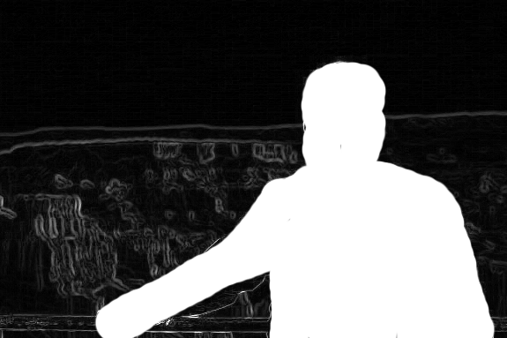
Protecting a region:

Slide 10

Protecting a region:

Slide 11
Protecting a region:

Slide 12
Demo

Slide 13
How Does Quick Selection Work?
All of these use the same technique:
  picking good seams for poisson matting
    (gradient domain cut and paste)
    pick a loop with low contrast
  picking good seams for panorama stitching
    pick a seam with low contrast
  picking boundaries of objects (Quick Selection)
    pick a loop with high contrast

Slide 14
Lazy Snapping
Min Cut
Max Flow
Paint
Select
Grab Cut

Slide 15
Max Flow
Given a network of links of varying capacity, a source, and a sink, how much flows along each link?
1
10
15
4
7
+
-
11
8

Slide 16
Aside: It’s Linear Programming
One variable per edge (how much flow)
One linear constraint per vertex
  flow in = flow out
Two inequalities per edge
  -capacity < flow < capacity
One linear combination to maximize
  Total flow leaving source
  Equivalently, total flow entering sink

Slide 17
Aside: It’s Linear Programming
The optimimum occurs at the boundary of some high-D simplex
  Some variables are maxed out, the others are then determined by the linear constraints
The Simplex method:
  Start from some valid state
  Find a way to max out one of the variables in an attempt to make the solution better
  Repeat until convergence

Slide 18
Start with no flow
0/1
0/10
0/15
0/4
0/7
+
-
0/11
0/8

Slide 19
Find path from source to sink with capacity
0/1
0/10
0/15
0/4
0/7
+
-
0/11
0/8

Slide 20
Max out that path
Keep track of direction
0/1
4/10
0/15
4/4
0/7
+
-
0/11
4/8

Slide 21
Repeat
0/1
4/10
0/15
4/4
0/7
+
-
0/11
4/8

Slide 22
A maxed out edge can only be used in the other direction
1/1
4/10
1/15
3/4
0/7
+
-
1/11
4/8

Slide 23
Continue...
1/1
4/10
1/15
3/4
0/7
+
-
1/11
4/8

Slide 24
Continue...
1/1
4/10
8/15
3/4
7/7
+
-
8/11
4/8

Slide 25
Continue...
1/1
4/10
8/15
3/4
7/7
+
-
8/11
4/8

Slide 26
Continue...
1/1
4/10
8/15
3/4
7/7
+
-
11/11
7/8

Slide 27
Only one path left...
1/1
4/10
8/15
3/4
7/7
+
-
11/11
7/8

Slide 28
No paths left. Done.
1/1
5/10
8/15
4/4
7/7
+
-
11/11
8/8

Slide 29
The congested edges represent the bottleneck
1/1
5/10
8/15
4/4
7/7
+
-
11/11
8/8

Slide 30
Cutting across them cuts the graph while removing the minimum amount of capacity
1/1
5/10
8/15
4/4
7/7
+
-
11/11
8/8

Slide 31
Max Flow = Min Cut
1/1
5/10
8/15
4/4
7/7
+
-
11/11
8/8
Cut Cost = 1 + 4 + 11 = 16

Slide 32
Everything Reachable from Source vs
Everything Else
1/1
5/10
8/15
4/4
7/7
+
-
11/11
8/8
Cut Cost = 1 + 4 + 11 = 16

Slide 33
Everything Reachable from Sink vs
Everything Else
1/1
5/10
8/15
4/4
7/7
+
-
11/11
8/8
Cut Cost = 1 + 7 + 8 = 16

Slide 34
Aside: Linear Programming
It turns out min-cut is the dual linear program to max-flow
So optimizing max flow also optimizes min-cut

Slide 35
How does this relate to pixels?
Make a graph of pixels. 4 or 8-way connected

Slide 36
Foreground vs Background
Edge Capacity = Similarity
  So we want to cut between dissimilar pixels

Slide 37
Source and Sink?
Option A: Pick two pixels
-
+

Slide 38
Source and Sink?
Option B (better): Add extra nodes representing the foreground and background
FG
BG

Slide 39
Source and Sink?
Connect them with strengths corresponding to likelihood that pixels below to FG or BG
FG
BG

Slide 40
Switch to 1D
Edges between pixels
= similarity
Edges from FG to pixels
= likelihood that they belong to FG
Edges from BG to pixels
= likelihood that they belong to BG
FG
BG

Slide 41
Switch to 1D
The min cut leaves each pixel either connected to the FG node or the BG node
FG
BG

Slide 42
Edge strengths between pixels
Strength = likelihood that two pixels should be in the same category
likelihood = -log(1-probability)
probability = ?
  Gaussian about color distance will do
  P_{xy} = exp(-(I(x) - I(y))²)
  When colors match, likelihood is infinity
  When colors are very different, likelihood is small

Slide 43
Edge strengths to FG/BG
If a pixel was stroked over using the tool
  Strength to FG = large constant
  Strength to BG = 0
Otherwise
  Strength to FG/BG = likelihood that this pixel belongs to the foreground/background
  likelihood = -log(1-probability)
  probability = ?

Slide 44
Probability of belonging to FG/BG
Here’s one method:
Take all the pixels stroked over
  Compute a histogram
  FG Probability = height in this histogram
Do the same for all pixels not stroked over
  Or stroked over while holding alt
  BG Probability = height in this histogram
So if you stroked over red pixels, and a given new pixel is also red, FG probability is high.

Slide 45
In terms of minimization:
Graph cuts minimizes the sum of edge strengths cut
  sum of cuts from FG/BG + sum of cuts between pixels
  penalty considering each pixel in isolation + penalty for pixels not behaving like similar neighbours
  data term + smoothness term
Much like deconvolution

Slide 46
Picking seams for blending
Use Image 1
Image 1
Image 2
Use Image 2

Slide 47
Picking seams for blending
Use Image 1
Pixel exists in image 1
Image 1
Image 2
Use Image 2

Slide 48
Picking seams for blending
Use Image 1
Pixel does not exist in image 1
Image 1
Image 2
Use Image 2

Slide 49
Picking seams for blending
Use Image 1
Image 1
Image 2
Low Gradient in both images
(CUT HERE!)
Use Image 2

Slide 50
Picking seams for blending
Use Image 1
Image 1
Image 2
Low Gradient in one image
(meh...)
Use Image 2

Slide 51
Picking seams for blending
Use Image 1
Image 1
Image 2
High Gradient in both images (Don’t cut here)
Use Image 2

Slide 52
Picking seams for blending
Use Image 1
Image 1
Image 2
Off the edge of an image boundary
DON’T CUT HERE
Use Image 2

Slide 53
Picking seams for blending
Use Image 1
Image 1
Image 2
Use Image 2

Slide 54
Speeding up Graph Cuts
Use a fancy max-flow algorithm
  e.g. tree reuse
Use a smaller graph

Slide 55
Speeding up Graph Cuts
Use Image 1
Image 1
Image 2
There’s no decision to make at this pixel
Use Image 2

Slide 56
Only include the relevant pixels
Use Image 1
Image 1
Image 2
Use Image 2

Slide 57
Consider selection again
FG
BG

Slide 58
Clump pixels of near-constant color
FG
BG

Slide 59
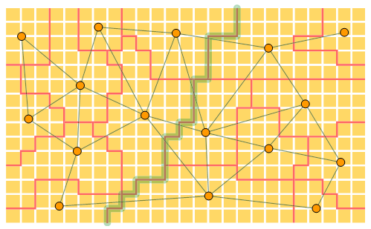
Clump pixels of near-constant color
Lazy Snapping does this
(Li et al. SIGGRAPH 04)

Slide 60
Coarse to Fine
1) Solve at low res.
FG
BG

Slide 61
Coarse to Fine
1) Solve at low res.
FG
BG

Slide 62
Coarse to Fine
2) Refine the boundary
Paint Selection does this
Liu et al. SIGGRAPH 2009
(and uses joint bilateral upsampling to determine the boundary width)
FG
BG

Slide 63
Videos
GrabCut (SIGGRAPH 04)
  http://research.microsoft.com/en-us/um/cambridge/projects/visionimagevideoediting/segmentation/images/Video.avi
Paint Selection (SIGGRAPH 09)
  http://research.microsoft.com/en-us/um/people/jiansun/videos/PaintSelection.wmv

