Slide 1
Learning with Academic Knowledge Graphs
Yuxiao Dong
Microsoft Research, Redmond
CS 520: Knowledges Graphs
Stanford University
https://web.stanford.edu/class/cs520/

Slide 2





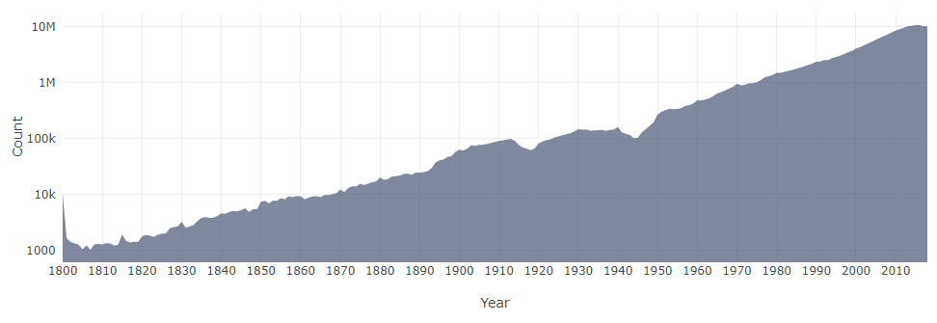

Microsoft Academic Graph (MAG)
711,012
fields of study
48,859 journals
4,457 conferences
233 million papers/patents/books/preprints
239 million authors
25,564 Institutions
As of Apr. 2020
The MAG data is open!

Slide 3
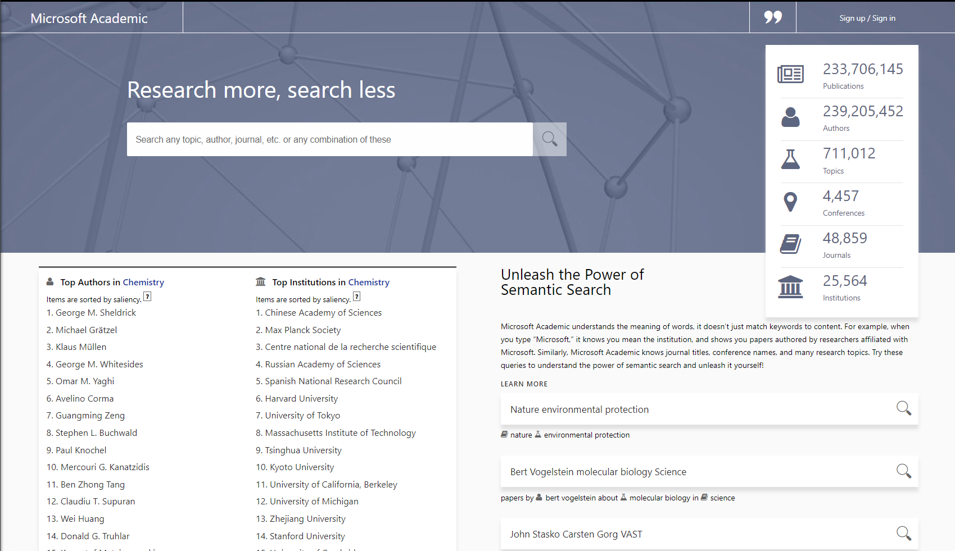
https://academic.microsoft.com

Slide 4
Live demo: Microsoft Academic Graph https://academic.microsoft.com

Slide 5
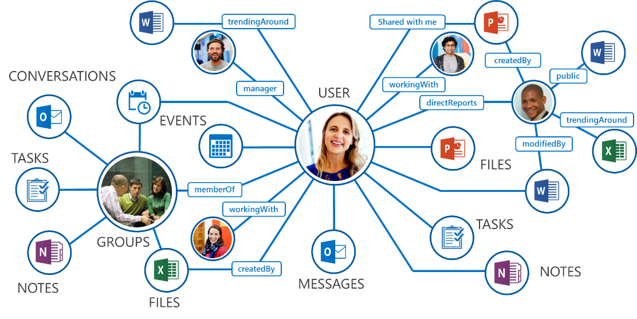
Microsoft Graph
photo credit: Microsoft

Slide 6
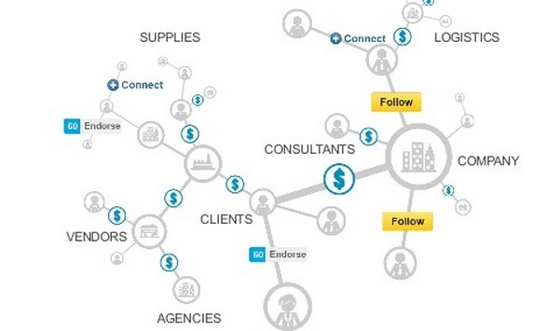

Heterogeneous Knowledge Graphs
Microsoft Academic Graph
Microsoft Graph
LinkedIn Economic Graph
Bing Satori Knowledge Graph
photo credit: Microsoft

Slide 7
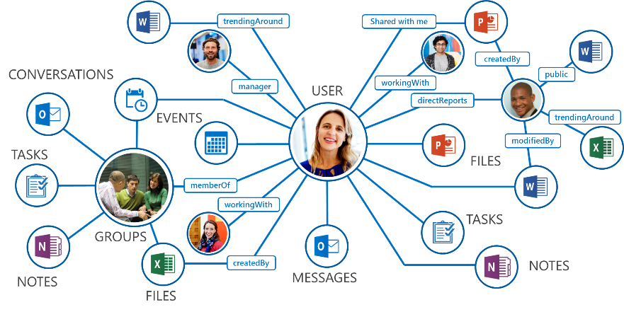
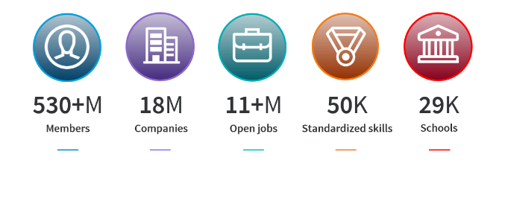
Heterogeneous Knowledge Graphs
Different types of entities
Various types of relations
Text info and documents
Dynamic graphs
Various business applications & associated learning tasks
  For each of them, we train a machine learning model to address it

Slide 8
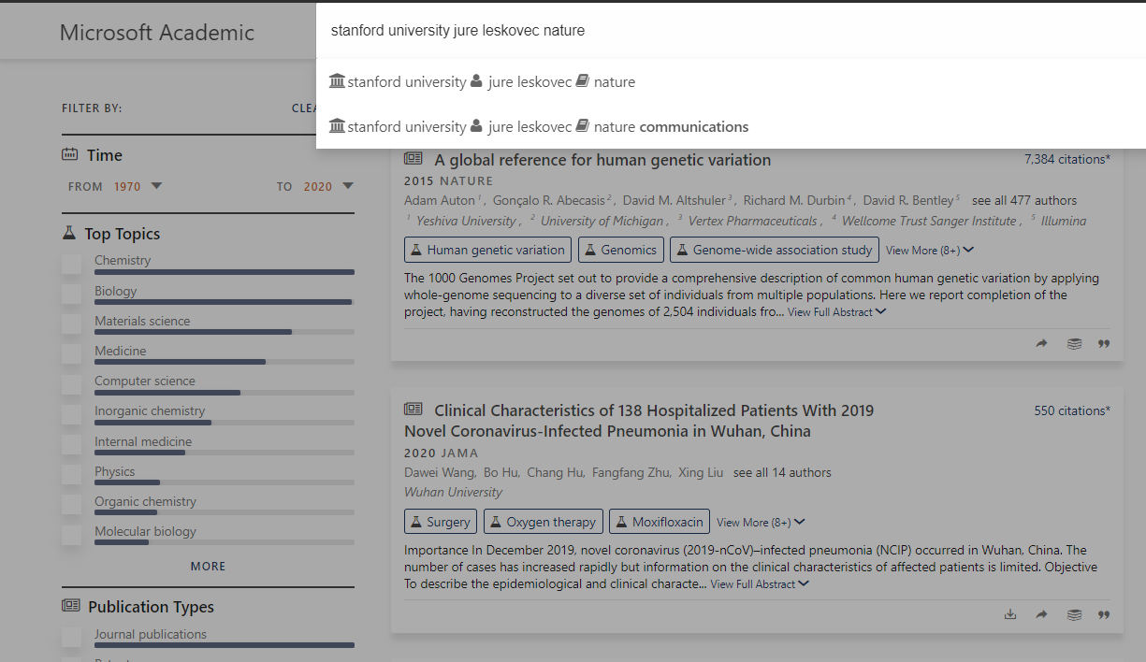
Entity Recognition

Slide 9
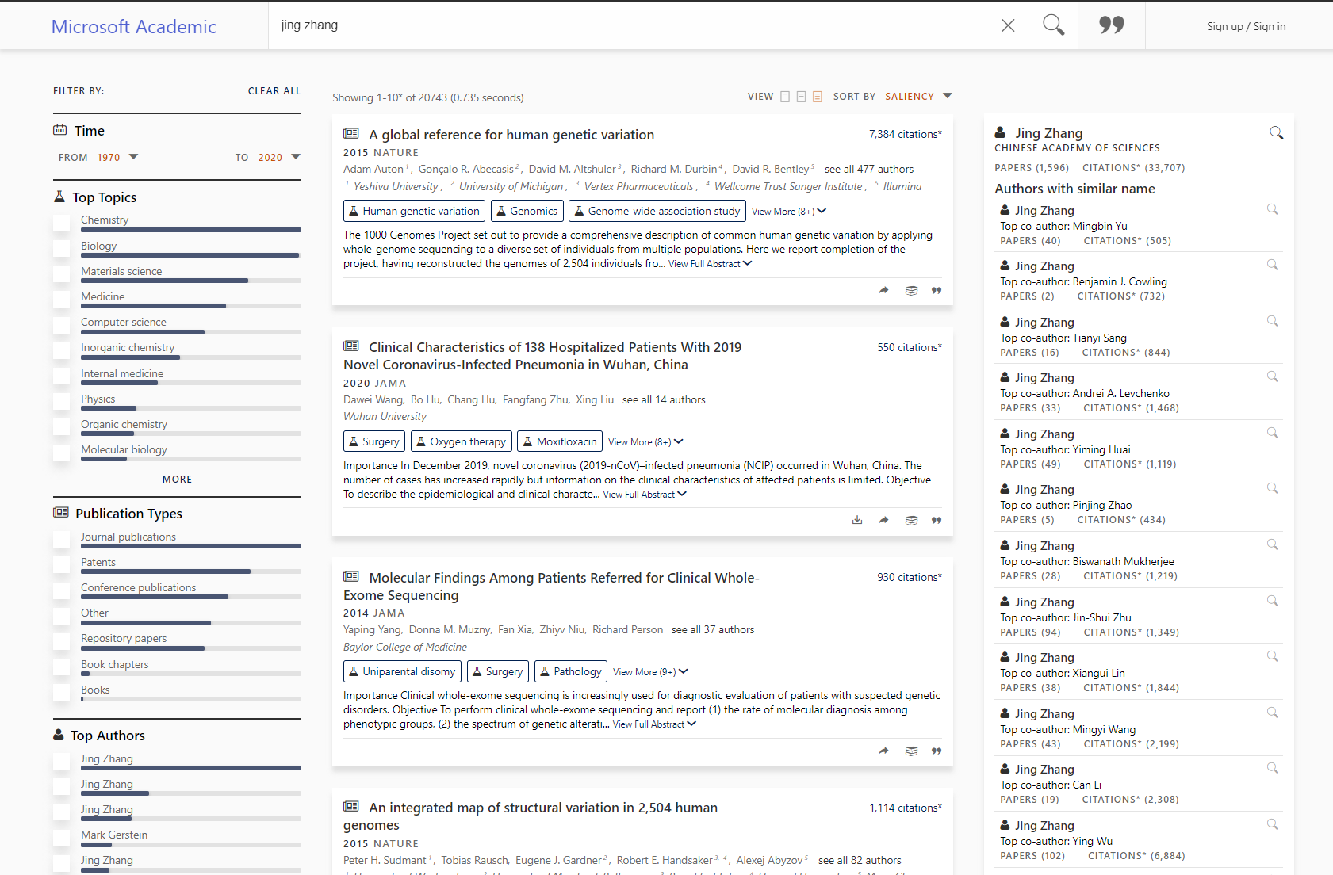
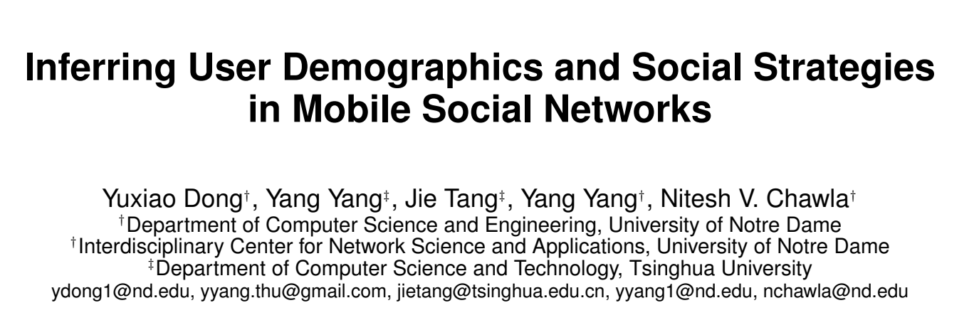
Name Disambiguation

Slide 10

Inferring Fields of Study

Slide 11
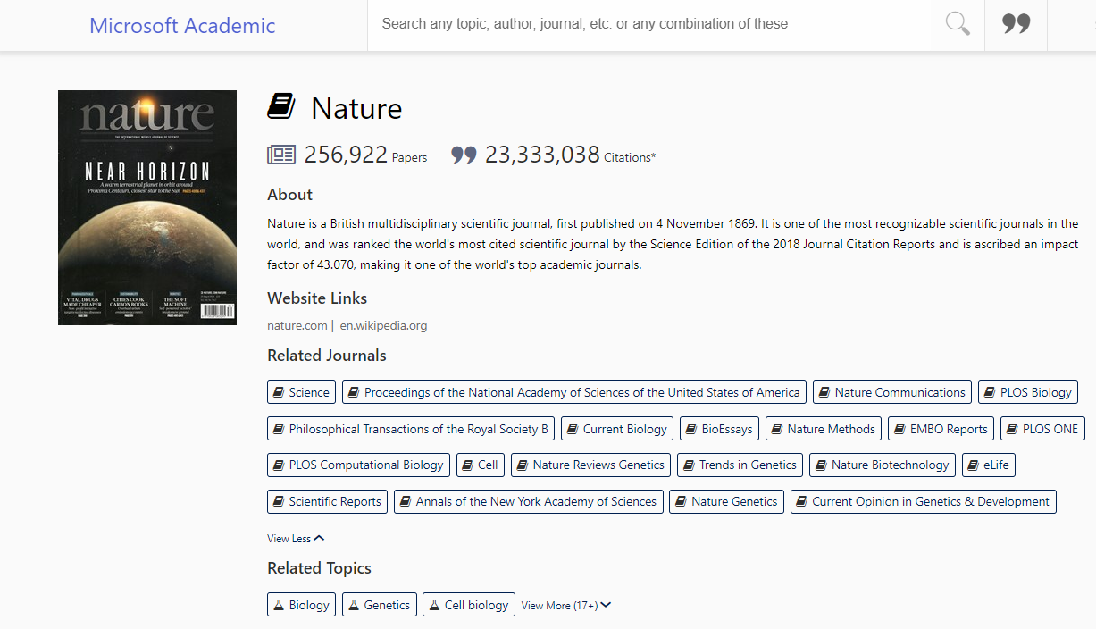
Related Entities (Venues)

Slide 12
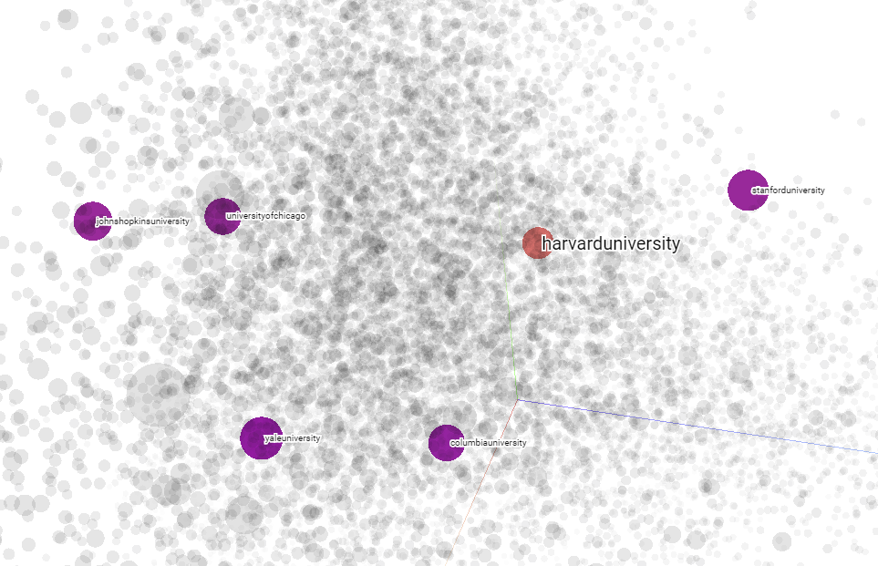
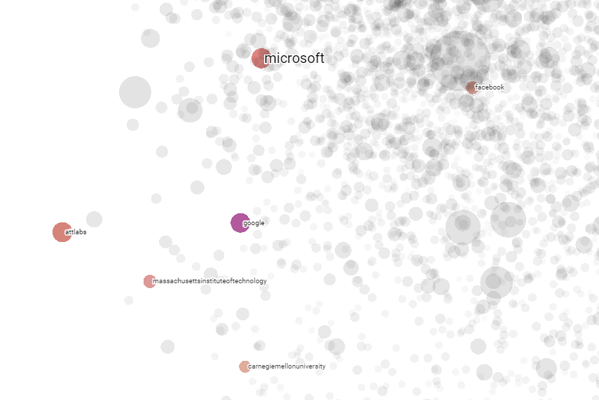
Related Institutions
Microsoft
Stanford
Facebook
Harvard
Johns Hopkins
UChicago
AT&T Labs
Google
MIT
Yale
Columbia
CMU
https://academic.microsoft.com/
metapath2vec: scalable representation learning for heterogeneous networks. In KDD 2017.

Slide 13
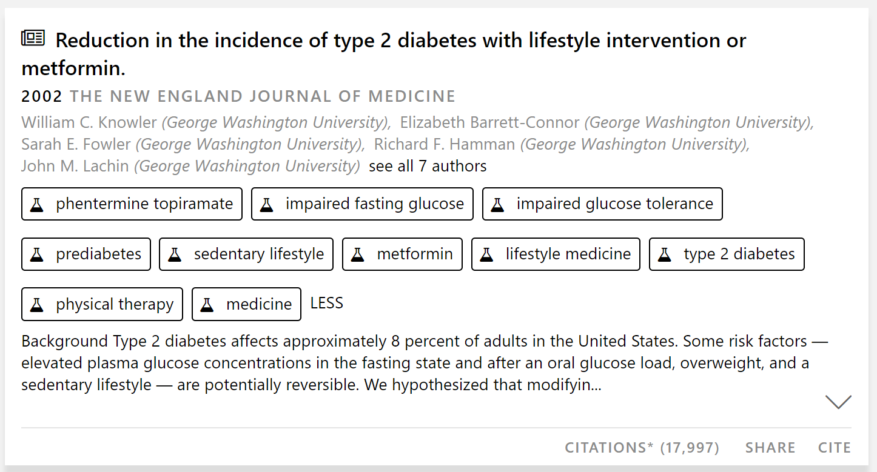
Reasoning about Diabetes from MAG

Slide 14
Reasoning about Diabetes from MAG
Diabetic diet
Ketoacidosis
Blurred vision
Polyphagia
Kidney disease
Autoimmunity
Polyuria
Insulin
Nephropathy
Insulin resistance
Polydipsia
Diabetes
Weight loss
Glycosuria
Insulin glargine
Streptozotocin
Edmonton protocol
Diabetic retinopathy
Cytokine
Albuminuria
Insulin glulisine
Insulin lispro
Regular insulin
Glucagon
Pregnancy
Pramlintide
Insulin aspart
Physical exercise
Pancreas transplantation
Insulin degludec
Autoimmune disease
Microalbuminuria
Miglitol
Cause
Symptom
Muscle cramp
Treatment
Acarbose

Slide 15
Reasoning about COVID-19 from MAG
SARS-CoV-2
Wasting
Oseltamivir
Diarrhea
Asymptomatic
Lamivudine
Coronavirus
Azithromycin
COVID-19
MERS
Antiviral drug
Zika Virus
Rash
Post-exposure prophylaxis
Ebola Virus
Abdominal pain
Cause
Symptom
Treatment

Slide 16
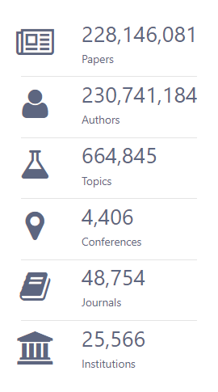
Tasks in Microsoft Academic Graph
Data Tasks
Name disambiguation
Infer spam/fake papers
Infer paper/author research topics
Infer future scientific impact
Infer collaboration and team formation
Infer future paper title?
… …

Slide 17
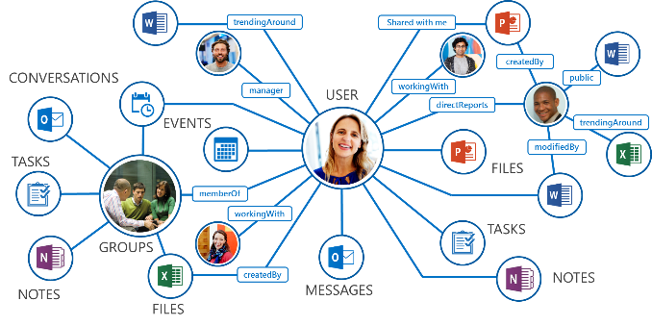
Pre-training with Heterogeneous Knowledge Graphs
  Can we pre-train with heterogeneous knowledge graphs and leverage the model to solve different down-stream tasks and applications?

Slide 18
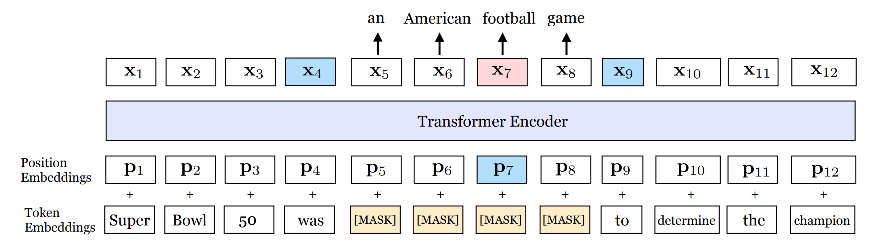
Pre-training with Heterogeneous Knowledge Graphs
  Recent progress of pre-training language models in NLP
    ELMO, BERT, XLNet etc.
Model level: transformer
Task level: masked language modeling/next sentence prediction

Slide 19
Challenges
Model level: Current graph neural networks are not capable enough to capture
  The graph heterogeneity
  The graph dynamics
Solution: Heterogeneous Graph Transformer
  A pre-training model that can learn to capture complex dependencies of entities with different types, relationships, and timestamps (without labeled data)
Task level: Traditional tasks are not informative enough to model the graph
  One-relation link inference
  Multi-relation link inference
Ziniu Hu, Yuxiao Dong, Kuansan Wang, Yizhou Sun. Heterogeneous Graph Transformer. WWW 2020.

Slide 20



Heterogeneous Graph Transformer
Model level: Current graph neural networks are not capable enough to capture
Solution: Heterogeneous Graph Transformer
  A model that can learn to capture complex dependencies of entities with different types, relationships, and timestamps (without labeled data)
    Unique parameters for each type of relationships
Paper
Target node
$$t$$
Write
Cite
Source nodes
$$s_{2}$$
$$s_{1}$$
Author
Paper
A heterogeneous sub-graph
Ziniu Hu, Yuxiao Dong, Kuansan Wang, Yizhou Sun. Heterogeneous Graph Transformer. WWW 2020.

Slide 21
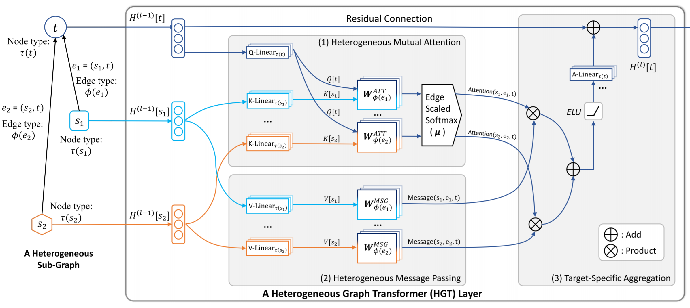
Heterogeneous Graph Transformer
Ziniu Hu, Yuxiao Dong, Kuansan Wang, Yizhou Sun. Heterogeneous Graph Transformer. WWW 2020.

Slide 22
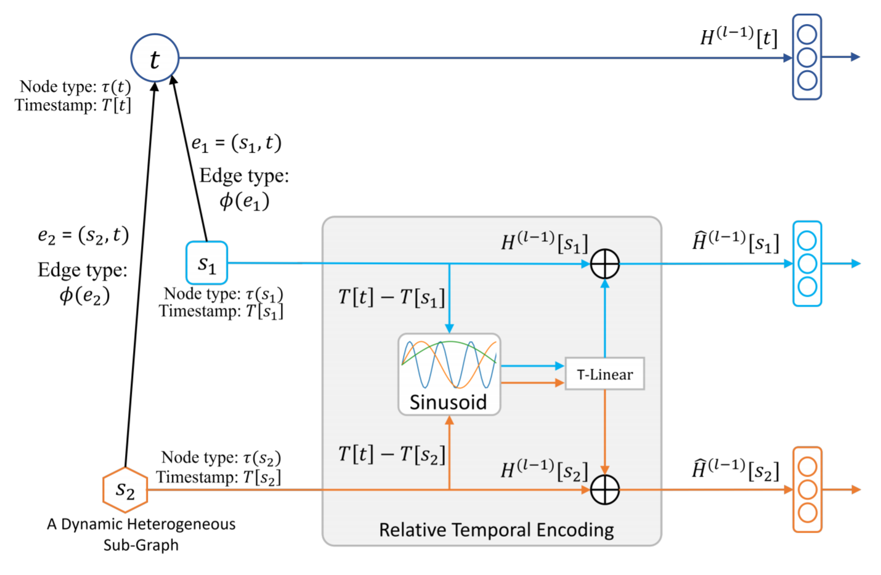
Relative Temporal Encoding

Slide 23
Challenges
Model level: Current graph neural networks are not capable enough to capture
  The graph heterogeneity
  The graph dynamics
Solution: Heterogeneous Graph Transformer
  A model that can learn to capture complex dependencies of entities with different types, relationships, and timestamps (without labeled data)
Task level: Traditional tasks are not informative enough to model the graph
  One-relation link inference
  Multi-relation link inference
Solution: Event-driven Info-NCE Training
  A learning objective that can guide a single model to learn all the relationships simultaneously.
Ziniu Hu, Yuxiao Dong, Kuansan Wang, Yizhou Sun. Heterogeneous Graph Transformer. WWW 2020.

Slide 24
Event-driven Info-NCE Training
Author 1
Published at 2012
DM
Paper
KDD
Author 2

Slide 25
Event-driven Info-NCE Training
Author 1
Published at 2012
DM
Paper
……
……
KDD
Author 2

Slide 26
Event-driven Info-NCE Training
Author 1
Published at 2012
DM
Paper
……
……
KDD
Author 2
Fake Paper
Author 3
Published at 2012
Security

Slide 27
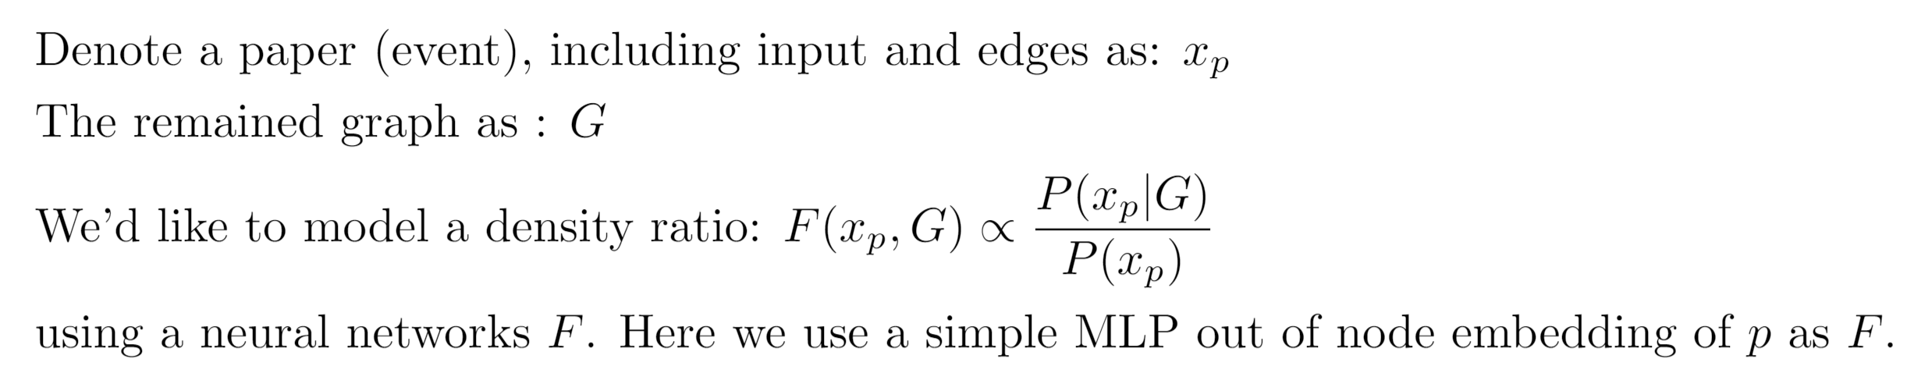
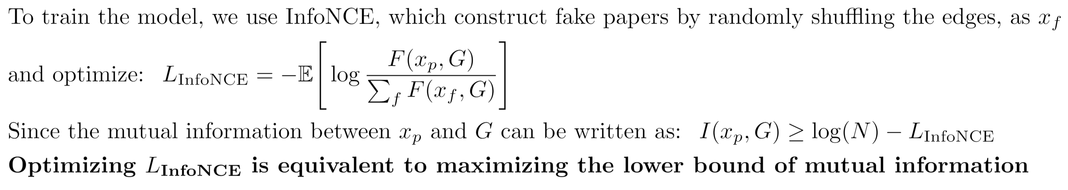
Theoretical Basis of Event-driven Info-NCE Training

Slide 28
Pretraining of Heterogeneous Graph Transformer
Model level: Current graph neural networks are not capable enough to capture
  The graph heterogeneity
  The graph dynamics
Solution: Heterogeneous Graph Transformer
  A model that can learn to capture complex dependencies of entities with different types, relationships, and timestamps (without labeled data)
Task level: Traditional tasks are not informative enough to model the graph
  One-relation link inference
  Multi-relation link inference
Solution: Event-driven Info-NCE Training
  A learning objective that can guide a single model to learn all the relationships simultaneously.
Ziniu Hu, Yuxiao Dong, Kuansan Wang, Yizhou Sun. Heterogeneous Graph Transformer. WWW 2020.

Slide 29
Results on MAG
Data Tasks
Name disambiguation
Infer spam/fake papers
Infer paper/author research topics
Infer future scientific impact
Infer collaboration and team formation
Infer future paper title?
… …

Slide 30
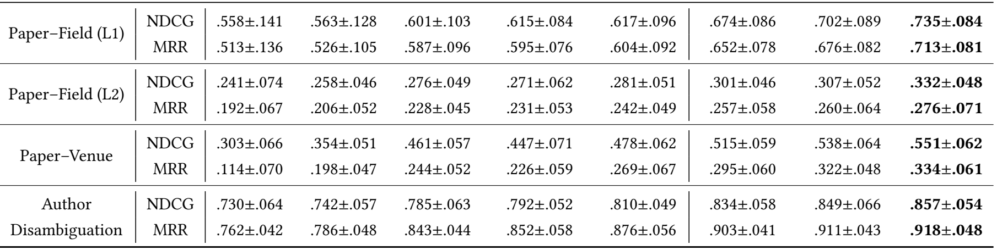
HGT Results
HGT offers ~9−21% improvements over existing GNNs
Pre-training offers ~1−5% improvements over HGT

Slide 31
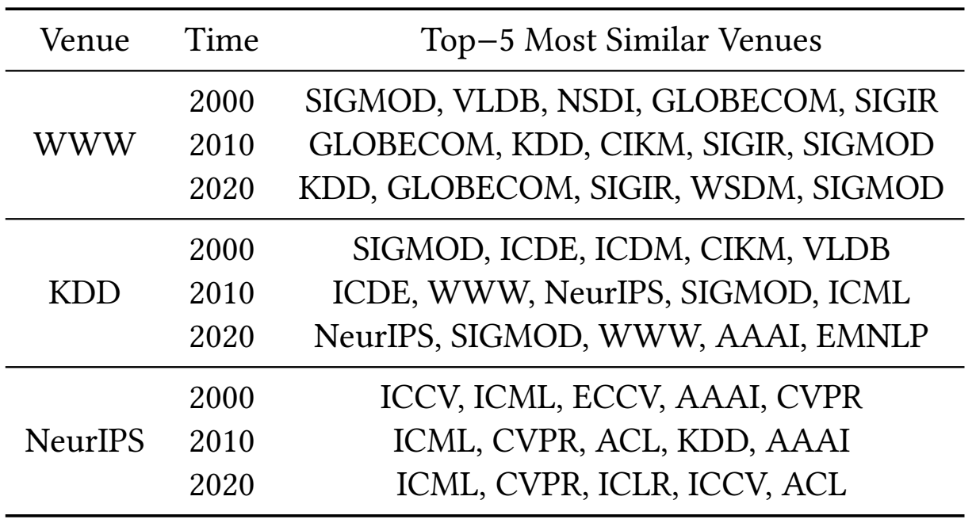
Case Study
DB + Networking + IR
DM + Networking + IR + DB

Slide 32
Case Study
DB + DM
ML + DB + Web + AI + NLP!!!

Slide 33
Case Study
CV + ML + AI
ML + CV + DL + NLP

Slide 34
Summary
Heterogeneous Graph Transformer for Knowledge Graph Inference
  A model that can learn to capture complex dependencies of entities with different types, relationships, and timestamps (without labeled data)
Pre-Training Strategies for Heterogeneous Graph Neural Networks
  A learning objective that can guide a single model to learn all the relationships simultaneously
  The Microsoft Academic Graph is Open to Download at
    https://docs.microsoft.com/en-us/academic-services/graph/get-started-setup-provisioning

Slide 35
  Thank you!
https://ericdongyx.github.io/

Slide 36
References
Ziniu Hu, Yuxiao Dong, Kuansan Wang, Yizhou Sun. Heterogeneous Graph Transformer. WWW 2020.
Kuansan Wang, Iris Shen, Charles Huang, Chieh-Han Wu, Yuxiao Dong, Anshul Kanakia. Microsoft Academic Graph: when experts are not enough. Quantitative Science Studies, Vol 1(1): 2020.
Kuansan Wang, Iris Shen, Charles Huang, Chieh-Han Wu, Darrin Eide, Yuxiao Dong, Junjie Qian, Anshul Kanakia, Alvin Chen, Rick Rogahn. A Review of Microsoft Academic Services for Science of Science Studies. Frontiers in Big Data, 2020.
Jie Zhang, Yuxiao Dong, Yan Wang, Jie Tang, and Ming Ding. ProNE: Fast and Scalable Network Representation Learning. IJCAI 2019.
Jiezhong Qiu, Yuxiao Dong, Hao Ma, Jian Li, Chi Wang, Kuansan Wang, and Jie Tang. NetSMF: Large-Scale Network Embedding as Sparse Matrix Factorization. WWW 2019.
Jiezhong Qiu, Yuxiao Dong, Hao Ma, Jian Li, Kuansan Wang, and Jie Tang. Network Embedding as Matrix Factorization: Unifying DeepWalk, LINE, PTE, and node2vec. WSDM 2018. (Most cited paper in WSDM’18)
Yuxiao Dong, Nitesh V. Chawla, Ananthram Swami. metapath2vec: Scalable Representation Learning for Heterogeneous Networks. KDD 2017. (Most cited paper in KDD’17)
Fanjing Zhang, et al. OAG: Toward Linking Large-scale Heterogeneous Entity Graphs. ACM KDD 2019.

Slide 37
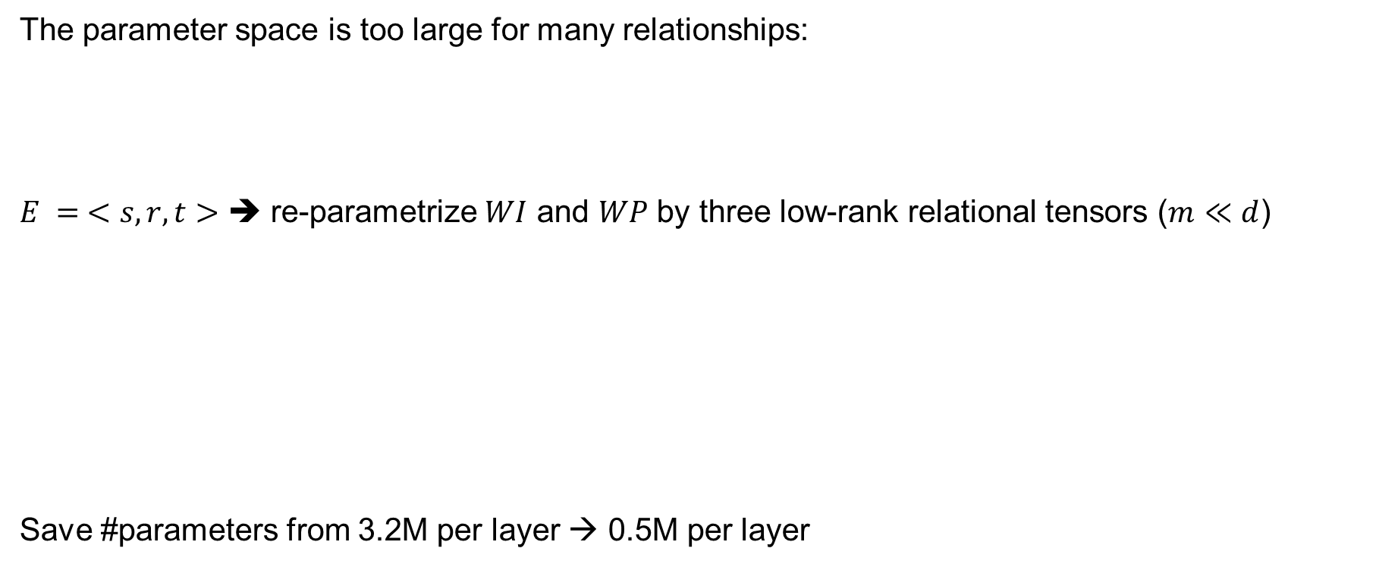
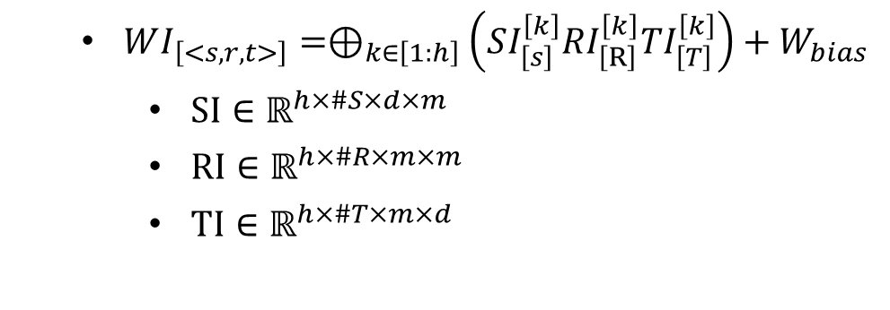


Weight Re-parametrization by Types
The parameter space is too large for many relationships:
$E = <s, r, t>$ ➔ re-parametrize $WI$ and $WP$ by three low-rank relational tensors ($m≪d$)
Save #parameters from 3.2M per layer → 0.5M per layer
  $WI∈ℝ^{h×\#E×d×d}$
  $WP∈ℝ^{h×\#E×d×d}$
  $WI_{\left[<s,r,t>\right]}=⊕_{k∈\left[1:h\right]}\left(SI_{\left[s\right]}^{\left[k\right]}RI_{\left[R\right]}^{\left[k\right]}TI_{\left[T\right]}^{\left[k\right]}\right)+W_{bias}$
    $SI∈ℝ^{h×\#S×d×m}$
    $RI∈ℝ^{h×\#R×m×m}$
    $TI∈ℝ^{h×\#T×m×d}$

Slide 38
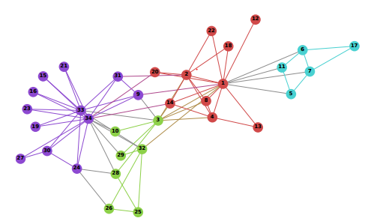
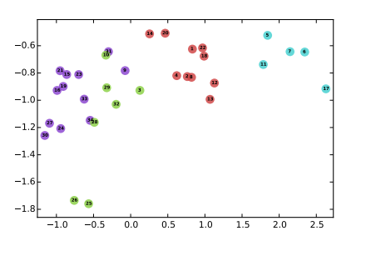
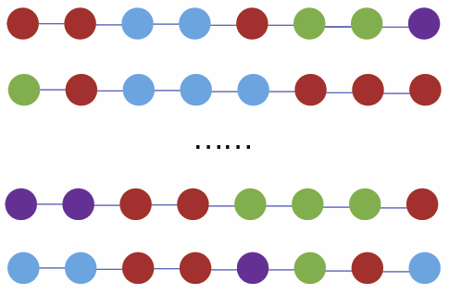





Network Embedding: Random Walk + Skip-Gram
$$w_{i−2 }$$
$$w_{i−1 }$$
$$w_{i}$$
$$w_{i+1 }$$
$$w_{i+2 }$$
sentences in NLP
vertex-paths in Networks
skip-gram
(word2vec)
Perozzi et al. DeepWalk: Online learning of social representations. In KDD’ 14, pp. 701–710.

Slide 39
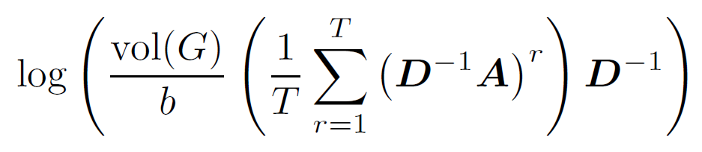



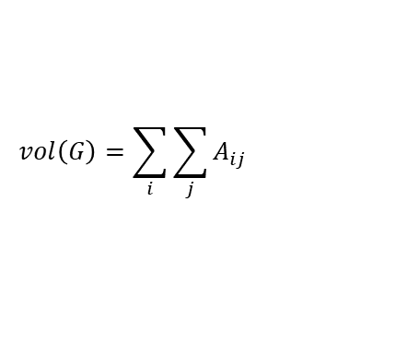




Understanding Random Walk + Skip Gram
$$w_{i−2 }$$
$$w_{i−1 }$$
$$w_{i}$$
$$w_{i+1 }$$
$$w_{i+2 }$$
DeepWalk is asymptotically and implicitly factorizing
$$A$$
Adjacency matrix
$$D$$
Degree matrix
$$vol\left(G\right)=\sum_{i}{\sum_{j}{A_{ij}}}$$
b: #negative samples
T: context window size
Qiu et al. Network embedding as matrix factorization: unifying deepwalk, line, pte, and node2vec. In WSDM’18.

Slide 40
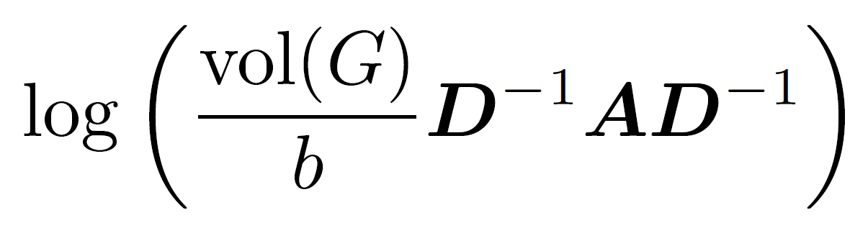
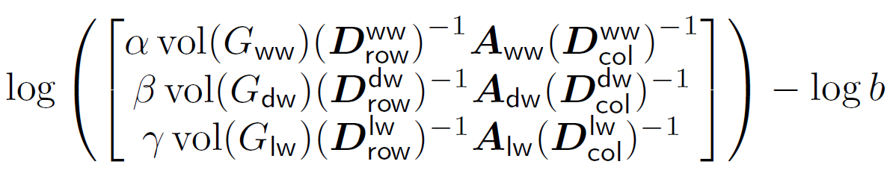
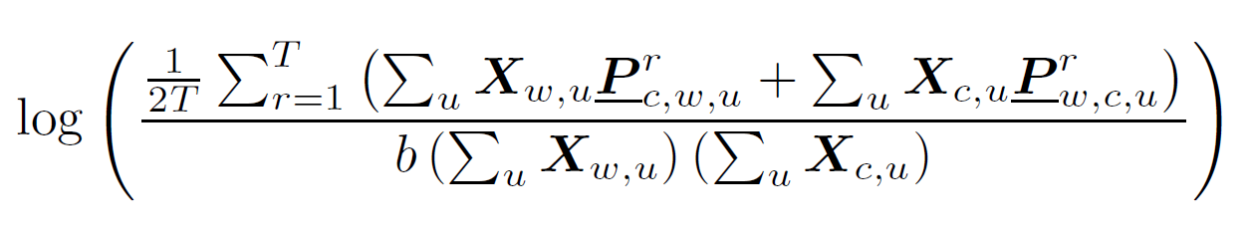
Unifying DeepWalk, LINE, PTE, & node2vec as Matrix Factorization
DeepWalk
LINE
PTE
node2vec
Qiu et al. Network embedding as matrix factorization: unifying deepwalk, line, pte, and node2vec. In WSDM’18. The most cited paper in WSDM’18 as of May 2019

Slide 41





NetMF: explicitly factorizing the DeepWalk matrix
Matrix Factorization
$$w_{i−2 }$$
$$w_{i−1 }$$
$$w_{i}$$
$$w_{i+1 }$$
$$w_{i+2 }$$
DeepWalk is asymptotically and implicitly factorizing
Qiu et al. Network embedding as matrix factorization: unifying deepwalk, line, pte, and node2vec. In WSDM’18.

Slide 42

the NetMF algorithm
  Construction
  Factorization
$$S=$$
Qiu et al. Network embedding as matrix factorization: unifying deepwalk, line, pte, and node2vec. In WSDM’18.

Slide 43

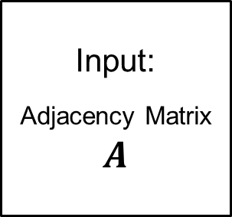
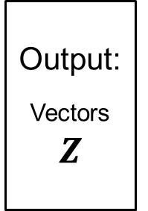
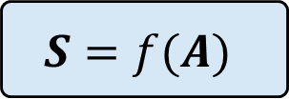
Network Embedding
Random Walk
Skip Gram
DeepWalk, LINE, node2vec, metapath2vec
Input:
Adjacency Matrix
$$A$$
Output:
Vectors
$$Z$$
$$S=f(A)$$
(dense) Matrix Factorization
NetMF
Incorporate network structures $A$ into the similarity matrix $S$, and then factorize $S$
$$f\left(A\right) =$$

Slide 44
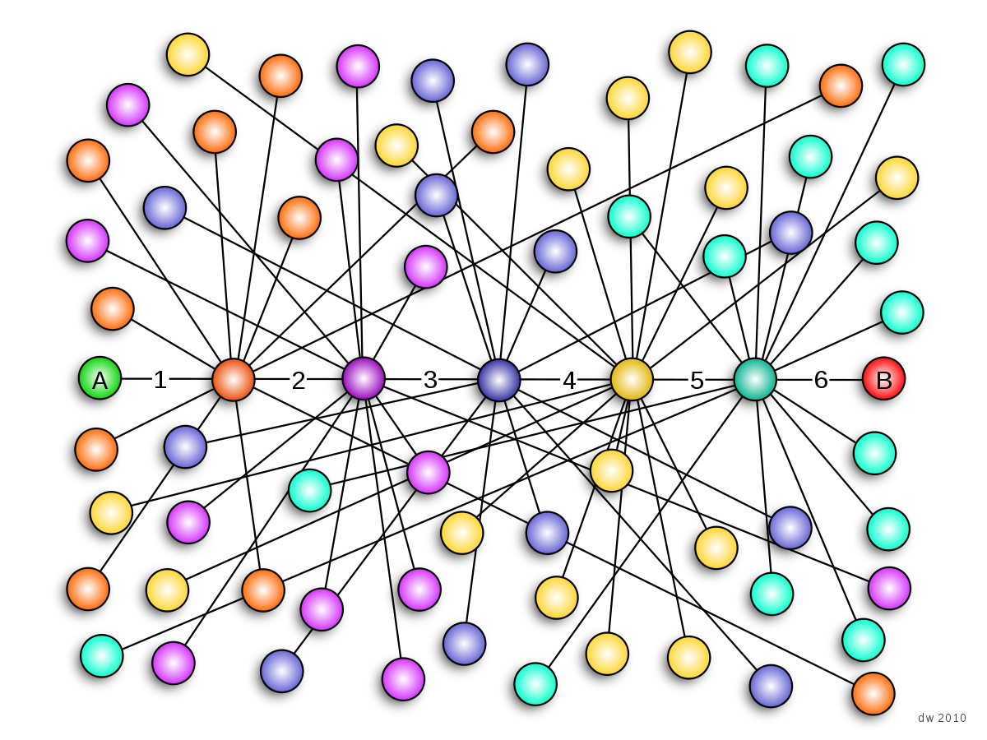

Challenges
$$S=$$
dense
NetMF is not practical for very large networks

Slide 45
NetMF
How can we solve this issue?
  Construction
  Factorization
$$S=$$
Qiu et al. NetSMF: Network embedding as sparse matrix factorization. In WWW 2019

Slide 46
NetSMF--Sparse
How can we solve this issue?
  Sparse Construction
  Sparse Factorization
$$S=$$
Qiu et al. NetSMF: Network embedding as sparse matrix factorization. In WWW 2019

Slide 47
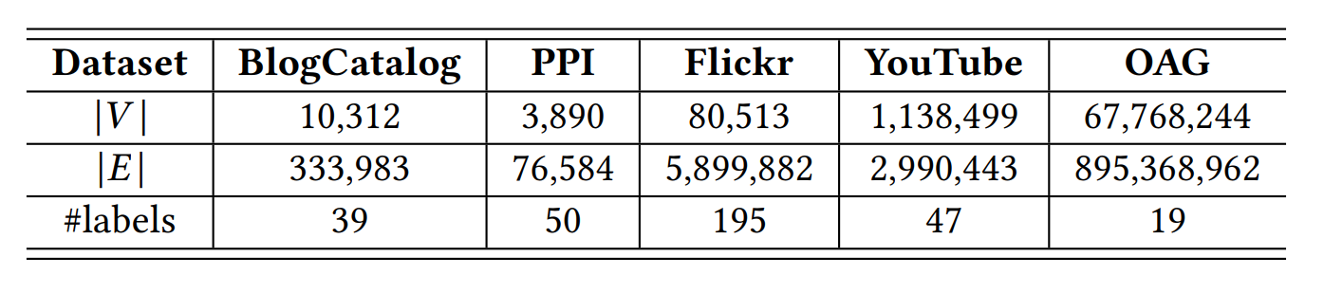
#non-zeros
~4.5 Quadrillion → 45 Billion
Qiu et al. NetSMF: Network embedding as sparse matrix factorization. In WWW 2019

Slide 48
Effectiveness:
(sparse MF)NetSMF ≈ (explicit MF)NetMF > (implicit MF) DeepWalk/LINE
Efficiency:
Sparse MF can handle billion-scale network embedding
Qiu et al. NetSMF: Network embedding as sparse matrix factorization. In WWW 2019

Slide 49
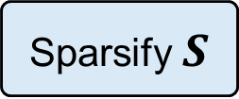
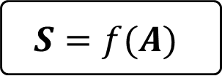
Network Embedding
Random Walk
Skip Gram
DeepWalk, LINE, node2vec, metapath2vec
Input:
Adjacency Matrix
$$A$$
Output:
Vectors
$$Z$$
$$S=f(A)$$
(dense) Matrix Factorization
NetMF
Sparsify $S$
(sparse) Matrix Factorization
NetSMF
Incorporate network structures $A$ into the similarity matrix $S$, and then factorize $S$
$$f\left(A\right) =$$

Slide 50
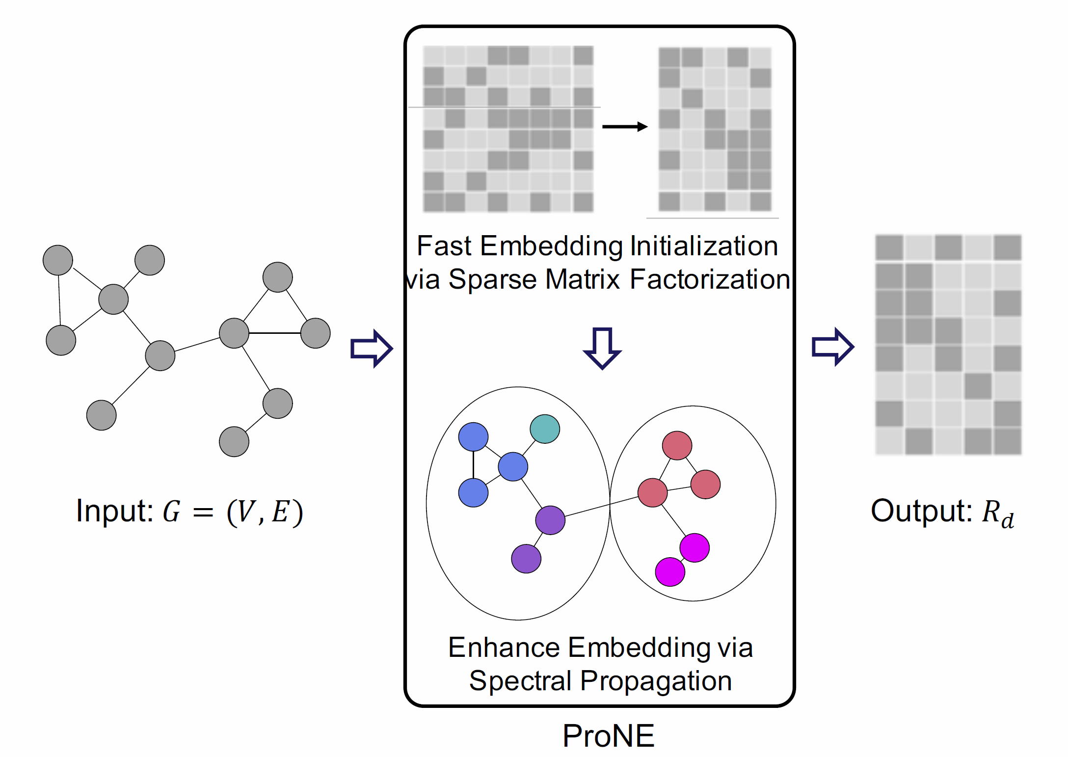
ProNE: More fast & scalable network embedding
Zhang et al. ProNE: Fast and Scalable Network Representation Learning. In IJCAI 2019

Slide 51
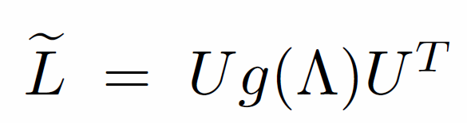

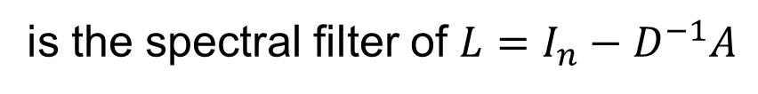
Embedding enhancement via spectral propagation
$$R_{d}←D^{−1}A(I_{n}−\tilde{L}){ R}_{d}$$
is the spectral filter of $L=I_{n}−D^{−1}A$
$D^{−1}A(I_{n}−\tilde{L})$ is $D^{−1}A$ modulated by the filter in the spectrum
The idea of Graph Neural Networks
Zhang et al. ProNE: Fast and Scalable Network Representation Learning. In IJCAI 2019

Slide 52
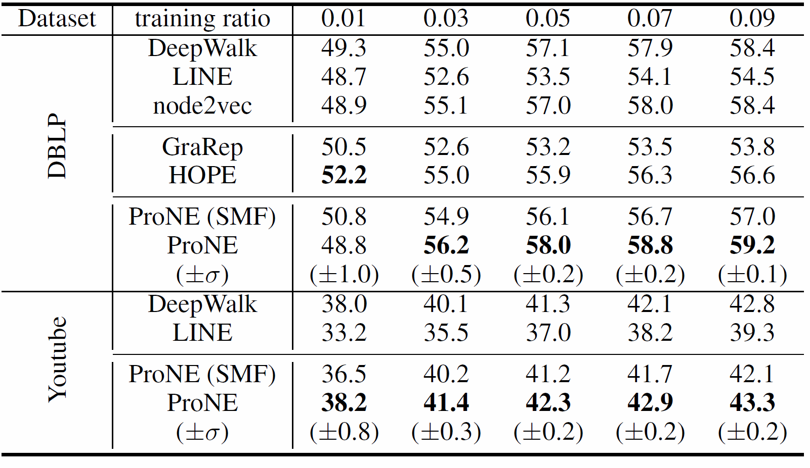
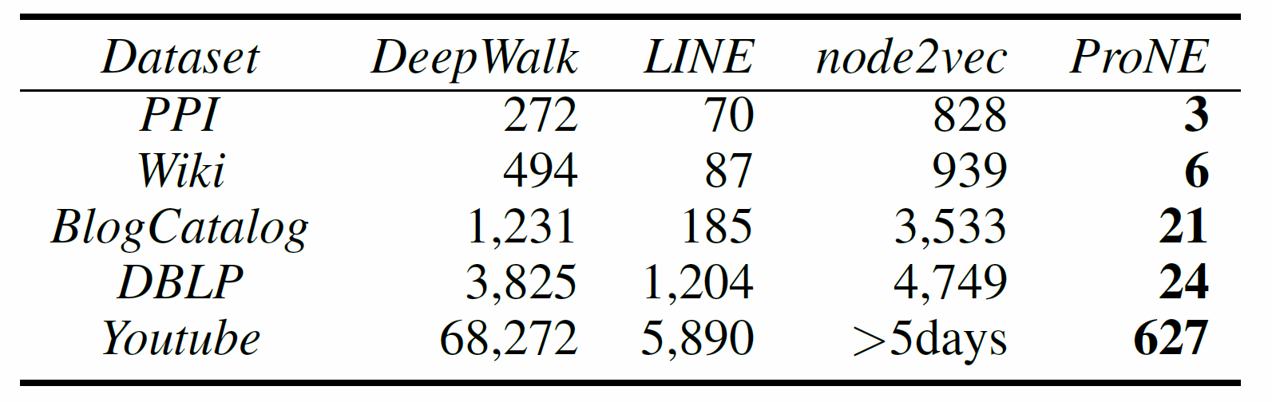
Performance
20 Threads
1 Thread
19hours 98mins
10mins
ProNE offers 10-400X speedups
(1 thread vs 20 threads)
ProNE embeds 100,000,000 nodes by 1 thread:
29 hours with performance superiority
Zhang et al. ProNE: Fast and Scalable Network Representation Learning. In IJCAI 2019

Slide 53
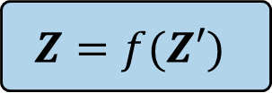
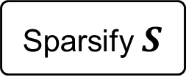
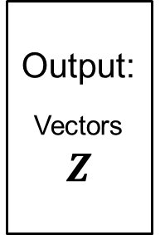
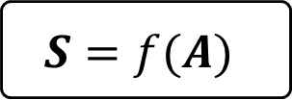
Network Embedding
Random Walk
Skip Gram
DeepWalk, LINE, node2vec, metapath2vec
Input:
Adjacency Matrix
$$A$$
Output:
Vectors
$$Z$$
$$S=f(A)$$
(dense) Matrix Factorization
NetMF
Sparsify $S$
(sparse) Matrix Factorization
NetSMF
(sparse) Matrix Factorization
$$Z=f(Z′)$$
ProNE
Factorize $A$, and then incorporate network structures via spectral propagation

Slide 54
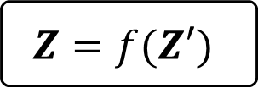
Network Embedding
Random Walk
Skip Gram
DeepWalk, LINE, node2vec, metapath2vec
Input:
Adjacency Matrix
$$A$$
Output:
Vectors
$$Z$$
$$S=f(A)$$
(dense) Matrix Factorization
NetMF: theory & better accuracy
Sparsify $S$
(sparse) Matrix Factorization
NetSMF: handle billion-scale graphs
(sparse) Matrix Factorization
$$Z=f(Z′)$$
ProNE: 10--400X speedups

Slide 55
References
Ziniu Hu, Yuxiao Dong, Kuansan Wang, Yizhou Sun. Heterogeneous Graph Transformer. WWW 2020.
Kuansan Wang, Iris Shen, Charles Huang, Chieh-Han Wu, Yuxiao Dong, Anshul Kanakia. Microsoft Academic Graph: when experts are not enough. Quantitative Science Studies, Vol 1(1): 2020.
Kuansan Wang, Iris Shen, Charles Huang, Chieh-Han Wu, Darrin Eide, Yuxiao Dong, Junjie Qian, Anshul Kanakia, Alvin Chen, Rick Rogahn. A Review of Microsoft Academic Services for Science of Science Studies. Frontiers in Big Data, 2020.
Jie Zhang, Yuxiao Dong, Yan Wang, Jie Tang, and Ming Ding. ProNE: Fast and Scalable Network Representation Learning. IJCAI 2019.
Jiezhong Qiu, Yuxiao Dong, Hao Ma, Jian Li, Chi Wang, Kuansan Wang, and Jie Tang. NetSMF: Large-Scale Network Embedding as Sparse Matrix Factorization. WWW 2019.
Jiezhong Qiu, Yuxiao Dong, Hao Ma, Jian Li, Kuansan Wang, and Jie Tang. Network Embedding as Matrix Factorization: Unifying DeepWalk, LINE, PTE, and node2vec. WSDM 2018. (Most cited paper in WSDM’18)
Yuxiao Dong, Nitesh V. Chawla, Ananthram Swami. metapath2vec: Scalable Representation Learning for Heterogeneous Networks. KDD 2017. (Most cited paper in KDD’17)
Fanjing Zhang, et al. OAG: Toward Linking Large-scale Heterogeneous Entity Graphs. ACM KDD 2019.

Slide 56
  Thank you!

