Slide 1
Knowledge Graphs for Natural Language Processing
Jose Manuel Gomez-Perez
CS 520 - Knowledge Graphs
Stanford University, April 28th 2020

Slide 2
Overview of the talk
Two main questions
  Why do we need knowledge graphs (KGs) in NLP?
  How can we extract information from text and KGs to build better representations for NLP?
Three main blocks/systems
  COGITO©: An industrial NLP system based on KGs
  Vecsigrafo: Learning joint word and concept representations from text corpora and KGs
  Transigrafo: Combining language models and KGs for word-sense disambiguation

Slide 3
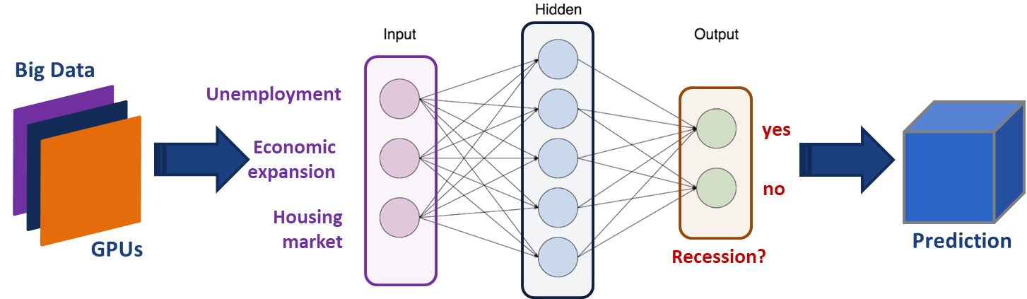
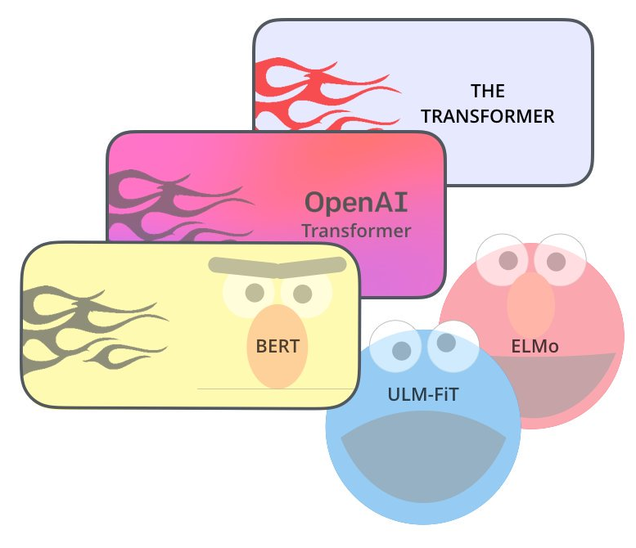
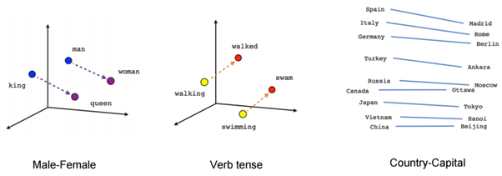
The neural (data-driven) approach
Is another recession coming?
Pros
  Grounded on the data
  Broad, flexible, scalable
  State of the Art in most NLP/NLU benchmarks (QA, RTE, NLI, etc.)
Cons
  Still a black box. Induction, not logical explanation
  Lack of true understanding of real-world semantics and pragmatics
  Training corpora needs to be carefully selected to prevent bias
Language models
Word embeddings

Slide 4
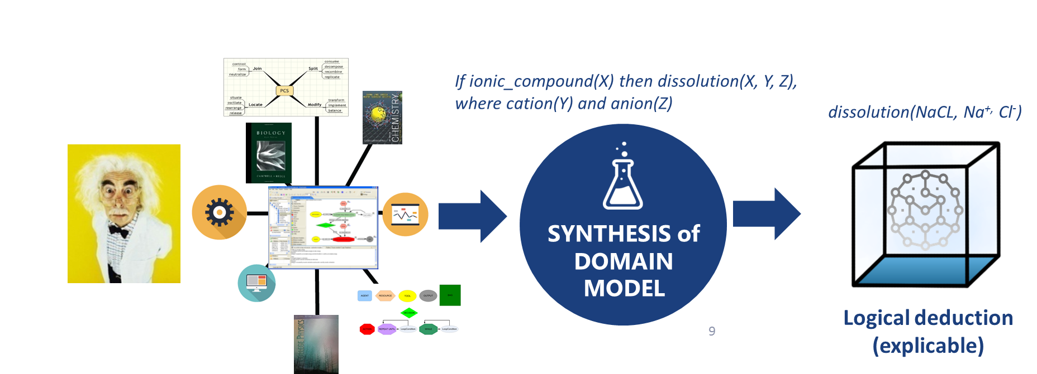
The knowledge-based approach
Knowledge engineer or domain expert
PROS
CONS
Based on highly curated resources
No need to train a model!
Logically interpretable, explainable
Graph structure is of direct benefit for NLP tasks like word-sense disambiguation (WSD)
Tools available to support modeling
Representations can be rich and deep but also rigid and brittle
Automation can be challenging
Well trained labor to manually encode knowledge can be expensive

Slide 5
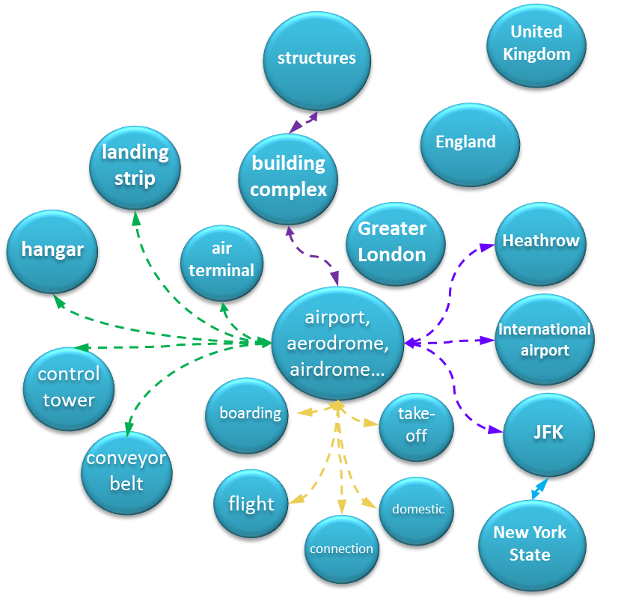
Natural language text is read and analyzed
COGITO
Natural language text is read and analyzed
1
Sentence splitting / parsing
Divide text into words
2
Morphological analysis
COGITO is Expert System’s NLP platform
Built on the Sensigrafo KG, which contains word definitions, related concepts and linguistic information
Sensigrafo includes concepts, lemmas (canonical representation of a word) and relations (properties, hypernymy, polysemy, synonymy…)
300K concepts, 400K lemmas and 80 relation types, which render 3 million links per language
COGITO covers the whole NLP/NLU pipeline, including Word-Sense Disambiguation, NLI, IE, Categorization…
Understand language forms (e.g. Verb conjugations)
3
Sentence / logical / grammatical analysis
Understand how words relate to other words, and what their function is in the sentence
4
Semantics analysis / disambiguation
Understanding sentences and texts as a whole, taking into account words synonyms, context, plausibility
...and then translated into a conceptual map
And then translated into a cognitive or conceptual map
“Chancellor Merkel is making a last-ditch attempt to persuade EU member states to back her coronavirus deal as Tuesday's key meeting vote looms closer.”
Word: making, lemma: make, concept: en#73741
Meaning of back: part of a garment (en#13189), body part (en#100133279), to support (en#66955)

Slide 6
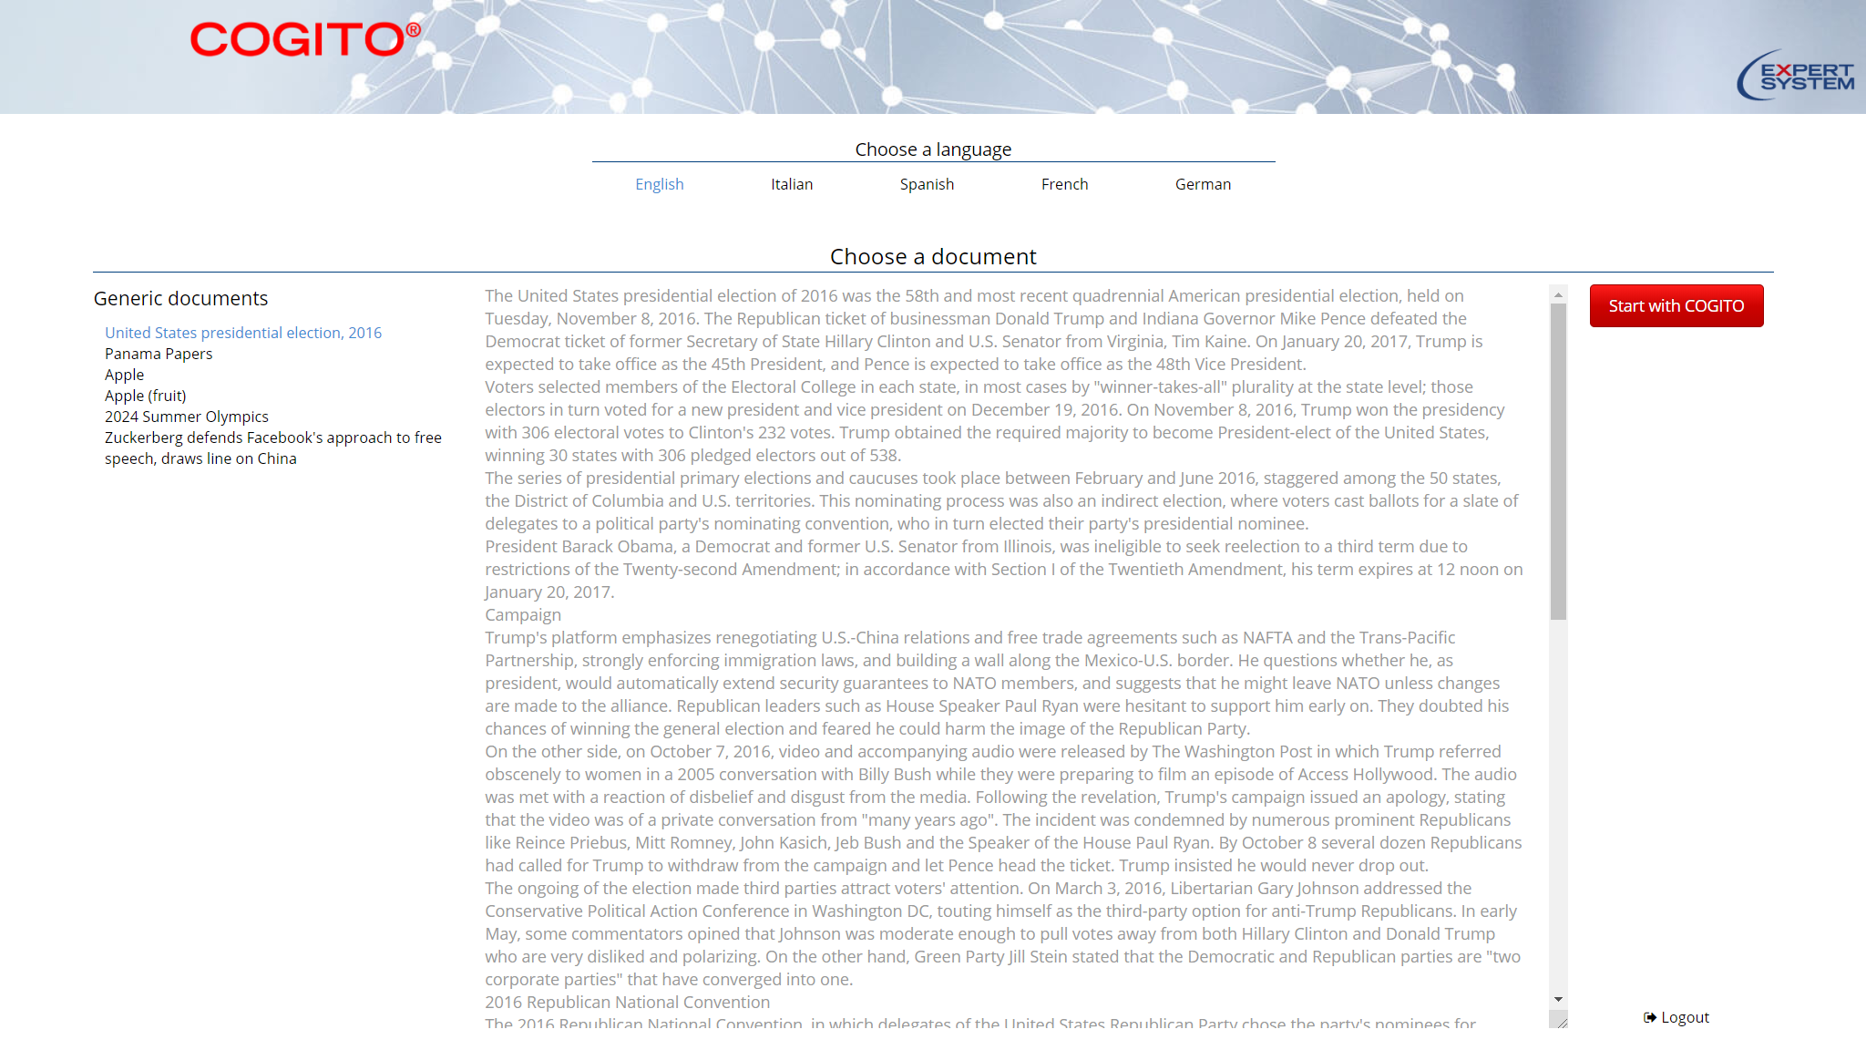
https://expertsystem.com/learning-center/technology
COGITO demo
Core technology demo: Sensigrafo + Disambiguator
Complete text analysis
Different views, same analysis
Concept clustering
Entity types
People quotes
Relations
Concept search on the KG
…

Slide 7
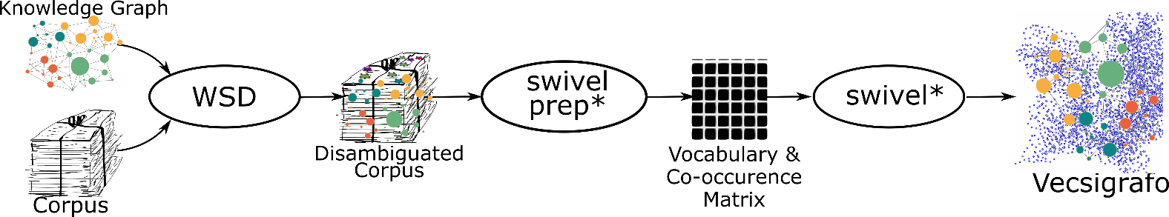
Vecsigrafo: Crossing the NLP chasm
Vecsigrafo jointly learns word and concept embeddings in a shared vector space
Combines corpus-based and graph-based approaches to build enriched word representations
Extends (*) the Swivel algorithm with both lexical and semantic entries as part of the vocabulary
  The corpus is lemmatized following different tokenization strategies, disambiguated and expanded
  Word and semantic (KG lemma and concept) embeddings are then jointly learnt
Denaux R and Gomez-Perez JM. 2019. Vecsigrafo: Corpus-based Word-Concept Embeddings. Semantic Web Journal (2019), 68–96. https://doi.org/10.3233/SW-190361

Slide 8
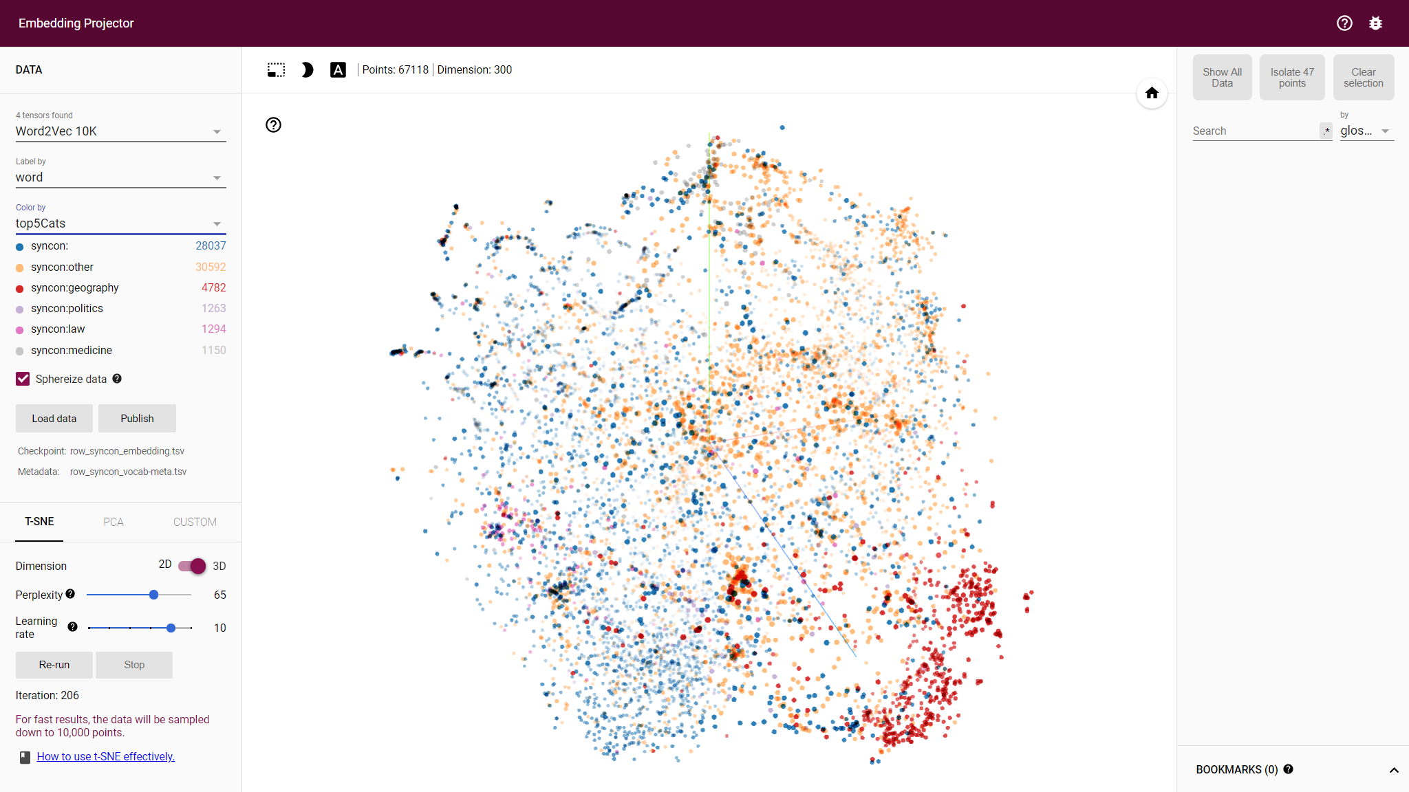
A common vector space
lem_conference
 | cosim | word
0 | 1.000 | lem_conference
1 | 0.783 | conferences
2 | 0.750 | en#conference
3 | 0.437 | en#session
4 | 0.436 | en#seminar
5 | 0.417 | lem_proceedings
6 | 0.409 | lem_meeting
7 | 0.406 | lem_seminar

Slide 9
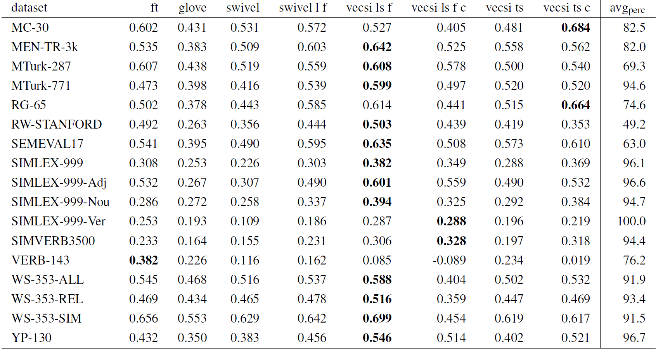
Comparative study – Similarity & Relatedness
Co-training word and KG embeddings produces enriched representations and improved accuracies
(*) Spearman correlation for word similarity datasets and embeddings extracted from UN corpus. The columns refer to the embedding algorithm, tokenization of the corpus and whether concept-based similarity was used
Notes:
Spearman correlations for word similarity datasets and UN-based embeddings. The column names refer to the method used to train the embeddings, the tokenization of the corpus (lemma, syncon and or text and whether the tokens were filtered), and whether concept-based word
similarity was used instead of the usual word-based similarity.

Slide 10
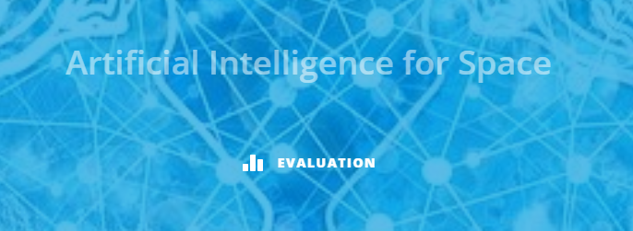

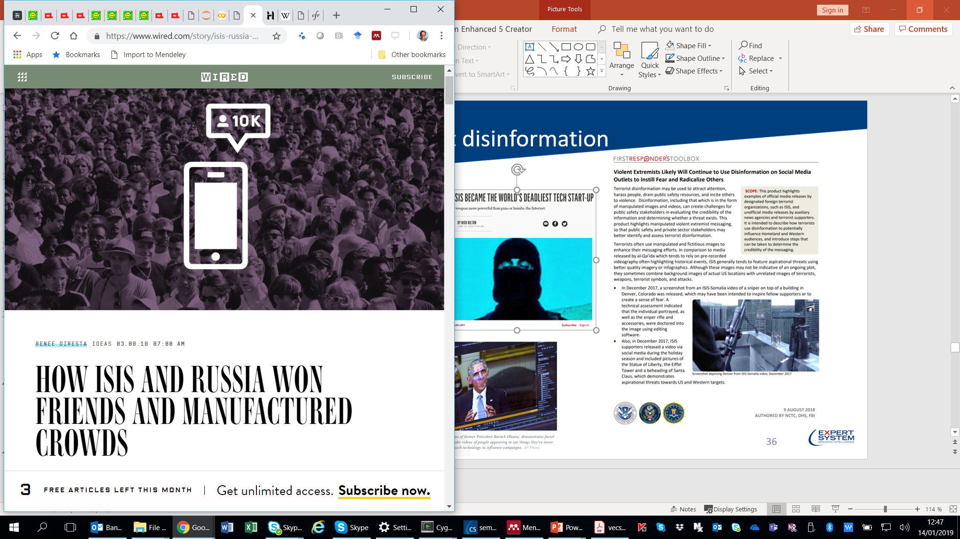


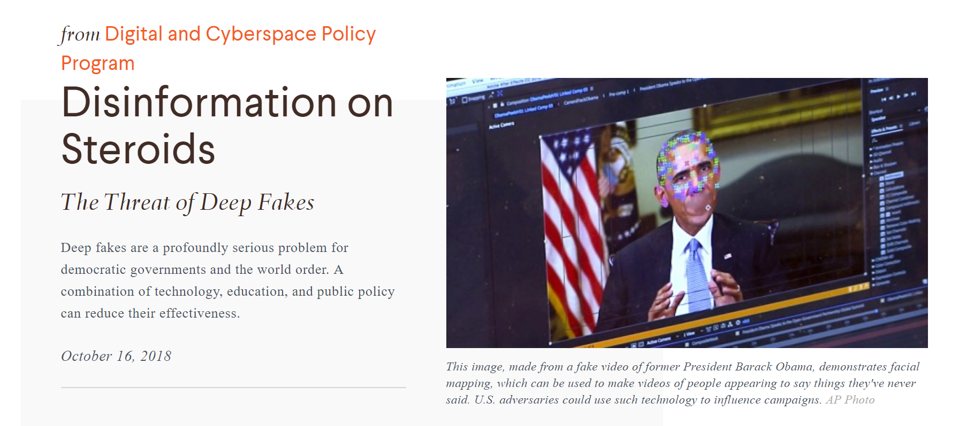
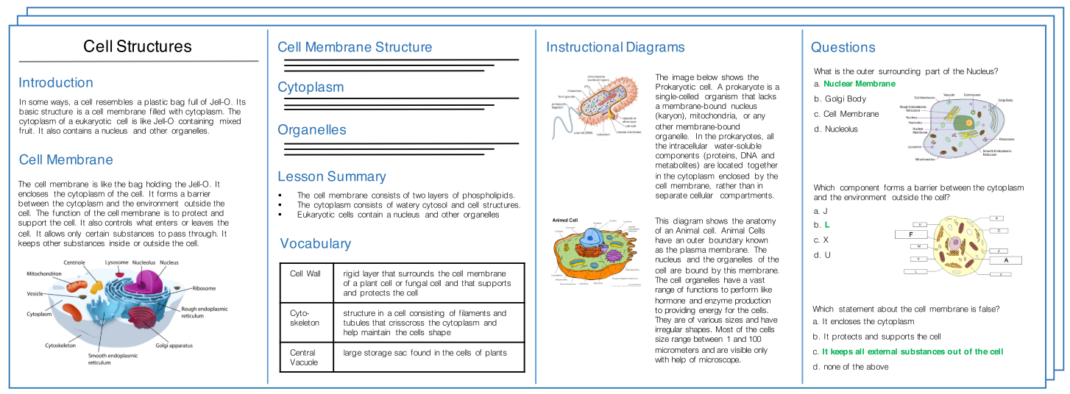

The power of enriched representations
Machine comprehension of scientific textbooks and question answering
Disinformation and fake news analysis on social media
Garcia-Silva A, Berrio C, Gomez-Perez JM: An empirical study on pre-trained embeddings and language models for bot detection. In Proc. of the Representation Learning for NLP (RepL4NLP-2019), pp. 148–155. ACL, Florence, Italy (2019). DOI https://doi.org/10.18653/v1/W19-4317
Gomez-Perez JM, Ortega R. Look, read and enrich - Learning from scientific figures and their captions. In Proc. of the 10th Intl. Conference on Knowledge Capture, KCAP’19. ACM, New York, NY, USA (2019). DOI https://doi.org/10.1145/3360901.3364420
Notes:
Using these enriched representations in conventional neural NLP architectures helped to obtain better results in tasks like disinformation detection and fake news analysis in social media and machine comprehension of scientific textbooks

Slide 11
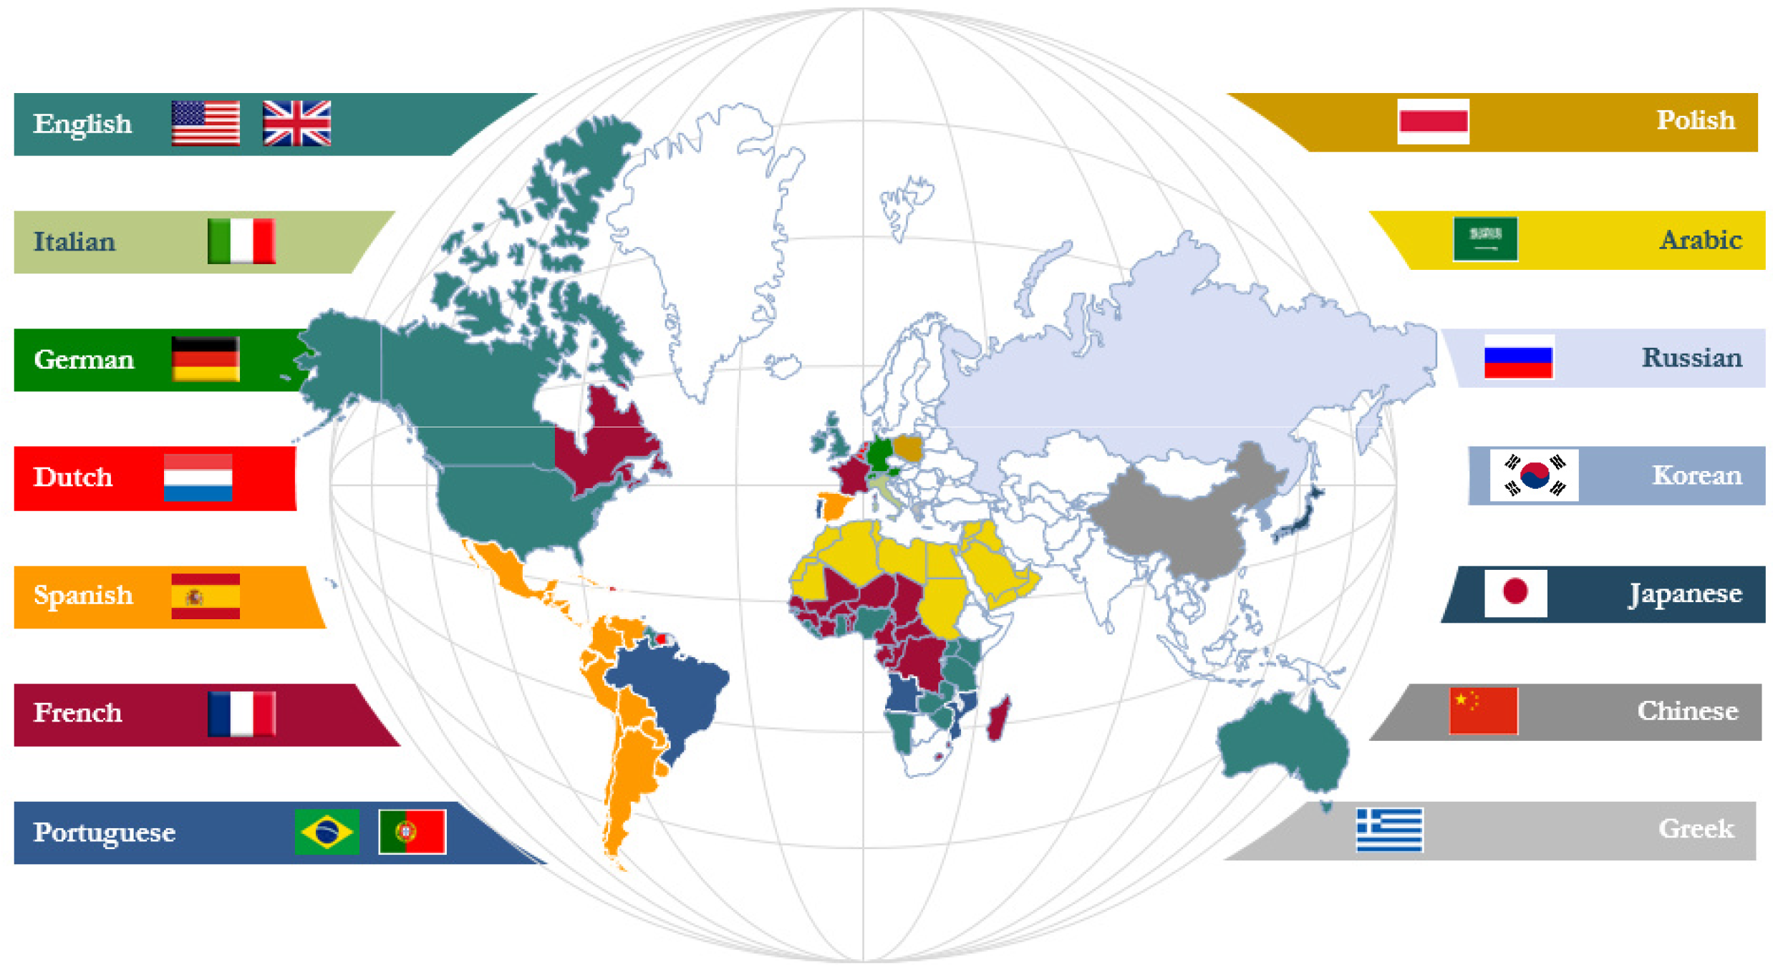
Co-evolution pipeline
Suggest cross-lingual Sensigrafo mappings
Curate Sensigrafos and identify modeling gaps
Assisted Sensigrafo curation
Denaux R and Gomez-Perez JM , Towards a Vecsigrafo: Portable semantics in knowledge-based text analytics. Hybrid Statistical Semantic Understanding and Emerging Semantics @ISWC17, 2017. http://ceur-ws.org/Vol-1923/article-04.pdf

Slide 12
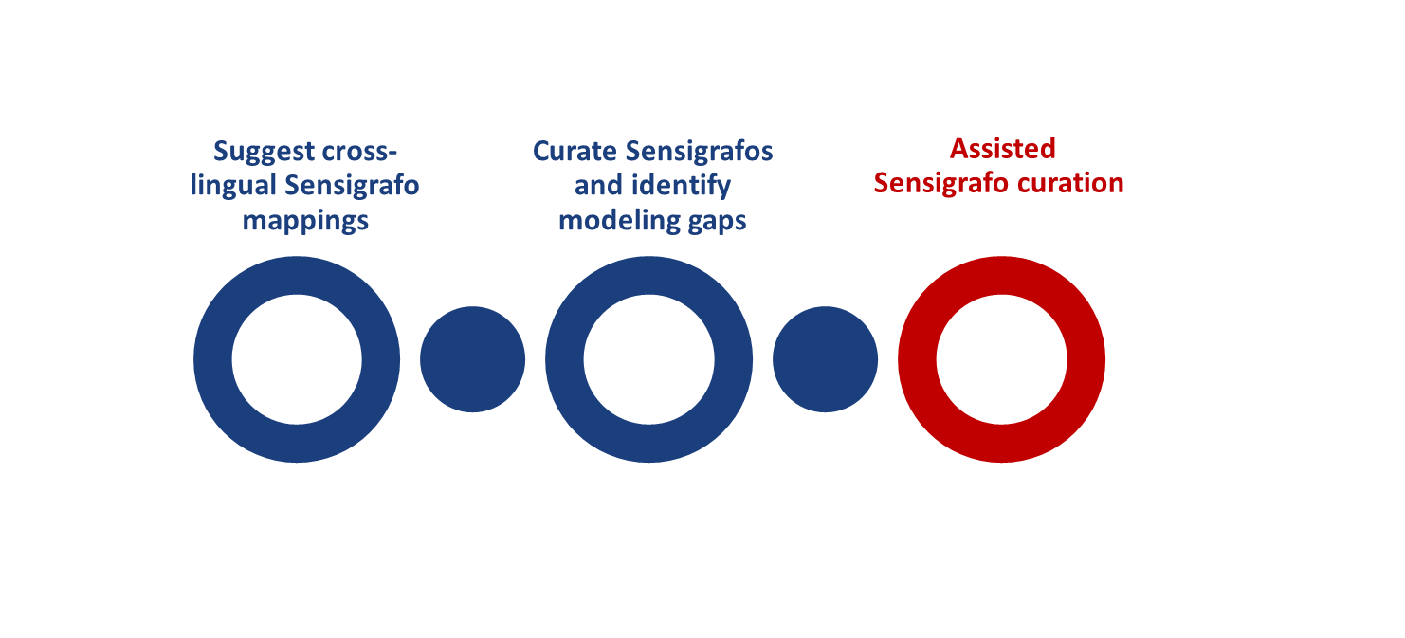
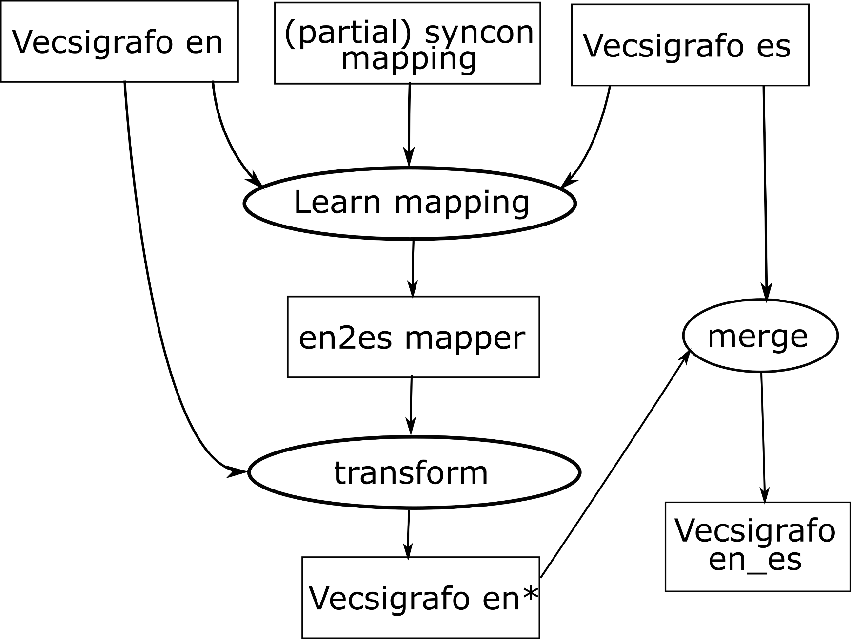
Vecsigrafo mapping and correlation
It is possible to map vector spaces for embeddings in different languages
Multi-lingual Vecsigrafo
  Linear transformation (Mikolov, 2013) produced poor results
  Non-linear transformation with DNNs: hit@5 = 0.78, semantic relatedness 90%
Some caveats: Manual inspection showed only 28% exact correspondence EN→ES
Reasons include
  Differences in KG size (EN-Sensigrafo is 75K concepts larger than ES-Sensigrafo)
  Strategic and territorial market decisions determine what is covered in each KG
Notes:
Crosslingual -> working seamlessly in multiple languages
Curation and identification of modeling gaps
Conceptual alignment across different languages
Automatic identification of disambiguation errors

Slide 13
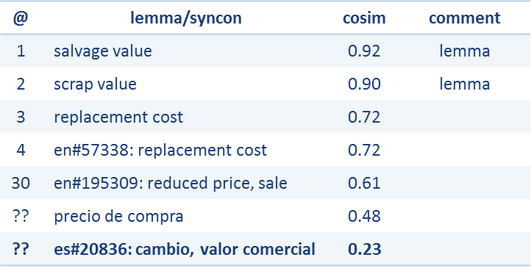

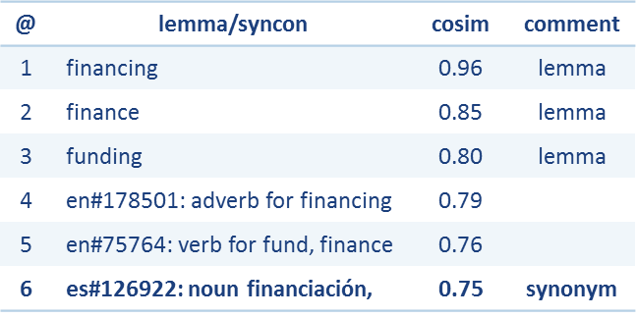
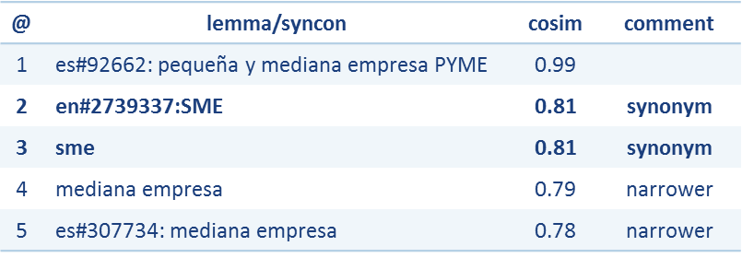

Co-evolution support & examples
“Scrap value” (EN→ES)
Supported co-evolution tasks include
  Identifying KG modeling gaps
  Suggesting merge of equivalent concepts
  Detecting disambiguation errors
More examples available in backup slides
“Financing” (EN→ES)
“PYME” (ES→EN)

Slide 14


Capturing relational knowledge from word embeddings
Can we set up a pipeline to evaluate how well pre-trained word embeddings capture a set of relations?
  Assume neural models are indeed very good at finding patterns in data
  Use hand-crafted KGs as silver-standard to avoid having to create custom/limited datasets
  Focus on lexico-semantic relations
  Use both lemmas and concepts to study effect of polysemy and abstraction capabilities of embedding models
Denaux R, Gomez-Perez JM: Assessing the lexico-semantic relational knowledge captured by word and concept embeddings. In Proceedings of the 10th International Conference on Knowledge Capture, pp. 29–36. ACM (2019)

Slide 15
KGs and Transformers
The field of NLP has advanced substantially with the advent of large-scale language models such as ELMo, ULMFit, and particularly transformers like GPT, BERT and RoBERTa
Trained to perform various language prediction tasks such as predicting a missing word or the next sentence
Large amounts of text used for training, e.g. BERT trained on Wikipedia + the Google Book Corpus of 10,000 books
They can also be fine-tuned for other language prediction tasks, such as question-answering, natural language inference, paraphrasing, or named entity recognition
Transformers actually contain linguistic and word knowledge. Are they the basis for the next-generation KGs?
How can transformers and KGs interplay, if possible at all?
Notes:
We need one more technical detail to make Transformers easier to understand: Attention. The attention-mechanism looks at an input sequence and decides at each step which other parts of the sequence are important. It sounds abstract, but let me clarify with an easy example: When reading this text, you always focus on the word you read but at the same time your mind still holds the important keywords of the text in memory in order to provide context.

Slide 16
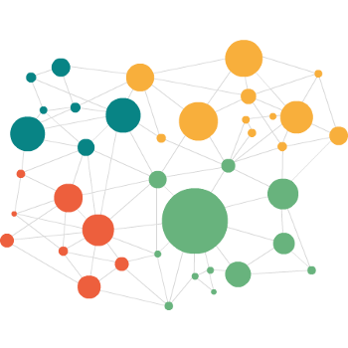

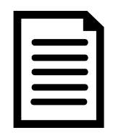
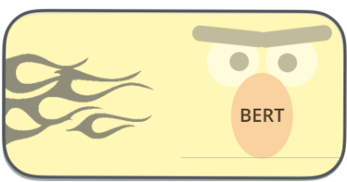
Transigrafo: Combining LM and KG (WSD)
“Driver sues after jaguar sped up on its own.”
KG (SensiGrafo, WordNet…)
Language Model
k-NN
EXTEND
Disambiguate
Word-sense disambiguated corpus (SemCor, silver standards…)
Contextualized sense embeddings
Extended KG coverage
Disambiguated sense
Decoupled linguistic and knowledge representation, allowing for parallel development by independent, possibly unrelated teams
LM -> Focus on human language and how sentences are built
KG -> Human-engineered, interpretable conceptualization of a domain
en#303396 (jaguar) “a luxury car”
Based on: Loureiro D, Jorge A: Language modelling makes sense: Propagating representations through WordNet for full-coverage word sense disambiguation. In: Proceedings of the 57th Annual Meeting of the ACL, pp. 5682–5691.
Notes:
Obtain contextual embeddings for each sense in the SemCor corpus.
Leverage the hierarchical structure of the graph (from sense to synset, hypernym, and lexname) in order to extend the coverage provided by such embeddings to the senses in the graph that do not appear in SemCor, and
Evaluate the resulting sense embeddings.
Subsequent stages of the LMMS algorithm focus on leveraging WordNet glosses and lemma information to optimize the quality of the resulting sense embeddings.
Based on Loureiro, D., Jorge, A.: Language modelling makes sense: Propagating representations through WordNet for full-coverage word sense disambiguation. In: Proceedings of the 57th Annual Meeting of the Association for Computational Linguistics, pp. 5682–5691. Association for Computational Linguistics, Florence, Italy (2019). DOI 10.18653/v1/P19-1569. URL https://www.aclweb.org/anthology/P19-1569

Slide 17
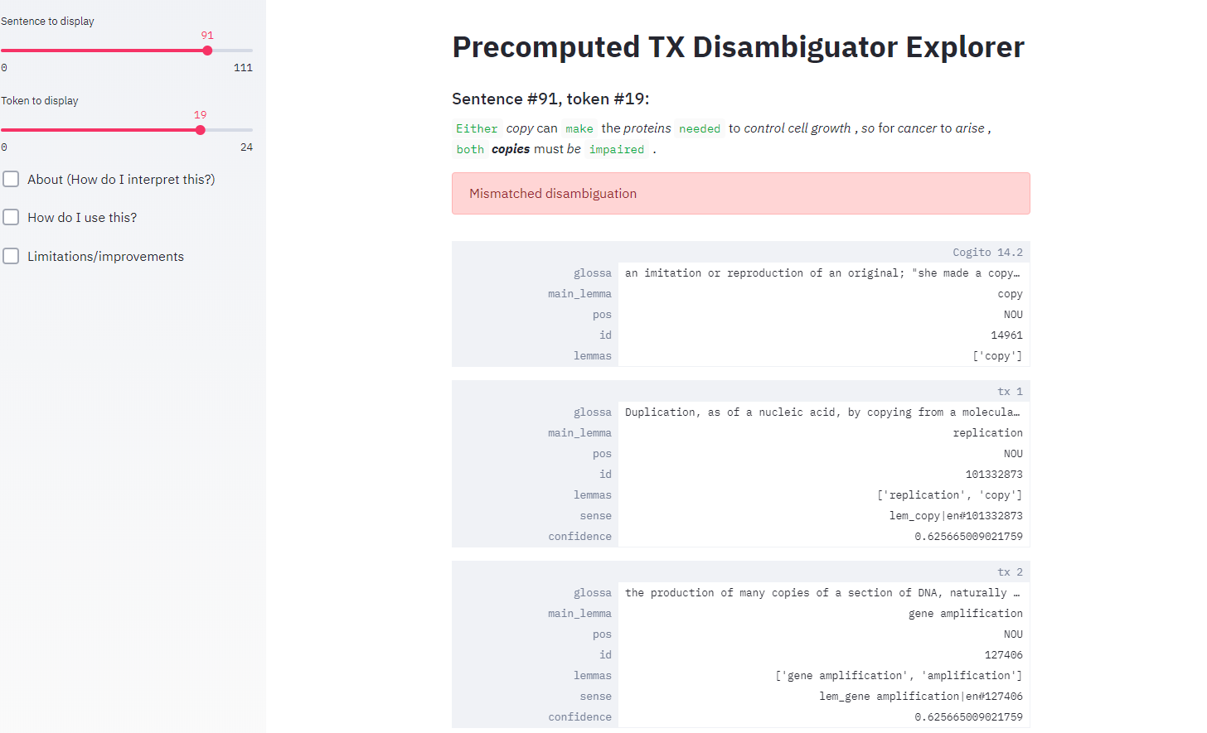
Transigrafo demo for WSD
Based on cogito disambiguation instead of a manually curated corpus
See this as: how much does Cogito and BERT agree? rather than which one is better at disambiguating
Model trained on 37K sentences from the SemCor corpus, disambiguated using Cogito 14.2
112 sentences from SemEval All
Limitations
  Biased training set
  Evidence limited to the senses in the relatively small training set
Notes:
Sentence 29 is good:
Totally absorbed , the ringers stare straight ahead , using peripheral vision ( they call it " rope - sight " ) to watch the other ropes and thus time their pulls .
Position 1: It shows a good mix of (dis)agreement and even one disagreement, where Tx is right over Cogito, on a difficult word “pull” in that context.
Sentence 30 is also good:
Far above in the belfry , the huge bronze bells , mounted on wheels , swing madly through a full 360 degrees , starting and ending , surprisingly , in the inverted , or mouth - up position .
Positions 7, 22: It shows words (“huge”) where Cogito and Tx provide two very similar but different senses (en#89085 vs en#89080), which should probably be merged. Same with “starting”
Position 13: Cogito considers “wheels” as a two-wheeled vehicle while Tx picks the right sense.
Sentence 49
Position 1: Cogito links a proper name (C.J.B. Marshall) with a hebrew name and syncon (Yiftach-El). Tx selects the right lemma (Clark), or at least a more plausible one.
Position 7: Church. Cogito interprets it as the institution while TX correctly interprets it as the place for worship.

Slide 18
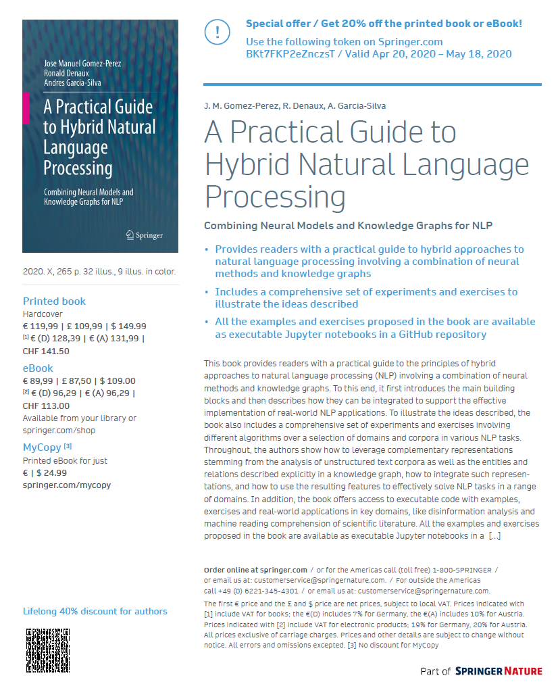


https://www.springer.com/gp/book/9783030448295
Resources: Book and tutorial
http://hybridnlp.expertsystemlab.com/tutorial

Slide 19
Knowledge Graphs for Natural Language Processing
Jose Manuel Gomez-Perez
R&D Director
jmgomez@expertsystem.com

Slide 20
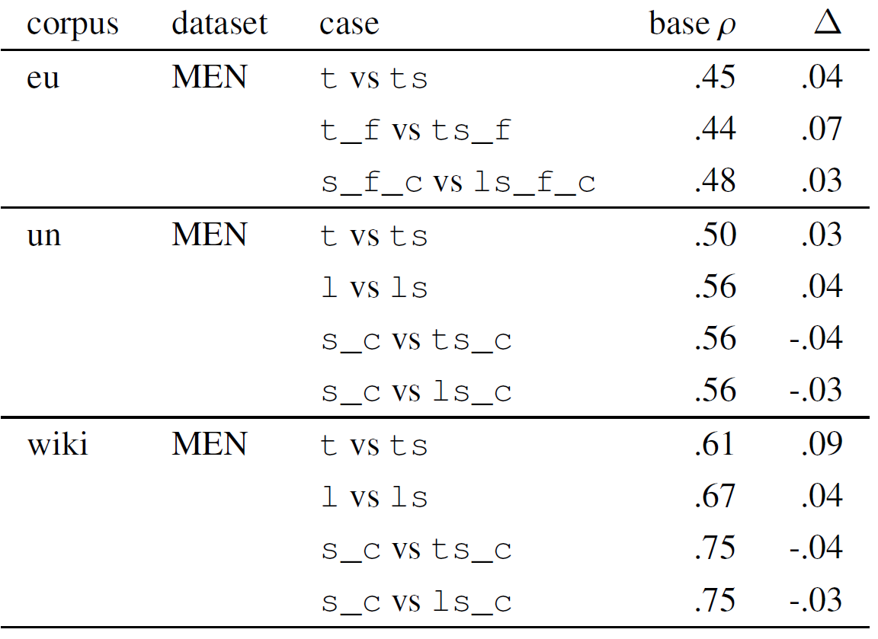
Lesson learnt: Co-training is good for you!
Co-training word, lemma and concept embeddings shows improved accuracies vs. individually learning lexical and semantic embeddings
Significant results e.g. on MEN
Always improves the lexical embeddings
The mild negative impact on semantic embeddings is a trade-off we are happy to assume
Notes:
Not only co-training but combining different types of embeddings usually pays off

Slide 21
Identifying modeling gaps in KGs
Example: Concept en#27495 <investigation) (probe, probing), “a thorough investigation or exploratory action, often into illegal or suspicious activities”
No mapping or good candidate
“Best” candidate: es#200694 <aparato) (sonda), “a device with a metal tip used to test or the behavior of electrical circuits”
Manual inspection of es-Sensigrafo shows no matching concept under expected hypernym es#64222 [investigación]
Equivalent concept is missing from es-Sensigrafo and recommended for inclusion by knowledge engineers

Slide 22
Merging KG concepts
Example: en#69812 (acquit, exonerate), “to declare officially that somebody is not guilty of a charge or accusation”
Result: es#1435 (absolver, salvar), “to declare officially that somebody is not guilty of a charge or accusation”
Even though es#1435 hard mapped to en#146427 (absolve), “to state publicly or officially that somebody is not guilty and not to be held responsible”
The detected en synonyms should probably be merged

Slide 23
Detecting disambiguation errors
Failed Example: en#45381 <warden) (corrections officer, jailer, prison guard, gaoler, jailor, turnkey, screw), “someone who guards prisoners”
Result: es#246045 <policía|agente de policía) (funcionario de prisiones, agente penitenciario, funcionario de la cárcel, guardia de prisiones), “the chief official in charge of a prison”
  Despite hard-map to: en#48054 <officer) (warden, gov.), “the chief official in charge of a prison”
Manual inspection of es-sensigrafo shows correct mapping: es #15204 <es#246045) [bastonero, carcelero]
  In vecsigrafo, but cosim 0.299 < [0.359, 0.481] of top 10
Disambiguation issue

