Slide 1
Search and AI driven Analytics
Amit Prakash
CTO, Co-founder

Slide 2



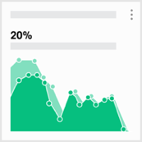
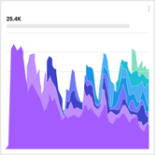
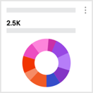





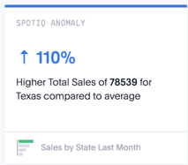
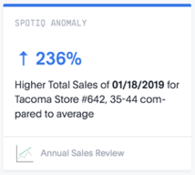



ThoughtSpot Overview
Technology
Customers
Momentum
Search & AI
Mid-to-large Enterprise
Fastest Growing Company
SEARCH
100%
growth
which stores are selling the most?
2019
100M
run rate
AI-DRIVEN INSIGHTS
2018
2017
Magic Quadrant Leader
Notes:
For those of you who are new to ThoughtSpot, let me give you a quick overview of the company.
We’ve brought two disruptive technology innovations to the world of analytics that led us to be named a leader in the Gartner Magic Quadrant last year – making us the fastest ever vendor to reach the Leader’s quadrant,
and the first new vendor there in 6 years.
First, we’ve built an entirely new breed of search engine designed from the ground up for analytics. Anyone can ask data questions and get answers in seconds.
Second we’ve led the industry with the introduction of a AI-driven insights engine we call SpotIQ that automatically provides you with relevant data questions you might not have thought to ask.
This technology is being used by the largest enterprise customers in the world, across all major industry verticals like Walmart, BT, Apple, and Fannie Mae.
As an example, Walmart has been a customer since 2014. As you know Walmart has a massive amount of data – hundreds of TBs. But due to the constraints of traditional BI platforms they could never get insights at the shelf-level,
they were only looking at aggregate by region or store…
With ThoughtSpot, they know how much a product-X is selling with women ages 35-50 in store z, last week which means they can more accurately forecast inventory and do SKU-level mark-downs that have led to to hundreds of
millions of dollars in savings.
This success with the world’s largest companies is why we’re growing faster than any of the other companies in our space. 100% year over year at a 100M run rate.
Lastly, we are the top funded private analytics company, backed by top venture firms like LightSpeed, Fidelity, and SAP Sapphire, with a nearly $2B valuation.

Slide 3




We’ve made fact-finding and distribution easy via search & AI
AI-driven insights
Scheduled
Continuous, Self-driving
PUSH
Report Distribution
Bots
PULL
Search to analyze
Search & auto-analyze
Pervasive and contextual
KNOWN QUESTIONS
UNKNOWN QUESTIONS
Anyone can find their own insights using search, or get automated insights before you have to ask

Slide 4
Outline
Motivation
ThoughtSpot – Product Introduction
Architecture and Design choices
Challenges
Some Open Problems
Building Knowledge Systems – General Advice

Slide 5
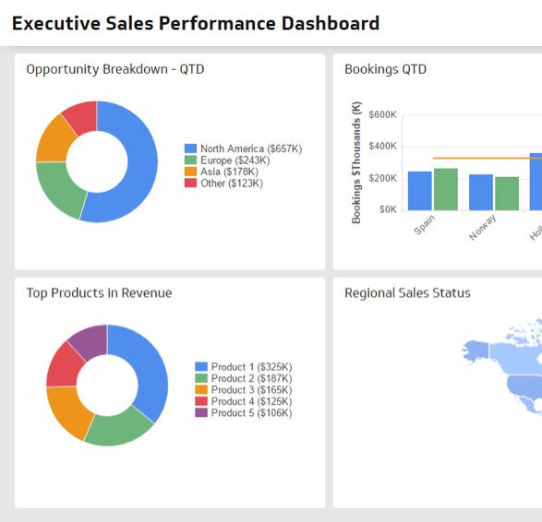
Static reports and dashboards are fundamentally broken
…?
…?
Why is credit card spending
in the South up this year?
Which cities and months had spikes
in credit card usage?
Region
…?
…?
…?
Which customers have savings accounts but no mortgages?
…?
Demographics
What’s the credit rating scores for top mortgage candidates?
…?
…?
Which products have the highest growth rate this year?
Product
…?
…?
Which city in California had highest IRA growth for customers ages 25-34?
…?
…?
Notes:
Let’s take a step back at the state of the analytics industry much of what you might be feeling in your organization today.
For most organizations we work with, analytics means running your business on thousands of reports and dashboards. This paradigm is completely broken.
Why? Because these static, lifeless artifacts that is incredibly hard to create and change, and often go stale before anyone has looked at them.
As business people see charts on a dashboard, their natural inclination is to ask that dreaded next question – something that they have in their mind, driven by the current state of their business, but not something
that can be answered immediately by the dashboard.
To make matters worse, dashboards have to be aggregated for performance reasons which buries the insights so many business people crave.
As a result, we’re now all victim to the tyranny of averages. We don’t see our customers as individuals or the details about our products and people. We only see summaries that obscure the truth.
If DO you want to get into the granular details, as business people we are reliant on the data teams to do the heavy-lifting.

Slide 6


How long does your business wait for answers?
1.5
1.2
MILLION
BILLION
Data Experts
Workers
4.8
DAYS
To build
one report
Notes:
Our reliance on data teams has created a massive bottleneck – where business people wait, and wait, and wait for answers.
With only 1.5M million data experts in the world (according to McKinsey) on one side…
And over a billion knowledge workers on the other and an average report build time of 5 days...
It’s obvious why so many of us are left waiting weeks or sometimes even months for reports.
And it creates a vicious cycle.
If you’re a business person and you know this bottleneck exists. What happens?
You give up! You might use what you’re given, but it’s not worth waiting in line for more.
We call this the curiosity tax. Curiosity is the currency of innovation and business. And here we are with a massive tax that no one wants to pay.

Slide 7















The backend for dashboards is complex and slow
Sales
Marketing
BI Team
Enterprise Data
Sources
Data Warehouse/ Lake
Cubes & Aggregates
Reports & Dashboard
HR
Finance
Notes:
So why does it take so long to get answers? Because the dashboard creation pipeline is slow and complicated.
Across all the companies we work with, the typical pipeline looks like this? It might look painfully familiar to you?
You’ve probably got data is usually scattered across tables across dozens of data sources. Which your data teams must be extract and put through a complicated ETL process to simplify the data model.
Then the data needs to be moved into a data warehouse or data lake for centralized storage. In order to get around performance issues, you have to segment data into data marts, and then summarize data even further into cubes and views.
This process for most companies we talk to? It can takes almost two months before the business gets a usable data set they can get insights from.
And we haven’t even touched on the skill required to create dashboards – which given the complexity of today’s analytics products takes days and requires highly skilled data analysts to use.
Even if you make it all the way though this nasty pipeline, that dreaded “next question” from the business person often sends you back to square one.
This is why most companies are plagued with a massive reporting backlog.

Slide 8

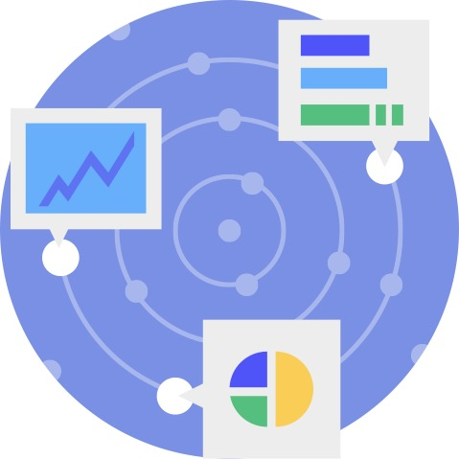

What makes ThoughtSpot different?
Simple
Smart
Fast
Fast and easy access to data for everyone
Automated
data discovery
Performance at Enterprise Scale
Notes:
So how does it work?
ThoughtSpot provides value in 3 unique ways:
1. It’s simple. We empower everyone in your organization to make smarter decisions with easy access to data.
2. It’s smart. Our AI asks questions of data to detect anomalies, identify root causes, and uncover opportunities that users might never have thought to ask.
3. It’s fast. We help you uncover granular insights from billions of rows in seconds.

Slide 9
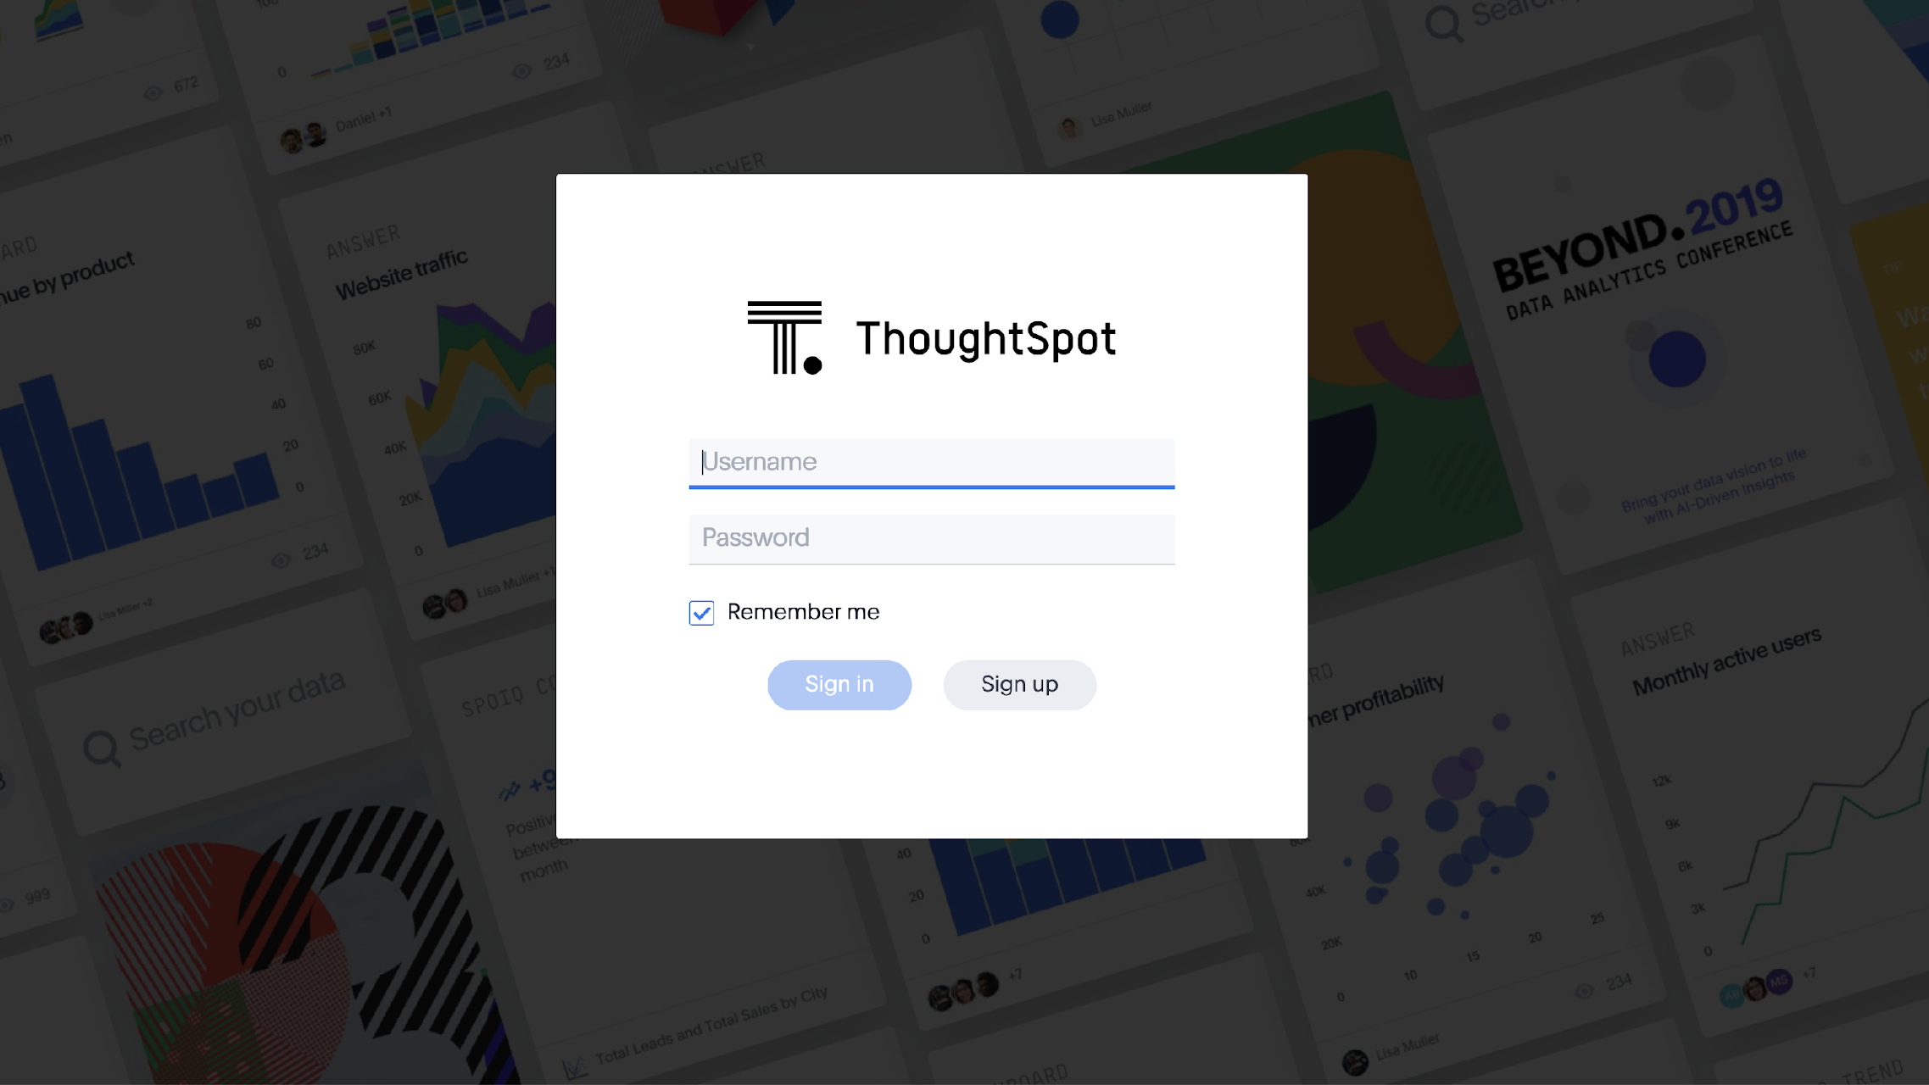
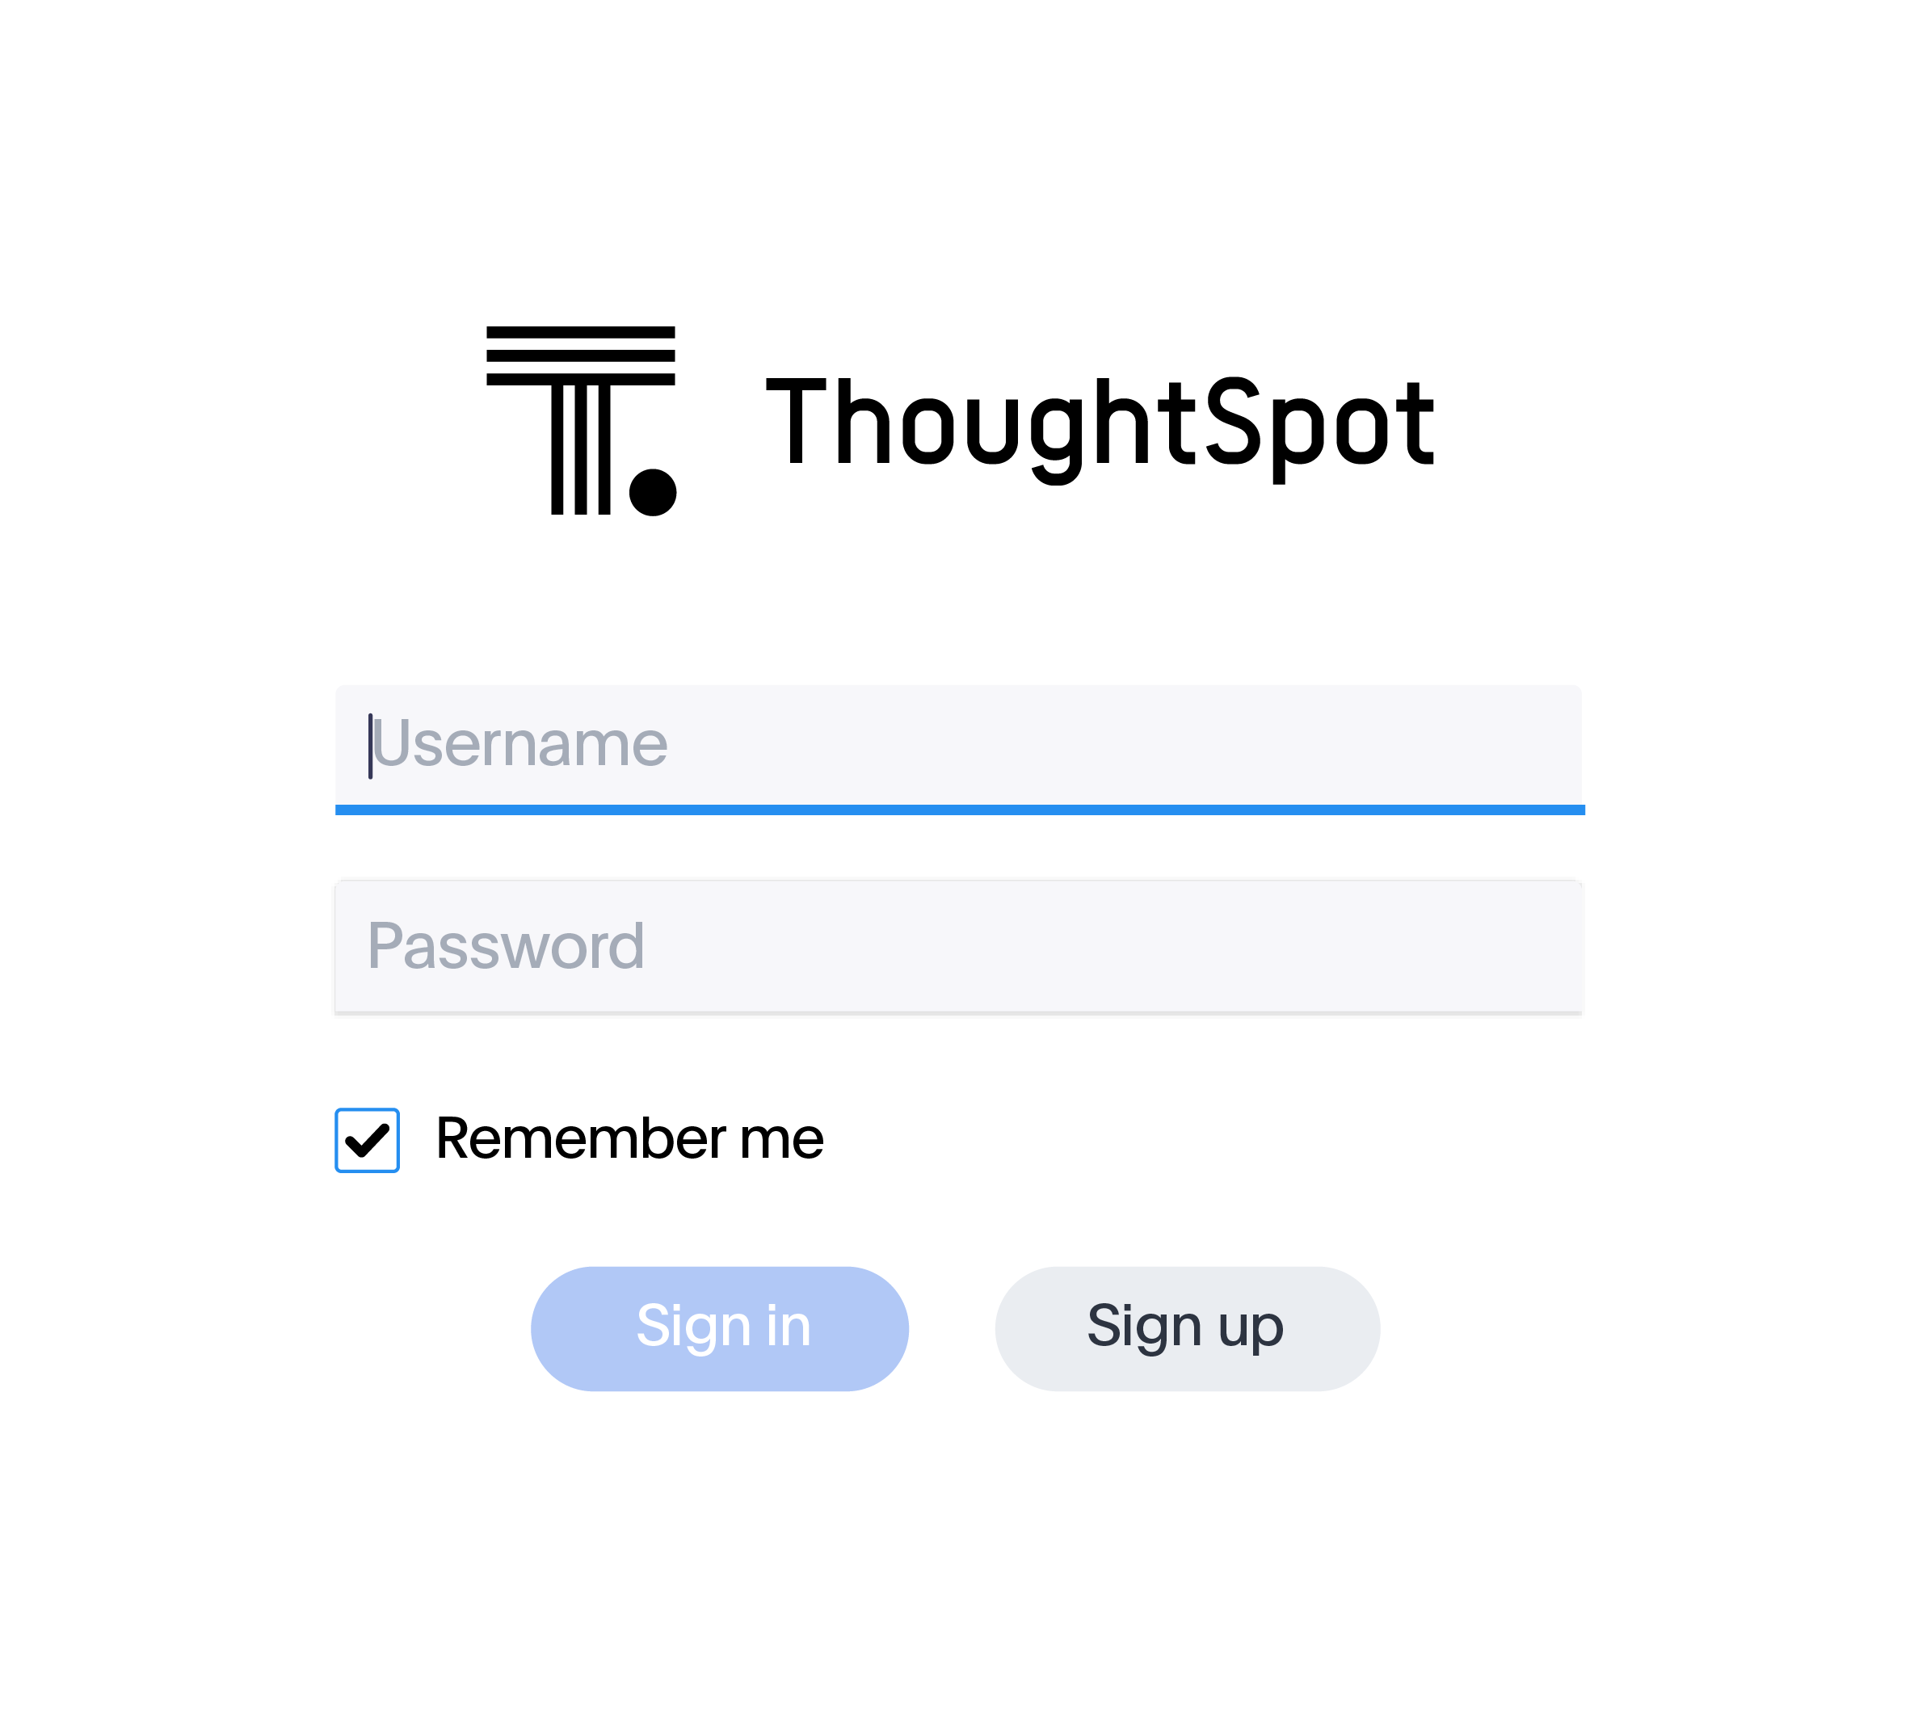
Notes:
Let’s take a look!

Slide 10
Systems Challenges
Database: Answers within seconds from hundreds of billions of records
  Purely in-memory system
  Optimized JIT code for execution
  Custom optimizations for the application
  Horizontal Scale-out
Relational Search:
  Build an indexing system that can maintain
    billions of tokens across 100s of tables fresh
    Search through these tokens within 2-5 millisecond
    Provide ranked matches
    Honor full, prefix, substring and approximate matches
    Honor context constrains based on where in the sentence we are matching
    Honor security constraints based on who can see what data
  Scalable compilation and auto-completion engine for arbitrary DSL without tokenization rules
  Online learning system that learns from usage

Slide 11
AI Challenges
Search Auto-completion Ranking
SpotIQ (Automated Insights)
Online Bayesian model that learns ranking based on
  User selections
  Table Join Graph
  Data types
  Cardinality of each column
  Semantic encoding of each column
Directing exploration towards likely interesting hypothesis in a combinatorial explosion of possibilities
Ranking Insights generated by exploration
  Statistical scoring
  Feedback based scoring
  Day-zero ranking configuration
Lack of input around how the system is expected to behave

Slide 12
AI Challenges
Natural Language Query Interpretation (SearchIQ)
  AI Complete problem --- one of the hardest problems I have worked on
    NLU is unsolved problem
    A lot of real world knowledge is assumed in understanding of question
    A lot of business specific context is needed
    In answering business questions, Trust and Transparency is paramount
    It is hard to know when you are failing

Slide 13

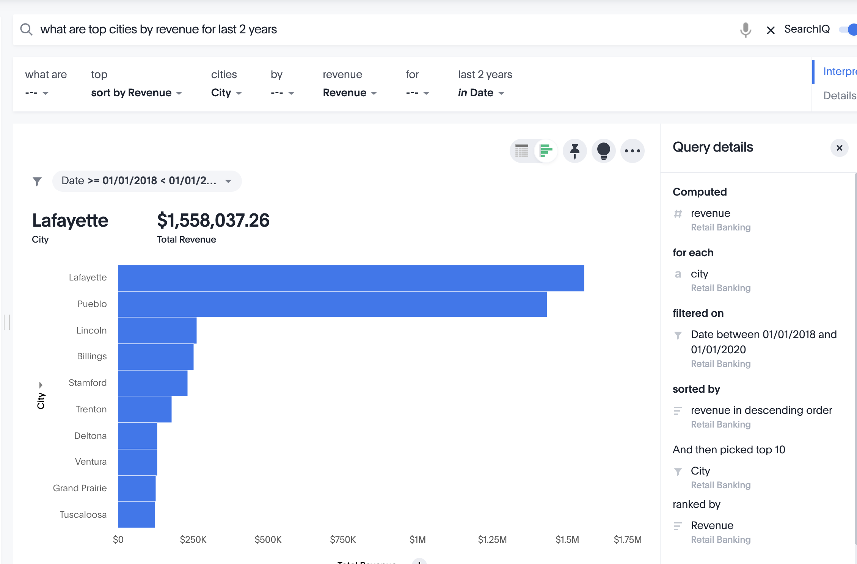
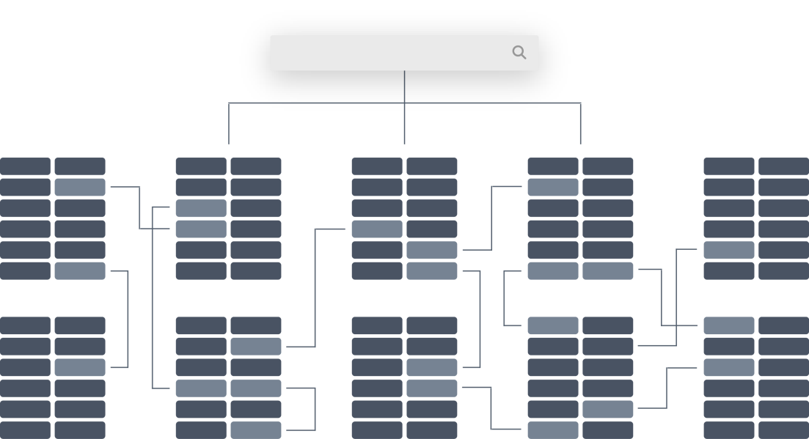
SearchIQ – NLQ Engine
Information Retrieval
S
UX
NLP
Powerful Indexing System for Columns, Values, Synonyms, Keywords, Common phrases that can be queried 100s of times processing single query
Parse Tree
Contextualized Word Embedding's
Pattern Matching
Rule based Translations
Transparency
Trust
Feedback
Capture Knowledge
Billions of Tokens
100 ms budget
Millions of training examples needed
Complex Interaction with Simple Interface

Slide 14


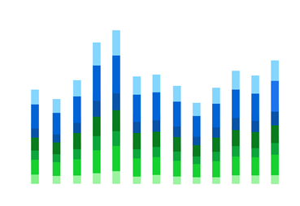
SearchIQ: Smart Engine on top of Thoughtspot’s Relation Search
What are the hottest Adidas products
SearchIQ
Translate End User Query to Relational Search
Translation Layer
top 10 products sorted by sales brand name= ‘Adidas’
Relational Search
Ensure trustworthy, 100% accurate results on complex data at scale
SearchIQ: A smart engine built on top of ThoughtSpot’s Relation Search Engine.
Notes:
SearchIQ is a smart, flexible yet transparent engine designed specifically for business users who have not received any training.
We built SearchIQ to leverage the current capabilities of ThoughtSpot’s relational search and in-memory database to be an interactive natural language search interface for end users.

Slide 15
Information Retrieval Engine
What are the hottest Adidas products
[What, are, …., hottest, …, Adidas, …, products]
Distributed Lookup Engine
Match Ranking Engine
Adidas - Value (Brand Name)
Products - Product Name, Product ID
Scalable, fast, distributed index
Adidas
Nike
A highly distributed and scalable IR architecture helps extracts all the entities.

Slide 16
Our Approach: Natural Language Understanding
Example: What are the hottest Adidas products ?
  Language Signals
    Parts of Speech Signals
    Dependency Parse
    Contextualized Meaning
Modifies “products”
Word | What | are | the | hottest | Adidas | products
Parts of Speech Tag | Pronoun | Verb | Determinant | Superlative | Noun | Noun
Natural Language Understanding helps us in understanding the user’s intent.

Slide 17
Our Approach: Pattern Library
Example: What are the hottest Adidas products ?
  Pattern Library Matches
Modifies “products”
Generated Predicate
Word | hottest | Adidas | products
Pattern | Superlative | Noun | Noun
Top | 10 | Products | Sort By | <Measure>
A pattern library to use the IR and NL signals to generate predicates.
Notes:
After getting signals from the English language parse and data/metadata indices the engine parses for pre-defined patterns within the query to construct a meaningful question.
This is done using a static list of highly used patterns in the English Language to translate user’s intent into SQL predicates.
Eg. for the query “hottest Adidas products” a match on a pattern that encodes <superlative> <attribute> is found and translated into a sort+filter phrase that picks the top 10 products and displays them to the user.

Slide 18




Our Approach: User Feedback
1
Ask a question
What are the hottest Adidas products
2
System intelligently interprets the question
3
If interpretation incorrect, user easily teaches the system
5
System accelerates learning smart algorithms
top product name ranked sort by sales
4
System pools teachings from all users
SearchIQ uses users’ feedback to understand implicit business context.
Notes:
One of the fundamental challenges that any search engine faces is understanding the business context of the end-user.
For eg. in the aforementioned query the word “hottest” could be sort by “sales”, “quantity”, “profit” or “loss”.
In order to learn that we have designed a smart learning algorithm within the engine that learns from crowdsourcing. The algorithm for the smart learning is as following:
If the interpretation is incorrect, get feedback from the user.
Learn the feedback in the context of the query made the user.
Pool in the feedback across all the users.
Apply the feedback in a new and a similar query made by any user in the business.

Slide 19
Knowledge Gap – The biggest challenge
Who directed Titanic
  Directors Direct Movies, Who -> should match a person
“Whats the Longest Movie” vs. “Whats the longest movie name”
  Superlative context
“Best Product by Revenue” vs. “Best product by return rate”
  Positive or Negative Metric?
“Whats the A0 for Dallas” vs. “Whats the D0 for dallas”
  What you measure changes the meaning of entity
“How much sales opportunity do I have” vs. “which Sales Opportunity has best chance of conversion”

Slide 20
UX challenge
How do you design an interface here users tell you:
  What you got wrong
  Why you got it wrong
  Under what circumstances you can make the choice suggested by user
How do you build a Knowledge graph rapidly
  In a new domain
  With volunteer workforce
  Learning complex relationships

Slide 21
NLP Challenges
How do you learn quickly from small amount of data
  Transfer Learning?
How do you mine entity relationships from existing Text
How do you reliably classify entities into known ontology
  People, Places, Money, Organizations
Better contextualization of words

Slide 22
Broad Advise on building Knowledge based Systems
Most simplest algorithms get you 70% of the way
  Build a usable system gives you the ability of collect training data which is crucial
Shorten the time between idea->measurement maniacally
Focus on one or two metrics only
Build a system to measure the smallest delta in your metrics reliably
UX is probably more important than any algorithmic improvement
There is a big difference between experimental result and production improvement

