Slide 1
EE359 – Lecture 15 Outline
Announcements:
  HW posted, due Friday
  MT exam grading done
    Can pick up after class or from Dash
  Makeup lecture next week on Monday (not Wednesday)
MIMO Fading Channel Capacity
Massive MIMO
MIMO Beamforming
Diversity/Multiplexing Tradeoffs
MIMO Receiver Design

Slide 2
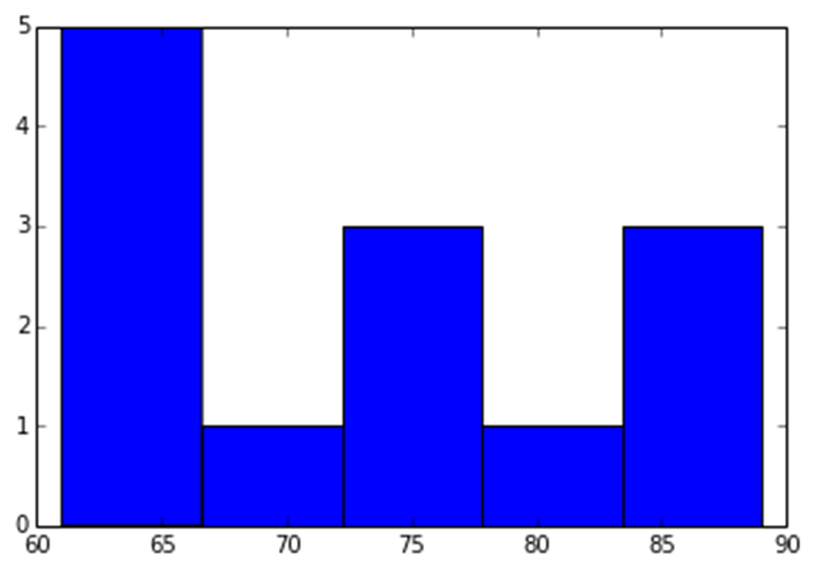
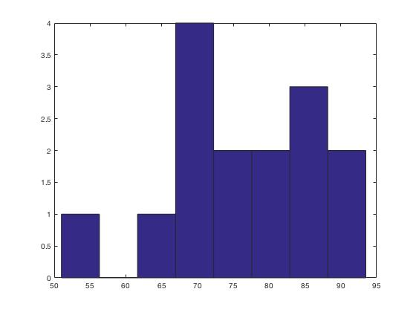
Midterm Grade Distribution
2016: Mean: 73.08, STD:10.4.
Mean: 84, STD: 13
Rough “curve”
95-100: A+
80-94: A
70-79: A-
60-69: B+
2017: Mean: 76, STD: 11

Slide 3
Grade breakdown by problem and common mistakes
Q2: Capacity w/ waterfilling, channel inversion
Q1: Channel Impulse Response + Performance
2.b. and 2.c: Maximum outage capacity under truncated inversion mistaken for channel capacity under channel inversion. Also for 2c, Pout is minimized if Pout = 0.
1c. The effect of ISI on this channel was not considered.
Q3: Diversity Performance (SC-MIMO)
1d. The outage probability based on an SNR threshold for average BER due to Rayleigh fading was not properly computed
3a: Choice of i;j should maximize |h_{ij}|^{2,} not h_{ij}

Slide 4
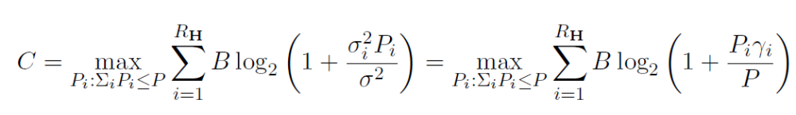
Review of Last Lecture
MIMO systems have multiple TX and RX antennas
  System model defined via matrices and vectors
  Channel decomposition: TX precoding, RX shaping
Capacity of MIMO Systems
  Depends on what is known at TX/RX and if channel is static or fading
  For static channel with perfect TX/Rx CSI, water-fill over space:
  Without transmitter channel knowledge, capacity metric is based on an outage probability
    P_{out} is the probability that the channel capacity given the channel realization is below the transmission rate.
~
~
~
y=Hx+n
y=Σ x+n
H=UΣV^{H}
~
~
~
y_{i}=σ_{ι}x+n_{i}

Slide 5
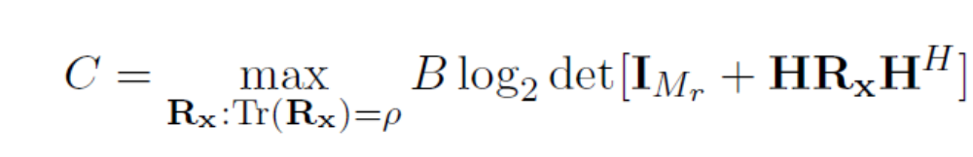
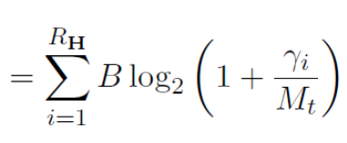

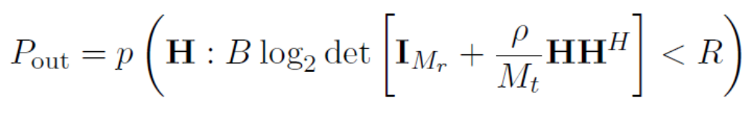
MIMO Fading Channel Capacity
If channel H known, waterfill over space (fixed power at each time instant) or space-time
Capacity without TX CSI:
  General expression for AWGN MIMO capacity
  Without TX CSI, send equal power at each TX antenna (R_{x}=(ρ/M_{t})I_{Mt}); capacity based on outage probability
  P_{out} is probability that channel capacity given the channel realization is below the transmission rate C.

Slide 6

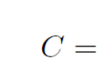
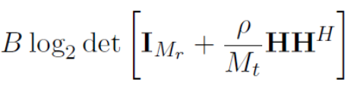


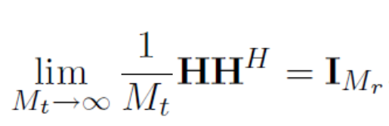
Massive MIMO
Hundreds of antennas;
Equal power on each one
For fixed M_{r}, singular values converge to a constant as M_{t} grows large:
Capacity grows linearly with M=min(M_{t},M_{r})
  Same is true for high SNR and finite M_{t},M_{r}

Slide 7








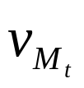
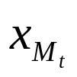
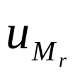
Beamforming
Scalar codes with transmit precoding
y=u^{H}Hvx+u^{H}n
Transforms system into a SISO system with diversity.
  Array and diversity gain
  Greatly simplifies encoding and decoding.
  Channel indicates the best direction to beamform
  Need “sufficient” knowledge for optimality of beamforming

Slide 8
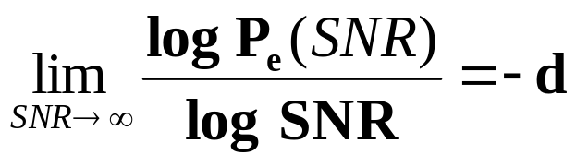
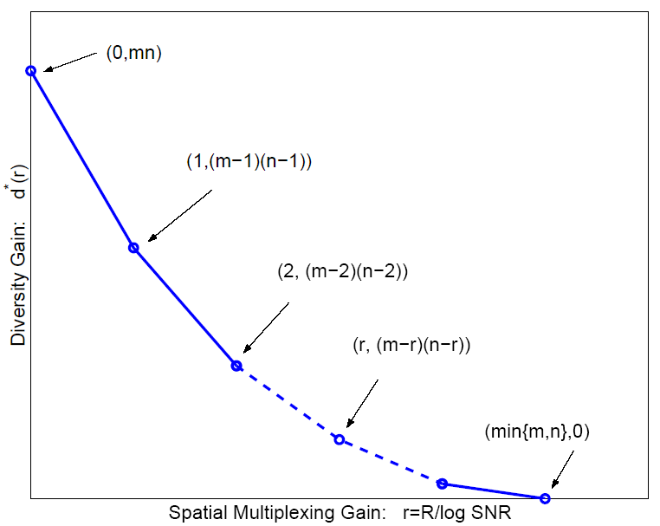
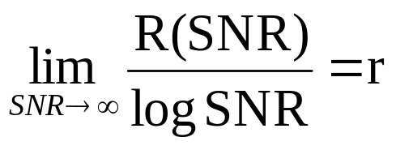
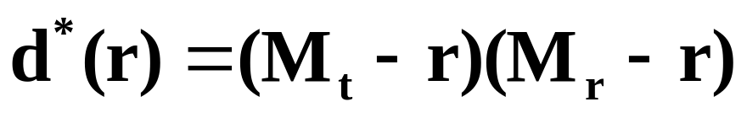
Diversity vs. Multiplexing
Use antennas for multiplexing or diversity
Diversity/Multiplexing tradeoffs (Zheng/Tse)
Error Prone
Low P_{e}

Slide 9

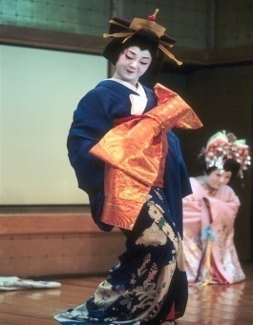


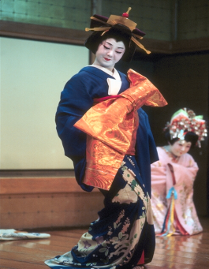
How should antennas be used?
Use antennas for multiplexing:
High-Rate
Quantizer
ST Code
High Rate
Decoder
Error Prone
Use antennas for diversity
Low-Rate
Quantizer
ST Code
High
Diversity
Decoder
Low P_{e}
Depends on end-to-end metric: Solve by optimizing app. metric

Slide 10
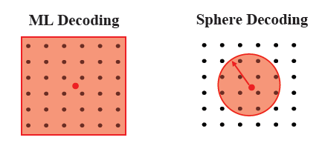
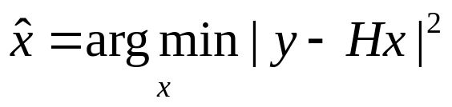
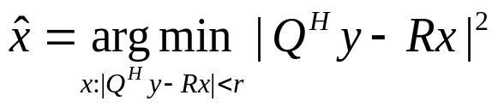
MIMO Receiver Design
Optimal Receiver:
  Maximum likelihood: finds input symbol most likely to have resulted in received vector
  Exponentially complex # of streams and constellation size
Linear Receivers
  Zero-Forcing: forces off-diagonal elements to zero, enhances noise
  Minimum Mean Square Error: Balances zero forcing against noise enhancement
Sphere Decoder:
  Only considers possibilities within a sphere of received symbol.
    If minimum distance symbol is within sphere, optimal, otherwise null is returned

Slide 11
Main Points
Capacity of fading MIMO systems
  With TX and RX channel knowledge, water-fill power over space or space-time to achieve capacity
  Without TX CSI, outage is the capacity metric
For massive MIMO or high SNR, capacity scales as min(M_{t},M_{r})
Beamforming transforms MIMO system into a SISO system with TX and RX diversity.
  Beamform along direction of maximum singular value
MIMO introduces diversity/multiplexing tradeoff
  Optimal use of antennas depends on application
MIMO RX design trades complexity for performance
  ML detector optimal - exponentially complex
  Linear receivers balance noise enhancement against stream interference
  Sphere decoding provides near ML performance with linear complexity

