Slide 1
EE359 – Lecture 16 Outline
Announcements:
  HW due Fri, new HW to be posted today
  End-of-Quarter schedule and possible bonus lecture
    No lecture March 5, makeup lecture Monday March 2, 10:30-11:50, Gates B03
    Advanced topics lecture? Could extend last class March 12 to 3:30 (i.e. 1:30-3:30)
    Final exam: Tues March 17, 3:30-6:30pm, here. More details next week.
MIMO Receiver Design
  Linear Receivers, Sphere Decoder
Other MIMO Design Issues
  Space-time coding, adaptive techniques, limited feedback
ISI Countermeasures
Multicarrier Modulation

Slide 2
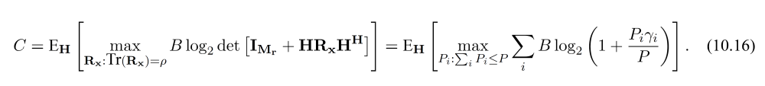
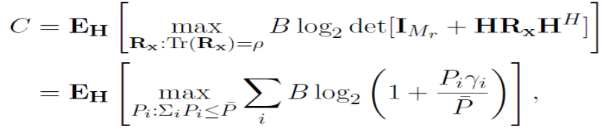
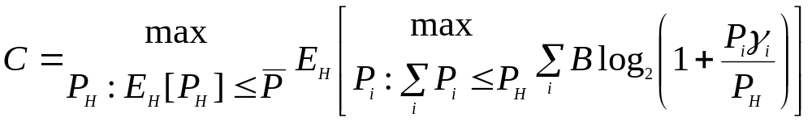
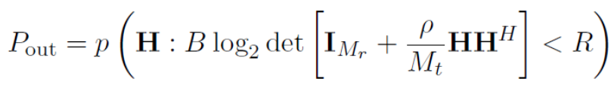
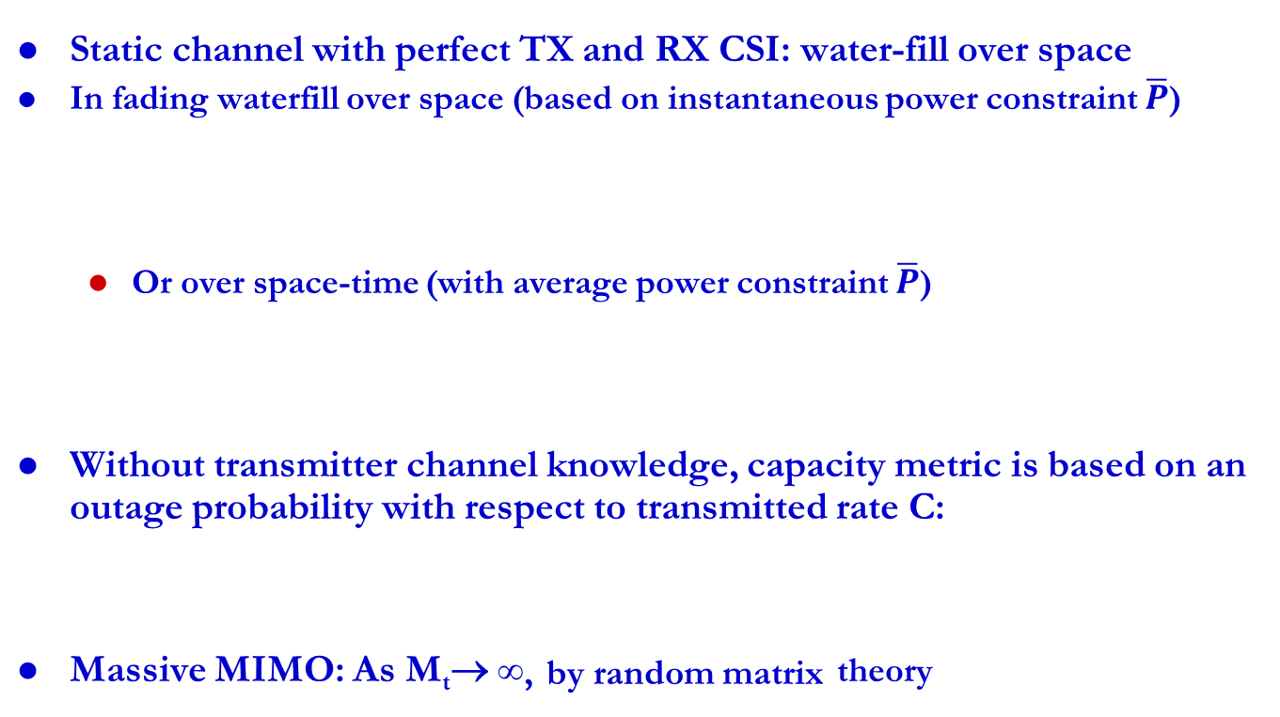
Review of last lecture
Capacity of Fading & Massive MIMO Systems
Static channel with perfect TX and RX CSI: water-fill over space
In fading waterfill over space (based on instantaneous power constraint $\overline{P}$)
  Or over space-time (with average power constraint $\overline{P}$)
Without transmitter channel knowledge, capacity metric is based on an outage probability with respect to transmitted rate C:
Massive MIMO: As M_{t}→ ∞, by random matrix theory

Slide 3











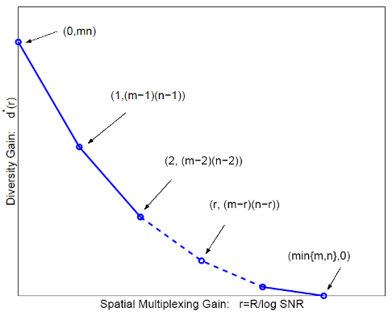

Review of Last Lecture (Cont’d)
Beamforming: Scalar transmission
  Principle vectors of U and V are weights: maximizes SNR
y=u^{H}Hvx+u^{H}n
Diversity-Multiplexing Tradeoff: high SNR
  Can use some antennas for diversity, some for capacity gain:
  How antennas used depends on system metric
  If requirements unmet, need more antennas
Need more
antennas
Voice
HD Video
Video

Slide 4
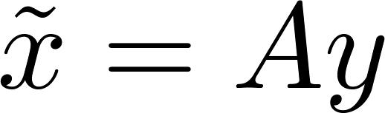








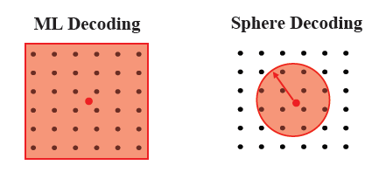

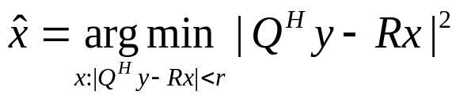
MIMO RX Design
Optimal Receiver is ML: finds input vector x most likely to have resulted in y=Hx+n, exponentially complex in M_{t}
Linear Receivers: performs linear equalization then quantizes to nearest constellation point
    Zero-Forcing ( , the Moore-Penrose pseudo inverse of H):
    (if H invertible, equals inverse, else ); forces off-diagonal terms to zero ( , enhances noise)
    Minimum Mean Square Error (A= ) ): λ 1/SNR Balances zero forcing against noise enhancement
Sphere Decoder: Uses QR decomposition of H
  Considers possibilities within sphere of transformed received symbol.
    If minimum distance symbol is within sphere, optimal, otherwise null is returned
Hx+n
Q^{H}y=Rx+Q^{H}n

Slide 5
Other MIMO Design Issues
Not covered in lecture/HW/exams
Space-time coding:
  Map symbols to both space and time via space-time block and convolutional codes.
  For OFDM systems, codes are also mapped over frequency tones.
Adaptive techniques:
  Need fast and accurate channel estimation
  Adapt the use of transmit/receive antennas
  Adapting modulation and coding.
Limited feedback transmit precoding:
  Partial CSI introduces interference in parallel decomp: can use interference cancellation at RX
  TX codebook design for quantized channel

Slide 6
ISI Countermeasures
Equalization
  Signal processing at receiver to eliminate ISI
  Complex at high data rates, performs poorly in fast-fading
  Not used in state-of-the-art wireless systems
Multicarrier Modulation
  Break data stream into lower-rate substreams modulated onto narrowband flat-fading subchannels
Spread spectrum
  Superimpose a fast (wideband) spreading sequence on top of data sequence, allows resolution for combining or attenuation of multipath components.
Antenna techniques (Massive MIMO)
  (Highly) directional antennas reduce delay spread/ISI

Slide 7
Multicarrier Modulation
R/N bps
QAM
Modulator
x
R bps
Serial
To
Parallel
Converter
cos(2πf₀t)
Σ
R/N bps
QAM
Modulator
x
cos(2πf_{N}t)
Breaks data into N substreams
Substream modulated onto separate carriers
  Substream passband BW is B/N for B total BW
  B/N<B_{c} implies flat fading on each subcarrier (no ISI)

Slide 8
Overlapping Substreams
Can have completely separate subchannels
  Required passband bandwidth is B.
OFDM overlaps substreams
  Substreams (symbol time T_{N}) separated in RX
  Minimum substream separation is 1/T_{N} for rectangular pulses
  Total required bandwidth is B/2
B/N
f₀
f_{N-1}

Slide 9
Main Points
MIMO RX design trades complexity for performance
  ML detector optimal - exponentially complex
  DF receivers prone to error propagation
  Sphere decoders allow performance tradeoff via radius
Other MIMO design issues include space-time coding, adaptation, codebooks for limited feedback
ISI mitigated through equalization, multicarrier modulation (MCM) or spread spectrum
  Today, equalizers often too complex or can’t track channel.
  MCM splits channel into NB flat fading subchannels
  Can overlap subcarriers to preserve bandwidth

