Slide 1
EE359 – Lecture 4 Outline
Announcements:
  1st HW due Friday 4pm: HW can be submitted in hardcopy (box outside Dash’s office) or upload to canvas.
Review of Last Lecture
Random Multipath Model
Time Varying Channel Impulse Response
Narrowband Fading Model
In-Phase and Quad Signal Components
Auto and Crosscorrelation of received signal

Slide 2
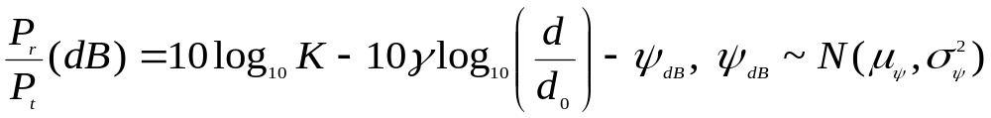

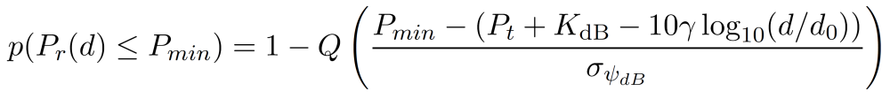
Review of Last Lecture
Shadowing: Log-normal random variable based on CLT applied to many attenuating objects
Combined Path Loss and Shadowing
Outage probability:
For log-normal shadowing model
r
_{dB}
_{dB}
K_{dB}
μ_{ψ}=0 when average shadowing incorporated into K and γ, else μ_{ψ}>0
_{dB}
_{dB}
E[P_{r}(d)]
r
Notes:
Lecture notes not consistent with text, should be –psi_dB

Slide 3
Review continued
K (dB)
2
σ_{ψ}
P_{r}(dB)
_{dB}
Fit model to data
Path loss (K,γ), d_{r} known:
  “Best fit” line through dB data:
  1D (γ) or 2D (γ,K) minimization of the MSE
  For 1D, K obtained from free-space or at d_{r}.
  Captures mean due to shadowing
Shadowing variance
  Variance of data relative to path loss model (straight line) with MMSE estimate for γ
-10γ
log(d)
log(d_{r})

Slide 4


Statistical Multipath Model
Random # of multipath components, each with
  Random amplitude
  Random phase
  Random Doppler shift
  Random delay
Random components change with time
Leads to time-varying channel impulse response

Slide 5
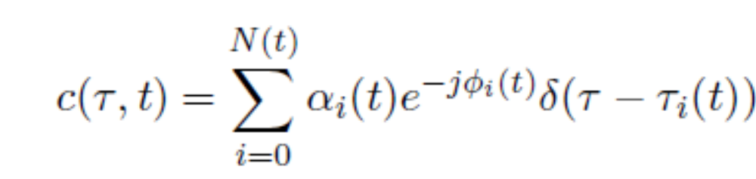
Time Varying Impulse Response
Response of channel at t to impulse at t-τ:
  t is time when impulse response is observed
  t-τ is time when impulse put into the channel
  τ is how long ago impulse was put into the channel for the current observation
    path delay for MP component currently observed

Slide 6
Received Signal Characteristics
Received signal consists of many multipath components
Amplitudes change slowly
Phases change rapidly
  Constructive and destructive addition of signal components
  Amplitude fading of received signal (both wideband and narrowband signals)

Slide 7
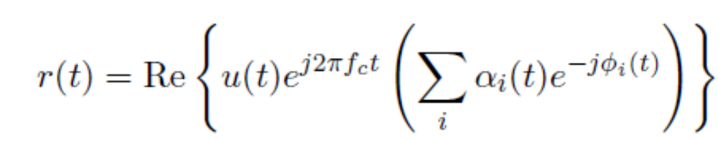
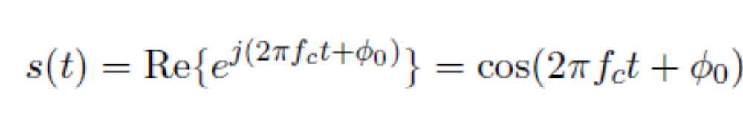
Narrowband Model
Assume delay spread max_{m,n}|τ_{n}(t)-τ_{m}(t)|<<1/B
Then u(t)≈u(t-τ).
Received signal given by
No signal distortion (spreading in time)
Multipath affects complex scale factor in brackets.
Characterize scale factor by setting u(t)=e^{jφ0}:

Slide 8
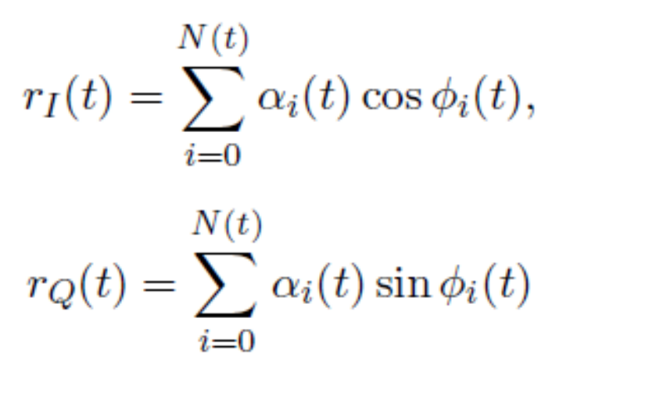
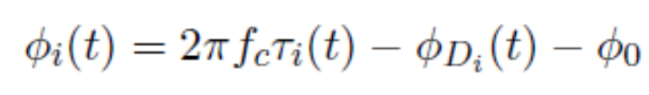
In-Phase and Quadrature under CLT Approximation
In phase and quadrature signal components:
For N(t) large, r_{I}(t) and r_{Q}(t) jointly Gaussian by CLT (sum of large # of random vars).
Received signal characterized by its mean, autocorrelation, and cross correlation.
If ϕ_{i}(t) uniform, the in-phase/quad components are mean zero, independent, and stationary.

Slide 9

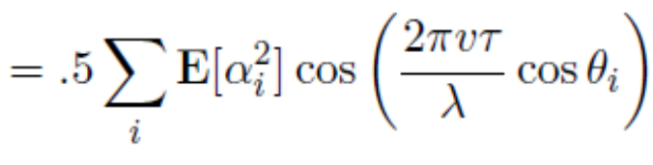
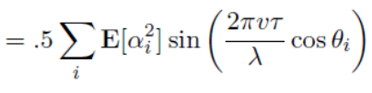


Auto and Cross Correlation
Assume φ_{i}~U[0,2π]
Recall that θ_{i} is the multipath arrival angle
Autocorrelation of inphase/quad signal is
Cross Correlation of inphase/quad signal is
Autocorrelation of received signal is
+

Slide 10
Main Points
Statistical multipath model leads to a time-varying channel impulse response
Resulting received signal has rapidly varying amplitude due to constructive and destructive multipath combining
Narrowband model has in-phase and quad. comps that are zero-mean stationary Gaussian processes
  Auto and cross correlation depends on AOAs of multipath

