Slide 1
EE359 – Lecture 5 Outline
Announcements:
  HW posted, due Friday 4pm
  Background on random processes in Appendix B
Review of Last Lecture: Narrowband Fading
Auto and Cross Correlation of In-Phase and Quadrature Signal Components
Correlation and PSD in uniform scattering
Signal Envelope Distributions
Wideband Channels and their Characterization

Slide 2


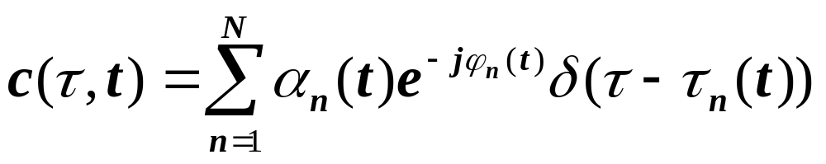
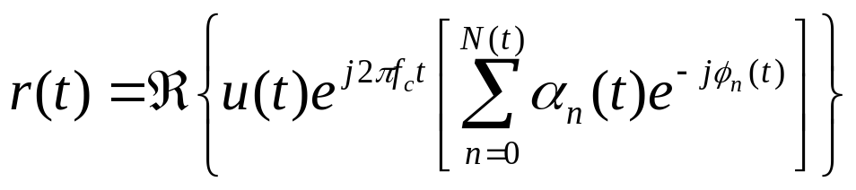
Review of Last Lecture
Model Parameters from Measurements
Random Multipath Model
Channel Impulse Response
  Many multipath components, Amplitudes change slowly, Phases change rapidly
For delay spread max|τ_{n}(t)-τ_{m}(t)|<<1/B, u(t)≈u(t-τ).
  Received signal given by
i
i
i
i
No signal distortion in time
Multipath yields complex scale factor in brackets
i
i
i

Slide 3
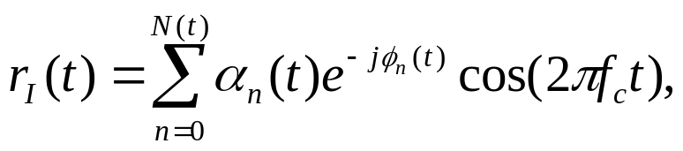
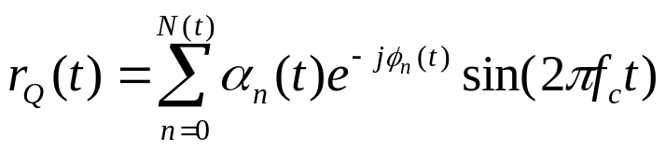

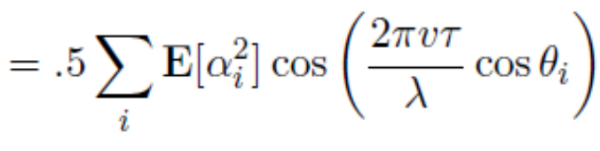

Review Continued:
Narrowband Model
For u(t)=e^{jφ0},
In-phase and quadrature signal components:
For N(t) large, r_{I}(t) & r_{Q}(t) jointly Gaussian by CLT
Received signal characterized by its mean, autocorrelation, and cross correlation. Let
If ϕ_{i}(t) uniform, in-phase/quad components are mean zero, independent, and stationary (WSS)
i
i
i
i
i
i
i
i
i
φ_{i}~U[0,2π]
E_{θi}

Slide 4
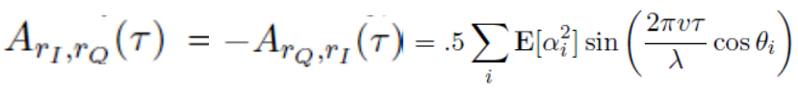

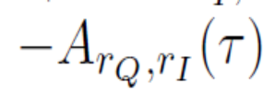
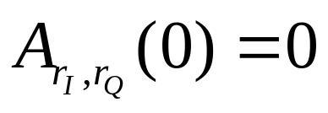
Cross Correlation
i
i
, φ_{i}~U[0,2π]
i
i
i
i
Cross Correlation of inphase/quad signal is
  Thus, , so r_{I}(t) and r_{Q}(t) independent
Autocorrelation of received signal is
Thus, r(t) is stationary (WSS)
E_{θi}

Slide 5

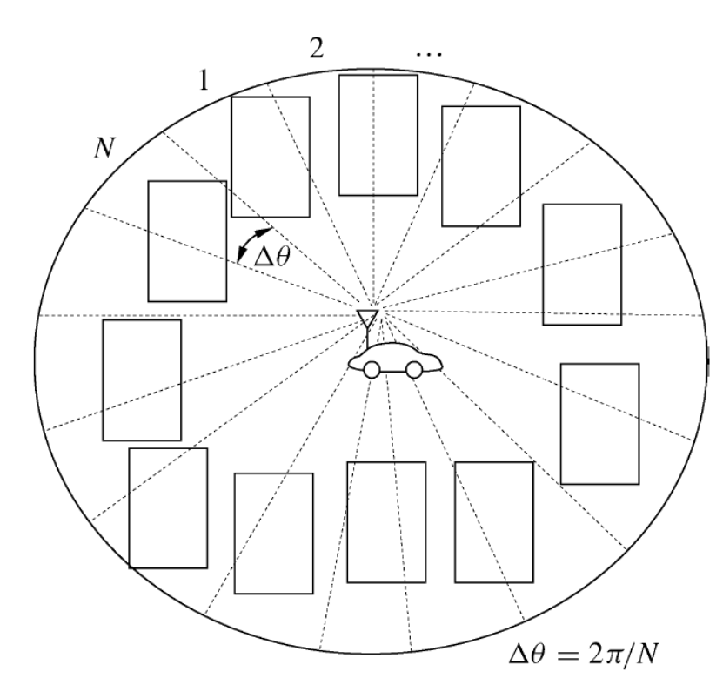
Uniform Scattering
Multipath comes uniformly from all directions
Power in each component is the same:

Slide 6
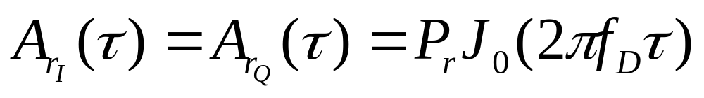
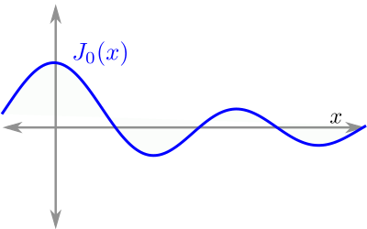
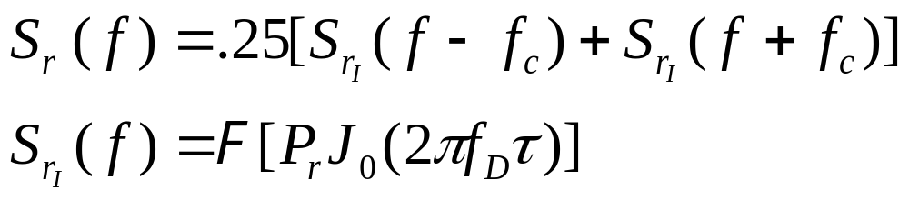
Autocorrelation and PSD under uniform scattering
Under uniform scattering, in phase and quad comps have no cross correlation and autocorrelation is
The PSD of received signal is
1
f_{D}=v/λ
vτ=d
.4λ
Decorrelates over roughly half a wavelength
S_{r}(f)
Used to generate simulation values
f_{c}-f_{D}
f_{c}
f_{c}+f_{D}

Slide 7
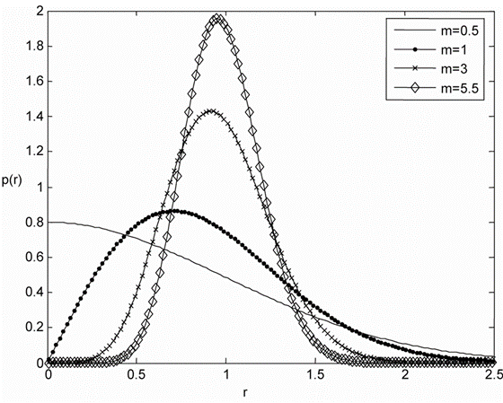
Signal Envelope Distribution
CLT approx. leads to Rayleigh distribution (power is exponential)
When LOS component present, Ricean distribution is used
Measurements support Nakagami distribution in some environments
  Similar to Ricean, but models “worse than Rayleigh”
  Lends itself better to closed form BER expressions

Slide 8




Wideband Channels
Individual multipath components resolvable
True when time difference between components exceeds signal bandwidth
Requires statistical characterization of c(τ,t)
  Assume CLT, stationarity and uncorrelated scattering
  Leads to simplification of its autocorrelation function
τ
τ
Narrowband
Wideband

Slide 9
Main Points
Narrowband model has in-phase and quad. comps that are zero-mean stationary Gaussian processes
  Auto and cross correlation depends on AOAs of multipath
Uniform scattering makes autocorrelation of inphase and quad comps of RX signal follow Bessel function
  Signal components decorrelate over half wavelength
  The PSD has a bowel shape centered at carrier frequency
Fading distribution depends on environment
  Rayleigh, Ricean, and Nakagami all common
Wideband channels have resolvable multipath
  Will statistically characterize c(τ,t) for WSSUS model

