Slide 1
EE359 – Lecture 9 Outline
Announcements:
  OHs today12:50-2pm and tomorrow 2:50-3:10 (in Thorton) and before class by appointment.
  Updated reader (Chapters 1-7) available today or tomorrow.
  Project proposals due midnight Friday; get early feedback
  Midterm Feb. 21, 2-4pm (food after), more details next week
    Email me/TA if you have a conflict
    Open book/notes. Covers through diversity. No HW that week.
    Over next week: propose dates for MT review, post practice MTs.
Linear Modulation Performance in AWGN
Q-Function representations
Probability of error in fading
Outage probability
Average P_{s} (P_{b})

Slide 2
Review of Last Lecture
Capacity in Flat-Fading: γ known at TX/RX
    Optimal Adaptation: Power: 1/γ₀-1/γ, Rate: Blog₂(γ/γ₀); Depend on p(γ) only through γ₀
    Channel Inversion and Truncated Inversion
      Received SNR constant; Capacity is Blog₂(1+σ) above an outage level associated with truncation
Capacity of ISI channels
  Divide wideband channel into narrowband flat-fading subchannels of bandwidth B approximately equal to B_{c}
    Each subchannel has NB fading approx. independent from others
  Water-filling of power over freq; or time and freq.
1/|H(f)|²
Total Power
1/γ₀
P(f_{i})
B_{c}
1/|H(f_{i})|²
f
f_{i}

Slide 3
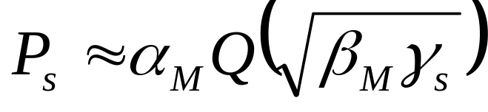
Linear Digital Modulation
Signal over ith symbol period:
  Pulse g(t) typically Nyquist, assumed square
  Signal constellation defined by (s_{i1},s_{i2}) pairs
    M values for (s_{i1},s_{i2})⇒log₂ M bits per symbol
    We focus on MPSK and MQAM
    MPSK can be differentially encoded
For MQAM and MPSK, P_{s} depends on
  Minimum distance d_{min} (depends on γ_{s})
  # of nearest neighbors α_{M}
  Approximate expression:
    Standard/alternate Q function

Slide 4
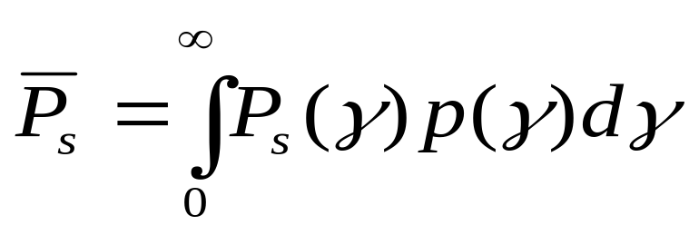
Linear Modulation in Fading
In fading γ_{s} and therefore P_{s} random
Performance metrics:
  Outage probability: p(P_{s}>P_{target})=p(γ<γ_{target})
  Average P_{s} , P_{s}:
  Combined outage and average P_{s}

Slide 5
Outage Probability
T_{s}
P_{s}
Outage
P_{s(target)}
t or d
Probability that P_{s} is above target
Equivalently, probability γ_{s} below target
Used when T_{c}>>T_{s}

Slide 6
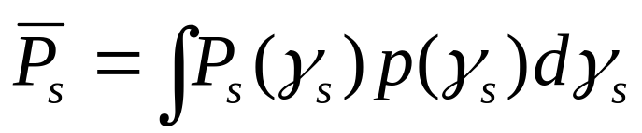
Average P_{s}
T_{s}
P_{s}
P_{s}
t or d
Expected value of random variable P_{s}
Used when T_{c}~T_{s}
Error probability much higher than in AWGN alone
Rarely obtain average error probability in closed form
  Probability in AWGN is Q-function, double infinite integral

Slide 7
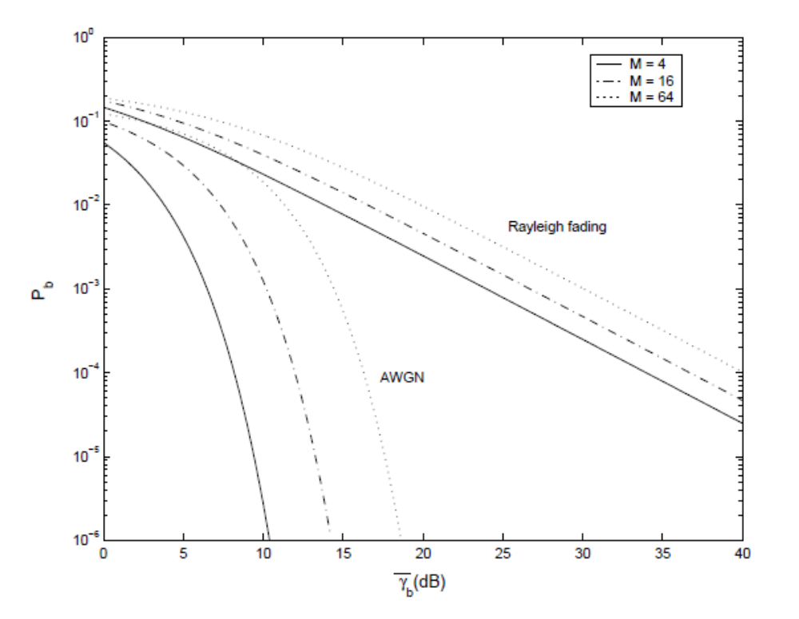
Average Probability of Error (MQAM)
Fading severely degrades performance

Slide 8
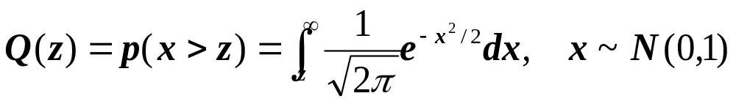
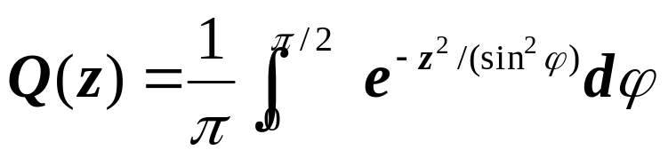
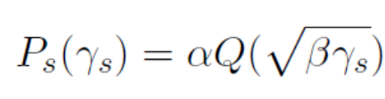
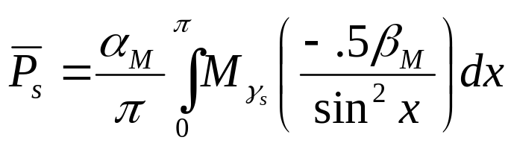
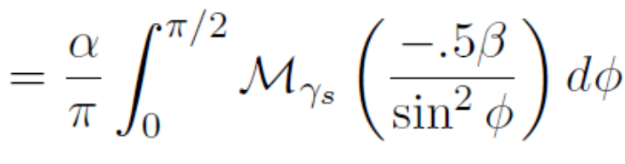
Alternate Q Function Analysis
Traditional Q function representation
  Infinite integrand, argument in integral limits
  Average P_{e} entails infinite integral over Q(z)
Craig’s representation:
  Very useful in fading and diversity analysis
    AWGN formula:
    Fading formula:
≅
M_{γs} is MGF of fading pdf of γ_{s}; α,β, depend on modulation*
≅
*current reader has -.5β=g notation

Slide 9
Main Points
P_{s} approximation in AWGN:
  For MPSK, MQAM
In fading P_{s} is a random variable, characterized by average value, outage, or combined outage/average
Fading greatly increases average P_{s} or required power for a given target P_{s} with some outage
  Outage probability based on target SNR in AWGN.
Need to combat flat fading or waste lots of power

