Slide 1
EE 359: Wireless Communications
Advanced Topics in Wireless
Dec. 7, 2017

Slide 2







Future Wireless Networks
Ubiquitous Communication Among People and Devices
Next-Gen Cellular/WiFi
Smart Homes/Spaces
Autonomous Cars
Smart Cities
Body-Area Networks
Internet of Things
All this and more …

Slide 3
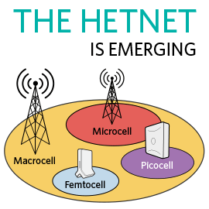



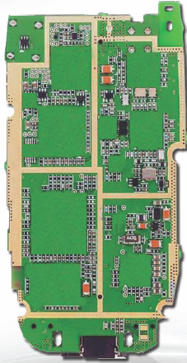
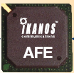
Challenges
5G
AdHoc
Network Challenges
  High performance
  Extreme energy efficiency
  Scarce/bifurcated spectrum
  Heterogeneous networks
  Reliability and coverage
  Seamless internetwork handoff
Device/SoC Challenges
  Performance
  Complexity
  Size, Power, Cost
  High frequencies/mmWave
  Multiple Antennas
  Multiradio Integration
  Coexistance
Short-Range
BT
Radio
Cellular
GPS
Cog
Mem
WiFi
CPU
mmW

Slide 4
Emerging Systems
New cellular system architectures
mmWave/massive MIMO communications
Software-defined network architectures
Ad hoc/mesh wireless networks
Cognitive radio networks
Wireless sensor networks
Energy-constrained radios
Distributed control networks
Chemical Communications
Applications of Communications in Health, Bio-medicine, and Neuroscience

Slide 5
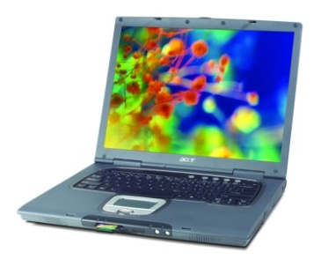
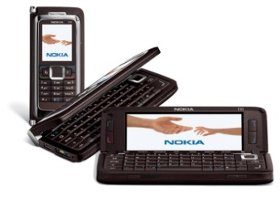



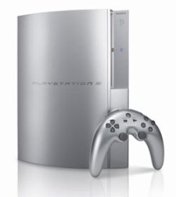
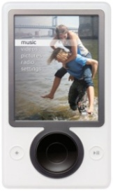
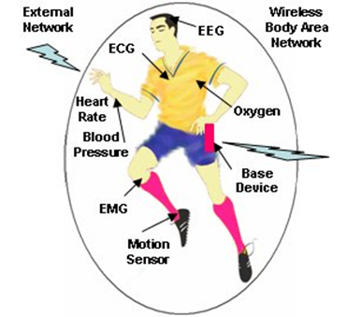

Future Cell Phones
Everything wireless in one device
Burden for this performance is on the backbone network
San Francisco
BS
BS
LTE backbone is the Internet
Internet
Boston
N^{th}-Gen
Cellular
Phone
System
N^{th}-Gen
Cellular
BS
Much better performance and reliability than today
- Gbps rates, low latency/energy , 99.999% coverage

Slide 6
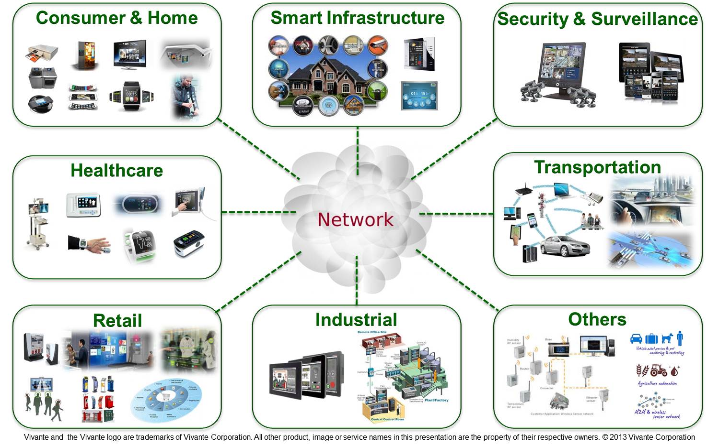
What is the Internet of Things:
Enabling every electronic device to be connected to each other and the Internet
Includes smartphones, consumer electronics, cars, lights, clothes, sensors, medical devices,…
Value in IoT is data processing in the cloud
Different requirements than smartphones: low rates/energy consumption

Slide 7
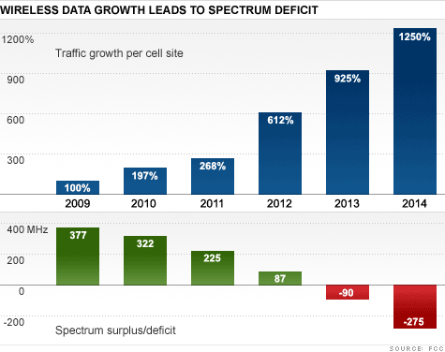



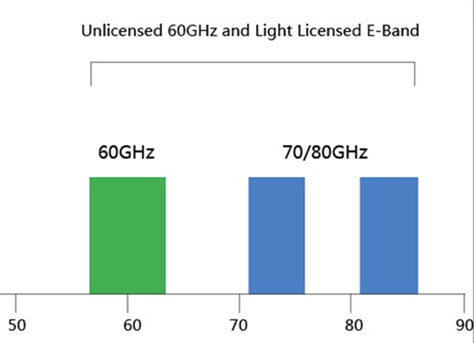
The Licensed Airwaves are “Full”
Also have Wifi
Exponential Growth in Data Demand
Leading to massive spectrum deficit
And mmWave
⬅10s of GHz of Spectrum➔
Source: FCC
Notes:
Spectrum Deficit =>
Small Cells for Cellular Capacity enhancement
WiFi Data Offload to complement available Cellular Spectrum

Slide 8
Enablers for increasing wireless data rates
More spectrum (mmWave)
(Massive) MIMO
Innovations in cellular system design
Software-defined wireless networking

Slide 9
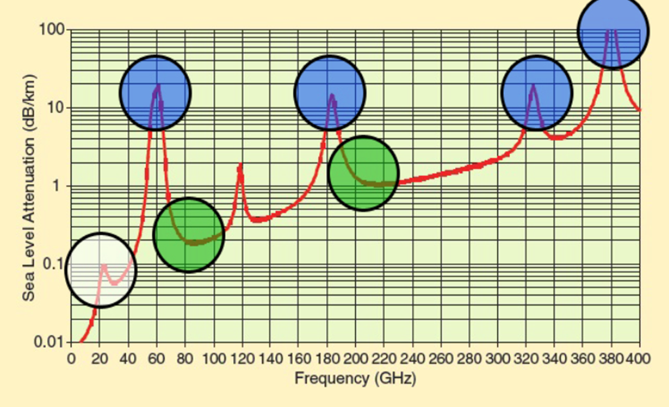
mmW as the next spectral frontier
Large bandwidth allocations, far beyond the 20MHz of 4G
Rain and atmosphere absorption not a big issue in small cells
  Not that high at some frequencies; can be overcome with MIMO
Need cost-effective mmWave CMOS; products now available
Challenges: Range, cost, channel estimation, large arrays

Slide 10

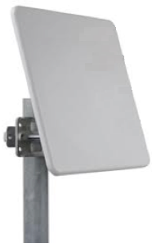

What is Massive MIMO?
Dozens of devices
Hundreds of
BS antennas
A very large antenna array at each base station
  An order of magnitude more antenna elements than in conventional systems
A large number of users are served simultaneously
An excess of base station (BS) antennas
Essentially multiuser MIMO with lots of base station antennas
T. L. Marzetta, “Noncooperative cellular wireless with unlimited numbers of base station
antennas,” IEEE Trans. Wireless Commun., vol. 9, no. 11, pp. 3590–3600, Nov. 2010.

Slide 11


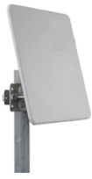
mmWave Massive MIMO
⬅10s of GHz of Spectrum➔
Dozens of devices
Hundreds
of antennas
mmWaves have large attenuation and path loss
For asymptotically large arrays with channel state information, no attenuation, fading, interference or noise
mmWave antennas are small: perfect for massive MIMO
Bottlenecks: channel estimation and system complexity
Non-coherent design holds significant promise

Slide 12
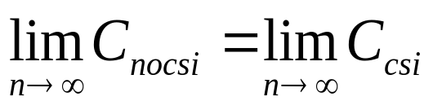
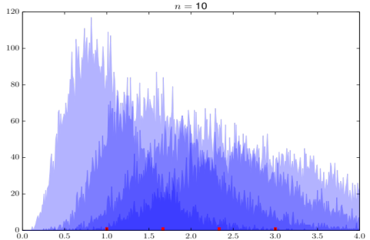
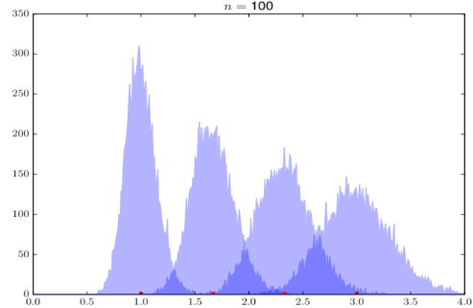
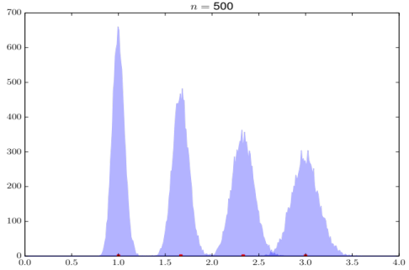
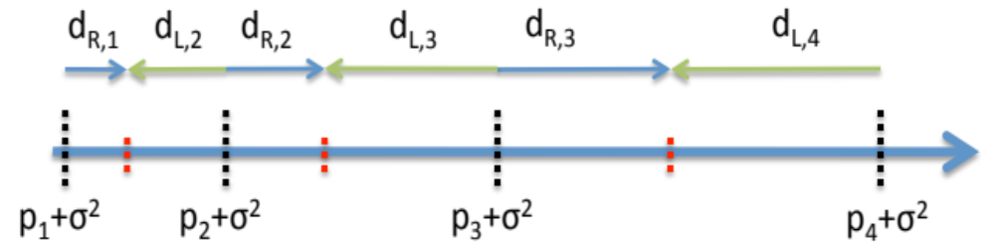
Non-coherent massive MIMO
Propose simple energy-based modulation
No capacity loss for large arrays:
  Holds for single/multiple users (1 TX antenna, n RX antennas)
Constellation optimization: unequal spacing

Slide 13
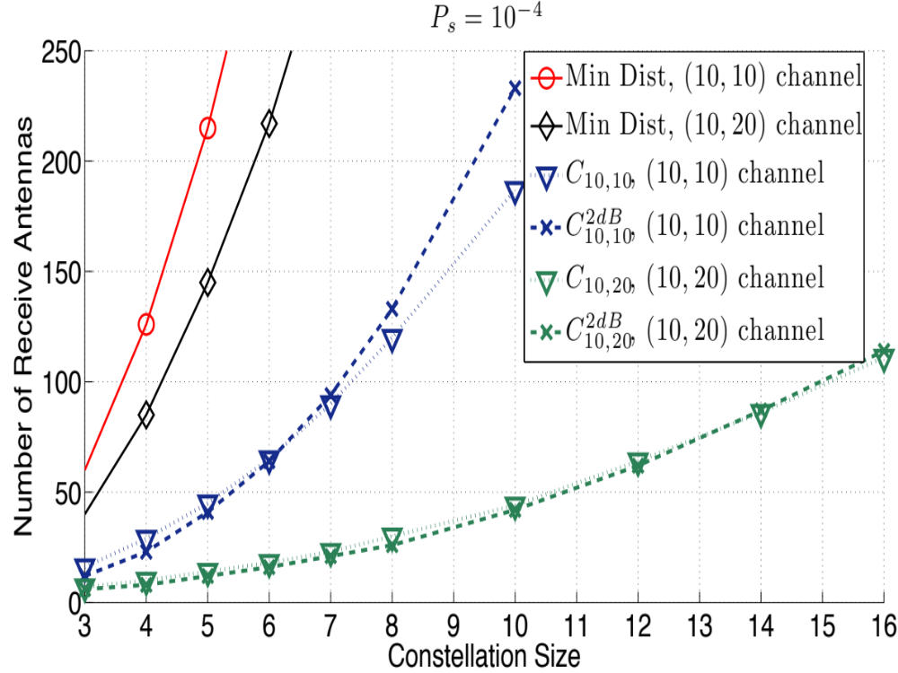
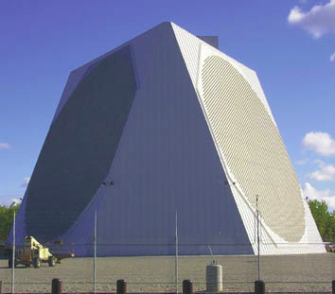
Need 50-100 antennas for an SER of 10⁻⁴
Depending on data rate requirements
Minimum Distance Design criterion: Significantly worse performance than the new designs.
Design robust to channel uncertainty
Noncoherent communication demonstrates promising performance with reasonably-sized arrays

Slide 14
Rethinking Cellular System Design
Cooperating
Transmitters
How should cellular
systems be designed?
Small
Cell
Massive
MIMO
Relay
Dynamic
Access
Will gains be big or
incremental; in capacity,
coverage or energy?
Distributed
Antennas
Traditional cellular design assumes system is “interference-limited”
No longer the case with recent technology advances:
  MIMO, multiuser detection, cooperating BSs (CoMP) and relays
Raises interesting questions such as “what is a cell?”
Energy efficiency via distributed antennas, small cells, MIMO, and relays
Dynamic self-organization (SoN) needed for deployment and optimization

Slide 15

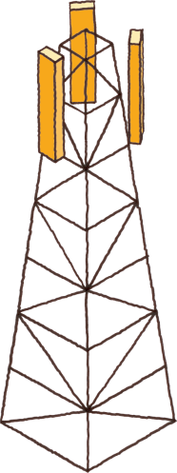

Small cells are the solution to increasing cellular system capacity
In theory, provide exponential capacity gain
SoN
Server
Future cellular networks will be hierarchical
  Large cells for coverage
  Small cells for capacity and power efficiency
  Small cells require self-optimization in the cloud
IP Network
X2
X2
SW
Agent
Small Cell Challenges
  SoN algorithmic complexity
  Distributed vs centralized control
  Backhaul and site acquisition
X2
X2
Small cell BS
Macrocell BS

Slide 16



WiFi is the small cell of today
Primary access mode in residences, offices, and
wherever you can get a WiFi signal
Lots of spectrum, excellent PHY design
The Big Problem with WiFi
The WiFi standard lacks good mechanisms to mitigate interference in dense AP deployments
  Static channel assignment, power levels, and carrier sense thresholds
  In such deployments WiFi systems exhibit poor spectrum reuse and significant contention among APs and clients
  Result is low throughput and a poor user experience

Slide 17


Why not use SoN for WiFi?
all wireless networks?
Vehicle networks
SoN
Server
mmWave networks
TV White Space &
Cognitive Radio

Slide 18
Software-Defined Network Architecture
(generalization of NFV, SDN, cloud-RAN, and distributed cloud)
App layer
Cloud Computing
Video
Security
Vehicular
Networks
M2M
Health
Freq.
Allocation
Power
Control
Self
Healing
ICIC
QoS
Opt.
CS
Threshold
Network Optimization
UNIFIED CONTROL PLANE
HW layer
Distributed Antennas
WiFi
Cellular
mmWave
…
Ad-Hoc
Networks

Slide 19
SDWN Challenges
Algorithmic complexity
  Frequency allocation alone is NP hard
  Also have MIMO, power control, CST, hierarchical networks: NP-really-hard
  Advanced optimization tools needed, including a combination of centralized (cloud) distributed, and locally centralized (fog) control
Hardware Interfaces
Seamless handoff
Resource pooling
Cloud Optimization
Fog
Optimization
X2
X2
X2
X2
Small cell BS
Macrocell BS

Slide 20
New PHY and MAC Techniques
New Waveforms
  Robust to rapidly changing channels (OTFS)
  More flexible and efficient subcarrier allocation (variants of OFDM)
Coding
  Incremental research (polar vs. LDPC), no new breakthroughs
Access
  Efficient access for low-rate IoT Devices (sparse code MAC, GFDM, OTFS, variants of OFDMA)
  Access/interference mitigation for unlicensed LTE

Slide 21
Ad-Hoc Networks
Peer-to-peer communications
  No backbone infrastructure or centralized control
Routing can be multihop.
Topology is dynamic.
Fully connected with different link SINRs
Open questions
  Fundamental capacity region
  Resource allocation (power, rate, spectrum, etc.)
  Routing
Notes:
-No backbone: nodes must self-configure into a network.
-In principle all nodes can communicate with all other nodes, but multihop routing can reduce the interference associated with direct transmission.
-Topology dynamic since nodes move around and link characteristics change.
-Applications: appliances and entertainment units in the home, community networks that bypass the Internet. Military networks for robust flexible easily-deployed network (every soldier is a node).

Slide 22
Cooperation in
Wireless Networks
Many possible cooperation strategies:
  Virtual MIMO, relaying (DF, CF, AF), one-shot/iterative conferencing, and network coding
  Nodes can use orthogonal or non-orthogonal channels.
  Many practice and theoretical challenges
  New full duplex relays can be exploited

Slide 23
General Relay Strategies
TX1
RX1
X₁
Y₄=X₁+X₂+X₃+Z₄
relay
Y₃=X₁+X₂+Z₃
X₃= f(Y₃)
Y₅=X₁+X₂+X₃+Z₅
X₂
TX2
RX2
Can forward message and/or interference
  Relay can forward all or part of the messages
    Much room for innovation
  Relay can forward interference
    To help subtract it out

Slide 24
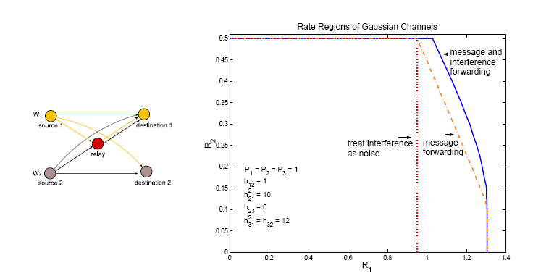
Beneficial to forward both interference and message
For large powers, this strategy approaches capacity

Slide 25
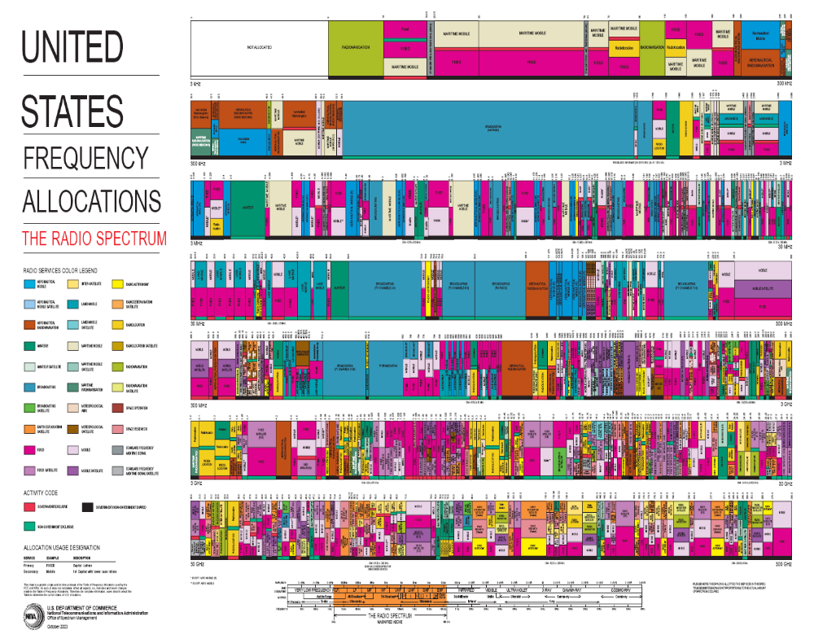
Spectrum innovations beyond licensed/unlicensed paradigms

Slide 26
Cognitive Radios
I_{P}
CRTx
CRRx
NCR
NCR
CR
CR
NCRTx
NCRRx
MIMO Cognitive Underlay
Cognitive Overlay
Cognitive radios support new users in existing crowded spectrum without degrading licensed users
  Utilize advanced communication and DSP techniques
  Coupled with novel spectrum allocation policies
Multiple paradigms
  (MIMO) Underlay (interference below a threshold)
  Interweave finds/uses unused time/freq/space slots
  Overlay (overhears/relays primary message while cancelling interference it causes to cognitive receiver)

Slide 27
“Green” Wireless Networks
Pico/Femto
How should wireless
systems be redesigned
for minimum energy?
Coop
MIMO
Relay
Research indicates that
significant savings is possible
DAS
Drastic energy reduction needed (especially for IoT)
  New Infrastuctures: Cell Size, BS/AP placement, Distributed Antennas (DAS), Massive MIMO, Relays
  New Protocols: Coop MIMO, RRM, Sleeping, Relaying
  Low-Power (Green) Radios: Radio Architectures, Modulation, Coding, Massive MIMO

Slide 28
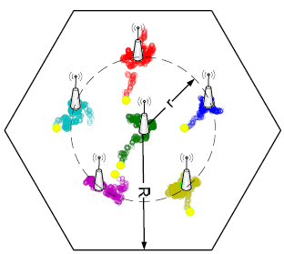
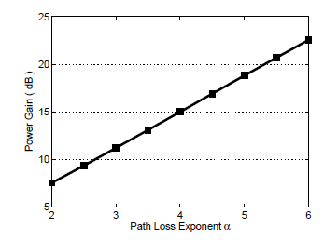
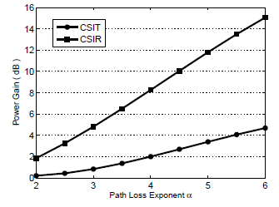
DAS to minimize energy
Optimize distributed BS antenna location
Primal/dual optimization framework
Convex; standard solutions apply
For 4+ ports, one moves to the center
Up to 23 dB power gain in downlink
  Gain higher when CSIT not available
6 Ports
3 Ports

Slide 29
Energy-Constrained Radios
Transmit energy minimized by sending bits very slowly
  Leads to increased circuit energy consumption
Short-range networks must consider both transmit and processing/circuit energy.
  Sophisticated encoding/decoding not always energy-efficient.
  MIMO techniques not necessarily energy-efficient
  Long transmission times not necessarily optimal
  Multihop routing not necessarily optimal
Sub-Nyquist Sampling
Notes:
All the sophisticated high-performance communication techniques developed since WW2 may need to be thrown out the window.
By cooperating, nodes can save energy

Slide 30
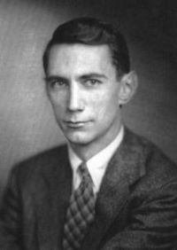




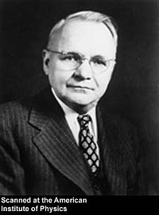
Sub-Nyquist Sampled Channels
Analog Channel
Message
Encoder
Decoder
Message
Wideband systems may preclude Nyquist-rate sampling!
C. Shannon
Sub-Nyquist sampling well explored in signal processing
    Landau-rate sampling, compressed sensing, etc.
    Performance metric: MSE
H. Nyquist
We ask: what is the capacity-achieving sub-Nyquist sampler and communication design

Slide 31


















Capacity and Sub-Nyquist Sampling
Consider linear time-invariant sub-sampled channels
Preprocessor
Theorem: Capacity-achieving sampler
zzzzzzzzzz
zzzzzzzzzz
or
    Optimal filters suppress aliasing
  Sub-Nyquist sampling is optimal for some channels!

Slide 32



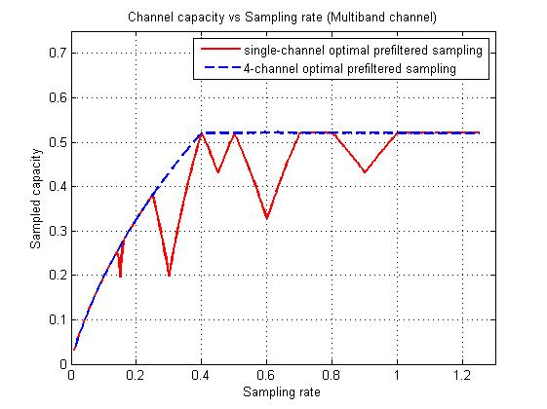
Example: Multiband Channel
Consider a “sparse” channel, and an optimally designed 4-branch filter bank sampler
Outperforms single-branch sampling.
Achieves full-capacity above Landau Rate
Landau Rate: sum of total bandwidths

Slide 33
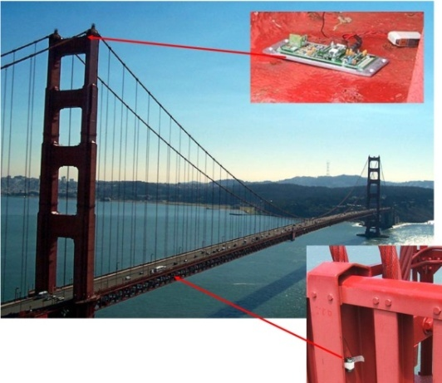
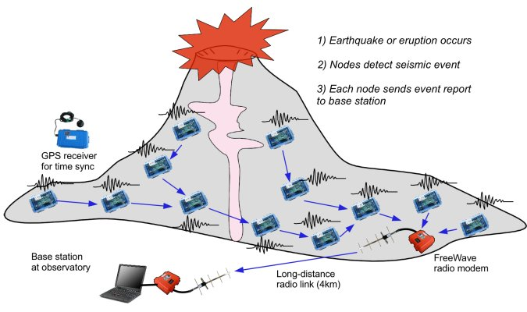
Wireless Sensor Networks
Data Collection and Distributed Control
Smart homes/buildings
Smart structures
Search and rescue
Homeland security
Event detection
Battlefield surveillance
Energy (transmit and processing) is the driving constraint
Data flows to centralized location (joint compression)
Low per-node rates but tens to thousands of nodes
Intelligence is in the network rather than in the devices

Slide 34

Where should energy come from?
Batteries and traditional charging mechanisms
  Well-understood devices and systems
Wireless-power transfer
  Poorly understood, especially at large distances and with high efficiency
Communication with Energy Harvesting Radios
  Intermittent and random energy arrivals
  Communication becomes energy-dependent
  Can combine information and energy transmission
  New principles for radio and network design needed.

Slide 35

Distributed Control over Wireless
Automated Vehicles
- Cars
- Airplanes/UAVs
- Insect flyers
  Interdisciplinary design approach
    Control requires fast, accurate, and reliable feedback.
    Wireless networks introduce delay and loss
    Need reliable networks and robust controllers
    Mostly open problems
: Many design challenges

Slide 36
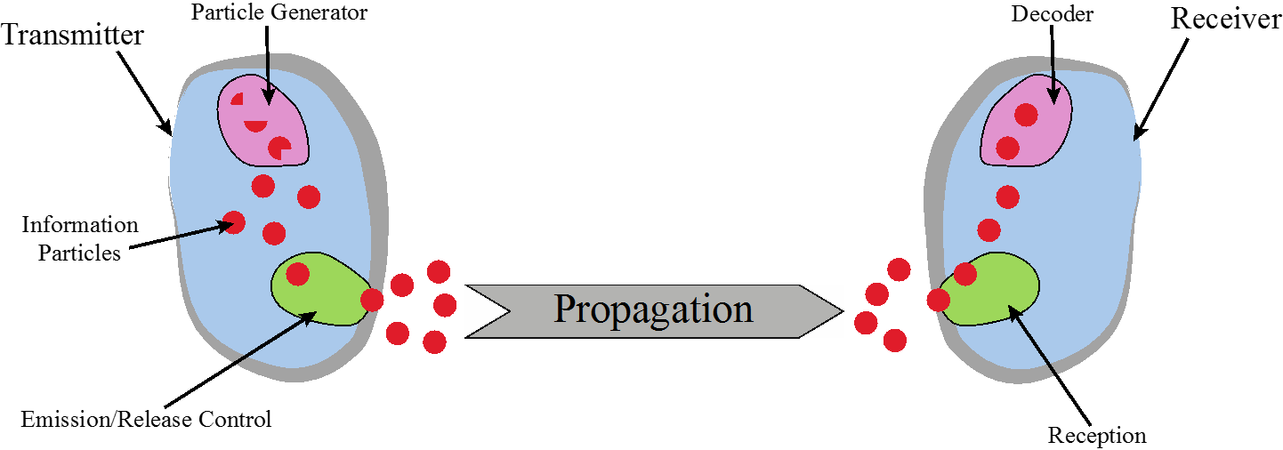
Chemical Communications
Can be developed for both macro (>cm) and micro (<mm) scale communications
Greenfield area of research:
  Need new modulation schemes, channel impairment mitigation, multiple acces, etc.

Slide 37
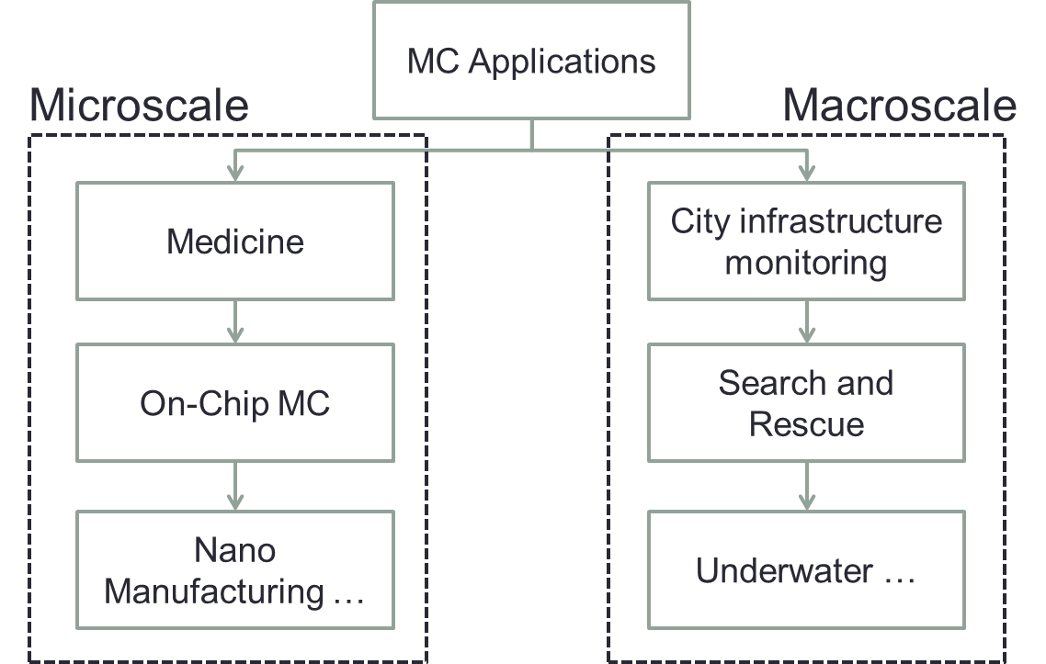

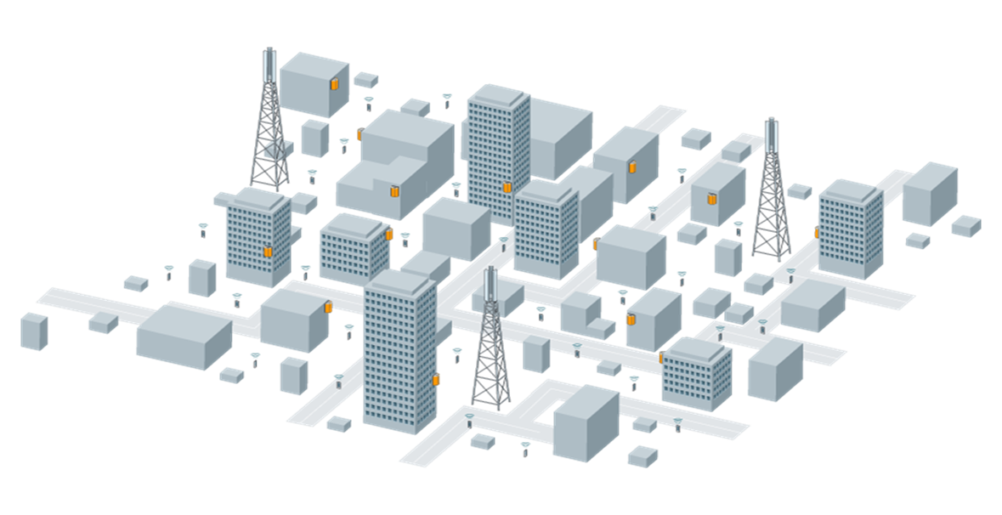

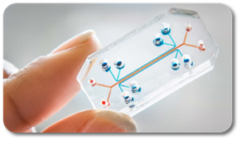
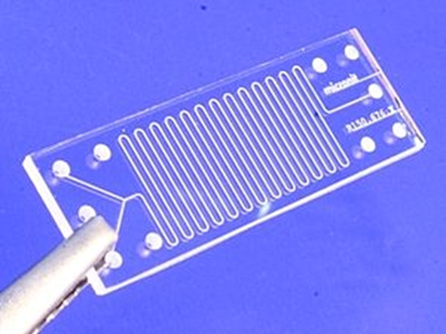


Applications
Data rate: .5 bps
“fan-enhanced” channel

Slide 38
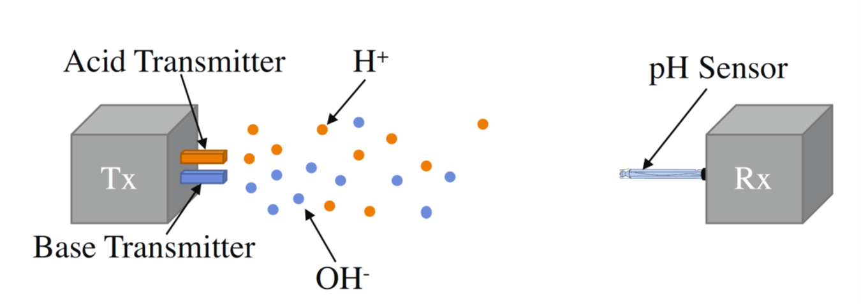
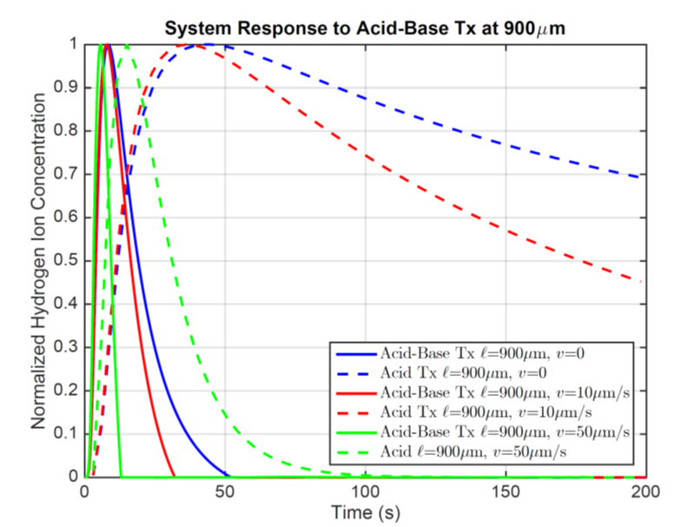
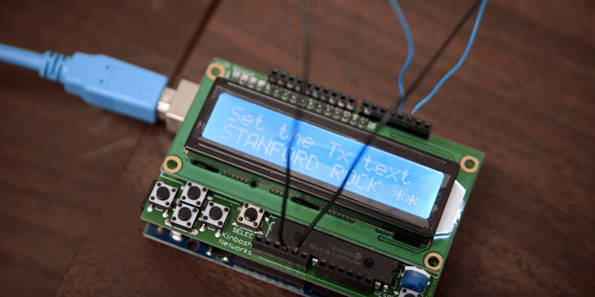
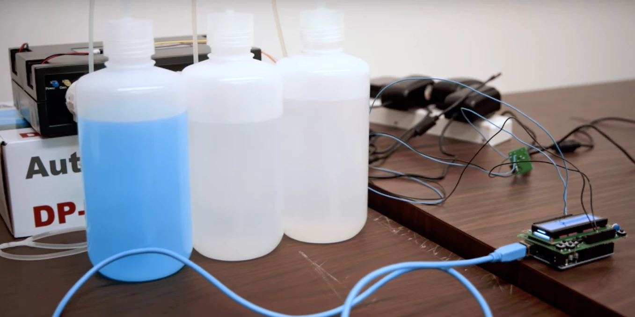
Current Work
Slow dissipation of chemicals leads to ISI
Can use acid/base transmission to decrease ISI
Similar ideas can be applied for multilevel modulation and multiuser techniques
Currently testing in our lab
  New equalization based on machine learning
  Increased data rate 10x
Sending text messages with windex and vinegar
Stanford Report:
November 15, 2016

Slide 39


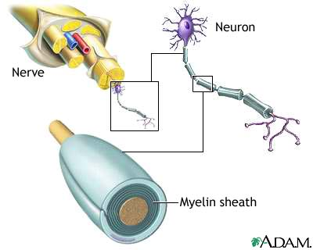
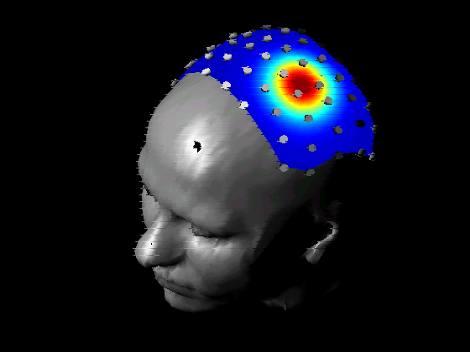
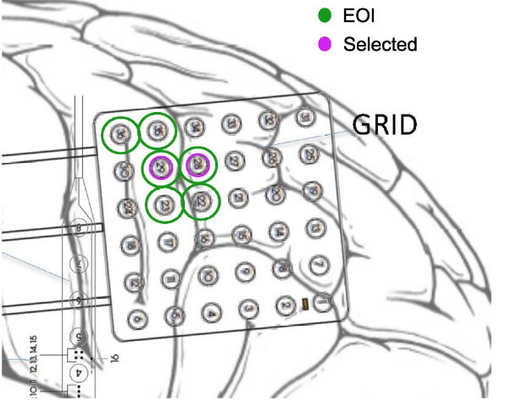
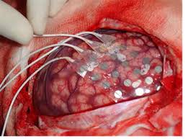
Applications in Health,
Biomedicine and Neuroscience
Neuroscience
Nerve network (re)configuration
EEG/ECoG signal processing
Signal processing/control for deep brain stimulation
SP/Comm applied to bioscience
Body-Area
Networks
Recovery from Nerve Damage
ECoG Epileptic Seizure Localization
EEG
ECoG

Slide 40
Epileptic Seizure Focal Points
Seizure caused by an oscillating signal moving across neurons
  When enough neurons oscillate, a seizure occurs
  Treatment “cuts out” signal origin: errors have serious implications
Directed mutual information spanning tree algorithm applied to ECoG measurements estimates the focal point of the seizure
Application of our algorithm to existing data sets on 3 patients matched well with their medical records
ECoG
Data

Slide 41
Summary
The next wave in wireless technology is upon us
  This technology will enable new applications that will change people’s lives worldwide
Future wireless networks must support high rates for some users and extreme energy efficiency for others
  Small cells, mmWave massive MIMO, Software-Defined Wireless Networks, and energy-efficient design key enablers.
Communication tools and modeling techniques may provide breakthroughs in other areas of science

Slide 42

The End
Thanks!!!
Good luck on the final and final project
Have a great winter break
Unless you are studying for quals – if so, good luck!

