Slide 1
Midterm Review
Midterm only covers material from lectures and HWs
Overview of Wireless Systems:
  Nothing from Chapter 1 is on the MT
Signal Propagation and Channel Models
  Chapter 2.1-2.4, 2.6-2.10
Modulation and Performance Metrics
  Chapter 3.1,3.2.1-3.2.2, 3.3
Fundamental Capacity Limits
  Chapter 4
Impact of Channel on Performance
  Chapter 6
Diversity Techniques
  Chapter 7.1,7.2.1-7.2.2,7.2.4,7.3.1,7.4.1

Slide 2




Future Wireless Networks
Not on MT
Ubiquitous Communication Among People and Devices
Wireless Internet access
Nth generation Cellular
Wireless Ad Hoc Networks
Sensor Networks
Wireless Entertainment
Smart Homes/Spaces
Automated Highways
All this and more…
Hard Delay/Energy Constraints
Hard Rate Requirements

Slide 3
Design Challenges
Not on MT
Wireless channels are a difficult and capacity-limited broadcast communications medium
Traffic patterns, user locations, and network conditions are constantly changing
Applications are heterogeneous with hard constraints that must be met by the network
Energy, delay, and rate constraints change design principles across all layers of the protocol stack

Slide 4
Current/Futre Wireless Systems
Not on MT
Current Systems
  4G Cellular Systems
  802.11b/a/n/ac Wireless LANs
  Satellite Systems
  Paging Systems
  Bluetooth
  Zigbee radios
Emerging Systems (Can cover in bonus lecture)
  Ad hoc/mesh wireless networks
  Cognitive radio networks
  Wireless sensor networks
  Energy-harvesting radios
  Distributed control networks
  Communications/SP in Health, Bio-medicine, and Neuroscience

Slide 5

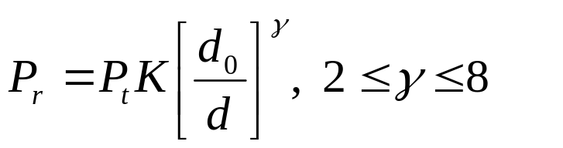
Signal Propagation
Path Loss
  Free space, 2-path,…
  Simplified model
Shadowing
  dB value is Gaussian
  Find path loss exponent and shadow STD by curve fitting
Multipath
  Ray tracing
  Statistical model
d
P_{r}/P_{t}
d=vt

Slide 6

Outage Probability and Cell Coverage Area
Path loss: circular cells
Path loss+shadowing: amoeba cells
  Tradeoff between coverage and interference
Outage probability
  Probability received power below given minimum
Cell coverage area
  % of cell locations at desired power
  Increases as shadowing variance decreases
  Large % indicates interference to other cells

Slide 7

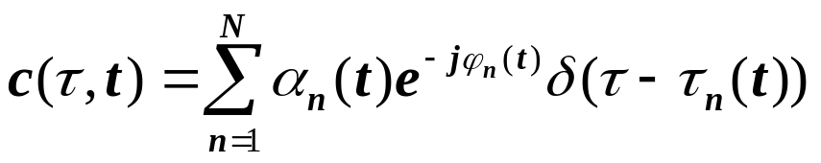
Statistical Multipath Model
Random # of multipath components, each with varying amplitude, phase, doppler, and delay
Leads to time-varying channel impulse response
Narrowband channel
  No signal distortion, just a complex amplitude gain
  Signal amplitude varies randomly (Rayleigh, Ricean, Nakagami).
  2nd order statistics (Bessel function), Average fade duration

Slide 8




Wideband Channels
Individual multipath components resolvable
True when time difference between components exceeds signal bandwidth
Scattering function
  Yields delay spread/coherence BW (σ_{τ}~1/B_{c})
  Yields Doppler spread/coherence time (B_{d}~1/T_{c})
τ
A_{c}(f)
Wideband
0
f
Bc
ρ
Doppler Power Spectrum
s(τ,ρ)=F_{Δt}[A_{c}(τ,Δt)]
τ
Delay Power Spectrum

Slide 9
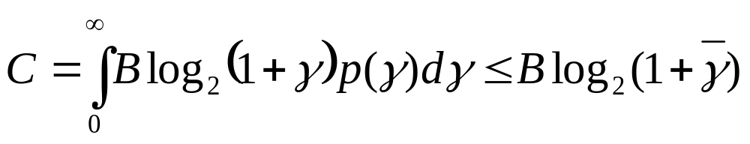
Capacity of Flat Fading Channels
Channel Capacity
  Maximum data rate that can be transmitted over a channel with arbitrarily small error
Capacity of AWGN Channel: Blog₂[1+γ] bps
  γ=P_{r}/(N₀B) is the receiver SNR
Capacity of Flat-Fading Channels
  Nothing known: capacity typically zero
  Fading Statistics Known (few results)
  Fading Known at RX (average capacity)

Slide 10
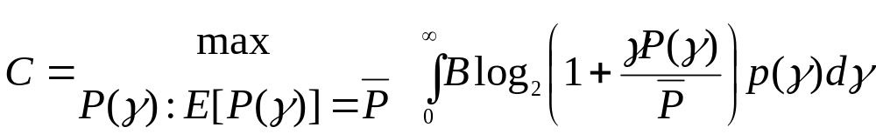
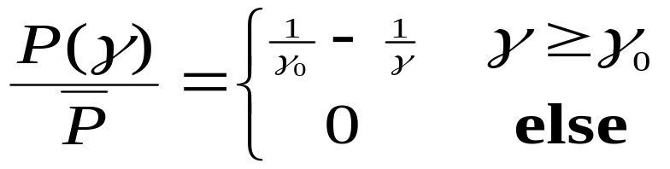

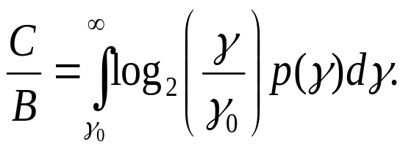
Capacity in Flat-Fading: γ known at TX/RX
Optimal Rate and Power Adaptation
The instantaneous power/rate only depend on p(γ) through γ₀
Waterfilling
1
γ
γ₀
γ

Slide 11
Channel Inversion
Fading inverted to maintain constant SNR
Simplifies design (fixed rate)
Greatly reduces capacity
  Capacity is zero in Rayleigh fading
Truncated inversion
  Invert channel above cutoff fade depth
  Constant SNR (fixed rate) above cutoff
  Cutoff greatly increases capacity
    Close to optimal

Slide 12
Frequency Selective
Fading Channels
For time-invariant channels, capacity achieved by water-filling in frequency
Capacity of time-varying channel unknown
Approximate by dividing into subbands
  Each subband has width B_{c}
  Independent fading in each subband
  Capacity is the sum of subband capacities
1/|H(f)|²
P
B_{c}
f

Slide 13
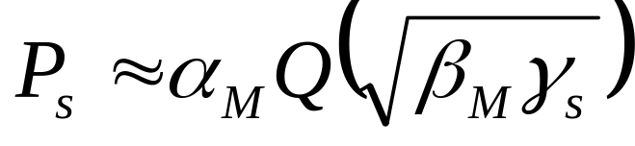
Linear Modulation in AWGN: MPSK and MQAM
ML detection induces decision regions
  Example: 8PSK
P_{s} depends on
  # of nearest neighbors
  Minimum distance d_{min} (depends on γ_{s})
  Approximate expression
d_{min}

Slide 14
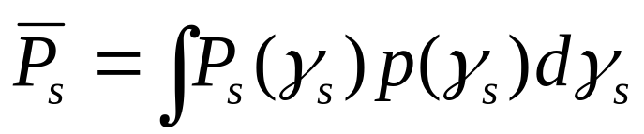
Linear Modulation in Fading
In fading γ_{s} and therefore P_{s} random
Metrics: outage, average P_{s} , combined outage and average.
T_{s}
P_{s}
Outage
P_{s(target)}
P_{s}
T_{s}

Slide 15
Moment Generating
Function Approach
Simplifies average P_{s} calculation
Uses alternate Q function representation
P_{s} reduces to MGF of γ_{s} distribution
Closed form or simple numerical calculation for general fading distributions
Fading greatly increases average P_{s} .

Slide 16
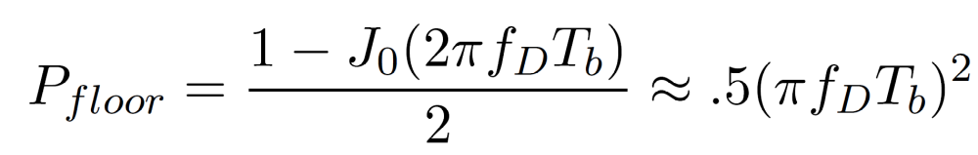
Doppler Effects
High doppler causes channel phase to decorrelate between symbols
Leads to an irreducible error floor for differential modulation
  Increasing power does not reduce error
Error floor depends on f_{D}T_{b} as

Slide 17
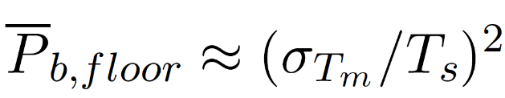
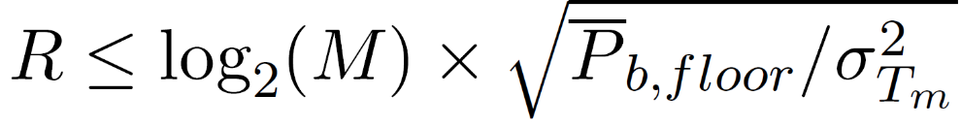
Delay Spread (ISI) Effects
Delay spread exceeding a symbol time causes ISI (self interference).
ISI leads to irreducible error floor:
  Increasing signal power increases ISI power
ISI imposes data rate constraint: T_{s}>>T_{m} (R_{s}<<B_{c})
1
2
4
Delay T_{m}
0
T_{s}
T_{m}
3
5

Slide 18
Diversity
Send bits over independent fading paths
  Combine paths to mitigate fading effects.
Independent fading paths
  Space, time, frequency, polarization diversity.
Combining techniques
  Selection combining (SC)
  Maximal ratio combining (MRC)
Can have diversity at TX or RX
  In TX diversity, weights constrained by TX power

Slide 19
Selection Combining
Selects the path with the highest gain
Combiner SNR is the maximum of the branch SNRs.
CDF easy to obtain (Π_{i}p(γ_{i}<γ_{thr})), pdf found by differentiating the CDF
P_{out} obtained from CDF. Average P_{s} typically found numerically
Diminishing returns with number of antennas.
Can get up to about 20 dB of gain.

Slide 20
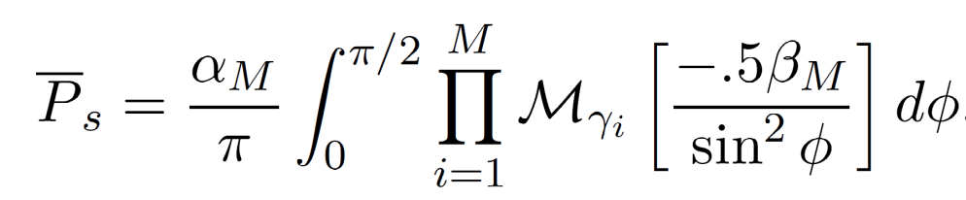
MRC and its Performance
With MRC, γ_{Σ}=Σγ_{i} for branch SNRs γ_{i}
  Optimal technique to maximize output SNR
  Yields 20-40 dB performance gains
  Distribution of γ_{Σ} hard to obtain
Standard average BER calculation
  Hard to obtain in closed form
  Integral often diverges
MGF Approach:
TX diversity gain with CSI same as RX diversity
s
s
s

Slide 21
Main Points
Wireless channels introduce path-loss, shadowing and multipath fading
  Shadowing introduced outage
  Flat-fading causes large power fluctuations
  ISI causes self-interference
Performance of digital communications in wireless channels random
  Characterized by outage probability and average probability of error in flat-fading
  Characterized by irreducible error floors in ISI/Doppler
Need mechanisms to compensate for multipath
Diversity compensates for effects of flat fading.

