Slide 1
EE359 – Lecture 10 Outline
Announcements:
  Project proposals due tomorrow midnight (post, email link)
  Midterm will be Nov. 9 6-8pm
    No HW that week, may extend next week’s HW deadline
    Exam open book/notes, covers thru Chp. 7.
    Midterm review date/timeTBD. Brief in-class summary as well
    SCPD students can take exam on campus or remotely
    More MT announcements next week (practice MTs)
MGF approach for average P_{s}
Combined average and outage P_{s}
Doppler and delay spread effect on error probability
Introduction to diversity
Combining techniques

Slide 2
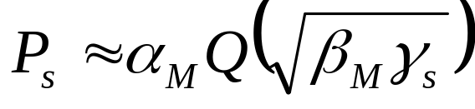
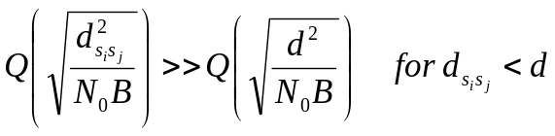
Review of Last Lecture
Focus on linear modulation
P_{s} approximation in AWGN:
  Nearest neighbor error dominates
Probability of error in fading is random
  Characterized by outage, average Ps, combination
Outage probability
  Probability P_{s} is above target; Probability γ_{s} below target
Fading severely degrades performance
Correction to
board lecture
T_{s}
P_{s}
Outage
P_{s(target)}
  Used when T_{c}>>T_{s}
t or d

Slide 3
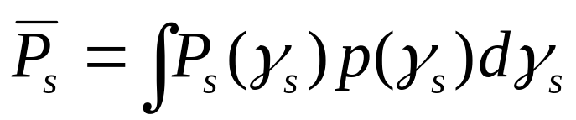
Review Continued: Average P_{s}
T_{s}
P_{s}
P_{s}
t or d
Expected value of random variable P_{s}
Used when T_{c}~T_{s}
Error probability much higher than in AWGN alone
Rarely obtain average error probability in closed form
  Probability in AWGN is Q-function, double infinite integral

Slide 4
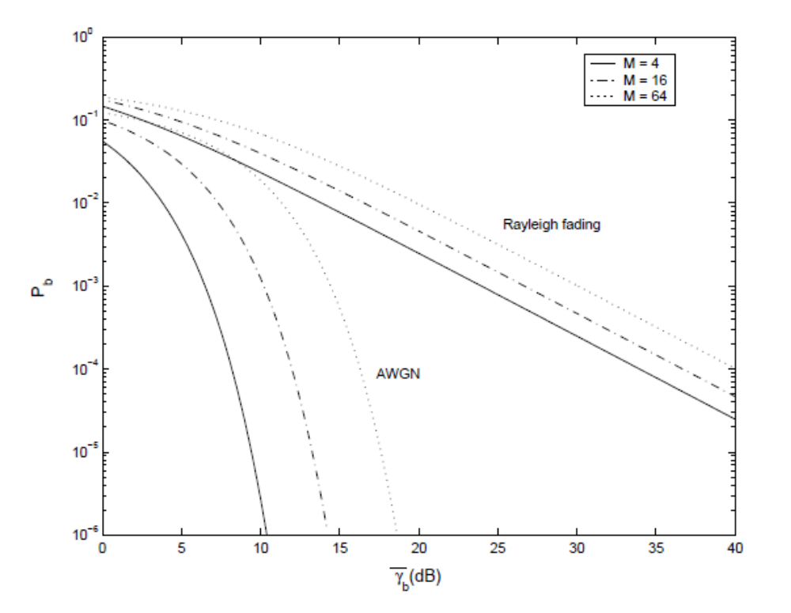
Average Probability of Error
Fading severely degrades performance

Slide 5
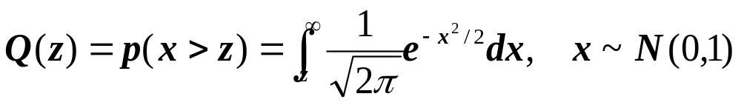
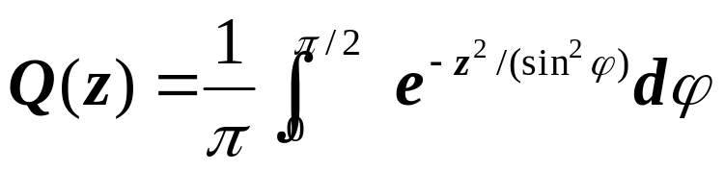
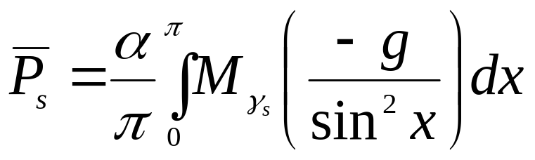
Alternate Q Function Representation
Chap. 6.2 & 6.3.3
Cover in HW,
not lecture
Traditional Q function representation
  Infinite integrand, argument in integral limits
  Average P_{e} entails infinite integral over Q(z)
Craig’s representation:
  Very useful in fading and diversity analysis
M_{γs} is MGF of fading distribution
γ_{s}, g depends on modulation

Slide 6
Combined outage and average P_{s}
P_{s}(γ_{s})
Outage
P_{s}(γ_{s})
P_{starget}
P_{s}(γ_{s})
Used in combined shadowing and flat-fading
P_{s} varies slowly, locally determined by flat fading
Declare outage when P_{s} above target value

Slide 7
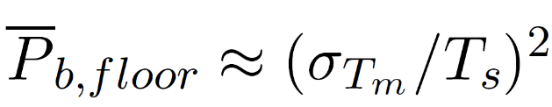
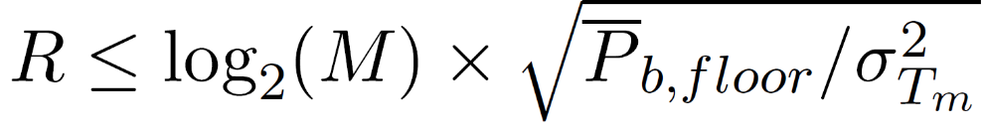
Delay Spread (ISI) Effects
Delay spread exceeding a symbol time causes ISI (self interference).
ISI leads to irreducible error floor:
  Increasing signal power increases ISI power
ISI imposes data rate constraint: T_{s}>>T_{m} (R_{s}<<B_{c})
1
2
4
Delay T_{m}
0
T_{s}
T_{m}
3
5

Slide 8
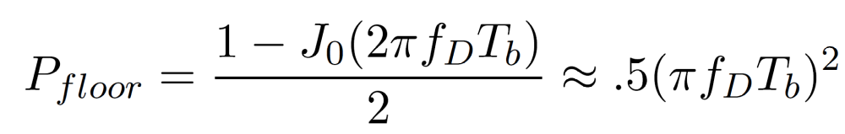
Doppler Effects
Chap. 6.4
Cover in HW,
not lecture
High doppler causes channel phase to decorrelate between symbols
Leads to an irreducible error floor for differential modulation
  Increasing power does not reduce error
Error floor depends on f_{D}T_{b} as

Slide 9
Introduction to Diversity
Basic Idea
  Send same bits over independent fading paths
    Independent fading paths obtained by time, space, frequency, or polarization diversity
  Combine paths to mitigate fading effects
T_{b}
t
Multiple paths unlikely to fade simultaneously

Slide 10
Combining Techniques
Selection Combining
  Fading path with highest gain used
Maximal Ratio Combining
  All paths cophased and summed with optimal weighting to maximize combiner output SNR
Equal Gain Combining
  All paths cophased and summed with equal weighting
Array/Diversity gain
  Array gain is from noise averaging (AWGN and fading)
  Diversity gain is change in BER slope (fading)
Our
focus

Slide 11
Main Points
Fading greatly increases average P_{s} or required power for a given target P_{s} with some outage
Alternate Q function approach simplifies P_{s} calculation, especially its average value in fading
  Average P_{s} becomes a Laplace transform.
In fast/slow fading, outage due to shadowing, probability of error averaged over fast fading pdf
Need to combat flat fading or waste lots of power
  Adaptive modulation and diversity are main techniques to combat flat fading: adapt to fading or remove it
Delay spread causes irreducible error floor at high data rates
  Doppler causes irreducible error floor at low data rates
Diversity overcomes fading effects by combining fading paths
  Typically entails penalty in rate, bandwidth, complexity, or size.

