Slide 1
EE359 – Lecture 18 Outline
Announcements
  HW due Fri; last HW posted, due Sunday 12/10 at 4 pm (no late HWs)
  Lecture next Thu 12/7 10-11:50 (course review+advanced topics)
  Final info (coverage, format, extra OHs, etc) given in 12/5 lecture
  Final exam 12/13, 12:15pm-3:15pm in Thornton 102
  Final projects must be posted 12/9 at midnight.
Spread Spectrum
  Direct sequence (DSSS)
  ISI and Interference Rejection of DSSS
  RAKE Receiver
Multiuser Systems
  Multiple access techniques
  Random access techniques

Slide 2
Review of Last Lecture
MCM, Overlapping Subcarriers and FFT Implementation (OFDM)
  MCM splits high rate data stream into lower rate flat-fading substreams
  Overlapping subcarriers reduces BW by factor of 2
  Modulate symbols with IFFT at TX, Reverse structure (with FFT) in RX
  Cyclic prefix makes linear convolution of channel circular, so no interference between FFT blocks in RX processing
X₀
x₀
TX
n(t)
R bps
Add cyclic
prefix and
Parallel
To Serial
Convert
QAM
Modulator
Serial
To
Parallel
Converter
x
D/A
h(t)
+
IFFT
X_{N-1}
x_{N-1}
cos(2πf_{c}t)
y₀
Y₀
RX
Remove
cyclic
prefix and
Serial to
Parallel
Convert
R bps
x
Parallel
To Serial
Convert
QAM
Modulator
LPF
A/D
FFT
y_{N-1}
Y_{N-1}
cos(2πf_{c}t)
Y_{i}=H_{i}X_{i}+n_{i}

Slide 3
Review Continued
OFDM Design Issues
Timing/frequency offset:
  Impacts subcarrier orthogonality; self-interference
Peak-to-Average Power Ratio (PAPR)
  Adding subcarrier signals creates large signal peaks
  Solve with clipping or PAPR-optimized coding
Mitigation for fading across subcarriers
  Precoding (fading inversion): Used in DSL as there is minimal deep fades, not used in wireless systems
  Adaptive modulation: data rate (and power) adapted to subcarrier SNR. Used in LTE and 802.11a-g-n-ac
  Coding across subcarriers: bits are encoded into a block code of length N for N subcarriers. Each coded symbol is sent on a different subcarrier.

Slide 4
Intro. to Spread Spectrum
Modulation that increases signal bandwidth
  Spreads modulated signal over wider BW B~1/T_{s} than needed for transmission (R=log₂(M)/T_{s})
  Mitigates or coherently combines ISI
  Mitigates narrowband interference/jamming
  Hides signal below noise (DSSS) or makes it hard to track (FH)
  Also used as a multiple access technique
Two types
  Frequency Hopping:
    Narrowband signal hopped over wide bandwidth
  Direction Sequence:
    Modulated signal multiplied by faster chip sequence

Slide 5
Direct Sequence Spread Spectrum
Bit sequence modulated by chip sequence
Spreads bandwidth by large factor (G)
Despread by multiplying by s_{c}(t) again (s_{c}(t)=1)
Mitigates ISI and narrowband interference
S(f)
s(t)
s_{c}(t)
S_{c}(f)
S(f)*S_{c}(f)
1/T_{b}
T_{c}
T_{b}=KT_{c}
1/T_{c}
2

Slide 6
ISI and Interference Rejection
Narrowband Interference Rejection (1/K)
Multipath Rejection (Autocorrelation ρ(τ))
S(f)
I(f)
S(f)
S(f)*S_{c}(f)
I(f)*S_{c}(f)
Info. Signal
Receiver Input
Despread Signal
S(f)
S(f)*S_{c}(f)[αδ(t)+β(t-τ)]
αS(f)
βρS’(f)
Info. Signal
Receiver Input
Despread Signal
Can coherently combine all multipath components via a RAKE receiver

Slide 7
RAKE Receiver
Multibranch receiver
  Branches synchronized to different MP components
These components can be coherently combined
  Use SC, MRC, or EGC
x
Demod
y(t)
s_{c}(t)
^
d_{k}
x
Diversity
Combiner
Demod
s_{c}(t-iT_{c})
x
Demod
s_{c}(t-NT_{c})

Slide 8
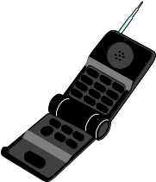

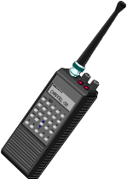

Multiuser Channels:
Uplink and Downlink
Uplink (Multiple Access
Channel or MAC):
Many Transmitters
to One Receiver.
x
R₃
h₃(t)
x
h₂₂(t)
Downlink (Broadcast Channel or BC):
One Transmitter
to Many Receivers.
x
h₂₁(t)
x
h₁(t)
R₂
R₁
Uplink and Downlink typically duplexed in time or frequency
Full-duplex radios are being considered for 5G systems

Slide 9




Bandwidth Sharing in Multiple Access
Channels assigned by central controller
Frequency Division
  OFDMA
Time Division
Code Division
  Code cross-correlation dictates interference
  Multiuser Detection
Space Division (SDMA)
Hybrid Schemes
Code Space
Time
Frequency
  Code Space
Time
Frequency
Code Space
Time
Frequency
7C29822.033-Cimini-9/97

Slide 10
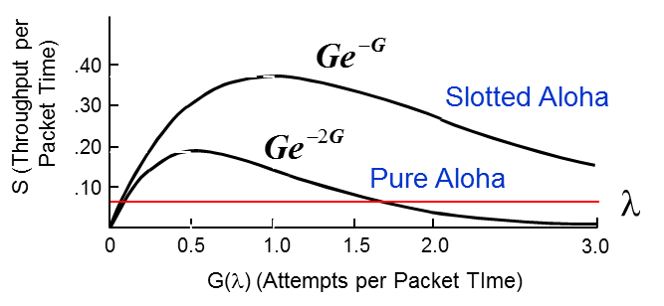
Random vs. Multiple Access
• In multiple access, channels are assigned by a centralized controller
- Requires a central controller and control channel
- Inefficient for short and/or infrequent data transmissions
In random access, users access channel randomly when they have data to send
  A simple random access scheme will be explored in homework
• ALOHA Schemes (not on exams/HW)
  Data is packetized.
  Packets occupy a given time interval
• Pure ALOHA
• Slotted ALOHA
– send packet whenever data is available
– same as ALOHA but with packet slotting
– a collision occurs for any partial overlap of
– packets sent during predefined timeslots
packets (nonorthogonal slots)
– A collision occurs when packets overlap,
but there is no partial overlap of packets
– Packets received in error are retransmitted
after random delay interval.
– Packets received in error are retransmitted after random delay interval (avoids subsequent collisions).

Slide 11
Main Points
Spread spectrum increases signal bandwidth above that required for information transmission
Benefits of spread spectrum:
  ISI/narrowband interference rejection by spreading gain
  Also used as a multiuser/multiple access technique
Multiple access: users can share the same spectrum via time/frequency/code/space division
Random access more efficient than multiple access for short/infrequent data transmission

