Slide 1
EE359 – Lecture 6 Outline
Announcements:
  HW due tomorrow 4pm
  Makeup lecture next Friday, Oct. 20, 10:30-11:50 in this room
Review of Last Lecture
Wideband Multipath Channels
Scattering Function
Multipath Intensity Profile
Doppler Power Spectrum

Slide 2
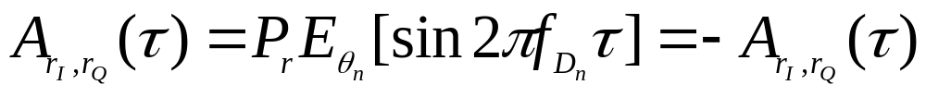
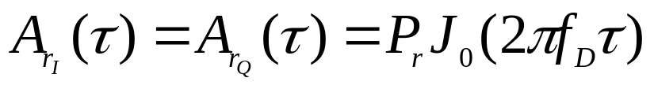
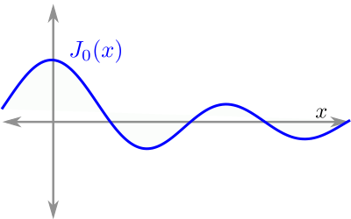
Review of Last Lecture
  For φ_{n}~U[0,2π], r_{I}(t),r_{Q}(t) zero mean, WSS, with
Uniform AoAs in Narrowband Model
  In-phase/quad comps have zero cross correlation and
PSD maximum at the maximum Doppler frequency
    PSD used to generate simulation values
1
f_{D}=v/λ
vτ=d
Decorrelates over roughly half a wavelength
.4λ
S_{r}(f)
f_{c}-f_{D}
f_{c}
f_{c}+f_{D}

Slide 3
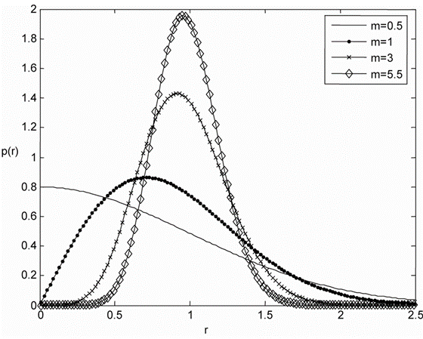
Review Continued:
Signal Envelope Distribution
CLT approx. leads to Rayleigh distribution (power is exponential)
When LOS component present, Ricean distribution is used
Measurements support Nakagami distribution in some environments
  Similar to Ricean, but models “worse than Rayleigh”
  Lends itself better to closed form BER expressions
To cover today

Slide 4




Wideband Channels
Individual multipath components resolvable
True when time difference between components exceeds signal bandwidth
  High-speed wireless systems are wideband for most environments
τ
τ
Narrowband
Wideband

Slide 5
Scattering Function
Typically characterize c(τ,t) by its statistics, since it is a random process
Underlying process WSS and Gaussian, so only characterize mean (0) and correlation
Autocorrelation is A_{c}(τ₁,τ₂,Δt)=A_{c}(τ,Δt)
  Correlation for single mp delay/time difference
Statistical scattering function:
  Average power for given mp delay and doppler
ρ
s(τ,ρ)=F_{Δt}[A_{c}(τ,Δt)]
τ
Easy to measure

Slide 6


Multipath Intensity Profile
A_{c}(τ)
T_{M}
Defined as A_{c}(τ,Δt=0)= A_{c}(τ)
  Determines average (μ_{Tm} ) and rms (σ_{Tm}) delay spread
  Approximates maximum delay of significant multipath
Coherence bandwidth B_{c}=1/σ_{Tm}
  Maximum frequency over which A_{c}(Δf)=F[A_{c}(τ)]>0
  A_{c}(Δf)=0 implies signals separated in freq. by Δf will be uncorrelated after going through channel: freq. distortion
τ
Wideband signal
distorted in time and in frequency
A_{c}(f)
τ
0
B_{c}
f

Slide 7
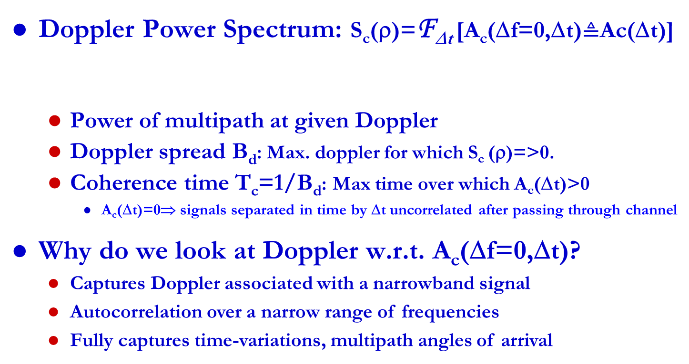
Doppler Power Spectrum
Scattering Function: s(τ,ρ)=F_{Δt}[A_{c}(τ,Δt)]
Doppler Power Spectrum: S_{c}(ρ)=F_{Δt} [A_{c}(Δf=0,Δt)$≜$Ac(Δt)]
  Power of multipath at given Doppler
  Doppler spread B_{d}: Max. doppler for which S_{c} (ρ)=>0.
  Coherence time T_{c}=1/B_{d}: Max time over which A_{c}(Δt)>0
    A_{c}(Δt)=0⇒ signals separated in time by Δt uncorrelated after passing through channel
Why do we look at Doppler w.r.t. A_{c}(Δf=0,Δt)?
  Captures Doppler associated with a narrowband signal
  Autocorrelation over a narrow range of frequencies
  Fully captures time-variations, multipath angles of arrival
A_{c}(Δf,Δt)=F_{τ}[A_{c}(τ,Δt)]
S_{c}(ρ)
B_{d}
ρ

Slide 8
Main Points
Wideband channels have resolvable multipath
  Statistically characterize c(τ,t) for WSSUS model
  Scattering function characterizes rms delay and Doppler spread. Key parameters for system design.
Delay spread defines maximum delay of significant multipath components. Inverse is coherence BW
  Signal distortion in time/freq. when delay spread exceeds inverse signal BW (signal BW exceeds coherence BW)
Doppler spread defines maximum nonzero doppler, its inverse is coherence time
  Channel decorrelates over channel coherence time

