Slide 1
EE359 – Lecture 7 Outline
Announcements:
  Schedule changes this week
    10/18 – Discussion 5-6pm Pack 364, OHs 4:00PM - 5:00PM (3rd Floor Packard) and just after Discussion.
    Makeup class Friday 10/20 (no lecture next Tues 10/24). Makeup class will be 10/20 at 10:30AM at Thornton 102 (with donuts)
    Tom's OHs 10/20 will be 9:30-10:20 (3rd Floor Packard)
    Email OHs 10/20 from 1-2pm
  Project proposals due 10/28; I can provide early feedback
  MT Nov. 7, 8, or 9 from 6-8pm (pizza after), poll today; details soon
Shannon Capacity
Capacity of Flat-Fading Channels
  Fading Statistics Known
  Fading Known at RX
  Fading Known at TX and RX: water-filling
  Channel Inversion
  Truncated Channel Inversion

Slide 2




Review of Last Lecture
Wideband channels: B_{u}>>1/σ_{Tm}
Scattering Function:
  Used to characterize c(τ,t) statistically
Multipath Intensity Profile:
Determines average (μ_{Tm} ) and rms (σ_{Tm}) delay spread
  Coherence bandwidth B_{c}=1/σ_{Tm}
ρ
s(τ,ρ)=F_{Δt}[A_{c}(τ,Δt)]
τ
A_{c}(f)
0
f
τ
Bc

Slide 3
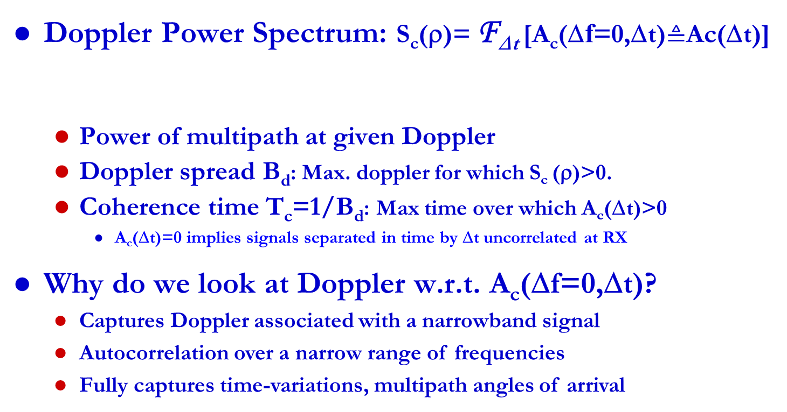
Review Continued
Scattering Function: s(τ,ρ)=F_{Δt}[A_{c}(τ,Δt)]
Doppler Power Spectrum: S_{c}(ρ)= F_{Δt} [A_{c}(Δf=0,Δt)$≜$Ac(Δt)]
  Power of multipath at given Doppler
  Doppler spread B_{d}: Max. doppler for which S_{c} (ρ)>0.
  Coherence time T_{c}=1/B_{d}: Max time over which A_{c}(Δt)>0
    A_{c}(Δt)=0 implies signals separated in time by Δt uncorrelated at RX
Why do we look at Doppler w.r.t. A_{c}(Δf=0,Δt)?
  Captures Doppler associated with a narrowband signal
  Autocorrelation over a narrow range of frequencies
  Fully captures time-variations, multipath angles of arrival
A_{c}(Δf,Δt)=F_{τ}[A_{c}(τ,Δt)]
S_{c}(ρ)
B_{d}
ρ

Slide 4
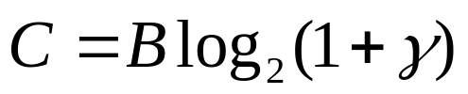
Shannon Capacity
Defined as channel’s maximum mutual information
Shannon proved that capacity is the maximum error-free data rate a channel can support.
Theoretical limit (not achievable)
Channel characteristic
  Not dependent on design techniques
In AWGN, bps
  B is the signal bandwidth
  γ=P_{r}/(N₀B) is the received signal to noise power ratio

Slide 5
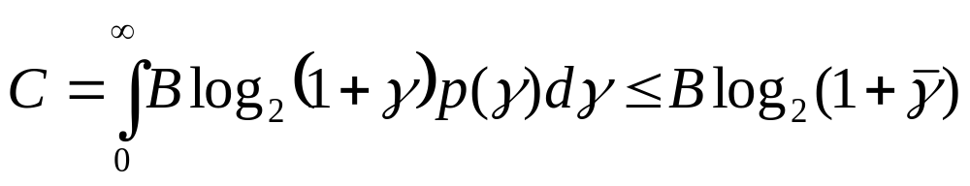
Capacity of Flat-Fading Channels
Capacity defines theoretical rate limit
  Maximum error free rate a channel can support
Depends on what is known about channel
Fading Statistics Known
  Hard to find capacity
Fading Known at Receiver Only
Fading known at TX and RX
  Multiplex optimal strategy over each channel state

Slide 6
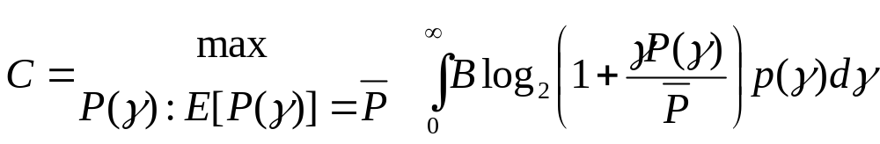
Capacity with Fading Known at
Transmitter and Receiver
For fixed transmit power, same as with only receiver knowledge of fading
Transmit power P(γ) can also be adapted
Leads to optimization problem

Slide 7

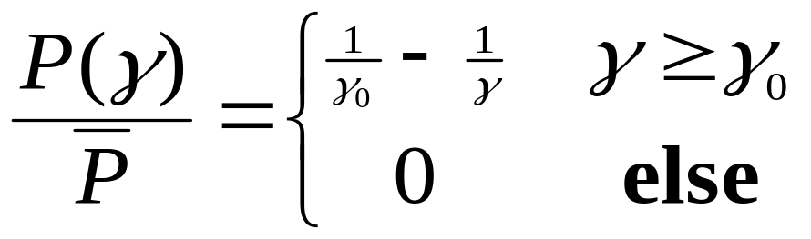
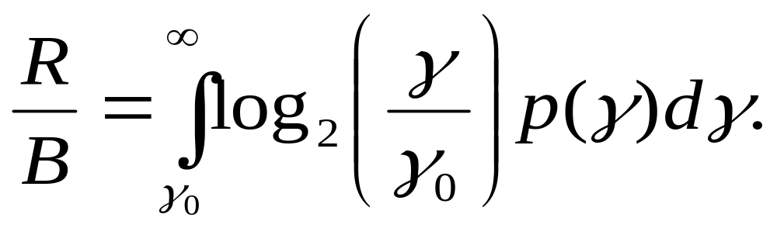
Optimal Adaptive Scheme
Waterfilling
Power Adaptation
Capacity
1
γ
γ₀
γ

Slide 8
Channel Inversion
Fading inverted to maintain constant SNR
Simplifies design (fixed rate)
Greatly reduces capacity
  Capacity is zero in Rayleigh fading
Truncated inversion
  Invert channel above cutoff fade depth
  Constant SNR (fixed rate) above cutoff
  Cutoff greatly increases capacity
    Close to optimal

Slide 9
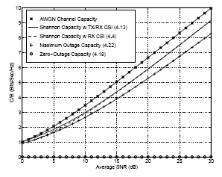
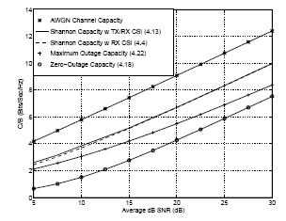
Capacity in Flat-Fading
Rayleigh
Log-Normal

Slide 10
Main Points
Fundamental channel capacity defines maximum data rate that can be supported on a channel
Capacity in fading depends what is known at TX/RX
Capacity with RX CSI is average of AWGN capacity
Capacity with TX/RX knowledge requires optimal adaptation based on current channel state
Almost same capacity as with RX knowledge only
Channel inversion has poor performance, but significantly improved with truncation

