Slide 1
XORs in The Air:
Practical Wireless Network Coding
EE 360 Paper Presentation
Presented by Gerald Hng
5 Feb 2014

Slide 2
Contents
Introduction
    Network coding & COPE
COPE – Ideas & Approaches
    Opportunistic Listening
    Opportunistic Coding
    Learning Neighbor States
Results
    Ad Hoc Network results
My Experience with Practical NC
Conclusion

Slide 3
Introduction
Network Coding
A technique to improve a network’s throughput and efficiency
First proposed by Ahlswede et al (2000)
General idea
    Nodes do not simply relay packets they received
    Instead nodes combine several packets together to send in one single transmission
  COPE
  XORs in The Air: Practical Wireless Network Coding
    S. Katti, D. Katabi, H. Rahul, W. Hu, M. Medard and J. Crowcroft (2006)
    Stands for “Coding Opportunistically”
  First system architecture for wireless network coding
    Proposed a design that makes practical deployment of wireless NC feasible
R. Ahlswede, N. Cai, S. R. Li, and R. W. Yeung. Network Information Flow. In IEEE Transactions on Information Theory, 2000.

Slide 4

Conventional Information Exchange
Relay
Alice
Bob
Alice’s packet
Bob’s packet
Bob’s packet
Alice’s packet
Requires 4 transmissions
Relay faces scalability issues
Can COPE do better?
Source: XORs in The Air: Practical Wireless Network Coding, S. Katti et al

Slide 5
With COPE/Network Coding
XOR
=
Relay
Alice
Bob
Alice’s packet
Bob’s packet
Bob’s packet
Alice’s packet
Improvements
    3 instead of 4 transmissions
    Increase in throughput
    Bandwidth and power efficient
Source: XORs in The Air: Practical Wireless Network Coding, S. Katti et al

Slide 6
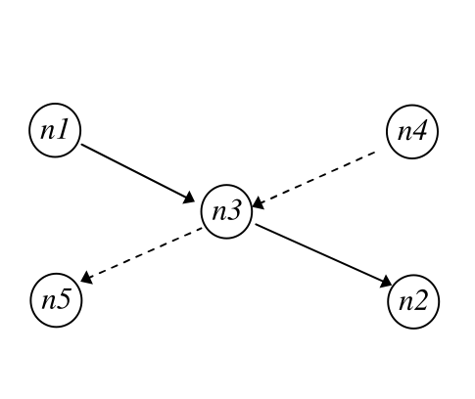
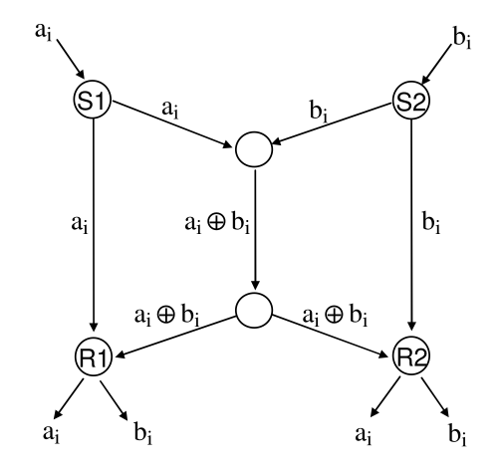
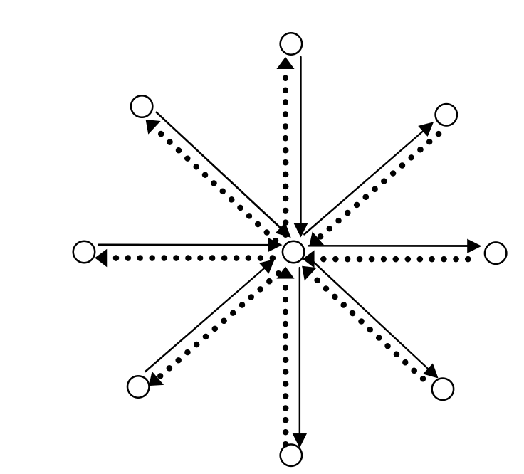
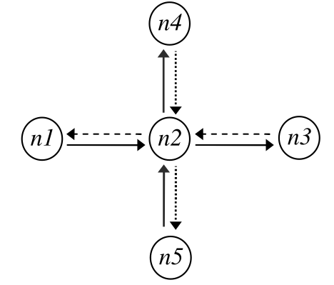
Beyond Three Nodes
COPE scales beyond 3 nodes to a variety of wireless network topologies
Source: XORs in The Air: Practical Wireless Network Coding, S. Katti et al

Slide 7
COPE – What’s So Special?
Main idea
Take advantage of opportunities in wireless networks
    Exploits broadcast nature of wireless channels instead of abstracting it as point to point
Inserts coding layer between IP and MAC layers
    Addresses common case of unicast traffic
COPE enables wireless NC by
Opportunistic Listening
Opportunistic Coding
Learning Neighbors’ States
IP
COPE
MAC

Slide 8
COPE – What’s So Special?
Opportunistic Listening
Wireless is a broadcast medium
    Many opportunities to overhear packets
  COPE sets nodes to promiscuous mode
    Snoops and stores all overheard packets for a limited period T
    Stored packets used for future decoding
  Broadcasts reception reports to inform neighbors of overheard packets
    Help neighbors to make informed coding decisions
    Reception reports incur overheads

Slide 9
COPE – What’s So Special?
Opportunistic Coding
Detect coding opportunities
    Code only packets in queue at that instance
Nodes follow simple coding rules:
    Maximize the number of native packets delivered in a single transmission
    Ensure each intended next hop has enough information to decode
  Aims to maximize benefits of coding

Slide 10
Opportunistic Coding
P2
C’s Packet Pool
P4
P1
P1→A
P2→C
P3→C
P4→D
B’s Output Queue
P4
P3
P2
P1
C
A
B
=
P1
+
P2
P4
P3
A’s Packet Pool
D
Bad coding decision,
A & D cannot decode!
D’s Packet Pool
P3
P1
Source: XORs in The Air: Practical Wireless Network Coding, S. Katti et al

Slide 11
Opportunistic Coding
P3
C’s Packet Pool
P4
P1
B’s Output Queue
P4
P3
P2
P1
C
P1
A
B
=
P1
+
P3
P4
P3
A’s Packet Pool
D
Better coding decision,
A & C can decode.
D’s Packet Pool
P3
P1
Source: XORs in The Air: Practical Wireless Network Coding, S. Katti et al

Slide 12
Opportunistic Coding
P3
P4
P1
B’s Output Queue
C’s Packet Pool
P4
P3
P2
P1
C
P1
A
B
=
P1
+
P3
+
P4
P4
P3
D
P4
A’s Packet Pool
Best coding decision,
A, C & D can decode!
D’s Packet Pool
P3
P1
Source: XORs in The Air: Practical Wireless Network Coding, S. Katti et al

Slide 13
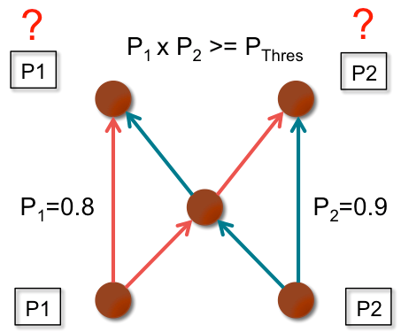
COPE – What’s So Special?
Learning Neighbor States
Nodes need accurate global view, i.e. know what packets neighbors have
    Reception reports
    Guessing
      Reports may be lost or late
      Use link state routing information to estimate delivery probability of links
      Decide whether to code based on configurable threshold
  Implications
    If nodes make wrong coding decisions,
    packets will be un-decodable at destination
    May end up wasting bandwidth instead

Slide 14
Making it Work
Key Implementation Decisions
Never delay packets in order to code
Try to XOR packets of similar lengths to maximize savings
Never code together packets headed for same next hop
Pseudo-Broadcast
    802.11 broadcast lacks reliability, back off & retransmission
      Poor performance under high collision
    COPE uses pseudo-broadcast
      Uses unicast and sets nodes to listen to all packets
      Inserts COPE header after link layer headers
      Nodes checks COPE header to know if it is a next hop
      Utilizes reliability and retransmission of unicast

Slide 15
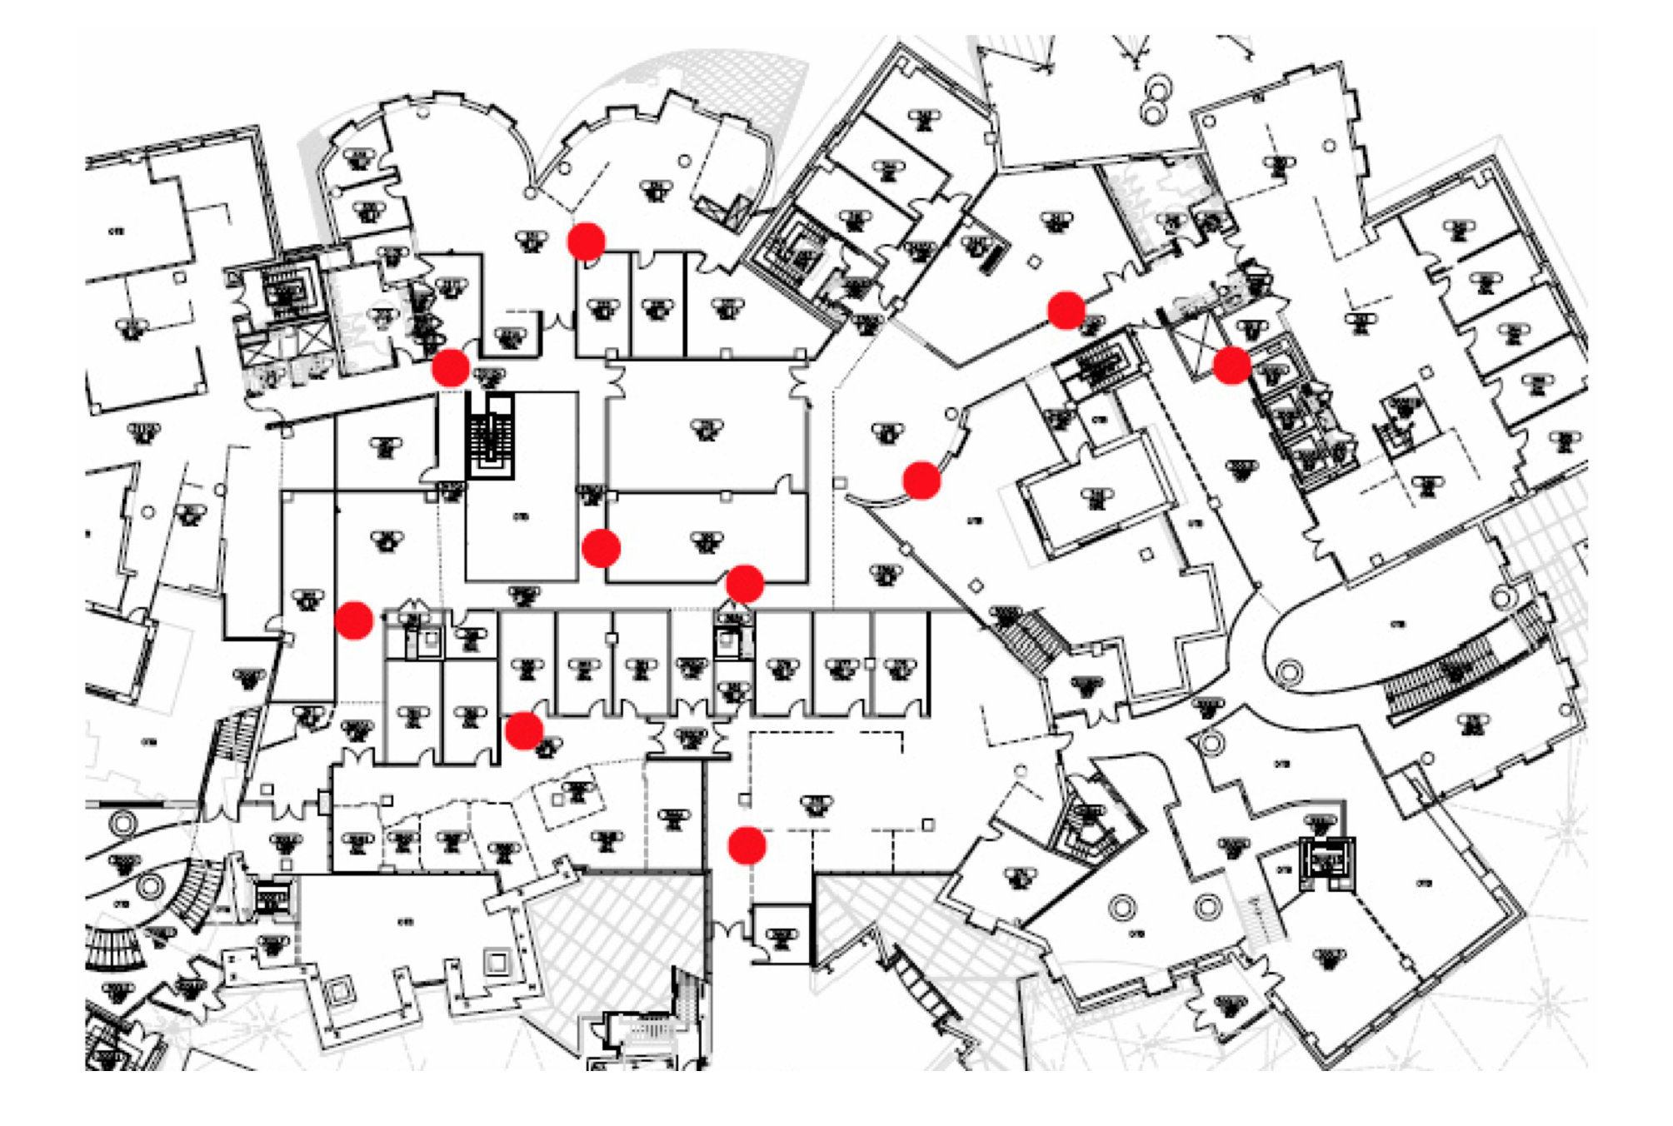
Experimental Results
Testbed
20 static wireless nodes indoors
802.11a ad hoc mode at 6Mb/s
Paths between 1 to 6 hops
Loss rates between 0% to 30%
TCP & UDP traffic models
Metrics
Network throughput
    Sum of throughput of all flows
Throughput gain
    Ratio of throughput with and without COPE

Slide 16
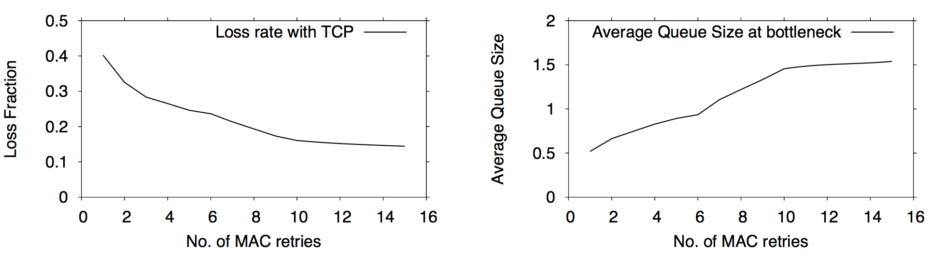
Ad Hoc Network Results
TCP Flows
Initial results did not show any significant improvement with coding (2-3% average gain)
Due to TCP’s reaction to collision losses
    Interprets collision losses as congestion
    Flows back off excessively and unable to ramp up, even with MAC retransmission set to max
    Nodes have little packets in their queue resulting in few coding opportunities

Slide 17
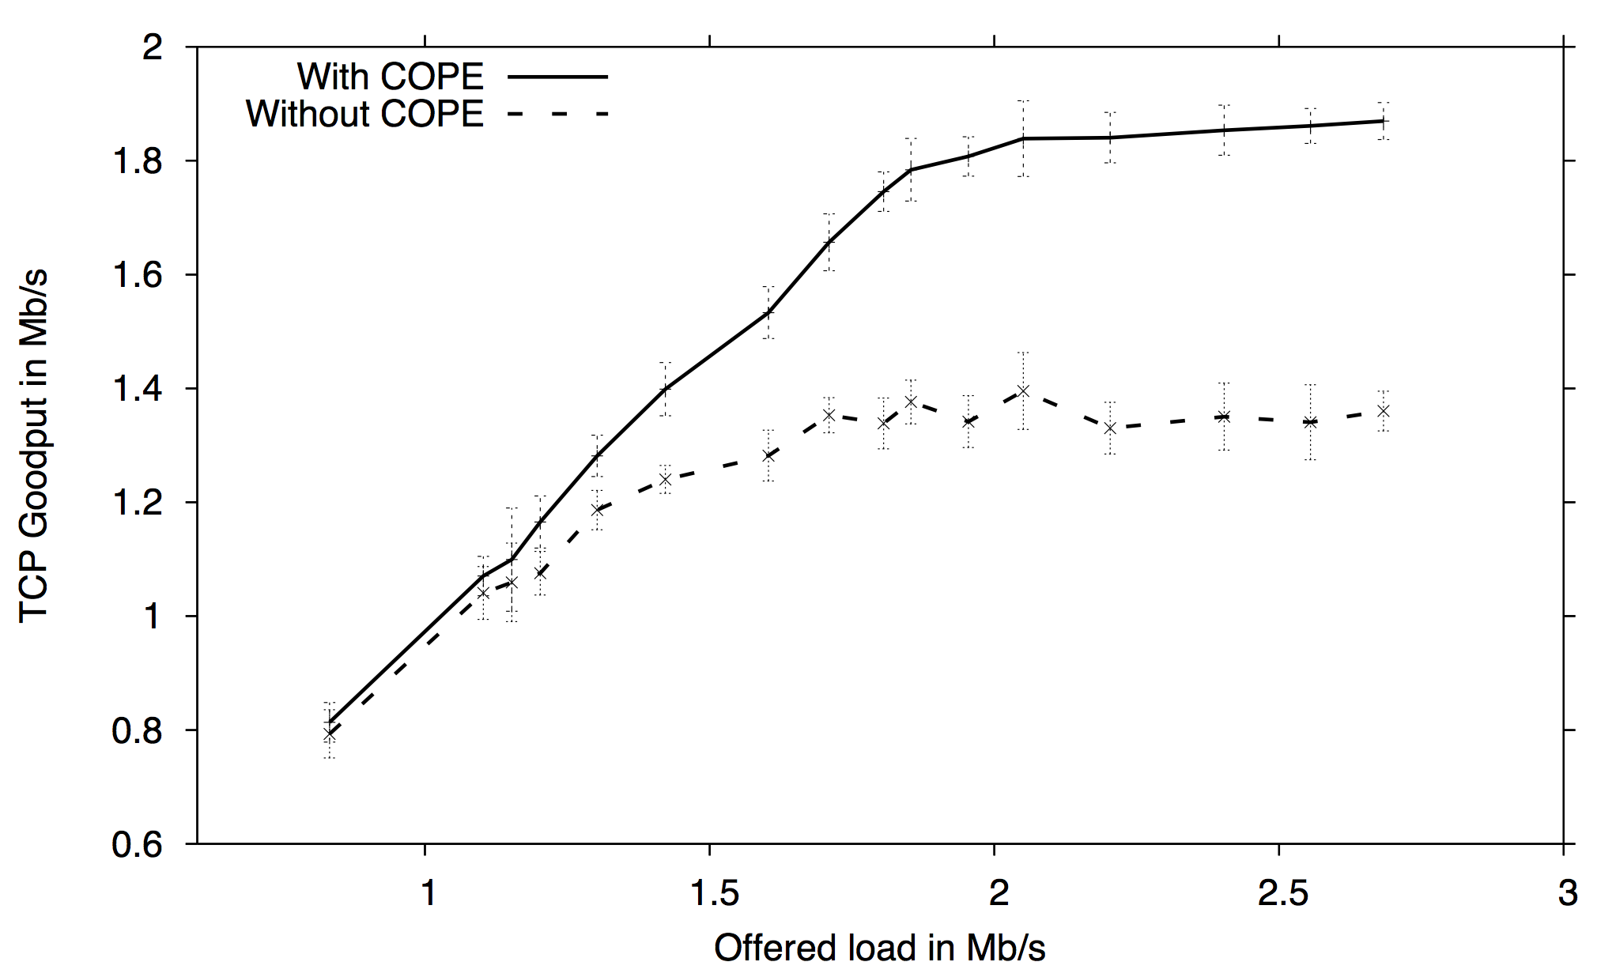
Ad Hoc Network Results
Retried TCP test without hidden nodes
Hypothetical test to see how COPE performs without collision losses
COPE provides up to 38% improvement over no coding
    Gains less obvious with small loads due to less coding opportunities

Slide 18
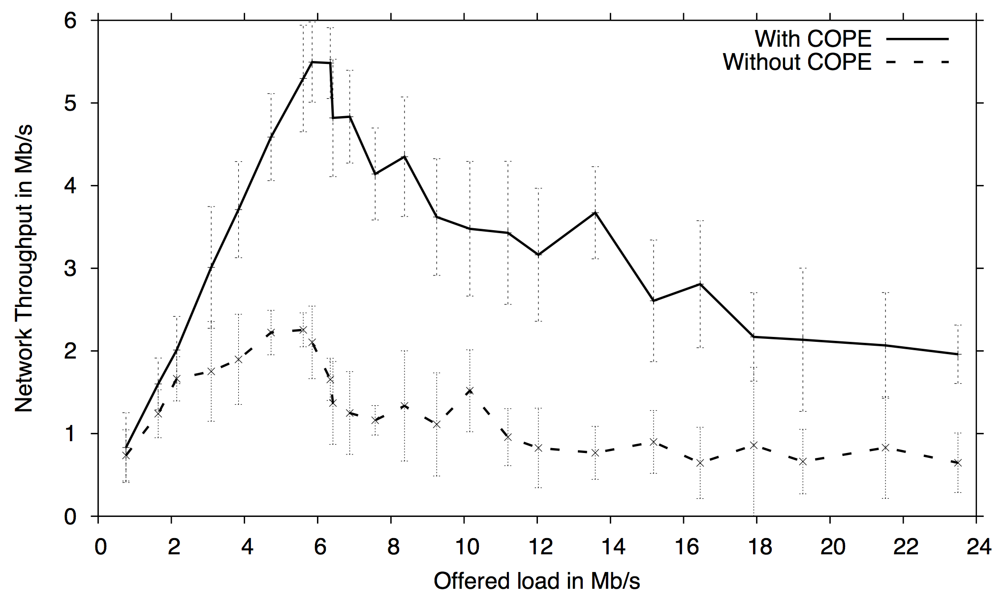
Ad Hoc Network Results
UDP Flows
Without congestion control, COPE improved throughput by a factor of 3 to 4 times
Main reasons for gains
    Coding gain: Less transmissions needed for same amount of data
    Coding + MAC gain: Packets drain faster, less packets dropped in downstream routers due to queue overflow

Slide 19
My Experience with COPE
Comments and thoughts
Found that UDP throughput with static nodes is similar to paper
    Main caveat: Traffic needs to be large enough with opposing flows
Throughput gains fall significantly with mobility
    More un-decodable messages at destinations
    Main reason: Wrong coding decisions due to inaccurate global view
      Routing information could not update fast enough for accurate guessing
  What threshold probability to configure?
    Tradeoff: Set too high, less coding. Set too low, higher chance of un-decodable messages due to wrong guess.
  How often to send reception reports?
    Tradeoff between accuracy of states and managing overheads
  Maybe simply limit coding to Alice and Bob for high mobility scenarios?
    Less gains but a lot more robust and practical

Slide 20
Conclusion
COPE - First practical wireless implementation of network coding
    Demonstrated that network coding has practical benefits and can substantially improve wireless throughput
COPE thrives on opportunities
    Opportunistic listening
    Opportunistic coding
    Learning neighbors’ states
  Key results in Ad Hoc Networks
    Little improvements in TCP with hidden nodes
    Without hidden nodes, COPE can improve TCP throughput by up to 38%
    COPE improves UDP throughput by factor of 3 to 4
  My experience with COPE
    More work needs to be done to improve performance under mobility
    Tradeoffs between performance and overheads

Slide 21
Some Useful References
Fragouli, C.; Le Boudec, J. & Widmer, J. "Network coding: An instant primer" in Computer Communication Review, 2006
R. Ahlswede, N. Cai, S. R. Li, and R. W. Yeung. “Network Information Flow” in IEEE Transactions on Information Theory, 2000.
S. Li, R. Yeung, and N. Cai, "Linear Network Coding” in IEEE Transactions on Information Theory, Vol 49, No. 2, pp. 371–381, 2003

Slide 22
THE END

