Slide 1
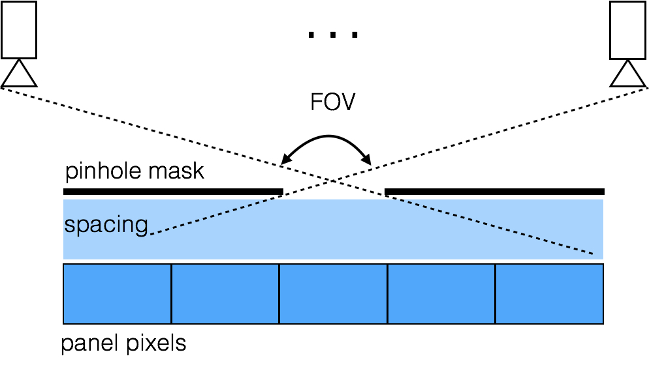
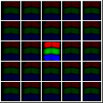
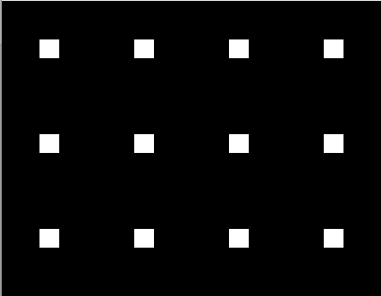
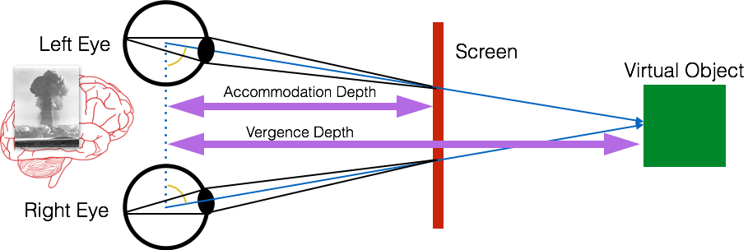
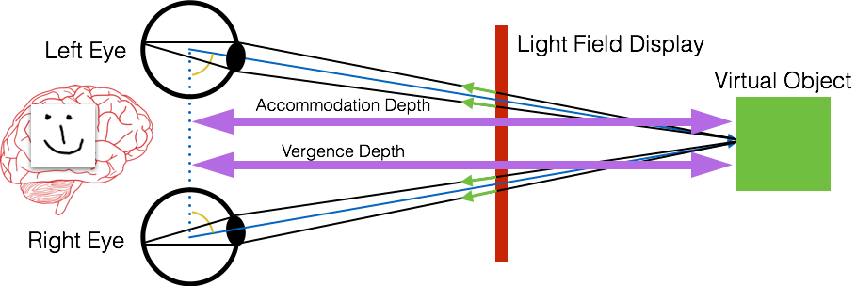
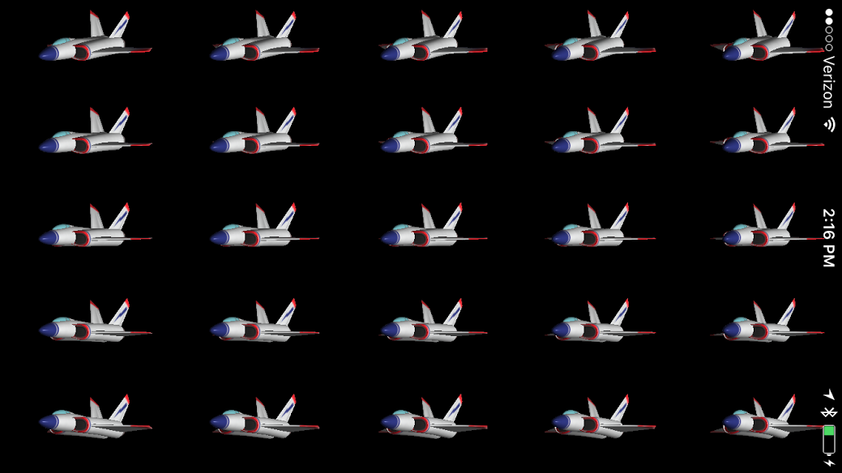
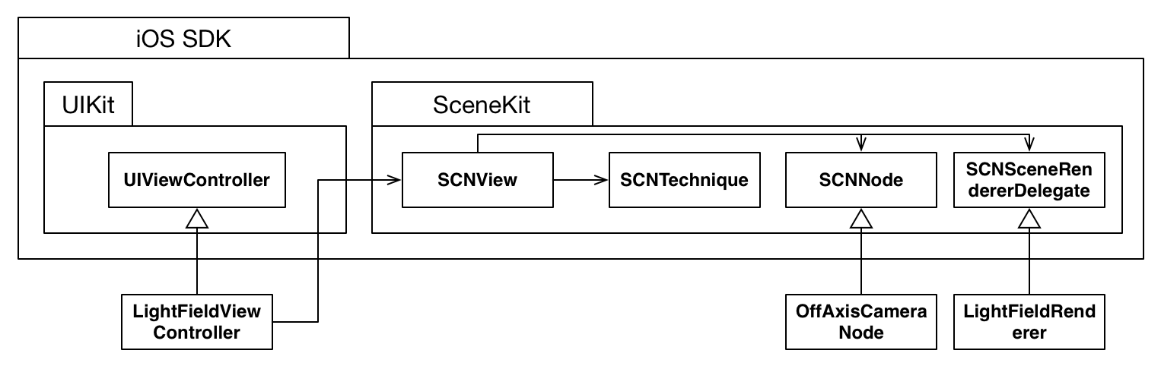
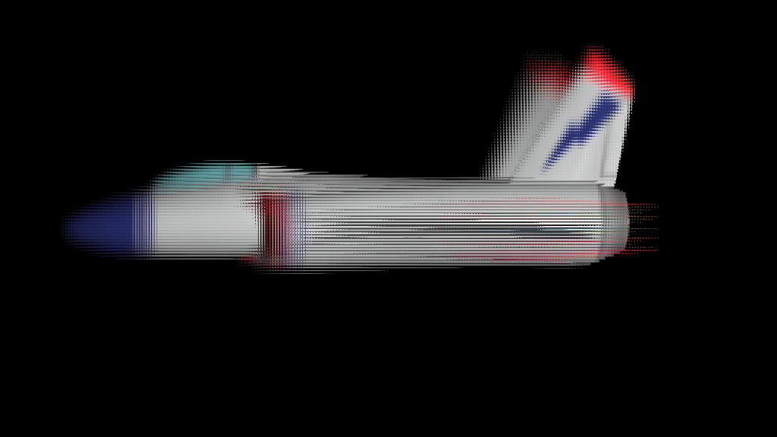

DIY iPhone Light Field Renderer
Ryan Burgoyne, Salman Naqvi
Stanford University
Motivation and Related Work
Parallax Barrier
Current virtual and augmented reality systems provide binocular disparity for ocular vergence, but lack accommodation cues. This leads to a conflict in the human visual system which causes discomfort and reduces immersion.
Light field display resolve this conflict by reproducing correct vergence and accommodation cues. A simple light field display can be created by placing a pinhole mask, or “parallax barrier” over a high resolution LCD panel [2].
Superpixel side view
Superpixel top view
Correctly-spaced pinholes
The parallax barrier is a simple grid printed on a transparency which blocks all but one pixel out of every 5x5 pixel group, or “superpixel”. It allows a different pixel to be seen depending on the angle from which the superpixel is viewed.
The pinholes in the mask must align perfectly with the pixels on the screen. Ordinary printers did not have high enough resolution. We were successfully able to use a mask created by a photolithography shop.
Irregular pinholes
References
[1] Matthew Hirsch and Douglas Lanman. Build your own 3D display. In ACM SIGGRAPH 2010 Courses (SIGGRAPH '10). ACM, New York, NY, USA, Article 4, 106 pages. DOI=http://dx.doi.org/10.1145/1837101.1837105 (2010)
[2] Huang, Fu-Chung. (n.d.). Parallax barrier display. Retrieved from http://displayblocks.org/diycompressivedisplays/parallax-barrier-display/
[3] Hirsch, Matthew, Douglas Lanman, Gordon Wetzstein, and Ramesh Raskar. “Construction and Calibration of Optically Efficient LCD-based Multi-Layer Light Field Displays.” Journal of Physics: Conference Series 415 (February 22, 2013): 012071.
“Numbers” test pattern demonstrates multiple views
Alignment using moiré interference pattern [3]
Software Architecture
Light Field Rendering
Off-axis perspective projection
5x5 grid of 150x267-pixel views
4
The 3D scene is rendered using an off-axis projection from the perspective of 25 equally-spaced viewpoints.
Each view is drawn to a sub-viewport of an intermediate render target.
The views are interlaced. For each pixel on the final output buffer, we look up the corresponding location within the appropriate view of the intermediate render target.
2
3
1
5
6
Sets up the scene graph and the rendering technique.
Is a user interface widget that performs the actual rendering.
Describes the rendering passes required to draw the scene from 25 viewpoints, then interlace.
Renders each viewpoint using a custom projection matrix.
Represents a node in the scene graph.
Updates all the viewpoint positions and projections each frame.
Final interlaced image
150x267 grid of 5x5-pixel superpixels
The source view is determined by the destination pixel’s location within it local 5x5 superpixel.

