Slide 1
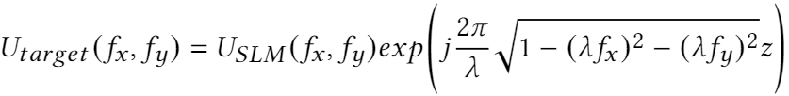
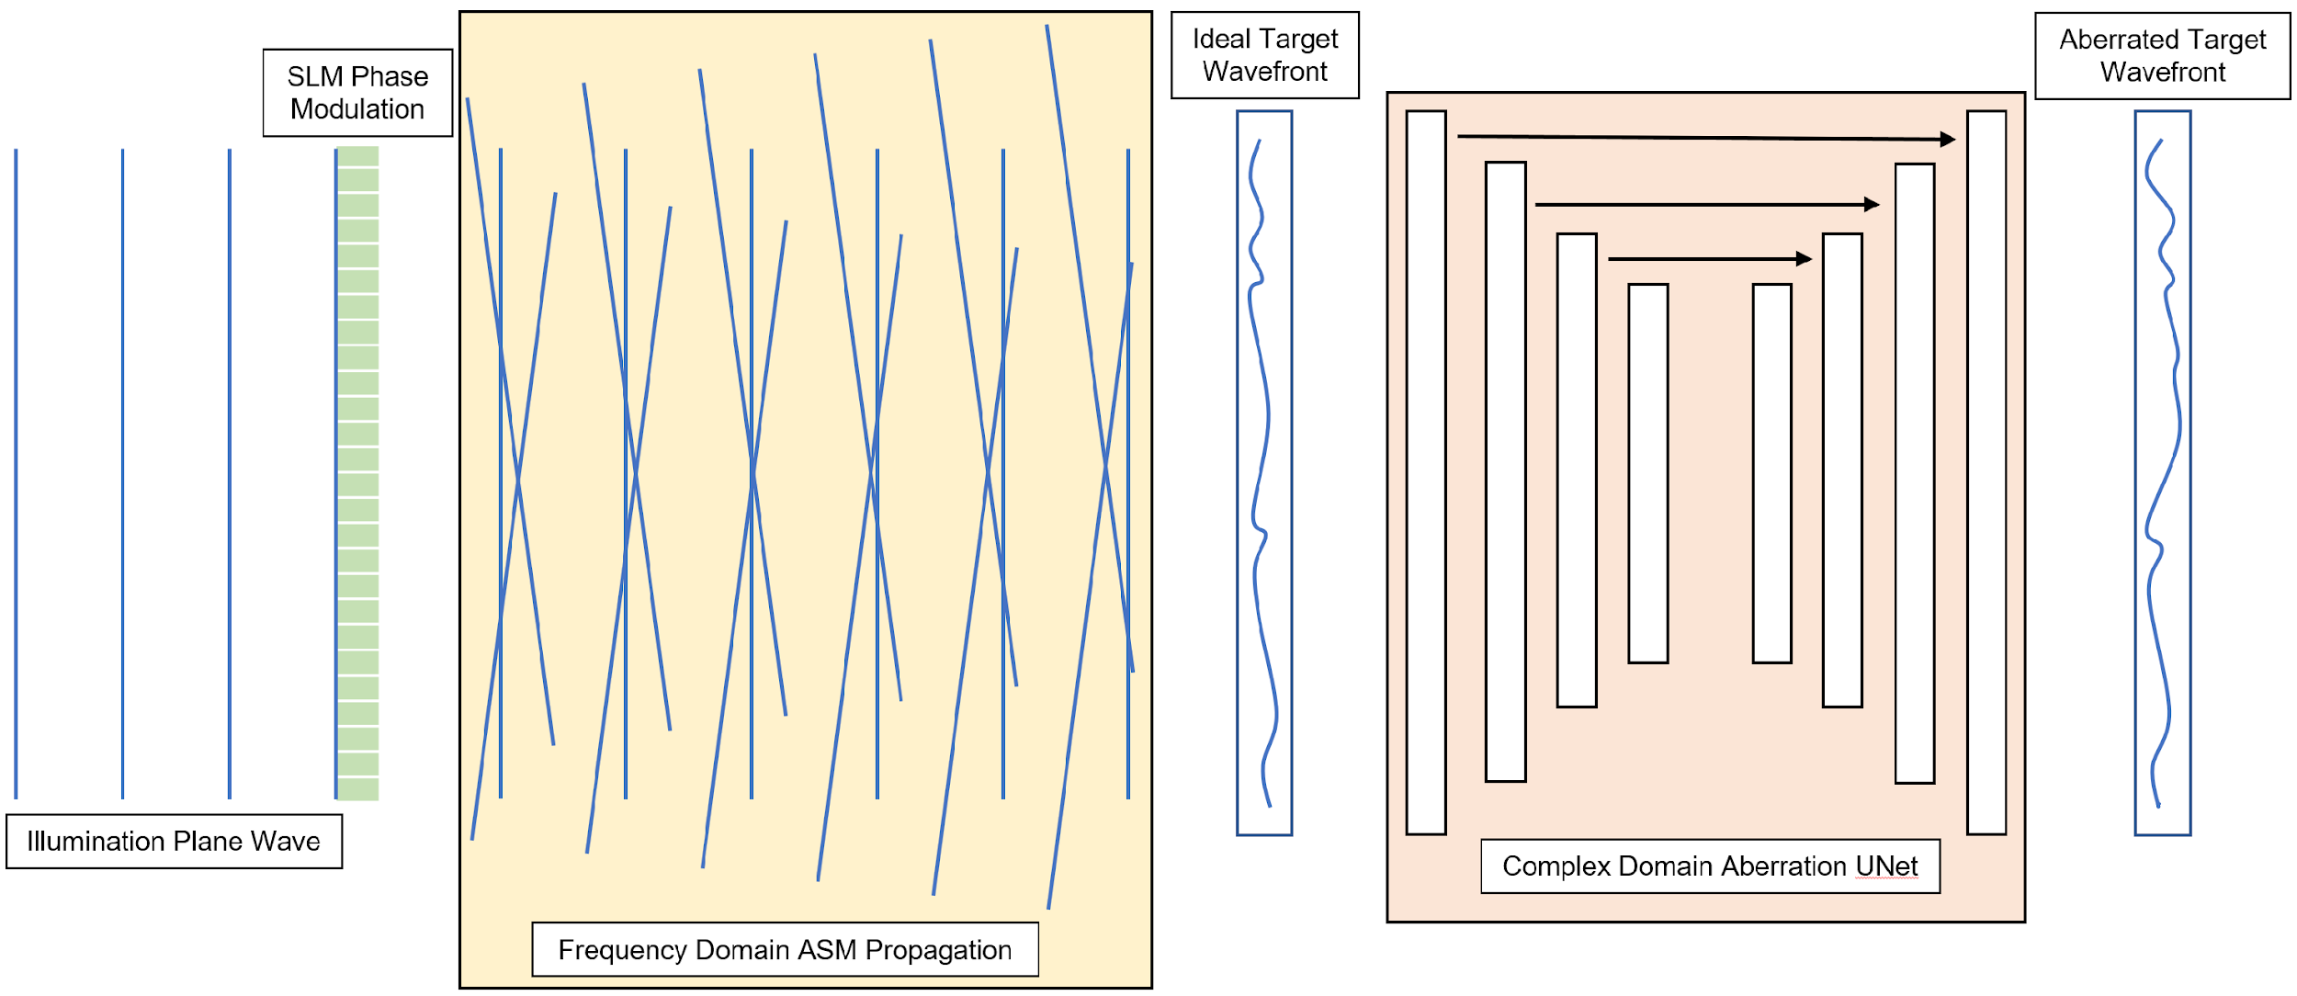
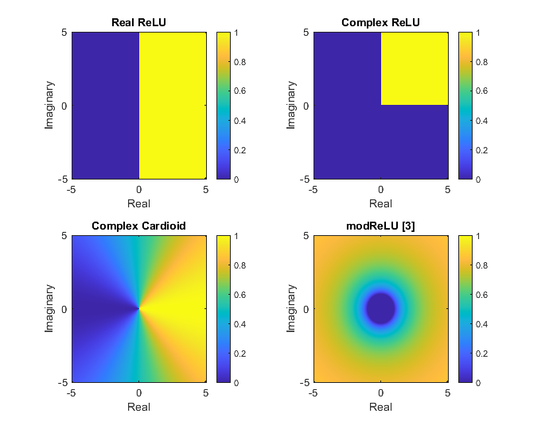
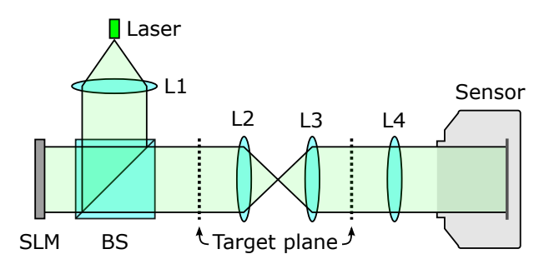
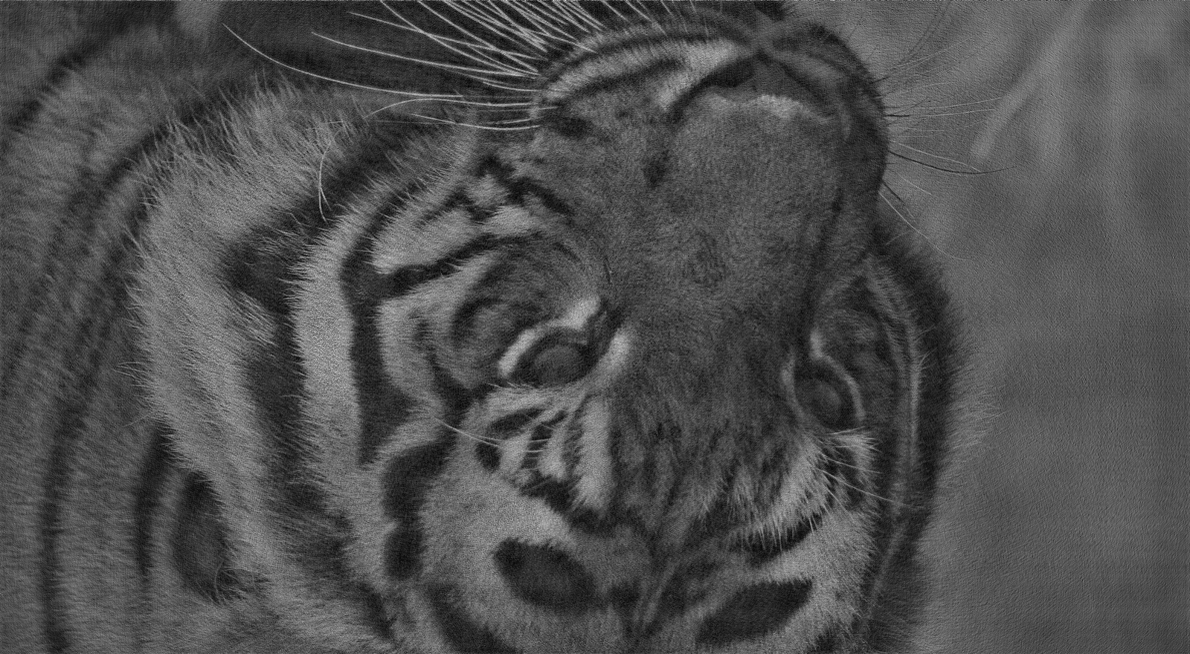
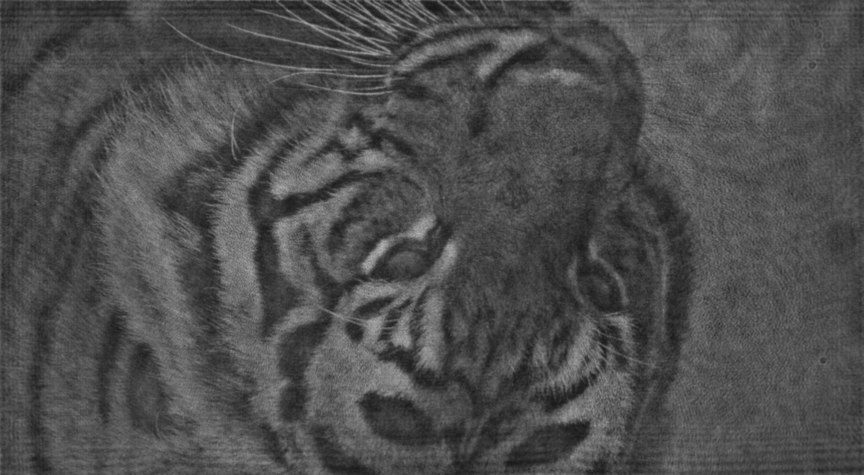

Learned Propagation Model for Holographic Displays
Manu Gopakumar, Bryan Chiang
Stanford University
Motivation
Learned Propagation Model with Complex Convolutions
Holographic displays use phase modulation and coherent light to produce interference patterns that form images
ASM propagation in frequency domain:
    |
Our learned propagation model introduces physical aberrations to the simulated wavefront at target plane.
This method has the flexibility of the prior machine learning approach but uses the complex valued support of JAX to operate directly on the target wavefront.
Optical components of holographic display prototype which produce deviations from free space propagation [1]
Our simulation pipeline incorporating ASM propagation and learned complex operator on target wavefront
Modulation of activation functions
over complex plane
Related Work
Experimental Results
Recent work introduced learned terms that explicitly model physical phenomena such as undiffracted light and phase non-linearities [1].
Other prior work has adopted the strategies of machine learning image-to-image translation to learn the physical deviation from the simulation model [2].
Our method as well as prior approaches were trained and evaluated on a dataset of 10,200 phase and target intensity pairs captured on a holographic display prototype setup as described in [1].
Network Architecture | Train PSNR | Test PSNR
ASM | 20.6 dB | 20.7 dB
Neural Holography[1] | 29.3 dB | 29.2 dB
HIL Holography [2] | 29.7 dB | 29.6 dB
ComplexCNNc | 28.9 dB | 28.8 dB
StackedCNNc | 33.7 dB | 32.9 dB
References
[1] Y. Peng, S. Choi, N. Padmanaban, J. Kim, and G. Wetzstein. Neural holography. In ACM SIGGRAPH 2020 Emerging Technologies, pages 1–2. 2020.
[2] P. Chakravarthula, E. Tseng, T. Srivastava, H. Fuchs, and F. Heide. Learned hardware-in-the-loop phase retrieval for holographic near-eye displays. ACM Transactions on Graphics (TOG), 39(6):1–18, 2020.
[3] Arjovsky, Martin, Amar Shah, and Yoshua Bengio. "Unitary evolution recurrent neural networks." International Conference on Machine Learning. PMLR, 2016.
(Left to Right) Ideal, Predicted, and Captured Intensity at Target Plane
Notes:
Hi, we’re Manu and Bryan, and our work focuses on a learned propagation model for holographic displays through the use of complex convolutions.
Motivation (1 minute)
Holographic displays are a promising alternative to conventional methods — by directly modulating the emitted wavefront of light, they offer a unique degree of control over a viewer’s experience. However, physical implementations have struggled to approach their simulated potential due to the presence of optical aberrations. Computer-generated holography algorithms rely on simple propagation models that do not accurately predict the actual propagation in physical prototypes. For instance, the the angular spectrum method, or ASM for short, models free space propagation from an ideal SLM with ideal illumination, but neglects the imperfections of an actual coherent illumination source, the phase non-linearities and undiffracted light of an SLM, as well as the aberrations introduced by the lenses and apertures, illustrated in the small diagram in the motivation box, between the viewer and the SLM.
Related Work (1 minute)
Recent works have sought to introduce additional learned terms that aim to explicitly model the effects of content independent source and target field variations, Zernike aberrations along the optical propagation, phase non-linearities, and content-dependent undiffracted light. While these physically inspired parameters provide interpretability for the learned operations, they lack the flexibility to fully model the aberrations of the physical system.
Other prior work has adopted the strategies of machine learning image-to-image translation to learn the physical deviation of the simulated model. While this architecture provides more flexibility for the learned propagation operator, it is still limited because it attempts to learn the aberrations as a function of only the amplitude of the complex ASM predicted wavefront.
Approach (1 minute)
We propose a learned propagation model that introduces physical aberrations to the simulated wavefront at the target plane through a UNet architecture. Our pipeline, which is illustrated in the large diagram in the middle of the poster, begins by using ASM propagation to model the wavefront produced by an ideal holographic display system. Then at the target plane, our complex model aims to learn the transformation between the ideal simulated wavefront and the true aberrated wavefront (using a dataset of images captured in a physical prototype).
Our method has the flexibility of prior machine learning approaches but operates directly in the domain of the target wavefront by leveraging the native complex valued support of the JAX framework.
We hypothesize that our UNet may be able to learn a more accurate and efficient forward model because it has more information than prior approaches which were restricted to operating solely on the amplitude. We also experiment with the effects of different complex non-linearities which modulate the complex plane as illustrated on the far right of the poster.
Experimental Results (1 minute)
Our method as well as prior approaches were trained and evaluated on a dataset of 10,200 phase and target intensity pairs captured on a holographic display prototype setup.
Our experiments illustrated significant performance improvements over the ASM simulated wavefront, clearly indicating the pitfalls of just modelling an ideal holographic system. While generating our networks we noticed that the conventional JAX optimizers struggled to train networks which operated in the complex domain, so we produced our own modified Adam optimizer which utilized descent steps in the negative conjugate gradient direction. This allowed our networks to converge much more reliably producing this fourth row of results but still struggled to improve on prior works. In our report we record the performance of various network configurations.
Along with our networks in the complex domain we also tried networks which passed real and imaginary components stacked in the channel domain. These networks take advantage of the full information of the complex wavefront at the target plane, but are not constrained to complex convolutions between the layers. They have performed significantly better than the prior works producing the last row of results. In the bottom right, the outputs of this network (middle) are compared with the ideal amplitude (left) and the captured amplitude (right). The zoomed in photos illustrate how the predicted amplitude captures the ripples and aberrations present in the real system which ASM does not model.
While using complex channels did not perform better than stacking the complex components, for next steps we would be interested in analyzing other potential benefits of using complex channels. As an example, we are interested in seeing if the increased information in each complex channel could yield networks with fewer channels potentially reducing the inference time.

