Slide 1
Polar code successive cancellation decoding example
For BEC
Block length = 8
Rate = ½
Each step is the 2x2 decoding you saw in class

Slide 2
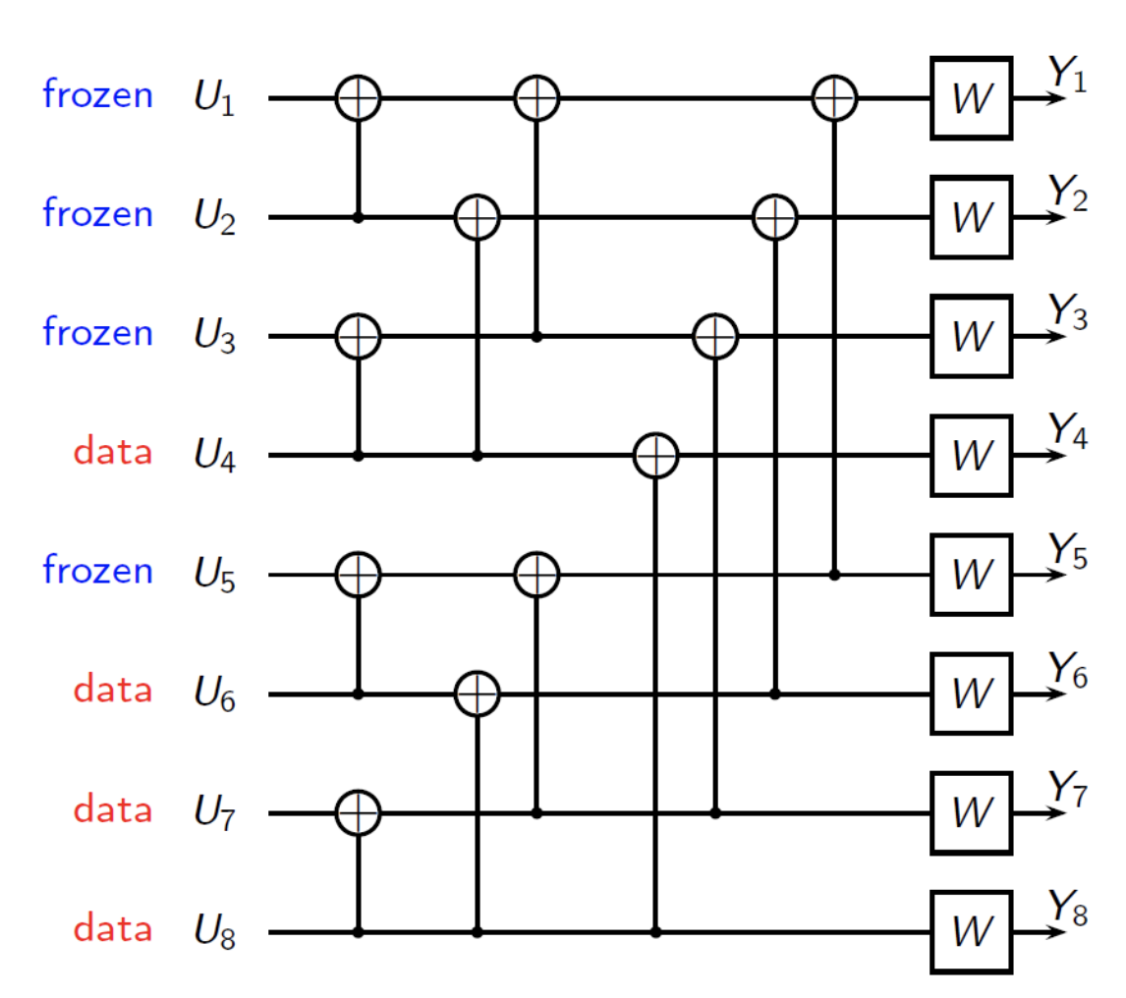
0
?
0
0
0
0
?
0
0
0
?
0

Slide 3
0
?
0
0
0
0
?
0
0
0
?
0

Slide 4
?
0
?
0
0
0
0
?
0
0
0
?
0

Slide 5
?
0
?
0
0
0
0
?
0
0
0
?
0

Slide 6
?
0
?
0
0
0
0
0
?
0
0
0
?
0

Slide 7
?
0
?
0
0
0
0
0
?
0
0
0
?
0

Slide 8
?
0
?
0
0
0
?
0
0
?
0
0
0
?
0

Slide 9
?
0
?
0
0
0
?
0
0
?
0
0
0
?
0

Slide 10
?
0
?
0
0
0
?
0
0
?
?
0
0
0
?
0

Slide 11
?
0
?
0
0
0
?
0
0
?
?
0
0
0
?
0

Slide 12
?
?
0
?
0
0
0
?
0
0
?
?
0
0
0
?
0

Slide 13
?
?
0
?
0
0
0
?
0
0
?
?
0
0
0
?
0

Slide 14
?
?
0
?
?
0
0
0
?
0
0
?
?
0
0
0
?
0

Slide 15
?
?
0
?
?
0
0
0
?
0
0
?
?
0
0
0
?
0

Slide 16
?
?
?
0
?
?
0
0
0
?
0
0
?
?
0
0
0
?
0

Slide 17
?
?
?
0
?
?
0
0
0
?
0
0
?
?
0
0
0
?
0

Slide 18
0
?
?
0
?
?
0
0
0
?
0
0
?
?
0
0
0
?
0

Slide 19
0
?
?
0
?
?
0
0
0
?
0
0
?
?
0
0
0
?
0

Slide 20
0
?
?
0
?
?
0
0
0
?
0
0
?
?
0
0
0
?
0

Slide 21
0
?
?
0
?
?
?
0
0
0
?
0
0
?
?
0
0
0
?
0

Slide 22
0
?
?
0
?
?
?
0
0
0
?
0
0
?
?
0
0
0
?
0

Slide 23
0
?
?
0
?
0
?
0
0
0
?
0
0
?
?
0
0
0
?
0

Slide 24
0
?
?
0
?
0
?
0
0
0
?
0
0
?
?
0
0
0
?
0

Slide 25
0
0
?
0
?
0
0
0
0
0
?
0
0
?
?
0
0
0
?
0

Slide 26
0
0
?
0
?
0
0
0
0
0
?
0
0
?
?
0
0
0
?
0

Slide 27
After a few steps …

Slide 28
0
0
?
0
?
0
0
0
0
0
0
?
?
0
0
0
?
?
0
0
0
?
0

Slide 29
0
0
?
0
?
0
0
0
0
0
0
?
?
0
0
0
0
?
?
0
0
0
?
0

Slide 30
0
0
?
0
?
0
0
0
0
0
0
?
?
0
0
0
0
?
?
0
0
0
?
0

Slide 31
0
0
?
0
?
0
0
0
0
0
0
?
?
0
0
0
0
?
?
0
0
0
?
0

Slide 32
0
0
?
0
?
0
0
0
0
0
0
0
?
0
0
0
0
?
?
0
0
0
?
0

Slide 33
0
0
?
0
?
0
0
0
0
0
0
0
?
0
0
0
0
?
?
0
0
0
?
0

Slide 34
0
0
0
0
?
0
0
0
0
0
0
0
0
0
0
0
0
?
?
0
0
0
?
0

Slide 35
0
0
0
0
?
0
0
0
0
0
0
0
0
0
0
0
0
?
?
0
0
0
?
0

Slide 36
0
0
0
0
?
0
0
0
0
0
0
0
0
0
0
0
0
0
?
0
0
0
?
0

Slide 37
0
0
0
0
?
0
0
0
0
0
0
0
0
0
0
0
0
0
?
0
0
0
?
0

Slide 38
Now you get it (hopefully), so we’ll be quicker

Slide 39
0
0
0
0
?
0
0
0
0
0
0
0
0
0
0
0
0
0
?
0
0
0
0
?
0

Slide 40
0
0
0
0
?
0
0
0
0
0
0
0
0
0
0
0
0
0
?
0
0
0
0
0
?
0

Slide 41
0
0
0
0
?
0
0
0
0
0
0
0
0
0
0
0
0
0
?
0
0
0
0
0
0
?
0

Slide 42
0
0
0
0
?
0
0
0
0
0
0
0
0
0
0
0
0
0
?
0
0
0
0
0
0
?
0
0

Slide 43
0
0
0
0
?
0
0
0
0
0
0
0
0
0
0
0
0
0
?
0
0
0
0
0
0
0
?
0
0

Slide 44
0
0
0
0
?
0
0
0
0
0
0
0
0
0
0
0
0
0
?
0
0
0
0
0
0
0
0
?
0
0

Slide 45
0
0
0
0
?
0
0
0
0
0
0
0
0
0
0
0
0
0
?
0
0
0
0
0
0
0
0
0
?
0
0

Slide 46
0
0
0
0
?
0
0
0
0
0
0
0
0
0
0
0
0
0
?
0
0
0
0
0
0
0
0
0
0
?
0
0

Slide 47
And so on until

Slide 48
0
0
0
0
?
0
0
0
0
0
0
0
0
0
0
0
0
0
?
0
0
0
0
0
0
0
0
0
0
0
0
?
0
0
0
0

Slide 49
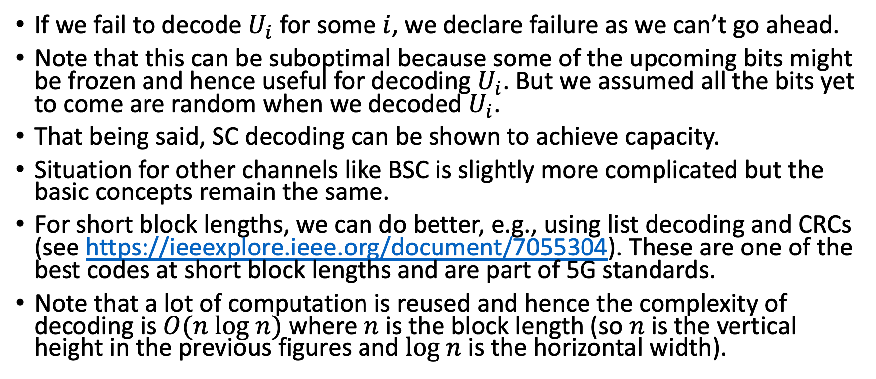
And so we succeed!!!
If we fail to decode $U_{i}$for some $i$, we declare failure as we can’t go ahead.
Note that this can be suboptimal because some of the upcoming bits might be frozen and hence useful for decoding $U_{i}$. But we assumed all the bits yet to come are random when we decoded $U_{i}$.
That being said, SC decoding can be shown to achieve capacity.
Situation for other channels like BSC is slightly more complicated but the basic concepts remain the same.
For short block lengths, we can do better, e.g., using list decoding and CRCs (see https://ieeexplore.ieee.org/document/7055304). These are one of the best codes at short block lengths and are part of 5G standards.
Note that a lot of computation is reused and hence the complexity of decoding is $O(n log n)$ where $n$ is the block length (so $n$ is the vertical height in the previous figures and $log n$ is the horizontal width).

