Slide 1
The Allure of Informational Explanations
Rosa Cao (for EE376A)
Notes:
Informational explanations are offered for a wide range of phenomena. The brain processes information; genes are informational entities; cognition is computation. But what is information, really? ( a metaphysical question)
And what is it good for explaining?

Slide 2

Informational explanations
“Most of the phenomena that are central to us as human beings - the mysteries of life and evolution, of perception and feeling and thought - are primarily phenomena of information processing, and if we are ever to understand them fully, our thinking about them must include this perspective.”
- David Marr (Vision 1982)
Notes:
What exactly is this perspective?

Slide 3
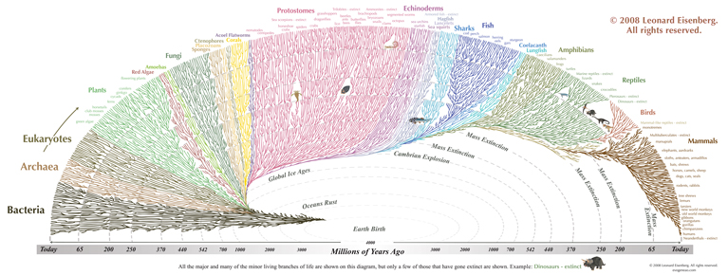
Genetic information
“Three billion bits of DNA code … spell out instructions for every function a human body carries … In just twelve months, a highly useful working draft of 90 percent of the genome will be available, and by 2003, the full DNA sequence of the human will give us unprecedented opportunities to observe and understand the literal Book of Life.”
- Francis Collins (NEJM 1999)
Notes:
One perspective: Information can be understood as INSTRUCTIONS.

Slide 4
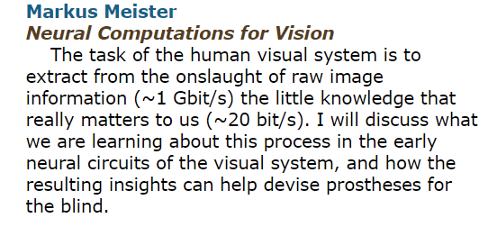

“The task of the human visual system is to extract from the onslaught of raw image information (~1 Gbit/s) the little knowledge that really matters to us (~20 bit/s).”
“I will discuss what we are learning about this process in the early neural circuits of the visual system, and how the resulting insights can help devise prostheses for the blind.”
http://www.cmi.caltech.edu/pastevents-lunches.shtml
Notes:
Another perspective: a more specific example, from a talk Markus Meister gave a couple years ago at Caltech. The visual system takes a 1gbit/s input and produces a 20 bit/s output. How are we to make sense of a claim like this? What is it even saying??

Slide 5
Meister on “Cracking the Neural Code”
Input of vision: “6 x 10^6 cones x 20 Hz bandwidth x 8 bits SNR”
Output of vision: “20 bits/s = 2 words x 5 letters/word x 2 bits/letter”
“The overall throughput of human behavior – what you can do, think, understand, remember, recall, is about 20 bits/s.”
“That is about one choice out of a million in every second!”
“The thing the visual system does is find THOSE [special] 20 bits out of so many, so that you can do what you do.”
From Meister talk: “Cracking the Neural Code for Vision” Stanford May 2017
Notes:
Now, you might have some questions at this point. What do the bits represent? In what language? Is the output of vision really in words?? How do we represent human behavior – the vast VARIETY of human behavior – in bits?
You might also think – there is no DETERMINATE 20 bits that is the output of vision – rather, we can generate ANY of a huge set of outputs, depending on context, and figuring out how and why we do that is really what we want to figure out
So what are we really talking about when we talk about information in vision, or in the brain?

Slide 6




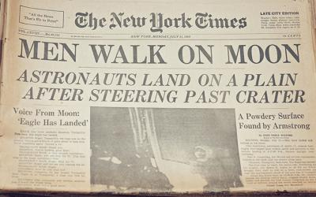
Different concepts of information
1) Statistical
2) Semantic
Notes:
Basically, the first concept is everything you might haved proved some formal result involving in this class….
And the second concept is our everyday concept, where information is ABOUT something – and used either to describe the world (as a newspaper might), or to change it, perhaps if you’re trying to bake a cake.
How are the two related?? Shannon famously said that he wasn’t concerned with the semantic content or MEANING of the messages being sent.

Slide 7
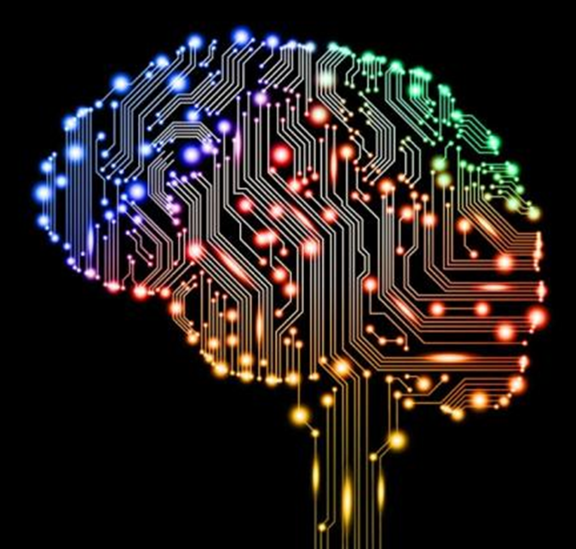
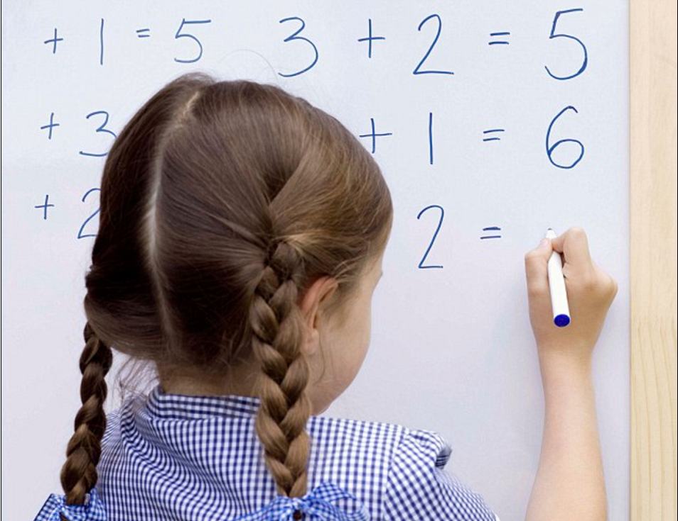
The brain is an information processing system
Notes:
What does it mean to say that the brain is an information processing system? WHICH notion are we talking about here? (You might think that every system is information processing in the first sense, but then, what’s special about the brain? What have we learned by saying it processes information?) Perhaps the exciting and interesting claim is rather than the brain processes information in the second, SEMANTIC or MEANINGFUL sense).
… or that it is a COMPUTATIONAL system. But then what is computation?

Slide 8
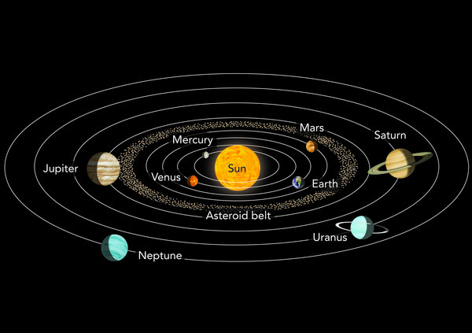
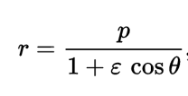
The problem of pan-computationalism
What isn’t information processing?
Notes:
Is there some activity that all and only brains and computers engage in?
That’s what would make the thesis that brains are information-processing/computational systems INTERESTING. That perception, thought, etc. are cases of information processing – unlike say, the motion of the planets.

Slide 9
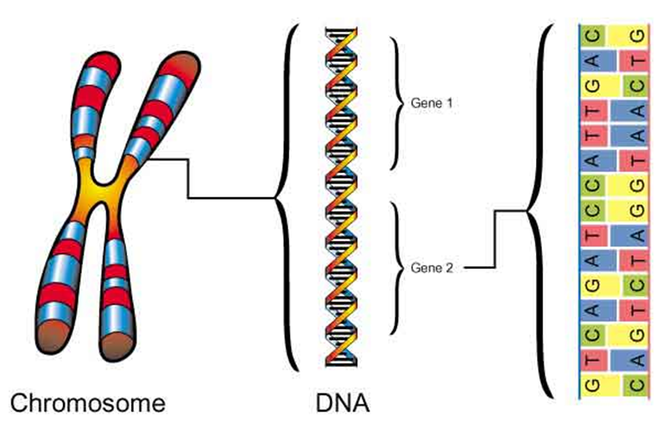

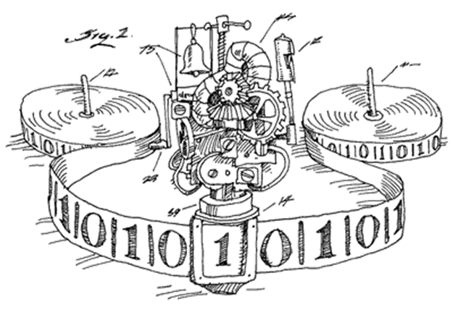
Are these cases of information processing?
Notes:
Is the transcription or translation of DNA A kind of info processing? What about light falling into a black hole? Or the operation of a TM? Processing implies something dynamic – it is manipulating, combining, using information to DO things.
But this clearly means something different for each of the two notions of information (semantic and statistical).

Slide 10
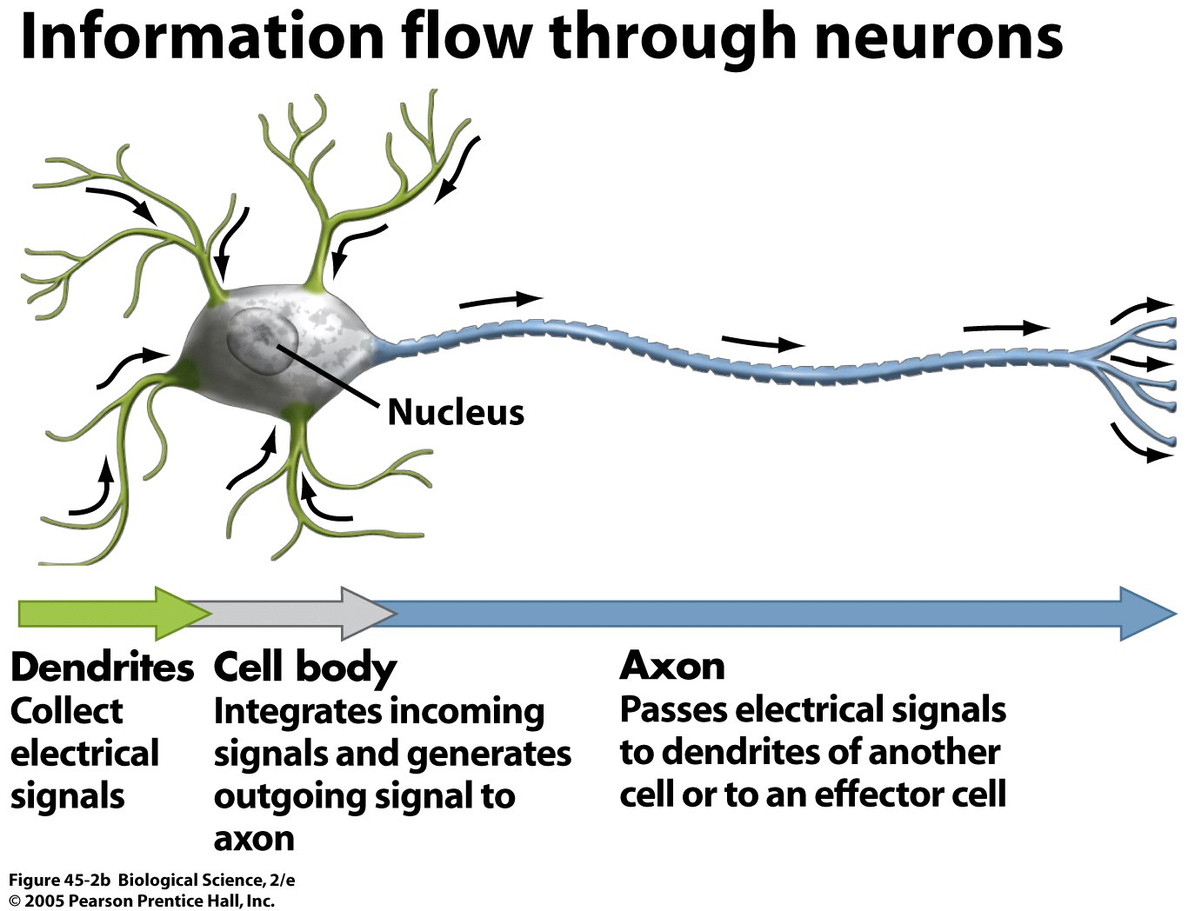
What about the brain?

Slide 11
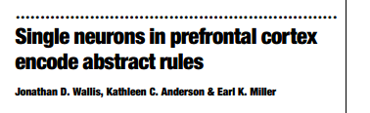
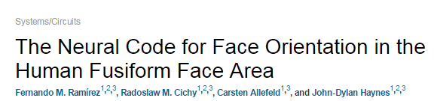
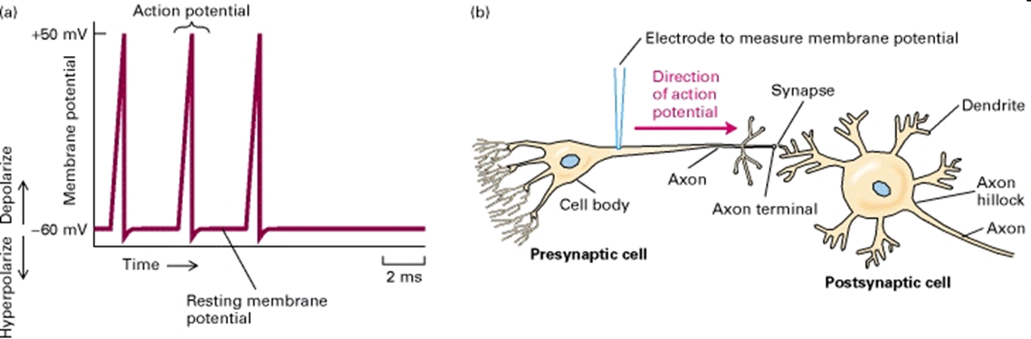
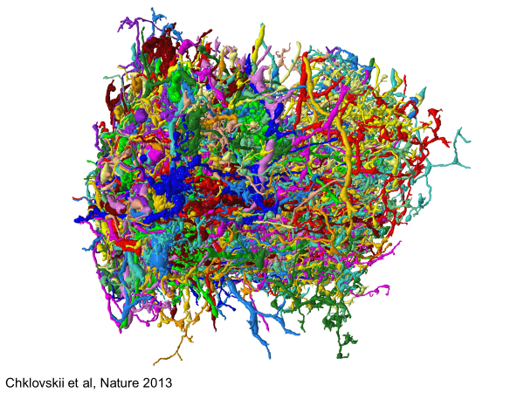
Action potentials are signals, used by the system to carry information in a neural code

Slide 12
What information do neural signals carry?
“We propose that 'understanding the neural code' means that we would know how to make sense out of the bewildering array of spike trains streaming in from the sense organs: If we understand the code, we can function as the homunculus."
Rieke, Warland, de Ruyter, & Bialek (1999) Spikes: Exploring the Neural Code
Notes:
And that view is made really explicit here.
But this is problematic in the single neuron case. Because even if we can extract information from the spiking activity of a single neuron, NOTHING in the brain plays the role of the electrophysiologist with respect to that one neuron.
If we go back, we can see that the brain is a mess.

Slide 13
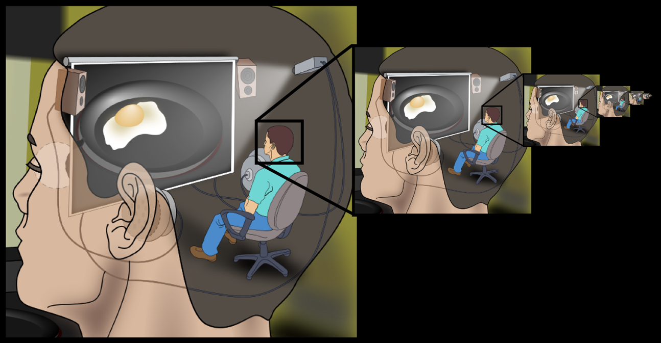
What is the user of neural information?

Slide 14
What information do neural signals carry?
It depends!
  What is the internal spike decoder?
  Does the system extract information from the spiking activity of a single neuron? Or many neurons? What information can it extract? And in virtue of what do we say that it is extracting information at all, rather than just being pushed around?
Notes:
What is assumed in studies like the ones above is that what we measure by sticking electrodes into a cell is also what the brain USES. I think we can agree that what is important SCIENTIFICALLY is information-for-the-brain. That’s what we are trying to understand. What information is this pattern of spikes carrying FOR THE SYSTEM that is going to be using it (as opposed to the observer sticking electrodes into it)?

Slide 15
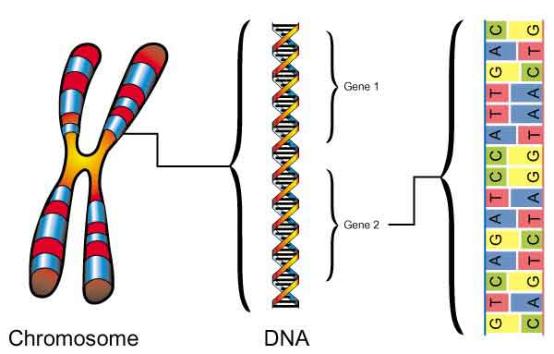
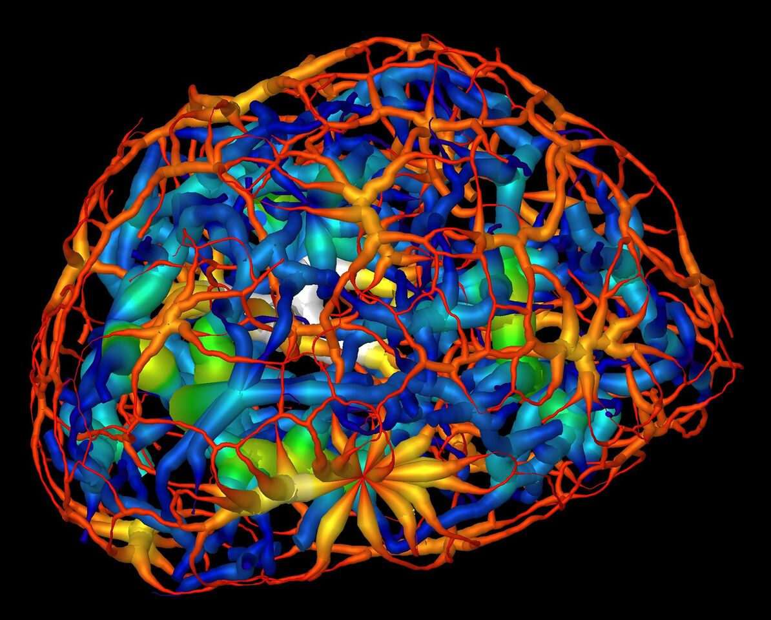
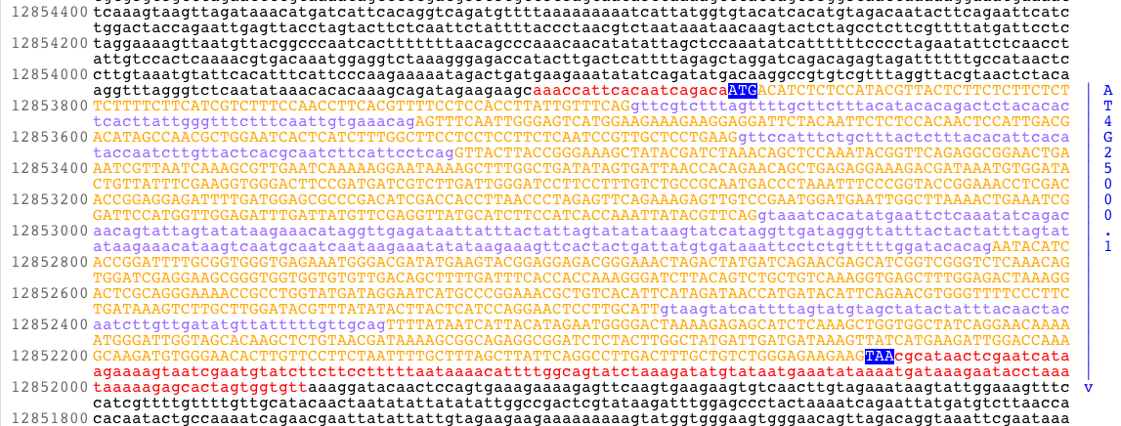
Genes
Notes:
People like Dawkins think that genes are obviously informational. But why? What is informational about them, that is not informational about a pile of rocks?
https://www.sciencedirect.com/science/article/pii/S2211124716314802
Soft x-ray tomography nuclear DNA

Slide 16
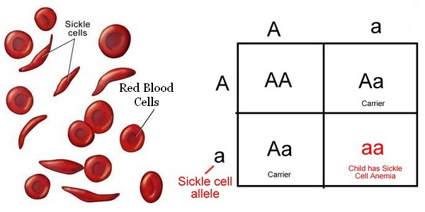

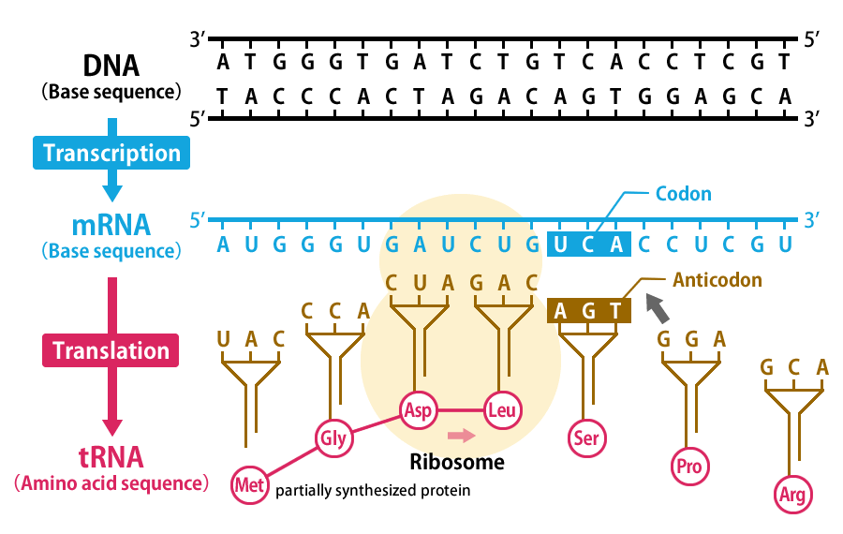
What do genes explain?
Notes:
The specificity of protein synthesis, inheritance, (why do offspring resemble their parents), the proportion of traits in a population …
How do they explain it?
Information for the developmental system?
Or just their physical properties?

Slide 17
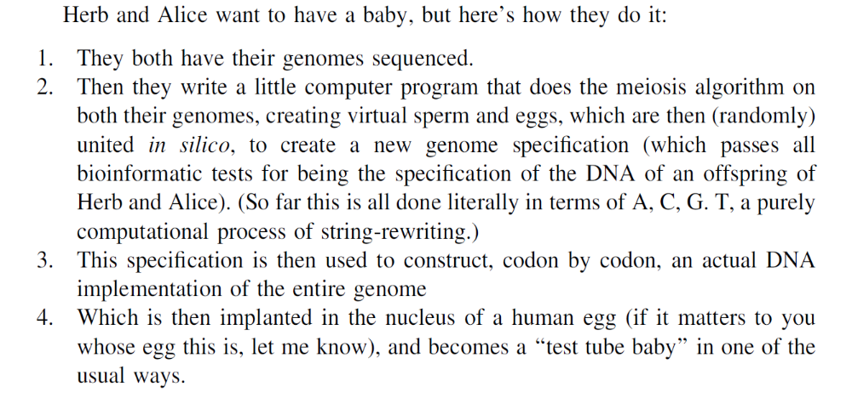
The informational gene and Baby Hal
- Dennett (2010)
Notes:
This example is supposed to demonstrate that the transmission of genes is essentially informational. Why? Because it seems that the vehicle carrying DNA information doesn’t’ matter. It could be replaced, so long as we transduce the answer back into a form (actual DNA molecule) that can be used to generate a baby.

Slide 18
How can information be causally effective?
…. Information requires users

Slide 19
The informational gene and Baby Hal
- Dennett (2010)
Notes:
It seems that the relevant reproductive technicians in this scenario are using the information.
But once you acknowledge this, then you might find yourself being pushed away from an informational perspective, and towards a view more like Searle’s. Searle famously argued that computers could NEVER think (or feel or … )

Slide 20
The Myth of the Computer
A computer can simulate the formal properties of the sequence of chemical and electrical phenomena in the production of thirst just as much as it can simulate the formal properties of anything else—we can simulate thirst just as we can simulate hurricanes, rainstorms, five-alarms fires, internal combustion engines, photosynthesis, lactation, or the flow of currency in a depressed economy. But no one in his right mind thinks that a computer simulation of a five-alarm fire will burn down the neighborhood, or that a computer simulation of an internal combustion engine will power a car or that computer simulations of lactation and photosynthesis will produce milk and sugar. To my amazement, however, I have found that a large number of people suppose that computer simulations of mental phenomena, whether at the level of brain processes or not, literally produce mental phenomena.
Searle (1982)

Slide 21
A response?
Eliezer Yudkowsky:
“ … The classic reply of course to this whole line of argument is, can you have simulated arithmetic? Can you have simulated chess? Can you have simulated information that is not really information? Can you have correct answers which are only simulated correct answers?
… intelligence is producing correct answers, and those are as good as gold no matter how you get them.”
From a Bloggingheads.tv debate between Pigliucci and Yudkowsky (2010)
https://intelligence.org/2013/01/09/new-transcript-eliezer-yudkowsky-and-massimo-pigliucci-on-the-singularity/

Slide 22
Why are answers “as good as gold”?
… because we take them to be answers, whatever the substrate?
… because we take them to be answers?
Notes:
Why is it that answers are as good as gold, whether they come on paper or in some other physical form? You might be tempted to say that it’s because answers are informational (and information, by definition, is substrate independent).
But what kind of claim is that? Is it just axiomatic that intelligence is substrate independent? (and thus no argument for that fact is either available or necessary?)
I think we do need an argument, and people only think otherwise partly because of a slide between “information” and “information-for”. We can agree that information is (by definition) substrate independent. And we can agree that answers, and knowledge, are informational. But answers and information aren’t things that are just out there, in the world. Answers are always answers for someone. Knowledge is always the knowledge of an agent (or system) – it’s what the agent knows. So in the most obvious case answers and knowledge are informational for us.
So if we are puzzled about the next move in a chess game, we can be presented with a slip of paper or a whisper, and use the information “in” either signal to make the best move. I put “in” in quotation marks because I think it’s misleading to suppose that the information is inside the signal, and all we are doing is extracting something that is has some existence independent of us.

Slide 23

If information is merely in the eye of the beholder …
Then we probably can’t
… build babies from genetic information alone
… upload ourselves
… understand our mental lives
as nothing more than
computation

Slide 24
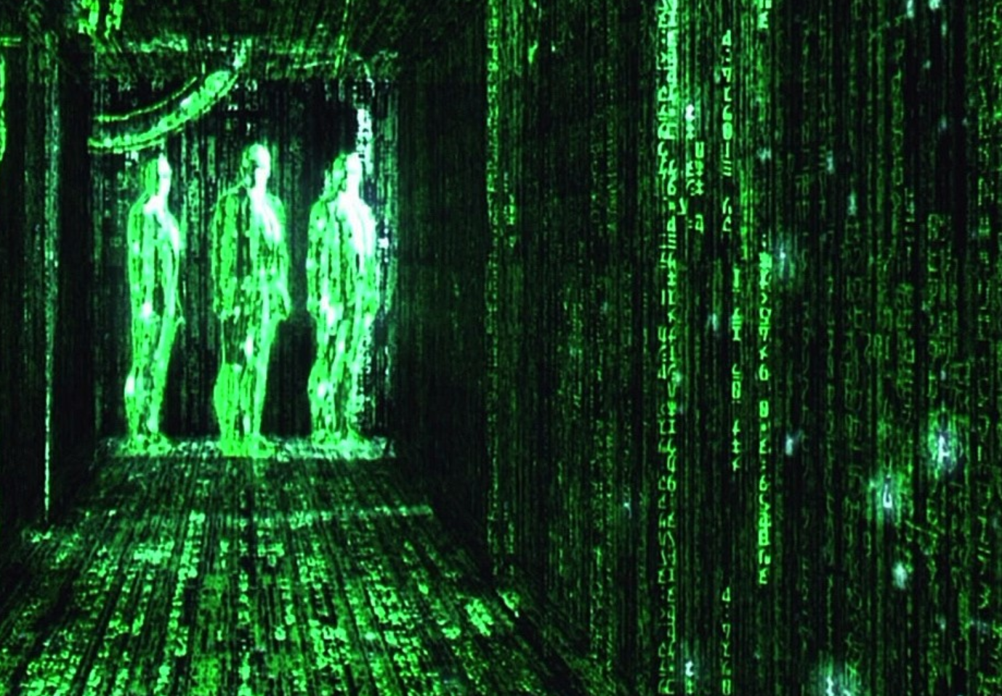
Information is a perspective on the world
Notes:
But AS a perspective, it depends on US. It is what happens when WE focus on abstract structure and function
, and when WE abstract away from particular implementations
It allows us to pick out a (potentially) physically disparate group of causal difference-makers in virtue of their same functional role, relative to our explanatory interests. (For those of you familiar with Dennett’s three stances, this might remind you of them).
They can be valuable heuristically, but we shouldn’t mistake informational descriptions for metaphysical ground truth.

Slide 25
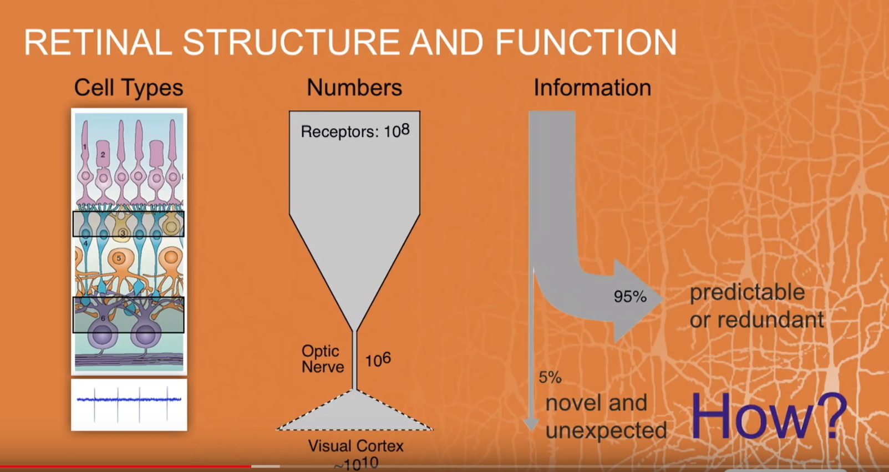
Slide stolen from Meister’s TEDx talk, Caltech 2013
Notes:
Stolen from Meister’s TedX talk…
So of course, from SOME perspective, the claim about vision makes perfect sense. But the perspective itself needs to be spelled out explicitly, and this is rarely done so in neuroscience. (Novel and expected … for whom? Predictable or redundant – given what? Do the receivers “remember” what happened last time? etc)

Slide 26
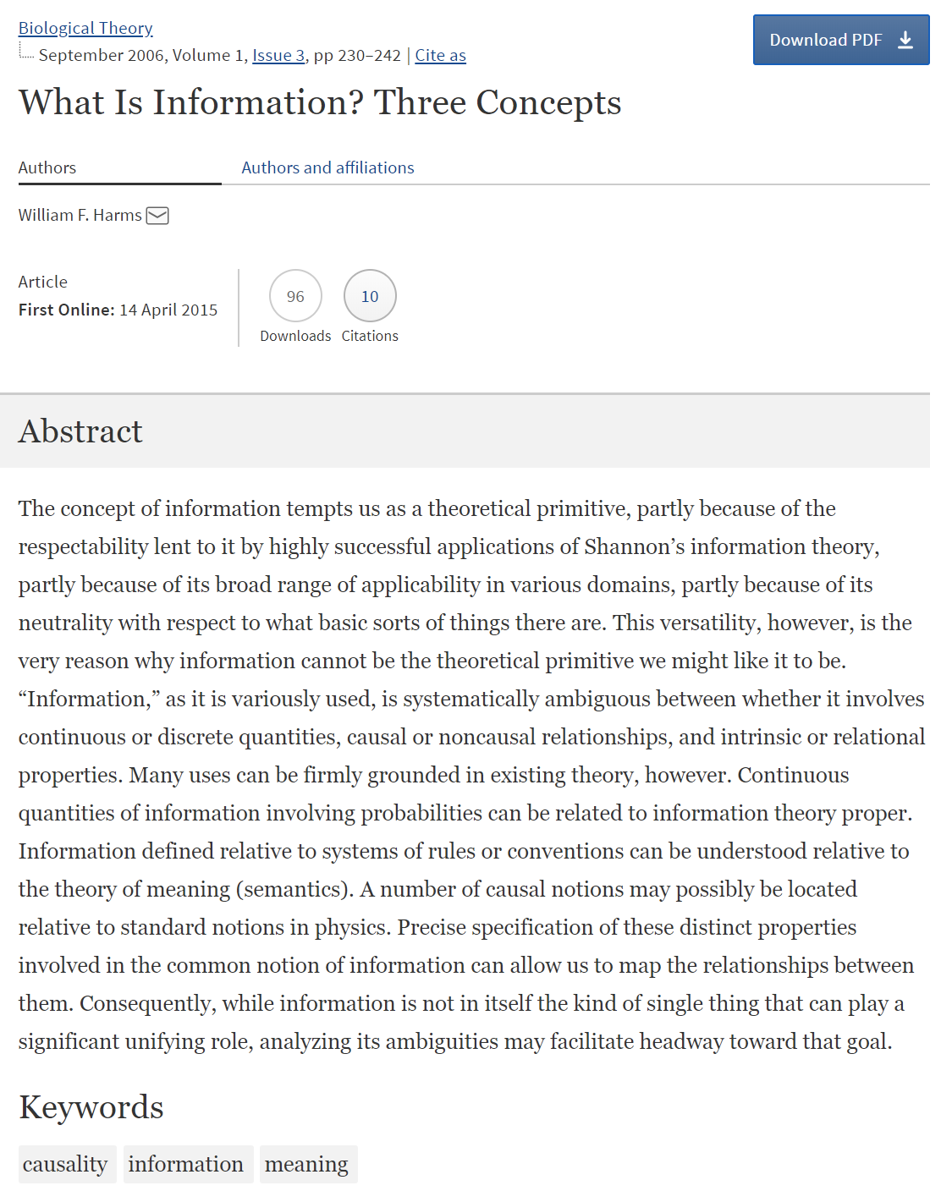
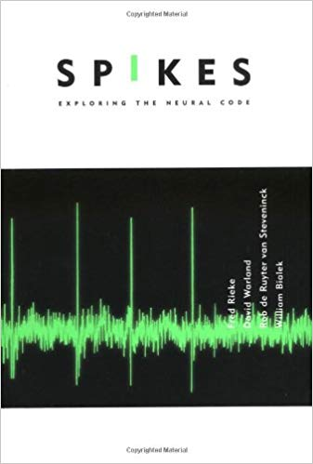
For further reading …

Slide 27
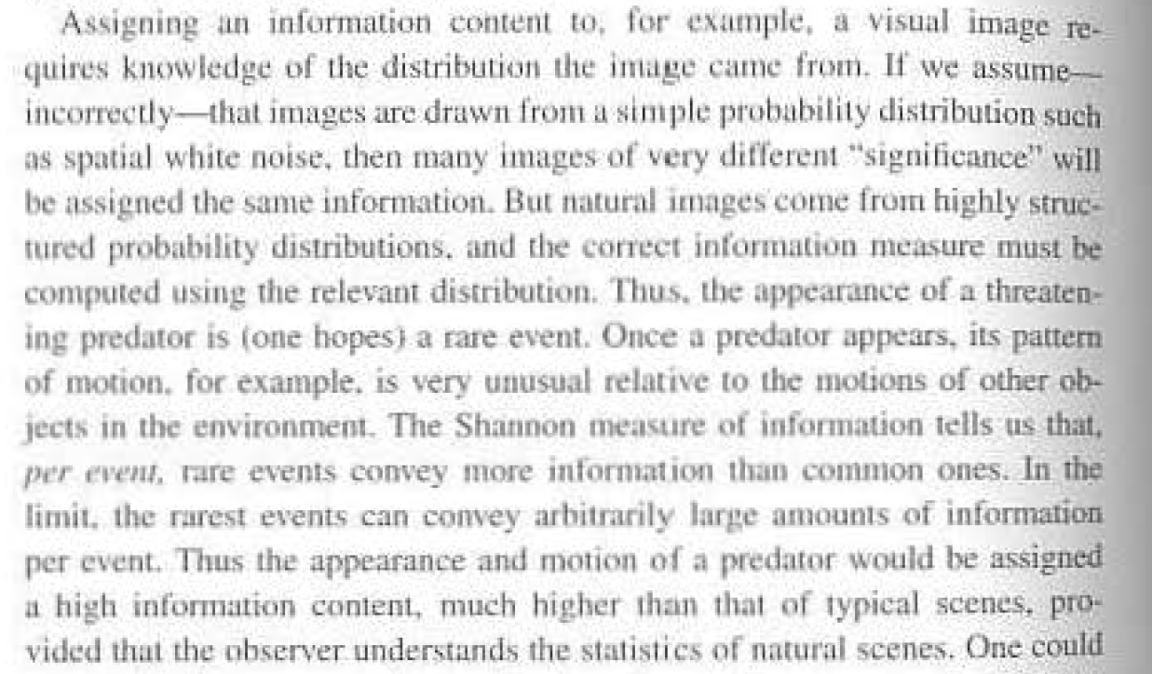
Notes:
More helpful excerpts from Rieke et al’s book

Slide 28
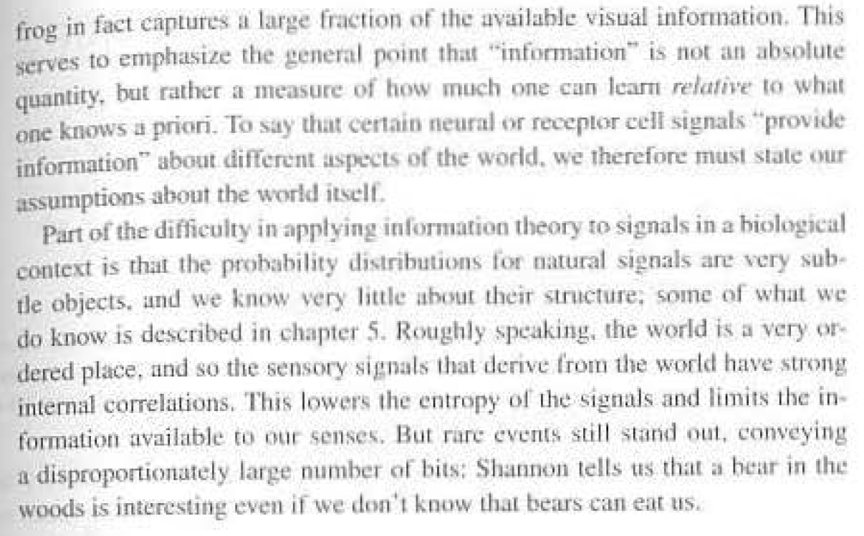

Slide 29
What information theory can do for neuroscience
Given a few assumptions, it can tell us about the limits of how much information may be transferred using the patterns of spiking activity observed in particular brain regions
Given many more assumptions, it can tell us about optimality constraints, and perhaps about more and less efficient ways of using particular spike patterns (including rate, timing, etc.) to convey information - but remember these assumptions themselves are doing lots of heavy lifting in terms of neuroscientific explanation.
In particular, if we are strongly adaptationist, we can assume optimality in order to specify the coding scheme
(see e.g. Palmer, Chirimuuta, Bialek).
It can help us with data analysis and data collection, as a matter of engineering
Notes:
What information theory can and cannot do for neuroscience:
1 – Given a few assumptions, it can tell us about the limits of how much information may be transferred using the patterns of spiking activity observed in particular regions.
2 – Given many MORE assumptions, it can tell us about optimality constraints, and perhaps about more and less efficient ways of using particular spike pattenrs (including rate, timing, etc.) to convey infomraiton. (but these assumptiosn themselves are doing lots of heavy lifting).
2a – In particular, if we are strongly adaptationist (and it’s not clear we should be), we can assume optimality in order to specify the coding scheme. (i.e. it’s always optimal – see Palmer, Chirimuuta, Bialek).
3 – It can help us with data analysis and data collection, as a matter of engineering.

Slide 30
What information theory cannot do for neuroscience
… It cannot explain meaning or representation.
It does not tell you what the information being passed is about, nor how the brain makes use of it.
Notes:
What it CANNOT do:
Any of the things that Tsachy promised you in the first class!
In particular, it does not explain MEANING, it does not tell you what the informaiton that is being passed is ABOUT, or how the brain makes USE of it.
Partly this is because we don’t know what the decoder is; there might be many decodings of the same signal.
WHY? What is crucial in connecting info theory to things we actually care about are the CONVENTIONS – for example, the conventions that we use to connect the things we care about to these abstract representations in terms of 1s and 0s. In systems we build, we stipulate these conventions, and they are embodied in the decoders that we design to handle the signals that we encode.
In neuroscience, we are engaged in an enterprise of REVERSE ENGINEERING, and so the conventions are just as much of a mystery as the content that is conveyed using those conventions.

Slide 31
Why is information special?
The ontological question
How is information different from other resources for a biological system?
The explanatory question
How is information different from other explanatory resources for a theorist?
Notes:
Let’s take a step back now. In posing these questions, I am supposing that information is a genuine resource for biological systems,including orgnaisms, but also congitive systems. I say biological, but you could apply this account to any system where you feel justified in saying that it is a system with AIMS, or function, and that can do well or poorly with respect to those aims.
As with other resources, information may be sought, stored, consumed, lost. But how is it UNLIKE other resources?
Epistemic: I’m supposing that there is a special NEED to appeal to information in some explanations, again, in biology but also in other sciences dealing with goal-oriented systems.
So I’m going to try to address these questions. And to make the job easier, I’m going to consider the information in SIGNALS: that is, in intermediaries either between parts of the same system, or between different individuals. I won’t be talking about other kinds of information (e.g. structural or physical information).
And to distinguish, you might think of the kind of information I’m interested in as minimally semantic natural information – correlational infromation between a signal and some state of affairs, where the information carreid by the signal is ABOUT that *other* state of affairs. And I’ll distinguish between signal vehicles - the physical stuff of the signal, and signal CONTENTS – the information carried by the sginal.

Slide 32
Information is a resource for dealing with coordination problems
Complex organisms need to coordinate their parts and processes
- motor control
- development
… or match behavior to environment
- perceptual guidance of action
- learning
Distinct individuals may need to work together
- mating
- alarm calls
- language
Notes:
There are different behaviors or actions appropriate to different states of the world. How does the system know which one to execute? How does it match up the right action with the sitaution it’s in?
So quite naturlaly, the theorist adverts to information when explaining how certain coordination problems are solved – including, and especially, the problem of communication. I’m supposing here that represntaitonal explanaitons are a kind of informational explanaiton, but may have further requriemetns.

Slide 33
Proposal
Unlike other resources, informational signals are valuable to the organism for their relational features, rather than the material properties of the vehicle.
A signal M has the potential to be exploited for its informational content about a state of affairs S when P(S|M) ≠ P(S)
Notes:
So for exmaple, food is not like this. Clothing is not like this.
Other ways to solve coordination problems can be non-informational.

Slide 34
Informational explanations abstract away from physical properties of the vehicle
Explanation aims at an optimal level of generality.
Explanations invoking information will be robust to changes in the vehicle, but sensitive to changes in correlational facts between vehicle and relevant states of affairs.
Information is paradigmatically substrate independent and multiply realizable.
Notes:
So when as theorists we invoke information, we are trying to give an explaantion that is more genreal than one that appeals to physical features of the vehicle.
Informational explanations thus match the phenomena: they are ROBUST to changes in the vehicle, but sensitive ot hcanges in correlaitonal facts.
if the vhicle in the system changed, the explanatio nwould still be valid. But if the correlational facts changed, it would not.
The very idea of a vehicle content distinction requires that we think of information as something that could be carried in many dfiferent vehicles. And once we have given an informatiaonal explanation, the inference to “and thus this system is multiply realizable” is often automatic. (espeically in philosophy of mind). I think this inference will only be valid if we are judicious in applying informational explanation to systems with MR functions in the first place.

Slide 35
What kinds of systems call out for informational explanation?
Ones that
… solve a coordination problem
… use a multiply realizable or substrate independent mechanism
… exploit correlations between vehicles and states of affairs
Notes:
So to bring our two questions together: what kinds of systems call out for informatiaon explantion? Only those systems that a) solve a coordination problem b) via an MR mechanism that exploits correlations between vheicles and states of affairs. These correlations may be directive, in the sense of program information. The presence of a vehicle can make a future state of affairs more likely, by setting into effect a causal chain of events that changes the probability of a particular outcome.

Slide 36
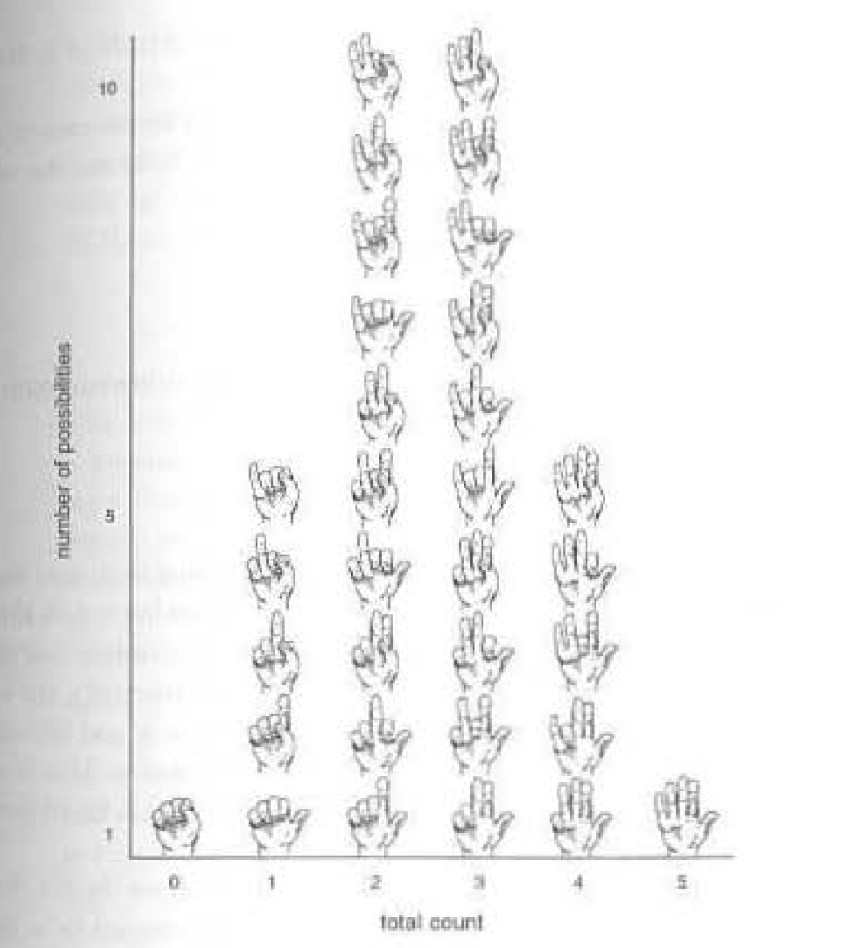
Notes:
Rieke ch 3.1

Slide 37
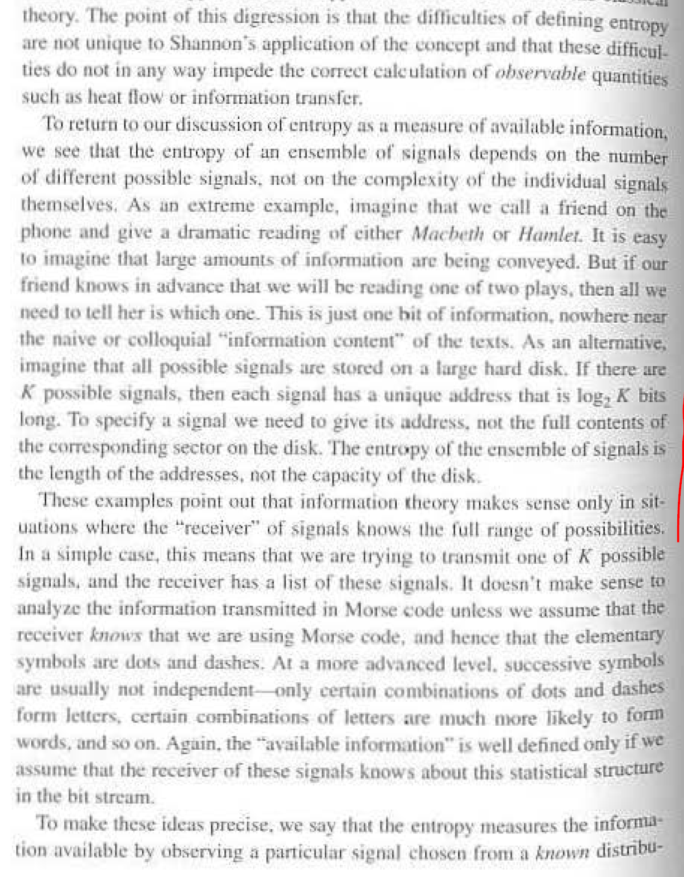

Slide 38
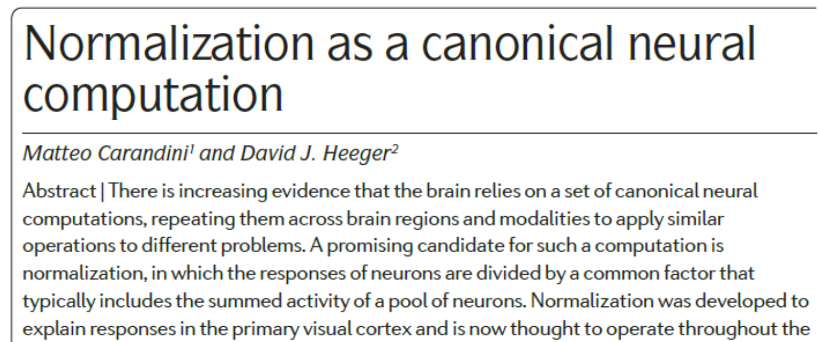
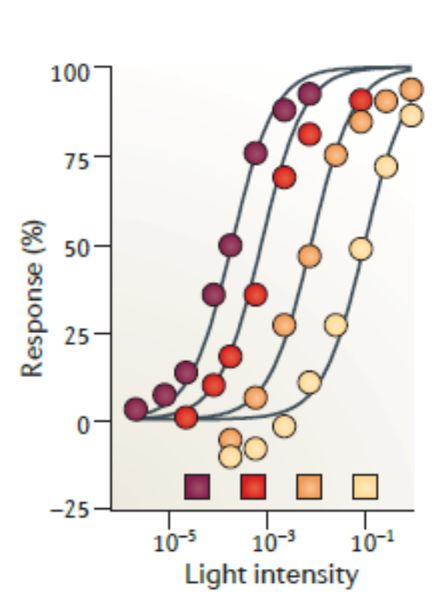
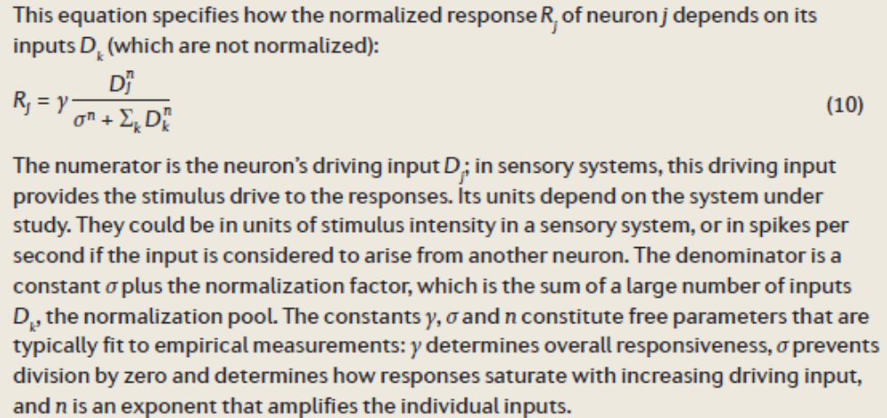
from Carandini & Heeger (2012)
Notes:
Normalization can serve as a means of gain control – here we see maintained sensitivity to contrast under different background light intensities. This allows for maximum sensitivity and invariance to certain features (in this case, light intensity). It is also a mechanism for “winner-take-all” effects, as you can see below. (2nd and 3rd panels).

Slide 39

What is being normalized?
Input drive→ →Firing response
Input from normalization pool
Notes:
Two things to note. The drive is measured as stimulus intensity (potentially), or spikes from an upstream neuron.
The response is measured in the firing rate of the cell. The same holds for the other canonical computations – linear filtering and exponentiation.

Slide 40
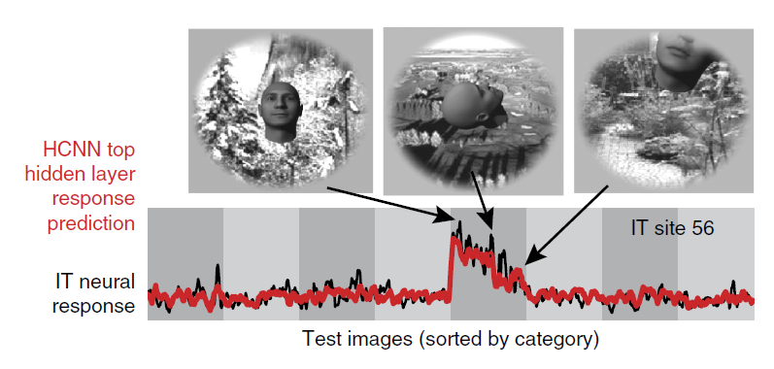
The brain processes semantic information
Yamins & DiCarlo (2016)
Notes:
Maybe instead we want to say something more restrictive: that the brain processes SEMANTIC information. Recall that semantic information is information ABOUT something.
Why would we think that? Two reasons. Top down and bottom up.
Top-down .. As Marr says. A computational problem is the problem of performing some task, or solving some PROBLEM.
Bottom-up … neurons and their stimulus evoked activities REPRESENT the thigns-in-the-world that caused them to respond.
Do these meet up in the middle? Well, sometimes. (newsom).
But even if they DO meet up in the middle, it’s not SUFFIIENT .. Is it? Bceause we can tell this same story about plaents.
What makes it GENUINE repesntaiton? (well, does it have to feel like something? Does there have to be something that I’s like, some intenral IMAGERY that makes it represntaiton? Does it just have to be in US?)

Slide 41
Searle’s “Myth of the Computer”
Massimo Pigliucci:
“Suppose that, instead of human thought, we're talking about another biological function, let's say photosynthesis for instance, which is very well understood at a chemical level.
… you can simulate all you want, the one thing you're not going to get out of the simulation is sugar, which is the outcome of photosynthesis … what's important about photosynthesis is not just the [informational] structure of the process, it's the actual physical particular implementation.”
Notes:
This is from a bloggingheads debate a few years back …
A computer can simulate the formal properties of the sequence of chemical and electrical phenomena in the production of thirst just as much as it can simulate the formal properties of anything else—we can simulate thirst just as we can simulate hurricanes, rainstorms, five-alarms fires, internal combustion engines, photosynthesis, lactation, or the flow of currency in a depressed economy. But no one in his right mind thinks that a computer simulation of a five-alarm fire will burn down the neighborhood, or that a computer simulation of an internal combustion engine will power a car or that computer simulations of lactation and photosynthesis will produce milk and sugar. To my amazement, however, I have found that a large number of people suppose that computer simulations of mental phenomena, whether at the level of brain processes or not, literally produce mental phenomena.

Slide 42
If, on the other hand, the set of possible difference-makers are physically similar, and only manage to do what they do in ways that depend on physical features that they share, then it may be that an explanation that picks them out in virtue of their informational (correlational) features will not have explanatory advantages over one that picks them out by their common physical features. Instead of being virtuously general, and unifying multiple stories into a single explanation, it would overgeneralize, capturing non-difference-makers as well.

Slide 43

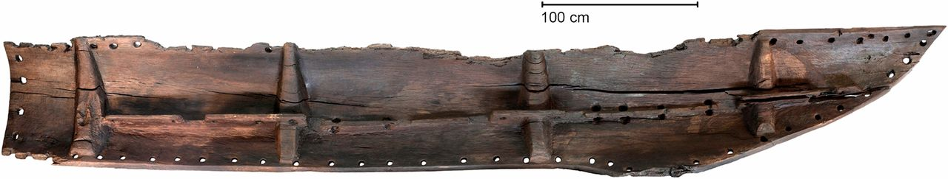
What are memes?
“A unit of cultural transmission, or a unit of imitation”
- Dawkins, The Selfish Gene (1976)
“Memes are ways” [of behaving, doing, making]
- Dennett, From Bacteria to Bach (2017)
Words
Designs (canoes, hats, tools …)
Behaviors
Tunes, movies, books ...
Notes:
Tunes, ideas, catchphrases, way of making canoes …
Anyone know what this cat is watching?
How do we identify memes? How do we pick them out, when they have nothing in common BUT their information? They’re like snippets of information.

Slide 44
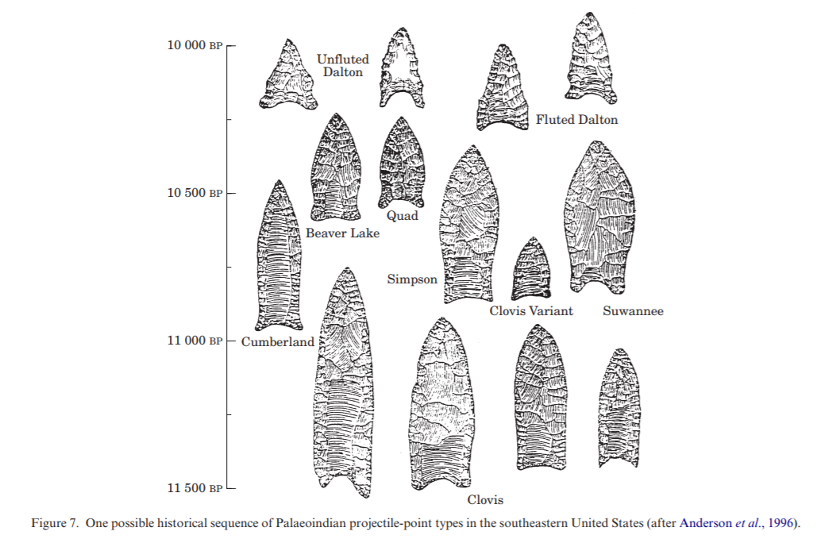

What do memes explain?
Notes:
That is, if evolutionary processes involving memes are the answer – what is the question? Is it the spread and distribution of memes? Their relative prevalence? … There are ambitious proposals: the evolution of tools, and LANGUAGE as a particular kind of cognitive tool. Less ambitiously …
But now I’m getting to the worry: Compare memetic explanation with regular evolutionary explanations,w hich are supposed to tell us WHY there’s a higher prevalence of sickle cell anemia in areas where malaria is endemic. Evolutionary eplxanations demystify facts about evolved creatures by appealing to facts about their selective environments.
But then, if we want to explain why memes are distrubited or hae the features that THEY do, ew haveto appeal to features of THEIR selective environments. And their selective enviroemnts … are us. are our cognitive systems and our behavioral profiles.
So we can certainly appeal to those to explain the distrubtion of various things. (we find cats cute because their faces are babylike, and therefore the internet is overrun by cat pictures …)
but it then we have to be CAREFUL if we turn around and try to explain our cognitive systems and profiles in turn by appealing to MEMES. (co-evolutionary stories are okay as long as they are spirals, and not circles … )
https://www.sciencedirect.com/science/article/pii/S0305440301906818

Slide 45
Generative entrenchment
Wimsatt has argued that evolved systems show multiplexing of functions over time (1986)
Sometimes the same infrastructure simultaneously supports many functions (e.g. oxytocin)
The more thoroughly a biological system makes use of its material substrate, the tighter the constraints on possible materials that can play the same functional role
Generative entrenchment creates multiplexed functions, which are more likely to have unique realizers because more functional requirements impose more constraints.
Notes:
I’ll also note here that many evolved systems tend towards pleitropic non-modularity in the absence of specific selection FOR modularity because of what Wimsatt calls generative entrenchment. When some infrastructure is always present, it can get co-opted for multiple functions.
Evolutionary or developmental processes produce characterisitic deependencies of a kind described by Wimsatt as GENERATIVE ENTRENCHMENT.
If even one interface molecule (responsible for signaling between components) plays a dual purpose, that serves to lock down variation in the realization substrate of the components on either end. Those components are now constrainted to respond o the interface molecule. And they have to respond in two or more ways at once.
(So one implciaiton is that cue sensitivty may not be as highly sepcialized as signal sensitivity)
w

Slide 48
Information is a resource for dealing with coordination problems
Complex organisms need to coordinate their parts and processes
- motor control
- development
Or match behavior to environment
- perceptual guidance of action
- learning
Distinct individuals may need to work together
- mating
- alarm calls
Notes:
There are different behaviors or actions appropriate to different states of the world. How does the system know which one to execute? How does it match up the right action with the sitaution it’s in?
So quite naturlaly, the theorist adverts to information when explaining how certain coordination problems are solved. I’m supposing here that represntaitonal explanaitons are a kind of informational explanaiton, but may have further requriemetns.

Slide 50
Notes:
In these contexts, the circularity isn’t’ an issue, since we aren’t ASSUMING what is to be eplxained.

Slide 52
Five aptness conditions for invoking information.
Agent-like-ness of user R, with the capacity to “care” about X
Strength of correlation between Y and X
Degree of substrate independence (multiple realizability)
Specialization of informational vehicles as such (i.e. modularity with respect to informational function of the system in which Y operates)
Separation of X from Y (distinct, and temporally or spatially distant)
Notes:
Although there seems to be enough flexibility/variation/vagueness in information language so that it can and is imposed just about anywhere, I want to argue that it does the most honest work when following conditions apply.

Slide 53
When is there exploitation of the information in a signal?
Swap Test
The resource would maintain (much of) its value if we changed the vehicle, but maintained the correlation between the signal and the relevant states of affairs.
Wiggle test
If we were to strengthen the correlation between the signal and what it carries correlational information about, the system should exhibit greater success in its task. (And if we were to break the correlation between the signal and what it carries information about, the system should do less well). Shea (2012)
Notes:
Here are two tests: and my proposal is that when the signal seems likely to pass these tests, the theorist adverts to information to describe the signal’s contirbution to the functioning of the system.
For the counterfactual test, we would also need to provide a transducer to allow the new signal vehicle the ability to interface appropraitely with its receiver.
For Shea’s test, we’re holding everything else constant, not increasing false positives or false negatives, and supposing no ceiling effects.

Slide 54
Some popular examples of info epxln

Slide 55
What kinds of systems have parts with multiply realizable functions?
Modular systems exhibit functional specialization and functional separation.
  Functional specialization allows for division of labor
  Simpler functions impose fewer constraints on their realizers.
  Functional separation limits the degree of interaction across module boundaries.
By contrast, when a system is holistically organized, realizers may have to participate in many tasks and are thus subject to more constraints.
Notes:
Substrate independence comes in degrees. But here are some condiitons which make it easier to for a function to be multiply realized (and thus for the signal vehicels involved in performing that function to be substrate independent).
Let me start with something obvious – functions impose constraints on realizers. You can’t make a skating rink out of just anything. But it IS supposed to be the case that you CAN make an info vehicle out of anything – so long as the info channel nad receiver together are appropriate.
Some functional architectures impose more constraints on what physical components can realize functional roles within those architectures than others.
When the functional organization of a system is modular, each module is replaceable – lal you need to worry about is that your replacement is faithful to the interactions across the interface.
The nature of the interactions across that interface will also matter. When interactions between components are dense and varied, more constraints are imposed.
By dense I mean numerous, and by varied, I mean that a variety of mediums of exchange are employed. If we are allowed only to signal to each other using a single medium, be it currency or electrons, then we only need one kind of transducer. If the interactions are localized to an interface that is a small part of the component, then again, that frees up the rest of the component to be made of other things.
Modularity is a matter of degree – and depending on what you are interested in, which of the innumerable actual physical interactions across a boundary are the important ones will vary.

Slide 56
Generative entrenchment
Wimsatt has argued that evolved systems show multiplexing of functions over time (1986)
Sometimes the same infrastructure simultaneously supports many functions (e.g. oxytocin)
The more thoroughly a biological system makes use of its material substrate, the tighter the constraints on possible materials that can play the same functional role
Generative entrenchment creates multiplexed functions, which are more likely to have unique realizers because more functional requirements impose more constraints.
Notes:
I’ll also note here that many evolved systems tend towards pleitropic non-modularity in the absence of specific selection FOR modularity because of what Wimsatt calls generative entrenchment. When some infrastructure is always present, it can get co-opted for multiple functions.
Evolutionary or developmental processes produce characterisitic deependencies of a kind described by Wimsatt as GENERATIVE ENTRENCHMENT.
If even one interface molecule (responsible for signaling between components) plays a dual purpose, that serves to lock down variation in the realization substrate of the components on either end. Those components are now constrainted to respond o the interface molecule. And they have to respond in two or more ways at once.
(So one implciaiton is that cue sensitivty may not be as highly sepcialized as signal sensitivity)

Slide 57
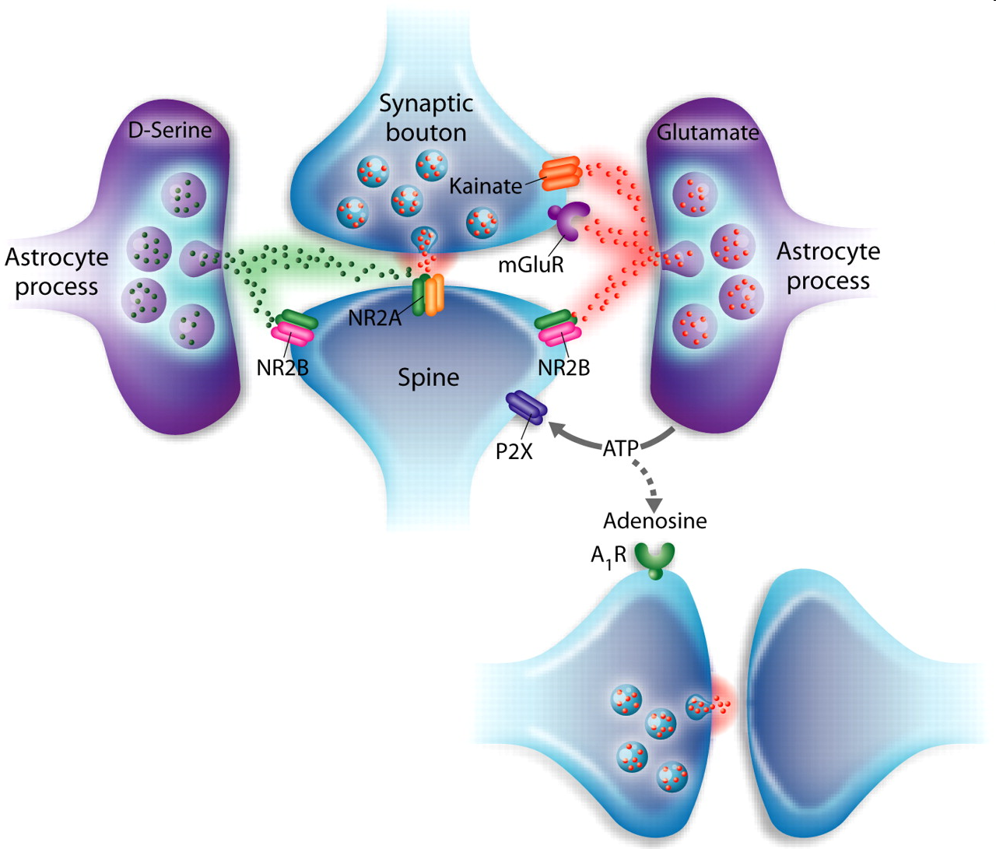
ATP
Haydon & Carmignoto 2006
Notes:
The multiple uses of ATP within the system illustrate a case of generative entrenchment. One example of pleitropy. Lots of others. Oxytocin, etc.
Here are some more functional interactions that seem to be substrate dependent.
ATP (adenosine triphosphate) is commonly described as the energy currency of the cell. In the brain, as elsewhere in the body, ATP is the high energy product of cellular respiration, and is trafficked around the cell and used as the mobile power source for ion pumps, protein regulation, and synthesis. These functions appear entirely biological, and one might suppose that they play no role in causal economy of the brain that gives rise to mental states. However, ATP also plays an role in intercellular signaling in the brain. Astrocytic calcium waves, which have been shown to modulate neural activity, propagate via ATP. ATP is also degraded in the extracellular space into adenosine, which inhibits neural activity. Within neurons, ATP hydrolysis is one of the sources of cyclic AMP, which is involved in numerous signaling pathways within the cell, including those that modulate the effects of several neurotransmitters producing effects on the neuronal response to subsequent stimuli in less than a second. Cyclic AMP is also involved in the regulation of intracellular calcium concentrations from internal stores, which can have immediate and large effects on the efficacy of neurotransmitter release from a pre-synaptic neuron.
Astrocyte-derived signals act both presynaptically and postsynaptically to regulate synaptic transmission. The release of glutamate, D-serine, and ATP from astrocytes has a diversity of synaptic actions. Presynaptically, glutamate can access metabotropic glutamate receptors (58) and kainate receptors (120) to enhance synaptic transmission. Postsynaptically, glutamate can act on extrasynaptic NMDA receptors to depolarize the neuronal membrane and promotes neuronal synchrony (54), while D-serine acts on the glycine-binding site of NMDA receptors and can regulate synaptic plasticity (159). ATP may also act postsynaptically on P2X receptors to depolarize the neuronal membrane and regulate the insertion of postsynaptic AMPA receptors (68). After hydrolysis by ectonucleotidases to adenosine, ATP can have distant action on presynaptic A1 receptors to cause heterosynaptic depression of excitatory synaptic transmission (164).

Slide 58
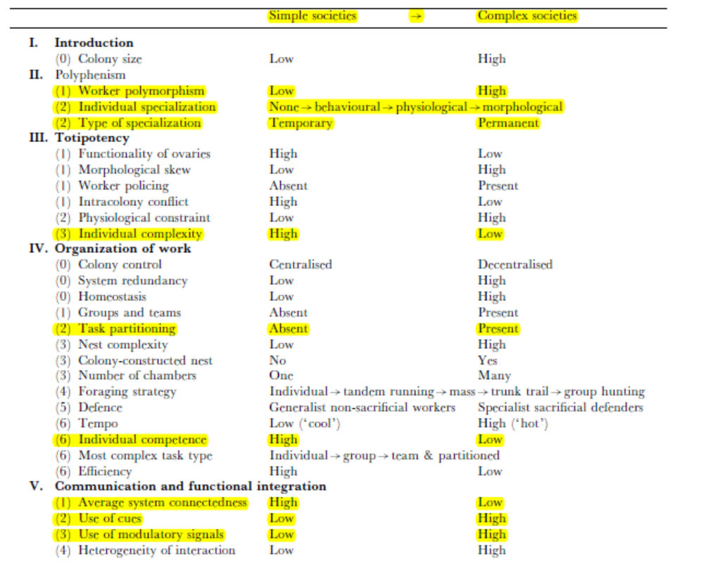
Table 1 from
Anderson & McShea (2001)
Notes:
Here’s a fascinating example from Anderson and McShea, showing some concomitants of functional specialization. Complex ant societies exhibit higher degrees of functional specialization.

Slide 59
Concomitants of functional specialization
Complex colonies
- Members exhibit greater functional specialization
Lower individual complexity
Lower individual competence
Higher use of signals and cues
More spatial specificity in signals sent
Smaller colonies with simpler structure
Members exhibit little/no functional specialization
Higher individual complexity
High individual competence
Low use of signals and cues
Low spatial specificity in signals sent
Notes:
As you can see: and all of these contribute to easier multiple realizability of the ocmpoentns.
Complex colonies show more use of signals and cues (that we might presume are exploited for their informational content). And at the same time exhibit the orgnaizational features of functional sepcialziaiton that make multipel realizability more likely (and thus informatioanl explantion more appealing).

Slide 60
Interim Summary
Informational explanations are apt when the system is solving a coordination problem by employing signals whose value lies not in their vehicle properties but rather in the correlational information they carry.
When the signaling apparatus is multiply realizable, vehicle properties become unimportant in the explanation.
Multiple realizability requires functional specialization and modularity of the system.
Informational explanations are best suited to describe modular systems with a specialized information transmission mechanism.
Notes:
I’ll go through a couple of more examples, trying to show that modularity and a general purpose informational mehcanism makes the ifnormation ascrtipion look more apt.
Only those systems that a) solve a coordination problem b) via an MR mechanism that exploits correlations between vheicles and states of affairs.

Slide 61
Baby Hal
Dennett (2010)
Notes:
Dennett thinks that this exmaple demonstrates that the transmission of genes is essentially informational. Why? Because it seems that the vehicle carrying DNA information doesn’t’ matter. It could be replaced, so long as we transduce the answer back into a form (actual DNA molecule) that can be used to generate a baby.
I’m not sure this example works – I imagine there are a lot of biological details (histones, configutaiton of the genome etc.) that go into determining the “DNA implemetnation” that would be lost if we tried to do thing sthis way. (ie. Dnenett’s codon by codon constructoin might not work). But if it doesn’t work, it will be because modularity was violated – it turns out that the DNA implementation is successful not jus tbecause it correlates well with the DNA of the parents, but also because the vehicle has a paritcular shape, and kinetic dispositions.
AND, if it does work, it will be because they system is MODULAR in an interesting way.
(also, I realize this isn’t obviously best interpreted coordination problem, although it does require the system to bridge a gap in space and tiem. (it could be that Hal needs to coordnate with the enviroment and does so best by this eemcahnism). But that might be a othe rreason to think that info eplxn is not apt here).

Slide 62
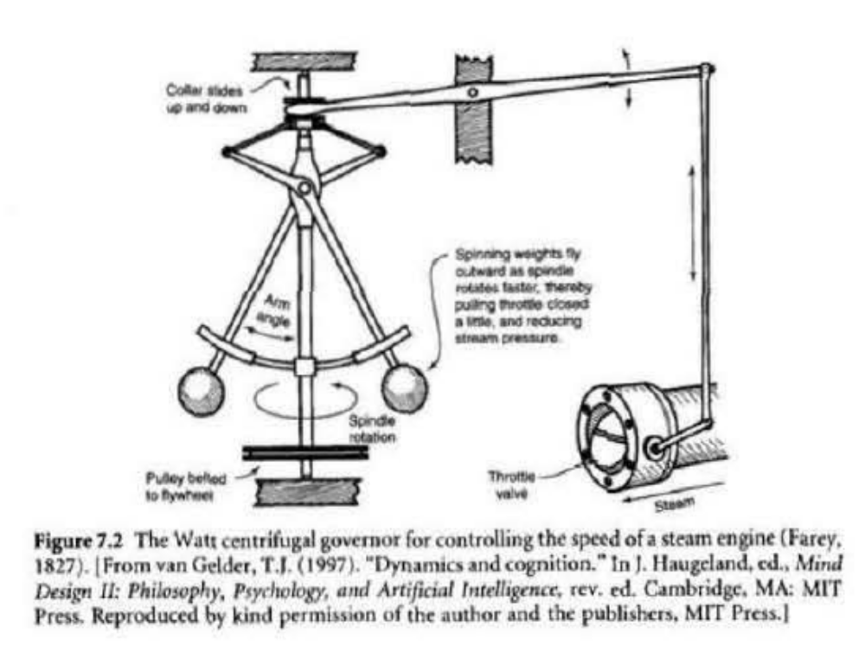
Notes:
So this is a machien that solves a coordination problem. Keeping the flow of steam steady. There are strong correlations throughout the system between the amount of steam coming out, the angle of the arms, the throttle valve, etc. But it is contentious whether this system is best given an informational description, or rather a dynamical/mechanical one. For one thing, there is no clear SPECIALIZED portion for acting as a signal – each physical compoent whose state carries infromatio nabout the steam pressure, for example, is also directly invovled in action. There is no separation between signal and receiver.
At this point I should note that an informatiaonl desceirption is almost always available. But it is not always obviously better than the non-informational alternatives.
Although the angle of the arms correlates with speed of the engine (input) and controlled the steam pressure (output), van gelder argued that that there was no gain in explanatory utility from attributing representational content to the arm angles, as opposed to describing all the parts and how they interfaced with each other to produce the desired output – without any reference to representaitons.

Slide 63
The algorithmic steam governor
Algorithm
1. Measure the speed of the flywheel.
2. Compare the actual speed against the desired speed.
3. If there is no discrepancy, return to step 1. Otherwise,
a. measure the current steam pressure;
b. calculate the desired alteration in steam pressure;
c. calculate the necessary throttle valve adjustment.
4. Make the throttle valve adjustment.
Return to step 1.
Parts Needed
Tachometer
Device for calculating speed discrepancy
Steam pressure meter
Device for calculating throttle valve adjustment
Throttle valve adjuster
Central executive to handle sequencing operations
Notes:
On the other hand, a steam governor designed in this way might look more informational. Notice the modularity of the design. And notice the functional specialization of the parts. If you think this is an apt descirption of the original governor, then you should think that an informational explanation is approrpaite. If instead you think that there is a functional specialization in this description that is not there in the original, then you might maintain that the original governor’s function is more aptly described in non-informational terms.
IN red: reps. In black: computations on reps. (in blue, effector/motor output).
Occurrent function has not changed but some counterfactuals have changed.

Slide 64
What about the brain?
Notes:
Finally, the part you’ve been waiting for. here’s something you might remember from high school biology. And it looks like this is an ideal applciaiton of informational description, where we explain neural function as informatiaon processing and transmission.
Neural action potentials
- bridging distances, solving a coordiantion problem.
- specialized for transmission, seem like ideal signals

Slide 65
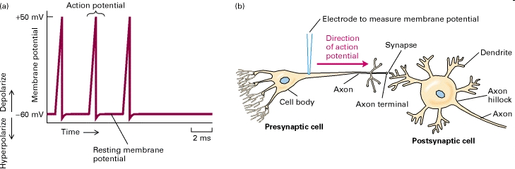
Neural signaling
The “Neuron Doctrine” (Bullock et al 2005):
Neurons are the functional units of the brain
Neurons are all-or-none switches which fire action potentials in response to their neighbors
Notes:
65
Notice that this is a quite MR-firendly view of the action potnetial. Spikes are all-or-nothing electrical events, discrete in time and traveling along well-defined pathways. They are SPECIALIZED for transmission across distances. If anything is MR, surely digital signal transmitters/processors are.
Neurons have a SINGLE function, to move action potentails along. And it seems plausible that if we were to increase the correlation of action potentials with respect to some relevant distal variable in a task, the system would do better. The’res excellent evidence that disrupting that correalation causes the system to do worse. (Maunsell, microstim, TMS). And htus picture has spawned some radical calims in pholosophy of mind, where people have argued that it would be trivial to replace neurosn with silicon chips. And if this were all that the brain did, it would be a good reason to think that the brain’s activiites are exhuasted by signaling and information processing.
HOWEVER.
Picture source http://www.ncbi.nlm.nih.gov/bookshelf/br.fcgi?book=mcb&part=A6108

Slide 66
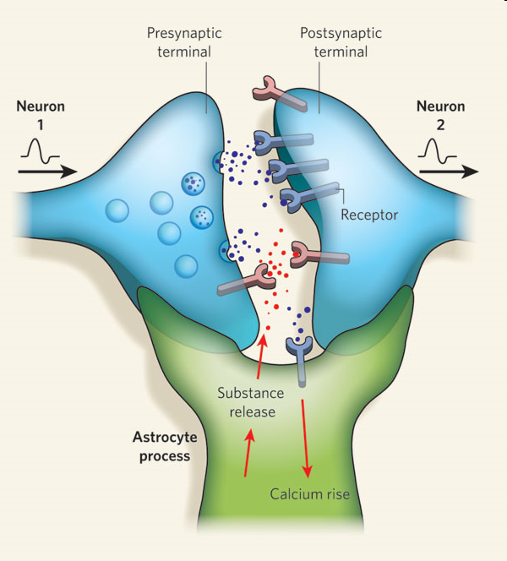
Slow …. signaling?
CELL BODY
Receiver
Sender
Receiver
Signal
Tripartite synapse
Fast signaling
Notes:
Slow signaling involves the cell body and its complex machinery of protein synthesis and corresponding control of cellular morphology. Protein complexes are translocated between the nucleus and the synapses, using energy-intensive machinery. Those protein complexes can contribute to morphological hcange of the neuron and synaptic remodeling. While those processes do seem to carry information (and that information may indeed be exploited), it seems clear that their primary function is not informational in the way that action potentials are.
Neurons do other things besides spike. So if we were to perform the swap test (e.g. replace neurosn with silicon chips), the system is likely to do worse.
To the extent that each nueron has many functions, it is not easily MR.

Slide 67
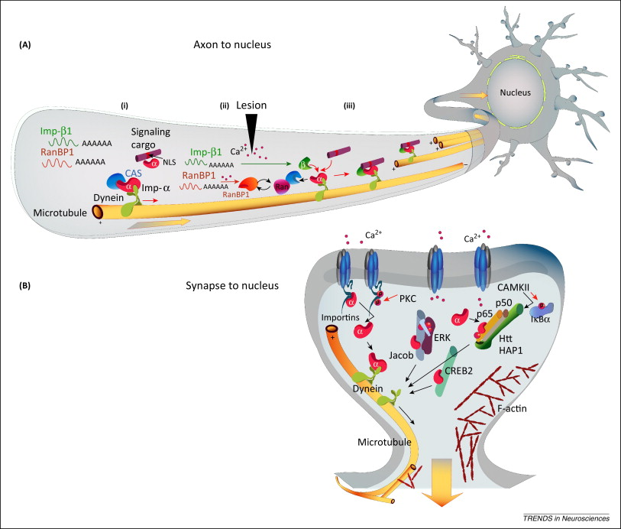
Macromolecular transport in synapse to nucleus communication
Panayotis et al (2015)
Notes:
So is this a contradiciton in terms? Is macromolecular transport really best described as informational? Some of thes ethings are literally reeceptor subunits.
Othres are trnascriptio nfactors, or signaling moleucles that activate transcirption factors.
Neurons do other things besides spike. Maybe most improtantly, they remodel themsevles in response to actiivty. So if we were to perform the swap test (e.g. replace neurosn with silicon chips), the system is likely to do worse.
To the extent that each nueron has many functions, it is not easily MR.

Slide 68
Aptly-called informational systems
Exploit the information carried in the signals they use – pass the wiggle test
Use signals or signal-receiver setups that are multiply realizable – pass the swap test
Show modular organization with functional specialization
Notes:
IN order to be a good cnadidate for inforamtiaon explaantion, a system should be funcitonally sepcialzied, and employ signals whose value depends not on their substrate or vehicle, but rather on the infromationa they carry.
Calling something “information” is a way of picking out a physically disparate group of difference-makers in virtue of their (same) functional role. Explanations that unite these disparate things under the same functional role are more robust/general than those that only invoke one of them, and they are more efficient/tractable than those that disjoin a bunch of the less general ones. If they are able to play the same functional role despite being physically diverse, that role must be (relatively) substrate-independent.
If, on the other hand, the set of possible difference-makers are physically similar, and only manage to do what they do in ways that depend on physical features that they share, then it may be that an explanation that picks them out in virtue of their informational (correlational) features will not have explanatory advantages over one that picks them out by their common physical features.
All of these desiderata come in degrees, and so does the aptness of infroamtiaonal epxlaantion.
Many systems may have informational aspects, but few will be purely informational.
The brain surely does transmti info, but not only.

Slide 69
Thank you

