Slide 1

Reactive Functional Programming
(or, Is That a Parenthesis in Your Pocket?)
Shriram Krishnamurthi

Slide 2
Pascal

Slide 3
begin
…
…
…
…
…
…
…
…
…
…
…
…
end.
begin
…
…
…
…
…
…
…
…
…
…
end;
begin
…
…
…
end;
begin
…
…
end;
begin
…
end;
begin
…
…
end;
begin
…
end;
.

Slide 4
“Pascal is part of the same machinery as hall passes, dress codes, advisors’ signatures, single-sex dorms, and so on.”
—Brian Harvey

Slide 5



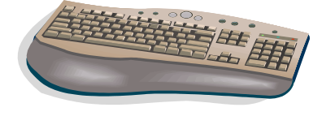

The Flow of Control
Model
The world is in charge,
not the program

Slide 6
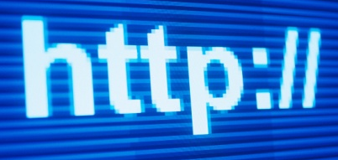
flights from PVD to CDG
must remember list of flights
list of flights
the third outward flight
must remember restricted list of return flights
restricted list of return flights
the second return flight
ok

Slide 7
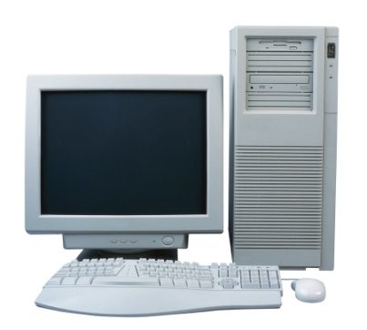
user typed ‘(’
ok
different
kinds of
handlers
user moved mouse
ok
user clicked mouse button
ok

Slide 8
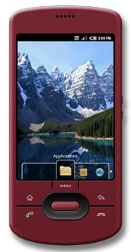
user moved right 10 yards
loc: (0,0)
ok
loc: (10,0)
user tilted phone left
loc: (10,0)
loc: (10,0)
ok
user moved left 10 yards
loc: (10,0)
loc: (0,0)
ok

Slide 9
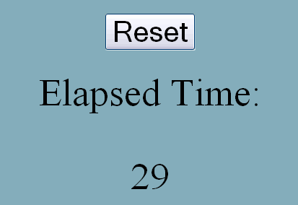

Slide 10
timers,
initialization,
overlap,
interference,
callbacks… oh my!
var timerID = null;
var elapsedTime = 0;
function doEverySecond() {
elapsedTime += 1;
document.getElementById('curTime').innerHTML = elapsedTime; }
function startTimer() {
timerId = setInterval(doEverySecond, 1000); }
function resetElapsed() {
elapsedTime = 0; }
<body onload="startTimer()">
<input id="reset" type="button" value="Reset" onclick="resetElapsed()" />
<div id='curTime'> </div>
</body>

Slide 11
Callback
void
void is a Four-Letter Word
database,
memory store,
Web
service,
hidden fields,
cont’ns
void
Event Loop
OS
Program

Slide 12
(define gauge
(new gauge% [label "Elapsed"]
[range 150]))
(new timer%
[interval 100]
[callback (lambda (event)
(send gauge set-value
(add1 (send gauge get-value))))])
(new button%
[label "Reset"]
[callback (lambda (event)
(send gauge set-value 0))])

Slide 13
(define gauge
(new gauge% [label "Elapsed"]
[range 150]))
(new timer%
[interval 100]
[callback (lambda (event)
(send gauge set-value
(add1 (send gauge get-value))))])
(new button%
[label "Reset"]
[callback (lambda (event)
(send gauge set-value 0))])

Slide 14
interface ChangeListener extends EventListener {
void stateChanged(ChangeEvent e) { ... } }
interface ActionListener extends EventListener {
void actionPerformed(ActionEvent e) { ... } }
interface MouseListener extends EventListener {
void mouseClicked(MouseEvent e) { ... }
void mouseEntered(MouseEvent e) { ... }
void mouseExited(MouseEvent e) { ... }
void mousePressed(MouseEvent e) { ... }
void mouseReleased(MouseEvent e) { ... } }

Slide 15
interface ChangeListener extends EventListener {
void stateChanged(ChangeEvent e) { ... } }
interface ActionListener extends EventListener {
void actionPerformed(ActionEvent e) { ... } }
interface MouseListener extends EventListener {
void mouseClicked(MouseEvent e) { ... }
void mouseEntered(MouseEvent e) { ... }
void mouseExited(MouseEvent e) { ... }
void mousePressed(MouseEvent e) { ... }
void mouseReleased(MouseEvent e) { ... } }

Slide 16
mainLoop : unit -> unit
closeTk : unit -> unit
destroy : 'a Widget.widget -> unit
update : unit -> unit
pack : ... -> 'd Widget.widget list -> unit
grid : ... -> 'b Widget.widget list -> unit
raise_window : ?above:'a Widget.widget
-> 'b Widget.widget -> unit
bind : events:event list
-> 'a Widget.widget -> unit

Slide 17
mainLoop : unit -> unit
closeTk : unit -> unit
destroy : 'a Widget.widget -> unit
update : unit -> unit
pack : ... -> 'd Widget.widget list -> unit
grid : ... -> 'b Widget.widget list -> unit
raise_window : ?above:'a Widget.widget
-> 'b Widget.widget -> unit
bind : events:event list
-> 'a Widget.widget -> unit

Slide 18
propagateEvent :: IO ()
select :: Selecting w => Event w (IO ())
mouse :: Reactive w => Event w (EventMouse -> IO ())
keyboard :: Reactive w =>
Event w (EventKey -> IO ())
resize :: Reactive w => Event w (IO ())
focus :: Reactive w => Event w (Bool -> IO ())
activate :: Reactive w => Event w (Bool -> IO ())
enter :: Reactive w => Event w (Point -> IO ())
leave :: Reactive w => Event w (Point -> IO ())
motion :: Reactive w => Event w (Point -> IO ())
drag :: Reactive w => Event w (Point -> IO ())
click :: Reactive w => Event w (Point -> IO ())
unclick :: Reactive w => Event w (Point -> IO ())
doubleClick :: Reactive w =>
Event w (Point -> IO ())

Slide 19
propagateEvent :: IO ()
select :: Selecting w => Event w (IO ())
mouse :: Reactive w => Event w (EventMouse -> IO ())
keyboard :: Reactive w =>
Event w (EventKey -> IO ())
resize :: Reactive w => Event w (IO ())
focus :: Reactive w => Event w (Bool -> IO ())
activate :: Reactive w => Event w (Bool -> IO ())
enter :: Reactive w => Event w (Point -> IO ())
leave :: Reactive w => Event w (Point -> IO ())
motion :: Reactive w => Event w (Point -> IO ())
drag :: Reactive w => Event w (Point -> IO ())
click :: Reactive w => Event w (Point -> IO ())
unclick :: Reactive w => Event w (Point -> IO ())
doubleClick :: Reactive w =>
Event w (Point -> IO ())

Slide 20
So What?
We care deeply about functions because of
Testing
Composition
Education

Slide 21
Solutions
Lazy evaluation
(Haskell FRP)
Continuations
(PLT Scheme Web Server)
Dataflow + state + GUIs in call-by-value
(FrTime, Flapjax, …)

Slide 22
Why void?
The hostile
operating
system
void
Why hostile?
Because
it’s neutral
void
But
neutrality ≠ hostility
Neutrals can cooperate (impartially)
void

Slide 23
Callback
User
OS
“World”
“World”
“World”
“World”

Slide 24
Current value of World
Will invoke
event-specific functions
Might be
enriched with additional event information
New value
of World
The information you need to restore the computation from a crash

Slide 25
What’s changing?
The location of the UFO.
How do we represent it?
As a coordinate pair.
The model
The Hollywood Principle
Model→view
transformation
Model→model
transformation

Slide 26


Slide 27
(define width 400)
(define height 300)
(define initial-world 0)
(define PLANE )
world → scene
(define (render w)
(place-image PLANE
(* w 10)
(image-height PLANE)
(empty-scene width height)))
world → world
(define (incr-time w)
(add1 w))
(big-bang initial-world
(on-tick incr-time)
(to-draw render))
model →model
model→view

Slide 28
(define width 400)
(define height 300)
(define initial-world 0)
(define PLANE )
world → scene
(define (render w)
(place-image PLANE
(* w 10)
(image-height PLANE)
(empty-scene width height)))
(animate initial-world render)
Functions as arguments (sssh!)

Slide 29
World
World
World
Scene
World
World

Slide 30
World
World
World
Scene
World
Bool

Slide 31

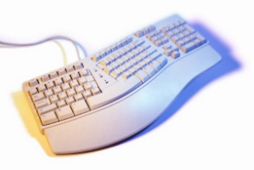

on-click :: w × btn → w
on-key :: w × key → w
on-tilt :: w × incl → w
on-move :: w × dist → w
to-draw :: w → scene
on-tick :: w → w
stop-when :: w → bool

Slide 32
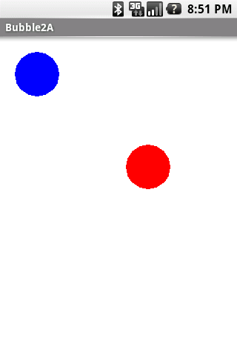
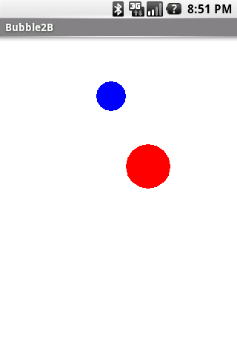
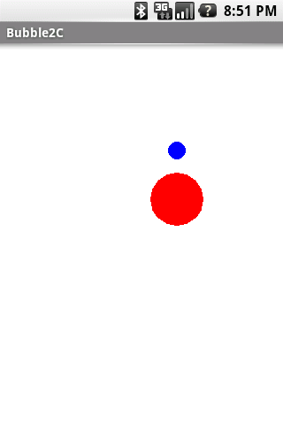

Slide 33
(define WIDTH 300)
(define HEIGHT 300)
(define-struct vel (x y))
(define target (make-posn (random WIDTH) …))
(define-struct world (posn r vel))
(define initial-world
(make-world (make-posn …)
30 (make-vel 0 0)))
world → bool
(define (game-ends? w)
(or (<= (world-r w) 1)
(collide? w)))

Slide 34
world → world
(define (tick w)
(make-world (posn+vel (world-posn w) (world-vel w))
(- (world-r w) 1/3)
(world-vel w)))
world × number × number × number → world
(define (tilt w azimuth pitch roll)
(update-world-vel w
(make-vel roll (- pitch))))
(big-bang initial-world
(to-draw render)
(on-tick tick)
(on-tilt tilt)
(stop-when game-ends?))

Slide 35
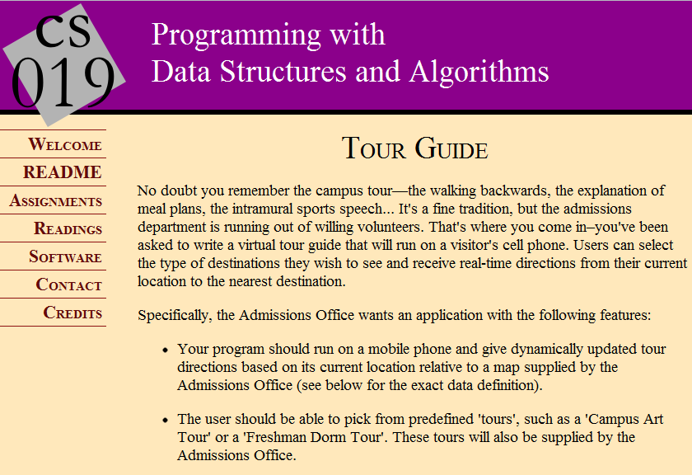

Slide 36



Slide 37


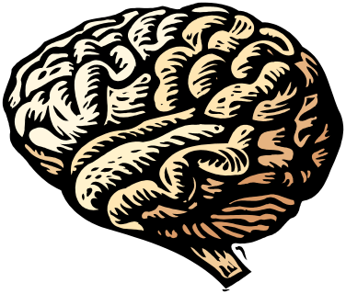

2006 PISA scores: USA not in top 20 in math, science, or reading
“Economic Time Bomb”
—June Kronholz, WSJ

Slide 38
Salient Curricular Facts
STEM “sorting” occurs in middle-school
Functions are a major barrier
Algebra only over numbers is boring

Slide 39
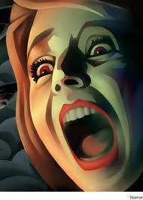
A train leaves Chicago at 6pm, traveling east at 50mph…

Slide 40

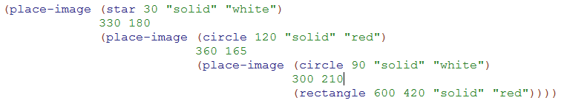

Slide 41
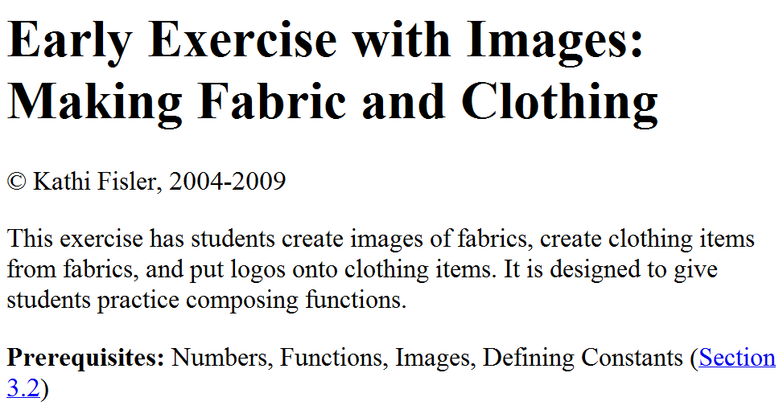

Slide 42
5 + 3
17 = □ - 11
x² = 25 - 16
process
17 + 33 = 3x - 20
1729 = x³ - 1000
object
f(x) = x²
with attributes
with multiple representations

Slide 43
Functions
f(x) = x²
Program
x | 1 | 2 | 3 | 4 | 5 | 6
f(x) | 1 | 4 | 9 | 16 | 25 | 36
Tests

Slide 44
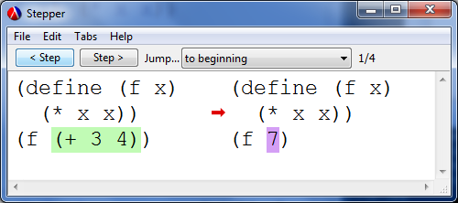
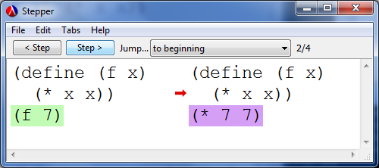
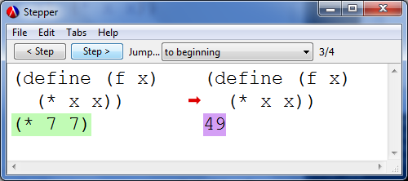

Slide 45
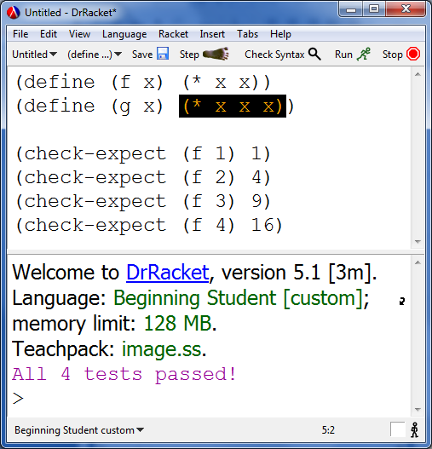
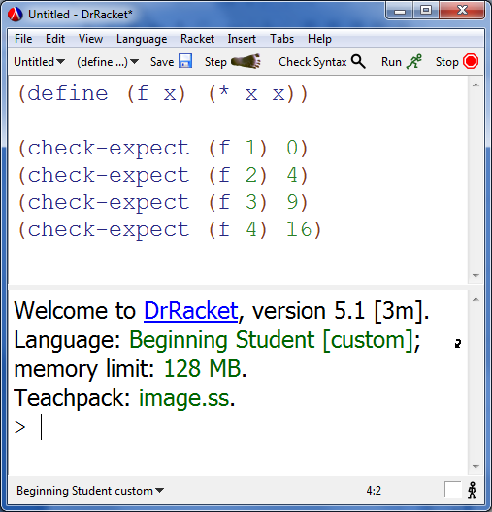
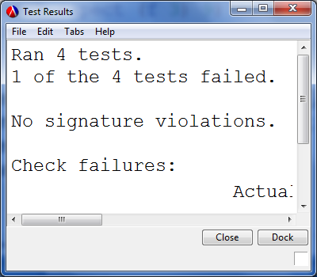

Slide 46
Vital Statistics
Middle-school, after-school (predominantly)
All teaching by volunteers (professionals, students)
Day 1: design your own game; 9 weeks: implement it
24% female; 70% reporting race are minority;
70% on free or reduced-price lunch
Emphasis on: testing, pair-programming, code-review

Slide 47
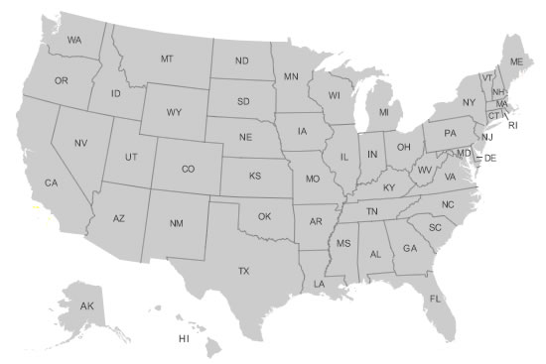
Over 700 students (average age: 11y9m) so far
About 200 new students this past year, growing /year

Slide 48
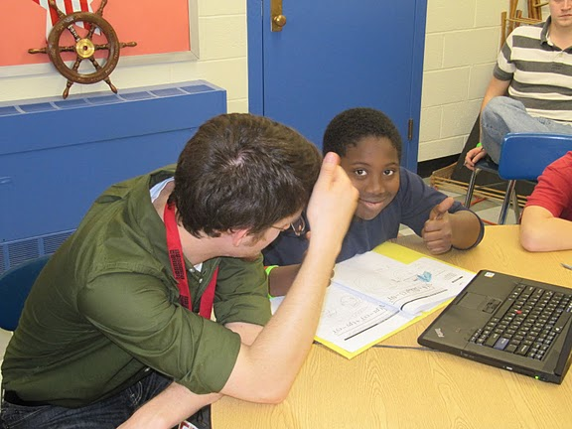
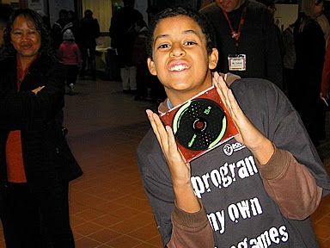
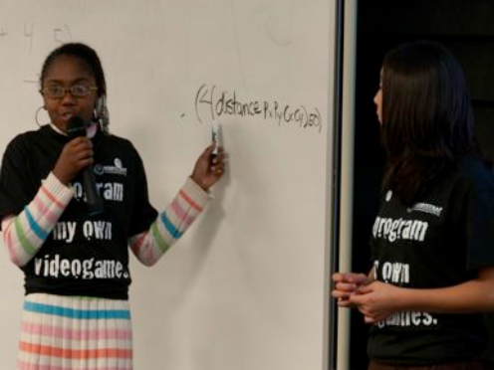
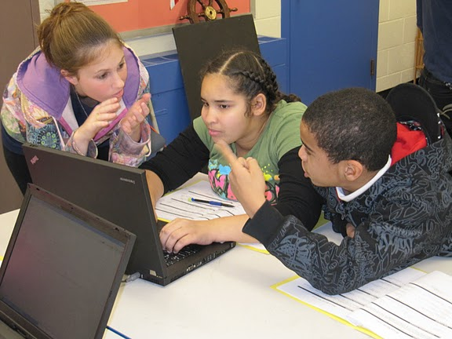

Slide 49
Technology
Scheme (Racket) on the desktop
Scheme → J2ME compiler for Android
Scheme → JavaScript
Works on both phones and browsers
Need to deal with asynchrony
Need to deal with re-entrance
(Futures, continuations, …)
World ported to Racket, Java, JavaScript…

Slide 50
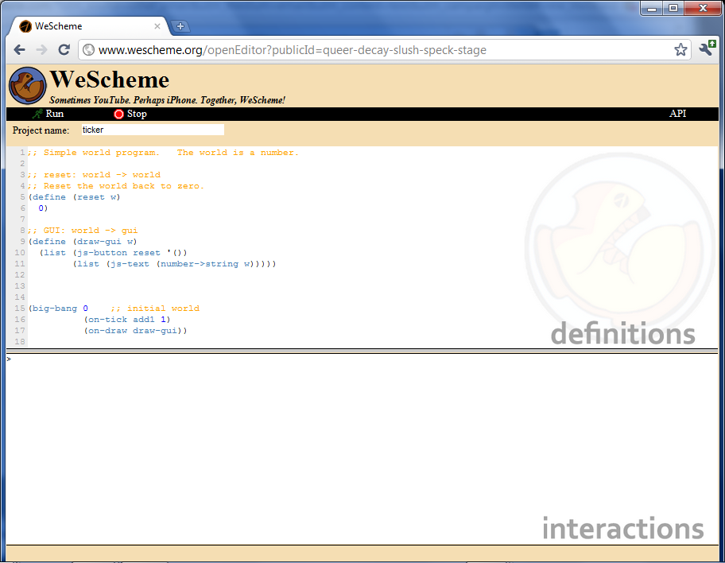

Slide 51
The World is Not Enough

Slide 52
Automatic adaptation of stateful APIs
In-place updates of world state
“Universe” for distributed computing
Moore versus Mealy

Slide 53
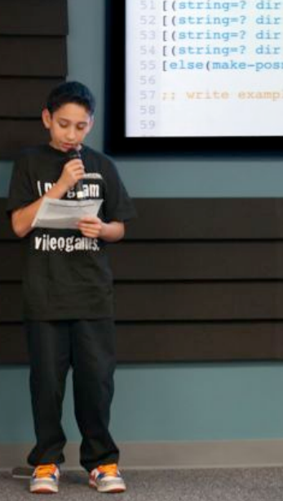
Take-Away Messages
Programming with functions creates a virtuous cycle
Middle-schoolers can write tests,
survive code-reviews, etc.
Programming models matter,
especially across platforms

Slide 54


Slide 55

www.bootstrapworld.org
www.facebook.com/BootstrapWorld
Thanks:
Danny Yoo
Kathi Fisler
Zhe Zhang
Emmanuel Schanzer
Matthias Felleisen
(rest )

