Slide 1
Deep Learning for Dummies
(Like me)
Carey Nachenberg
Notes:
Today I’m going to take you on an adventure that starts in an early 20th century theoretical physics lab, and ends today, with computers that can exhibit human-level intelligence. And if I’m successful, the talk might also give you some insight into how the human brain works.
Title: Deep Learning for Dummies
Abstract: While once considered a research dead-end, artificial neural networks are making a huge resurgence. Over the past decade, neural network researchers have leveraged a combination of novel research and hardware advances to drastically advance the state of the art in neural networking. This new area, called Deep Learning, has shown promise in tasks such as facial, speech, and handwriting recognition, and may hold promise for cyber-security use-cases as well. This talk will explain how Deep Learning works at a fundamental level - starting with basic concepts and building up gently until the audience understand the complete picture. It will also attempt to shed light on how the human brain works, since the Deep Learning approach is thought to mimic how the brain stores, retrieves and classifies information.
Carey Nachenberg is a leading cyber security expert and a co-inventor of Norton Antivirus – the world’s most popular computer security product. Selected for Computerworld magazine’s “40 Under 40 - 40 Innovative IT People to Watch” and winner of the The Wall Street Journal’s 2010 Technology Innovation Award (Computer Security Category) for his innovations in the security field, Nachenberg’s technology collectively protects hundreds of millions of computers worldwide. His work in the security field has garnered him over eighty United States patents. Nachenberg holds Bachelors and Masters degrees in Computer Science from UCLA, where he continues to serve as an Adjunct Assistant Professor.

Slide 2
The Goal of this Talk?
To provide you with an intuitive
(but not necessarily mathematical) understanding of what Deep Learning is and why it works.
I’m not a Deep Learning expert, nor a mathematician – so I reserve the right to say
“That’s a good question - I don’t know.”

Slide 3
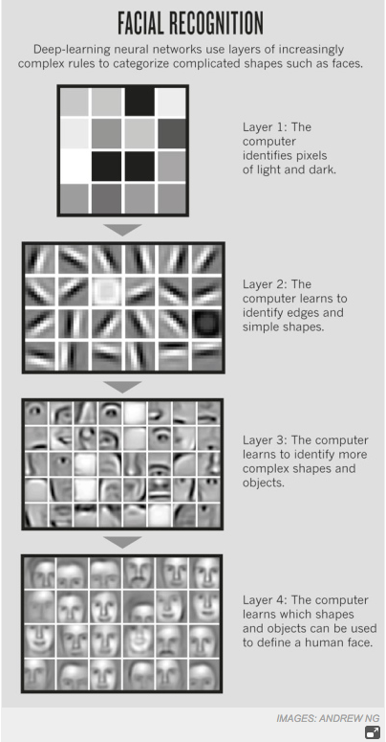
So what is Deep Learning?
Ultimately, the system gains a high-level understanding of the original data…
All automatically!
The algorithm discovers simple “regularities” that are present across many/all images, like curves & lines.
Deep Learning is a type of Machine Learning.
Machine Learning is class of algorithms that can automatically learn concepts through automated analysis of large amounts of information/data.
A Deep Learning algorithm is presented with millions of images made up of simple pixels.
The algorithm discovers how these regularities are related to form higher-level concepts.
These algorithms use this understanding of the data to solve problems, such as recognizing a person’s face, driving a car, or understanding a spoken command.
Deep Learning is a special type of machine learning that learns by discovering layers of increasingly abstract concepts about the data it’s trained on.
Images from Andrew Ng
Notes:
observe data, formulate a model, and make predictions
“Deep learning is a set of algorithms in machine
learning that attempt to learn in multiple levels, corresponding
to different levels of abstraction. It typically uses artificial
neural networks. The levels in these learned statistical models
correspond to distinct levels of concepts, where higher-level concepts
are defined from lower-level ones, and the same lowerlevel
concepts can help to define many higher-level concepts.”

Slide 4
Why is Deep Learning so Exciting?
Because Deep Learning algorithms discover these increasingly abstract concepts embedded in the data automatically!
Traditional Machine Learning approaches required a human to identify these and program them by hand – and it never really worked.
Images from Andrew Ng
Notes:
observe data, formulate a model, and make predictions
“Deep learning is a set of algorithms in machine
learning that attempt to learn in multiple levels, corresponding
to different levels of abstraction. It typically uses artificial
neural networks. The levels in these learned statistical models
correspond to distinct levels of concepts, where higher-level concepts
are defined from lower-level ones, and the same lowerlevel
concepts can help to define many higher-level concepts.”

Slide 5
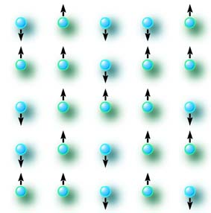

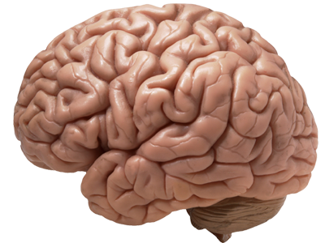
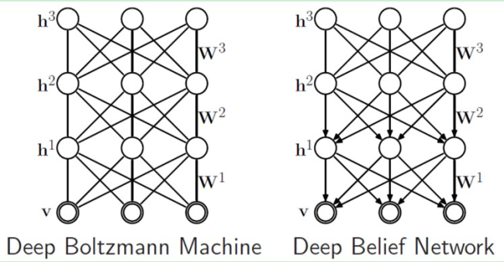
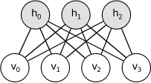
This talk is a journey… Please bear with me!

Slide 6
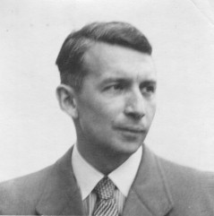

The Ising Model (Ernst Ising, 1922)
Notes:
The model consists of discrete variables that represent magnetic dipole moments of atomic spins that can be in one of two states (+1 or −1).
The Ising model was invented by the physicist Wilhelm Lenz (1920), who gave it as a problem to his student Ernst Ising. The Boltzmann distribution is named after Ludwig Boltzmann who first formulated it in 1868 during his studies of the statistical mechanics of gases in thermal equilibrium.[citation needed] The distribution was later investigated extensively, in its modern generic form, by Josiah Willard Gibbs in 1902.[2]:Ch.IV

Slide 7
The Ising Model
Each weight indicates how strongly the two adjacent atoms are correlated.
Negative weights drive anti-correlations in the direction of adjacent atoms!
300
1.0
500
99.0
-50
1.0
And atoms experience peer-pressure to flip when coaxed by multiple neighbors!
1.0
But ultimately, anything can happen – the interactions are probabilistic rather than deterministic!

Slide 8
Let’s See a Simulation!
1
1
1
1
1
1
1.4
-.22
-.10
1.4
-.22
-.10
1
1
1
1
1
1
1
.75
-3
.24
.75
-3
.24
.15
.15
1
999
1
1
999
1
3.1
.41
.59
3.1
.41
.59
-.4
999
999
-.4
999
999
1.1
-.9
1.7
1.1
-.9
1.7
1
999
1
1
999
1
.26
-.53
5.8
.26
-.53
5.8
1
1
1
1
1
1
1
.8
.71
8.1
.8
.71
8.1
-3.1
-3.1
1
1
1
1
1
1
.97
-.9
1.0
.97
-.9
1.0
1
1
1
999
1
1
1
.75
-3
.24
.75
-3
.24
.15
.15
1
1
1
1
1
1
3.1
.41
.59
3.1
.41
.59
1
1
1
1
1
1
1
-.4
1.1
-.9
-.4
1.1
-.9
1.7
1.7
1
1
1
1
1
1
.26
-.53
5.8
.26
-.53
5.8
1
999
1
1
1
999
1
.8
.71
8.1
.8
.71
8.1
-3.1
-3.1
1
999
999
999
999
1
.97
-.9
1.0
.97
-.9
1.0
1
1
1
1
1
1
1
1
1
1
1
1
1

Slide 9
Ising Model Energy
Every configuration of atoms and weights has a specific “energy” associated with it.
Let’s give each up-facing
“atom” a value of x = +1
x₁ = +1
Let’s give each down-facing “atom” a value of x = -1
w₀₁=
1.0
And between
atoms x_{i} and x_{j}
we’ll call the weight w_{ij}.
w₀₂=
w₀₄=
x₄ = +1
99.0
x₂ = -1
x₀ = +1
-50
We can then define the “energy” of a configuration of atoms and weights…
w₀₃=
1.0
x₃ = -1
E(x,w) = -
Σ
x_{i}*x_{j}*w_{ij}
all adjacent
pairs i,j of atoms
E(x,w) = -(
(1*1*1.0)
+(1*-1*-50)
+(1*-1*1.0)
)
+(1*1*99)

Slide 10
Ising Model Energy
Pairs of atoms with positive weights tend to be aligned.
E(x,w) = -
Σ
x_{i}*x_{j}*w_{ij}
all adjacent
pairs i,j of atoms
1.0
99.0
Low-energy configurations are those where atoms connected by positive weights are aligned, and atoms connected by negative weights are anti-aligned.
-50
Pairs of atoms with negative weights tend to be aligned.
1.0
Pairs of atoms with positive weights tend to be anti-aligned.
E(x,w) = -151
Pairs of atoms with negative weights tend to be anti-aligned.
These configurations tend
to be more “stable.”
1.0
High-energy configurations are the opposite – their alignment goes against the weights.
-50
99.0
1.0
These configurations tend
to be more “unstable.”
E(x,w) = +149
E(x,w) = -149

Slide 11
Ising Model Probabilities
Consider an Ising model with 3 atoms...
X₁
-50
99.0
E(x₁,w) = -49
There are 2³ or 8 possible configurations
of the atoms.
X₂
-50
99.0
E(x₂,w) = -149
If we let our atoms vibrate (flip up and down) naturally, they will oscillate through these various configurations…
-50
99.0
E(x₃,w) = +49
X₃
X₄
-50
99.0
E(x₄,w) = +149
And the probability of a particular configuration occurring depends entirely on the energy of that configuration vs. the energy of all of the other configurations.
X₅
-50
99.0
E(x₅,w) = +149
X₆
-50
99.0
E(x₆,w) = -149
-50
99.0
X₇
-50
99.0
E(x₇,w) = +49
X₈
-50
99.0
E(x₈,w) = -49
X₁ X₂ X₃ X₄ X₅ X₆ X₇ X₈

Slide 12
Ising Model Probabilities
-50
99.0
Low-energy configurations…
X₁
E(x₁,w) = -49
X₂
-50
99.0
E(x₂,w) = -149
99.0
High-energy configurations…
-50
E(x₃,w) = +49
X₃
X₄
-50
99.0
E(x₄,w) = +149
X₅
-50
99.0
E(x₅,w) = +149
Occur much more frequently
Occur much less frequently
X₆
-50
99.0
E(x₆,w) = -149
X₇
-50
99.0
E(x₇,w) = +49
X₈
-50
99.0
E(x₈,w) = -49
X₁ X₂ X₃ X₄ X₅ X₆ X₇ X₈

Slide 13
Ising Model Probabilities
The more negative x_{i}’s energy is…
The bigger the num-erator!
For simplicity, let’s call this
eNRG
from now on…
The probability of vibrating to each configuration x_{i} (given fixed weights w) can also be predicted by this formula:
-50
99.0
And thus the higher the probability of the system vibrating to x_{i}.
X₁
E(x₁,w) = -49
X₂
-50
99.0
E(x₂,w) = -149
p(x_{i}|w) = e
-E(x_{i},w)
n
-50
99.0
Σ e
E(x₃,w) = +49
-E(x_{k},w)
X₃
k=1
X₄
-50
99.0
E(x₄,w) = +149
p(the system vibrates to config. x_{i}) =
eNRG of config. x_{j}
sum of eNRG across all configs
X₅
-50
99.0
E(x₅,w) = +149
X₆
-50
99.0
E(x₆,w) = -149
The probability distribution described by this formula, and shown below, is called a “Boltzmann Distribution”.
X₇
-50
99.0
E(x₇,w) = +49
37.5%
X₈
-50
99.0
E(x₈,w) = -49
p(x_{i})
12.5%
12.5%
25%
12.5%
0%
0%
0%
All Possible Configurations of X
X₁ X₂ X₃ X₄ X₅ X₆ X₇ X₈

Slide 14
A 3-D Ising Model
1.4
-.22
-.10
.75
-3
.24
.15
Now what if instead of having the weights between adjacent atoms in a plane, we changed things up a bit…
3.1
.41
.59
-.4
1.1
-.9
1.7
.26
-.53
5.8
.8
.71
8.1
-3.1
Think of this plane
like the pixels on a touch-screen
.97
-.9
1.0
What if we switched to 2 planes…
a “visible” plane
and a “hidden” plane
In this case, we’ll have weights between each atom on the visible plane and every atom on the hidden plane.
.83
1.1
.4
-5
.2
-3
.8
.3
Atoms on each plane are now only influenced by the atoms on the other plane.
Notes:
The model consists of discrete variables that represent magnetic dipole moments of atomic spins that can be in one of two states (+1 or −1).

Slide 15
A 3-D Ising Model
1.4
-.22
-.10
.75
-3
.24
.15
Now what if instead of having the weights between adjacent atoms in a plane, we changed things up a bit…
3.1
.41
.59
-.4
1.1
-.9
1.7
.26
-.53
5.8
.8
.71
8.1
-3.1
.97
-.9
1.0
What if we switched to 2 planes…
a “visible” plane
and a “hidden” plane
In this case, we’ll have weights between each atom on the visible plane and every atom on the hidden plane.
.83
.4
-3
.3
Atoms on each plane are now only influenced by the atoms on the other plane.
Notes:
The model consists of discrete variables that represent magnetic dipole moments of atomic spins that can be in one of two states (+1 or −1).

Slide 16
A 3-D Ising Model
V₉
W₉₄
In such a model, energy is computed a bit differently:
W₁₂
V₁
V
H
W₁₁
E(V,H,W) = -
Σ Σ V_{i}*H_{j}*W_{ij}
i = 1
j = 1
H₁
= - (V₁*H₁*W₁₁ + V₁*H₂*W₁₂ + … + V₉*H₄*W₉₄)
H₄
H₂
And if we have a visible atom and a hidden atom facing the opposite direction, connected by a negative weight, this also contributes to low energy…
Low energy state
Just like before, if we have a visible atom and a hidden atom facing the same direction, connected by a positive weight, this contributes to low energy…
V_{i}
V_{i}
+5.0
-3.7
H_{j}
H_{j}
And as before, configurations with lower energy will occur with higher probability than those with higher energy.
Notes:
We take every pair of visible and hidden atoms and multiply both of their activation values
(-1 or 1) with the weight connecting them.

Slide 17
A 3-D Ising Model
“What are the odds that these
9 visible atoms will vibrate to this specific configuration?”
As before, once we can compute the energy of a config,
we can also find the probability of vibrating to it.
p(the system vibrates to a given 3-D config) =
eNRG of that configuration
Total eNRG across all possible configs
-1 -1
-1 1
1 1
1 1
-1 -1
-1 -1
And we can compute the probability of the system vibrating to a specific visual configuration irrespective of what the hidden side looks like…
To do so, we simply sum up the probability of config v showing up for all possible hidden configurations:
“Irrespective of what these atoms look like…”
p(the system displays visible config v) =
p(the system displays v when h is {-1,-1,-1,-1}) +
p(the system displays v when h is {-1,-1,-1,1}) +
…
p(the system displays v when h is {1,1,1,1})
Notes:
Now that we can compute the energy of a configuration, we can also determine its probability.

Slide 18
A 3-D Ising Model
Just as with our 2-D Ising model,
we can pick weights to bias certain configurations of atoms.
For instance, we can positively connect the upper-left hidden atom to odd columns…
This column
This column
And this column
And this column
and negatively tie it to even columns.
This atom is now negatively correlated with
This atom is now positively correlated with
Notes:
The model consists of discrete variables that represent magnetic dipole moments of atomic spins that can be in one of two states (+1 or −1).

Slide 19
A 3-D Ising Model
Just as with our 2-D Ising model,
we can pick weights to bias certain configurations of atoms.
And similarly, if a bunch of visible atoms just happen to randomly flip in a particular direction…
Positively connected visible atoms will likely flip up as well!
For instance, we can positively connect the upper-left hidden atom to odd columns…
Further reinforcing alignment on the visible plane!
and negatively tie it to even columns.
We’d now expect our visible layer to display stripes (on,off,on,off) or
(off,on,off,on) more frequently than if the weights were entirely random.
This creates a self-reinforcing set of stable configurations!
That’ll pressure the positively-connected hidden atom to flip too!
If a hidden atom just happens to randomly flip up…
But why?
Notes:
Of course, with 20 total atoms, we’d expect 2²⁰ or 1,048,576 total bins.

Slide 20
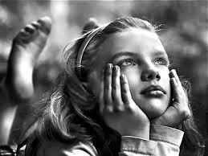
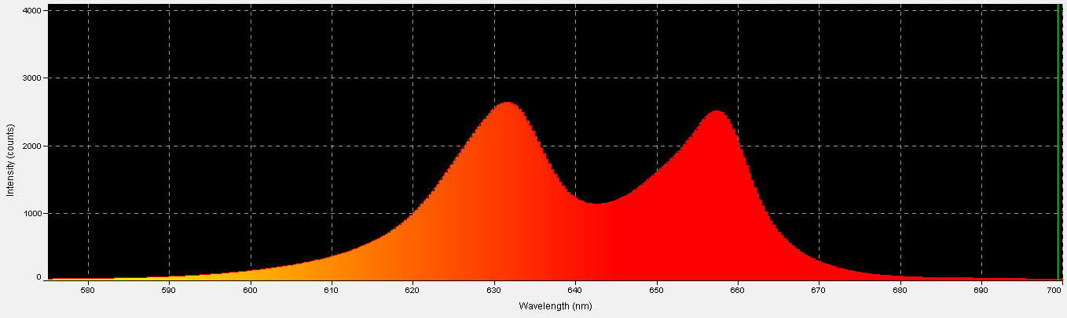
A 3-D Ising Model: A Generative Model
In fact, we say that our 3-D Ising model is “generative”.
When left to vibrate, it’s almost as if the system is daydreaming!
We call it generative because if we allow the system to vibrate…
it will naturally tend to generate patterns on its visible plane…
based on the specific weights connecting the atoms in the hidden and visible planes.
Odd columns on, even columns off
Even columns on, odd columns off
Talking about daydreaming, let’s see an example!
Boltzmann Distribution
(probability of each configuration occurring)

Slide 21
A 3-D Ising Model
Here’s a demo with 5 atoms in the hidden layer:
Hidden Atom
Has positive weights to …
#1
two sets of “eye” atoms near
the top of the visible plane.
#2
a set of “nose” atoms in the
middle of the visible plane.
#3
a line of “mouth” atoms in the
lower part of the visible plane.
#4
a set of “happy” atoms just
above the mouth.
#5
a set of “frown” atoms just
below the mouth.
So by manually adjusting the weights between the two planes, we can bias the distribution of what “images” are generated on the visible plane.
Notes:
The model consists of discrete variables that represent magnetic dipole moments of atomic spins that can be in one of two states (+1 or −1).

Slide 22
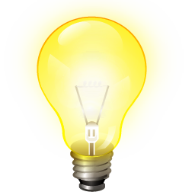
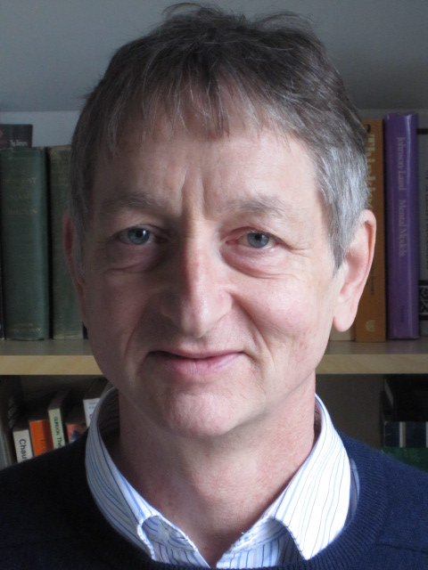
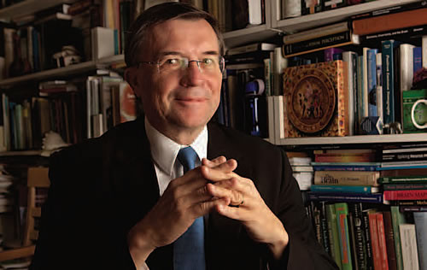
An Aha Moment: The 3-D Ising Model becomes the
Restricted Boltzmann Machine (RBM)
Geoffrey Hinton
Terry Sejnowski
“Let’s use a simulation of an Ising network to encode memories…”
- Approximate quote fabricated by Carey
Notes:
Based on work of Hopfield and Paul Smolensky
Geoffrey Hinton
Born 6 December 1947
Known for Backpropagation, Boltzmann machine, deep learning
University U Toronto
Terrence Joseph Sejnowski
Born 1947
An Investigator at the Howard Hughes Medical Institute and is the Francis Crick Professor at The Salk Institute for Biological Studies where he directs the Computational Neurobiology Laboratory. His research in neural networks and computational neuroscience has been pioneering.
Sejnowski is also Professor of Biological Sciences and Adjunct Professor in the Departments of Neurosciences, Psychology, Cognitive Science, and Computer Science and Engineering at the University of California, San Diego, where he is Director of the Institute for Neural Computation. In 2004 he was named the Francis Crick Professor and the Director of the Crick-Jacobs Center for Theoretical and Computational Biology at the Salk Institute.

Slide 23
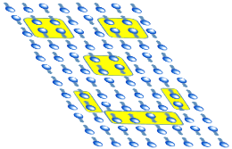
The Restricted Boltzmann Machine
Learning an Image and Daydreaming
In the early 1980’s, Hinton and Sejnowski started experimenting with
3-D Ising Models, also called Restricted Boltzmann Machines (RBMs).
Their goal was to come up with an algorithm that could take a “blank” RBM network…
And teach that network
(by modifying its weights) how to “encode” an image…
Random weights
So if allowed to vibrate, the RBM would vibrate up the encoded image on its visible plane with higher probability than other images…
Notes:
Geoffrey E. Hinton and Terrence J. Sejnowski, Analyzing Cooperative Computation. In Proceedings of the 5th Annual Congress of the Cognitive Science Society, Rochester, New York, May 1983.Geoffrey E. Hinton and Terrence J. Sejnowski, Optimal Perceptual Inference. In Proceedings of the IEEE conference on Computer Vision and Pattern Recognition (CVPR), pages 448–453, IEEE Computer Society, Washington, D.C., June 1983.

Slide 24
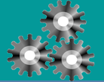
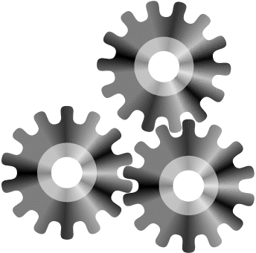
The Restricted Boltzmann Machine
Learning an Image and Daydreaming
“I want to be able to
pick an arbitrary image…
“Right! Then the Ising model will naturally vibrate to our training image more often.”
“I see. Well, as we know, an Ising model naturally vibrates to low-energy configurations more frequently than to high-energy ones…”
“Terry, I wonder if we can train a 3-D Ising model to remember a picture.”
“To remember a picture?”
And then find some automated way to pick the weights of an Ising model so that when it vibrates…
The resulting Ising model is a “generative model!”
Why? Because once it’s been trained, if we allow it to vibrate through its natural states, it’ll tend to generate the image that it’s learned!
“So we just need to pick a set of weights that causes our desired image to have as low an energy as possible.”
... it vibrates more often to my image than to other random images…”
Gradient Descent
Algorithm

Slide 25
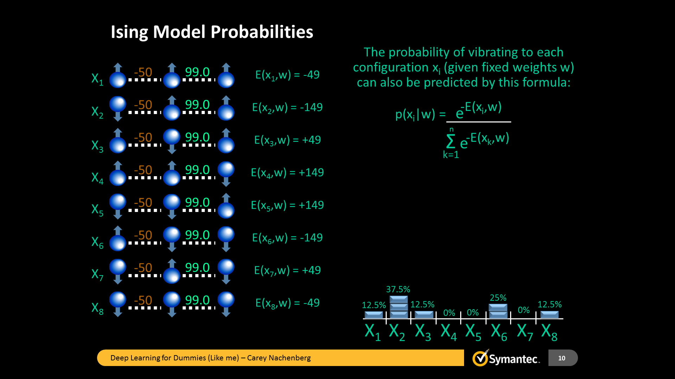
The Restricted Boltzmann Machine
Learning an Image and Daydreaming
prob. of the RBM
vibrating to
each image
Boltzmann Dist
Notes:
I know I can manually pick a set of weights to cause a 3D Ising model to vibrate more frequently to a particular visible configuration.
Go on.
I’m wondering if we can design a computer program to figure out
“Terry… I know that I can manually pick a set of weights to cause a 3-D Ising model to vibrate more frequently to a particular visible configuration.”
those weights for us.
“Well I’m wondering if we can
design a computer program to
figure out those weights for us?”

Slide 26
Learning an Image - Intuition
This will bias “vibration” of the system to configs resembling the trained image.
Why? Because in those random cases where our hidden atom activates…
it will generate our image on the visible plane.
So what is actually happening to the weights during our Gradient Descent algorithm?
All this happens because the desired visible-hidden config has a low energy state.
Training Image
And, any time the visible plane vibrates into a config that (remotely) resembles our training image…
this will likely result in the activation of our hidden atom…
which will then increase the odds of the trained image showing up, etc…
Let’s imagine for a moment that we only have a single hidden node.
…our Gradient Descent algorithm would likely assign positive weights to all atoms that need to be on in the image…
and negative weights (not depicted) to all of the off atoms.
Notes:
The model consists of discrete variables that represent magnetic dipole moments of atomic spins that can be in one of two states (+1 or −1).

Slide 27
The Restricted Boltzmann Machine
Learning Multiple Images
“OK, so we know how to
train an RBM on a single
image… But can we train
it to learn (to daydream)
multiple images?”
“Why not? Instead of using our Gradient Descent algorithm to learn weights to create a
single low-energy state…
we’ll use it to discover a set of weights that create multiple low-energy states…”
…
Boltzmann Distribution for multiple images
Notes:
“Good point. So we want to find a set of weights that cause our visible configuration to have low energy.”
“This is true. We can’t find a perfect set of weights that will minimize the energy of our desired visual configuration, for every possible hidden layer configuration.”

Slide 28
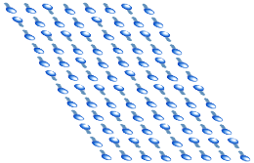
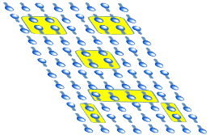
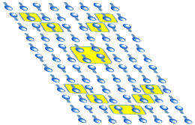
Learning Multiple Images - Intuition
So intuitively, how does the Gradient Descent algorithm discover a combination of weights that creates low energy states for multiple images?
All three images have these two activated atoms in common!
All three images have these two activated atoms in common!
And these two as well…
And these two as well…
Training
Image #1
Training
Image #2
As well as these…
Why?
Training
Image #3
Notice that some atoms are actually consistently on across multiple images…
Our Gradient Descent algorithm identifies these “regularities” and ties them to hidden atoms with strong positive weights!
It’ll similarly tie visible atoms that are consistently off across multiple training images to hidden atoms with strong negative weights.
Notes:
The model consists of discrete variables that represent magnetic dipole moments of atomic spins that can be in one of two states (+1 or −1).

Slide 29
Learning Multiple Images - Intuition
So intuitively, how does the Gradient Descent algorithm discover a combination of weights that creates low energy states for multiple images?
Training
Image #1
Training
Image #2
Why?
Training
Image #3
Notice that some atoms are actually consistently on across multiple images…
Our Gradient Descent algorithm identifies these “regularities” and ties them to hidden atoms with strong positive weights!
It’ll similarly tie visible atoms that are consistently off across multiple training images to hidden atoms with strong negative weights.
Notes:
The model consists of discrete variables that represent magnetic dipole moments of atomic spins that can be in one of two states (+1 or −1).

Slide 30
Learning Multiple Images - Intuition
Training
Image #1
Training
Image #2
Training
Image #3
Associating a positive weight between a hidden atom
and one or more visible atom(s) that are frequently on
across multiple training images…
means that any time that hidden atom activates,
there’s a good chance it’ll also activate visible atom(s) that are useful in reconstructing many of our training images …
this increases the odds that one of those multiple trained images
will vibrate up on the RBM’s visible surface!
Notes:
the RBM will probably activate a visible atom that is consistent with
those trained images.

Slide 31
Learning Multiple Images - Intuition
…may become associated with (parts of) left eyes.
…may become associated with noses.
In essence, our RBM gains an intuitive understanding of the images it’s been trained on.
It “learns” what features are common across the universe of images its seen.
Training
Image #1
Training
Image #2
Or this hidden atom…
So, for example, this hidden atom…
Training
Image #3
So the gradient descent process identifies “regularities” – common clusters of activated (or deactivated) visible atoms – across multiple training images…
And it associates these via stronger weights with various hidden atoms.
In practice, the identified regularities will be very simple – not complete eyes but rather simple edges and curves.
It’s this exploitation of regularities that causes our RBM to display its learned images more frequently than arbitrary/random images.
Notes:
The model consists of discrete variables that represent magnetic dipole moments of atomic spins that can be in one of two states (+1 or −1).

Slide 32
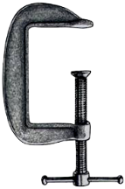
An Interesting Intuition
Now once we’ve trained our RBM on a bunch of images…
And it appears to have a nose…
This image appears to have at least part of a left eye.
And it appears to have part of a right eye…
What would happen if we were to manually flip our visible atoms to one of our training images and hold them steady…
but let the hidden atoms vibrate as they like?
As expected, this would cause our hidden atoms to adjust based on our learned weights…
…
In essence, the resulting hidden atom configuration is a “code” that describes the set of regularities that were found within the visible image.
The hidden atom configuration thus represents a
“high-level description” of the original image.
Notes:
In essence, the resulting hidden atom configuration is a “code” that describes/represents the image on the visible plane.

Slide 33
An Interesting Intuition
OK, let’s take our trained RBM and use it to compute codes for each training image.
…
…
…
…
…
…
So now we have high-level descriptions for each of our original images:
Let’s do something wacky with them!

Slide 34
An Interesting Intuition
… to these specific configurations of atoms.
And, as before, to do so, we’ll need to find regularities across our inputs…
Let’s create a second Restricted Boltzmann Machine…
And this one with noses!
Recall that this atom is associated with left eyes.
So we’ll learn the weights to cause this RBM to vibrate frequently…
… and associate them with various hidden atoms.
and then use Gradient Descent to train this RBM using our freshly-generated sequences as the input training data.
…
Gradient Descent
…
…
…
So this atom might activate when an image has two eyes!
But wait – when we train our new RBM, its visible atoms don’t
represent raw dots in a picture, as in our previous RBM…
Instead, as we learned, these atoms represent more abstract concepts
like parts of eyes, curves of the mouth, etc.
…
As such, when our second RBM discovers regularities in its inputs, these will be even higher-order regularities - for instance that every face has two eyes.
…
…
Notes:
Recall that this atom is associated with left eyes.

Slide 35
An Interesting Intuition
And we can repeat this process over and over!
Each time we add an RBM layer, its hidden atoms “learn” successive
levels of abstraction about the original images!
Represents black and white “pixels” or dots...
Represents simple facial components like parts of eyes
Represents combinations of facial components, like pairs of eyes
Represents
entire faces
“Sad girl’s face.”
“Happy face with hair.”

Slide 36
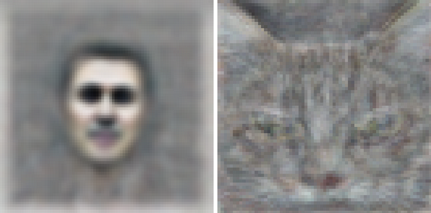
The Deep Belief Network
This network is called a “Deep Belief Network.”
Once we have such a network, we can present an image to
it at the top visible layer and fix it in place…
= happy face
“I was just presented with a picture of a happy person!”
“I was just presented with a picture of a happy person!”
= sad face
And then see how the atoms in the lower levels activate!
…
= neutral face
With a bit more coding, we can determine which atoms in the bottom layer activate for each type of input image.
If trained with enough
input images…
the DBN can actually learn to recognize common elements in those images (e.g., cats)…
without ever being told what they are!
And build a classifier that can recognize images!

Slide 37
The Deep Belief Network: Recognition of Noisy Inputs
And the network is resilient to noise!
Even when presented with a partial image or a similar (but not identical) image, the network generally activates as expected.
“I was just presented with a picture of a happy person!”
“I was just presented with a picture of a happy person!”

Slide 38
The Deep Belief Network: Reconstruction
Even more exciting, the network can reproduce the original image
from an incomplete or partial input!
All you have to do is propagate down and back up!
“Hmmm. That looks mostly like a happy face, although I’m a bit less confident.”
Then we fix our bottom layer and propagate back up…
“Hmmm. That looks mostly like a happy face, although I’m a bit less confident.”
First we propagate down…

Slide 39
The Deep Belief Network: Anomaly Detection
Finally, we can use our DBN to detect anomalous inputs
that don’t match what our network has been trained on!
We take a new input image and propagate down…
Then we propagate back up.
?
=
And we see what the network thinks it saw…
“I also see what looks like a mouth.”
Finally, we compare our input and output image to see how close they are…
“There seems to be a nose in this input image.”
If our output image is significantly different than the input,
this is strongly indicative of an “unusual” input!
And for those of you that speak “Machine Learning,” notice that we didn’t need any ground truth data to perform this operation!

Slide 40
And Here’s the Kicker
Notice that we literally “pumped in” raw input data into our
Restricted Boltzmann Machines!
They figured out the rest!
Most traditional Machine Learning approaches require the engineer
to do extensive manual feature extraction…
prior to applying Machine Learning on the input.

Slide 41

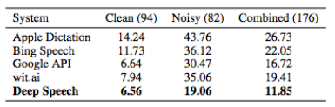
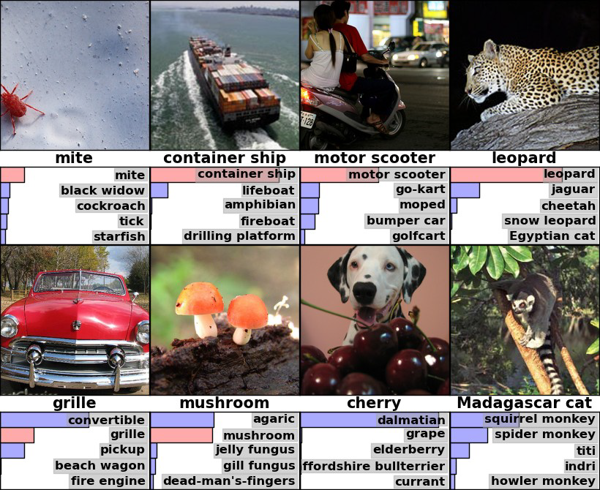

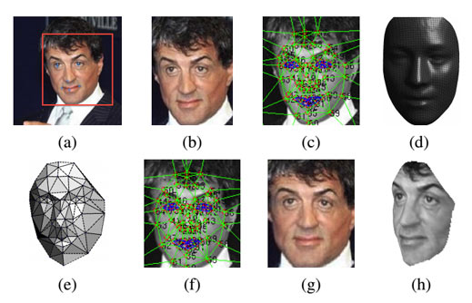

Deep Learning: Recent Wins
Baidu’s Deep Speech project
uses Recurrent Neural Networks and massive amounts of speech data (100x) to achieve a 29% improvement in speech recognition in 2 weeks!
Microsoft Research recently published image recognition results of 4.94% (top-5 error rate) on the 2012 ImageNet corpus… besting the established human error rate of 5.1%!
Facebook’s DeepFace is capable of facial recognition rates of 97.25% - roughly .28% less than human-level accuracy!

Slide 42
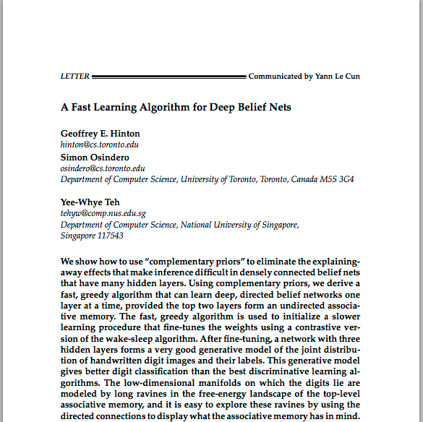
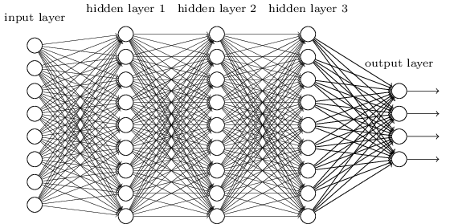
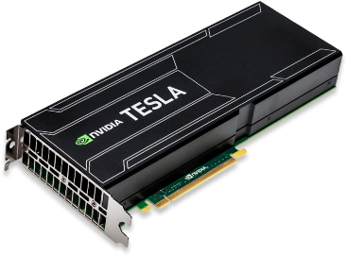
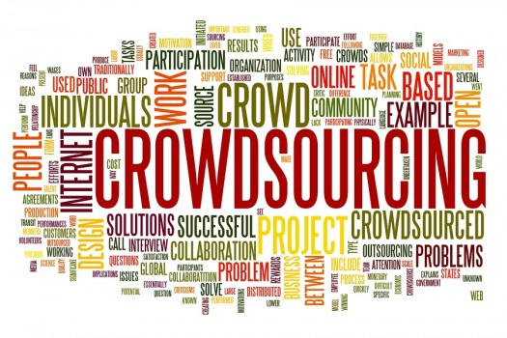
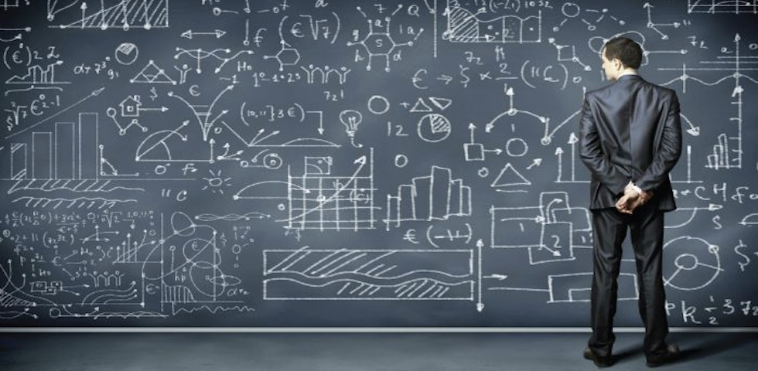
Deep Learning: The Catalysts
2006 – Geoffrey Hinton discovers Contrastive Divergence and greedy layer-wise pre-training.
Huge increases in computing power from GPUs and cloud computing.
The Internet yields orders of magnitude more data to train on.
A series of advances in machine learning algorithms: weight initialization, regularization, new activation functions
Notes:
Google Brain, with about 1 million simulated neurons and 1 billion simulated connections, was ten times larger than any deep neural network before it.
So back at Stanford, Ng started developing bigger, cheaper deep-learning networks using graphics processing units (GPUs) — the super-fast chips developed for home-computer gaming3. Others were doing the same. “For about US$100,000 in hardware, we can build an 11-billion-connection network, with 64 GPUs,” says Ng.
In that competition, teams train computer programs on a data set of about 1 million images that have each been manually labelled with a category. After training, the programs are tested by getting them to suggest labels for similar images that they have never seen before. They are given five guesses for each test image; if the right answer is not one of those five, the test counts as an error. Past winners had typically erred about 25% of the time. In 2012, Hinton's lab entered the first ever competitor to use deep learning. It had an error rate of just 15% (ref. 4).

Slide 43
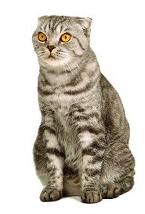
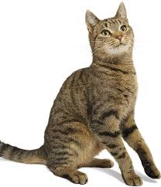
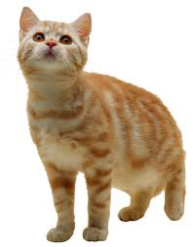
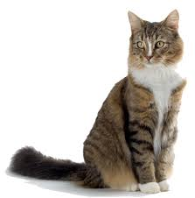
One Last Thought…
Have you ever thought about how amazing your visual memory is?
Do you think your brain literally stores away high-resolution snapshots of everything it sees?
Well maybe not!
This could explain why…
Given a memory cue you can suddenly remember a whole thought.
When viewing a partial image, your brain can visualize the rest…
When you see something unusual your brain knows it immediately…
After seeing hundreds of cats as a kid, but not knowing what they were called…
the moment your mom told you “that’s called a ‘cat’” you could
instantly classify every cat you’d ever seen.

Slide 44
Conclusion
Deep Learning is a Machine Learning technique that works by learning multiple levels of abstraction about its inputs.
Once a Deep Learning system learns the inherent structure of its inputs,
you can use it to…
classify items,
reconstruct partial inputs,
detect anomalies,
search for related items,
just daydream!
And finally, the engineer doesn’t have to do lots of pre-processing to apply
Deep Learning to many real-world problems!

Slide 45
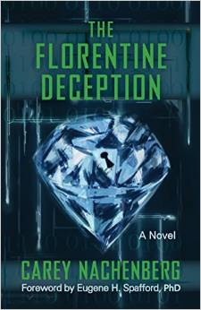
Finally… If you enjoyed this talk…
Consider reading my new techno-thriller!
Available April 14th on Amazon, iBooks, and B&N.com.
I’ll be donating all proceeds to charities benefiting underprivileged and low-income students, so it’s an exciting read for a good cause!

Slide 46
Carey Nachenberg
cnachenberg@symantec.com

Slide 47
The Ising Model With Equal Weights
1.0
1.0
1.0
1.0
Let’s see a simulation!

Slide 48
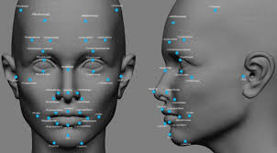
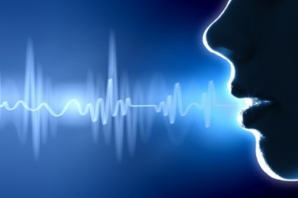
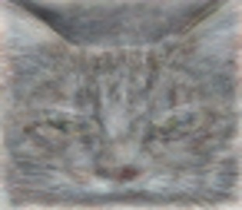

Deep Learning…

Slide 49
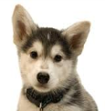
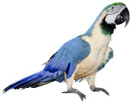

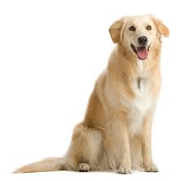

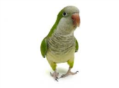
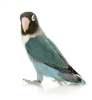
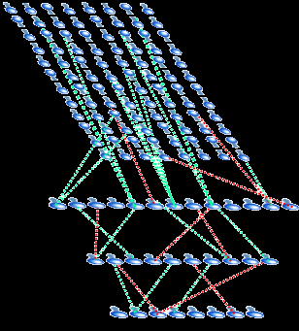

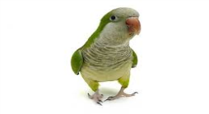
The Deep Belief Network: Fuzzy Searching
We can also use the network to search for similar items!
First we train a Deep Belief Network on millions of images to compute its weights…
Then we pump all of
our images through our network to compute the deepest layer activations for each…
Gradient Descent
Algorithm
And we store the association between each activation pattern and its image…
Later, when presented with a new image, we can then identify similar matches!

