Slide 1
Partisan Gerrymandering and the Supreme Court
The Role of Social Science
November 1, 2017
Eric McGhee

Slide 2
Outline
Legal status quo ante
The opportunity
The proposed metrics
Gill v Whitford
Where next?

Slide 3
Legal status quo ante
Davis v. Bandemer 1986
  Partisan gerrymandering is justiciable
  What is the standard?
  Court dismisses the claim but leaves the door open

Slide 4
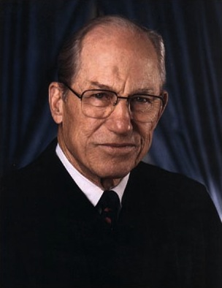
Davis v Bandemer (1986)
“The mere fact that there is no likely arithmetic presumption, such as the "one person, one vote" rule, in the present context does not compel a conclusion that the claims presented here are nonjusticiable.”

Slide 5
Davis v Bandemer (1986)
“….The [idea] that any interference with an opportunity to elect a representative of one's choice would be sufficient to allege or prove an equal protection violation…would invite attack on all or almost all reapportionment statutes.”

Slide 6
Legal status quo ante
Davis v. Bandemer 1986
  Partisan gerrymandering is justiciable
  What is the standard?
  Court dismisses the claim but leaves the door open
18 years of failure…
Vieth v. Jubelirer 2004
  4 justices want to give up
  4 justices have their own standards
  Kennedy says he hasn’t seen a standard, but there might be one

Slide 7
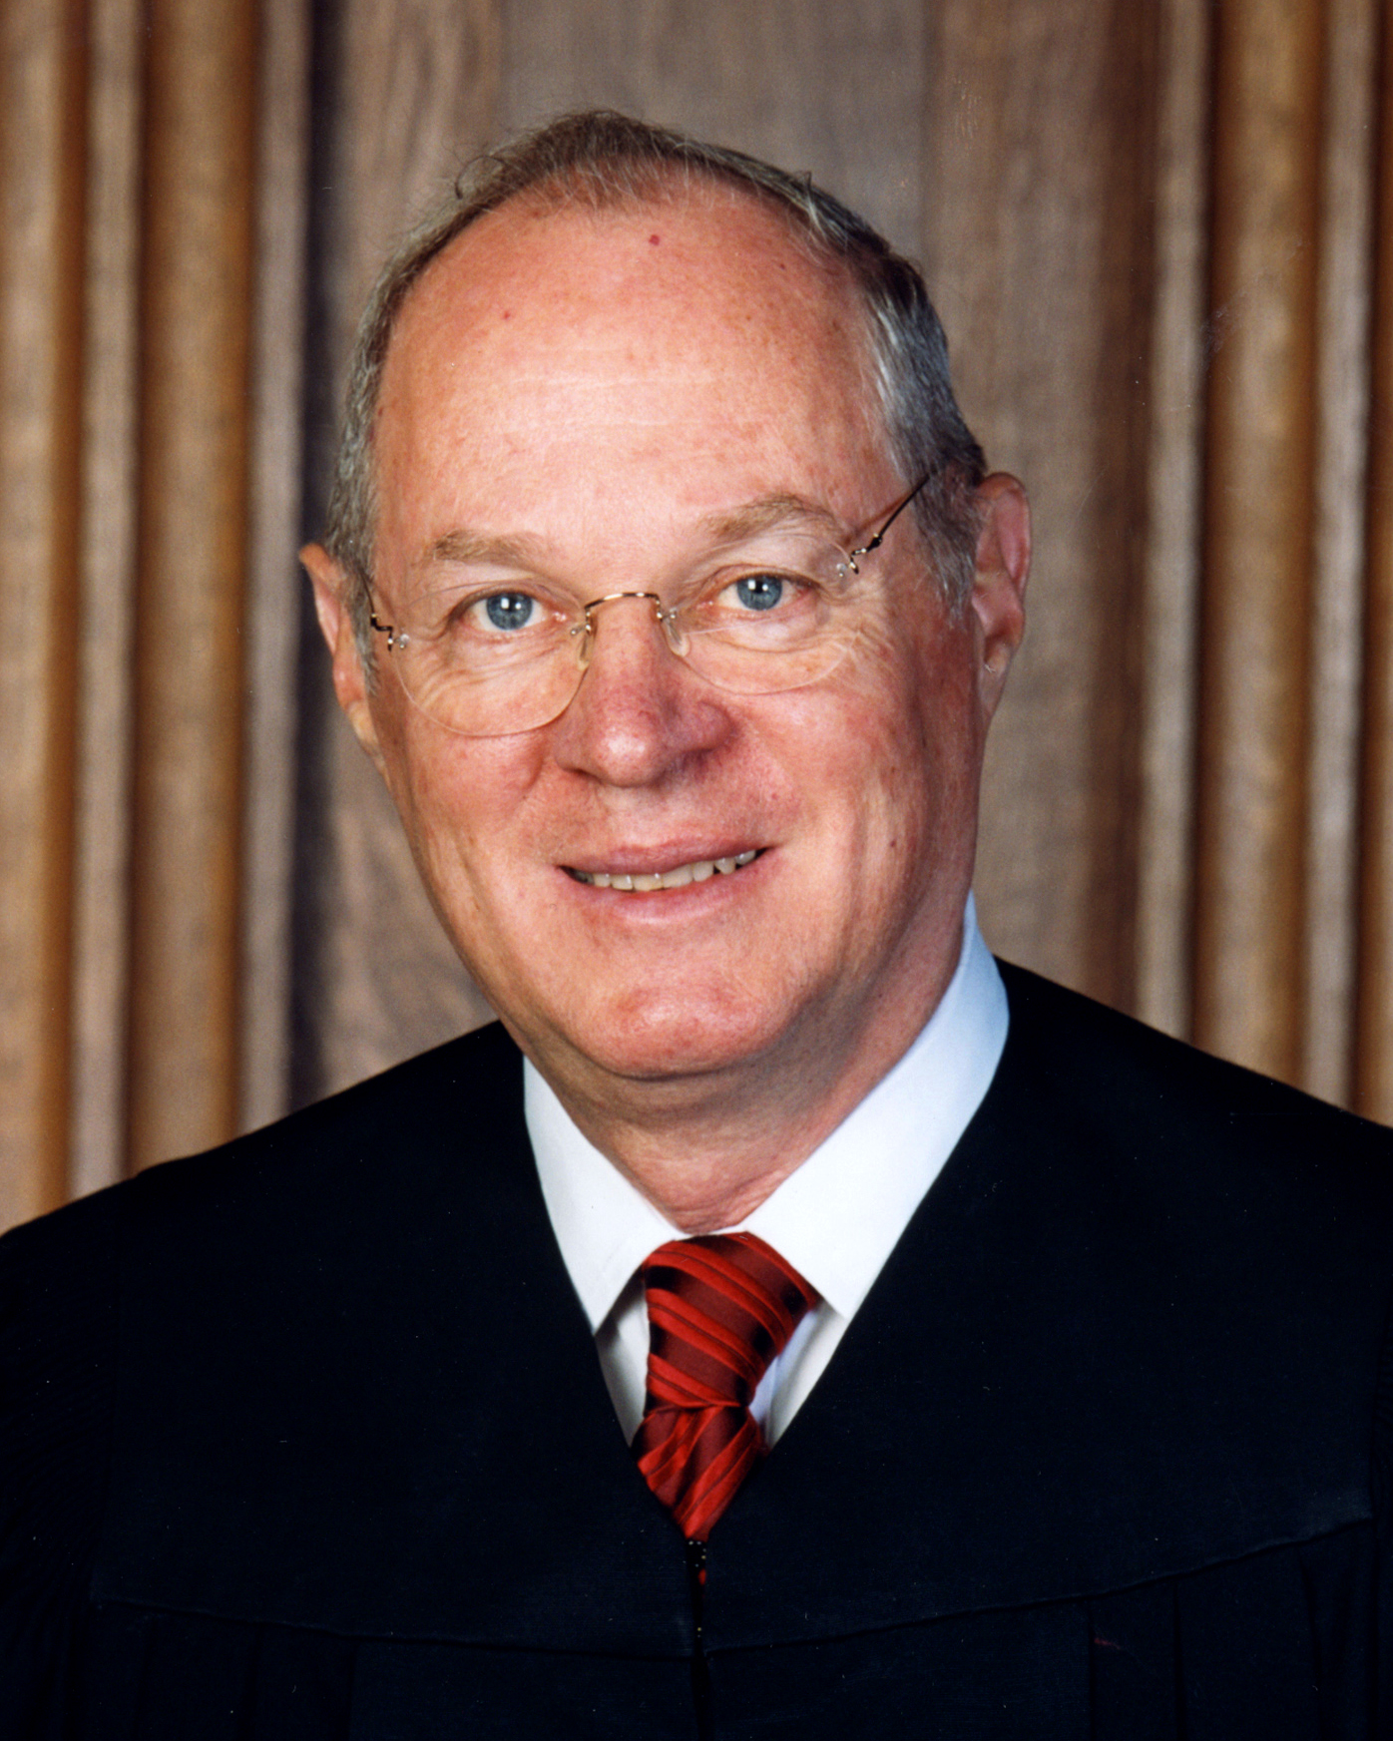
Vieth v Jubelirer (2004)
“…The failings of the many proposed standards for measuring the burden a gerrymander imposes on representational rights make our intervention improper. If workable standards do emerge to measure these burdens, however, courts should be prepared to order relief.”

Slide 8
Legal status quo ante, cont’d
LULAC v. Perry 2006
  4 justices want to give up
  4 justices have their own standards
  Kennedy says he hasn’t see a standard but there might be one
Key difference in LULAC: Gelman-King bias (“symmetry”)

Slide 9
Outline
Legal status quo ante
The opportunity
The proposed metrics
Gill v Whitford
Where next?

Slide 10
A call to action
“Technology is both a threat and a promise. On the one hand, if courts refuse to entertain any claims of partisan gerrymandering, the temptation to use partisan favoritism in districting in an unconstitutional manner will grow. On the other hand, these new technologies may produce new methods of analysis that make more evident the precise nature of the burdens gerrymanders impose on the representational rights of voters and parties….”
(Vieth v Jubelirer 2004)

Slide 11
The measurement problem is difficult
System was designed for geographic representation
  A district-specific concept
Parties now dominate American politics
  An aggregate concept
Other systems specify aggregate votes-seats relationships

Slide 12
The measurement problem is difficult
If votes-seats relationship is not specified in law, how can a party ever win too many seats?
BUT
If voters care mostly about parties, how can partisan manipulation have no limits?

Slide 13
The opening for social science
Real but complex phenomenon
Requires systematic, transparent measurement
Perfect fit for social science, but a challenge for the courts

Slide 14
Outline
Legal status quo ante
The opportunity
The proposed metrics
Gill v Whitford
Where next?

Slide 15
Gelman-King bias
Principle: equal parties should be treated equally (“symmetrically”)
  Same share of vote → same share of seats
If unequal vote shares, pretend as if they were equal
60% Democratic vote = 70% Democratic seats →
50% Democratic vote = ??% Democratic seats
60% Democratic vote = 70% Democratic seats →
60% Republican vote = ??% Republican seats

Slide 16
G-K bias: advantages
Grounded in firm normative idea: majority rule
  Party with vote majority deserves seat majority
  Great at capturing majority entrenchment
Otherwise permits any relationship between votes and seats

Slide 17
G-K bias: disadvantages
Assumes a world that doesn’t exist
Uncompetitive states: can be very misleading
  Seat gains from gerrymandering might not register
  Could actually appear to benefit other side!
Key question: is the counterfactual plausible?

Slide 18
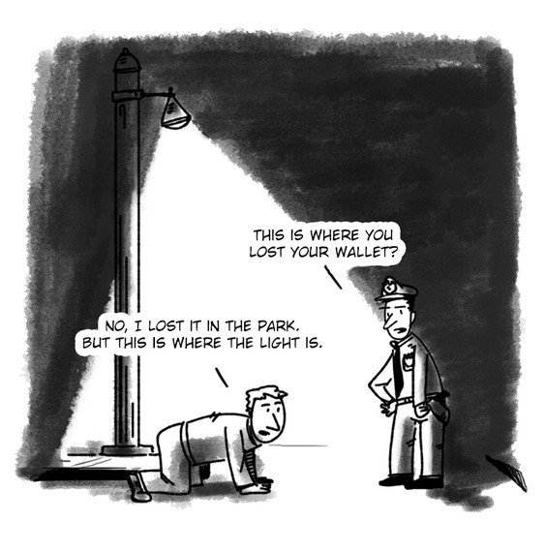

Slide 19
G-K bias: disadvantages
Assumes a world that doesn’t exist
Uncompetitive states: can be very misleading
  Seat gains from gerrymandering might not register
  Could actually appear to benefit other side!
Key question: is the counterfactual plausible?
Advocates have offered no thresholds
  When is it a gerrymander? How much is too much?
Also Kennedy’s concerns

Slide 20
LULAC v Perry (2006)
A brief for one of the amici proposes a symmetry standard that would measure partisan bias by “compar[ing] how both parties would fare hypothetically if they each (in turn) had received a given percentage of the vote…we are wary of adopting a constitutional standard that invalidates a map based on unfair results that would occur in a hypothetical state of affairs…More fundamentally…how much partisan dominance is too much[?]”

Slide 21
The mean-median difference
Difference between the average district outcome (mean) and the outcome that divides the districts in half (median)
  MMD = med(V) - mean(V)
Intuition: in a symmetric distribution the two will be equal
Advantages/disadvantages almost identical to G-K bias
  Easier to calculate than G-K bias
  But values less intuitive

Slide 22

The efficiency gap
Votes are “wasted” when they don’t contribute to a win
  Any vote in excess of the number required to win
  Any vote for a loser
Efficiency gap fairness: no party should waste more votes than any other party
Efficiency gap is difference between one party’s wasted votes and another’s, divided by the total votes cast
$$EG=\left(S−0.5\right)−2∗(V−0.5)$$

Slide 23
Efficiency gap: advantages
No specific counterfactual required
Competitive and uncompetitive: no problem
Excellent at measuring efficiency
2-to-1 seats-to-votes ratio fits historical pattern
Potential thresholds have been offered
  Based on analysis of historical data: size and durability
Fully extendable to all possible scenarios
  Variations in turnout across districts
  More than two parties

Slide 24
Efficiency gap: disadvantages
New idea: relatively untested
  Is it really the best/only way to aggregate wasted votes?
Requires strong commitment to equal wasted votes
Often varies from one election to the next

Slide 25
Simulations
Computer draws many random redistricting plans
Plans constrained to follow specified criteria (compactness, minority representation, etc.)
Actual plan is compared to this distribution
If an outlier, the political geography of a state can’t explain the adoption of a plan

Slide 26
Simulations: advantages
Offers good general sense of state’s political geography
Can be an effective measure of intent

Slide 27
Simulations: disadvantages
Do simulations really sample the entire set of possible plans?
Can a distribution really have normative force?
  Does it matter if a plan is improbable if it’s fair?

Slide 28
Vieth v Jubelirer (2004)
“…even those criteria that might seem promising at the outset (e.g., contiguity and compactness)…cannot promise political neutrality…a decision under these standards would unavoidably have significant political effect, whether intended or not…if we were to demand that congressional districts take a particular shape, we could not assure the parties that this criterion, neutral enough on its face, would not in fact benefit one political party over another.”

Slide 29
Outline
Legal status quo ante
The opportunity
The proposed metrics
Gill v Whitford
Where next?

Slide 30
The 2011 Wisconsin Assembly plan
2010: Republicans take control of Wisconsin legislature
2011: Republicans draw map with aggressive seat maximization strategy
2012: Republicans win 48.6% of the vote and 60 of 99 seats
High values on all metrics in all years (2012, 2014, 2016)
  G-K bias (13%, 12%, 13%)
  Mean-median difference (6%, 7%, 7%)
  Efficiency gap (13%, 10%, 11%)

Slide 31
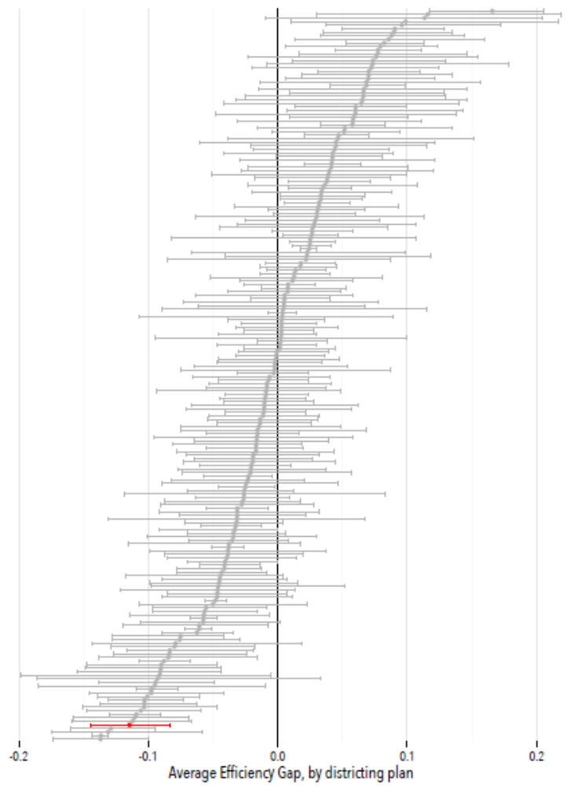

Slide 32
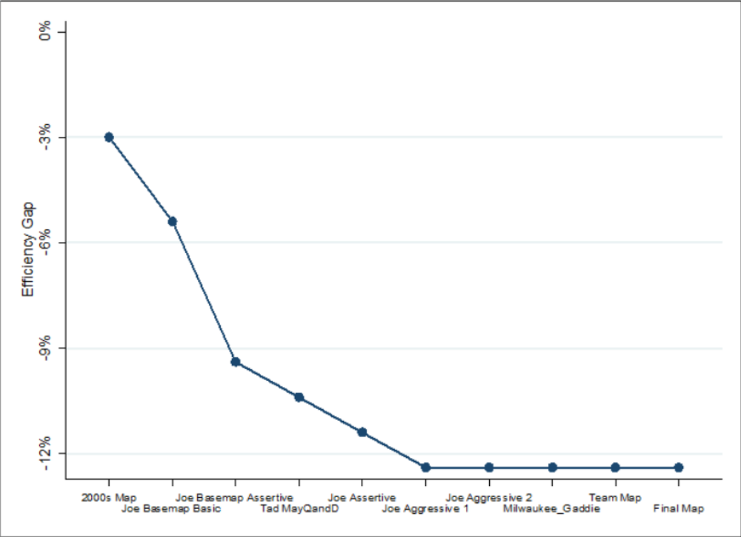

Slide 33
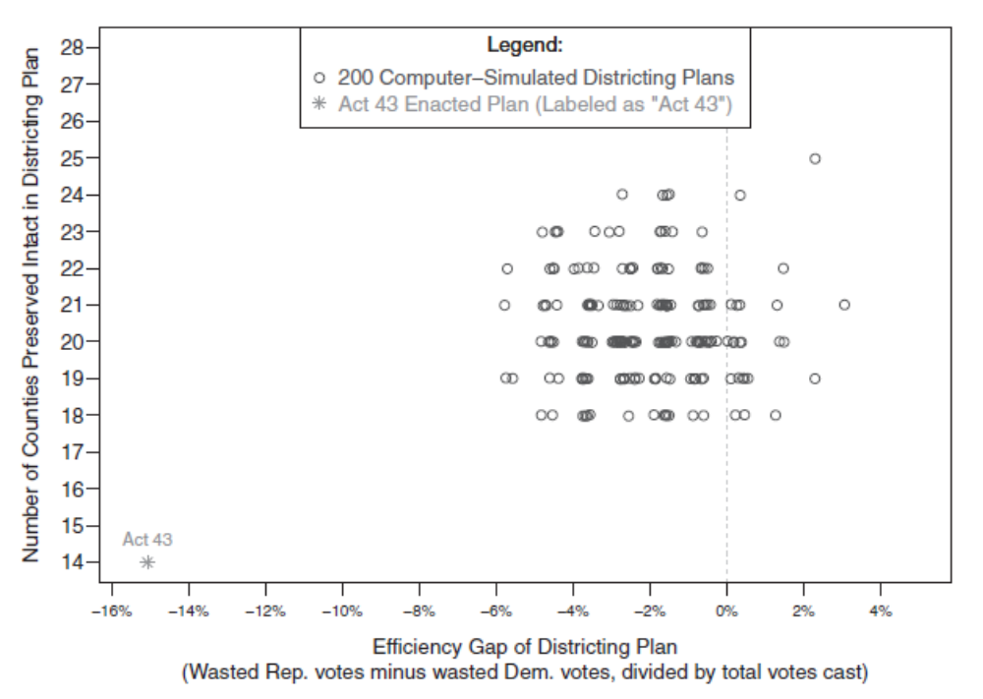

Slide 34
Outline
Legal status quo ante
The opportunity
The proposed metrics
Gill v Whitford
Where next?

Slide 35
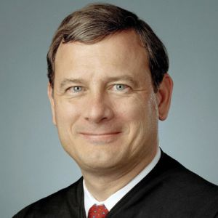
A culture clash
“…if you’re the intelligent man on the street and the Court issues a decision, and let’s say…the Democrats win, and that person will say: ‘Well, why did the Democrats win?’ And the answer is going to be because the EG was greater than 7 percent, where EG is the sigma of party X wasted votes minus the sigma of party Y wasted votes over the sigma of party X votes plus party Y votes. And the intelligent man on the street is going to say that’s a bunch of baloney.”

Slide 36
A culture clash
If the court needs social science to solve a problem, does that mean the court can’t solve it?
  Simple, straightforward concepts do not need social science
  Complex concepts will likely fail Roberts’s “man on the street” test
Can the court act on complex measures without compromising its legitimacy?

Slide 37
Where next?
Each measure has a Court weakness
  G-K bias and MMD → counterfactuals
  Efficiency gap → very new
  Simulations → punish political geography
Will there even be a “winning” metric?
More likely: intervention will require measures to substantially agree
  Would make litigation more likely in competitive states

Slide 38
Where next?
SCOTUS decision coming between January and June
Reform efforts
  Independent commissions
  Legal constraints on legislatures
Measures will continue to be valuable, regardless of the Court’s decision

Slide 39
Partisan Gerrymandering and the Supreme Court
The Role of Social Science
November 1, 2017
Eric McGhee

