Slide 1
Vathys: Petascale Deep Learning on a (Single) Chip
Tapa Ghosh
Vathys

Slide 2
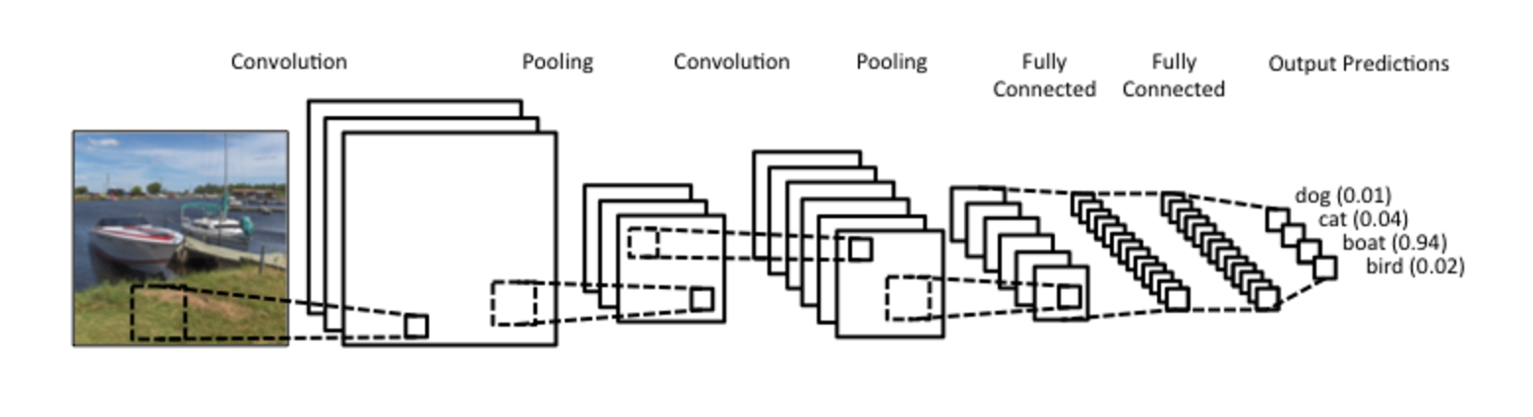

What is deep learning?
In a sentence: Layers of parametric, differentiable operations whose parameters are changed using gradient information.
Below is a Convolutional Neural Network, one of the most commonly used type ( along with LSTMs)

Slide 3
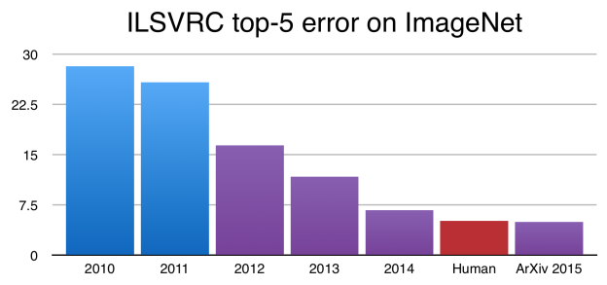
Deep Learning- Yes It Matters
(A picture is worth a thousand words)

Slide 4
Vision: Deep Learning Supercomputing on a Chip (“SoC”)
Ideal is 1 PetaFLOP of compute (fp8/fp16) in a TDP similar to the Volta.
And not only that, we want it to be an usable PetaFLOP, we don’t want to advertise something like 120 TFLOPs peak but get much less in the real world.
And of course, we need to find a way to feed these compute units with enough bandwidth.
Aggregate compute should not be measured in petaflops while memory bandwidth is measured in gigabytes.

Slide 5
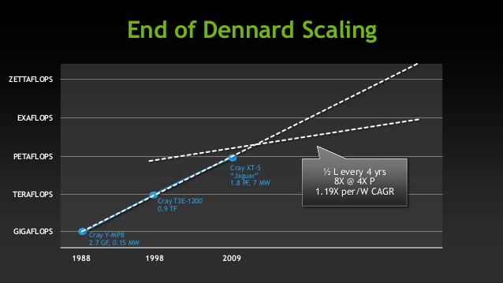
Can Moore’s Law Save us?
CMOS Scaling in Danger- “The party isn’t over yet but the cops have been called and the music has been turned down”.
Dennard Scaling already on its deathbed.
Picture Source: Nvidia

Slide 6
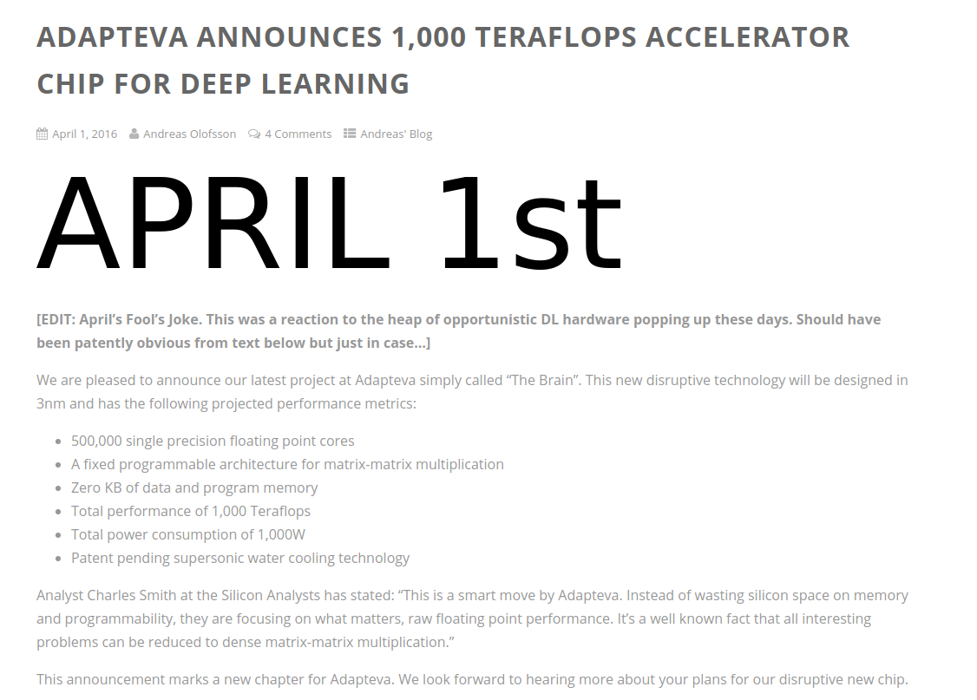
What we DON’T Want...

Slide 7

5-10X Better than TPU/IPU/?PU
To reach our goal, we need to be 5-10X better than the Google “TPU”, Graphcore “IPU”, Wave Computing “DPU”, etc.
These are already processors supposedly optimized for deep learning, how can we be an order of magnitude better than them?
Start where there is three orders of magnitude difference.
fJ (compute) vs pJ (memory)
So, Competitor’s “2.9/11.6 PetaOPs/s” → 345 kW/1.38 MegaW for memory only.

Slide 8
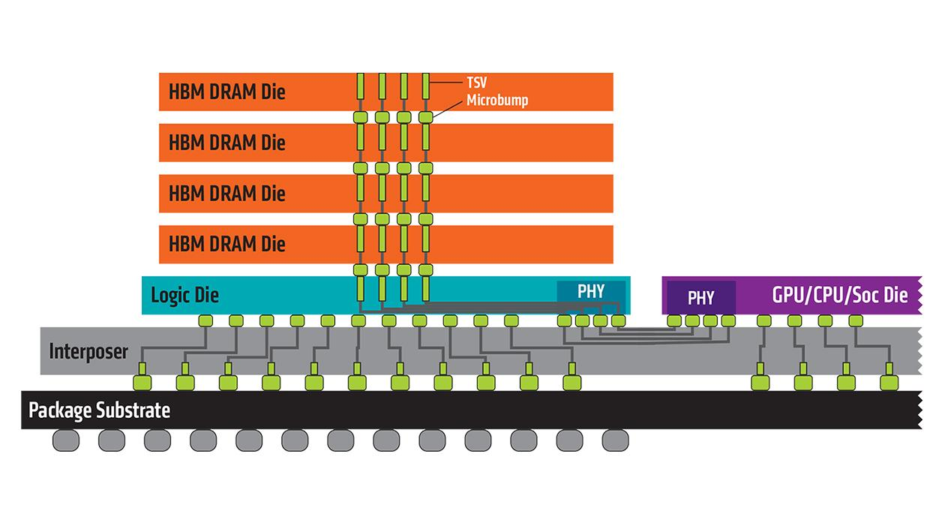
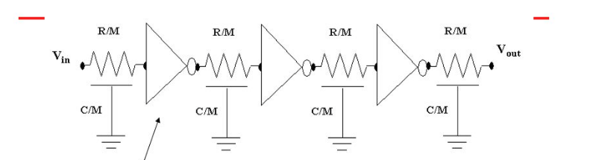
What’s the Obstacle to our “DL SoC” vision?
Biggest problem is data movement.
Problem is multi-level, both off-chip:
~119 pJ/byte for off-chip HMC memory access and ~56 pJ/byte for HBM
And on-chip:
8 pJ/byte/mm on-chip (Why we need Exascale and why we won ’t get there by 2020 )

Slide 9
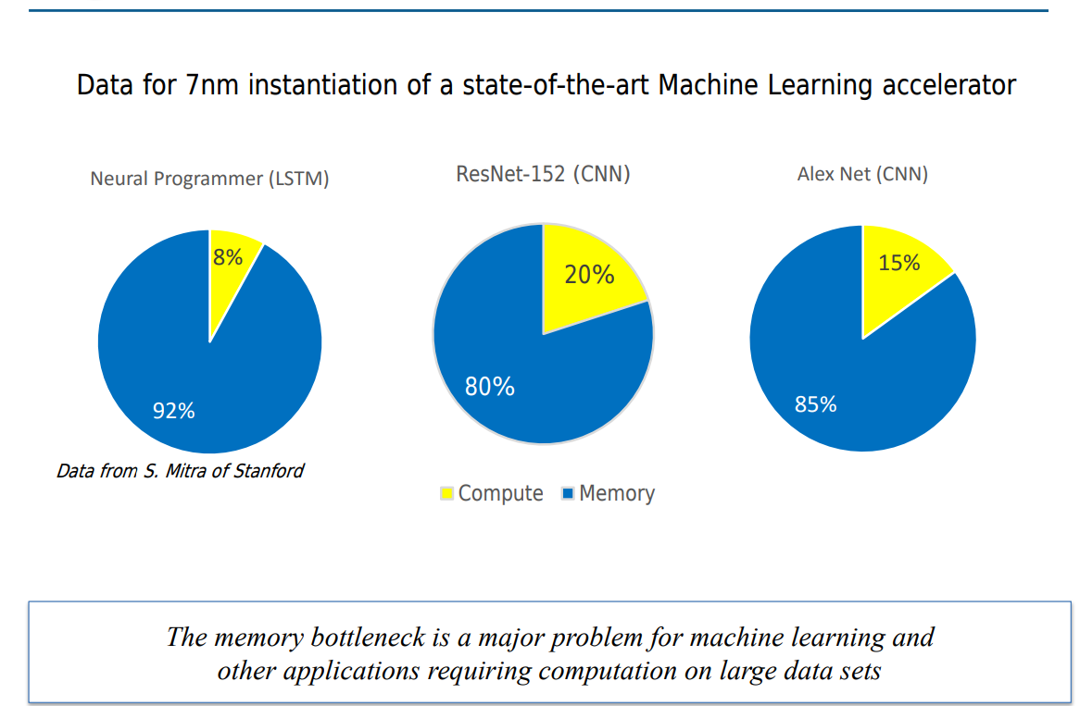
The Real Problem is Being Ignored
Industry and startups laser focused on this problem (e.g. INT16 math a la Intel )
Ignoring this problem
Or attempts are made in attacking the memory problem but clearly fall short (e.g. 300MB per die isn’t enough…)
Picture Source: DARPA

Slide 10
Hierarchical Approach
Architecture
Circuit Level
Device Level

Slide 11
Architecture Level Innovations
Optimized to reduce data movement
~50 um between compute stages (repeaterless!)
Dataflow (“dataflow-only”) architecture: more suitable for DL computations than control flow architecture used by competitors.
True dataflow, at both high/low level, not control flow + data flow.
Novel data use optimizations for key operations (e.g. convolutions) ahead of the literature.
“Tensor native” memory architecture- address large pieces of memory at once. Less work for address decoder, easier to get bandwidth and I/O and allows for novel bitline hierarchy techniques.
Pipelining to expose parallelism, not batches.
One DLE has all the memory it needs, no external memory needed.

Slide 12

High Level View- Just a Sea of DLEs
1 DLE ~= 1 Layer
One layer can use multiple DLEs for larger layers.
Communication between neighboring DLEs only.
“Flyover” network for skip connections (Level 1 + 2)
No instruction decoders- programmed like CGRA
Input and output are synchronous, internally asynchronous.
Input
Interface
Output
Interface
Nine DLEs for illustration only, ~2400 in a Petascale chip (approx 200K ALUs)

Slide 13
NoC
DLE Block Diagram
Activation Memory (Tensor and tensor slice addressable)
NoC
NoC
Activation Buffer(s)
Weight Memory (tensor slice addressable)
Convolution/MatMul Pipeline
Activation + Normalization Units
SIMD CUs
SIMD CUs
SIMD CUs
SIMD CUs
SIMD CUs
SIMD CUs
Writeback Buffer(s)
NoC

Slide 14
Circuit Level Innovation
Underappreciated source of “data movement” is in clock lines.
Up to ~60% of total power (Prof. Dally: Exascale Challenges)
New form of asynchronous logic:
10% overhead compared to 2X+ for previous SOTA.
Functionality immune to process variations
Higher performance and no guardbanding necessary
True asynchronous logic (not GALS like some competitors)
~12 “GHz” effective and sustainable “clock” rate (measured on 28nm).
~45.2ps delay and ~6 fJ energy at 0.7v supply for 4-bit ALU, deeply pipelined to 8-bit multiply and 16-bit accumulate.
Memory access hyper-pipelined with dynamic logic in sense amps.

Slide 15
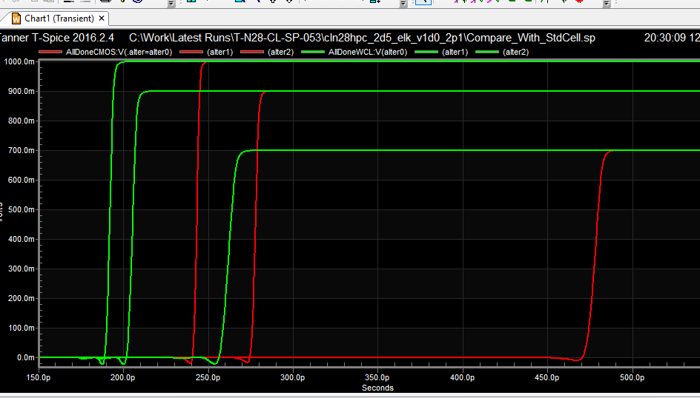
Data: Done/Ready Detection for Async
The “done/ready” detection is the critical core of (almost) all asynchronous logic systems.
Compared to standard technology, our advantages are:
Energy: 3.4642X to 3.5414X
Delay: 2.2998X to 3.5300X

Slide 16
Memory Cell
We can get huge advantages by putting all our memory on die.
-Unfortunately, impossible with standard 6T SRAM today.
Any feasible new memory must be CMOS compatible.
No new materials and no changes to the process (e.g. no litho steps)
Our memory cell is just that, “zero-change” to the process itself:
5X OR (with multilevel) 10X denser than the standard 6T SRAM, 6X to 12X (w/multilevel) lower leakage per bit than standard 6T SRAM.
TCAD simulations complete (promising for multilevel) and MPW in January for silicon validation.

Slide 17
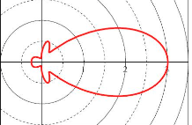
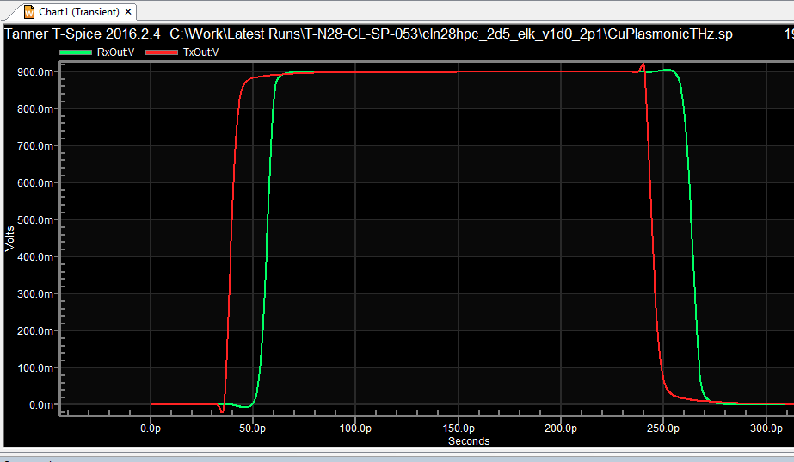
3D Stacking- the Wireless Way
Power | Speed | Area
~7.9 fJ/bit | ~40 GBits/S | ~9 um^2
Source: SPICE Simulation*
Area underneath CAN be used.
No ESD protection needed for these data links.
Cross-talk removed by spacing and/or multiplexing.
*Waveform

Slide 18
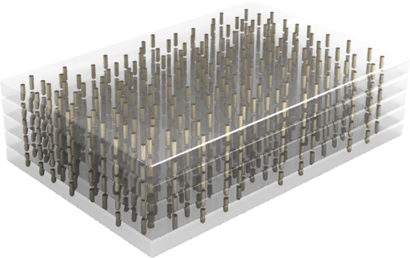
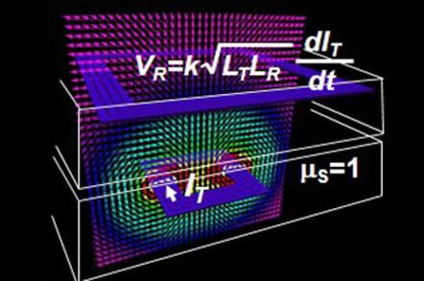
Maximum Achievable Bandwidth per mm^2
TSVs: 400 GBits/S @ ~110 fJ/bit Source (slide 23)
(But no logic underneath!)
Inductor coils: 800 GBit/S @ ~110 fJ/bit Source
(We get logic underneath though!)
Wireless link: 10,000 GBit/S @ ~8 fJ/bit
We get logic underneath too!
Can be made higher with multiplexing.
Image source: ThruChip

Slide 19
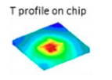
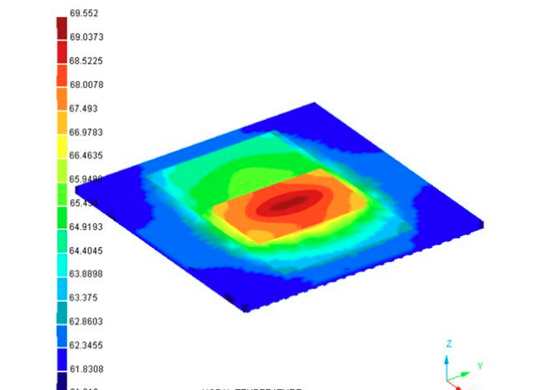
3D Stacking: The Thermal Wall
3D stacking is limited today by thermal constraints.
Stacking two dice in the ~300W TDP regime is impractical, limiting the usefulness of 3D stacking.
Observations from FEM analysis:
Heat is concentrated in the center in homogeneous dice as the escape of the sides aren’t there.
Compute regions are hotspots- do worse when a die is on top.
Source: SemiWiki
Source:
SemiEngineering

Slide 20
3D Stacking: Tackling the Thermal Wall
Exploit observations from FEM analysis: Heat “Gaussians” around hotspots:
Thermal density of memory regions of dice is less than the thermal density of compute regions.
→ Place memory regions on top of each other.
“Thermal Multiplexing”: Regions on top of each other work via space-time multiplexing.

Slide 21
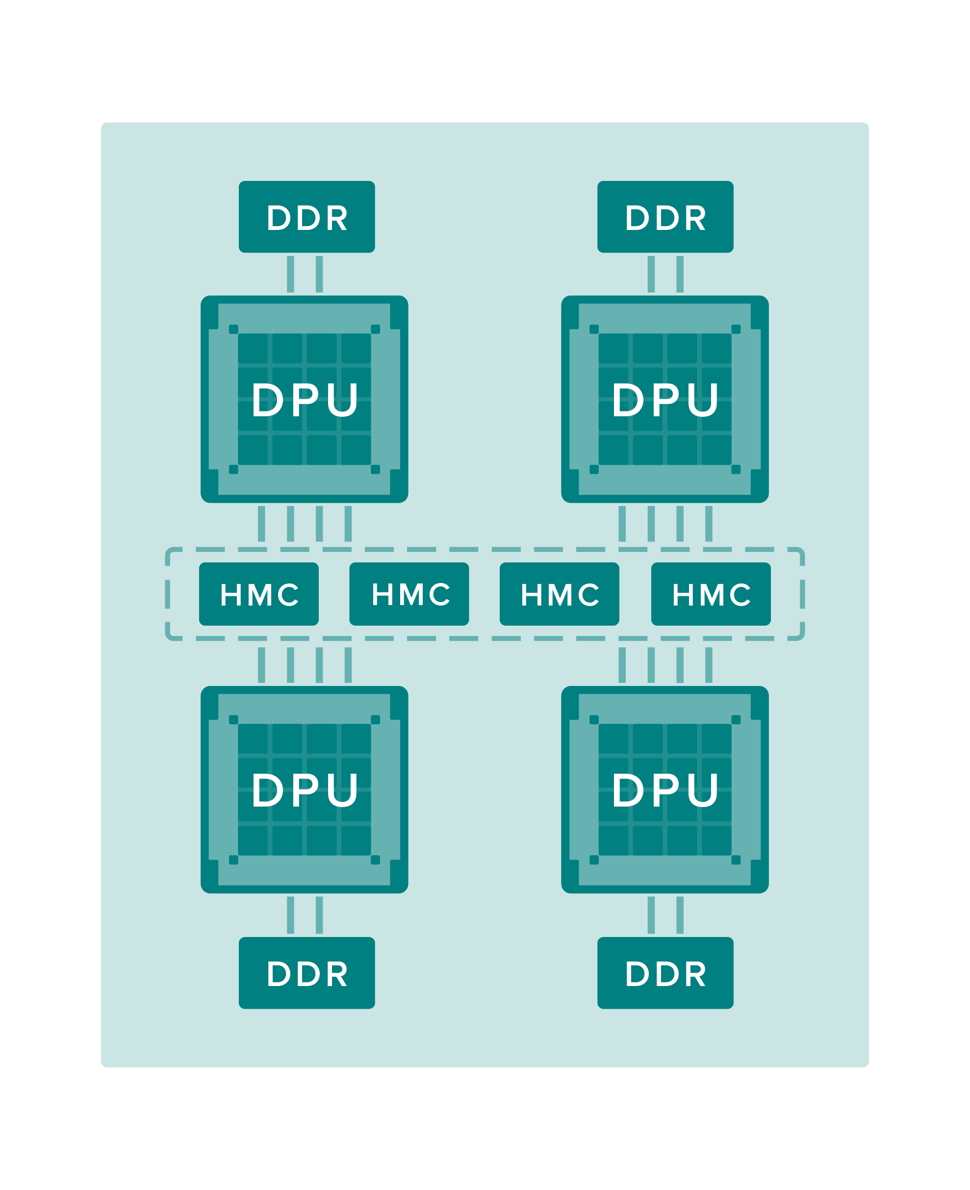
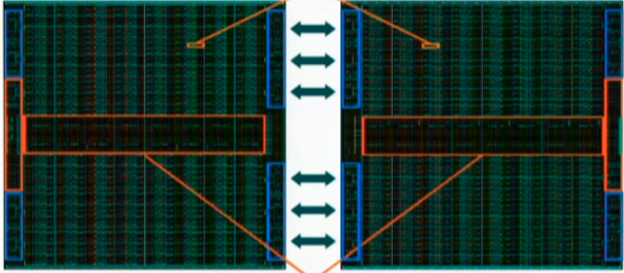
Comparisons to Other DL Chips
Graphcore
Their ~120 PJ vs our ~0.5 PJ...
Wave Computing
Has major bottlenecks (not on ours)
600 MB not enough (e.g. VGGNet > 600MB, real-world data up to 40X bigger ).
Our on-chip memory is ~1.5GB (on 28nm) to 6/8 GB (on FinFET 7nm)
Their ~200 TFLOPs vs our ~1 PetaFLOPs
Not performant, energy efficient OR sustainable.

Slide 22
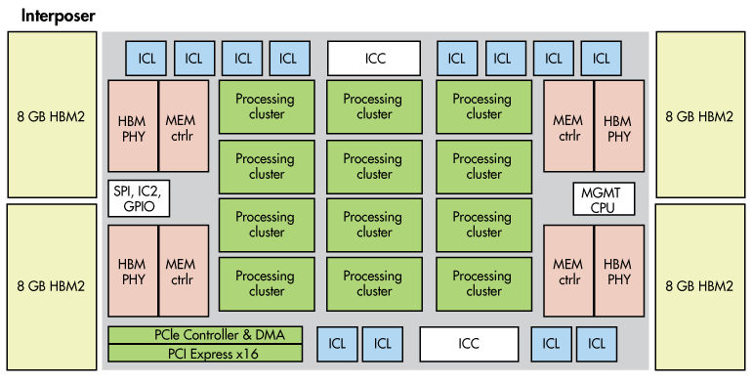
Compared to Intel Nervana (“Lake Crest”)
~60 pJ/byte (Nervana) vs ~0.5 pJ/byte (Vathys)

Slide 23
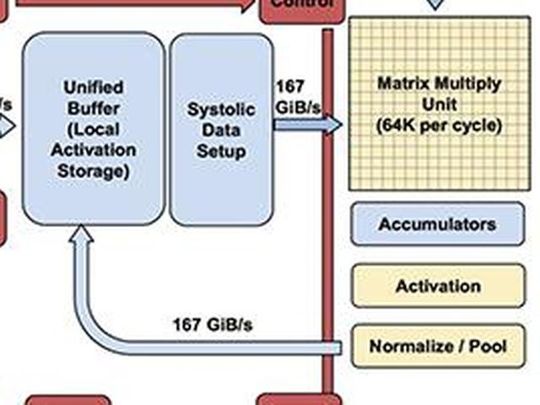
Compared to the TPU v1
A lot of on-chip data movement with an unified memory.
Also, must “lower” convolutions to a matmul, problematic for convolutions.
Move 8-bits 1mm On-Chip (on 10nm) | ~8 pJ
DRAM access | 640pJ !!!
Image courtesy of Google of course.

Slide 24
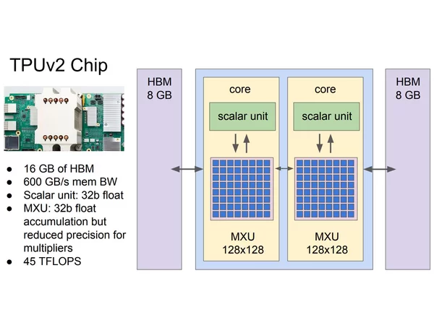
Compared to TPU v2
~60 pJ/byte (TPU v2) vs ~0.5 pJ/byte (Vathys)
No programmability : (

Slide 25
Compared to the “Analog Alternative”
Number of problems with analog computation, even for DL.
Current approaches are flash memory based
Requires power and area intensive ADCs and DACs
Does not solve the data movement problem (in fact makes it worse)
Huge endurance problem for flash memory (~10^6 max cycles)
    At “1 GHz” will die in ~1 millisecond
Flash memory is intrinsically unscalable to lower geometries due to leakage difficulties, low number of carriers in the floating gate.
And of course…. No evidence it can actually retain accuracy...

Slide 26
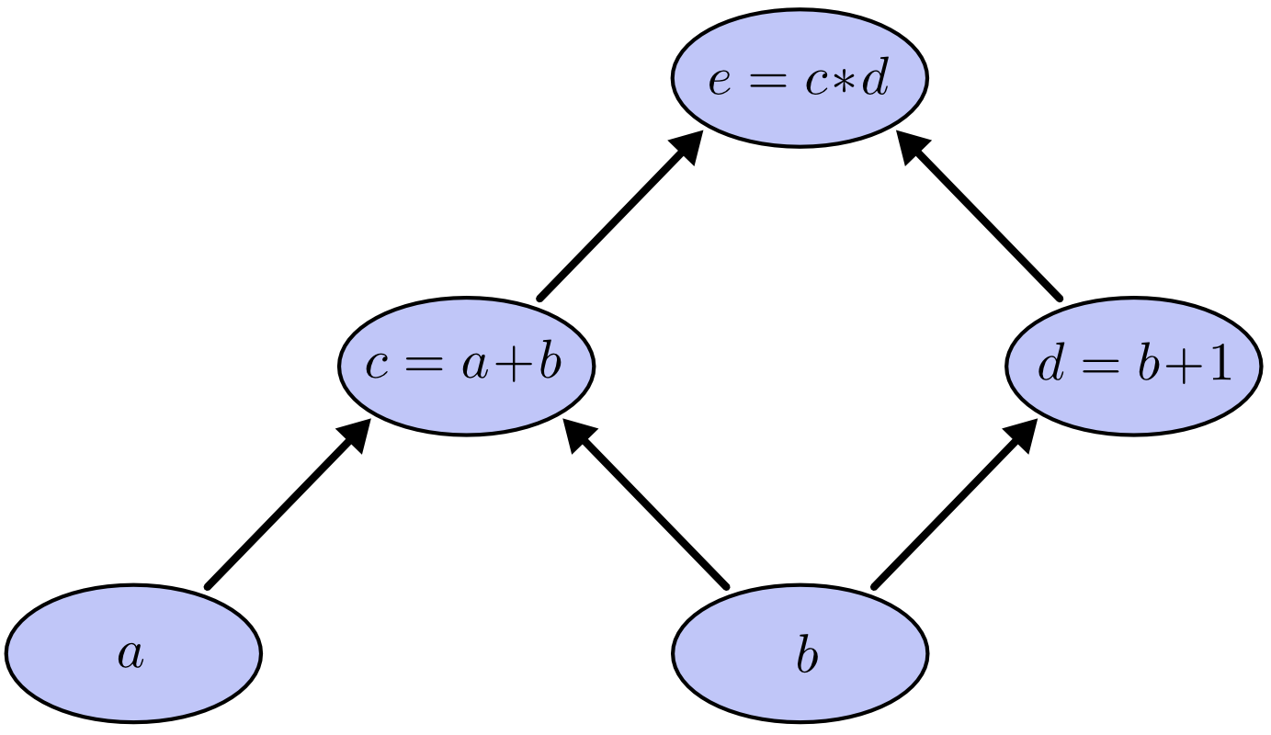
The Software Stack (aka “How do I actually use it?”)
Framework: TensorFlow, Torch, etc.
DNN-cc Graph Compiler
Computational Graph IR (e.g. ONNX)
Vathys chip is a drop-in replacement for nVidia GPU.
Data scientist sees no difference except 10X faster
than TPU, IPU, DPU etc.
Vathys Chip

Slide 27
Timeline (aka “I want one, when can I buy one?”)
MPW going out in January 2018 to silicon validate 3D stacking and memory cell.
Engineering samples in Q2 2018, funding contingent.
Production shipping in Q3 2018, funding contingent.
Production shipping on 7nm in Q1 2019, also funding contingent.

Slide 28
Thank you!
Any questions?

