Slide 1
The Evolution of Public Key Cryptography
Martin E. Hellman
Stanford University

Slide 2
Revolutionary or Evolutionary?
Revolutionary: Auguste Kerchoffs 1883
The general system must be considered public information. Security resides solely in the secrecy of the key.
How can you have a public key?

Slide 3
Evolutionary
Half the concept (privacy) occurred independently to three different groups almost simultaneously. In addition to Whit Diffie and me:
Ralph Merkle at UC Berkeley.
James Ellis, Clifford Cocks, and Malcolm Williamson at GCHQ.

Slide 4
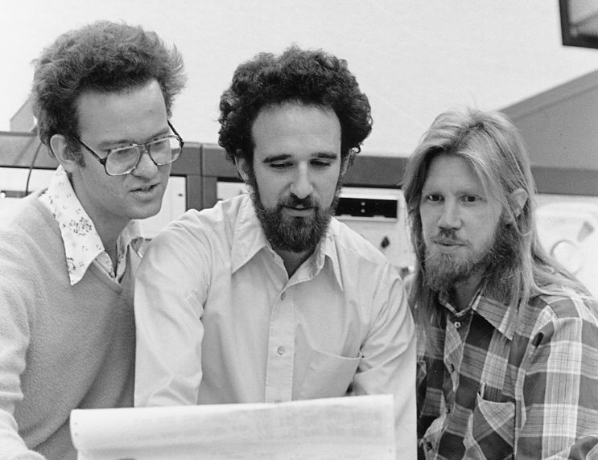
Diffie-Hellman AND Merkle
Photo by Chuck Painter
© Stanford News Service

Slide 5
Evolution via
Cryptographic Hierarchy
See “New Directions in Cryptography”
1. One-Way Function
2. Conventional (Symmetric) Cryptosystem
3. Trap Door Cryptosystem
4. Public Key (Asymmetric) Cryptosystem

Slide 6
One-Way Function
One-way functions are simpler than (conventional) cryptosystems.
P₀
AES
P
X
K
C
Y = f(X)

Slide 7
Trap Doors
While trap doors are associated with public key cryptography, they are fundamental to all cryptographic entities
Trap door quiz problem: Given Y=f(X) and Y find X.
Related to P=?NP

Slide 8
Trap Door Cryptosystem
Information known only to the designer allows him to easily break the system.
This is the dream of every nation’s military … and their equivalent of NSA.
Trap door cryptosystems allow public key exchange.

Slide 9
Public Key Cryptography
Whit Diffie and I developed the concept of a public key cryptosystem.
Ralph Merkle independently developed the concept of a public key distribution system and had a proof of concept.
“Diffie-Hellman” is a Merkle PKD system!

Slide 10
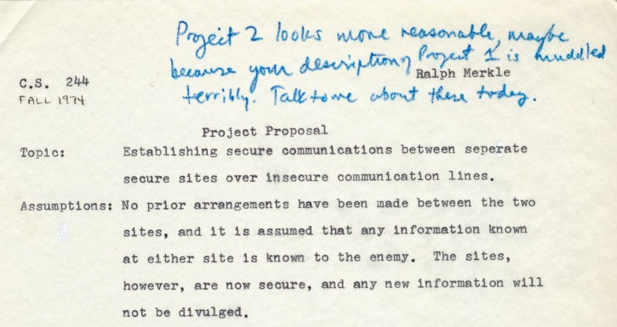
Merkle’s PKD Proposal

Slide 11
CACM Rejected Merkle Paper
Editor: “[I] was particularly bothered by the fact that there are no references to the literature. Has anyone else ever investigated this approach?”
An Experienced Cryptography Expert: “the paper is not in the mainstream of present cryptography thinking … I would not recommend that it be published.”

Slide 12
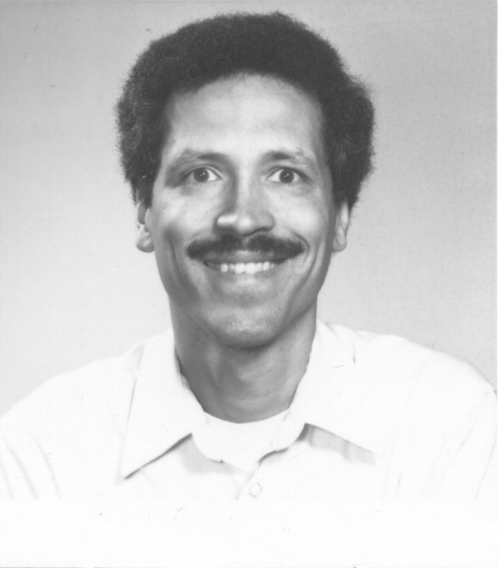
John Gill, Unsung Hero #2
Start with the simplest crypto-entity, a one-way function.
John Gill suggested indices (discrete logs).
Y = α^{X} mod q is fast:
α⁹ = (α²)²)² x α
X = log_{α}(Y) is slow
John Gill in 1976

Slide 13
“Derivation” of Pohlig-Hellman Conventional Cryptosystem
α,X -> Y easy (exponentiation)
α,Y -> X hard (discrete log)
X,Y -> α easy
P,K -> C easy (encipher)
C,K -> P easy (decipher)
P,C -> K hard (cryptanalysis)
X must be K!
The key is in
the exponent.

Slide 14
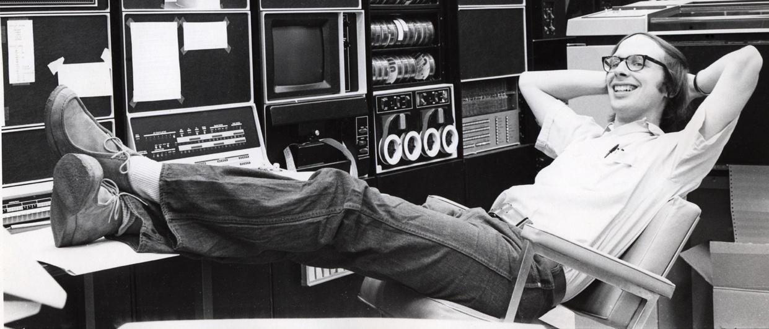
Pohlig-Hellman Cryptosystem
C = P^{K} mod q
P = C^{D} = P^{KD} mod q
KD = 1 mod φ(q) = q-1

Slide 15
RSA Public Key Cryptosystem
C = P^{E} mod n
D = C^{D} = P^{ED} mod n
ED = 1 mod φ(n) = (p-1)(q-1)
Only differences: K is called E, and
q is replaced by n=pq.
P-H paper appeared a few months after RSA, but was submitted about a year before it. We totally missed that it could become a PKC.

Slide 16
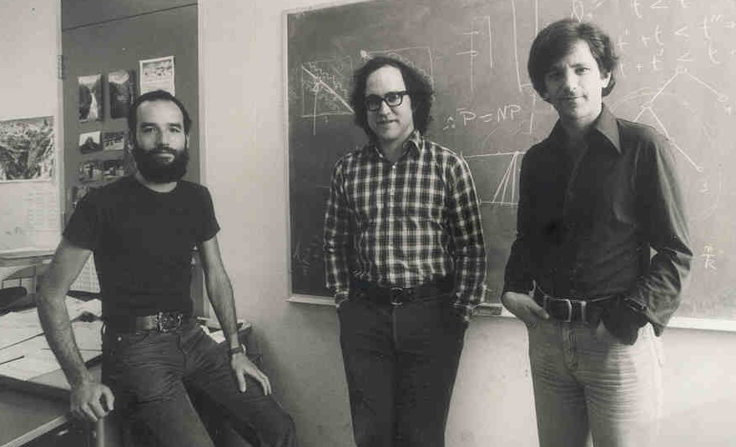
Rivest, Shamir & Adleman

Slide 17
Diffie-Hellman-Merkle PKD
Y(i) = α^{X(i)} mod q
K(i,j) = α^{X(i)X(j)} mod q
= Y(i)^{X(j)} = Y(j)^{X(i)} mod q
I was trying to find a public key cryptosystem based on discrete logs when I came up with this public key distribution system instead.

Slide 18
Late one night in May 1976 I played with
Y = α^{X} mod q
Let α and q be public (many variations).
Computing Y from X is easy (exponentiation).
Computing X from Y is hard (discrete log).
So try X(i) = i’s secret key and Y(i) = public key.
Then what? Eventually I tried:
Y(i)^{X(j)} = Y(j)^{X(i)} = α^{X(i)X(j)} = K_{ij} mod q

Slide 19
Schroeppel: Unsung Hero #4
RSA originally used 256-bit keys, but Richard Schroeppel’s work caused them to recommend ≥200 digits in their famous CACM paper.
Pomerance’s Quadratic Sieve Method is related and credits Schroeppel’s unpublished work as the “inspiration” for QS.

Slide 20
Kohnfelder: Unsung Hero #5
Loren Kohnfelder developed the concept of digital certificates in his 1978 MIT BS thesis under Len Adleman.
This created the foundation for VeriSign and all other Certificate Authorities (CA’s).

Slide 21
Born Classified?
March 1975: 56-bit key DES announced
2^56 = 10^17 possible keys
10^6 keys/sec/chip
10^6 chips
10^5 seconds = 1 day
$10,000/solution & decreasing an order of magnitude every 5 years. Short cuts?

Slide 22
Technical or political problem?
January 1976: “Continuing will cause grave harm to national security.”
The “devil on my shoulder.” See my Turing Lecture write-up in the DEC 2017 issue of the CACM.
May 1976: PKC increased NSA’s concern
July 1977 J. A. Meyer letter to IEEE
October 1977: IEEE ISIT at Cornell

Slide 23
Resolution Begins
1978: Call from Adm. Inman’s office
“It’s nice to see you don’t have horns.”
“I am meeting with you against the advice of all the other senior NSA people. But I don’t see any harm in talking.”
Adm. Inman signed a statement of support for my effort to assess and reduce the risk of nuclear deterrence.
It’s better to have friends than enemies!

Slide 24
Resolution Grows
1993 Congress requests NRC study
Cryptography’s Role in Securing the Information Society (1996 CRISIS report)
All constituencies were represented, yet unanimous conclusions:
Relaxation of export restrictions
Classified information largely irrelevant
Key escrow not well defined. (Now too!)

Slide 25
This talk has been about the evolution of PKC, but also shows personal evolution.
I am a very different person from the 30-year old who battled NSA 40 years ago.
“Get curious, not furious”
Friends are better than enemies.

