Slide 1
Solving Cybersecurity as an Economic Problem
Alex Gounares 11/20/19

Slide 2

Alex Gounares
CEO & Founder
Former Technology Advisor to Bill Gates
CTO, Microsoft Online Services
CTO, AOL
Inventor on over 200 patents

Slide 3
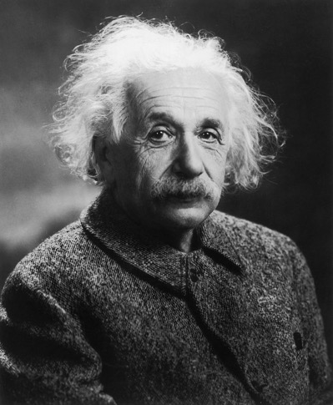
What do these have in common?

Slide 4
Sun Tzu was one of the early advocates of asymmetric warfare
“So in war, the way is to avoid what is strong, and strike at what is weak.”

Slide 5
Are we weak anywhere?
Cyber damages to hit $6 trillion annually by 2021
Up from $3 trillion in 2015
Cyber security spending to
exceed $1 trillion from 2017 to 2021
Cyber crime will more than triple the number of unfilled security jobs
Predicted to reach 3.5 million by 2021
Human attack surface to reach
6 billion people
by 2022
Ransomware damage costs are predicted to reach $11.5 billion
by 2019
CSO online: Top 5 cybersecurity facts, figures and statistics for 2018
Notes:
Despite that growth, cyber damages continue to outpace spend.
Cyber damages to hit $6 trillion dollars annually by the year 2021. That is up from $3 trillion in 2015
Cyber security spending to exceed $1 trillion dollars from 2017 to 2021
Cyber crime will more than triple the number of unfilled security jobs which is predicted to reach 3.5 million by 2021
Humans are now targeted more than machines and with the number of people expected to use the internet to reach 6 billion by 2022, the cost is high
And finally, ransomware damages are predicted to reach $11.5 billion dollars by 2019
[Click]

Slide 6
Classification Of Attackers
ATTACKER |  | OBJECTIVE | MEANS | APPROACH
STATE ACTORS, INTELLIGENCE |  | Information Espionage Combat crime Damage | Enormous financial possibilities Benefits more important than costs | Buy knowledge Training Inconspicuous attacks Sustainable
TERRORISTS |  | Damage Attention Political manipulation | Average financial means | Buying knowledge on the black market Physical and mental attacks
ORGANIZED CRIME |  | Money | Business Earn money Focus: cost benefits | Existing gangs Organized specialists Blackmail
HACKTIVISTS, GROUPS |  | Attention Damage Highlighting system vulnerabilities | Minimal means Huge bandwidth and coverage | Motivated amateurs & specialists Momentum
VANDALS, SCRIPT KIDDIES |  | Fame Reputation Attention | Minimal means Little knowledge | Applying available tools
Aim
Opportunistic
A Cyber Exploit Economic Waterfall

Slide 7
Fundamental Asymmetry in Cyber
Cheaper to attack than to defend

Slide 8
The Root Cause
Alan Turing:
The Halting Problem
All non-trivial software will have bugs

Slide 9
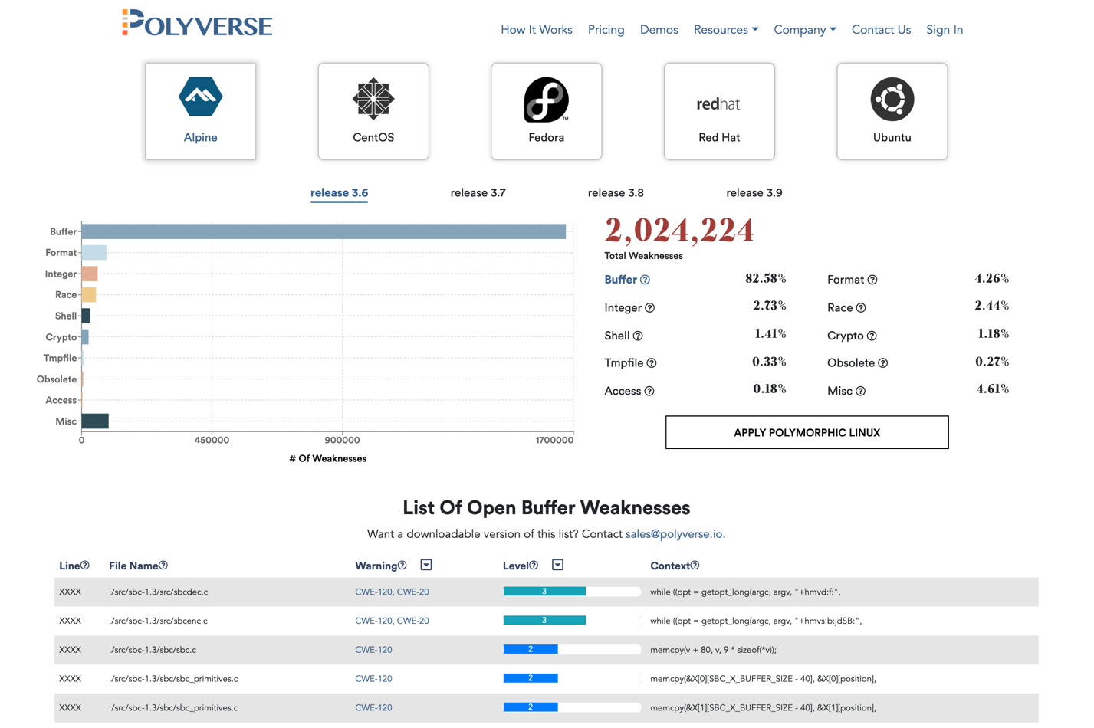
Open Linux Weakness Report
Polyverse runs static code analyzers across the entirety of the Linux stack—over 1.8 billion lines of code!
Millions of potential vulnerabilities found
https://polyverse.io/weakness-report/

Slide 10
How fast can you patch?

Slide 11
Insanity:
Doing the same thing over and over again and expecting different results
Notes:
*not sure if you want to keep this slide as it changes the flow of the presentation

Slide 12
Underlying Drivers of Cyberattacks
Errors
Cyberattack
Crisis
Monoculture
To truly solve cybersecurity, we have to assume errors will happen, and mitigate the impact of those errors.
Monocultures of homogenous systems multiply the cost of errors.

Slide 13
Changing the game with Moving Target Defense
Static, homogeneous systems are easy to hack
Moving Target Defense creates dynamic diversity, foiling zero-day and advanced persistent threats even if you are unpatched

Slide 14
Moving Target Defense Technologies (MTD)
Application Functionality: Multi-Factor Authentication
Constantly changing passwords and tokens
Application Logic: Polyscripting
Constantly changing script engines
SQL, PHP, shell, etc.
Software Stack: Polymorphic OS’s
Constantly changing binary and memory layouts
Windows, Linux, etc.
Infrastructure: Polymorphic Networks
Through software defined networking, network topologies can constantly shift
Notes:
MTD technologies add dynamic diversity through all layers of the software stack, from networking to applications

Slide 15
Two Factor Authentication

Slide 16
Comprehensive protection against remote code exploits
WannaCry
Attack utilized ROP gadgets (memory attack)
Attack utilized stolen passwords and memory attacks via Sakula
Equifax
Attack injected script to control server
DNC Hack
OPM Hack
Memory attack on Windows Kernel
Polymorphic Windows stops memory attacks, multi-factor authentication for passwords.
Polyscripting stops script injection attacks
Upcoming Polymorphic Windows version changes memory layouts
Polymorphic OS’s stop memory attacks
Vast majority of the prominent hacks in recent years relied on remote code or fileless (memory) exploits.
Moving Target Defense (MTD) technology can stop these exploits from working—at both the binary and the script level through polymorphism techniques
MTD technology can provide protection even if a system is not up to date with patches, and even if hostile entities have full access to source code.

Slide 17
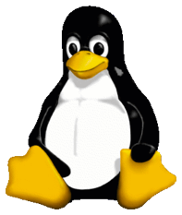
Polymorphic Operating Systems
Polymorphic Operating Systems are available for Linux and Windows across a range of deployment scenarios
  Cloud, on-premise servers, Internet of Things devices, etc.
Each instance of a polymorphic OS is unique at the binary level for the entire stack (kernel, libraries, runtimes, middleware, etc.)
Fileless and memory cyberattacks fail; adversaries do not know the technical details of the targets (aka “don’t run the same binaries the Russians have”).
  Protections work even on unpatched systems
Plug compatible with standard, homogenous OS versions—no change to operations or deployment methodologies and processes.
”Fire and Forget” management
  No phone-home
  No daily signature updates
Application
Kernel
Middleware (e.g. Apache)
Libraries (e.g. libc)
Runtimes (e.g. Java)

Slide 18
How: Polymorphic Operating Systems Works
Every polymorphic OS instance has uniquely scrambled binaries
Spectre and memory attacks stopped without patches
Spectre works because attackers know what to expect, down to every binary instruction
Polymorphism protects by changing those details in unknowable ways

Slide 19
Polyscripting
A common attack vector (e.g. the Equifax hack) attacks vulnerable script engines (a higher level of programming from binary code)
Famous example is SQL injection: a last name of “John DROP TABLE;” instead of ”John Smith” can delete a database
Polyscripting techniques dynamically create unique scripting languages for every server.
switch ($i)
{
case "apple":
echo "i is apple";
break;
case "bar":
echo "i is bar";
break;
case "cake":
echo "i is cake";
break;
}
yEmP ($i)
{
IScQJGp "apple":
vKbarGE "i is apple";
hRMxBL;
IScQJGp "bar":
vKbarGE "i is bar";
hRMxBL;
IScQJGp "cake":
vKbarGE "i is cake";
hRMxBL;
}
Notes:
*We may want to go to a higher level here, less technical detail. Here’s a small example of polyscripted code.
Scramble the reserved keywords (such as changing the command for echo, to be a randomized string) so that the original php-commands are no longer recognized. So like in this example: All keywords have been scrambled to randomized strings.
Once we scramble the grammar as well this will no longer look like a switch statement.
Though the code is written and debugged in php, behaves like php, and the output is identical to php, the deployed program looks like something completely unique and distinct.
And you can rescramble and the code again and again in a matter of seconds

Slide 20

Agile Security: comprehensive MTD based cybersecurity
Diverse
Dynamic
Minimal
Repeatable
Validated
Encrypted
Compartmentalized
Insight

Slide 21
Questions?
Consider Moving Target Defense to create intrinsic cyber-reliability.
Don’t be 100% predictable to your attackers!

