Slide 1
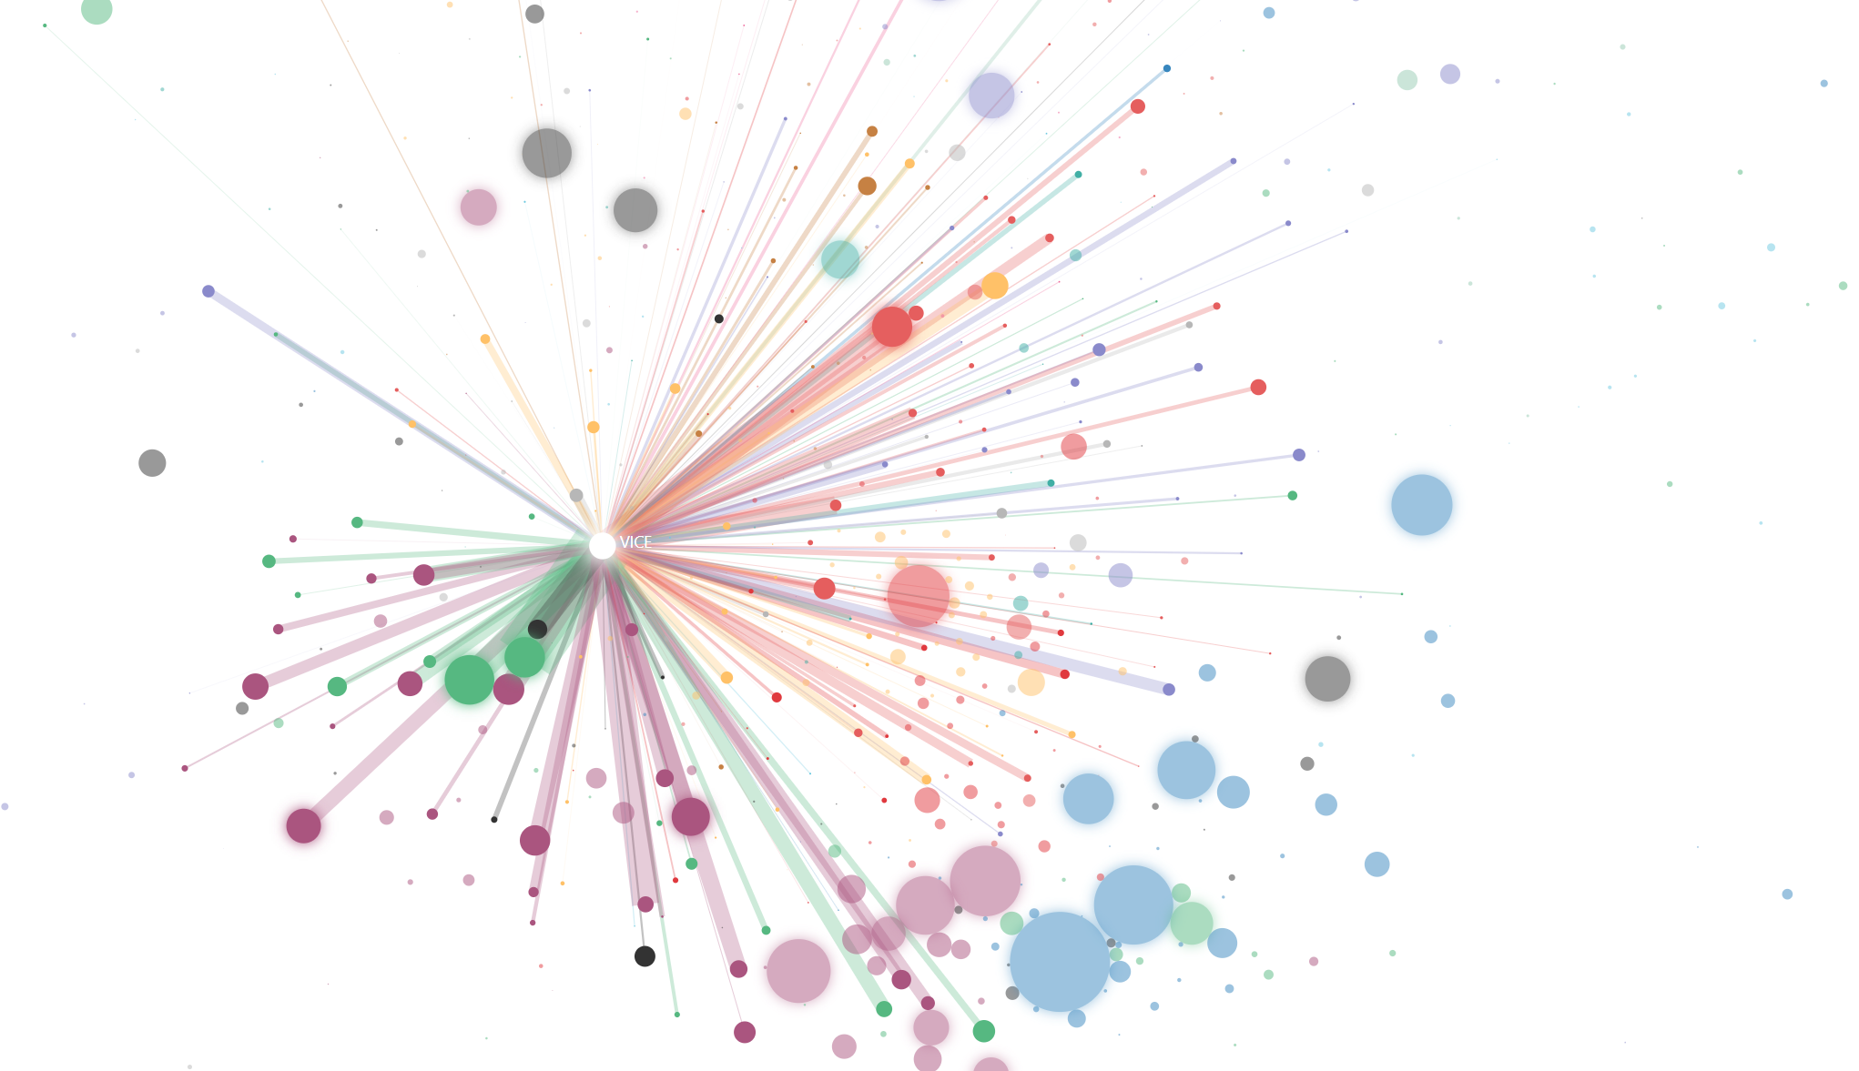
Algorithmic Extremism
Examining YouTube’s Rabbit Hole of Radicalization
Ann Zaitsev - University of California, Berkeley
Mark Ledwich - Unaffiliated

Slide 2
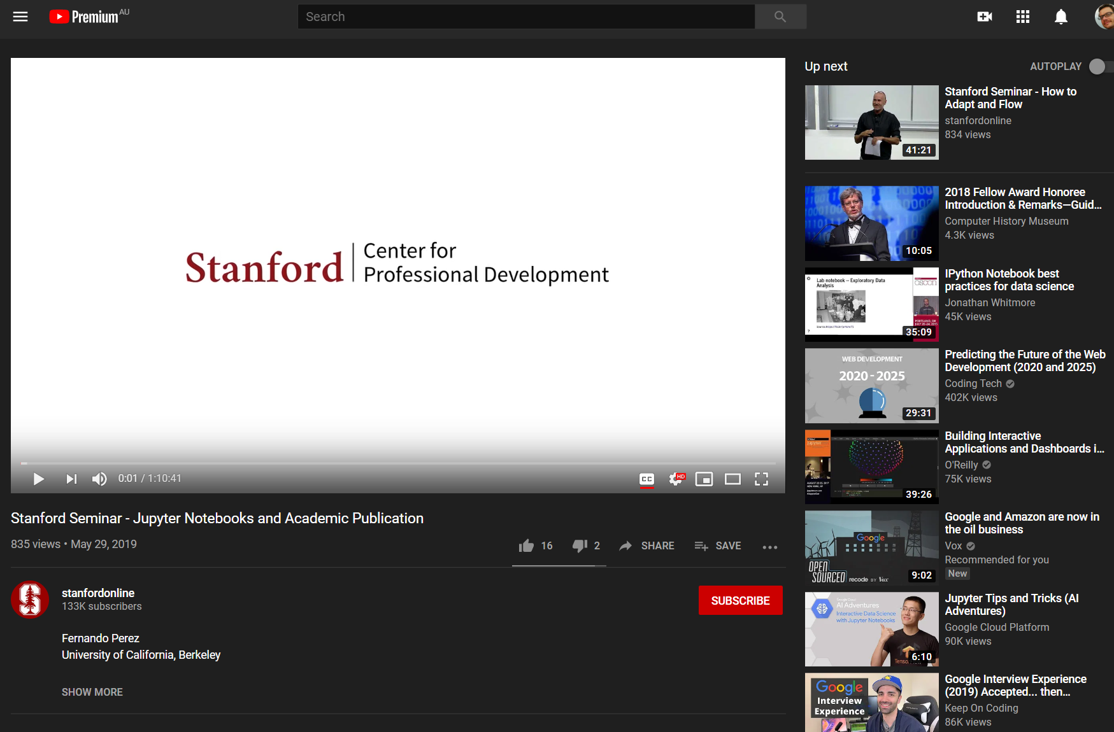


Recommendations
Up next

Slide 3



YouTube’s Political Influence
Soft power
18% of US adults watch YouTube for news (pew 2017)
70% of watch time is from recommendations (google)
Transparency
Strategic communication
Like the weather
Public interest research and journalism

Slide 4
Tech Stack
COLLECTION
TRANSFORMATION
PRESENTATION
Azure Function
Tableau
Static Website
Gatsby, Typescript,
React, D3, Azure, Cloudflare
launches
(on daily schedule)
Azure Container Instances
C#
Queries
(interactive)
Snowflake DB
Executes
(schema & transform)
Queries
Reads
(proxies if required)
Dataform
R & C#
Stores
Served From
YouTube API & Website
Reads
(incremental)
Writes
(aggregated results)
Azure Blob Storage

Slide 5
Data Collection – Overcoming YouTube’s Hurdles
YouTube
API
Container instances
Channel Stats
Video stats & recommendations
YouTube
Website
When blocked, use $$$ residential proxies
Residential proxies
(10M possible IP’s across USA)
Video stats & recommendations

Slide 6
Data Collection – Embarrassingly Parallel
Container 1
Blob Storage
videos
recommendations
videos.1.jsonl.gz
recs1.jsonl.gz
channels
videos.2.jsonl.gz
Container 2
C# Async Tasks + TPL DataFlow
recs.2.jsonl.gz
Container …X
video.3.jsonl.gz
recs.3.jsonl.gz

Slide 7


Data Collection - Stats
Daily Update Stats
2GB in 40K requests (94% via proxy)
30 requests /sec
30-50 min to complete
Infrastructure Costs/month (USD)
containers $10
storage $3
website $0.2
residential proxy $267
Snowflake DB $30-90
Dataform free for single user

Slide 8
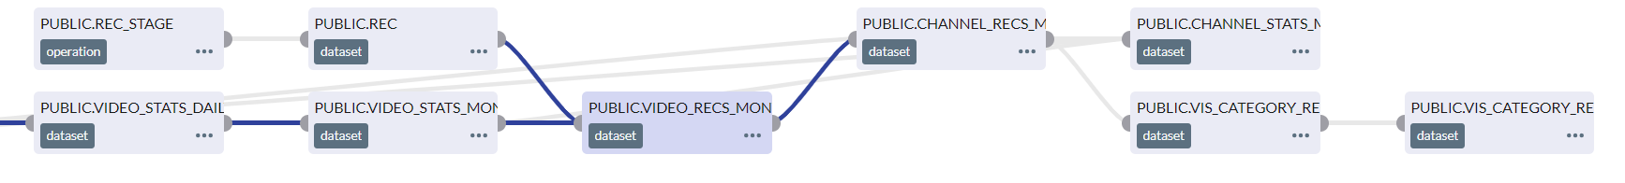



Data Transformation – Dataform
SQL workflow execution
Example dependency graph, executed within BigQuery or Snowflake
Dev
Prod
Report
GitHub Integration
Interactive & Prod ready
Machine learning
Tool with SQL push-down
(e.g. tableau, looker)
Any language e.g. R/Python
Simple
Cheap
Scalable

Slide 9



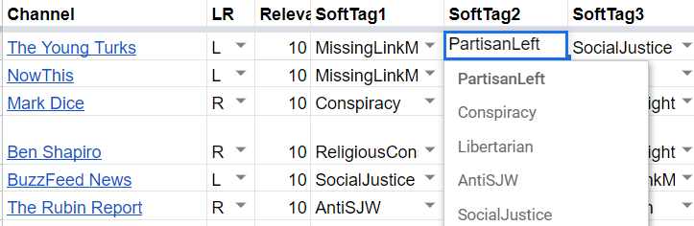
Channel Classification
Criteria
Discovery
Classification
10k+ subs, focus on US politics or cultural commentary
Many methods - Maximum coverage better than repeatability
3 Reviewers tagged channels based on content
Notes:
1 https://www.journalism.org/2017/09/07/news-use-across-social-media-platforms-2017/
2 https://www.cnet.com/news/youtube-ces-2018-neal-mohan/

Slide 10
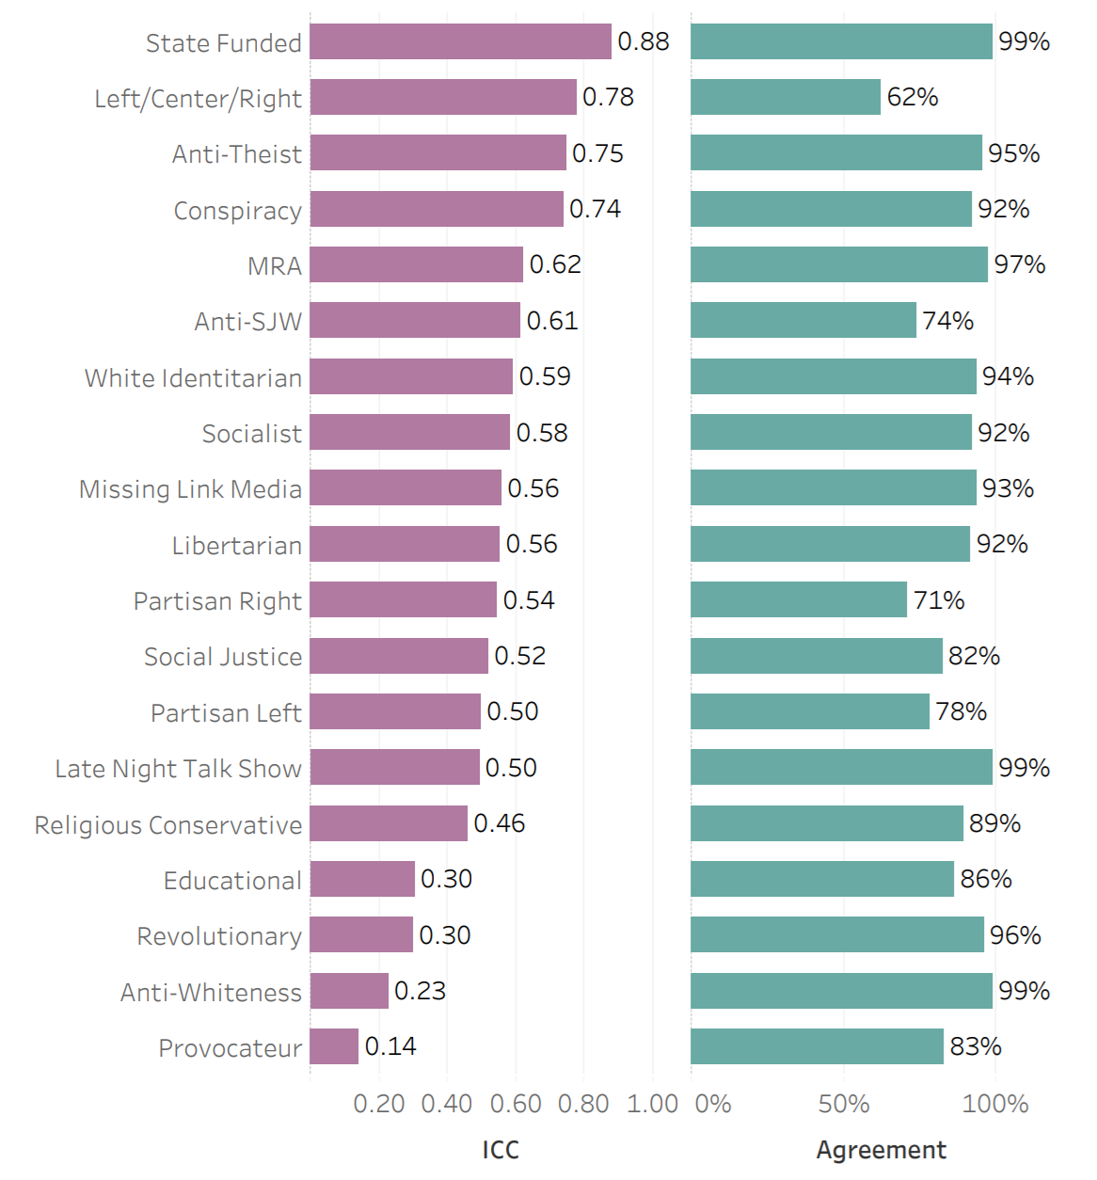
Channel
Classification
Majority view
Reviewer reliability
Group Categorization

Slide 11
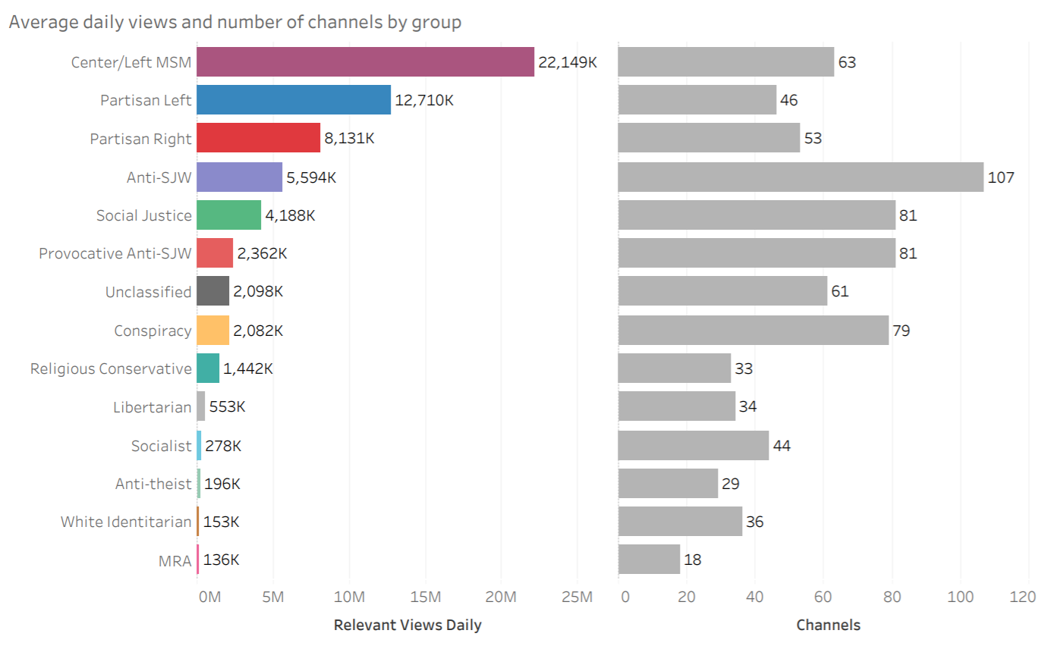
Channel
Classification - Results

Slide 12
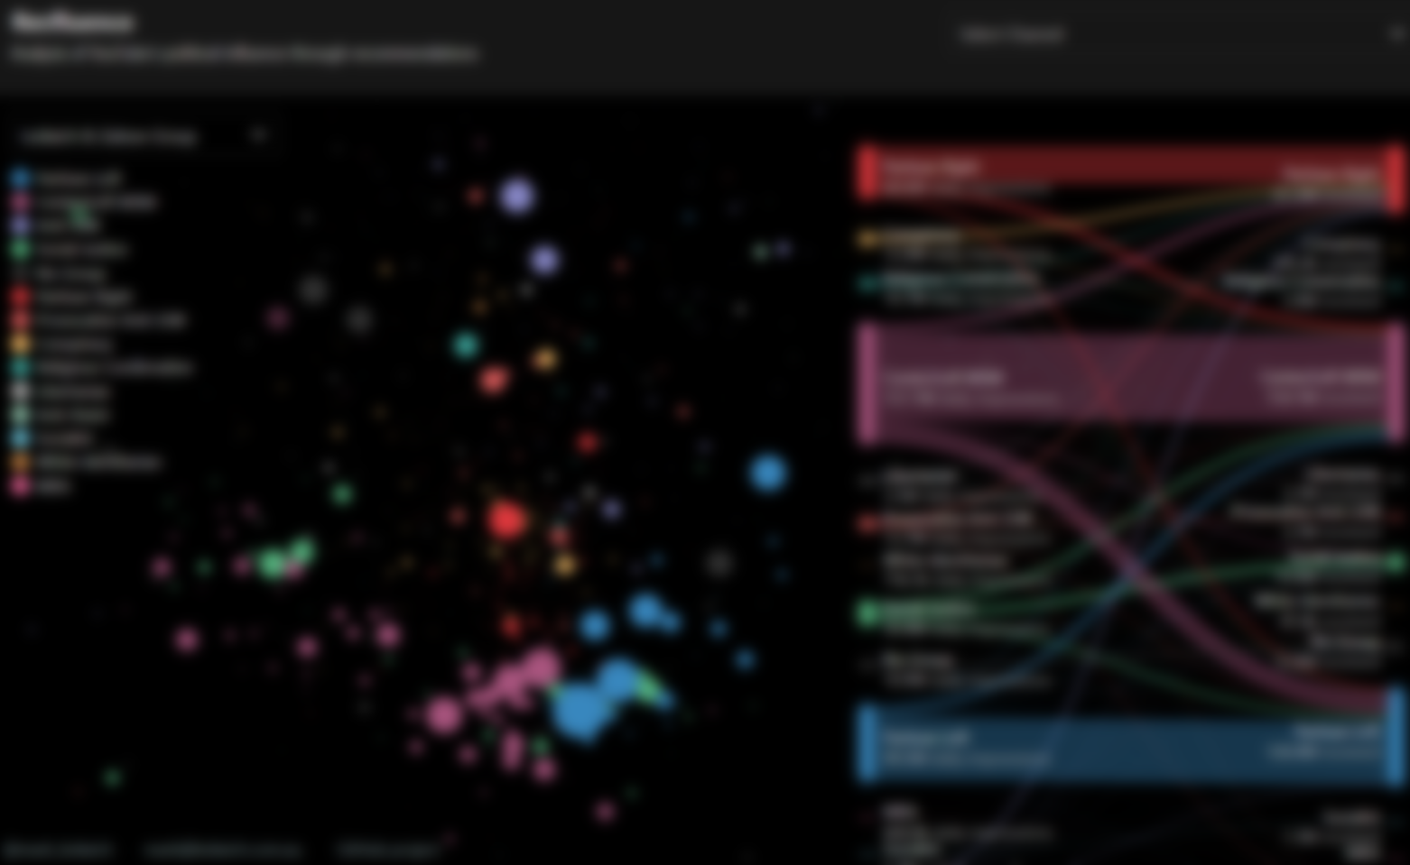
recfluence.net
Demo

Slide 13
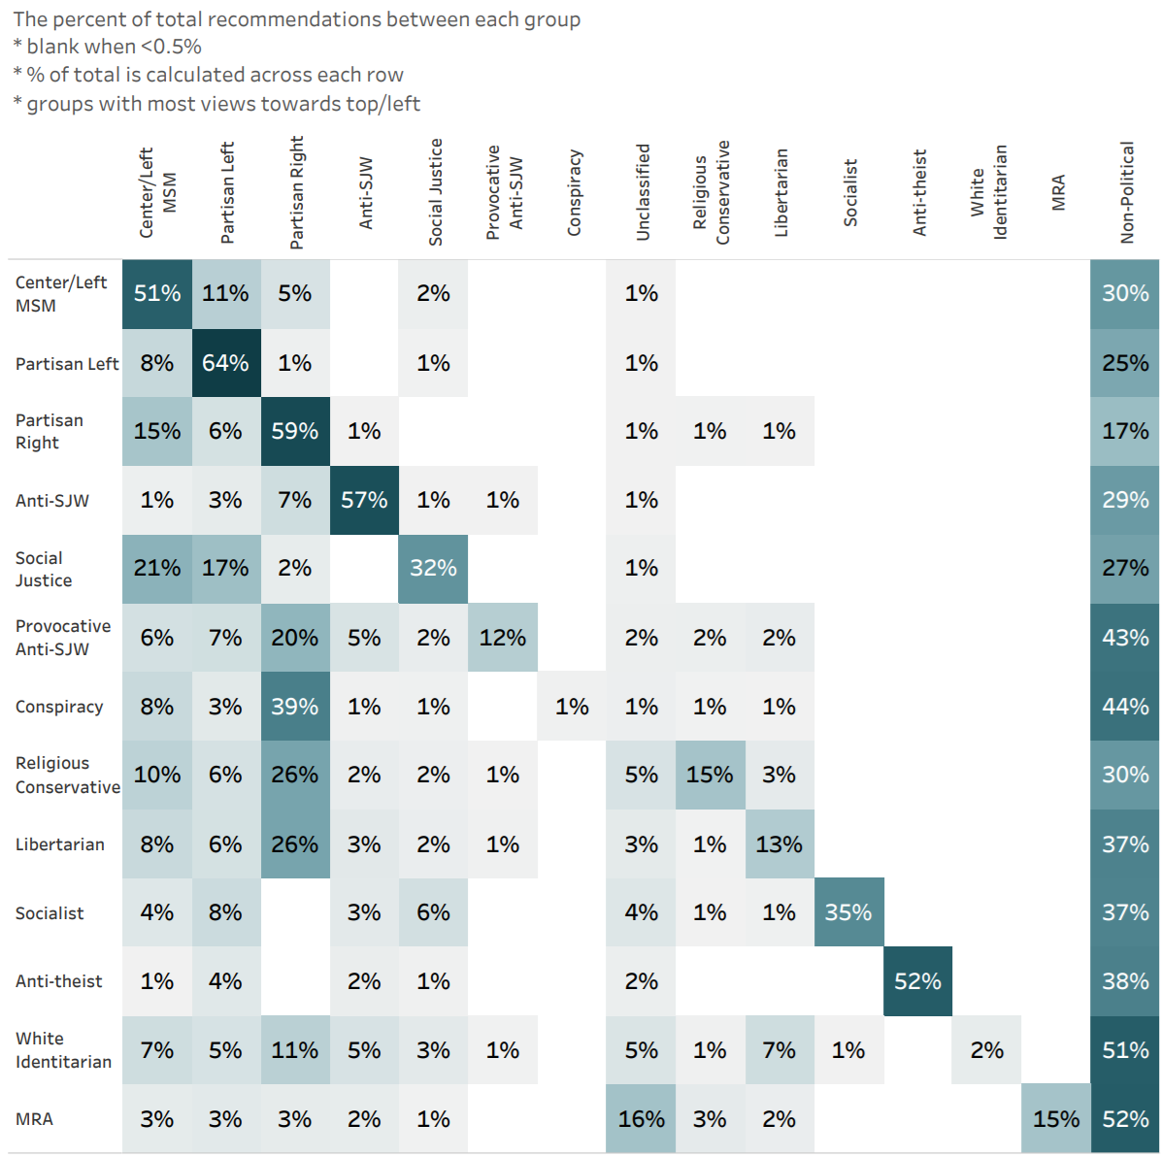
Recommendation %
Filter Bubbles?
Minority Right recommends Partisan Right
What would a neutral algorithm look like?

Slide 14
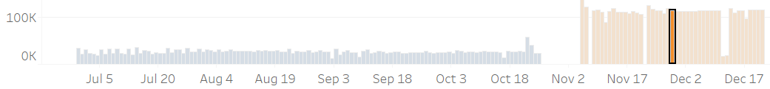
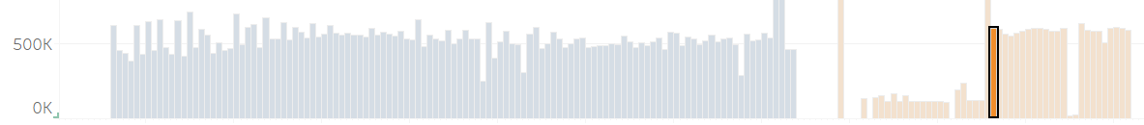
Analysis -
Net Impressions Explained
video stats collected
A sends 5K impressions
Video A
Video B
A receives 30K impressions
recommendations collected
Video C
Video B - 30K views
A sends 5K impressions
Video D
A sends 5K impressions
Video A - 5K views on 28th Nov
Video A sent 15k impressions and received 30K impressions
Net Impressions = 15k received
Impression Advantage = +100%

Slide 15
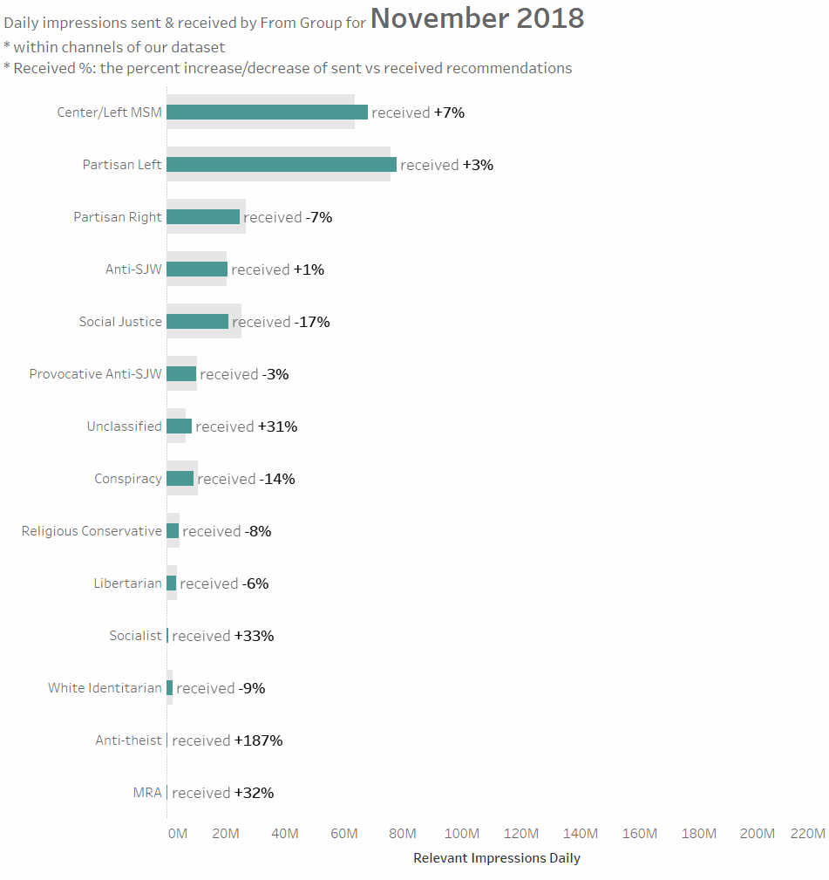
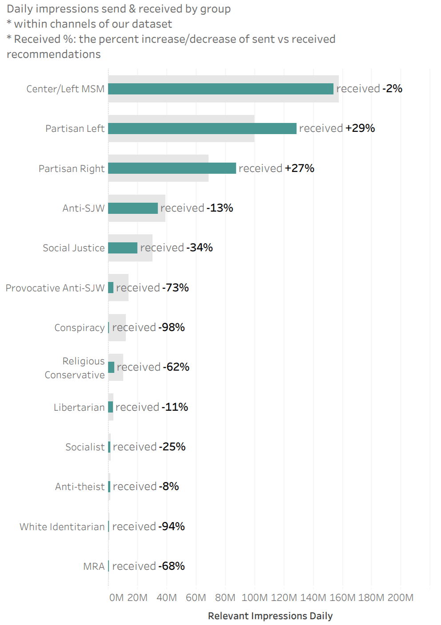
Impression Advantage
Sanction on conspiracy theorists, provocateurs and white identitarians
Benefits mainstream partisan channels such as Fox News and Last Week Tonight
Disadvantages almost everyone else

Slide 16
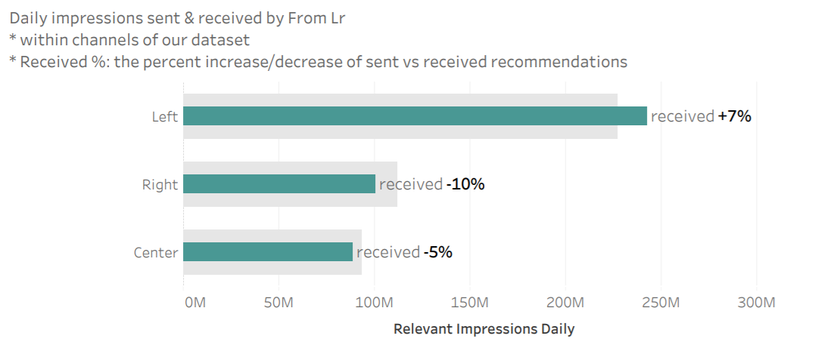
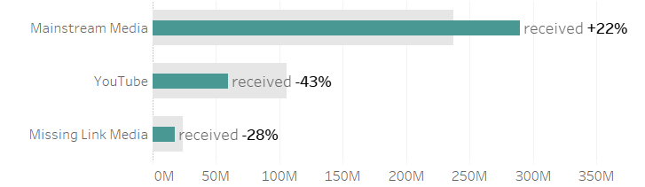
Impression
Advantage
Minimal left/right bias
Large mainstream bias

Slide 17
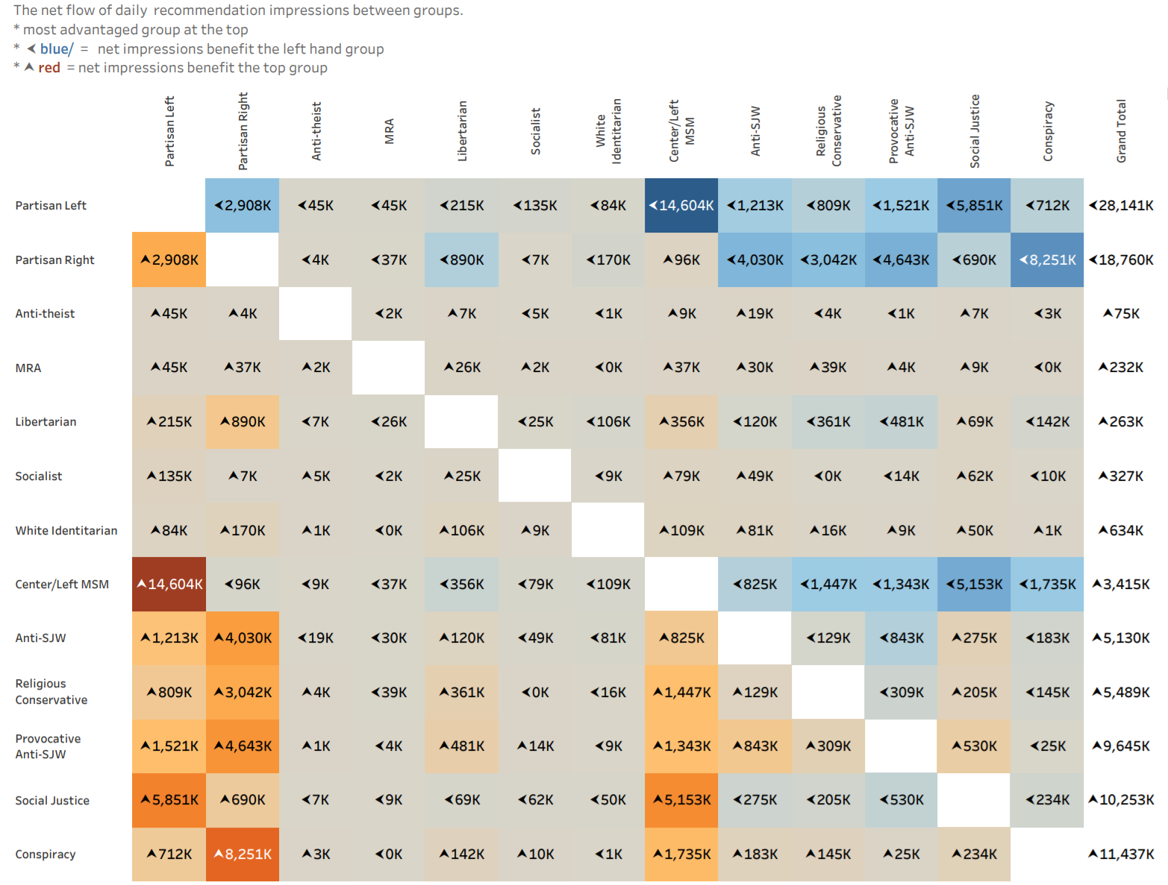
Impression
Flows
Balance of impressions
Presents absolute algo influence

Slide 18
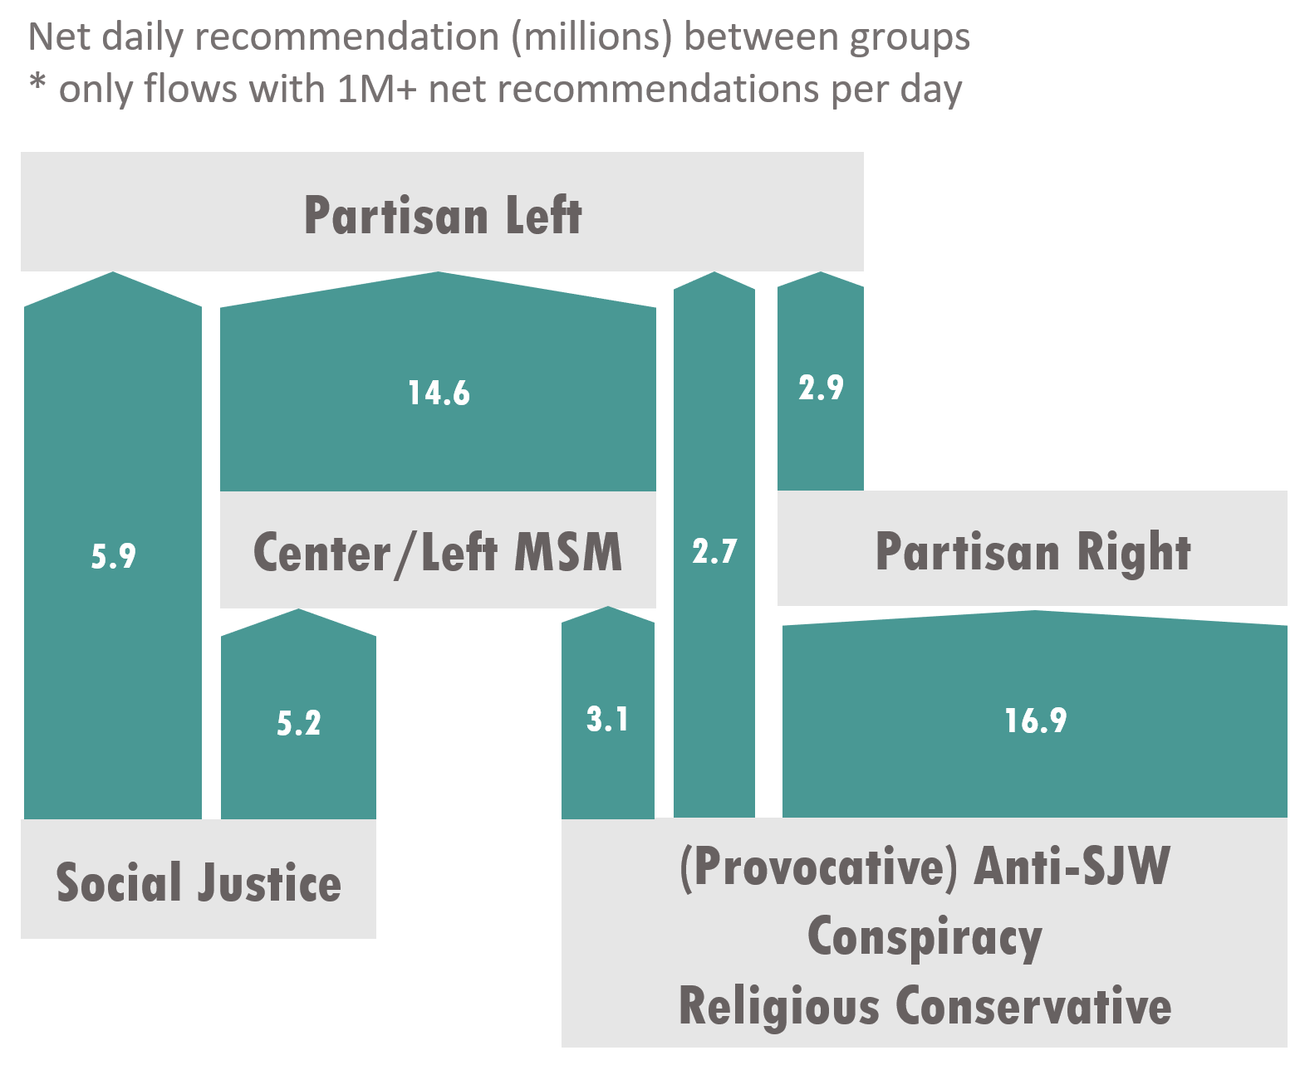
Recommendation
Flows

Slide 19


The Rabbit Hole Story
  To increase ad revenue and keep you watching, YouTube recommends increasingly extreme content. This is how they have you believe as many as six impossible things before breakfast.
  Intuitive
  Poor quality information
  Technical Difficulties
  Biased Research and Journalism
Notes:
1 https://www.journalism.org/2017/09/07/news-use-across-social-media-platforms-2017/
2 https://www.cnet.com/news/youtube-ces-2018-neal-mohan/

Slide 20


Data Collection - Anonymous Users
Practicalities
Simulate prototypical users
Collect via browser extensions
Working Assumption Personalization averages out
Plan - Compare creator's private impression analytics

Slide 21
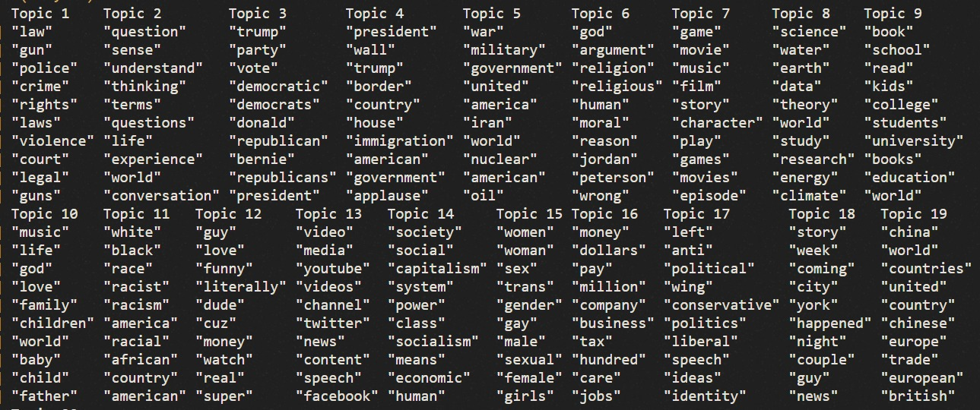
Channel Classification – Alternatives
Climate change
Party Politics
Immigration
War
Jordan Peterson?
Education
Race
Social Media
Socialism
Policy
Meta Politics
International news
Comedy
Gender & Trans

