Slide 1
polymorphisms
GWAS
traits

Slide 2
genetic association
"Cases"
"Controls"
? frequency of Brca1 sequence changes
~3% – 5%
< 0.1%
this difference is highly significant !!!

Slide 3
polymorphisms
~18 million in dbSNP
Functional mutations
Protein changes
expression changes
Traits
Breast cancer

Slide 4
polymorphisms
113 SNPs in actn3
Functional mutations
1 SNP is stop codon
Traits
Power muscle

Slide 5
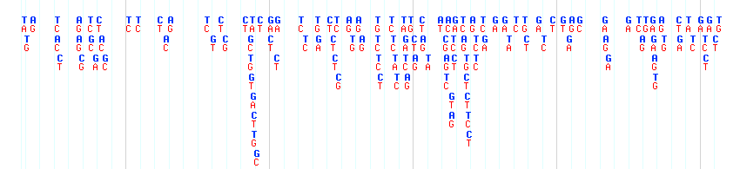
Functional mutations
MMP20
T
C
T
C
A
G
Coding SNPs
Expression SNP

Slide 6
G
A
Look at expression in :
G/G
High
G/A
Medium
A/A
Low

Slide 7
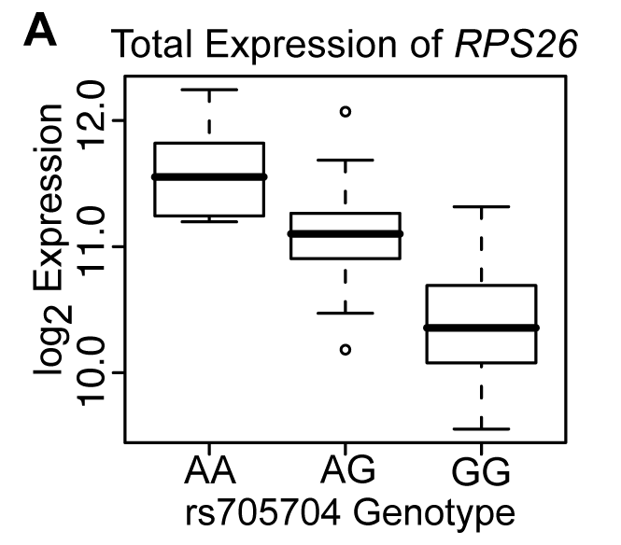
Total Expression Analysis
n=153
p=1.2x10⁻²⁰
Notes:
1041 SNPs in the promoter regions and 386 SNPs in the coding and untranslated regions

Slide 8
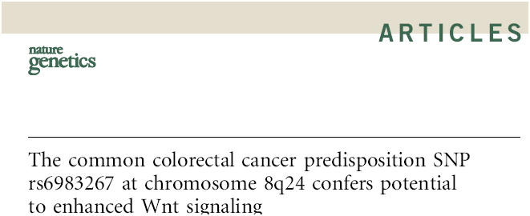
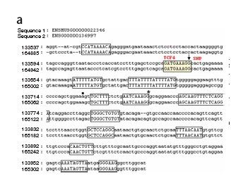
G/T
myc
rs6983267 is a G/T SNP in a TCF4
binding site near the myc oncogene
Nature Genetics 41, 885, 2009

Slide 9
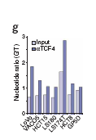
G/T
myc
The G allele shows stronger binding to TCF4 than
the T allele
Nature Genetics 41, 885, 2009

Slide 10
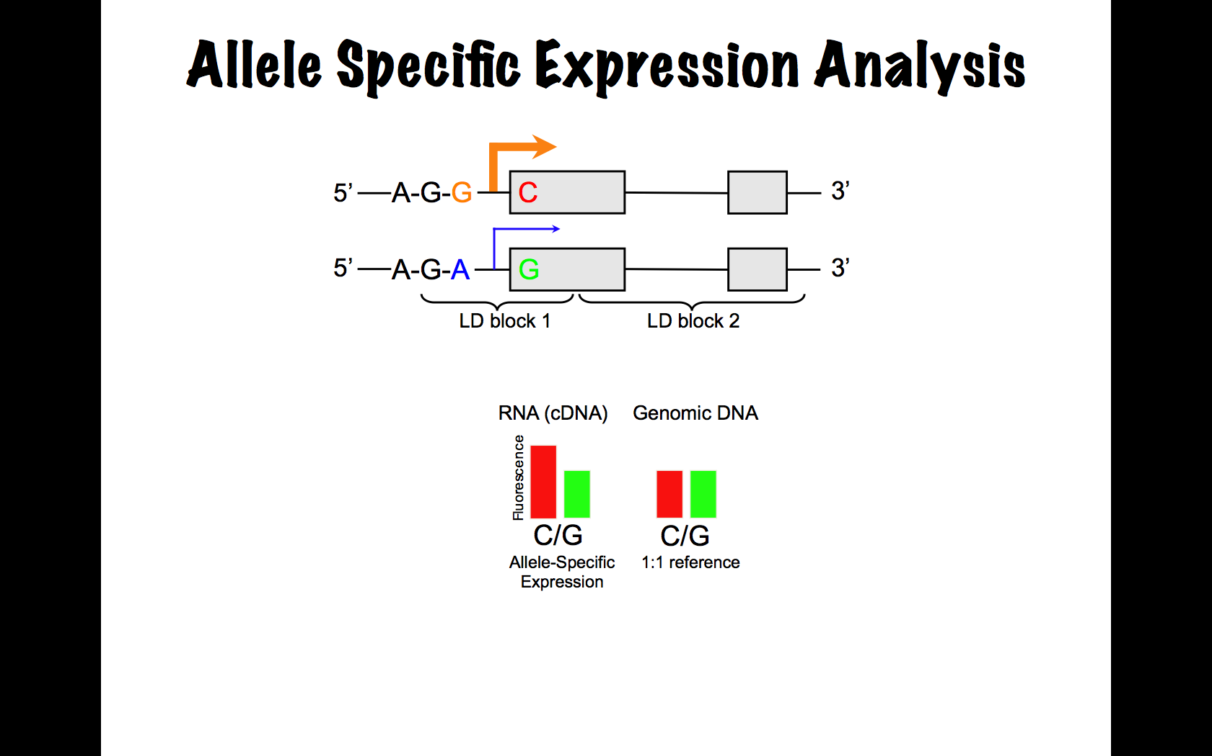
Allele-specific Expression
Look at expression in :
G/A heterozygotes
G allele is expressed higher than the A allele
Notes:
95 Individuals Kidney DNA and RNA
309 SNPs in 225 Candidate Aging Genes were tested for Allelic Imbalance (AI)
(≥5 expressing heterozygotes)
105 SNPs in 93 Candidate Aging Genes Display AI
(≥50% of heterozgotes were required to have an RNA allele ratio greater than 2 SD above the DNA-defined 1:1 allele ratio)
Expand ASE method

Slide 11
Allele-specific Expression
*
*
Expressed in the same nucleus
Same genetic background
Same environment
Extremely sensitive
Notes:
95 Individuals Kidney DNA and RNA
309 SNPs in 225 Candidate Aging Genes were tested for Allelic Imbalance (AI)
(≥5 expressing heterozygotes)
105 SNPs in 93 Candidate Aging Genes Display AI
(≥50% of heterozgotes were required to have an RNA allele ratio greater than 2 SD above the DNA-defined 1:1 allele ratio)
Expand ASE method

Slide 12
Allele-specific Expression
Make cDNA
Method 1: sequence cDNAs and count if C allele is more abundant than the G allele.
Method 2: use DNA arrays and see if the C oligo is more intense than the G oligo.
Notes:
95 Individuals Kidney DNA and RNA
309 SNPs in 225 Candidate Aging Genes were tested for Allelic Imbalance (AI)
(≥5 expressing heterozygotes)
105 SNPs in 93 Candidate Aging Genes Display AI
(≥50% of heterozgotes were required to have an RNA allele ratio greater than 2 SD above the DNA-defined 1:1 allele ratio)
Expand ASE method

Slide 13
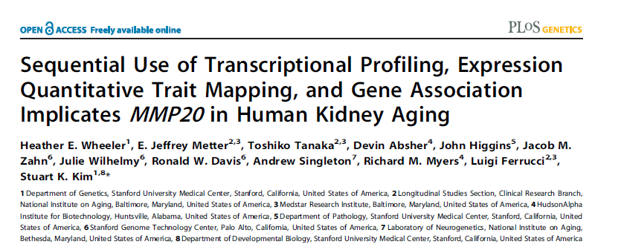
96 kidney cortex samples
For ASE:
  ≥5 expressing heterozygotes
  ≥50% hets outside DNA-defined confidence interval
  meta-p <10⁻⁶
Notes:
95 Individuals Kidney DNA and RNA
309 SNPs in 225 Candidate Aging Genes were tested for Allelic Imbalance (AI)
(≥5 expressing heterozygotes)
105 SNPs in 93 Candidate Aging Genes Display AI
(≥50% of heterozgotes were required to have an RNA allele ratio greater than 2 SD above the DNA-defined 1:1 allele ratio)
Expand ASE method

Slide 14
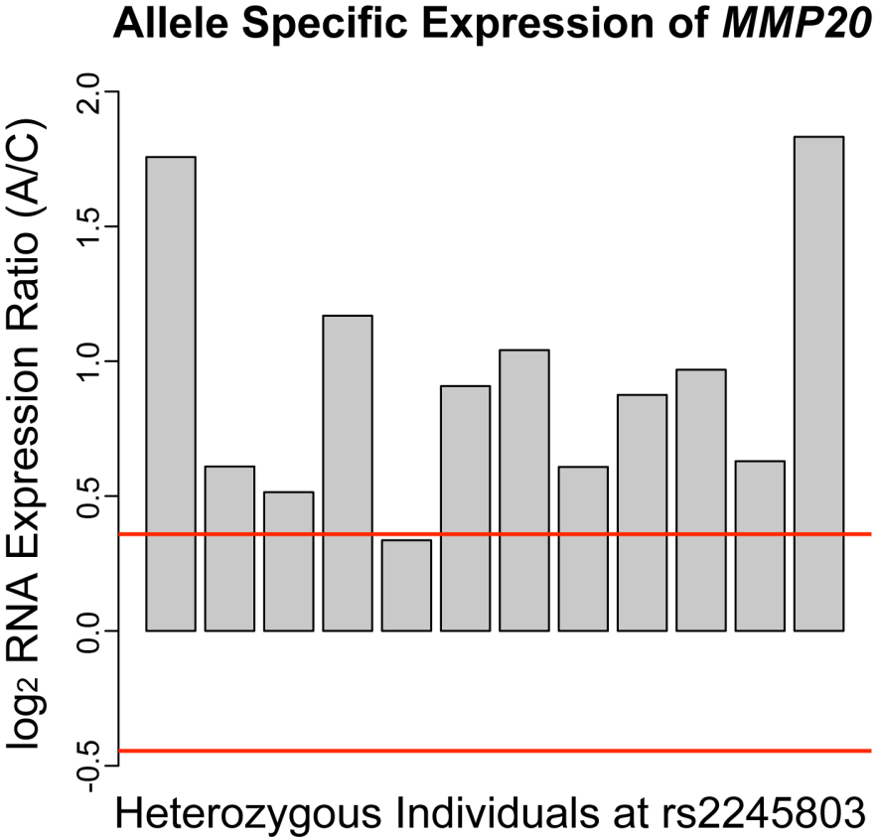
Allele-Specific Expression
Red lines indicate 95% confidence intervals
Example shows 11/12 heterozygotes have higher expression of A allele than C allele.

Slide 15
Functional mutations
Coding:
  About 2000-5000 missense SNPs that affect conserved amino acids
Expression:
  At least 40% of genes have SNPs that affects expression in cis.
  The median change in expression between alleles is about 2 fold

