Slide 1

Genetics 210: Personalized Medicine and Genomics
For: MDs, PhDs and curious students
Spring term. Tue 2:15 – 4:05 Workshop
Thur. 2:15-4:05 Presentation
LKSC 101
Genotyping : $49 copay
Gene210.stanford.edu: info and FAQs

Slide 2
Course Staff
Course Organizer: Stuart Kim stuartkm@stanford.edu
Participating Faculty: Euan Ashley, Russ Altman, Atul Butte, Mike Snyder, Aaron Gitler, Carlos Bustamente, Emmanuel Mignot
TAs:
  Damek Spacek dspacek@stanford.edu
  Helios Costa hcosta@stanford.edu
  Alicia Martin armartin@stanford.edu

Slide 3
Genetics 210: Personalized Medicine and Genomics
Goals
Who is this for?
Course Structure

Slide 4
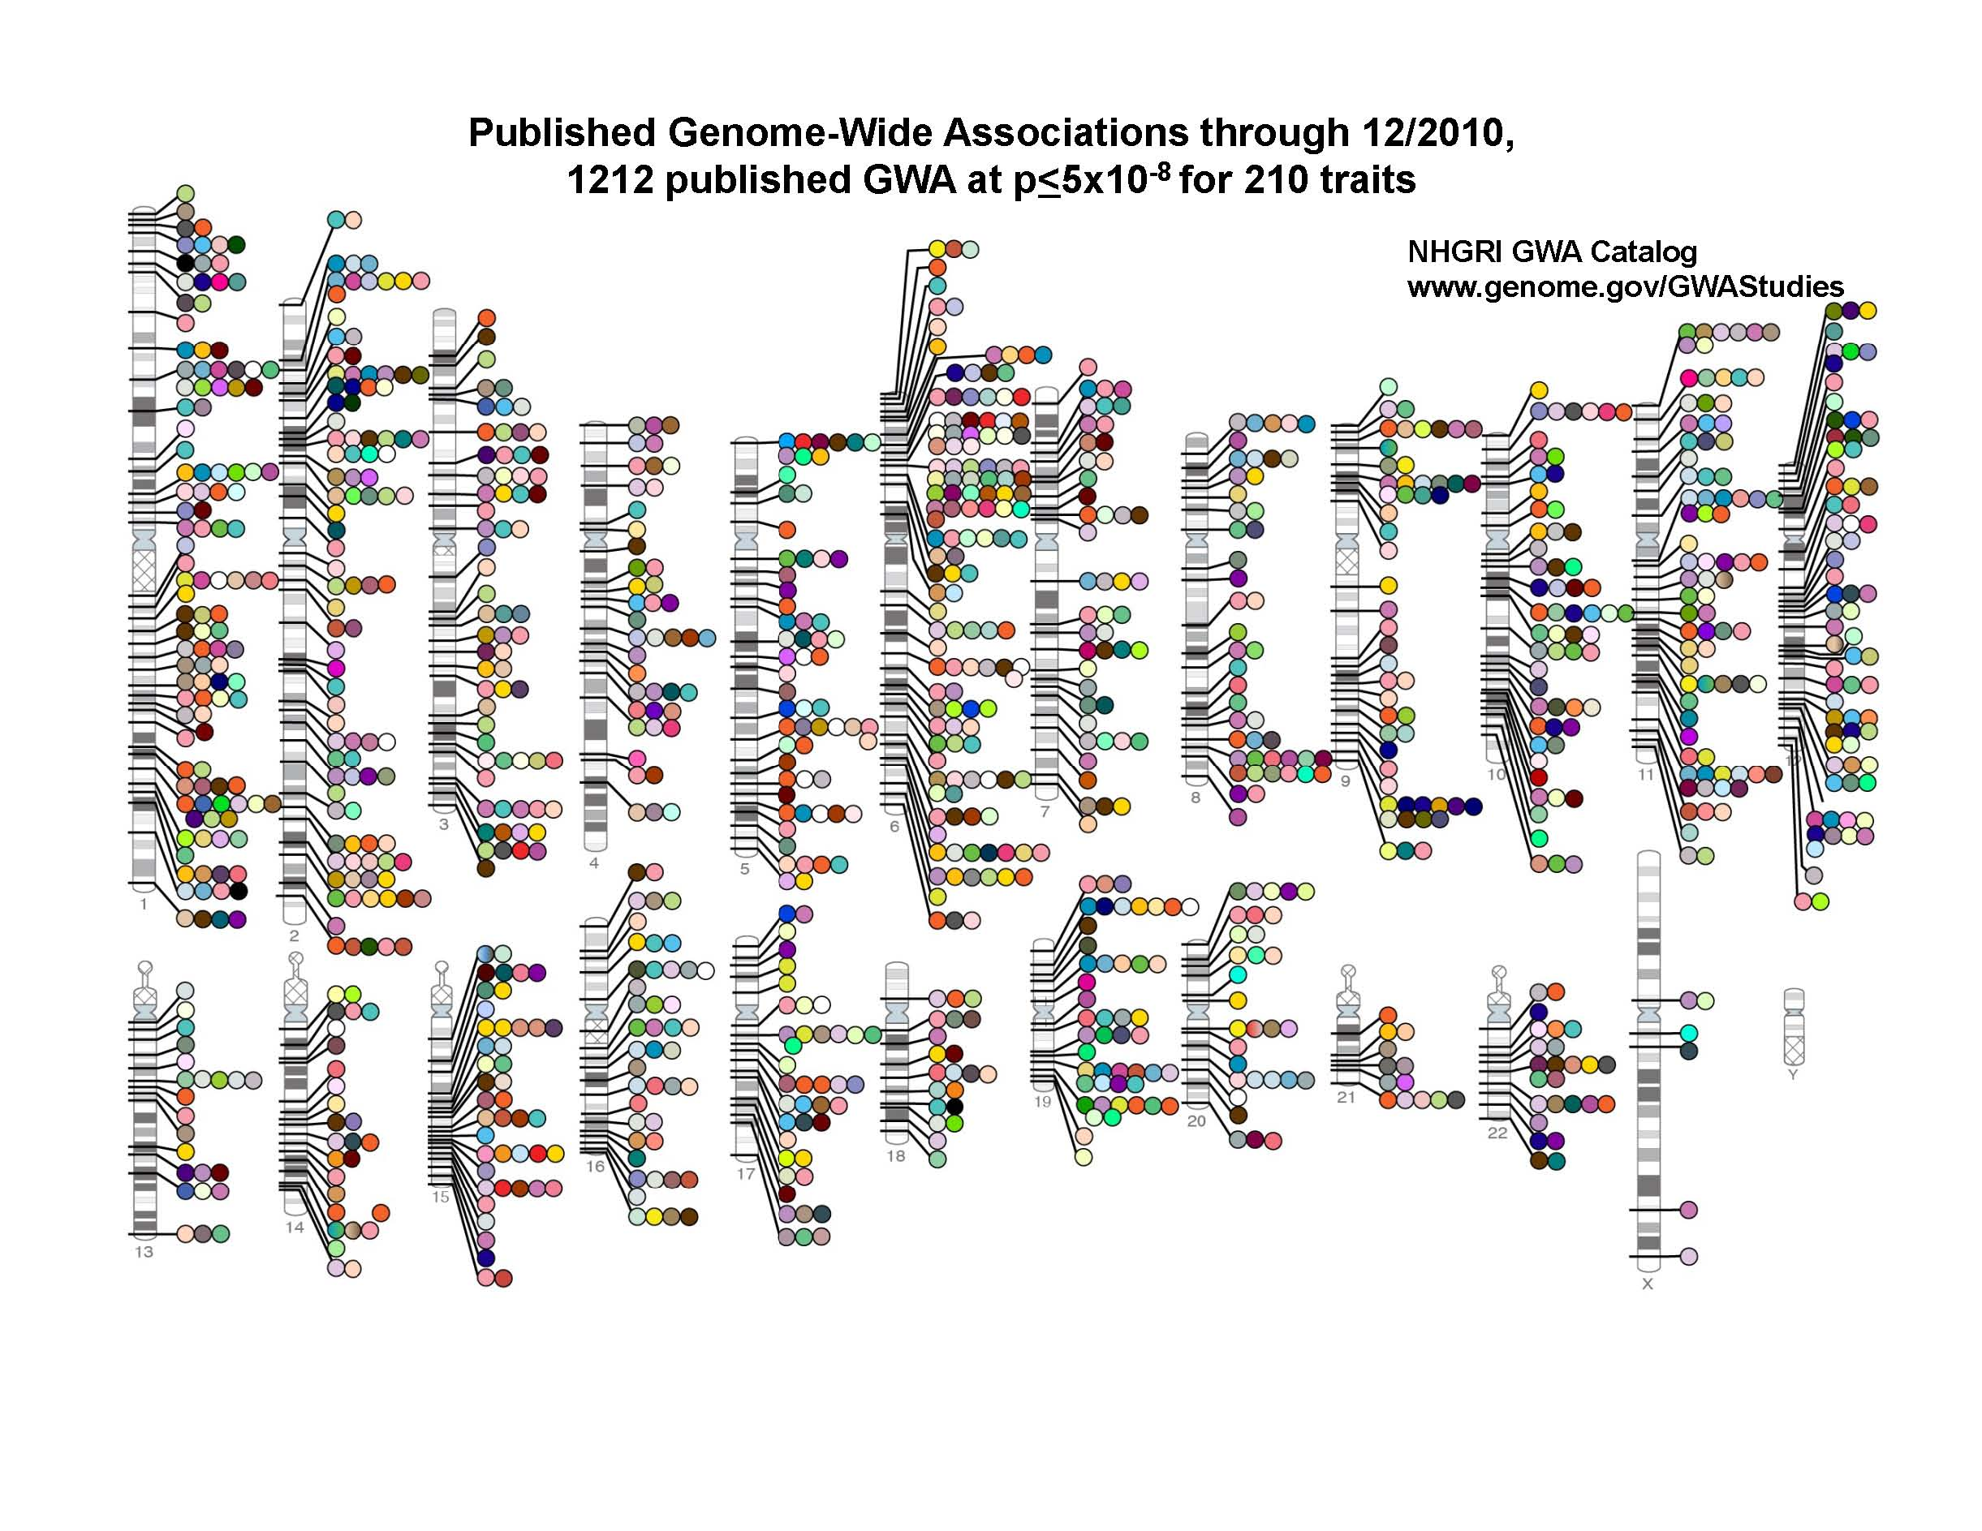

Slide 5
2011 Participatory Presentations
Date | Subject | Presenter
March 30 | Human Genetic Variation and GWAS | Stuart Kim
April 6 | Interpreting Genomic Data in Clinical Medicine. | Euan Ashley
April 20 | Pharmacogenetics | Russ Altman
April 27 | Human Ancestry. | Carlos Bustamante
May 4 | Networks. | Atul Butte
May 18 | Next generation technology. | Mike Snyder
May 25 | Narcolepsy | Emmanuel Mignot
June 1 | Aging | Stuart Kim

Slide 6
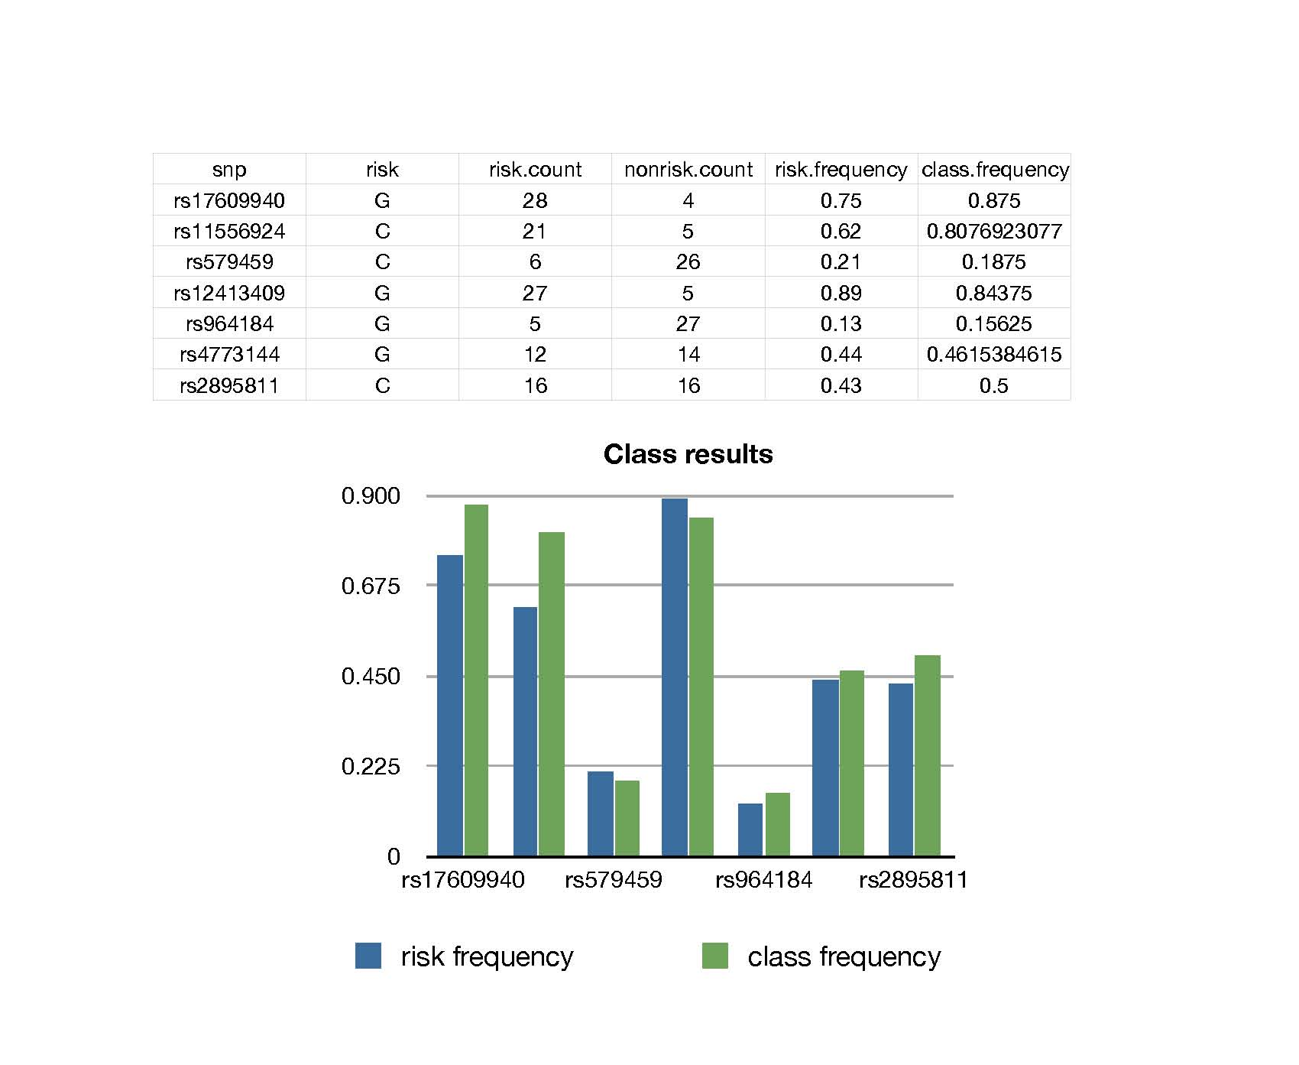

Slide 7
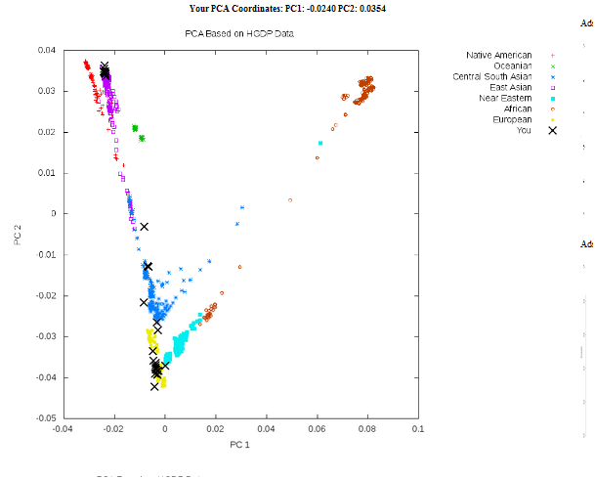
Human Ancestry

Slide 8
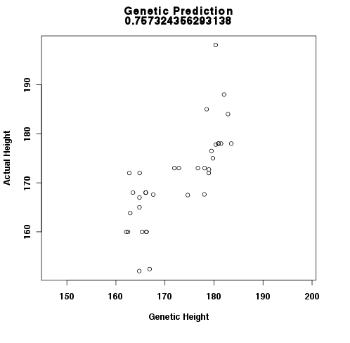
Height prediction

Slide 9
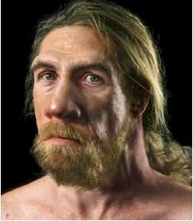
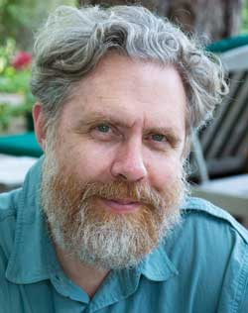
How much Neanderthal are you?
Neanderthal
George Church,
Harvard Geneticist

Slide 10
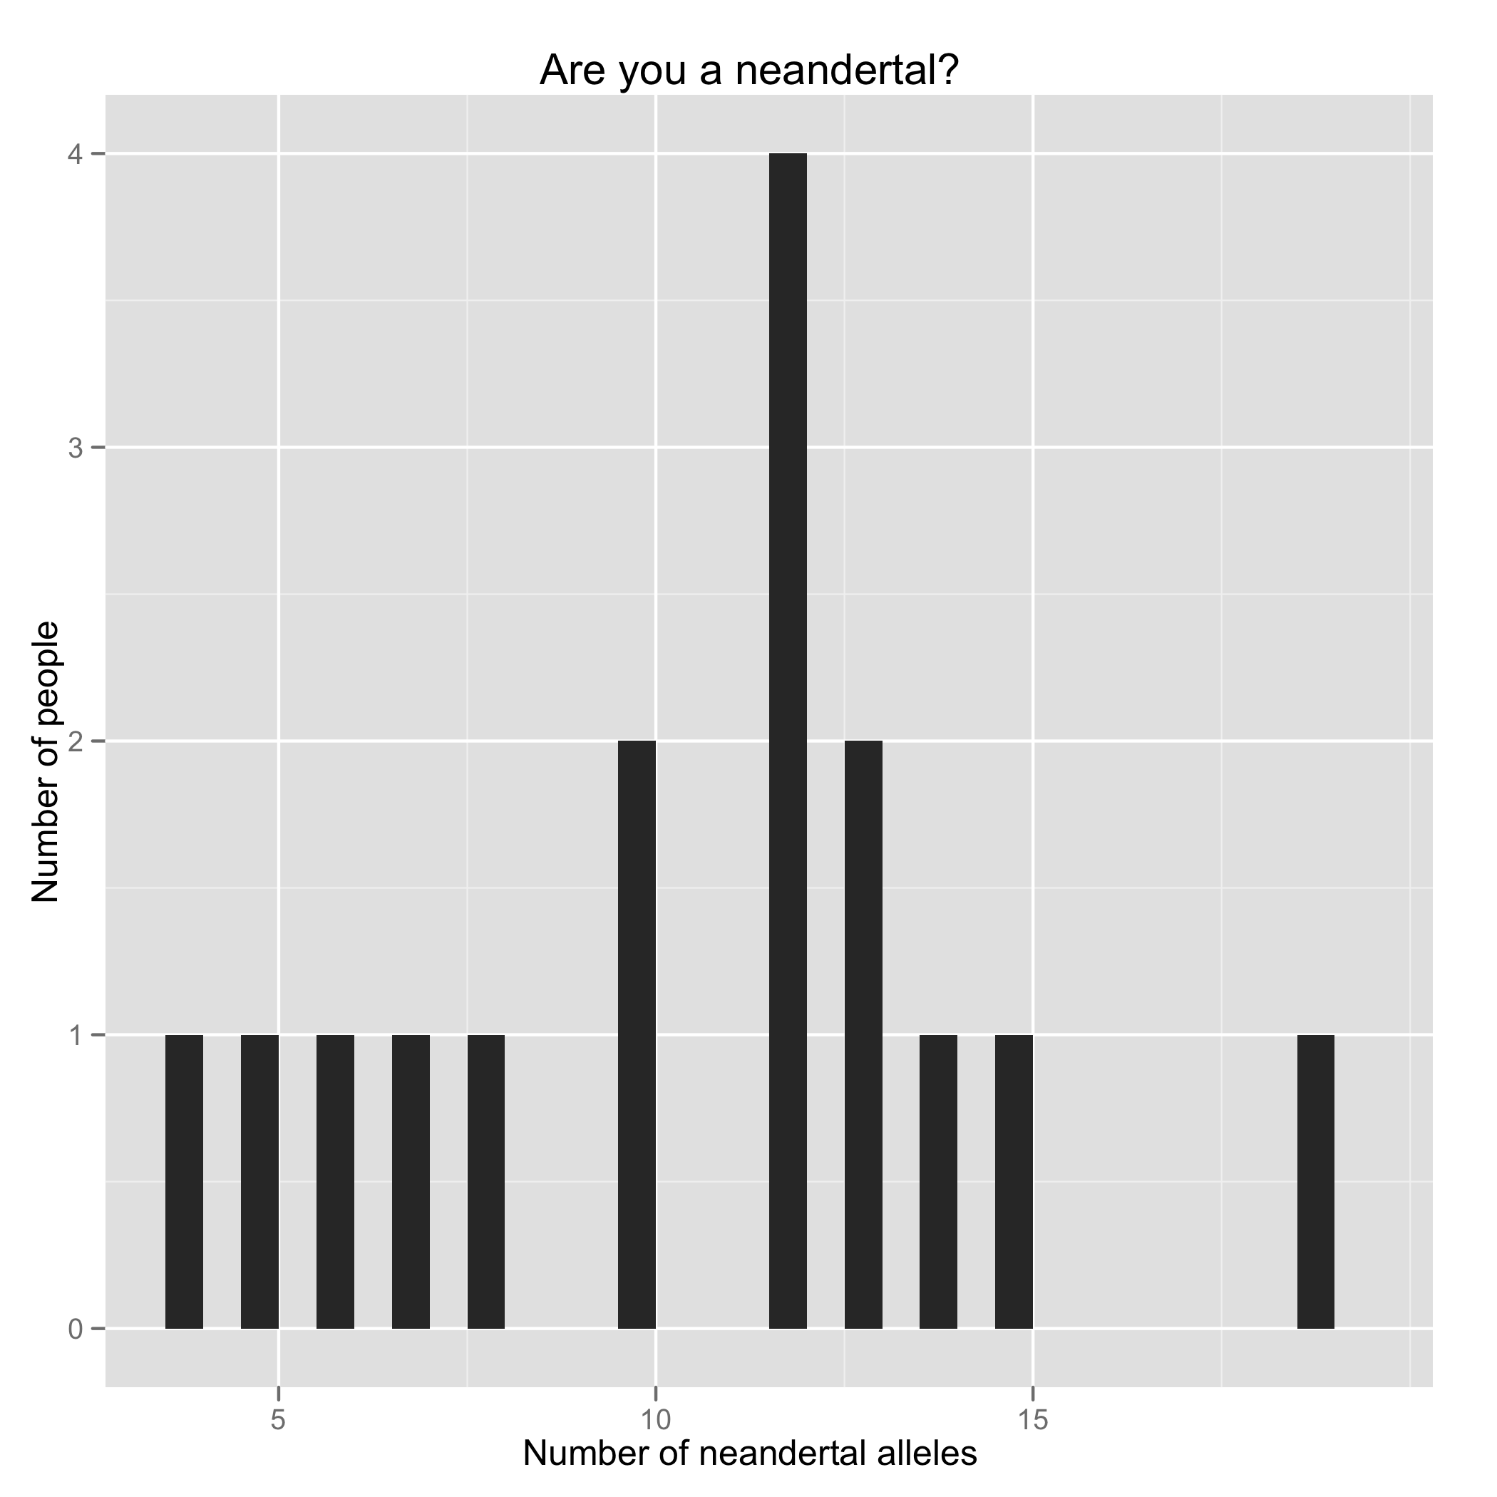

Slide 11
History
Joint Genotyping Task Force
Charles Prober Dean Hank Greely Law School
Russ Altman Genetics Clarence Braddock Med School
Pat Brown Biochem. Gil Chu Biochem
Mike Grecius Neur. Sean David Med. School
Carlos Bustamente Gen. Harry Greenberg Dean
Ralph Horwitz Psych Louanne Hudgins Epidemiology
Anne James Legal Counsel Jesse Karmazin Med. School
Stuart Kim Dev. Bio. Mark Krasnow Biochem
Phil Lavori HRP David Magnus Cen. BME
Kelly Ormond Genetics Alan Schatzberg Psych.
Mike Snyder Genetics Atul Butte BMI
Keyan Salari Med. School Mildred Cho Pediatrics

Slide 12
Personal Genotyping
Voluntary. You can use a public genome file instead of your own.
Confidential – instructors will not know who opted to be genotyped.
Private – You will not be asked to reveal your own private DNA information.
Counseling - genetic counseling via 23andMe and medical/psychological counseling via Dr. Alan Schatzberg (Psychology, Stanford).

Slide 13
How to get genotyping kits
Attend both informations sessions or watch them on the internet (Jan. 18 and 25).
Fill out form
Bring form and check to Kathy in Beckman B300.
Make check $49 to Stanford.
Bring samples back to Flora or Kathy B300
We will ship the group of samples back to company Monday 4pm Jan 30 by FEDEX
Results in 6-8 weeks.
Class starts Tuesday April 3, 2012.

Slide 14
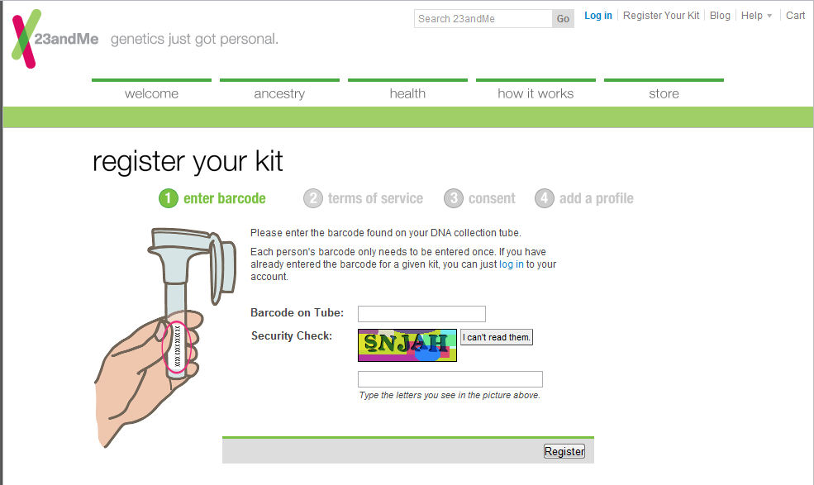
https://www.23andme.com/user/claim/

Slide 15
Informed Consent for Personal Genotyping
Approximately 3,000 genetic counselors and 1,100
medical geneticists in pediatrics, obstetrics, cancer
genetics, neurogenetics, cardiogenetics…

Slide 16
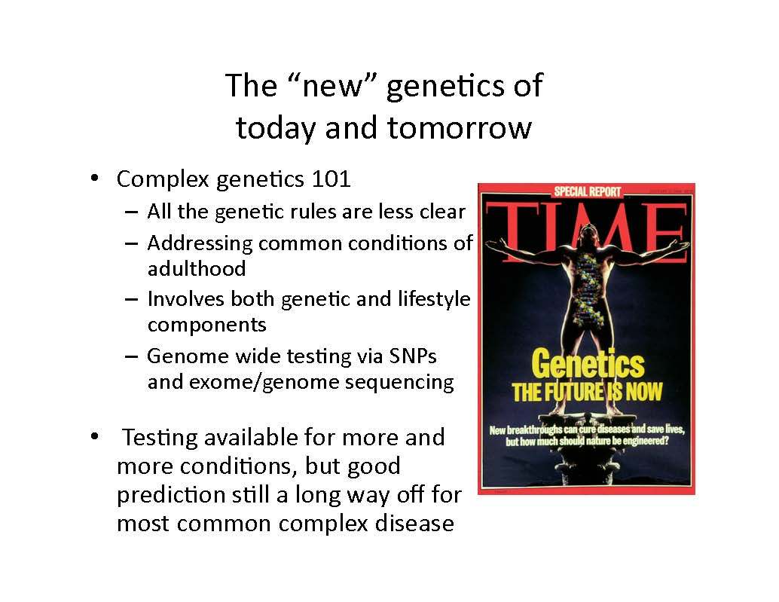

Slide 17
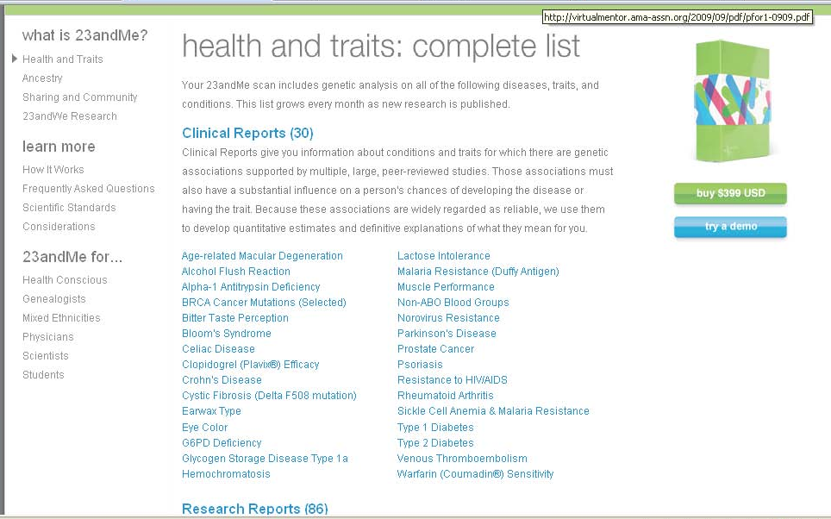

Slide 18
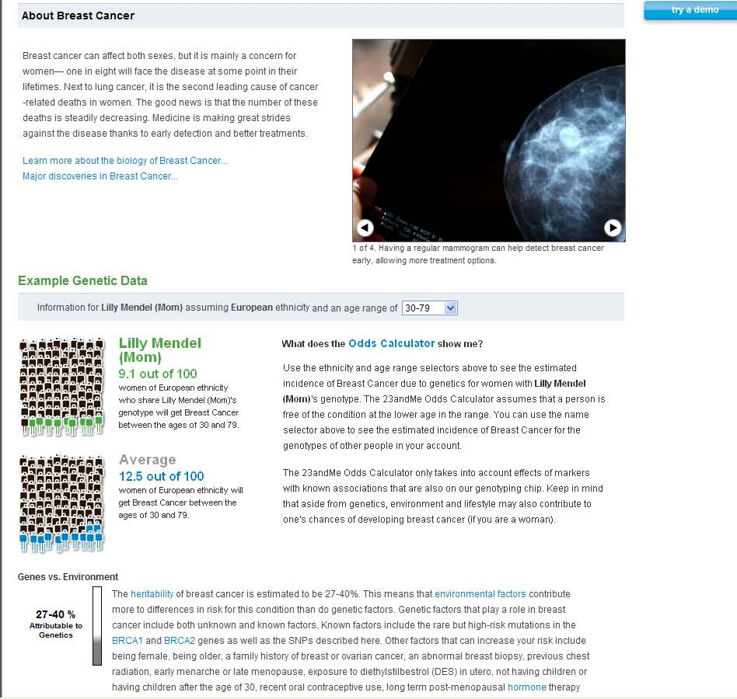

Slide 19
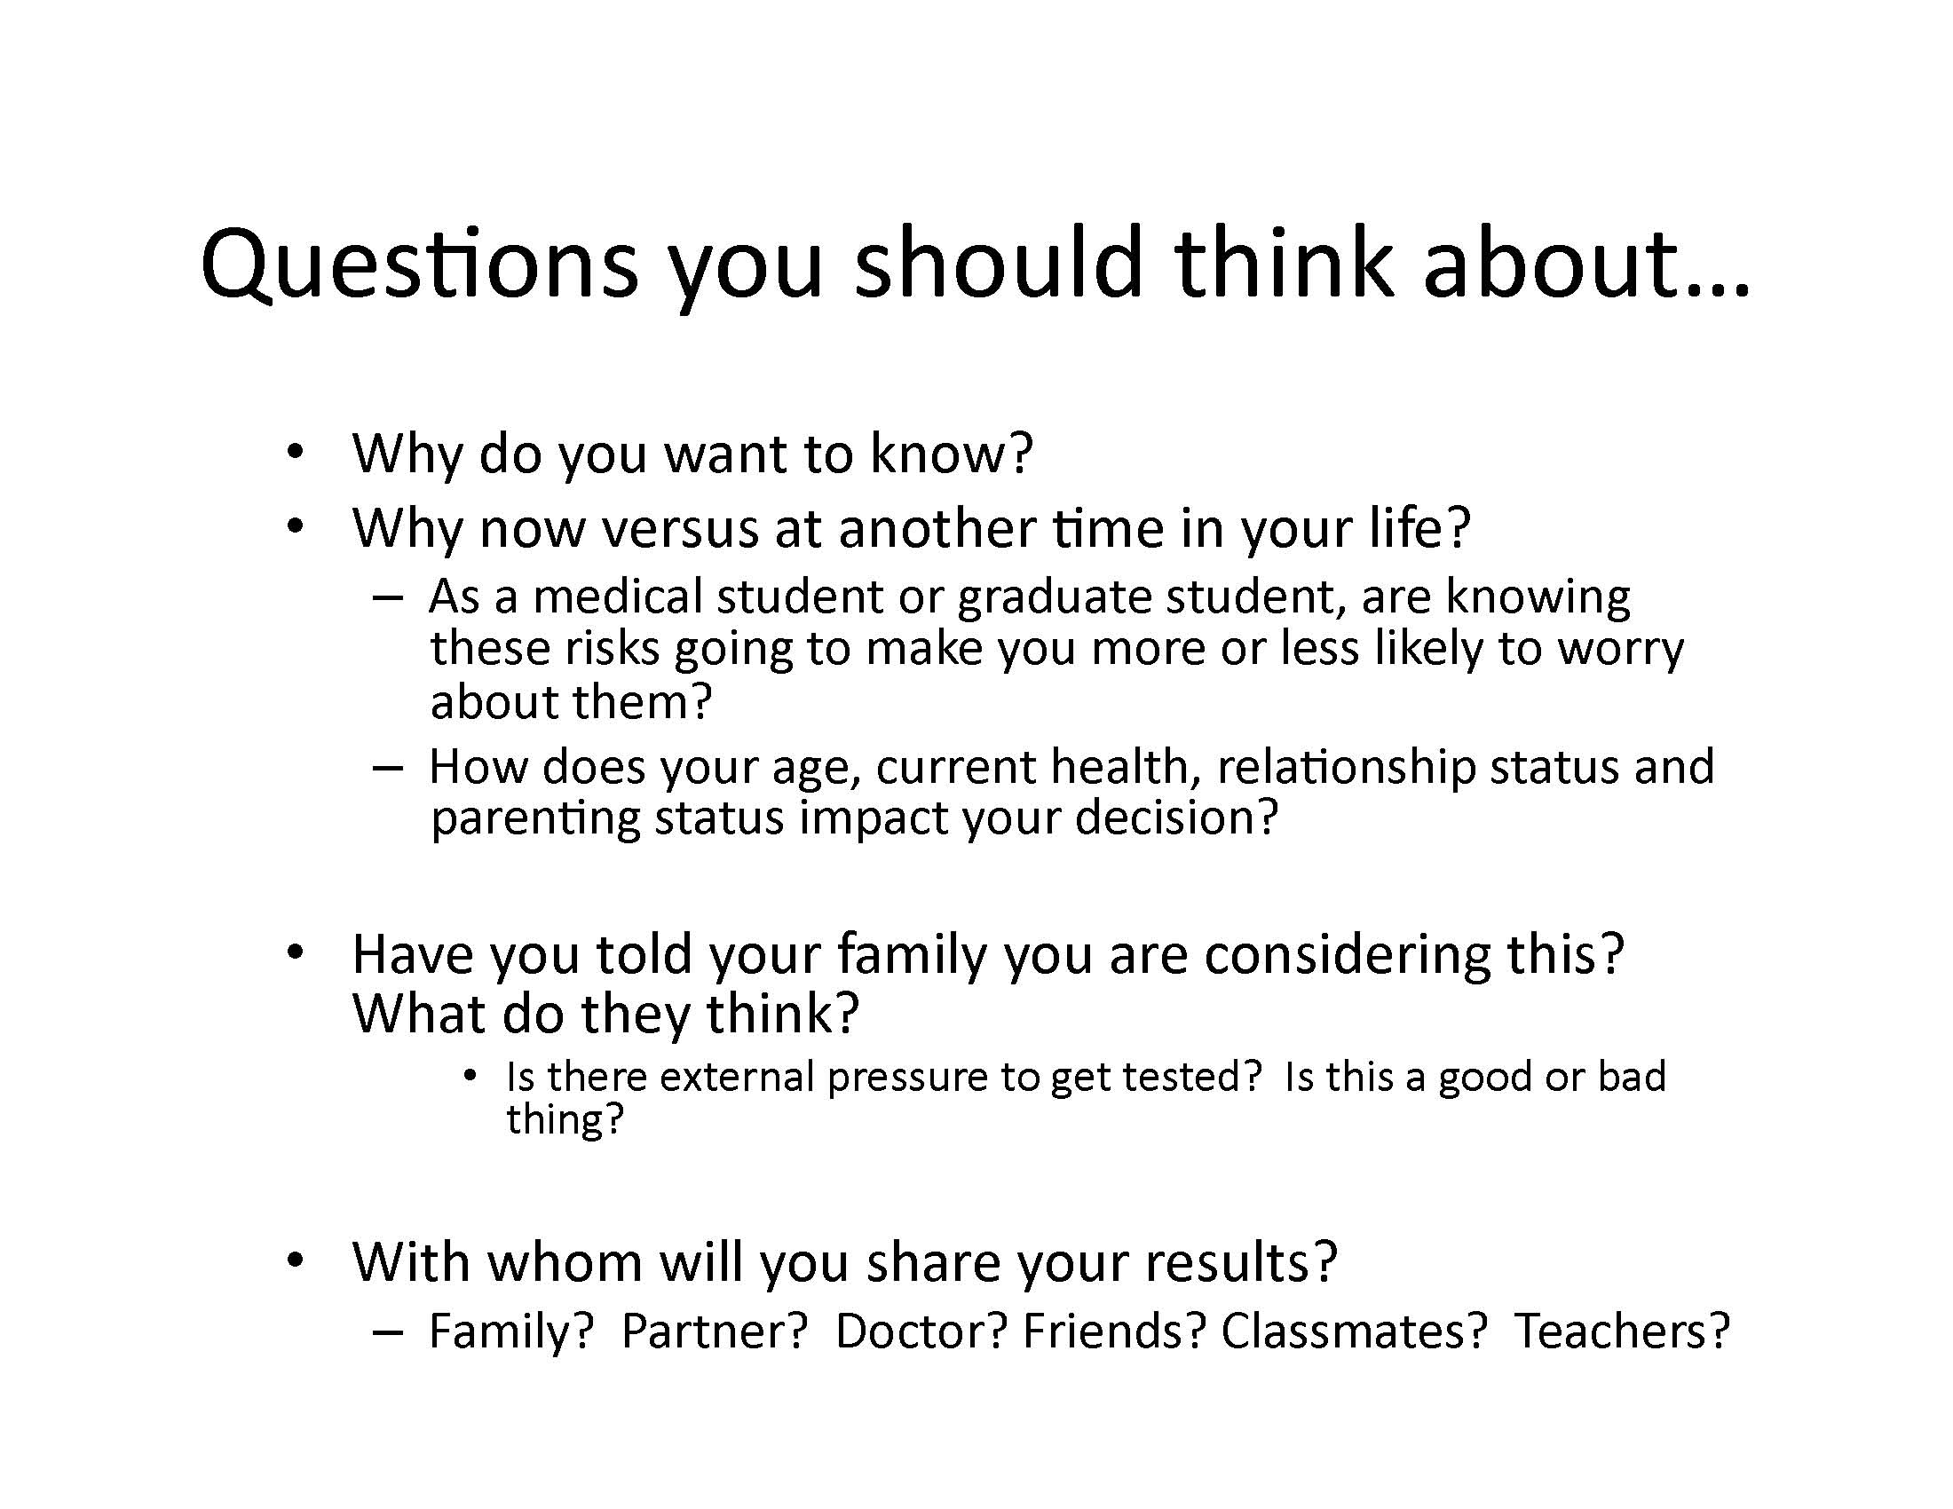

Slide 20
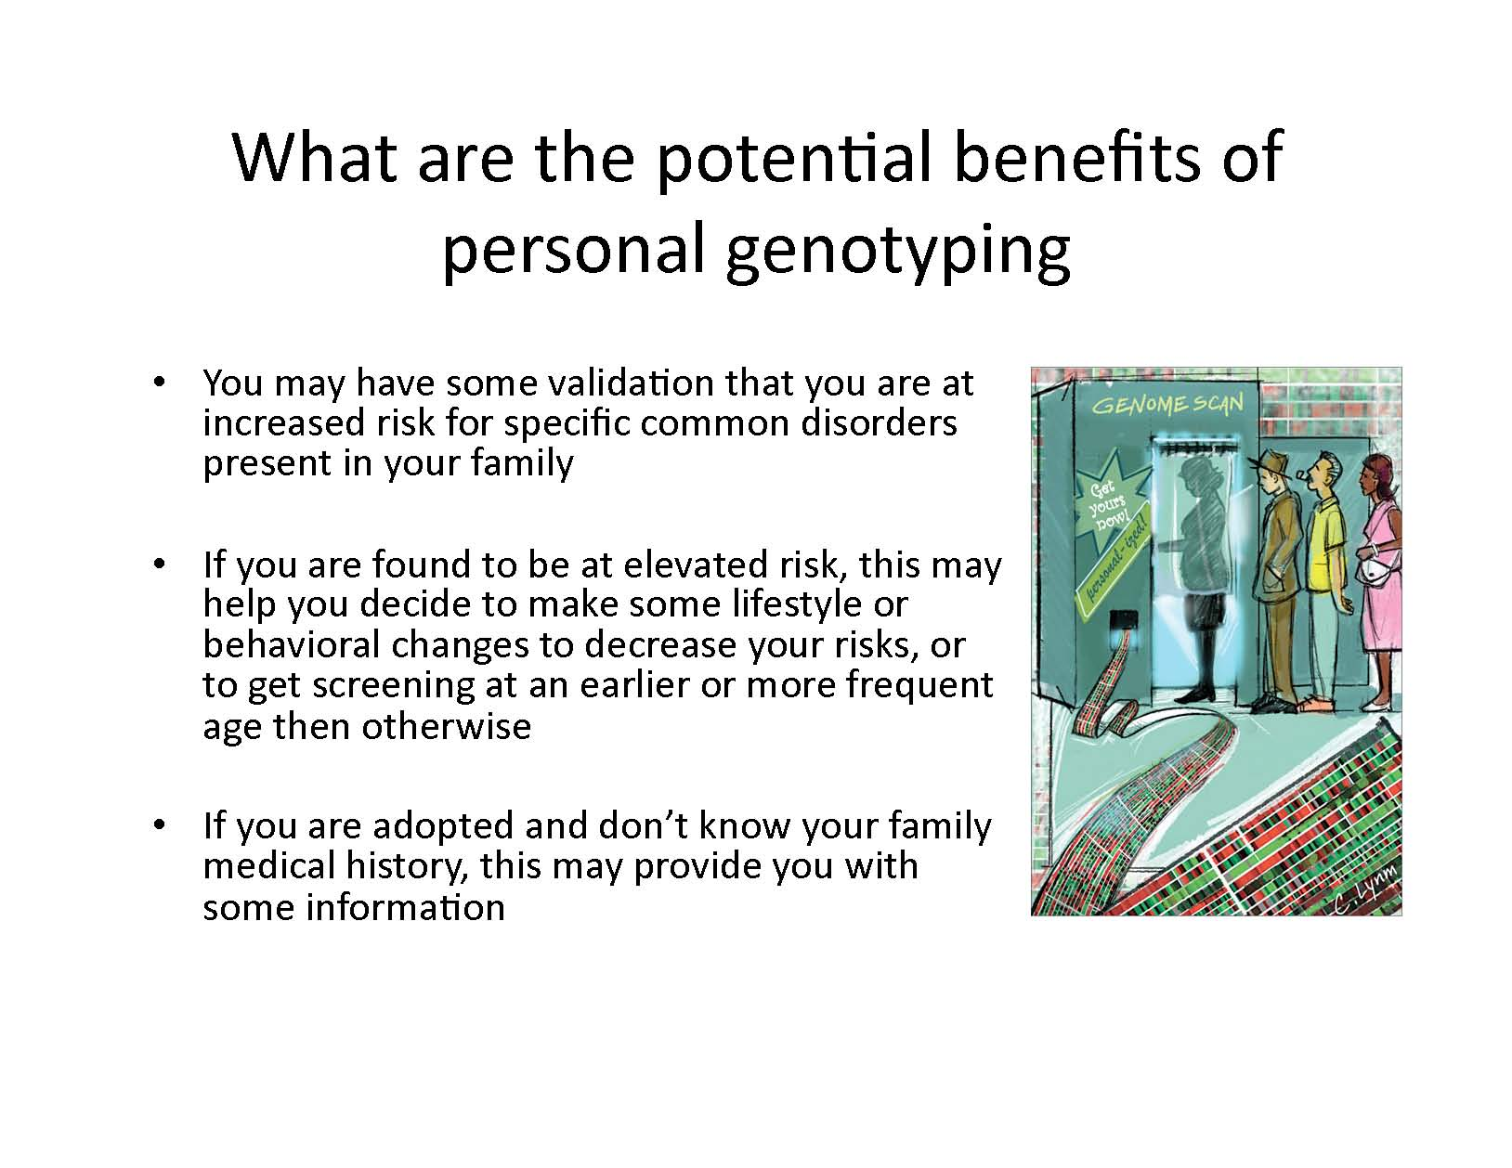

Slide 21
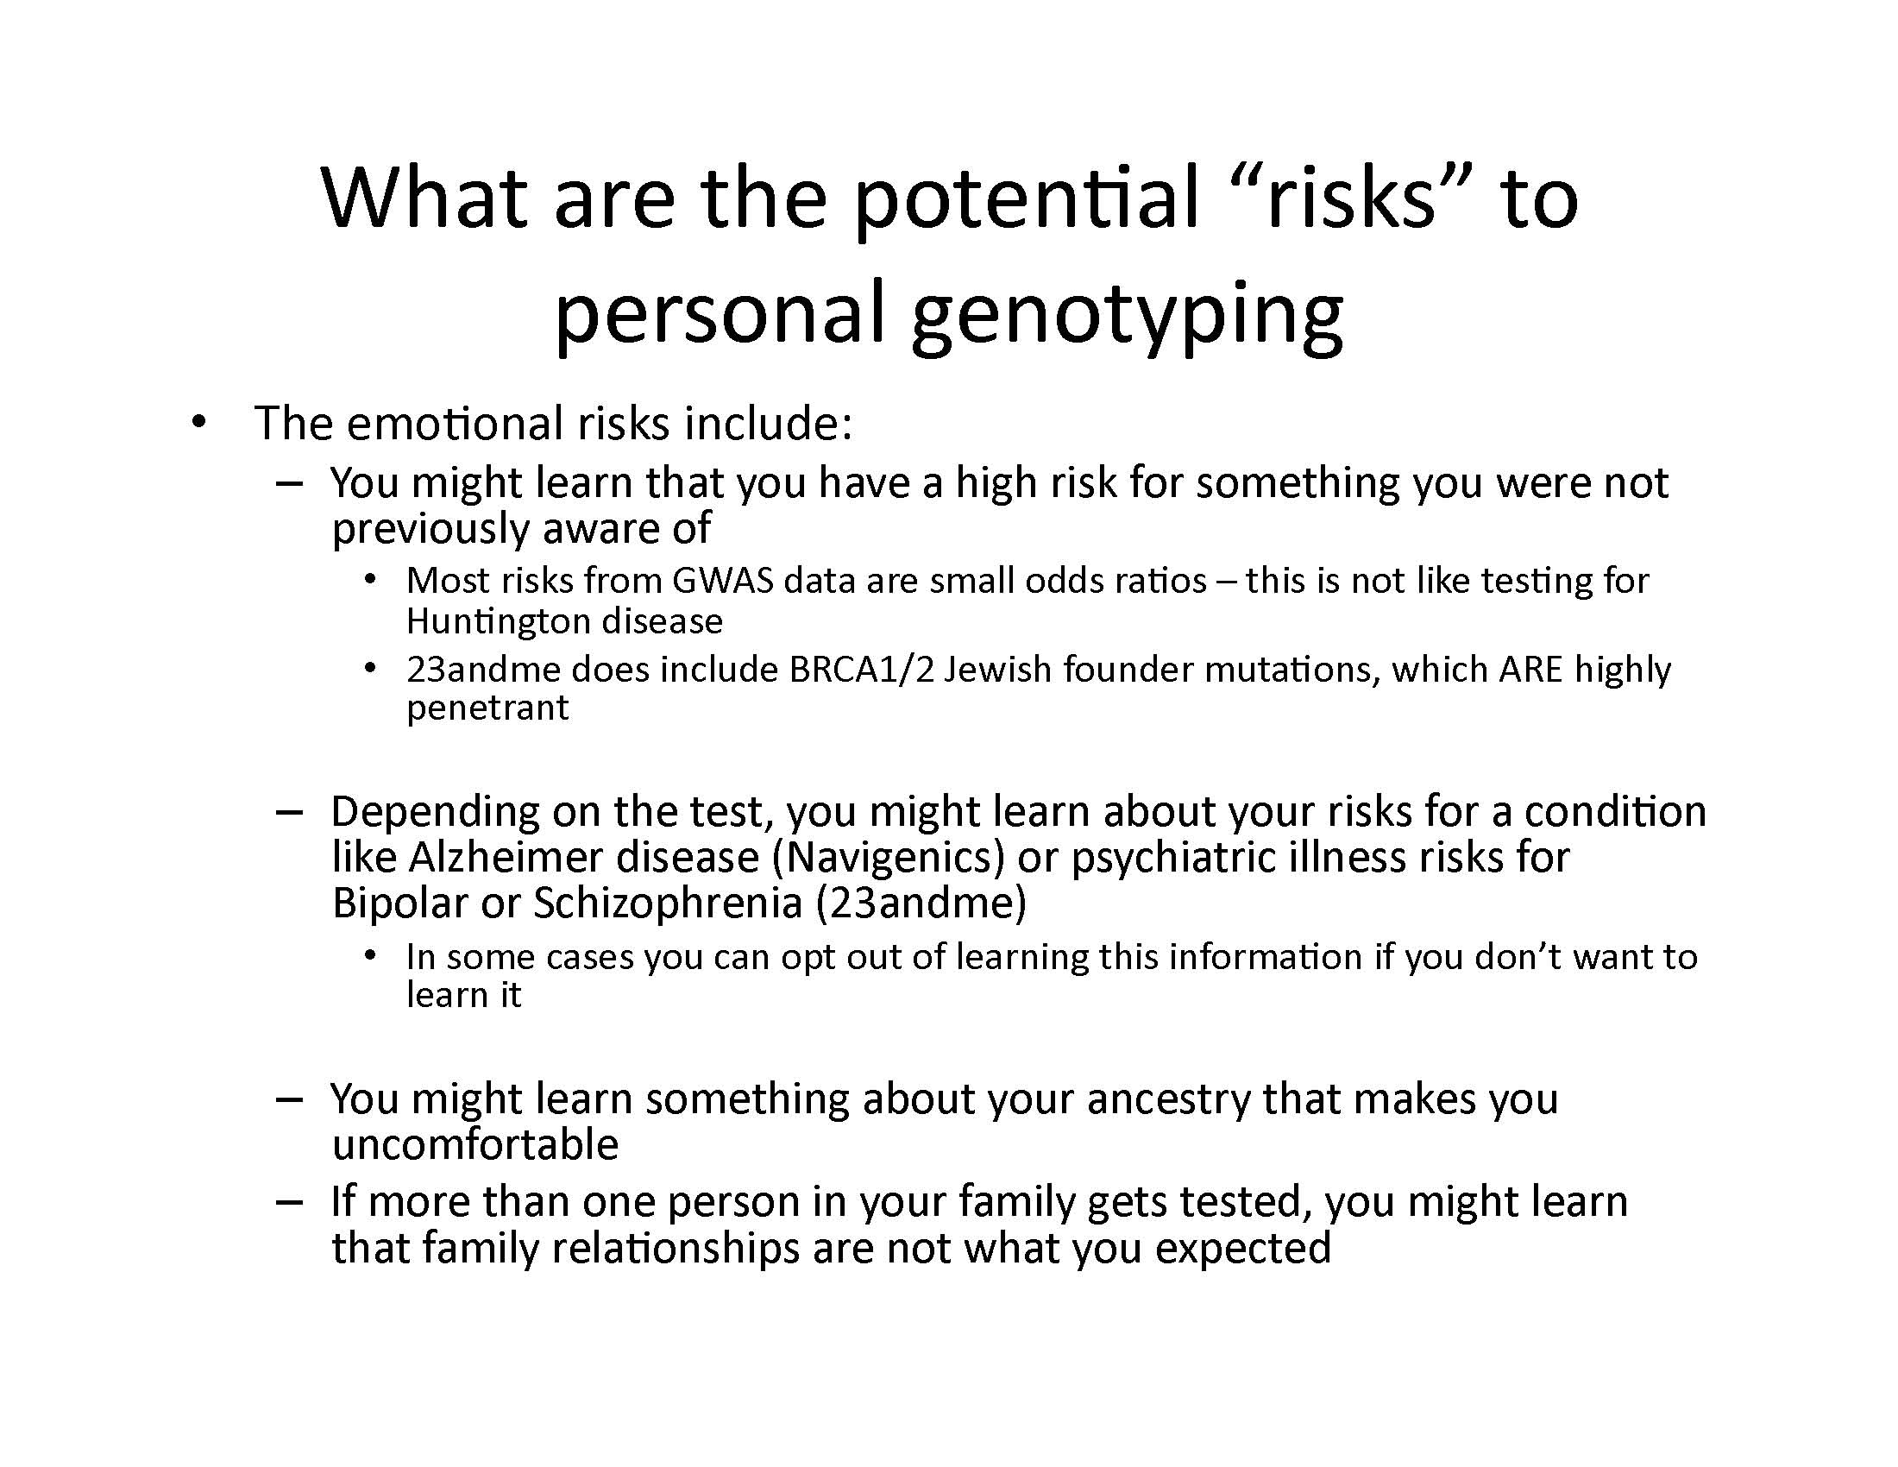

Slide 22
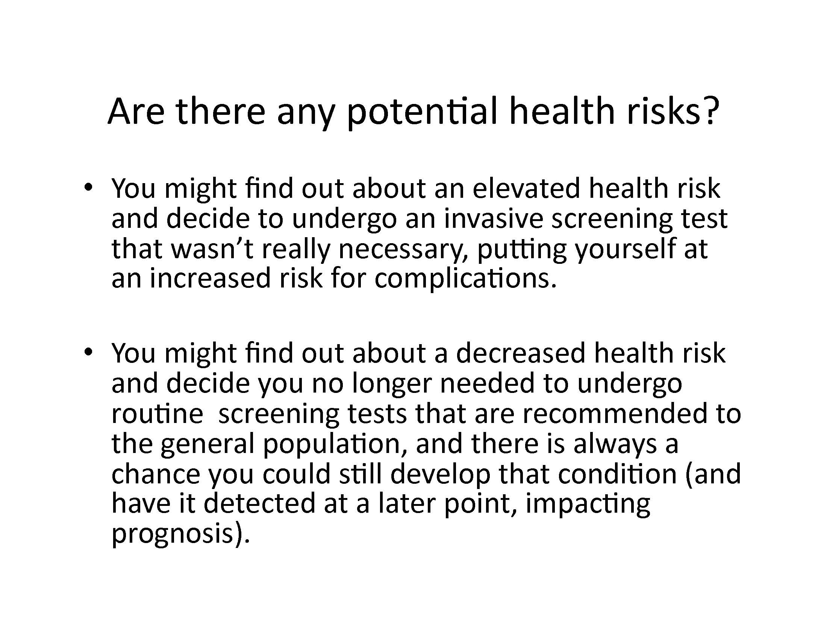

Slide 23
