Slide 1
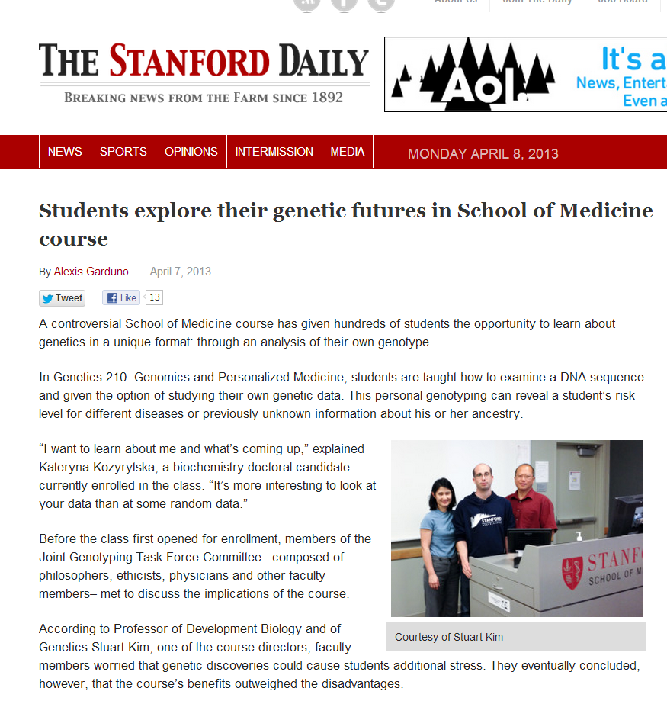

Slide 2
Class GWAS
Go to genotation.stanford.edu
Go to “traits”, then “GWAS”
Look up your SNPs
Fill out the table
Submit information

Slide 3
Class GWAS
Class should split into groups (~4/group)
Choose a trait
Each group should calculate association of all 5 SNPs with your trait. Use allele frequency to start.
Discuss with your team how to do this.
Ask us if you have questions
Raise your hand when you have results
We will make a table from the class results
http://stanford.edu/class/gene210/files/writeups/2012/gwas_notes_AM.pdf

Slide 4
Class GWAS
 | Earwax | Eye color | Asparagus | Bitter | Lactose Intolerant
7495174
17822931
4481887
713598
4988235

Slide 5
Class GWAS
Which SNP is best associated with which trait?
Is this significant? What should be the significance cut off?
Are there other significant associations?
What might cause the other significant associations?

Slide 6
Class GWAS
Each group should calculate association of all 5 SNPs with your trait. Use a recessive model.
Discuss with your team how to do this.
Ask us if you have questions
Raise your hand when you have results
We will make a table from the class results
http://stanford.edu/class/gene210/files/writeups/2012/gwas_notes_AM.pdf

Slide 7
Class GWAS
 | Earwax | Eye color | Asparagus | Bitter | Lactose Intolerant
7495174
17822931
4481887
713598
4988235

Slide 8
Allelic odds ratio: ratio of the allele ratios in the cases divided by the allele ratios in the controls
Calculate this for the best SNP in your trait
How different is this SNP in the cases versus the controls?

Slide 9
Allelic Odds Ratio Example
Can Taste Bitter?
rs713598
 | Yes | No
C | 31 | 22
G | 57 | 6
G seems to be enriched in the bitter tasters. How much?
Bitter tasters: G/C = 57/31 = 1.83
Not bitter tasters: G/C = 6/22 = .273
Allelic Odds Ratio = 1.83/.273 = 6.7
This is huge.
Remember, for colorectal cancer, OR for rs6983267 was 1.37
http://stanford.edu/class/gene210/files/writeups/2012/gwas_notes_AM.pdf

Slide 10
Class GWAS
Allelic Odds Ratio
 | Earwax | Eye color | Asparagus | Bitter | Lactose Intolerant
7495174
17822931
4481887
713598
4988235

Slide 11
Likelihood Ratio Example
Given a risk allele, what is the likelihood of having the disease?
Can Taste Bitter?
rs713598
 | Yes | No
C | 31 | 22
G | 57 | 6
The probability of G in the bitter tasters is: 57/(57+31)
The probability of G in the non-tasters is: 6/(6+22)
The likelihood ratio is 3.02
(note LR is not the same as OR (6.7))
http://stanford.edu/class/gene210/files/writeups/2012/Odds_Ratio_and_Likelihood_Ratio.pdf

Slide 12
Class GWAS
Likelihood ratio
 | Earwax | Eye color | Asparagus | Bitter | Lactose Intolerant
7495174
17822931
4481887
713598
4988235

Slide 13
Increased Risk Example
What is the likelihood of seeing a trait given a genotype compared to the overall likelihood of seeing that trait?
Can Taste Bitter?
rs713598
 | Yes | No
CC | 1 | 10
CG/GG | 45 | 5
For CC, 10/11 do not taste bitter = .91
For entire class, 15/61 do not taste bitter = .26
Increased Risk = .91/.26 = 3.5
http://stanford.edu/class/gene210/files/writeups/2012/Odds_Ratio_and_Likelihood_Ratio.pdf

Slide 14
Class GWAS
Increased Risk
 | Earwax | Eye color | Asparagus | Bitter | Lactose Intolerant
7495174 (AA)
17822931 (TT)
4481887 (GG)
713598 (CC)
4988235 (GG)

Slide 15
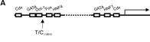
Lactose Intolerance
Rs4988235
Lactase Gene
A/G
A – lactase expressed in adulthood
G – lactase expression turns off in adulthood

Slide 16
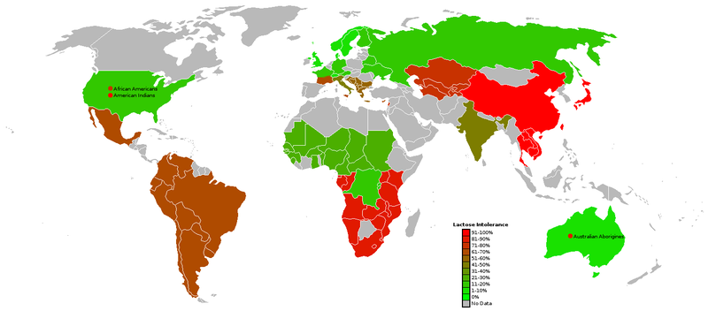
Lactose Intolerance

Slide 17
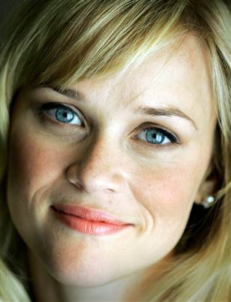
Eye Color
Rs7495174
In OCA2, the oculocutaneous albinism gene (also known as the human P protein gene).
Involved in making pigment for eyes, skin, hair.
accounts for 74% of variation in human eye color.
Rs7495174 leads to reduced expression in eye specifically.
Null alleles cause albinism

Slide 18
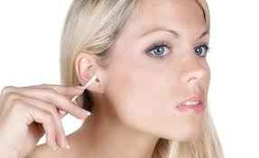
Ear Wax
Rs17822931
In ABCC11 gene that transports various molecules across extra- and intra-cellular membranes.
The A allele is loss of function of the protein.
Phenotypic implications of wet earwax: Insect trapping, self-cleaning and prevention of dryness of the external auditory canal.
Wet earwax: linked to axillary odor and apocrine colostrum.

Slide 19
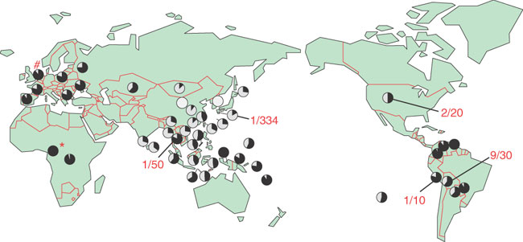
Ear Wax
Rs17822931
“the allele A arose in northeast Asia and thereafter spread through the world.”

Slide 20

Asparagus
Certain compounds in asparagus are metabolized to yield ammonia and various sulfur-containing degradation products, including various thiols and thioesters, which give urine a characteristic smell.
Methanethiol (pungent)
dimethyl sulfide (pungent)
dimethyl disulfide
bis(methylthio)methane
dimethyl sulfoxide (sweet aroma)
dimethyl sulfone (sweet aroma)
rs4481887 is in a region containing 39 olfactory receptors

Slide 21
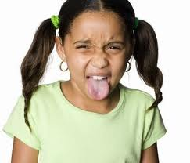
Bitter taste
Rs713598
Taste receptor 2 member 38
accounts for up to 85% of the variation in PTC tasting ability

