Slide 1
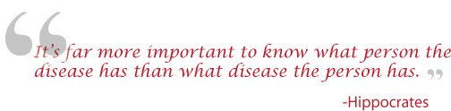
Genetics 210: Personalized Medicine and Genomics
For: MDs, PhDs and curious students
Spring term. Tue 2:15 – 4:05
Thur. 2:15-4:05
LKSC 102
Genotyping : $15 copay
Gene210.stanford.edu: info and FAQs

Slide 2
Course Staff
http://stanford.edu/class/gene210/web/html/contact.html
Course Organizers:
  Stuart Kim (Dev. Bio., Genetics)
  Aaron Gitler (Genetics)
  Rosalind Chuang (Neurology)
Tas (Tue: 4-6 pm, Third floor lobby Beckman Center
Wed: 11-1 pm, Third floor lobby Beckman Center):
  Andrew Roos
  Thomas Roos
IT support
  Greg Roe (Genetics)

Slide 3
Course makeup
http://stanford.edu/class/gene210/web/html/schedule.html
Activities
  In class GWAS exercise
  cardiovascular, diabetes, cancer, crohn’s etc.
  Neandertal
  Human positive selection
  Who done it?
  FDA regulation debate
Presentations
  Josh Knowles (cardiovascular)
  Russ Altman (pharmacogenetics)
  Yair Blumenfeld (prenatal sequencing)
  Steve Montgomery (eQTLs)
  Mike Snyder (next gen sequencing)
Spokespeople
  Robin Starr (breast cancer)
  Katie Moser (Huntington’s disease)

Slide 4
Course Requirements http://stanford.edu/class/gene210/web/html/course_requirements.html
1. Problem Sets (20%)
  Problem set 1. Out April 3. Due April 17.
  Problem set 2. Out April 17. Due May 1.
  OK to work in team, but need to work independently.

Slide 5
Course Requirements http://stanford.edu/class/gene210/web/html/course_requirements.html
2. Projects (40%) Choose one of the following projects.
  a. Write-up
    a. One page write up of association of how a SNP is linked with a particular trait. The format is the same as used at SNPedia.com.
  b. Special Project
    In the past, some students have found a specific interest in some aspect of Personalized Medicine. This may come from your interest in some aspect of your own genetics, the ethics of genetic testing, or entrepreneurial possibilities in Personalized Medicine. You may come up with an individualized project for class credit by discussing your idea with one of the course directors.

Slide 6
Course Requirements http://stanford.edu/class/gene210/web/html/course_requirements.html
Final Exam (40% credit) take home.
  Scenario is that you are an MD diagnosing a patient.
  You will be given the genotypes of a hypothetical family. The final will have various scenarios.
  Extra credit. (10%)
    a. You will be given the genotypes of 7 people (SK, KK, RT, NT, NZ, MPS, GC).
    b. You will be told ancestry and specific traits for these 7 people.
    c. You need to match the genotype with the person.

Slide 7
Course Requirements http://stanford.edu/class/gene210/web/html/course_requirements.html
Super-projects
  In the past, some students have taken this introductory class even though they are highly advanced in human genetics and bioinformatics. These students can do a more advanced project by consulting one of the course instructors. Students that undertake a super-project do not need to take the final exam. Possible super-projects topics include:
    a. Annotate whole-genome sequence for Stuart Kim or Aaron Gitler (adopted).
    b. Write a grant for Kaiser-Permanente GWAS (n=110,000 patients)
    c. Analyze exome sequence data from ALS patients
    d. Write an algorithm for choosing minimal n number of people to get all sequence data in a population

Slide 8
History
Joint Genotyping Task Force
Charles Prober Dean Hank Greely Law School
Russ Altman Genetics Clarence Braddock Med School
Pat Brown Biochem. Gil Chu Biochem
Mike Grecius Neur. Sean David Med. School
Carlos Bustamente Gen. Harry Greenberg Dean
Ralph Horwitz Psych Louanne Hudgins Epidemiology
Anne James Legal Counsel Jesse Karmazin Med. School
Stuart Kim Dev. Bio. Mark Krasnow Biochem
Phil Lavori HRP David Magnus Cen. BME
Kelly Ormond Genetics Alan Schatzberg Psych.
Mike Snyder Genetics Atul Butte BMI
Keyan Salari Med. School Mildred Cho Pediatrics

Slide 9
Course proposed in 2008
Joint Genotyping Task Force
Charles Prober Dean Hank Greely Law School
Russ Altman Genetics Clarence Braddock Med School
Pat Brown Biochem. Gil Chu Biochem
Mike Grecius Neur. Sean David Med. School
Carlos Bustamente Gen. Harry Greenberg Dean
Ralph Horwitz Psych Louanne Hudgins Epidemiology
Anne James Legal Counsel Jesse Karmazin Med. School
Stuart Kim Dev. Bio. Mark Krasnow Biochem
Phil Lavori HRP David Magnus Cen. BME
Kelly Ormond Genetics Alan Schatzberg Psych.
Mike Snyder Genetics Atul Butte BMI
Keyan Salari Med. School Mildred Cho Pediatrics

Slide 10
Concern over student stress
Joint Genotyping Task Force
Charles Prober Dean Hank Greely Law School
Russ Altman Genetics Clarence Braddock Med School
Pat Brown Biochem. Gil Chu Biochem
Mike Grecius Neur. Sean David Med. School
Carlos Bustamente Gen. Harry Greenberg Dean
Ralph Horwitz Psych Louanne Hudgins Epidemiology
Anne James Legal Counsel Jesse Karmazin Med. School
Stuart Kim Dev. Bio. Mark Krasnow Biochem
Phil Lavori HRP David Magnus Cen. BME
Kelly Ormond Genetics Alan Schatzberg Psych.
Mike Snyder Genetics Atul Butte BMI
Keyan Salari Med. School Mildred Cho Pediatrics

Slide 11
Support for counseling
Joint Genotyping Task Force
Charles Prober Dean Hank Greely Law School
Russ Altman Genetics Clarence Braddock Med School
Pat Brown Biochem. Gil Chu Biochem
Mike Grecius Neur. Sean David Med. School
Carlos Bustamente Gen. Harry Greenberg Dean
Ralph Horwitz Psych Louanne Hudgins Epidemiology
Anne James Legal Counsel Jesse Karmazin Med. School
Stuart Kim Dev. Bio. Mark Krasnow Biochem
Phil Lavori HRP David Magnus Cen. BME
Kelly Ormond Genetics Alan Schatzberg Psych.
Mike Snyder Genetics Atul Butte BMI
Keyan Salari Med. School Mildred Cho Pediatrics

Slide 12
No Coercion
Joint Genotyping Task Force
Charles Prober Dean Hank Greely Law School
Russ Altman Genetics Clarence Braddock Med School
Pat Brown Biochem. Gil Chu Biochem
Mike Grecius Neur. Sean David Med. School
Carlos Bustamente Gen. Harry Greenberg Dean
Ralph Horwitz Psych Louanne Hudgins Epidemiology
Anne James Legal Counsel Jesse Karmazin Med. School
Stuart Kim Dev. Bio. Mark Krasnow Biochem
Phil Lavori HRP David Magnus Cen. BME
Kelly Ormond Genetics Alan Schatzberg Psych.
Mike Snyder Genetics Atul Butte BMI
Keyan Salari Med. School Mildred Cho Pediatrics

Slide 13
No financial ties to 23andme
Joint Genotyping Task Force
Charles Prober Dean Hank Greely Law School
Russ Altman Genetics Clarence Braddock Med School
Pat Brown Biochem. Gil Chu Biochem
Mike Grecius Neur. Sean David Med. School
Carlos Bustamente Gen. Harry Greenberg Dean
Ralph Horwitz Psych Louanne Hudgins Epidemiology
Anne James Legal Counsel Jesse Karmazin Med. School
Stuart Kim Dev. Bio. Mark Krasnow Biochem
Phil Lavori HRP David Magnus Cen. BME
Kelly Ormond Genetics Alan Schatzberg Psych.
Mike Snyder Genetics Atul Butte BMI
Keyan Salari Med. School Mildred Cho Pediatrics

Slide 14
Informed consent
Joint Genotyping Task Force
Charles Prober Dean Hank Greely Law School
Russ Altman Genetics Clarence Braddock Med School
Pat Brown Biochem. Gil Chu Biochem
Mike Grecius Neur. Sean David Med. School
Carlos Bustamente Gen. Harry Greenberg Dean
Ralph Horwitz Psych Louanne Hudgins Epidemiology
Anne James Legal Counsel Jesse Karmazin Med. School
Stuart Kim Dev. Bio. Mark Krasnow Biochem
Phil Lavori HRP David Magnus Cen. BME
Kelly Ormond Genetics Alan Schatzberg Psych.
Mike Snyder Genetics Atul Butte BMI
Keyan Salari Med. School Mildred Cho Pediatrics

Slide 15
Personal Genotyping
Voluntary. You can use a public genome file instead of your own.
Confidential – instructors will not ask who opted to be genotyped.
Private – Your own DNA information will not be revealed.
Counseling - genetic counseling via 23andMe and medical/psychological counseling via Dr. Alan Schatzberg (Psychology, Stanford).

Slide 16
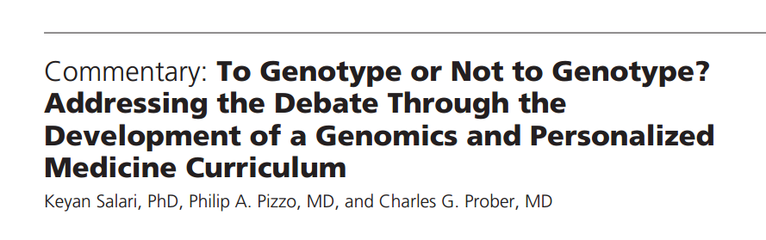
Summary of the Joint Genotyping Task Force Committee
Acad Med. 2011;86:925–927.

Slide 17
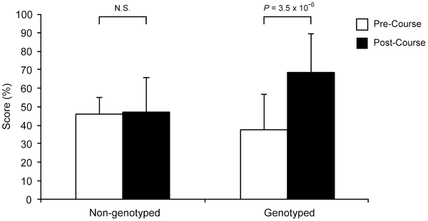

Figure 1. Student scores assessing knowledge of genomics.
Salari K, Karczewski KJ, Hudgins L, Ormond KE (2013) Evidence That Personal Genome Testing Enhances Student Learning in a Course on Genomics and Personalized Medicine. PLoS ONE 8(7): e68853. doi:10.1371/journal.pone.0068853
http://www.plosone.org/article/info:doi/10.1371/journal.pone.0068853

Slide 18
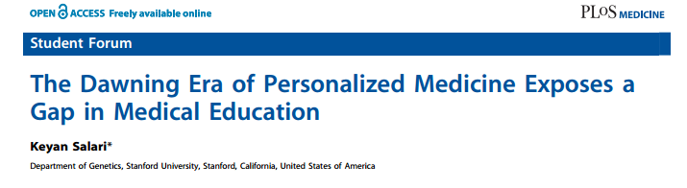
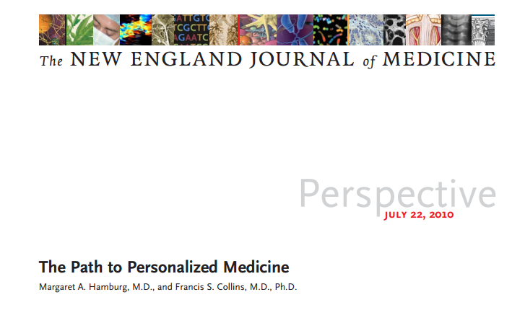
Readings today 4/1

Slide 19
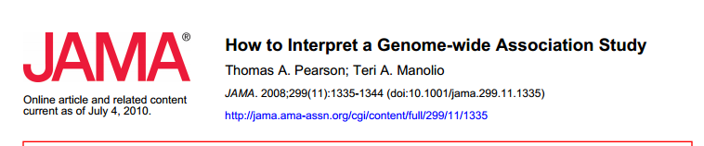
Reading #1: Thursday 4/3

Slide 20
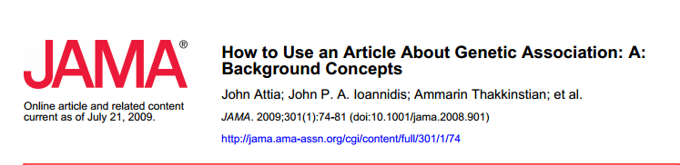
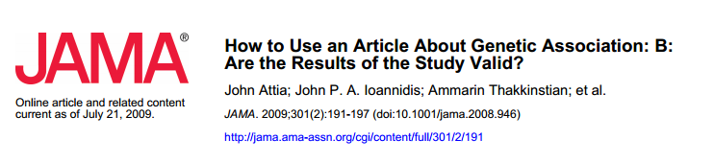
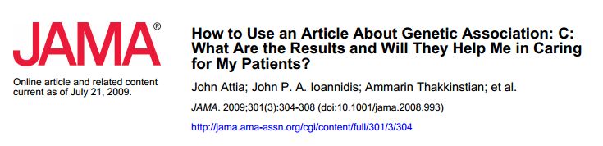
Reading #2: Thursday 4/3

Slide 21
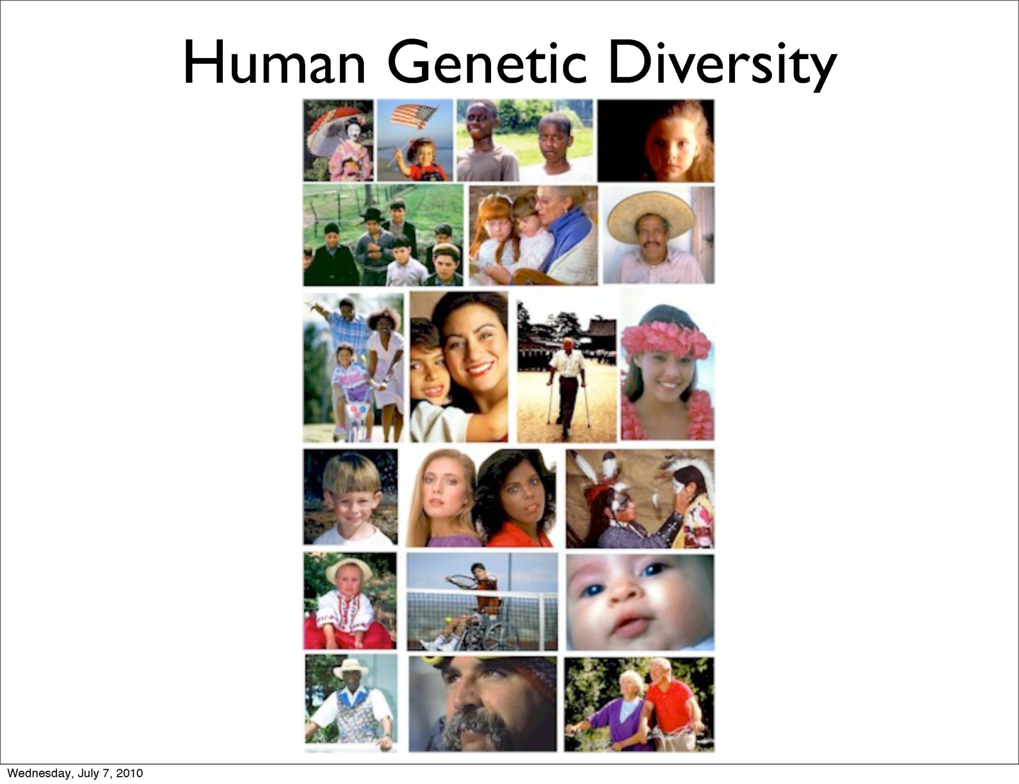

Slide 22
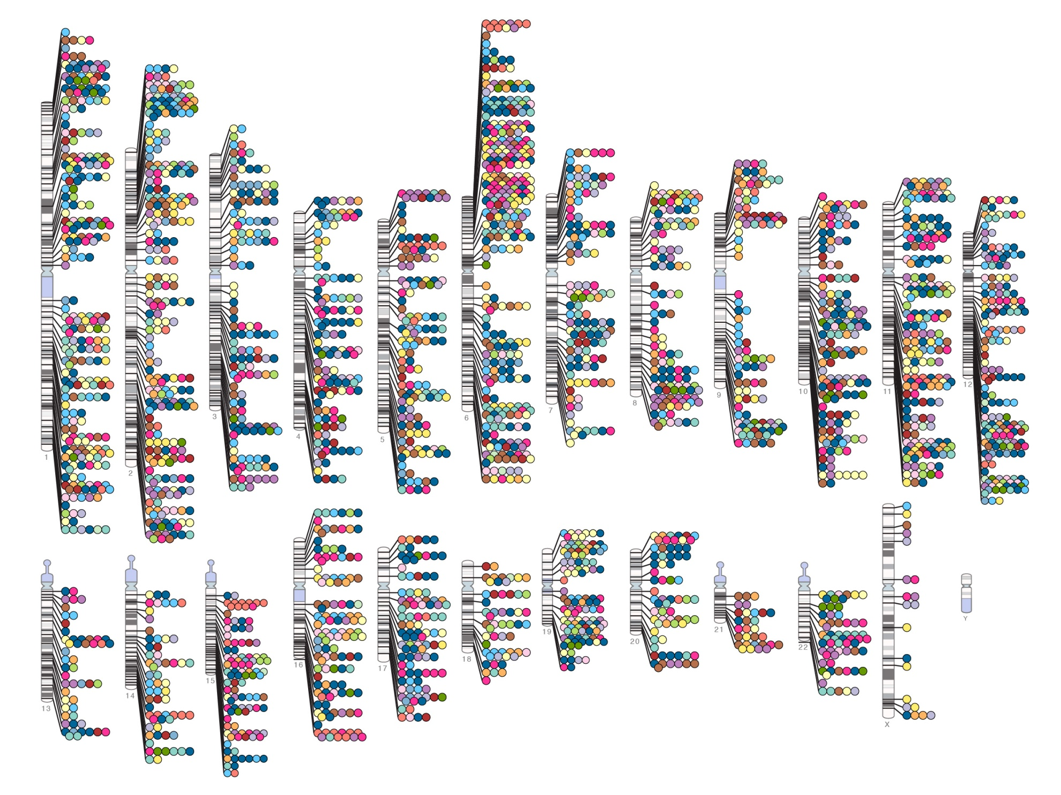
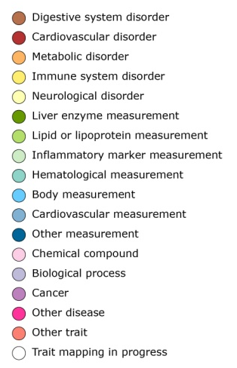

Published Genome-Wide Associations through 07/2012
Published GWA at p≤5X10⁻⁸ for 18 trait categories
NHGRI GWA Catalog
www.genome.gov/GWAStudies
www.ebi.ac.uk/fgpt/gwas/

Slide 23
Personalized Medicine
Alzheimer’s disease – ApoE (2,3,4)
Huntington’s disease (HTT)
Cystic fibrosis (CFTR)
Breast Cancer (BRCA1, BRCA2)
Warfarin sensitivity (VKORC)

Slide 24
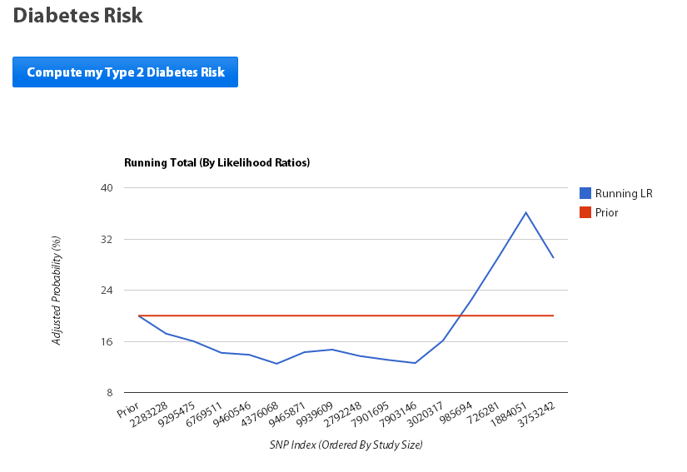
Type 2 diabetes

Slide 25
Low Bone Mineral Density
Osteoporosis
Stress fracture
17 GWA studies
33,000 people total
56 loci identified
Developed a genetic signature based on combined score from all 56 loci.

Slide 26
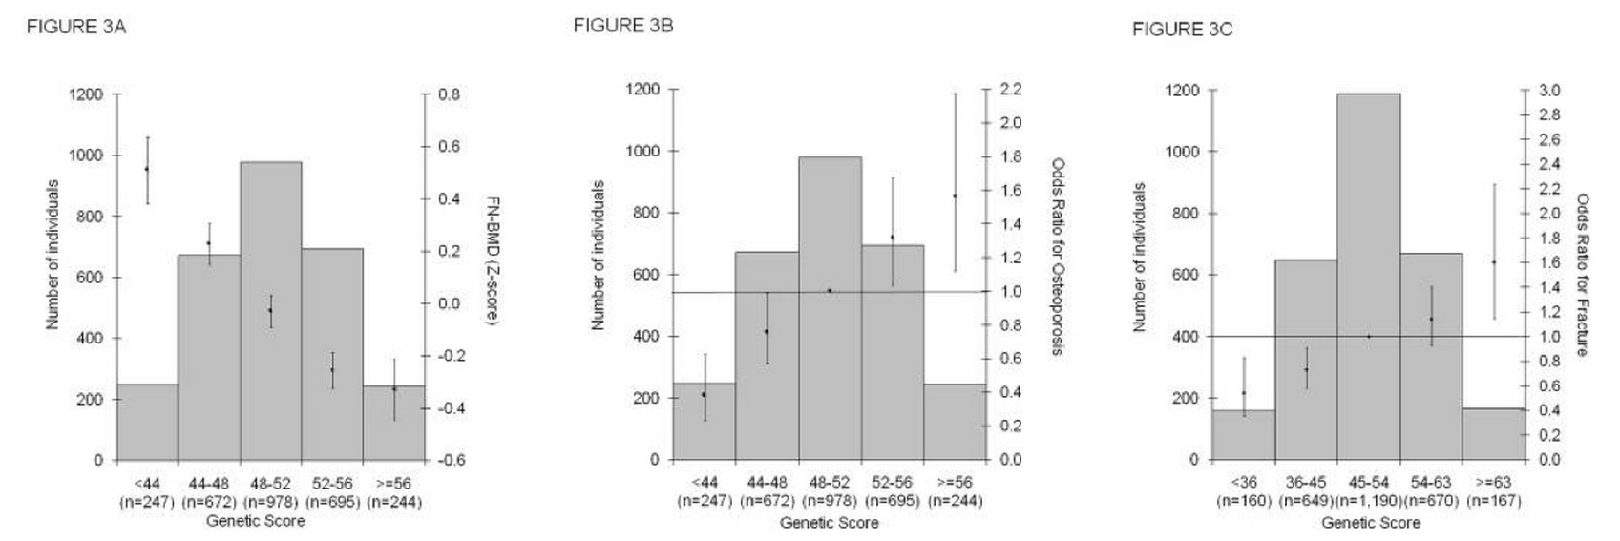
BMD/osteoporosis/fracture

Slide 27
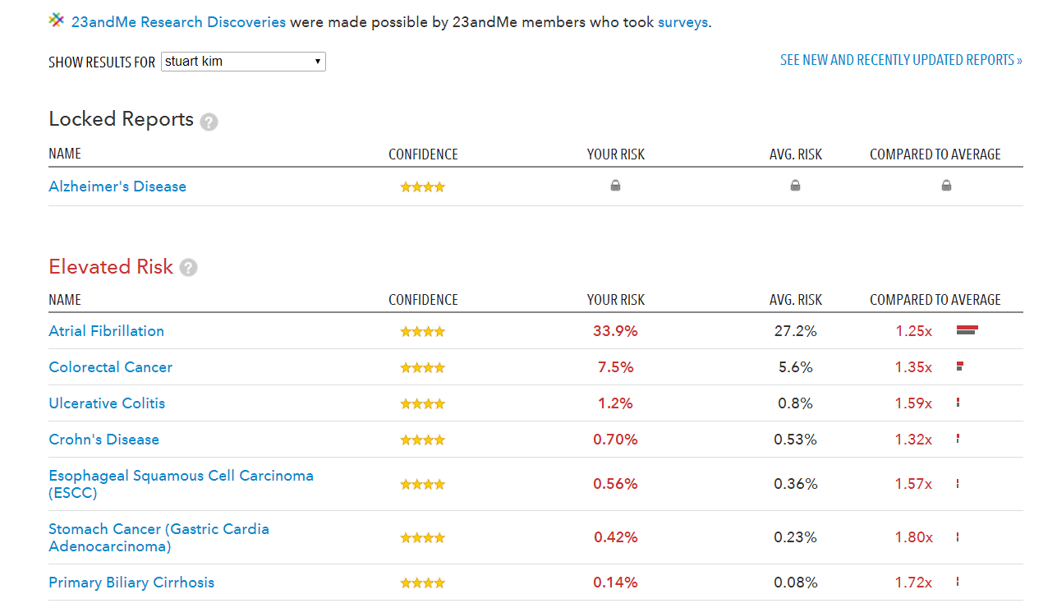

Slide 28
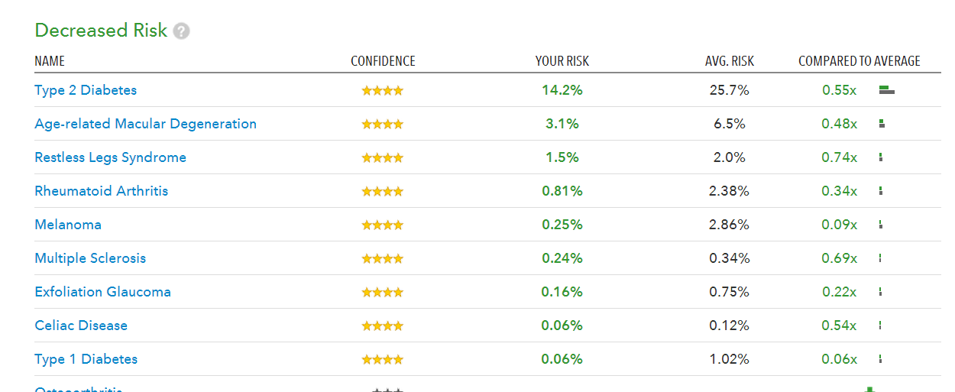

Slide 29
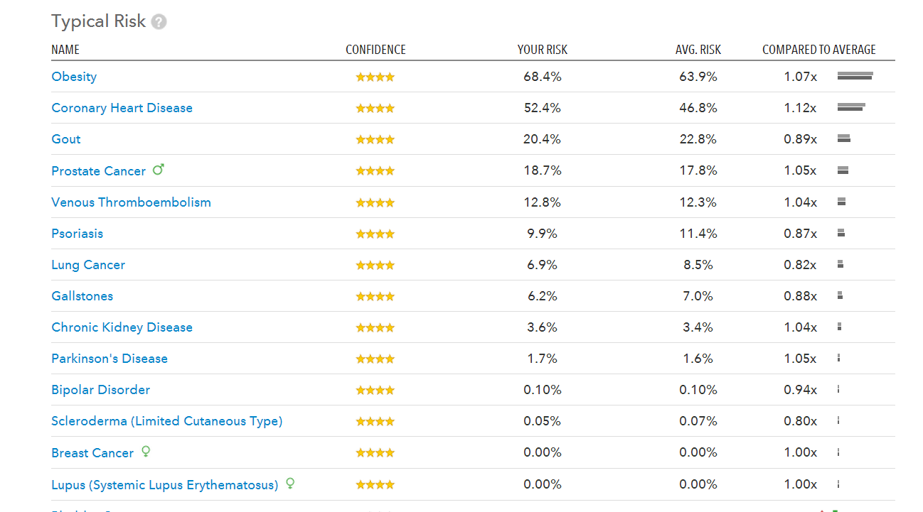

Slide 30
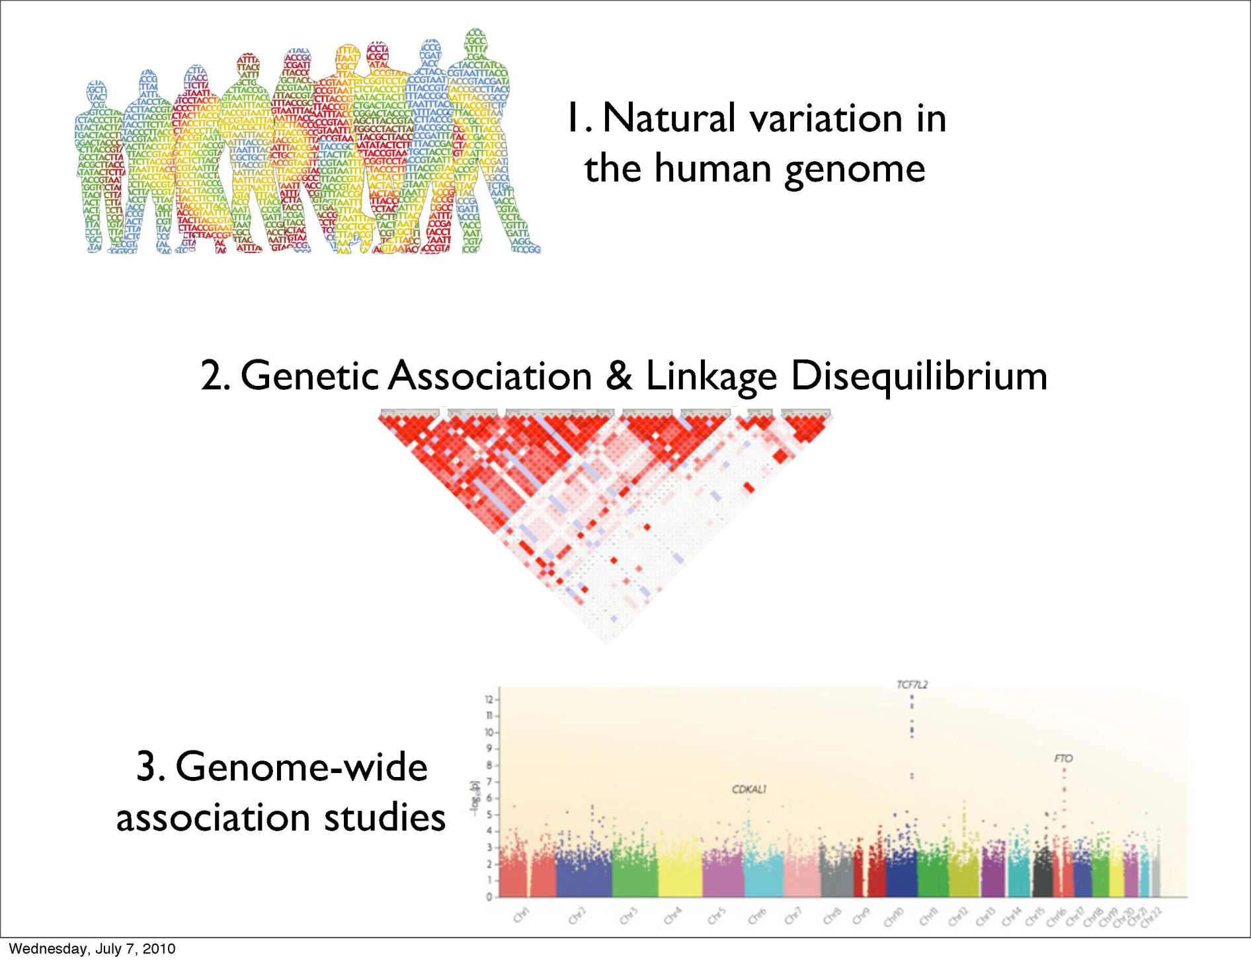

Slide 31
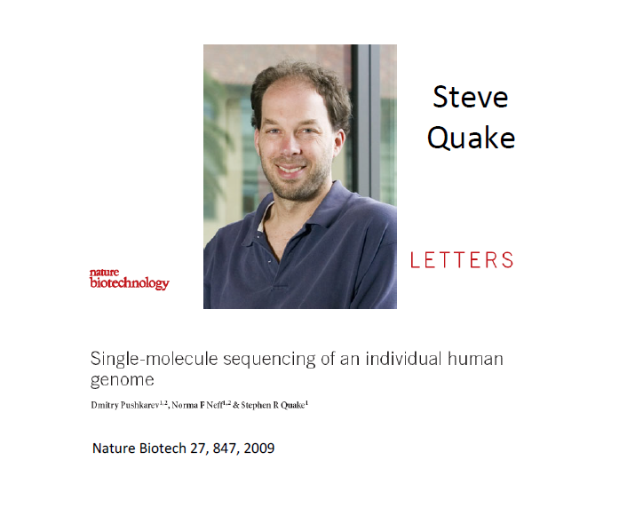

Slide 32
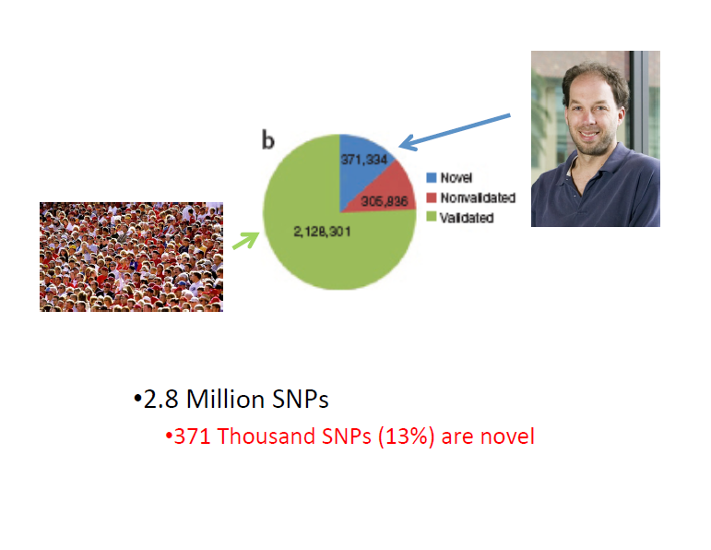

Slide 33
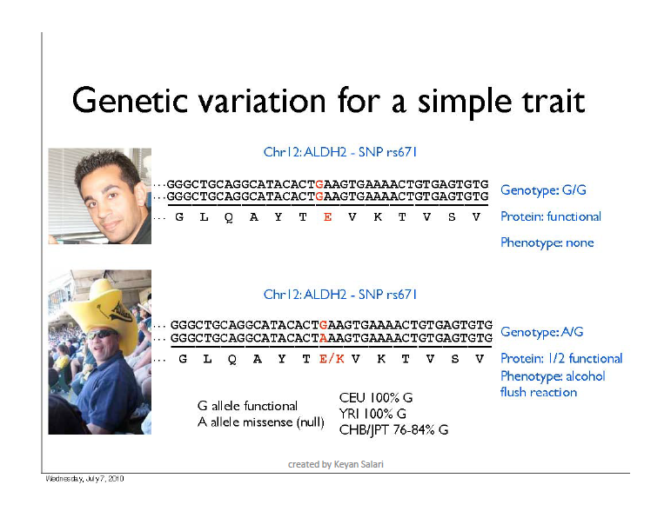

Slide 34
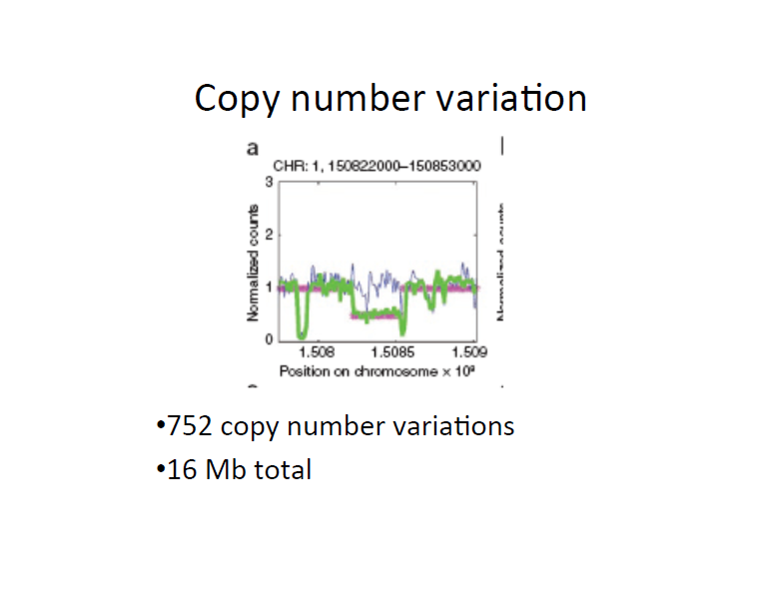
Notes:
Blue is similated
Green is real
Red is modelled

Slide 35
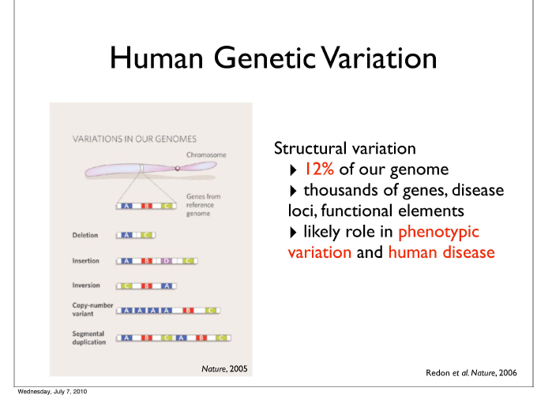

Slide 36
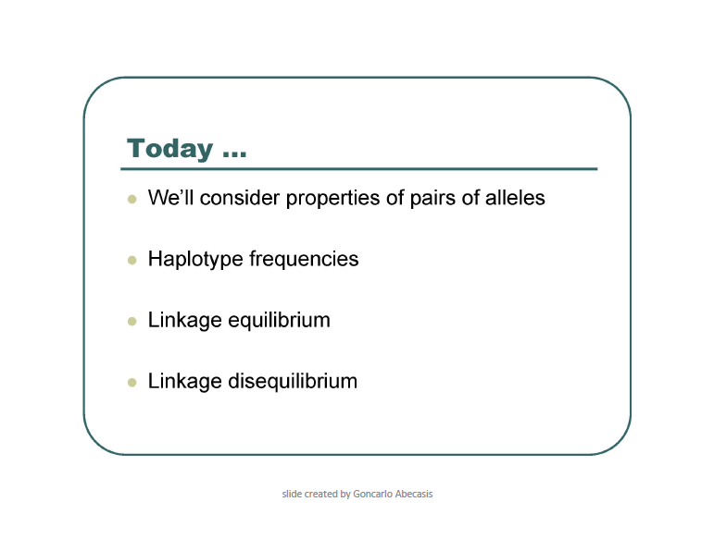

Slide 37
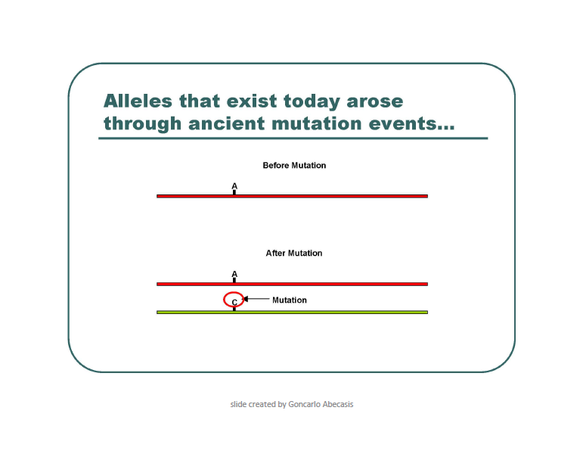

Slide 38
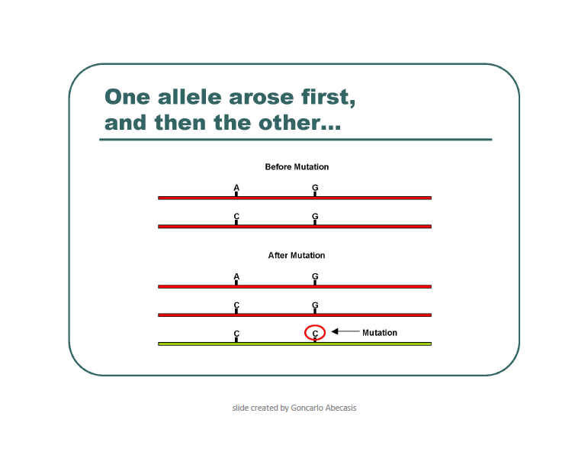

Slide 39
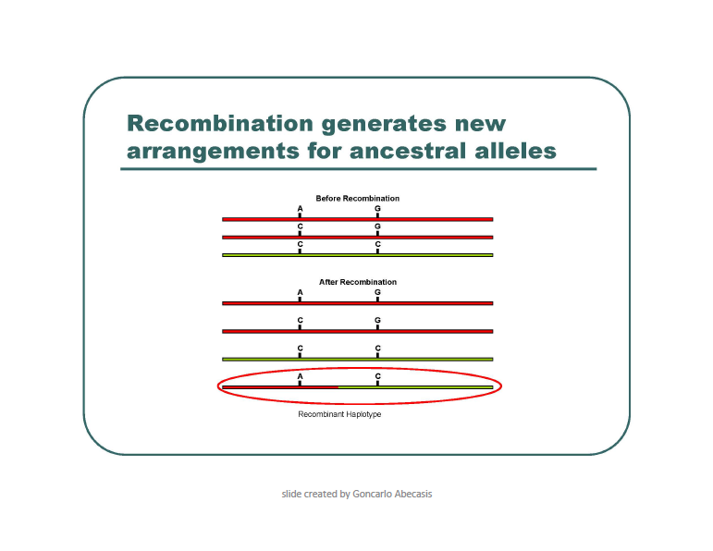

Slide 40
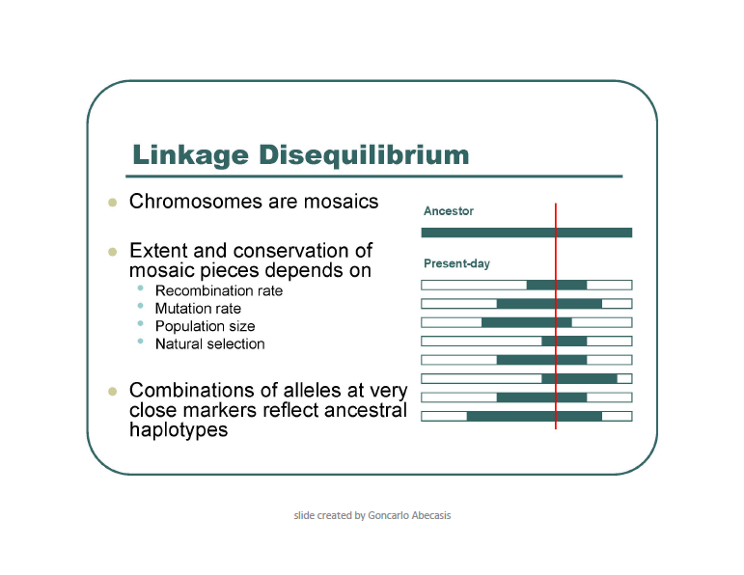

Slide 41
Terminology
Genotype frequency: If the SNPs segregate randomly, you can calculate this by multiplying each of the allele frequencies.
Linkage equilibrium: If the SNPs segregate randomly, they are said to be in equilibrium. If they do not segregate randomly, they are in linkage disequilibrium.
Haplotype: a set of markers that co-segregate with each other.
abc or abc or ABC
abc ABC ABC
Phase: refers to whether the alleles are in cis or in trans.
ab or aB
AB Ab

Slide 42
Linkage
The correlation between two markers (R) is a way to measure their linkage.
R=1 indicates that the two markers are completely linked.
R=0 indicates that the two markers segregate randomly.
R² measures the loss of information when marker A is replaced by marker B.

Slide 43
Scenario 1

Slide 44
Scenario 2
A
G
Chrom 1
Chrom 2
C
G
First polymorphism
Second polymorphism
A
G
Chrom 1
Chrom 2
C
C

Slide 45
Scenario 1
SNP1 SNP2
A C Ancestral
C C derived SNP1
C G derived SNP2
A G recombinant (not observed)
Scenario 2
SNP1 SNP2
A C Ancestral
C G derived SNP1 and SNP2
C C haplotype 1
A G haplotype 2

Slide 46
Linkage
Go to http://genotation.stanford.edu/
Load your genome, race
Under “presentations”, run “genetic linkage, part 1”
Click “look up exercise”
Click “submit my information”
Using the allele frequencies from class, calculate the chance of someone having your genotype.
Compare the predicted genotype frequency to the observed genotype frequency in the class.
Discuss.
Repeat for parts 2 and 3. Discuss.

