Slide 1
Linkage

Slide 2
Announcements
23andme genotyping. 23andme will genotype in ~3 weeks. You need to deliver finished spit kit by Friday NOON. http://www.stanford.edu/class/gene210/web/html/genotyping-agreement.html
Problem set 1 is available for download. Due April 17.
class videos are available from a link on the schedule web page, and at https://med.stanford.edu/mediadropbox/courseListing.html?identifier=gene210&cyyt=1146

Slide 3
Personalized Medicine blog
Write a 750 word essay on one of the 10 reasons why the human genome matters in medicine. The essay counts as a class project (e.g. instead of a SNPedia write-up) or it can count as extra credit for the course (up to 10%). The essay is due April 11th.
Besides course credit, you can also enter your essay into a contest run by 23andme. The contest entry is also due April 11th. Everyone will receive a free t shirt for entering. Winners will get $100 Amazon gift card and a 23andme kit. Class will get $300 for a class social event.
The essay is now posted on the course requirements page for the class. Contact Stuart Kim if you have questions or comments.

Slide 4
Terminology
Genotype frequency: If the SNPs segregate randomly, you can calculate this by multiplying each of the allele frequencies.
Linkage equilibrium: If the SNPs segregate randomly, they are said to be in equilibrium. If they do not segregate randomly, they are in linkage disequilibrium.
Haplotype: a set of markers that co-segregate with each other.
abc or abc or ABC
abc ABC ABC
Phase: refers to whether the alleles are in cis or in trans.
ab or aB
AB Ab

Slide 5
Scenario 1
A
G
Chrom 1
Chrom 2
C
G
First polymorphism
Second polymorphism
A
G
Chrom 1
Chrom 2
C
C

Slide 6
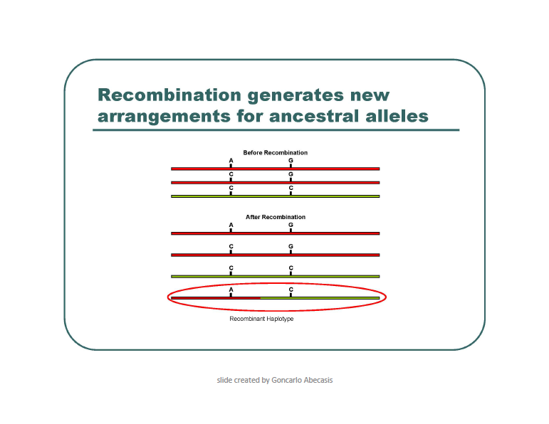
Scenario 2

Slide 7
Data 1
rs6447271 3 AA 5 AG 20 GG
rs12426597 1 CC 9 CT 18 TT
rs6447271 ___A alleles ___ G alleles ___ total
rs12426597 ___C alleles ___ T alleles ___ total
rs6447271 ___A freq. ___ G freq.
rs12426597 ___C freq. ___ T freq.

Slide 8
What can we say about rs6447271 and rs12426597?
rs6447271, rs12426597
haplotype expected observed
AA CC ___ 0
AA CT ___ .04
AA TT ___ .07
AG CC ___ 0
AG CT ___ .04
AG TT ___ .14
GG CC ___ .04
GG CT ___ .25
GG TT ___ .43

Slide 9
Genetic Linkage 1
rs6447271
Chr. 4
rs12426597
Chr. 12

Slide 10
Data 2
rs1333049 9 CC 12 CG 6 GG
rs10757274 6 AA 12 AG 9 GG
rs1333049 ___C alleles ___ G alleles ___ total
rs10757274 ___A alleles ___ G alleles ___ total
rs1333049 ___C freq. ___ G freq.
rs10757274 ___A freq. ___ G freq.

Slide 11
What can we say about rs1333049 and rs10757274?
rs1333049, rs10757274
haplotype expected observed
CC AA ___ 0
CC AG ___ 0
CC GG ___ .33
CG AA ___ 0
CG AG ___ .44
CG GG ___ 0
GG AA ___ .22
GG AG ___ 0
GG GG ___ 0

Slide 12
Genetic Linkage 2
rs10757274
rs1333049
Chr. 9
29 kb
R² = .901

Slide 13
Data 3
rs4988235 11 GG 7 GA 5 AA
rs17822931 9 CC 5 CT 9 TT
rs4988235 ___G alleles ___ A alleles ___ total
rs17822931 ___C alleles ___ T alleles ___ total
rs4988235 ___G freq. ___ A freq.
rs17822931 ___C freq. ___ T freq.

Slide 14
What can we say about rs4988235 and rs10757274?
rs4988235, rs17822931
haplotype expected observed
GG CC ___ .09
GG CT ___ .09
GG TT ___ .3
GA CC ___ .17
GA CT ___ .09
GA TT ___ .04
AA CC ___ .13
AA CT ___ .04
AA TT ___ .04

Slide 15
Genetic Linkage 3
Lactase, GG -> lactose intolerance
rs4988235
Chr. 2
Ear wax, TT-> dry earwax
rs17822931
Chr. 26

Slide 16
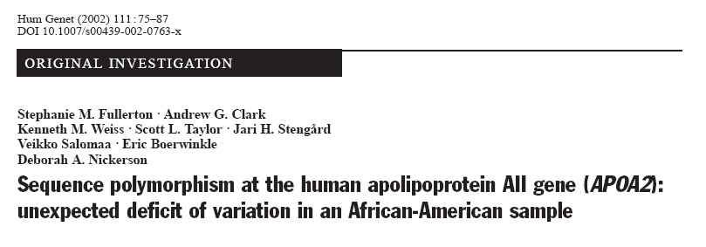
Sequence APOA2 in 72 people
Look at patterns of polymorphisms

Slide 17
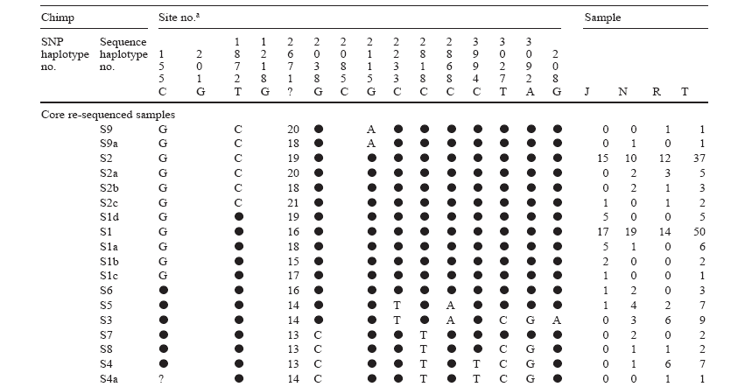
Find polymorphisms at these positions.
Reference sequence is listed.

Slide 18
Sequence of the first chromosome.
Circle is same as reference.

Slide 21
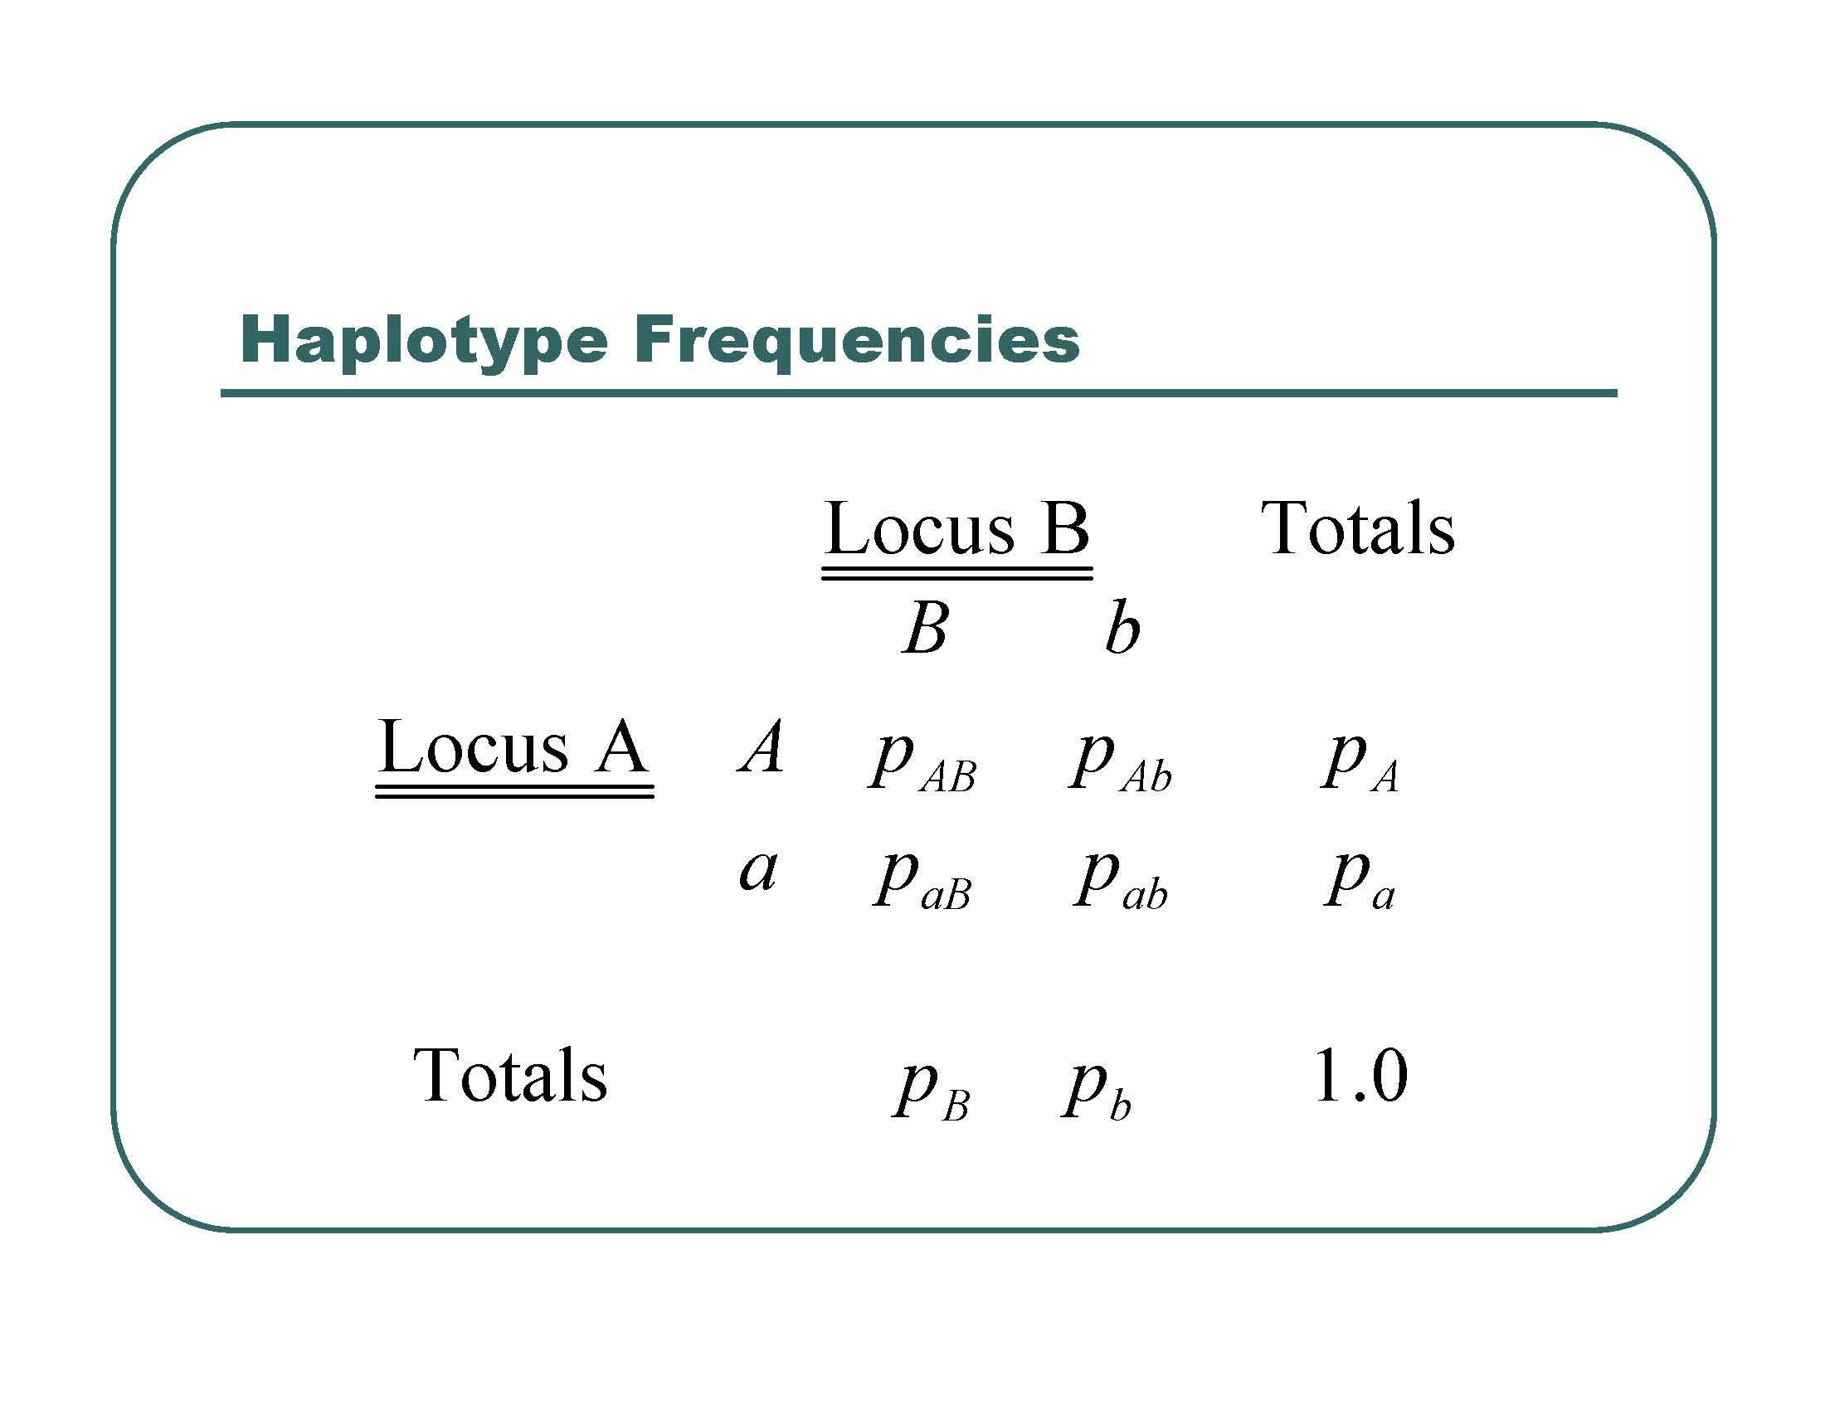

Slide 22
 | 2818 C | 2818 T
3027 T |  |  | .87 T alleles
3027 C |  |  | .13 C alleles
 | .92 C Allele | .08 T allele

Slide 23
Expected haplotype frequencies if unlinked
 | 2818 C | 2818 T
3027 T | .87 x .92 = .80 | .87 x .08 = .07 | .87 T alleles
3027 C | .13 x .92 = .12 | .13 x .08 = .02 | .13 C alleles
 | .92 C Allele | .08 T allele

Slide 24
Expected if unlinked
Observed
 | 2818 C | 2818 T
3027 T | .80 .86 | .07 .01 | .87 T alleles
3027 C | .12 .06 | .02 .07 | .13 C alleles
 | .92 C Allele | .08 T allele

Slide 25
R – correlation coefficient
P_{AB} – P_{A}P_{B}
R =
SQR(P_{A} x P_{a} x P_{B} x P_{b})

Slide 26
Calculate R
R = .86 – (.87)(.92) / SQR (.87 * .13 * .92 * .08)
= .06 / SQR (7.2 x 10⁻³)
= .06 / .085
= .706

Slide 27
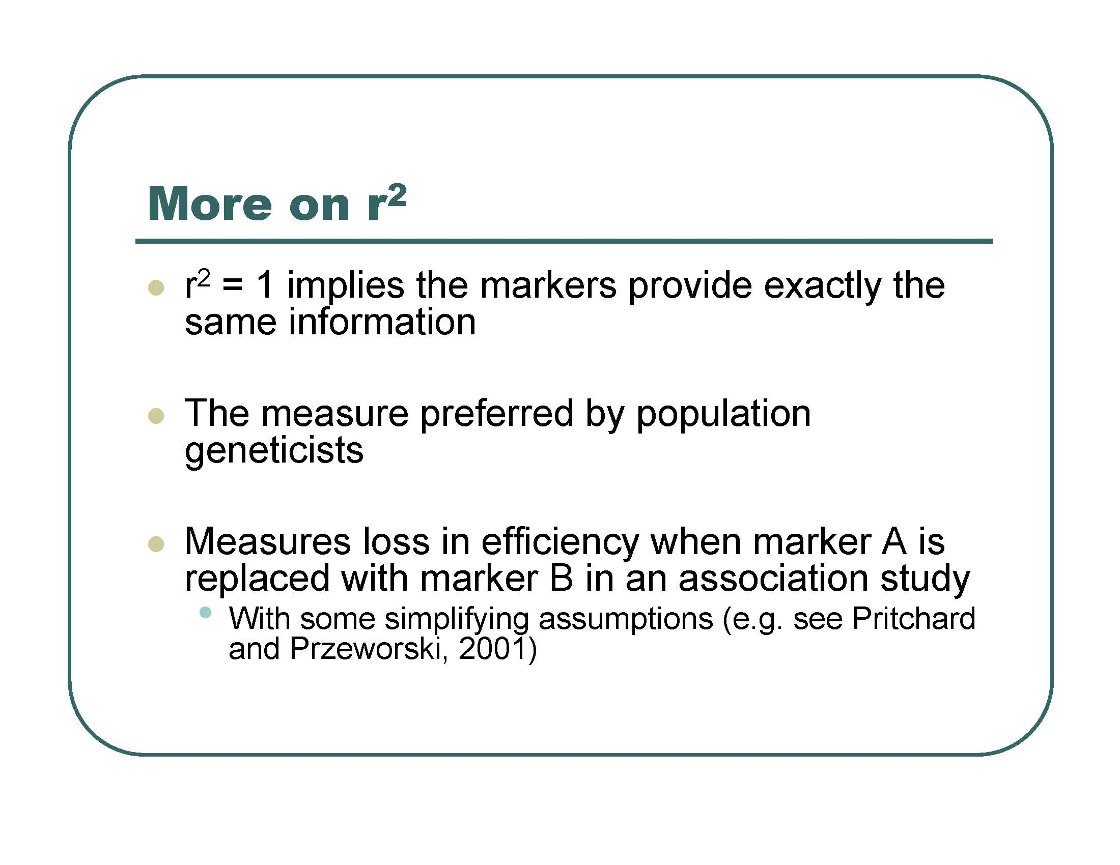

Slide 28
R² = 0.706²
= .497

Slide 29
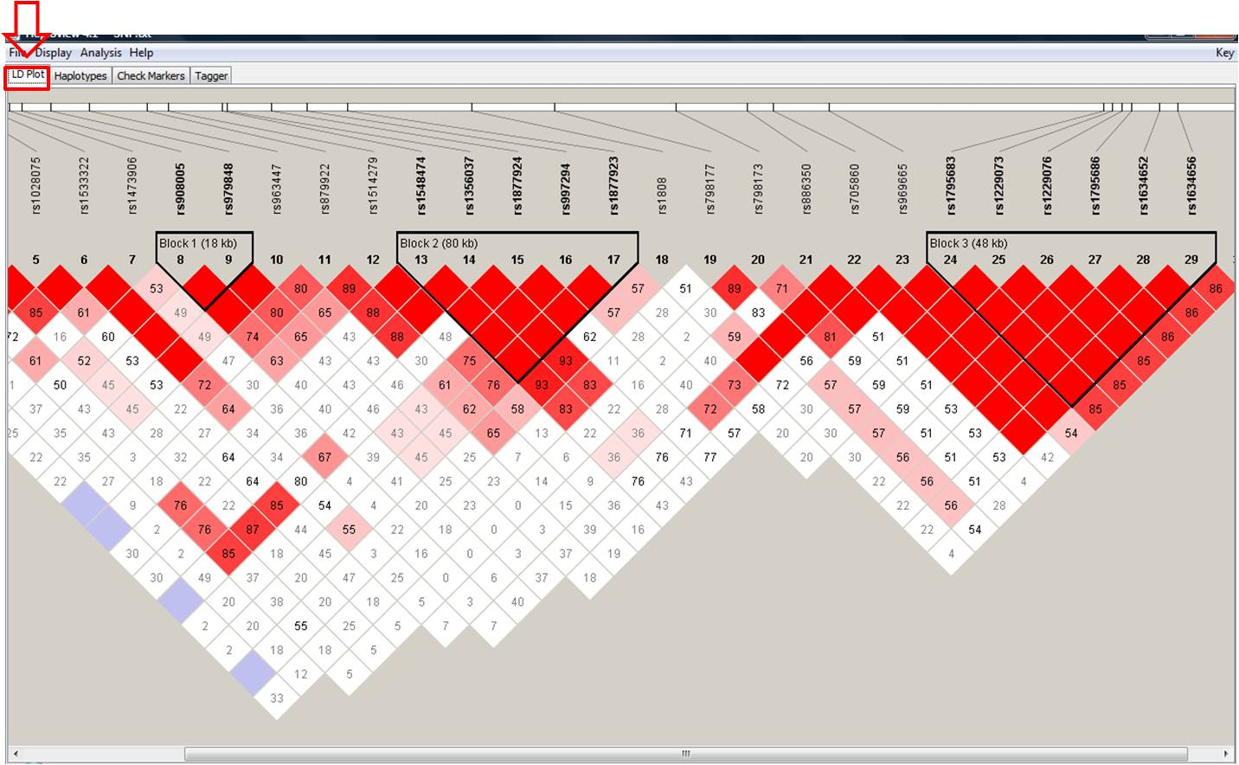
Haplotype blocks

Slide 30
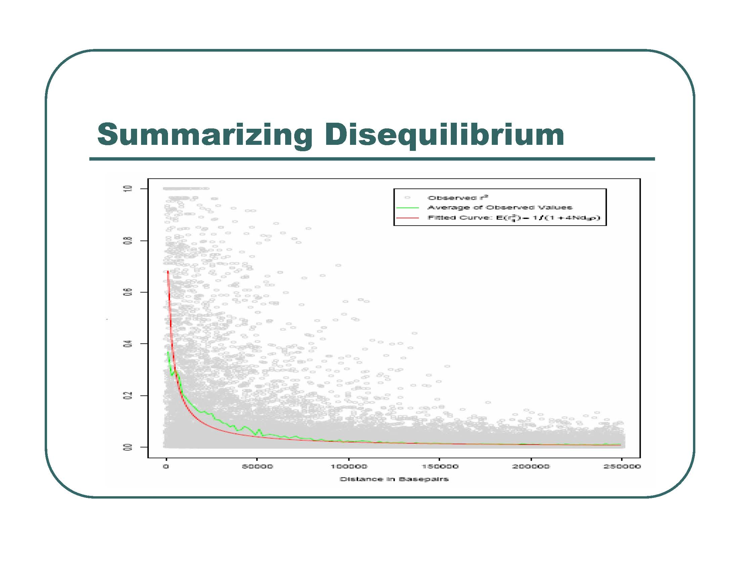

Slide 31
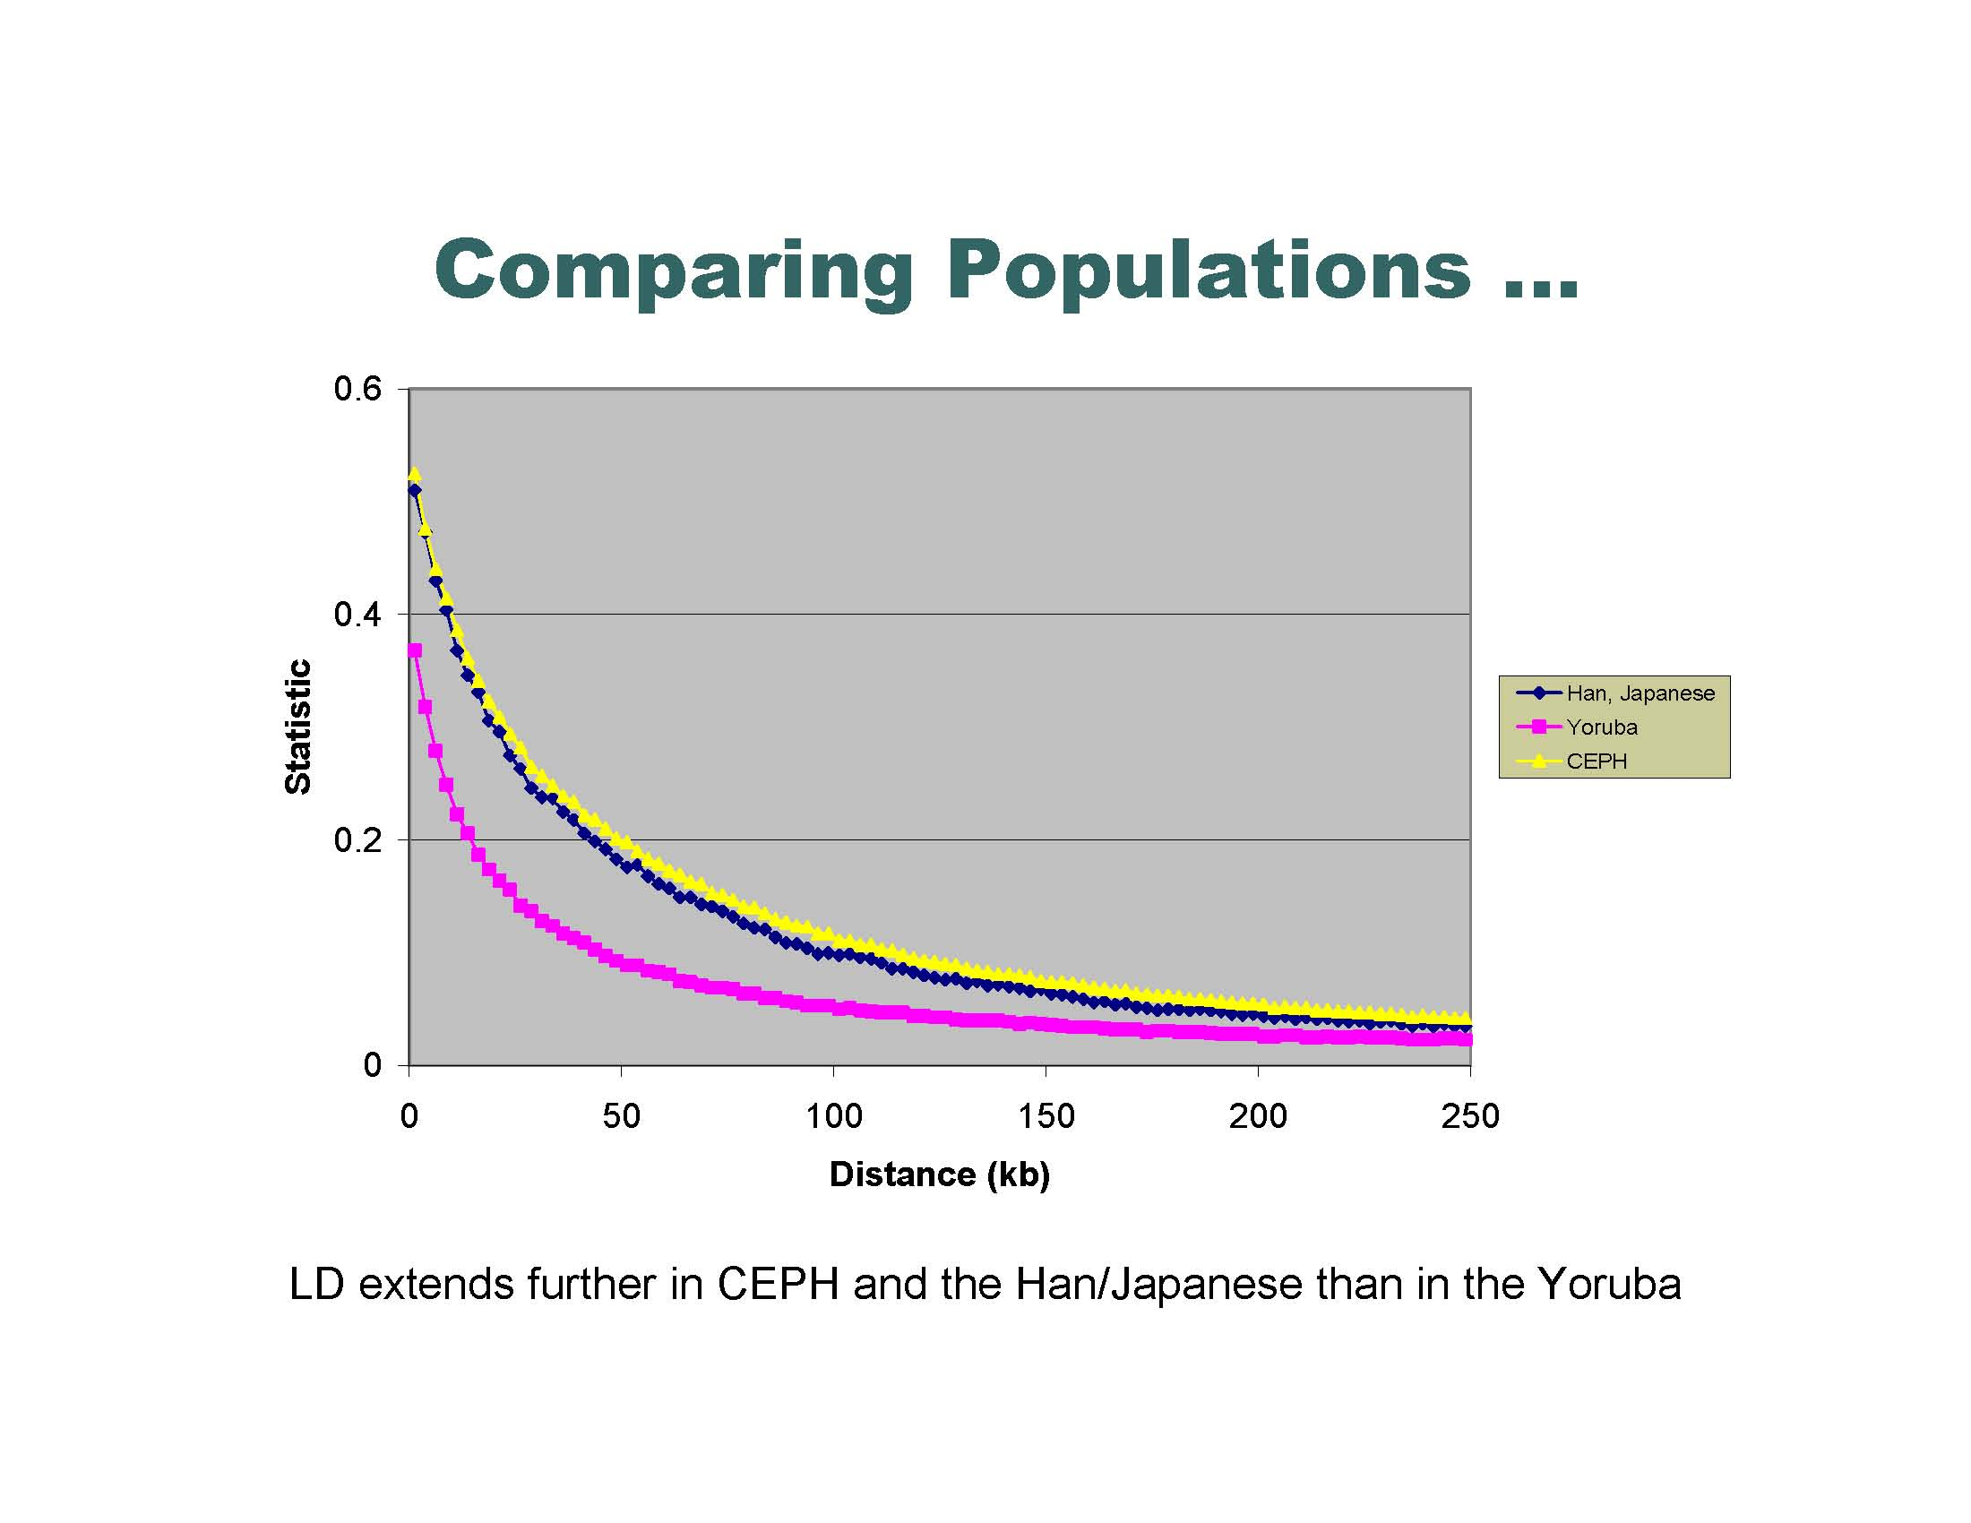

Slide 33
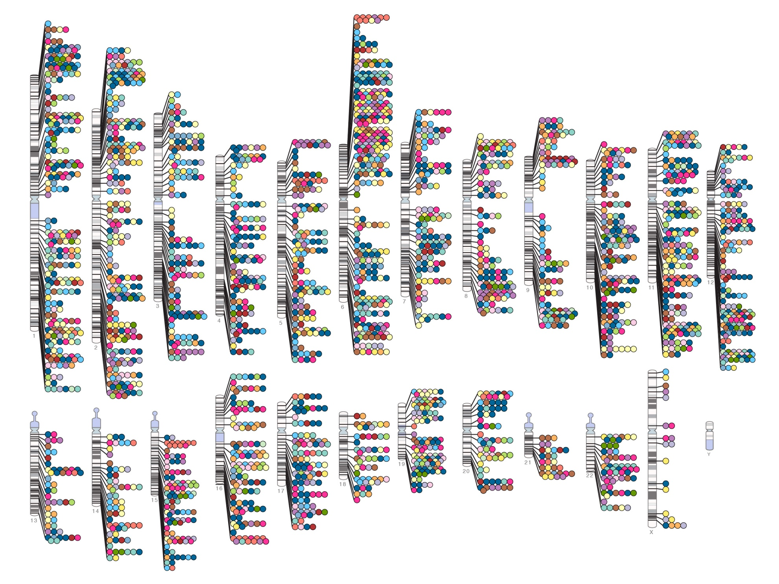
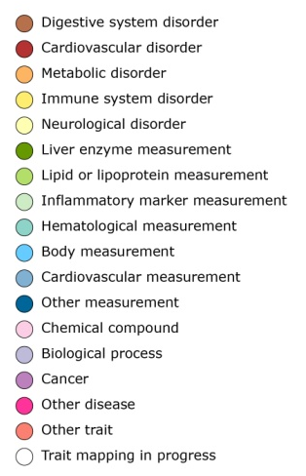

Published Genome-Wide Associations through 07/2012
Published GWA at p≤5X10⁻⁸ for 18 trait categories
NHGRI GWA Catalog
www.genome.gov/GWAStudies
www.ebi.ac.uk/fgpt/gwas/

Slide 34
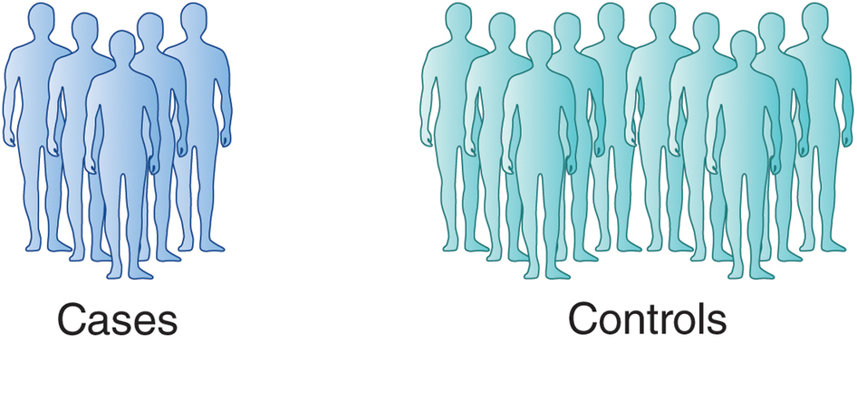
Genome Wide Association Studies
Genotype of SNPxxx
GGGGGGGGGGGGGGGGGGGGGGGGGGGGGGGGGGGGGGGGGGGGGGGGGGGGGGAAAAAAAAAAAAAAAAAAAA
Genotype of SNPxxx
GGGGGGGGGGGGGGGGGGAAAAAAAAAAAAAAAAAAAA
AAAAAAAAAAAAAAAAAAAA
AAAAAAAAAAAAAAAAAAAA
G is risk, A is protective

Slide 35
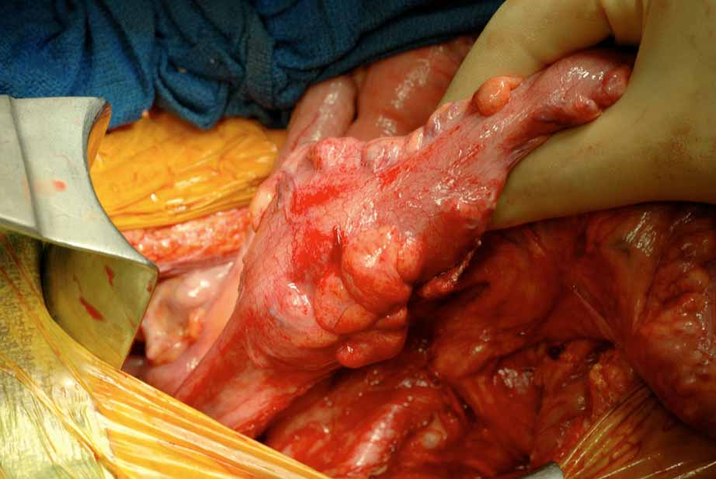
Colorectal cancer
1057 cases
960 controls
550K SNPs

Slide 36
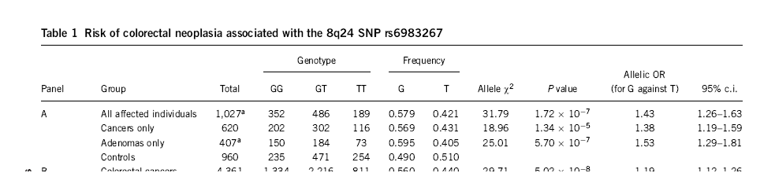
Colorectal cancer
data from rs6983267
Cancer: 0.57G 0.43T
controls: 0.49G 0.51T
1027 Colorectal cancer
960 controls

Slide 37
Cancer: 0.57G 0.43T
Are these different?
controls: 0.49G 0.51T
Chi squared

Slide 38
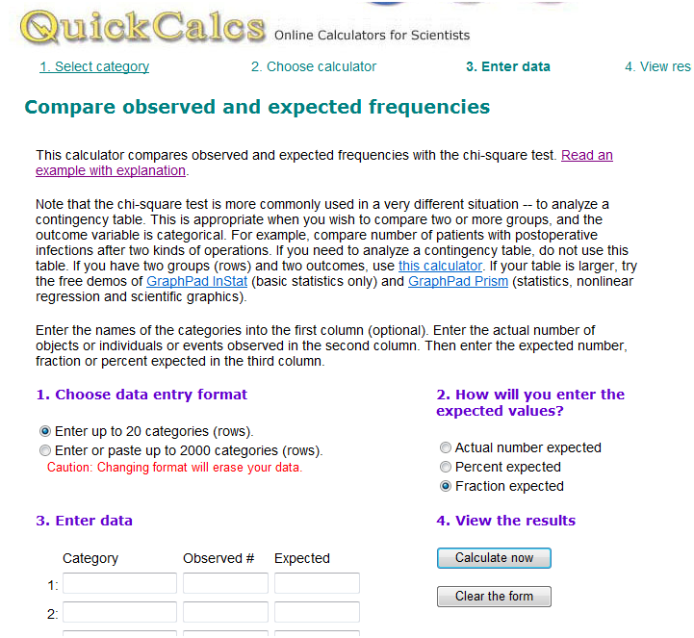
Chi squared http://www.graphpad.com/quickcalcs/chisquared1.cfm

Slide 39
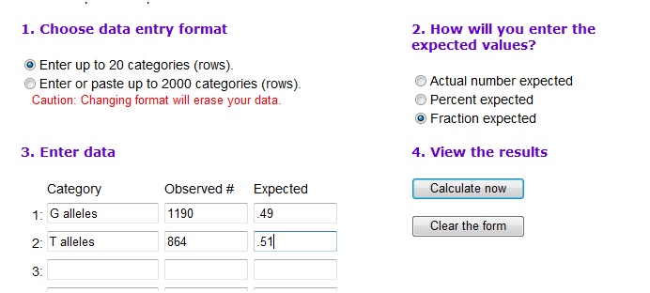
Chi squared
http://www.graphpad.com/quickcalcs/chisquared1.cfm
Chi squared = 31
P values = 10⁻⁷

Slide 40
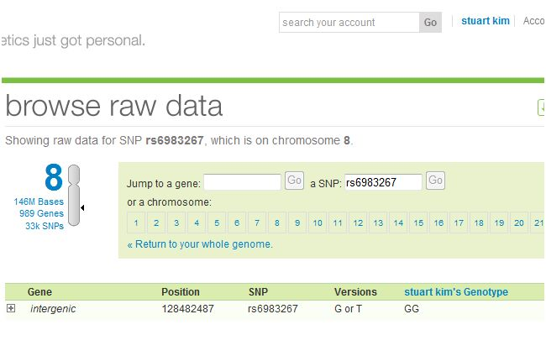
Stuart’s genotype
Homozygous bad allele ☹

Slide 41
Other models
Dominant: Assume G is dominant.
GG or GT vs TT
 | GG or GT | TT
Cases | 838 | 189
Controls | 706 | 254

Slide 42
Other models
Recessive: Assume G is recessive.
GG vs GT or TT
 | GG | GT or TT
Cases | 352 | 675
Controls | 235 | 725

Slide 43
Other models
additive: GG > GT > TT
Do linear regression 3 genotype x 2 groups

Slide 44
% cancer
TT
GT
GG
%cancer = β (genotype) + ε

Slide 45
Allelic odds ratio: ratio of the allele ratios in the cases divided by the allele ratios in the controls
How different is this SNP in the cases versus the controls?
Cancer .57 G/.43 T = 1.32
Control .49 G/ .51T = 0.96
Allelic Odds Ratio = 1.32/0.96 = 1.37

Slide 46
Allelic odds ratio*: ratio of the allele ratios in the cases divided by the allele ratio in the entire population
(need allele ratio from entire population to do this)
How different is this SNP in the cases versus everyone?

Slide 47
Likelihood ratio: What is the likelihood of seeing a genotype given the disease compared to the likelihood of seeing the genotype given no disease?
(need data from entire population to do this. We can do this in the class GWAS. For cancer vs controls, the two groups were separate and so we do not know the genotype frequencies of the population as a whole. )
Notes:
For GG genotype: 352/

Slide 48
Increased Risk: What is the likelihood of seeing a trait given a genotype compared to overall likelihood of seeing the trait in the population?
(need data from entire population to do this. We can do this in the class GWAS. For cancer vs controls, the two groups were separate and so we do not know the genotype frequencies of the population as a whole. )
Notes:
For GG genotype: 352/

Slide 49
Multiple hypothesis testing
“Of the 547,647 polymorphic tag SNPs, 27,673 showed an association with disease at P < .05.”
P = .05 means that there is a 5% chance for this to occur randomly.
If you try 100 times, you will get about 5 hits.
If you try 547,647 times, you should expect 547,647 x .05 = 27,382 hits.
So 27,673 (observed) is about the same as one would randomly expect.

Slide 50
Multiple hypothesis testing
“Of the 547,647 polymorphic tag SNPs, 27,673 showed an association with disease at P < .05.”
Here, have 547,647 SNPs = # hypotheses
False discover rate = q = p x # hypotheses. This is called the Bonferroni correction.
Want q = .05. This means a positive SNP has a .05 likelihood of rising by chance.
At q = .05, p = .05 / 547,647 = .91 x 10⁻⁷
This is the p value cutoff used in the paper.

Slide 51
Multiple hypothesis testing
“Of the 547,647 polymorphic tag SNPs, 27,673 showed an association with disease at P < .05.”
The Bonferroni correction is too conservative. It assumes that all of the tests are independent.
But the SNPs are linked in haplotype blocks, so there really are less independent hypotheses than SNPs.
Another way to correct is to permute the data many times, and see how many times a SNP comes up in the permuted data at a particular threshold.

Slide 52
SNPedia
The SNPedia website
  http://www.snpedia.com/index.php/SNPedia
A thank you from SNPedia
  http://snpedia.blogspot.com/2012/12/o-come-all-ye-faithful.html
Class website for SNPedia
  http://stanford.edu/class/gene210/web/html/projects.html
List of last years write-ups
  http://stanford.edu/class/gene210/archive/2012/projects_2012.html
How to write up a SNPedia entry
  http://stanford.edu/class/gene210/web/html/snpedia.html

Slide 53
SNPedia
Summarize the trait
Summarize the study
  How large was the cohort?
  How strong was the p-value?
  What was the OR, likelihood ratio or increased risk?
Which population?
What is known about the SNP?
  Associated genes?
  Protein coding?
  Allele frequency?
Does knowledge of the SNP affect diagnosis or treatment?

Slide 54
Class GWAS
Go to genotation.stanford.edu
Go to “traits”, then “GWAS”
Look up your SNPs
Fill out the table
Submit information

