Slide 1
Gene 210
Genetics of
Neurodevelopmental and Neurospychiatric disorders
April 15, 2014

Slide 2
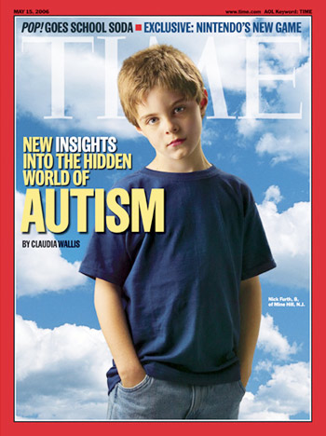
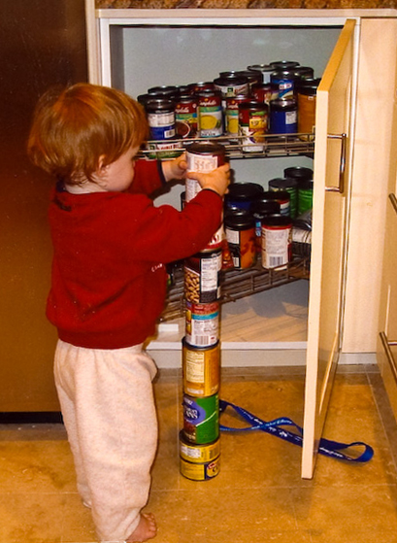
Autism Spectrum Disorders

Slide 3
Autism Spectrum Disorders
Autism: impairments in social interactions, communication, and imaginative play prior to age 3 years. Stereotyped behaviors, interests, and activities.
Asperger's Syndrome: impairments in social interactions and the presence of restricted interests and activities, with no clinically significant delay in language, and testing in the range of average to above average intelligence.
Pervasive Developmental Disorder - Not Otherwise Specified (PDD-NOS): child does not meet the criteria for a specific diagnosis, but there are severe and pervasive impairment in specified behaviors.
Rett Syndrome: a syndrome which occurs primarily in females and rarely in males. Period of normal development and then loss of previously acquired skills, loss of purposeful use of the hands replaced with repetitive hand movements beginning at the age of 1 to 4 years.
Childhood Disintegrative Disorder: characterized by normal development for at least the first two years, significant loss of previously acquired skills.

Slide 4
Autism is highly heritable
Relative risk of a child being diagnosed with autism is increased at least 25-fold over the population prevalence in families in which a sibling is affected.
Siblings and parents of an affected child are more likely than controls to show subtle cognitive or behavioral features that are qualitatively similar to those observed in probands.
Twin studies indicate that concordance rates for monozygotic twins (70–90%) are several-fold higher than the corresponding values for dizygotic twins (0–10%)
Abrahams and Geschwind, 2008

Slide 5
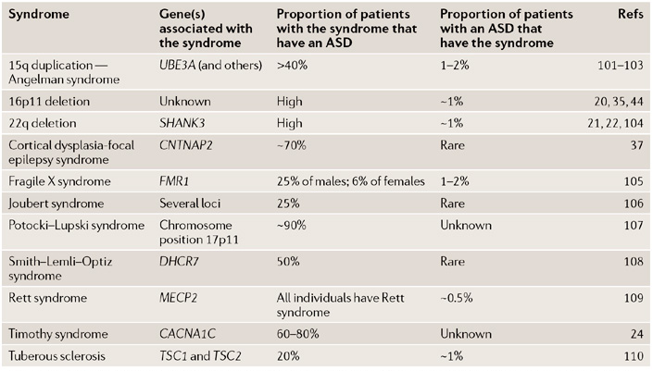
ASD-related syndromes
Biological themes: defective synaptic function and abnormal brain connectivity

Slide 6
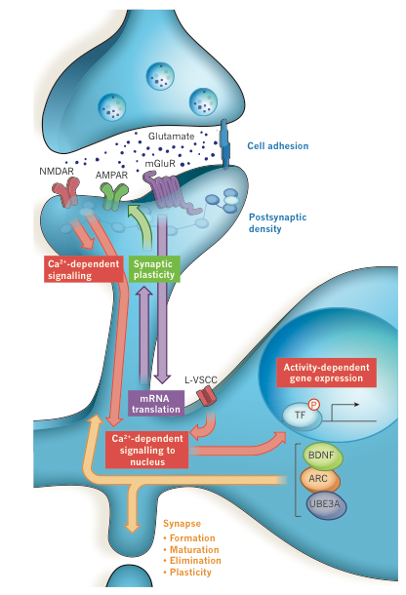
Regulation of synaptic function by neuronal activity
Ebert and Greenberg, 2013

Slide 7
Role of Rare Mutations in ASDs
6-7% of ASDs harbor chromosomal abnormalities (e.g., CNVs)
Inherited duplications of chromosomal region 15q11-15q13 are found in 1-2% of ASDs
  UBE3A and GABRB3 genes located in this region
Other regions implicated: 22q13 (SHANK3), 2q37, 5p15, 17p11, Xp22
Large Copy Number Variations (CNVs): 100kb to MBs
Abrahams and Geschwind, 2008

Slide 8
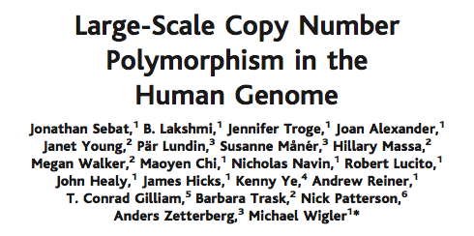
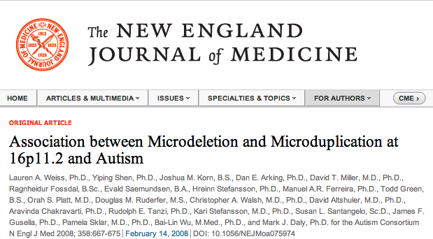
Copy Number Variations
On average, individuals differed by 11 CNVs, and the average length of a CNV interval was 465 kilobases

Slide 9
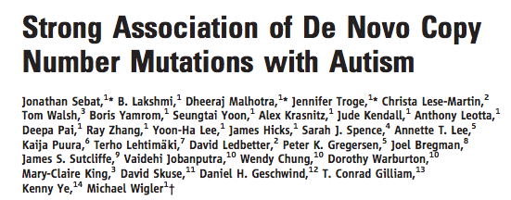
Copy Number Variations
Science, 2007
Confirmed de novo CNVs were significantly associated with autism (P = 0.0005)
CNVs were identified in 12 out of 118 (10%) of patients with sporadic autism vs. 2 out of 196 (1%) of controls and 2 out of 77 (3%) of inherited autism cases.

Slide 10
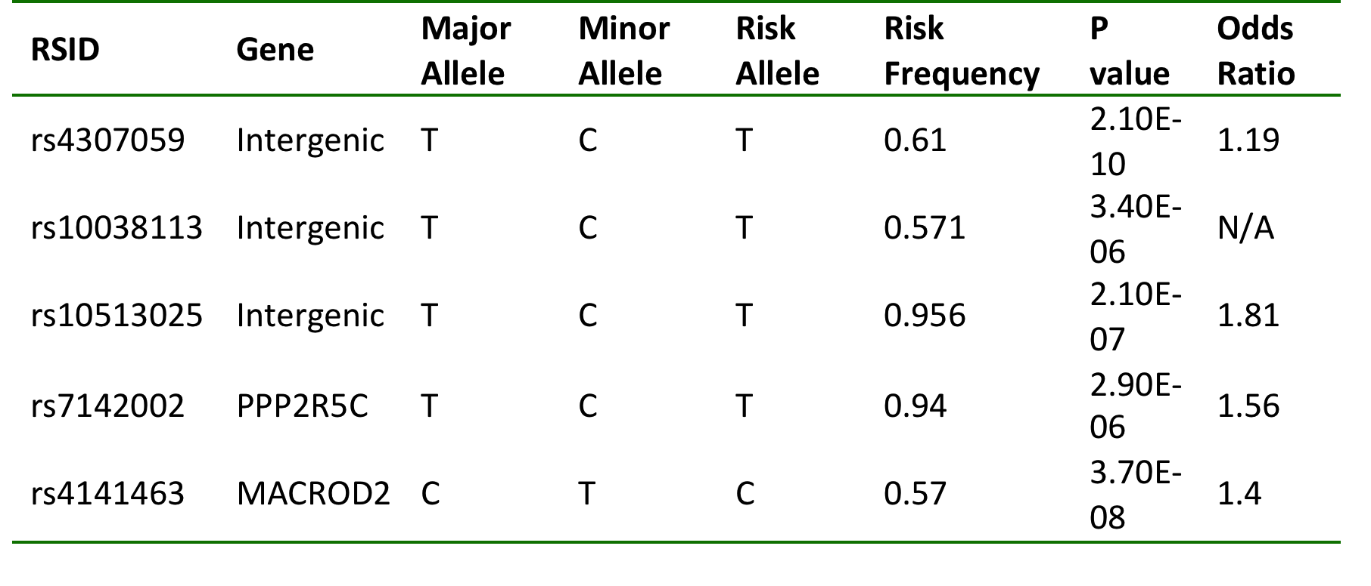
Common variants associated with ASDs
Wang et al., Nature 2009
Ma et al., Ann Hum Genet 2009
Weiss et al., Nature 2009
Anney et al., Hum Mol Genet 2010

Slide 11
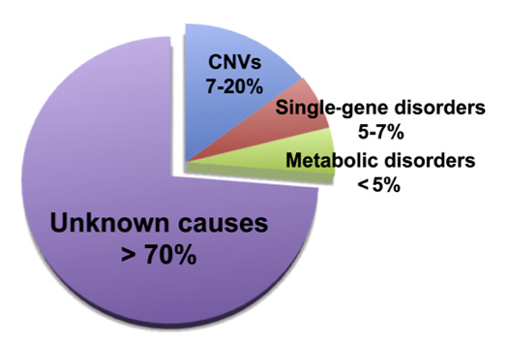
Autism Spectrum Disorders
Highly heritable – twin studies estimate 85-92%
Schaaf and Zoghbi, 2011
The most genetic of all developmental neuropsychiatric syndromes
Risk of 2-8% among siblings (20-80X higher than in general population)

Slide 12
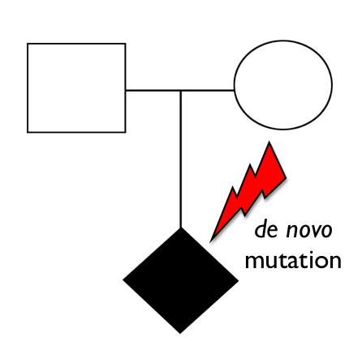
Rare de novo mutations in ASDs

Slide 13
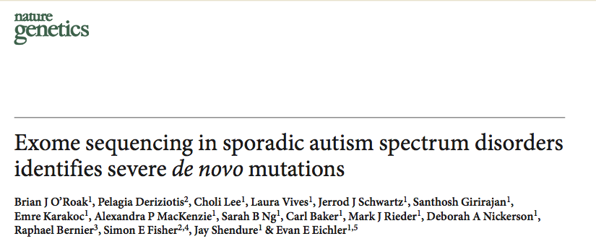
Sequenced 20 autism trios
Identified 21 de novo mutations (11 protein-altering)

Slide 14
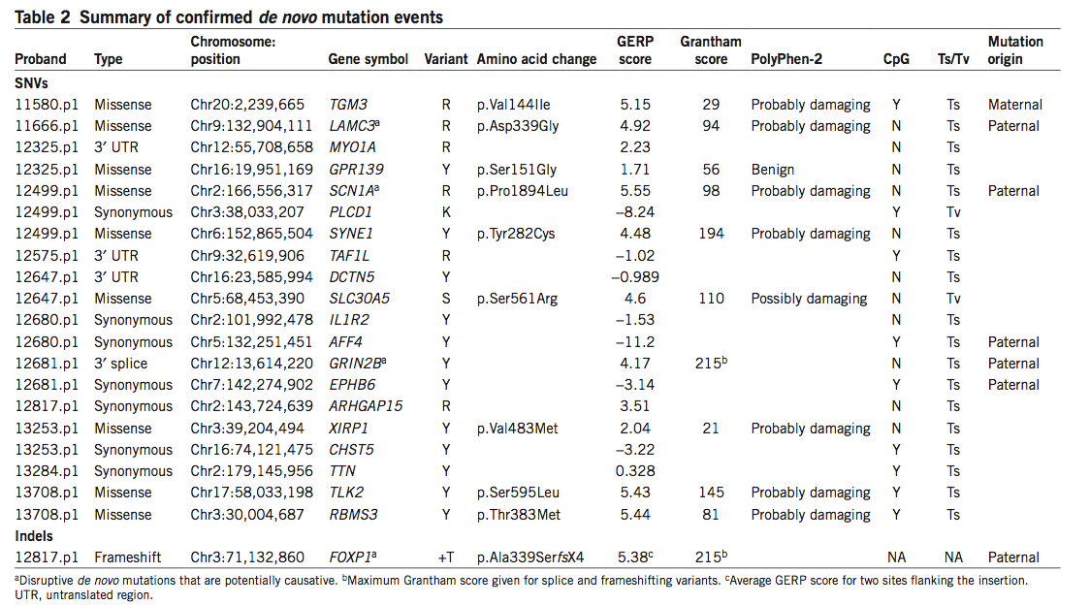

Slide 15
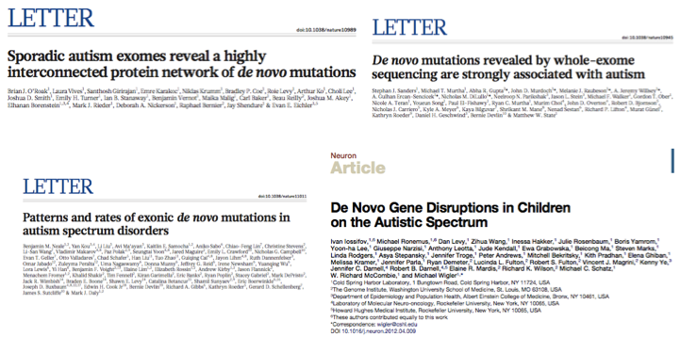
Rare de novo mutations in ASDs

Slide 16
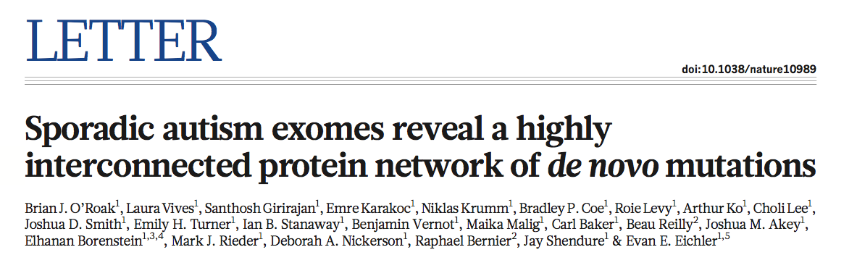
Sequenced exomes of 189 new trios (+ 20 original trios)
Also sequenced exomes of 50 unaffected siblings
Total of 677 exomes from 209 families

Slide 17
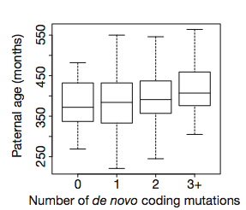
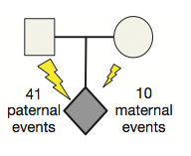
Number of de novo coding mutations increases with paternal age at conception
Paternally inherited de novo mutation bias

Slide 18
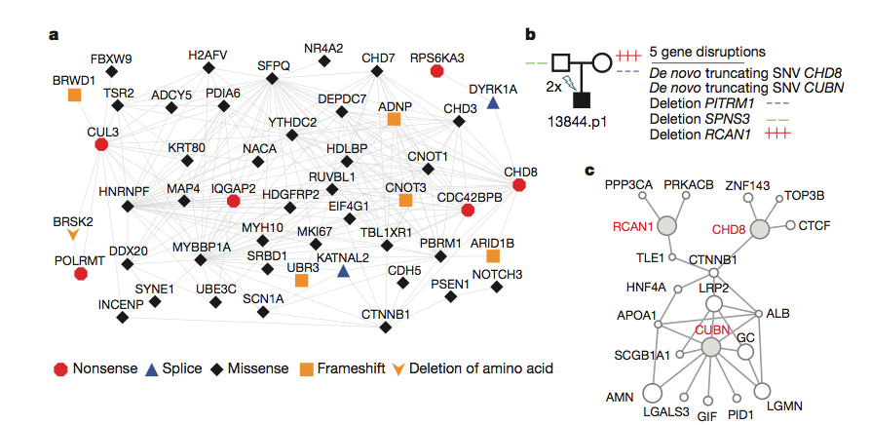
De novo mutations identified in protein-protein interaction networks

Slide 19
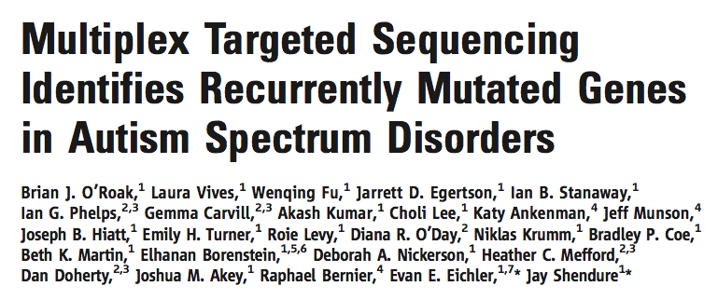
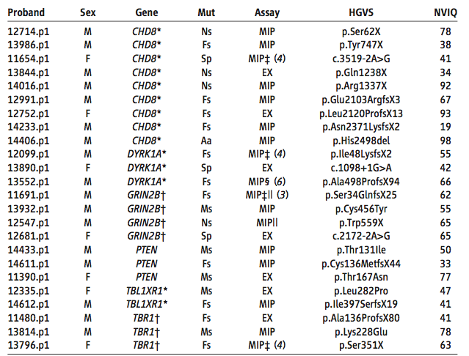
Re-sequenced 44 candidate genes in 2446 ASD probands
Estimate that recurrent disruptive mutations in six genes—CHD8, DYRK1A, GRIN2B, TBR1, PTEN, and TBL1XR1—may contribute to 1% of sporadic ASDs

Slide 20
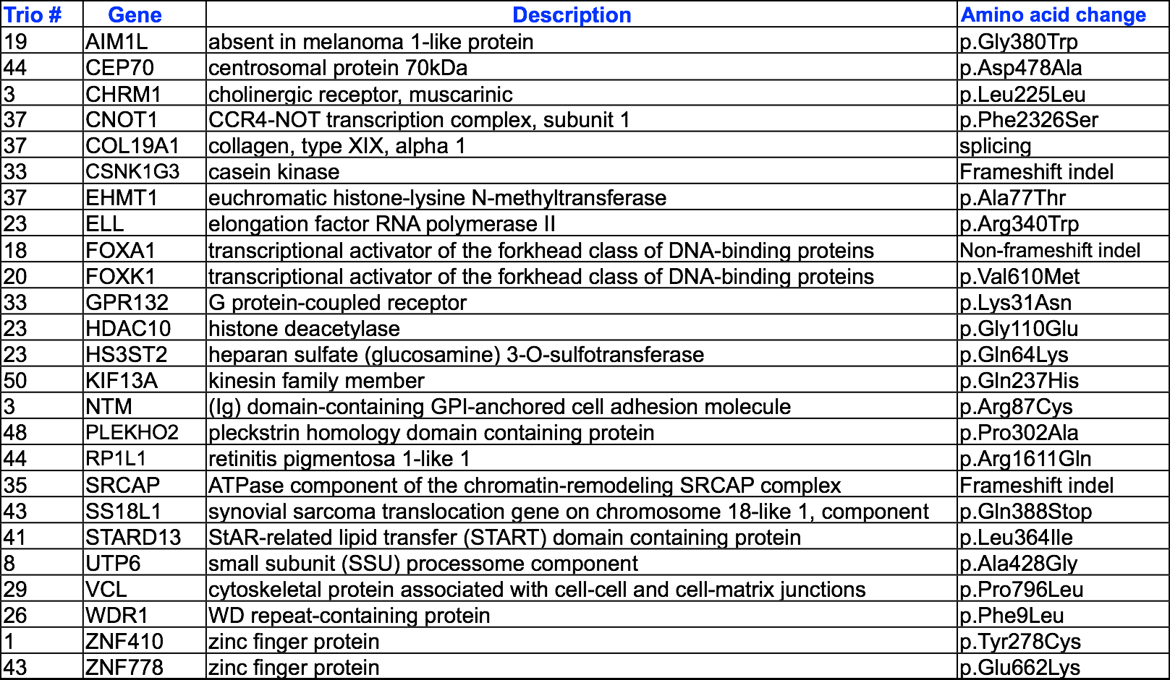
25 de novo variants in ALS trios
Chesi et al., Nat Neurosci 2013

Slide 21

Schizophrenia

Slide 22
Schizophrenia
Schizophrenia is a severe mental disorder
Schizophrenia may result in some combination of hallucinations, delusions, and disordered thinking and behavior
Loss of interest in everyday activities, appearing to lack emotion, reduced ability to plan or carry out activities, neglect of personal hygiene, social withdrawal, loss of motivation
Lifetime risk of ~1%. Heritability ~80%

Slide 23
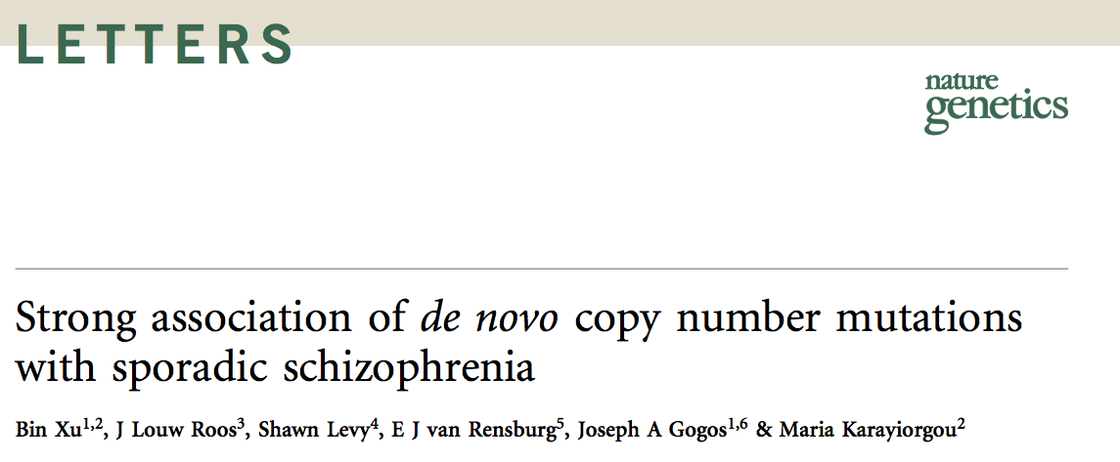
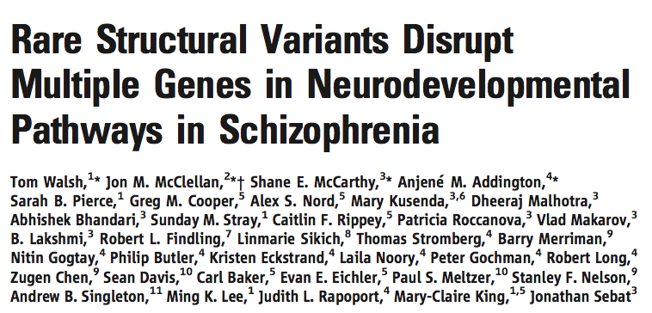
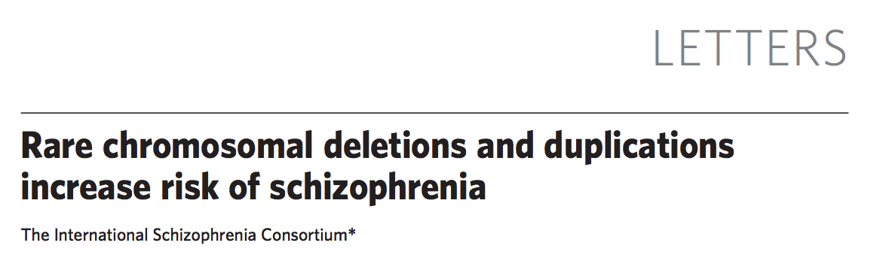
CNVs and schizophrenia

Slide 24
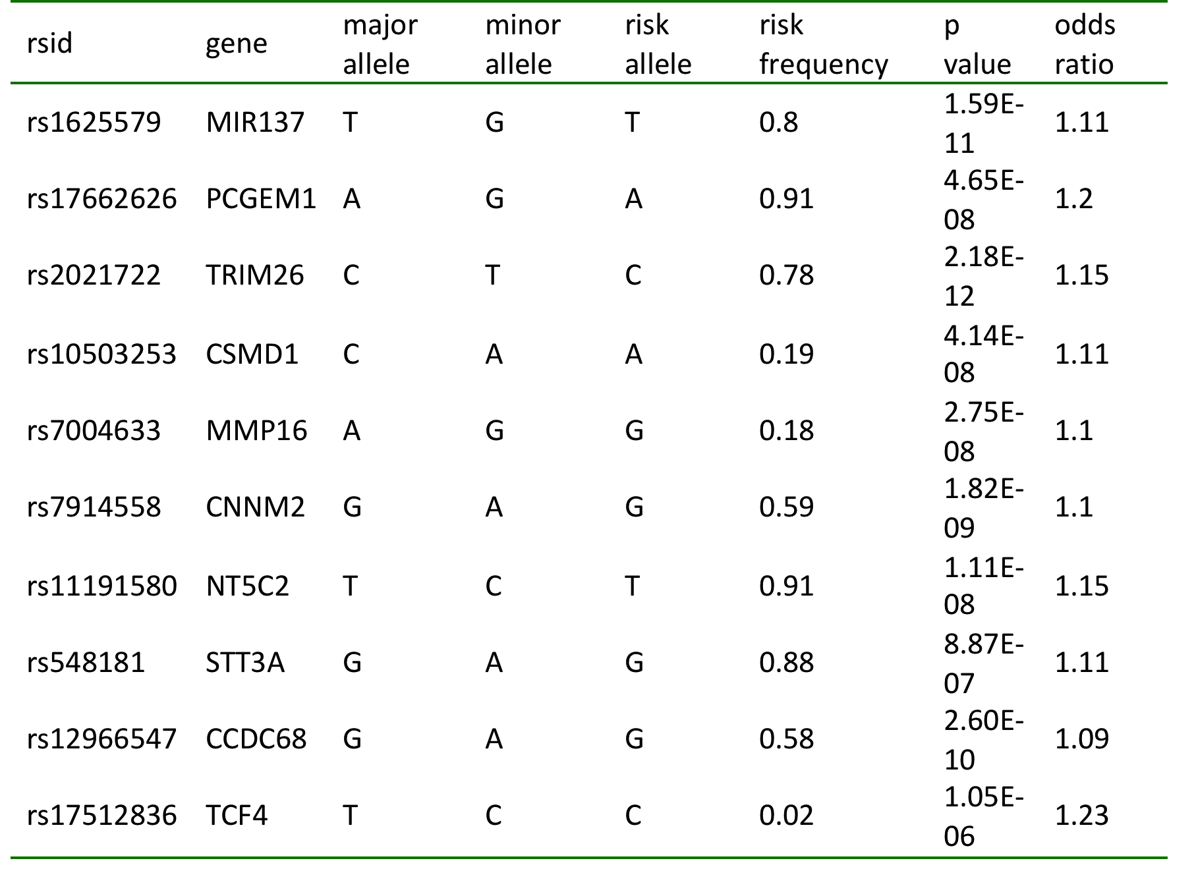
Common variants associated with schizophrenia

Slide 25
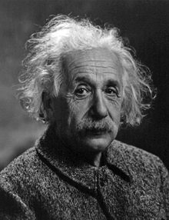
Intelligence

Slide 26
Intelligence
Intelligence in human populations is associated with a wide range of important life outcomes, including educational attainment, income, health and longevity, and intelligence in childhood is a predictor of those outcomes (Deary et al. 2012)
Twin, family and adoption studies have shown that intelligence, as measured by IQ tests, is one of the most heritable behavioral traits (Deary et al. 2009)

Slide 27
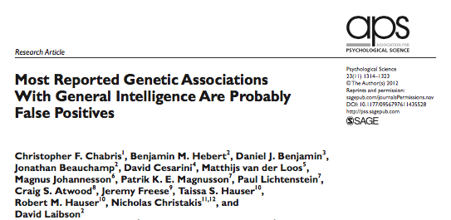
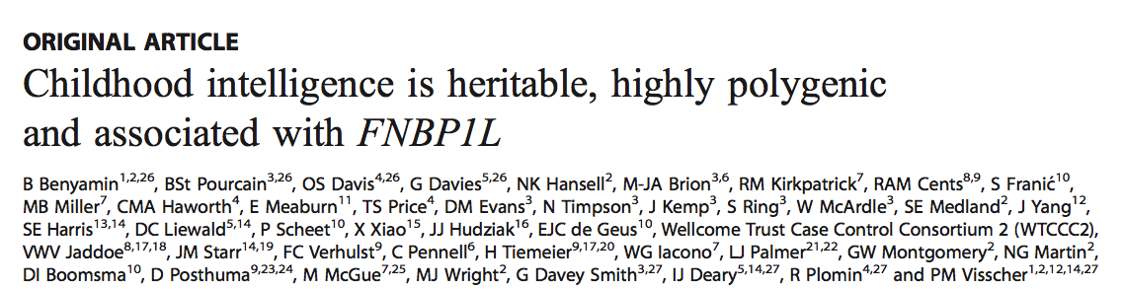

Slide 28
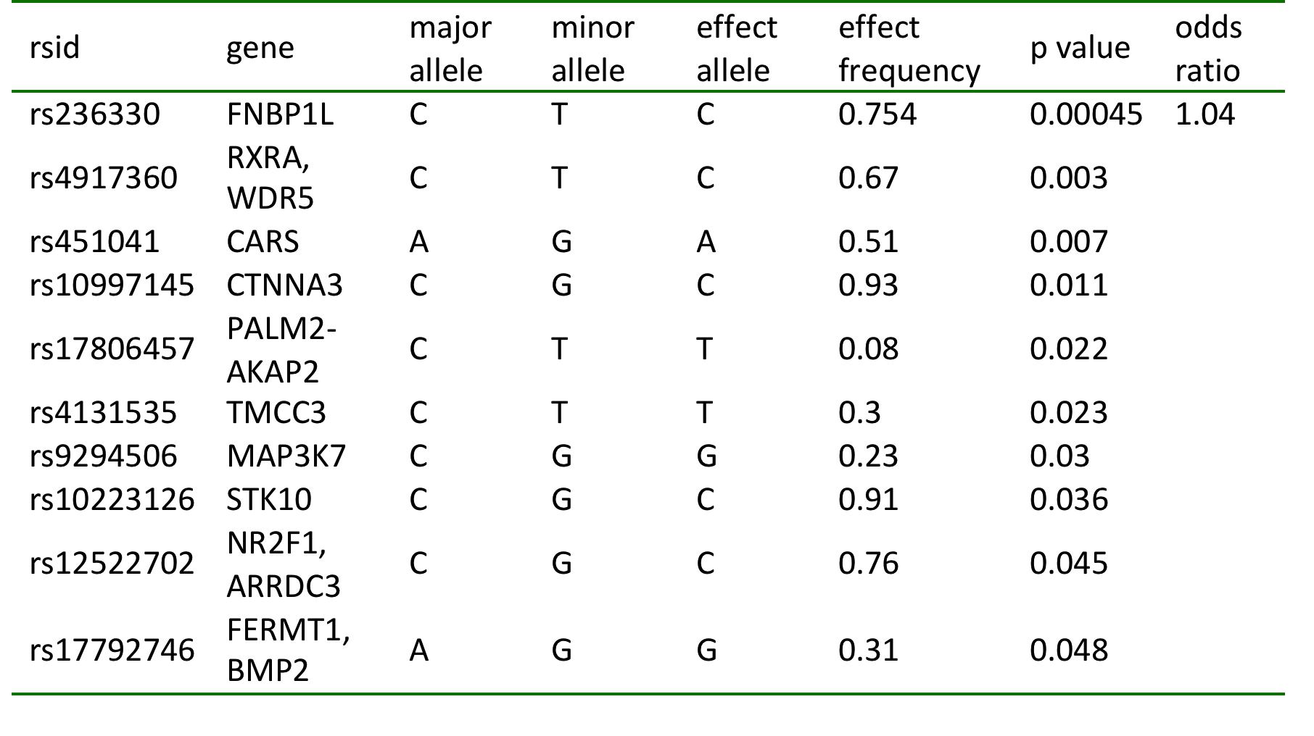
Common variants associated* with intelligence
*No individual SNP has reached genomewide significance

Slide 29
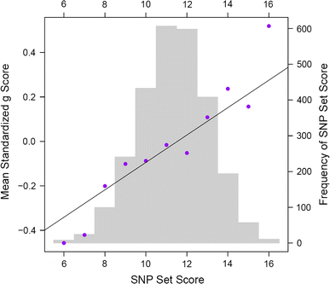
Davis et al., 2012
A SNP set using the 9 SNPs from the third stage of the analysis that were associated with g at the nominal significance level of P < 0.05. This SNP set correlates r = 0.11 with g, accounting for 1.2% of the variance. Or, to put it another way, each additional high-g associated allele increases g by 0.06 standard deviations or 0.92 IQ points.

Slide 30
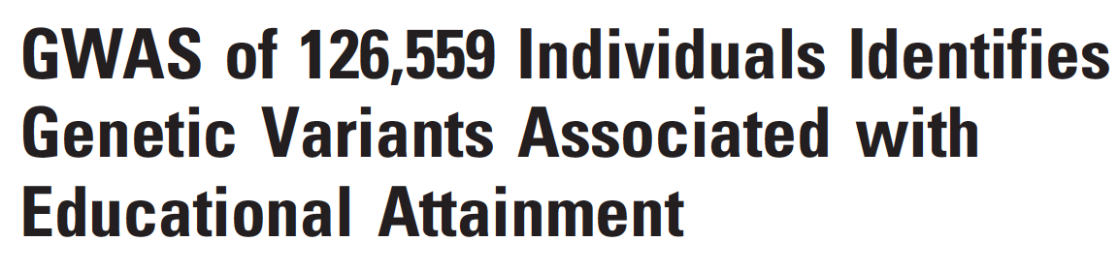
Common variants associated with educational attainment
Science, 2013

Slide 31
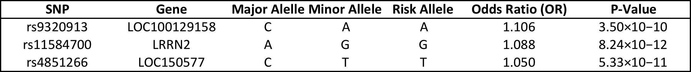
Common variants associated with educational attainment

