Slide 1
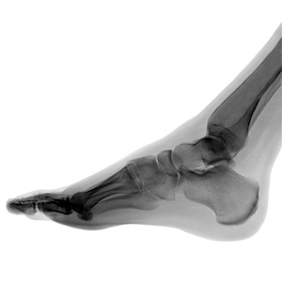
Stress Fracture
A stress fracture is one type of incomplete fracture in bones. It is caused by "unusual or repeated stress" and also heavy continuous weight on the ankle or leg. This is in contrast to other types of fractures, which are usually characterized by a solitary, severe impact.
It could be described as a very small sliver or crack in the bone; this is why it is sometimes dubbed "hairline fracture".

Slide 2

Stress fracture is a common sports injury, and most cases are associated with athletics.

Slide 3
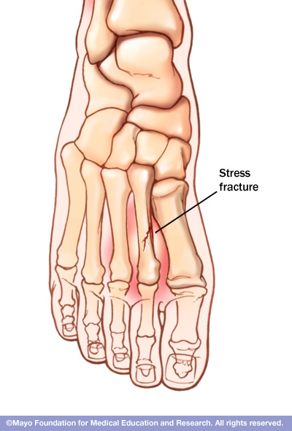
The most common sites of stress fractures are the second and third metatarsals of the foot. Stress fractures are also common in the heel (calcaneus), the outer bone of the lower leg (fibula), and the navicular, a bone on the top of the midfoot.

Slide 4
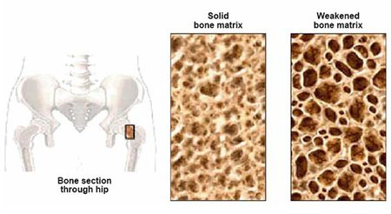
We all lose some bone mass as we age. Bones naturally become thinner (called osteopenia) as you grow older, because existing bone is broken down faster than new bone is made. As this occurs, our bones lose calcium and other minerals and become lighter, less dense, and more porous. This makes the bones weaker and increases the chance that they might break (fracture).

Slide 5
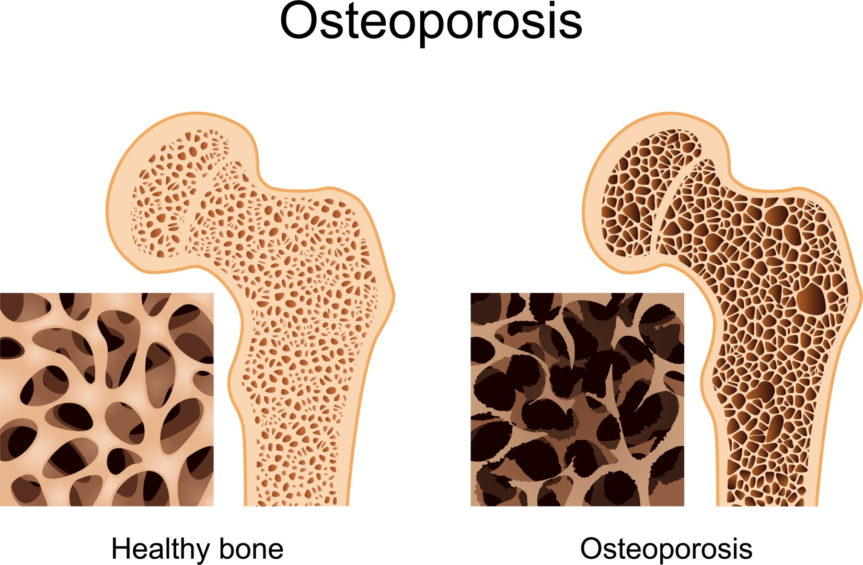
Bone is living tissue, which is constantly being absorbed and replaced. Osteoporosis occurs when the creation of new bone doesn't keep up with the removal of old bone.
White and Asian women — especially those who are past menopause — are at highest risk.

Slide 6
Osteoporosis symptoms
Back pain, caused by a fractured or collapsed vertebra
Loss of height over time
A stooped posture
A bone fracture that occurs much more easily than expected

Slide 7
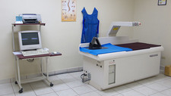
Dxa scan
Dual-energy X-ray absorptiometry (DXA) is a technique used to measure bone mineral density. Two X-ray beams of different energy levels are aimed at a patient’s bones to determine BMD.

Slide 8
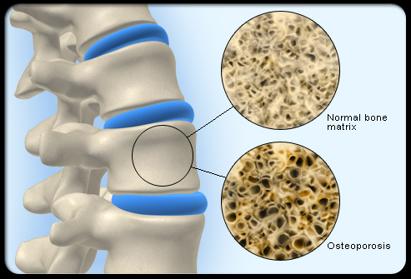
Low bone mass (medically termed osteopenia): A BMD defines osteopenia as a T-score between -1 and -2.5. This signifies an increased fracture risk but does not meet the criteria for osteoporosis.
Osteoporosis: A BMD greater than 2.5 standard deviations from the normal (T score less than or equal to -2.5) defines osteoporosis.

Slide 9
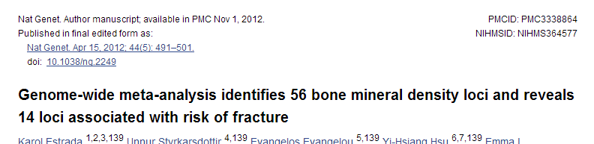
Meta-analysis of 17 GWA studies
Phenotypes
  Femoral neck bone mineral density (cases n=32,961; controls ~100K)
  Lumbar spine bone mineral density (cases n=31,800 ; controls ~100K)
2.5 million SNPs
56 SNPs are genome-wide significant (p < 5 x 10⁻⁸)

Slide 10
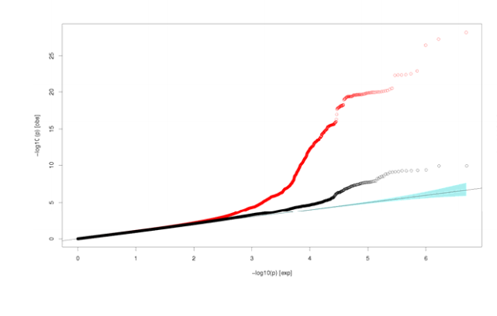
Femoral neck Quantile‐quantile (Q‐Q) plots.
(All analyzed HapMap CEU imputed SNPs passing quality control criteria in the studies (red dots) and after adjustment for 82 SNPs selected for replication(black dots).

Slide 11
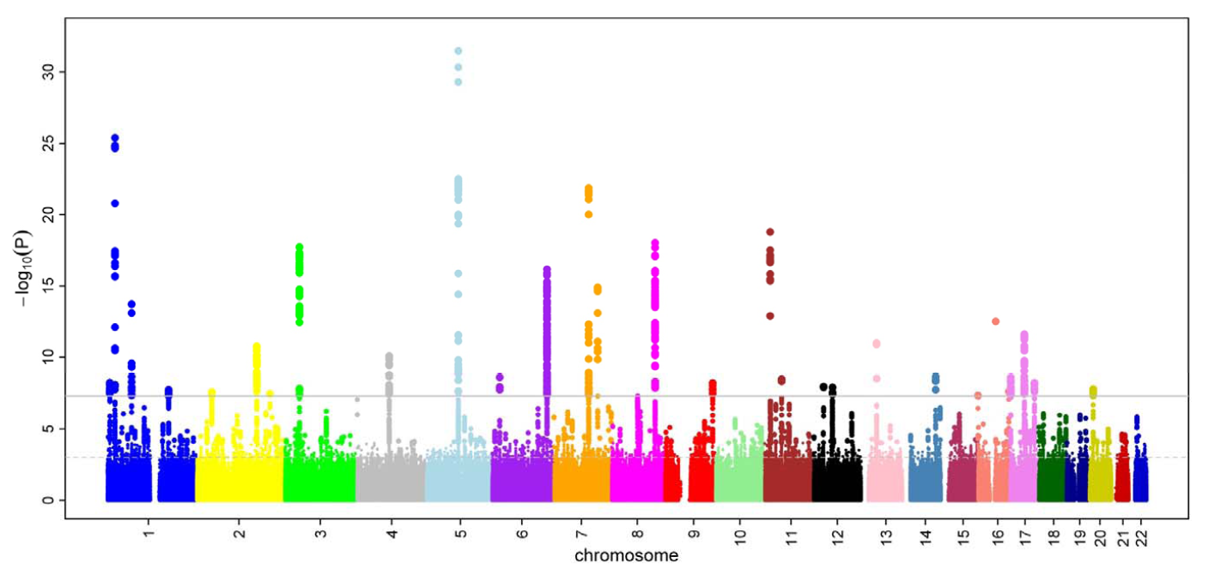
Femoral neck BMD Manhattan plot

Slide 12
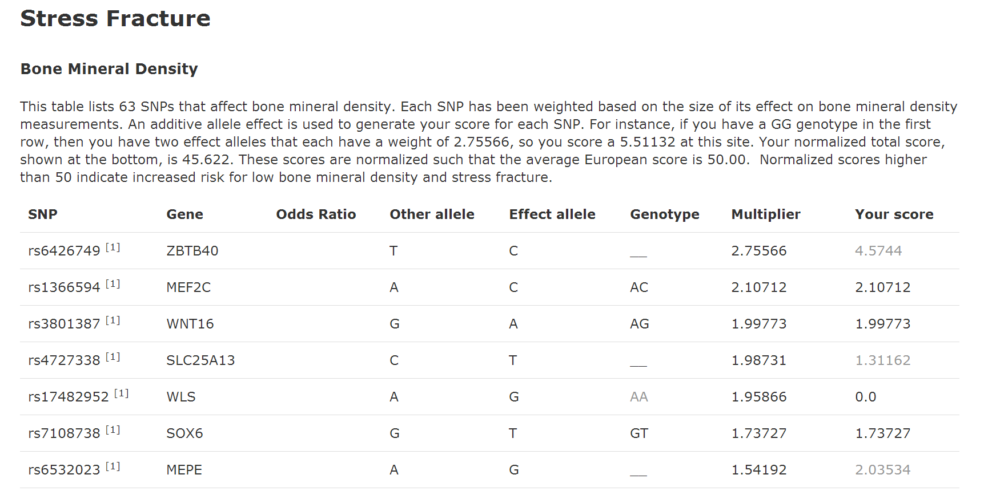

Slide 13
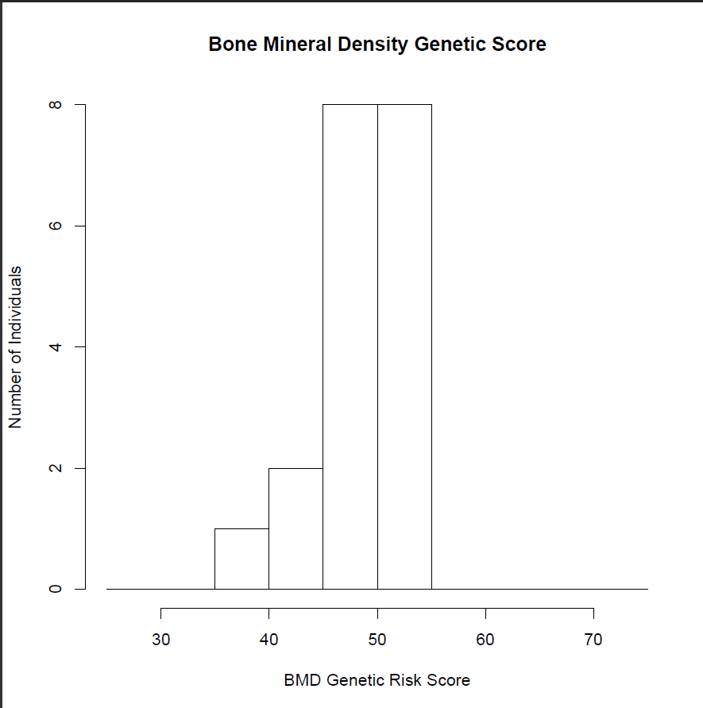
Gene 210 2014

Slide 14
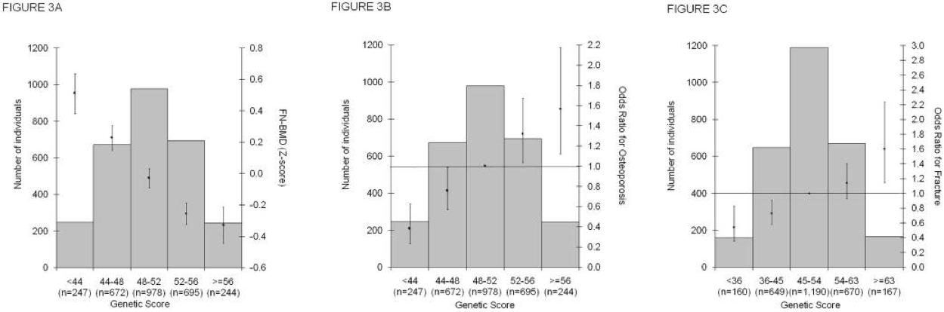

Slide 15
Low BMD/Osteoporosis prevention
Adequate amounts of calcium
Adequate amounts of vitamin D
Regular exercise

Slide 16
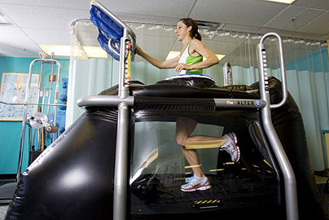
Alter G – reduce stress fracture risk

Slide 17
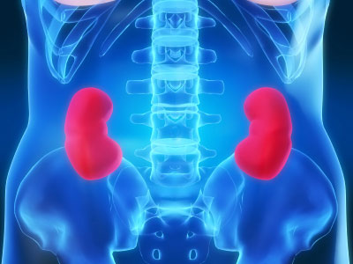
Chronic Kidney Disease
Chronic Kidney Disease is a slow loss of renal function over time. This leads to a decreased ability to remove waste products from the body and perform homeostatic functions.

Slide 18
Epidemiology
CKD affects about 26 million people in the US
Approximately 19 million adults are in the early stages of the disease
  On the rise do to increasing prevalence of diabetes and hypertension
Total cost of ESRD in US was approximately $40 billion in 2008

Slide 19
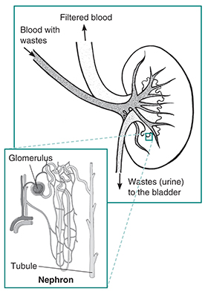

Slide 20
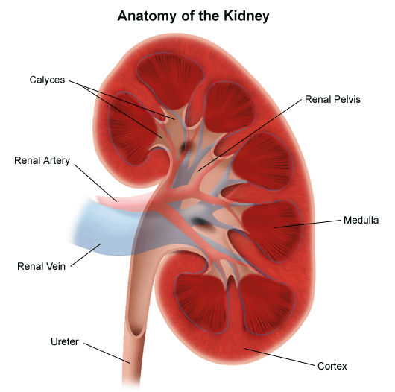
Clinical Definition
Glomerular Filtration Rate of less than 60 ml/minute per 1.73m² per body surface area (normal is 125ml/min) .
Presence of kidney damage, regardless of the cause, for three or more months
Notes:
Things that cause kidney disease:
-Glomerulonephritis, a group of diseases that cause inflammation and damage to the kidney's filtering units. These disorders are the third most common type of kidney disease.
-Inherited diseases, such as polycystic kidney disease, which causes large cysts to form in the kidneys and damage the surrounding tissue.
-Malformations that occur as a baby develops in its mother's womb. For example, a narrowing may occur that prevents normal outflow of urine and causes urine to flow back up to the kidney. This causes infections and may damage the kidneys.
-Lupus and other diseases that affect the body's immune system.
-Obstructions caused by problems like kidney stones, tumors or an enlarged prostate gland in men.
-Repeated urinary infections.

Slide 21
Measuring kidney function eGFR: MDRD calculation
eGFR = 175 x SerumCr^{-1.154} * age^{-0.203} * 1.212 (if patient is black) * 0.742 (if female)
Creatinine is a muscle waste product that is cleared by kidney filtration.
Low kidney function leads to high levels of creatinine.
Amount of muscle influences amount of creatinine made. High levels of muscle gives higher creatinine baseline, independent of kidney function.
Older people produce less creatinine from their muscles.
African Americans produce more creatinine.
Women produce less creatinine
10% error from true GFR

Slide 22
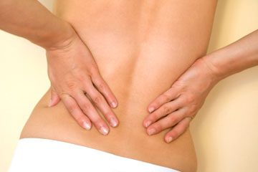
CKD Symptoms
Hematuria
Flank pain
Edema
Hypertension
Signs of uremia
Lethargy and fatigue
Loss of appetite
If asymptomatic may have elevated serum creatinine concentration or an abnormal urinalysis

Slide 23
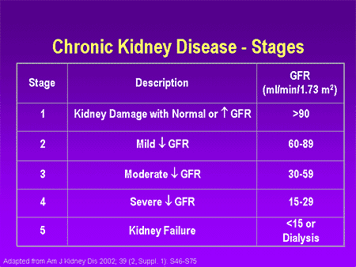

Slide 24
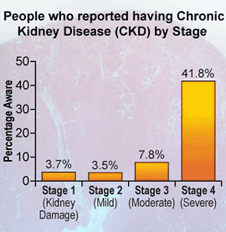
In the early stages of CKD, people do not notice any symptoms. The disease often develops so slowly that many people don't realize they're sick until the disease is advanced. In 2006, CKD was responsible for the death of nearly 45,000 people, ranking as the ninth leading cause of death in the United States.
However, the risk for kidney disease can be reduced by preventing – when possible – diabetes and high blood pressure and managing these conditions when present.

Slide 25
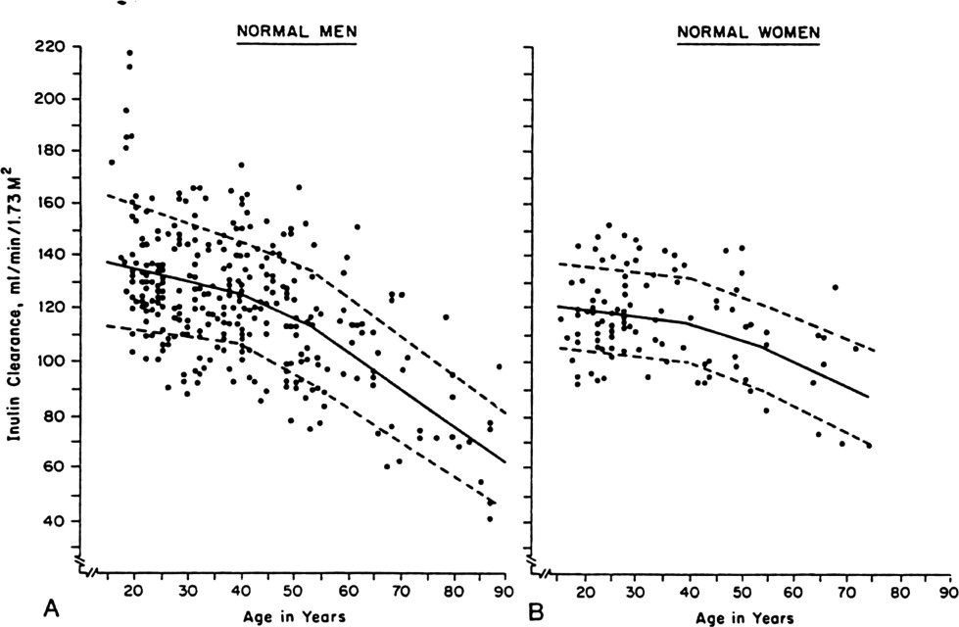
Kidney function declines with age in humans
Glomerular
Filtration
Rate
Poor kidney function is a risk factor for death from major age-related diseases:
-Chronic kidney disease
-Cardiovascular disease
-Stroke
-Type 2 Diabetes
Levey et al. 2009; Fan et al. 2011
Notes:
I work specifically on kidney aging so I’d like to highlight two important reasons why kidneys are a particularly important organ for aging. The first reason is that kidneys show a quantifiable decline in a key biomarker of function with age as shown on these scatter-plots showing that glomerular filtration rate (a biomarker of how well kidneys filter the blood) declines steadily with age.
The second important point is that poor kidney function is a major risk factor for leading causes of age-related death in humans- most notably chronic kidney disease as well as cardiovascular disease, stroke and type 2 diabetes which are collectively among the leading causes of death in the U.S.

Slide 26
Risk Factors
Age of more than 60 years
Hypertension and Diabetes
  Responsible for 2/3 of cases
Cardiovascular disease
Family history of the disease.
Race and ethnicity
    Highest incidence is for African Americans
    Hispanics have higher incidence rates of ESRD than non-Hispanics.
Notes:
_followed by American Indians and Alaska Natives, then Asian Americans and native Hawaiians and other Pacific Islanders, and finally Caucasians.

Slide 27
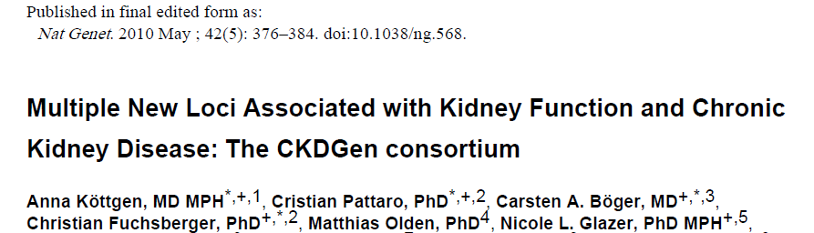
Meta-analysis of genome-wide association data from 20 Studies
67,093 Caucasian individuals
Serum creatinine (eGFRcrea), cystatin C (eGFRcys), and CKD (eGFRcrea <60 ml/min/1.73m²; n = 5,807 CKD cases).
20 new loci

Slide 28
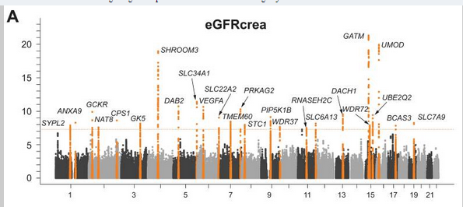

Slide 29
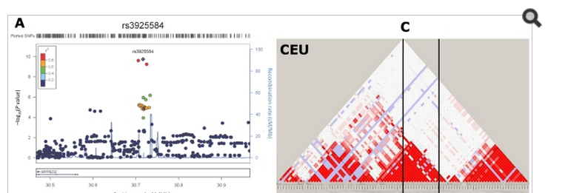

Slide 30
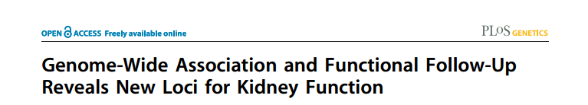
Meta-analysis of genome-wide association data from 20 Studies
130K Caucasian individuals
Serum creatinine (eGFRcrea)
6 new loci for CEU
4/6 validate in African Americans

Slide 31
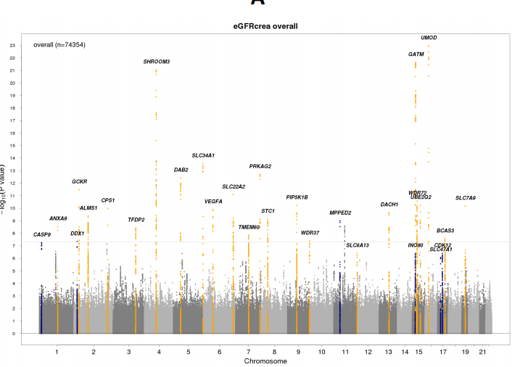

Slide 32
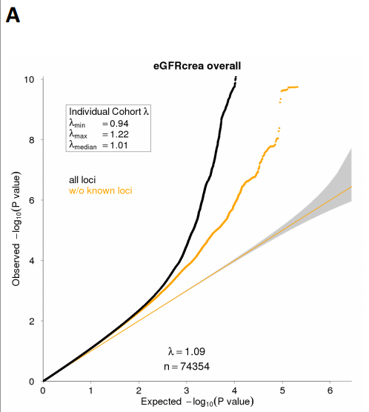

Slide 33
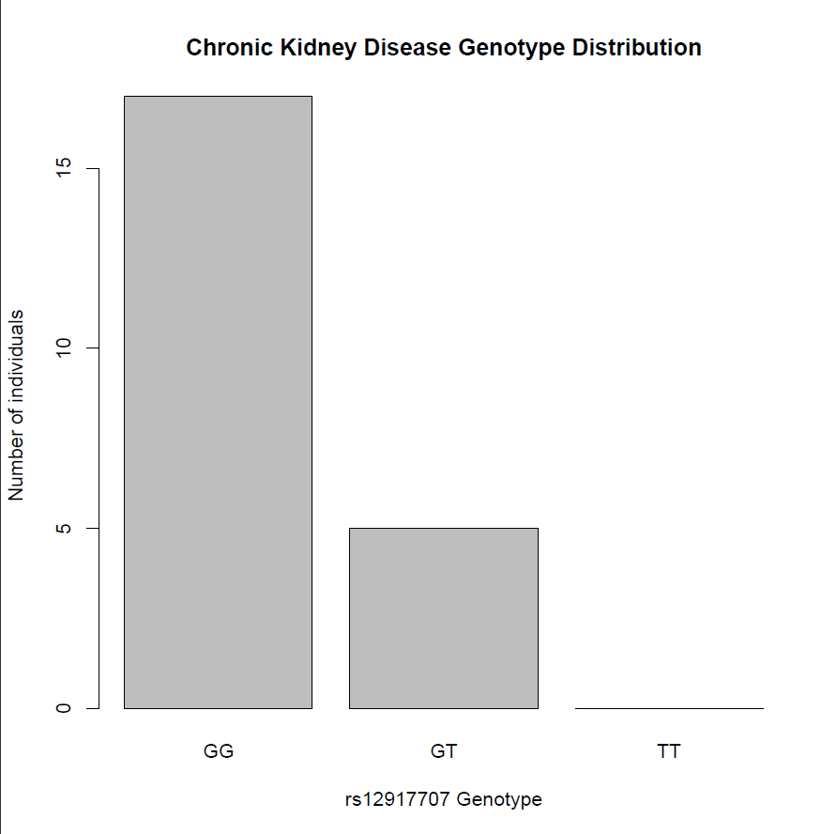
CKD: rs12917707

Slide 34
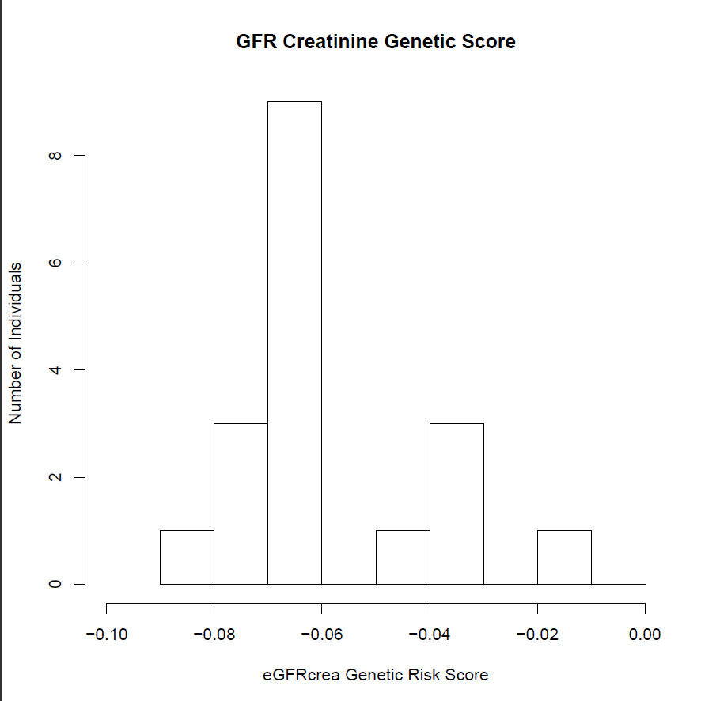
Estimated GFR creatinine

Slide 35
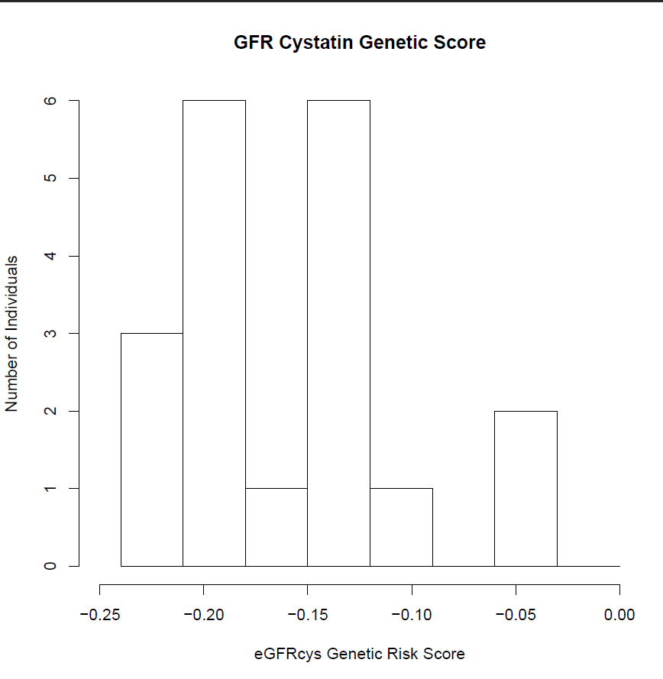
Estimated GFR cystatin C

