Slide 1
23andMe and FDA
A Legal Perspective

Slide 2
Outline
FDA Background - Zach
About 23andme - Laura
FDA letter and arguments - Zach
23andme potential defenses - Laura
Questions, comments, poll

Slide 3
About the FDA

Slide 4
FDA: Background
Food and Drug Administration is agency of the Department of Health and Human Services
Responsible for protecting public health through regulation and supervision of food safety, tobacco products, dietary supplements, prescription and OTC pharmaceutical drugs, vaccinations, biopharmaceuticals, blood transfusions, medical devices, electromagnetic radiation emitting devices, cosmetics, and veterinary products
The Center for Devices and Radiological Health is the branch of the FDA responsible for the premarket approval of all medical devices, as well as overseeing the manufacturing, performance, and safety of these devices.

Slide 5
What is a medical device?
21 U.S.C. § 321(h): a device is an “instrument, apparatus, implement, machine, contrivance, implant, in vitro reagent, or other similar or related article, including any component, part, or accessory, which is--...”
  (1) recognized in the official National Formulary, or the United States Pharmacopeia, or any supplement to them,
  (2) intended for use in the diagnosis of disease or other conditions, or in the cure, mitigation, treatment, or prevention of disease, in man or other animals, or
  (3) intended to affect the structure or any function of the body of man or other animals, and
  which does not achieve its primary intended purposes through chemical action within or on the body of man or other animals and which is not dependent upon being metabolized for the achievement of its primary intended purposes.

Slide 6
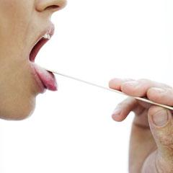
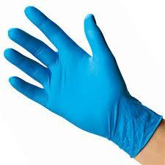
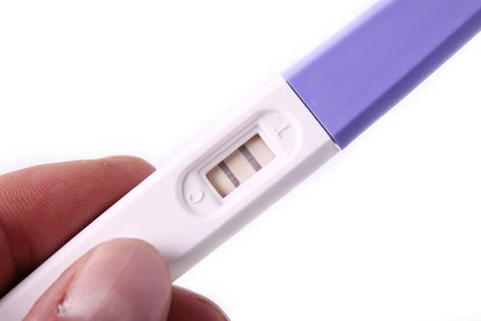
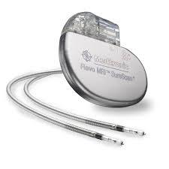
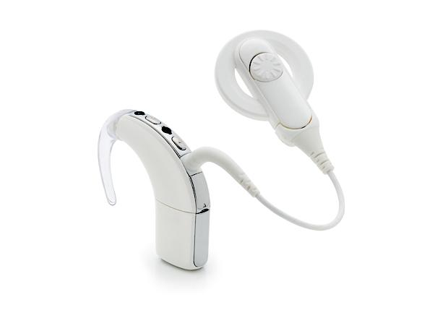
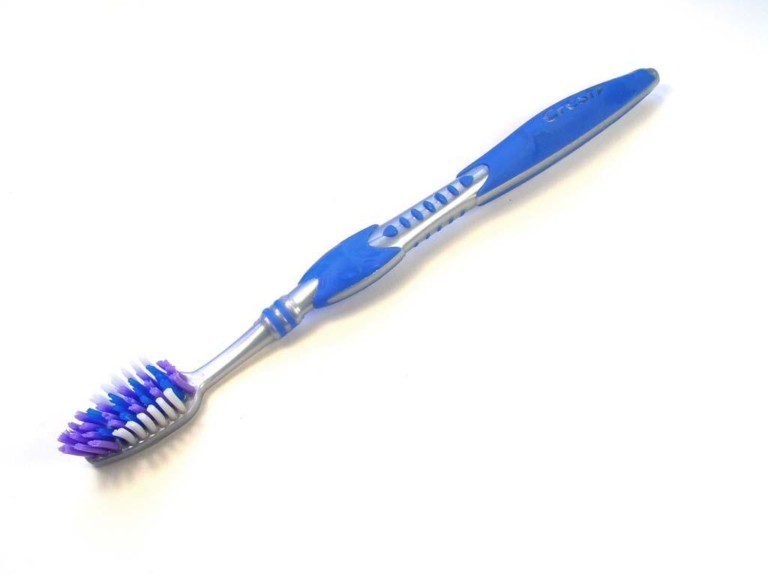
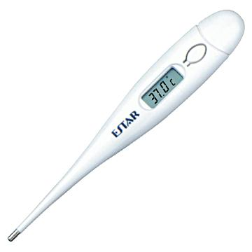
Examples of medical devices:

Slide 7
Once it is a medical device...
Company must show that the device is “substantially equivalent” to one already cleared for marketing, or
Company must submit an application for premarket approval

Slide 8
Premarket Approval Process
Most stringent type of device marketing application required by FDA
Based on determination by FDA that the premarket approval contains sufficient valid scientific evidence to assure that the device is safe and effective for its intended use

Slide 9
Safe and Effective
FDA considers as relevant factors
  Persons using the device
  Conditions of use for the device
  Probable health benefit vs. injury
  Reliability of device

Slide 10
Challenging the FDA: Legal Standard
Courts may not second-guess agencies when the agencies are exercising discretion that has been granted to them by statute.
A court is generally limited to asking:
  Whether the agency went outside the authority granted to it;
  Whether it followed proper procedures in reaching its decision; and
  Whether the decision is so clearly wrong that it must be set aside

Slide 11
About 23andme

Slide 12
Timeline of 23andme
founded in April 2006
began offering DNA test direct to consumers in November 2007
started communication with FDA ~2009
FDA letter issued in November 2013

Slide 13
23andme: Before the FDA
spit-tube device traveling through interstate commerce
health results; marketed as “first step in disease mitigation”
  but TOS?
direct-to-consumer marketing

Slide 14
Review of devices under FDCA
21 U.S.C. § 321(h): a device is an “instrument, apparatus, implement, machine, contrivance, implant, in vitro reagent, or other similar or related article, including any component, part, or accessory, which is--...”
  (1) recognized in the official National Formulary, or the United States Pharmacopeia, or any supplement to them,
  (2) intended for use in the diagnosis of disease or other conditions, or in the cure, mitigation, treatment, or prevention of disease, in man or other animals, or
  (3) intended to affect the structure or any function of the body of man or other animals, and
  which does not achieve its primary intended purposes through chemical action within or on the body of man or other animals and which is not dependent upon being metabolized for the achievement of its primary intended purposes.

Slide 15
23andme Terms of Service
“You understand that information you learn from 23andMe is not designed to independently diagnose, prevent, or treat any condition or disease or to ascertain the state of your health in the absence of medical and clinical information. You understand that the 23andMe services are intended for research, informational, and educational purposes only, and that while 23andMe information might point to a diagnosis or to a possible treatment, it should always be confirmed and supplemented by additional medical and clinical testing and information. You acknowledge that 23andMe urges you to seek the advice of your physician or other health care provider if you have questions or concerns arising from your Genetic Information.”

Slide 16
Applying “Safe and Effective”
FDA considers as relevant factors
  Persons using the device
  Conditions of use for the device
  Probable health benefit vs. injury
  Reliability of device

Slide 17
Events leading up to FDA letter
general counsel left
aggressive, stepped-up marketing
  facebook sharing?
  TV commercials
stopped replying to FDA correspondence

Slide 18
FDA’s Argument

Slide 19
FDA warns 23andMe
FDA claimed 23andMe has not provided information that its device is “substantially equivalent” to a legally marketed device
Also claimed there was no approved application for premarket approval
FDA ordered 23andMe to discontinue marketing its personal genome service

Slide 20
Is it a device?
“Intended for use in the diagnosis of disease or other conditions or in the cure, mitigation, treatment, or prevention of disease”
  “health reports on 254 diseases and conditions”
  a “first step in prevention”
  enables users to “take steps toward mitigating serious diseases”

Slide 21
FDA’s argument
FDA primarily concerned with whether devices are “safe and effective” for intended use
Effectiveness encompasses analytic validity and clinical validity
  Analytic validity: correctly identifying SNPs
  Clinical validity: accurately reporting health consequences

Slide 22
FDA’s argument
23andMe’s service generally thought to be analytically accurate
  Greater than 99% accuracy
  But, FDA concerned about worst case scenarios
Clinical validity of the personal genome service is uncertain

Slide 23
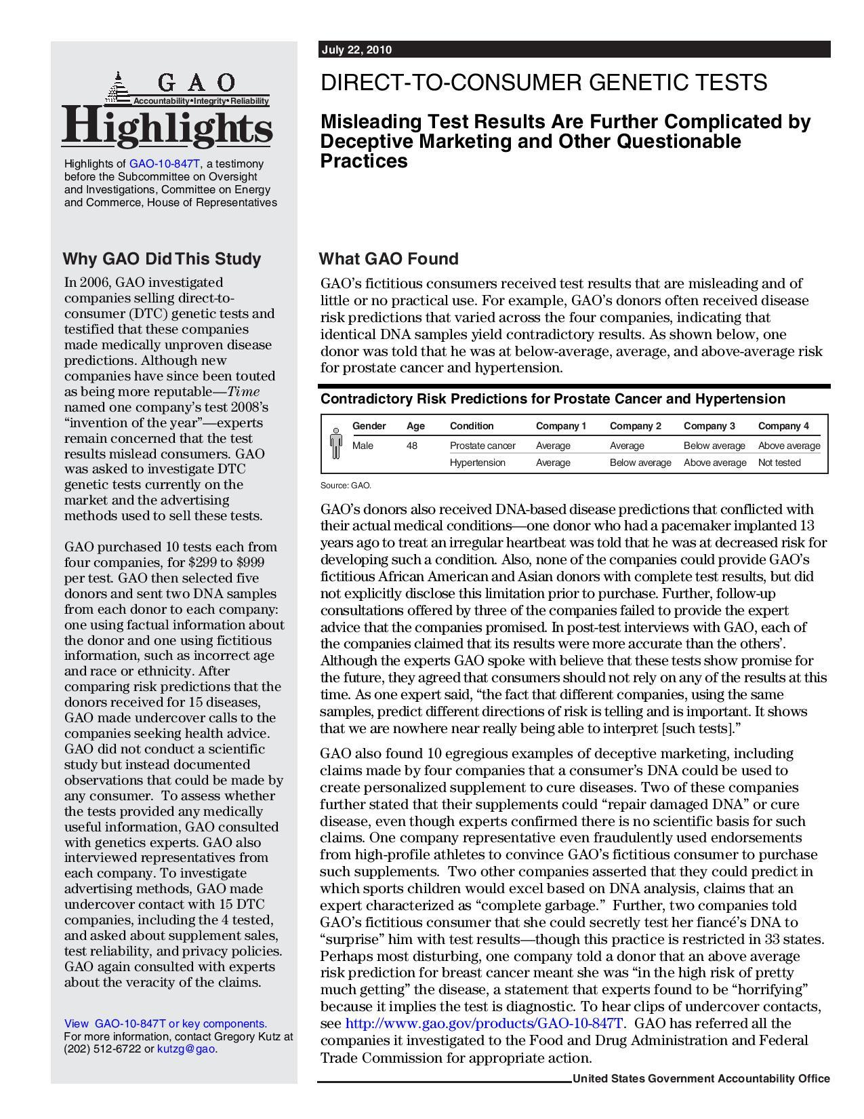
A range of clinical reporting

Slide 24
How we use medical devices
What do we expect from over-the-counter devices?

Slide 25
Worst case scenarios?
FDA letter cites examples of false positives and false negatives
  BRCA-related false positive leading to prophylactic surgery, chemoprevention, intensive screening, or other morbidity-inducing actions
  Assessments for drug responses carry the risks that patients relying on such tests may begin to self-manage their treatments through dose changes or even abandon certain therapies depending on the outcome of the assessment.

Slide 26
The doctor/patient relationship
Typical genetic testing timeline:
Tests ordered based on pre-test → Data → Filtering/Interpretation → Patient
probability assessed by health care
provider
Personal genome service’s role in diagnostics
Data -----------------------------------------------------------------------------------------> Patient
Example: Healthy Joe at risk of coronary artery disease

Slide 27
The Healthy Joe Problem
Joe’s pretest probability for coronary disease is minimal
Ethical to charge $ to take completely asymptomatic patient and perform tests, expose risks to invasive procedure?

Slide 28
The General Problem
Without proper assessment before the test, and without proper filtering and interpretation after the test, we are left with…
Layperson obtaining uncorrelated (maybe unnecessary) information, and then needing to draw their own conclusions without the requisite training
Strong potential for inappropriate interpretation

Slide 29
Inappropriate interpretation leads to...
Fear, emotional harm
Financial loss
  San Francisco-based neurologist: Some patients--all 23andMe customers--demanding unnecessary and expensive MRIs for Alzheimer’s disease.*
* “Why the FDA is targeting Google-backed 23andMe: Unnecessary MRIs, Mastectomies.” VentureBeat. Nov. 26, 2013.

Slide 30
23andme’s Argument

Slide 31
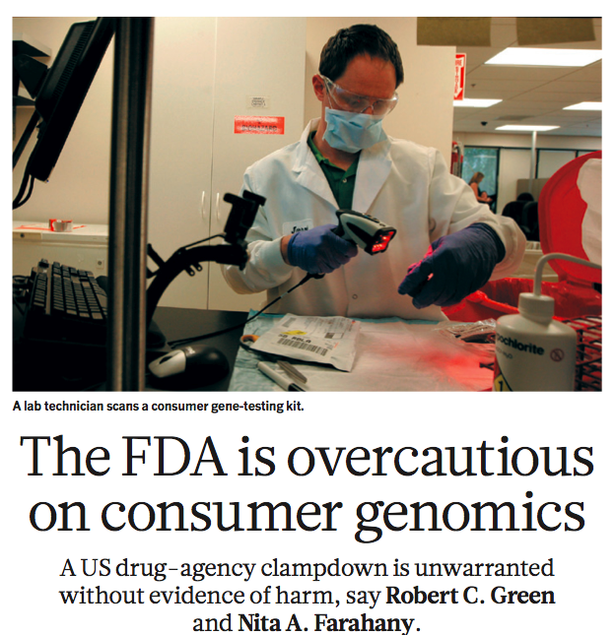
1. The threat of inappropriate or harmful patient responses is overstated.
most patients who discovered high risk genes consult a physician

Slide 32
2. Patients have a right to weigh the risks and benefits.
as long as transparency and honesty about the accuracy is achieved, allow consumers to weigh the pros and cons
libertarianism vs. paternalism

Slide 33
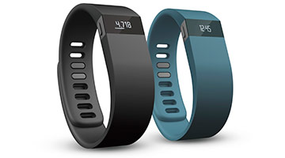
3. FDA’s regulation is inconsistent and ineffective
Promethease
Fitbit and other “wearable medical devices”

Slide 34
23andme arguments
1. 1st Amendment—freedom of information
2. patient empowerment
3. public policy—too much regulation is bad for innovation
Notes:
1.

Slide 35
4. Patient empowerment
Allows consumers to gain awareness about their own health
Increase demand for genetics-savvy physicians

Slide 36
5. 1st Amendment - freedom of information
Sorell v. IMS (U.S. 2011)
United States v. Caronia (2d Cir. 2012)

Slide 37
What’s next? Short term
23andme’s next steps
Chevron deference to FDA
    1. if Congress’s intent is clear then go with that
    2. if not clear, goes to what agency says as long as that is a permissible construction

Slide 38
What’s next? long term
how to deal with genetic information
“Next generation sequencing”--whole genome and exome sequencing
Illumina sequencing platform that tests for cystic fibrosis and a “universal” kit for laboratories

Slide 39
Questions for discussion
Is a libertarian or paternalistic approach more appropriate in the personalized genomics field?
What do you think is the correct resolution to this issue?

