Slide 1
Type 2 Diabetes
With type 2 diabetes, your body either resists the effects of insulin — a hormone that regulates the movement of sugar into your cells — or doesn't produce enough insulin to maintain a normal glucose level.

Slide 2
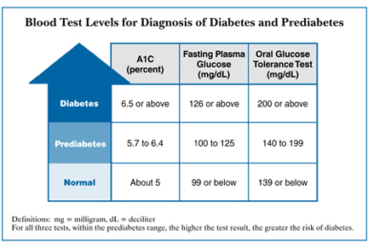

Slide 3
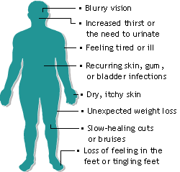
Type 2 Diabetes

Slide 4
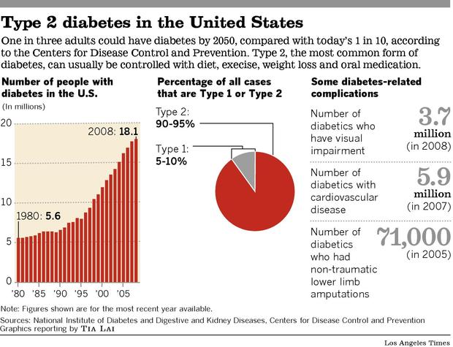

Slide 5
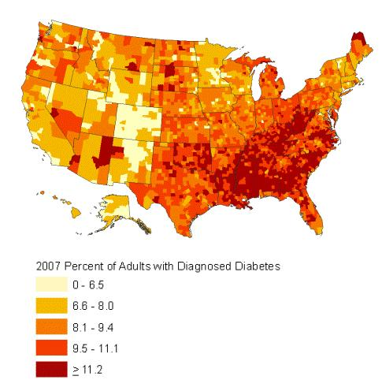

Slide 6
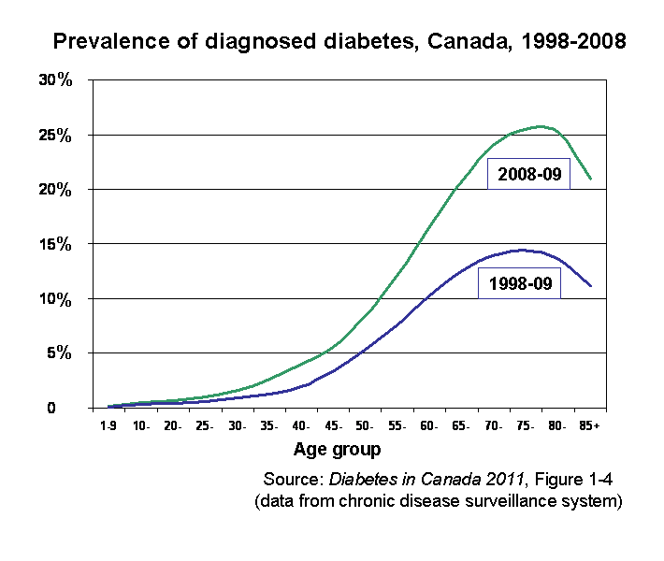

Slide 7
High blood glucose
Insulin secretion from pancreas
Eat
↑ Glucose absorption by muscle
Low blood glucose

Slide 8
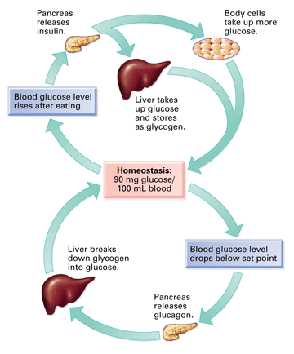

Slide 9
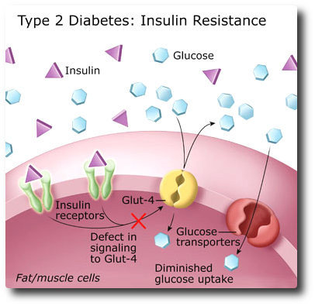

Slide 10
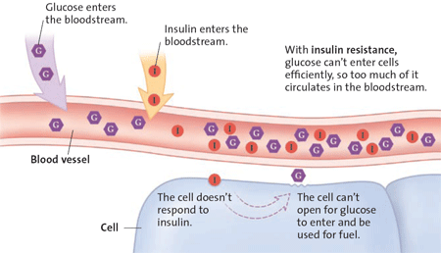

Slide 11
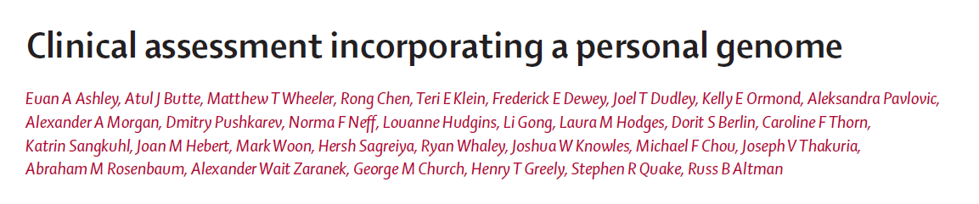
Analyzed genome sequence of Steve Quake
Rare protein altering SNPs
  But usually do not know what the gene does, so difficult to know if the mutation is causing a trait.
Common SNPs
  Analyzed Steve’s SNPs for risk at common diseases
  The known SNPs are all from GWAS
    GWAS all use DNA chips, not genome sequence
    Association only works for common SNPs
  For common SNPs, Steve could have gotten essentially the same information from a 23andme chip.

Slide 12
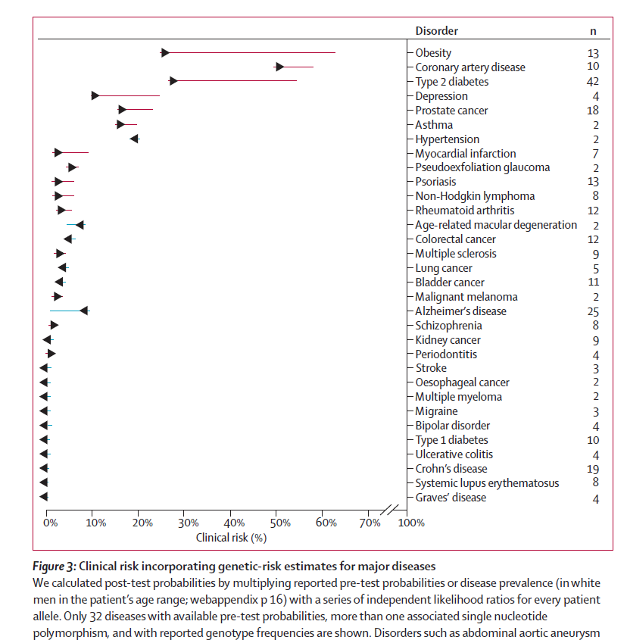

Slide 13
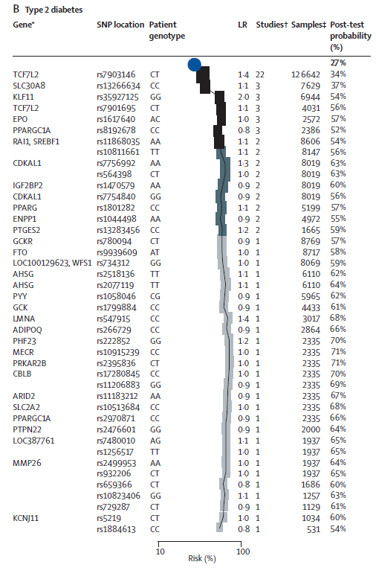

Slide 14
Genotation: clinical: Diabetes

Slide 15
Type 2 Diabetes GWAS
Date # cases trait SNPs
2008 10K T2D 16
2010 46K IR 17
2010 42K T2D 23
2012 34K T2D 33
2014 26K T2D 76

Slide 16
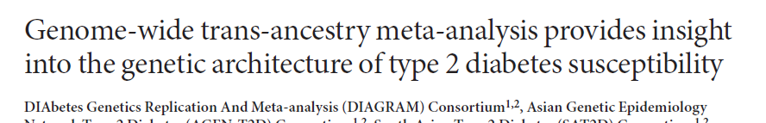
MARCH 2014 Nature Genetics
26,488 cases (T2 D) and 83,964 controls
European, east Asian, south Asian and Mexican and Mexican American ancestry.
Confirmed 69 previous SNPs associated with T2D
Found 7 new loci for T2D using multi-ethnic populations
Notes:
Genome-wide trans-ancestry meta-analysis provides insight into the genetic architecture of type 2 diabetes susceptibility
VOLUME 46 | NUMBER 3 | MARCH 2014 Nature Genetics

Slide 17
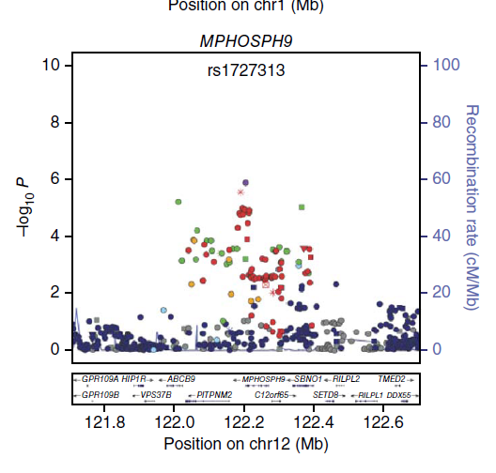
The causal mutation/gene is hard to identify from GWA studies
Purple: Lead SNP
Red: R² > 0.8
Causal mutation?
Affected gene?

Slide 18
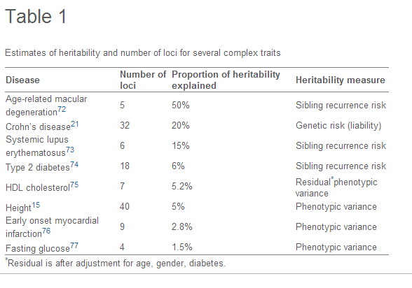
Missing heritability for Type 2 Diabetes
Notes:
Nature Genetics VOLUME 46 | NUMBER 4 | APRIL 2014

Slide 19
Mutation landscape in diabetes gene
Notes:
Nature Genetics VOLUME 46 | NUMBER 4 | APRIL 2014

Slide 20
Mutation landscape in diabetes gene
Cases
Controls
Notes:
Nature Genetics VOLUME 46 | NUMBER 4 | APRIL 2014

Slide 21
SLC30A8 and Type 2 Diabetes
SLC30A8 encodes an islet zinc transporter zinc transporter ZnT8
p.Trp325Arg is a missense change with a 30-50% minor allele frequency
p.Trp325Arg is thought to be a weak mutation and partially reduce ZnT8 function
p.Trp325Arg is associated with 1.2x risk for type 2 Diabetes, fasting glucose and insulin levels
If weak alleles of SLC30A8 result in a mild risk for Type 2 Diabetes, might strong (null) alleles have a high effect on Type 2 Diabetes?

Slide 22
Strong (null) alleles of SLC30A8 show strong protection from Type 2 Diabetes
Sequenced SLC30A8 in many people.
Found 12 strong loss-of-function mutations – stop mutations and splice site mutations
Heterozygous carriers for a SLC30A8 null mutation show 65% decreased for Type 2 diabetes
  Much stronger effect than the common allele
  Effect was opposite to expected. Null alleles lead to decreased rather than increased risk for Type 2 diabetes.

Slide 23
Mutation landscape in SLC30A8 gene
Cases
Controls
Notes:
Nature Genetics VOLUME 46 | NUMBER 4 | APRIL 2014

Slide 24
Rare mutations in GWAS genes do not explain the missing heritability for Type 2 Diabetes
Sequence SLC30A8 in 145K people, and only 345 had mutations.
Sequenced 115 GWAS genes in diabetics.
  Only SLC30A8 had mutations

Slide 25
Maturity Onset Diabetes of the Young
(MODY)
MODY is a good candidate for personal genomic screening for several reasons:
it is caused by dominant Mendelian mutations, such that heterozygous carriers develop disease;
clinical presentation occurs early in life (<25 years) with nonketotic hyperglycemia
the frequency of MODY is 0.1–0.2% in European populations, with the majority of affected individuals being undiagnosed or misdiagnosed;
MODY diagnosis can substantially affect diabetes prognosis and treatment of the individual or affected family members
mutations in MODY genes also influence late-onset phenotypes, as common variants near many of these genes are associated with type 2 diabetes (T2D) risk in the general population
this risk can be reduced by lifestyle intervention.

Slide 26
MODY genes
People with MODY often have mutations in these seven genes:
HNF1A30,
GCK31,32,
HNF4A33
HNF1B34
PDX1
INS36
NEUROD1

Slide 27
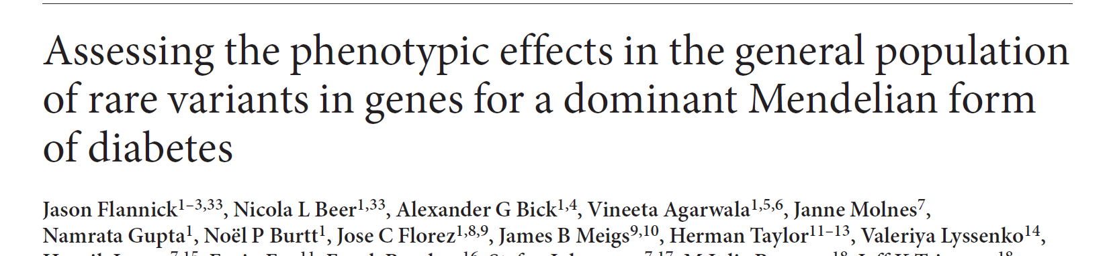
What is the penetrance of the MODY genes?
Penetrance – the fraction of people with the mutation that have MODY.
sequenced seven genes for maturity-onset diabetes of the young (MODY)
in 4003 people.
35 strong loss-of-function (pathogenic) mutations found in these genes
None of the 35 carriers had MODY.
Conclusions:
MODY is very rare (~1/1000).
These genes greatly increase the risk of MODY (10x).
But carriers still have a low overall chance of getting MODY (1/100).
Notes:
VOLUME 45 | NUMBER 11 | NOVEMBER 2013 Nature Genetics

